Slide 1
Agent-Based Model of Genotype Editing
Evolutionary Computation,
Vol. 15, No. 3, pp. 253-289, 2007
C.-F. Huang, J. Kaur, A. Maguitman and L. M. Rocha
Date: Apr. 1, 2009
Introducer: Hsing-Yen Ann

Slide 2
Abstract (1/3)
Evolutionary algorithms rarely deal with ontogenetic (個體發展), non-inherited alteration of genetic information because they are based on a direct genotype-phenotype (基因型-表現型) mapping. In contrast, several processes have been discovered in nature which alter genetic information encoded in DNA before it is translated into amino-acid chains. Ontogenetically altered genetic information is not inherited but extensively used in regulation and development of phenotypes, giving organisms the ability to, in a sense, re-program their genotypes according to environmental cues. An example of post-transcriptional alteration of gene-encoding sequences is the process of RNA Editing.

Slide 3
Abstract (2/3)
Here we introduce a novel Agent-based model of genotype editing and a computational study of its evolutionary performance in static and dynamic environments. This model builds on our previous Genetic Algorithm with Editing, but presents a fundamentally novel architecture in which coding and non-coding genetic components are allowed to co-evolve. Our goals are: (1) to study the role of RNA Editing regulation in the evolutionary process, (2) to understand how genotype editing leads to a different, and novel evolutionary search algorithm, and (3) the conditions under which genotype editing improves the optimization performance of traditional evolutionary algorithms.

Slide 4
Abstract (3/3)
We show that genotype editing allows evolving agents to perform better in several classes of fitness functions, both in static and dynamic environments. We also present evidence that the indirect genotype / phenotype mapping resulting from genotype editing leads to a better exploration / exploitation compromise (搜尋廣度與深度的妥協) of the search process. Therefore, we show that our biologically-inspired model of genotype editing can be used to both facilitate understanding of the evolutionary role of RNA regulation based on genotype editing in biology, and advance the current state of research in Evolutionary Computation.

Slide 5
Outline
The Genotype Editing phenomena in nature, e.g. RNA Editing
The proposed modified GA algorithm, Agent-based Model of Genotype Editing (ABMGE)
Designing good tests, i.e. good artificial fitness functions
The experimental results

Slide 6
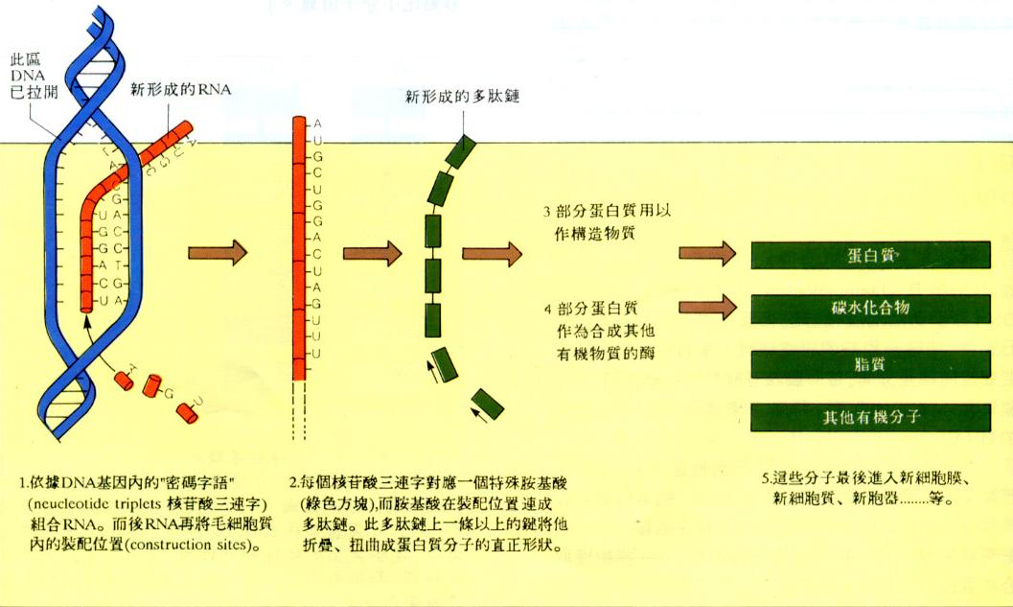
From DNA via RNA to Protein

Slide 7
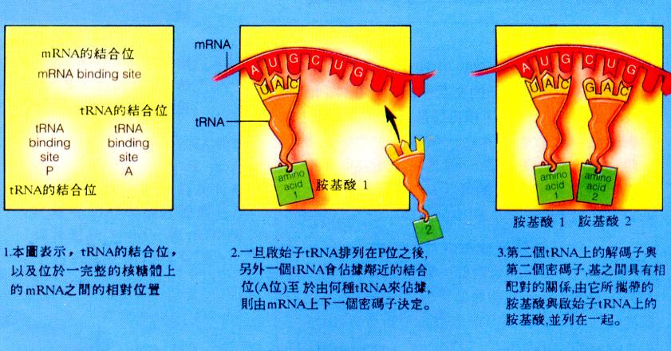
From RNA to Protein

Slide 8
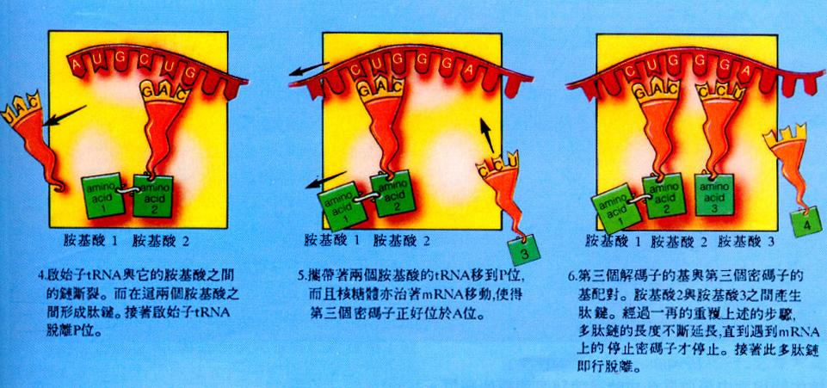
From RNA to Protein

Slide 9
RNA Editing — Post Transcriptional Alternation of Genetic Information
However, the process is not so regular.
Counter examples:
  Guide RNA’s (gRNA) can insert/delete U’s into the mRNA.
  Viral G-addition editing can insert/delete G’s into the tRNA.
  C-to-U substitution exists in mitochondrial (粒線體) and chloroplast (葉綠素) RNA of many higher plants (高等植物).
  A-to-I substitution exists in the genome of higher eukaryotes (高等真核生物) such as mammals (哺乳類).

Slide 10
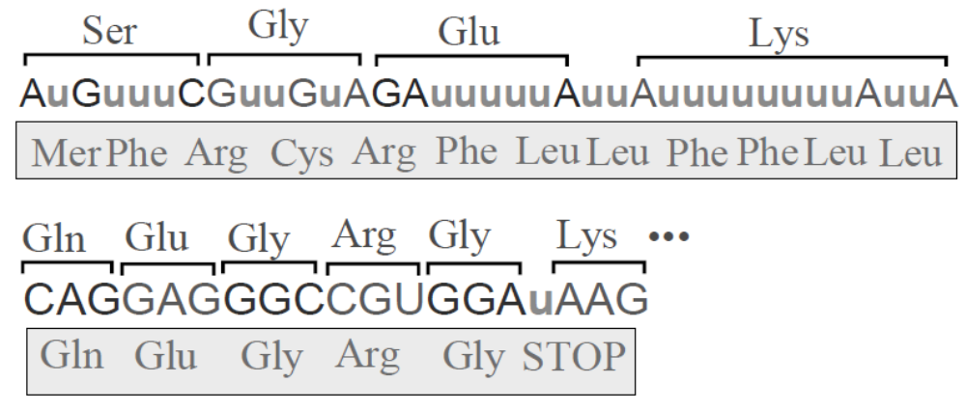
U-Insertion in the RNA of Trypanosomes (錐體蟲)

Slide 11
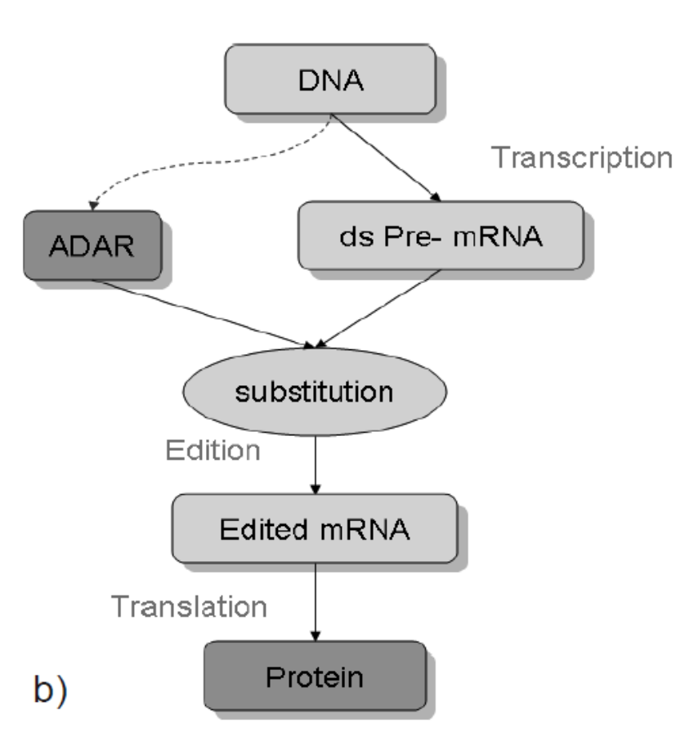
A-to-I Substitution in Human Brains
(A ➔ I)
(I ➔ G)

Slide 12
Brief Conclusion of RNA Editing in Nature
RNA Editase (editors) are usually encoded in non-coding area and triggered by environmental factors.
Some RNA editing may cause diseases. However, some others involve in the brains developmental process. It is meaningful!!
Genotype editing is not equivalent to mutation. It changes the phenotype and, however, these changes are not inheritable.

Slide 13
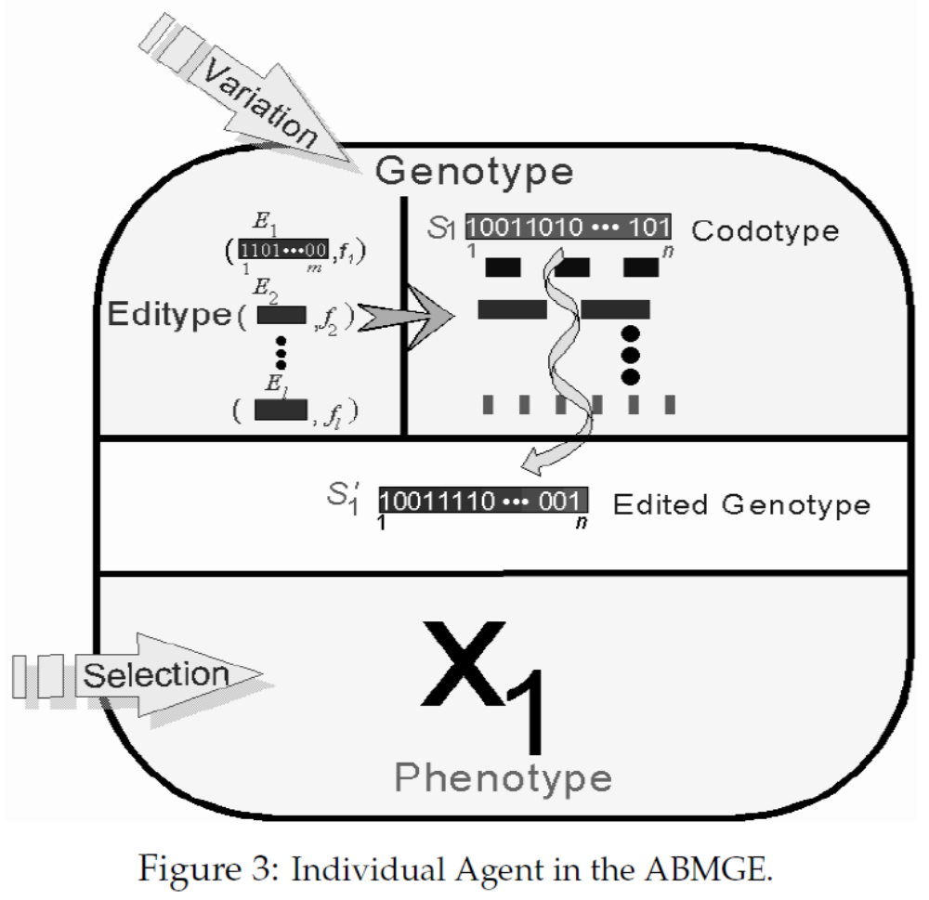
Agent-Based Model of Genotype Editing

Slide 14
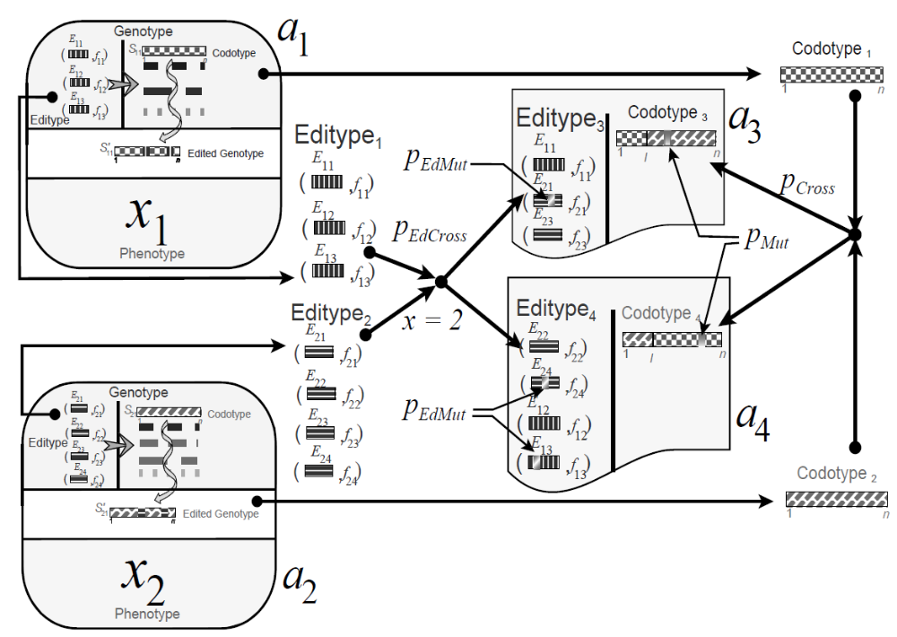
Co-evolving Codotype and Editype

Slide 15
Testing the ABMGE
Some artificial fitness functions are used.
  Small Royal Road
  De Jong function F₃
  The optimal control test problem
  Modified Schaffer’s function F₇
  Schwefel’s function

Slide 16
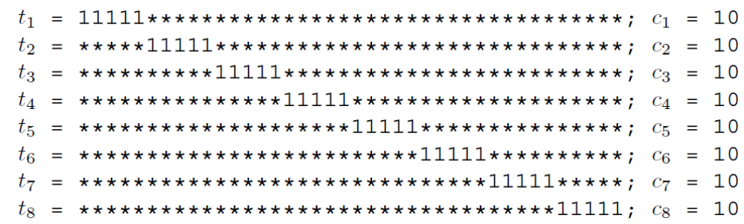
Small Royal Road
Each solution is a bit string of length 40.
The optimal solution is a string with 40 1’s, where the optimal score is 80.

Slide 17
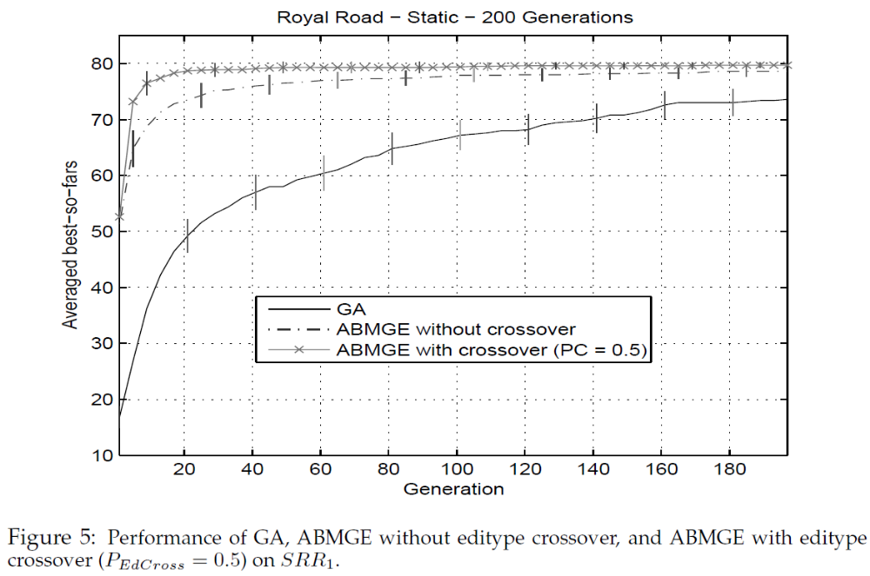
Result—Small Royal Road

Slide 18
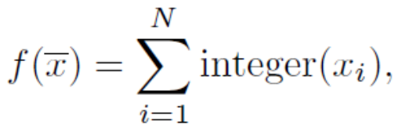
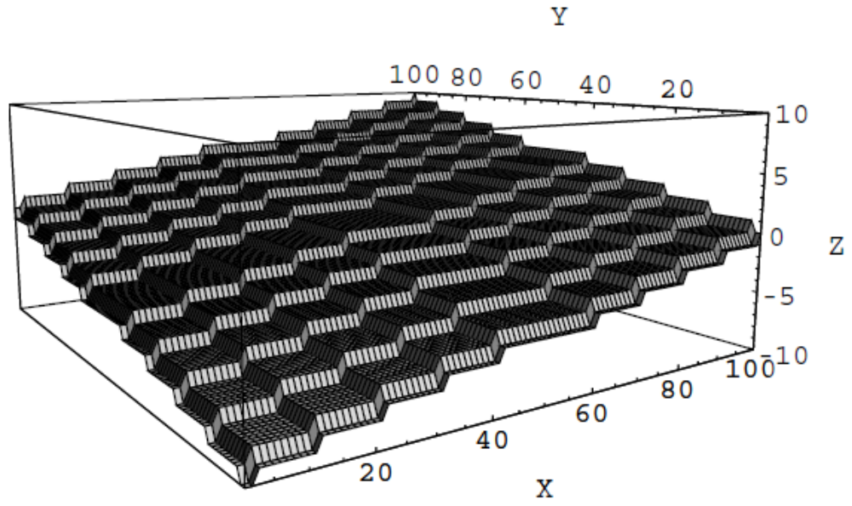
De Jong Function F₃

Slide 19
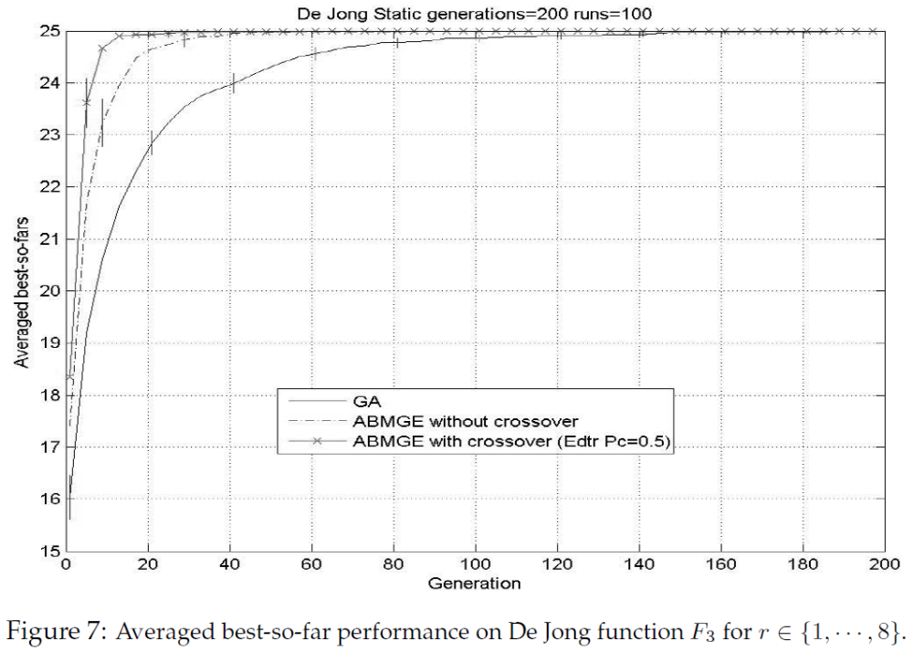
Result—De Jong Function F₃

Slide 20
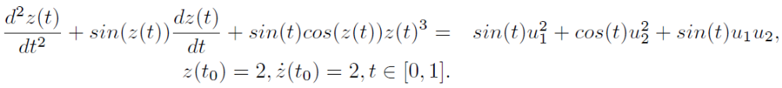
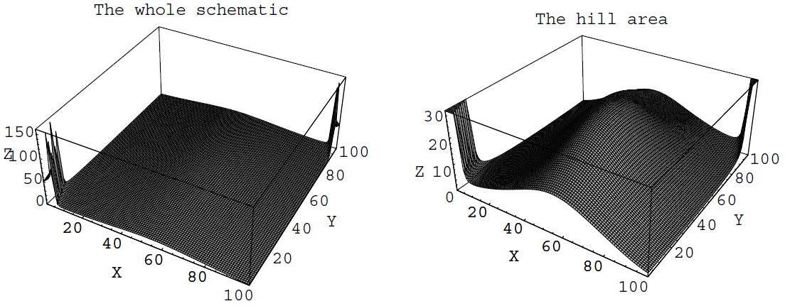
The Optimal Control Test Problem
The goal is to maximize z(t_{f})² by searching for two constant control variables, u₁ and u₂ (-5 ≦ u₁, u₂ ≦5).

Slide 21
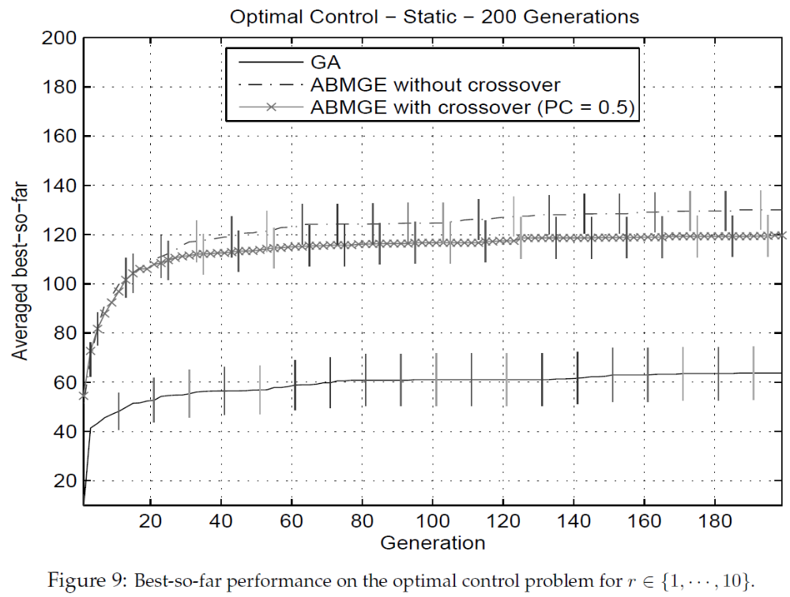
Result—The Optimal Control Test Problem

Slide 22
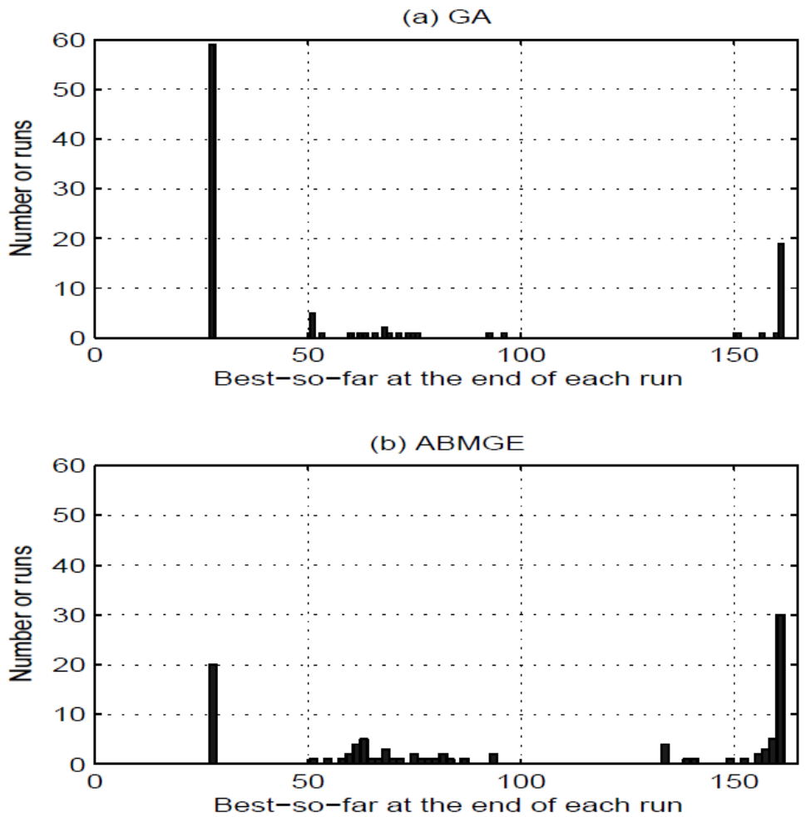
Distribution—The Optimal Control Test Problem
Local optimum
Global optimum

Slide 23
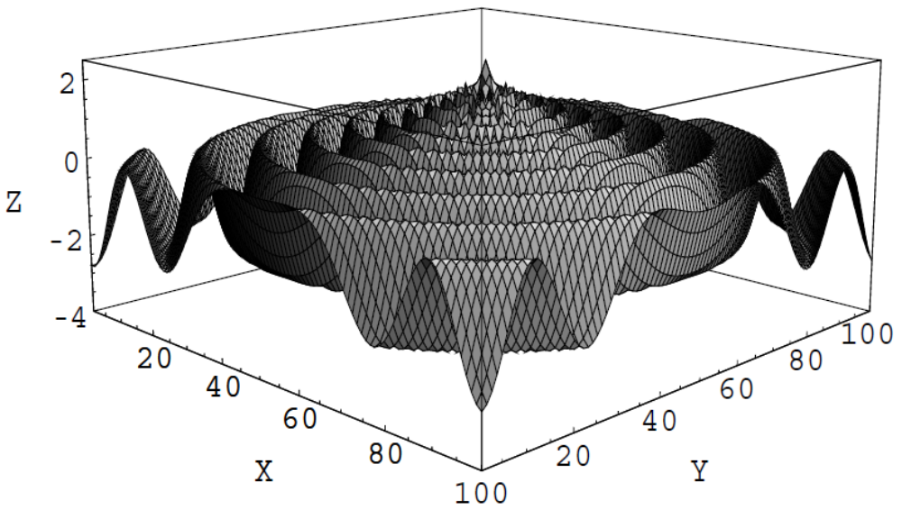
Modified Schaffer’s Function F₇
The global optimum is at the center (2.5).

Slide 24
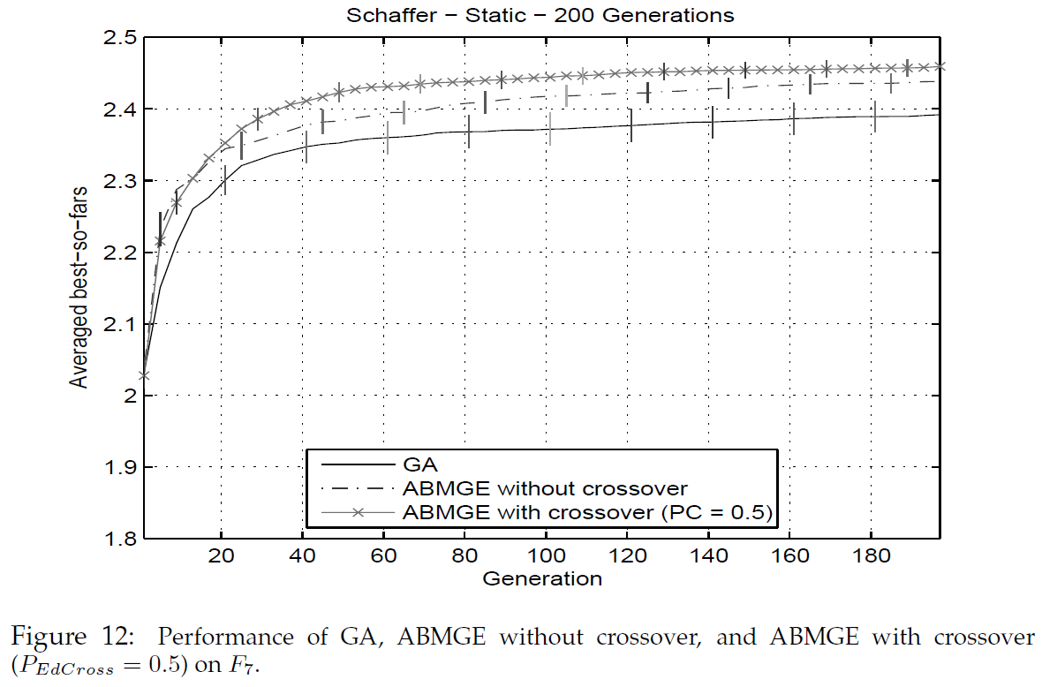
Result—Modified Schaffer’s Function F₇

Slide 25
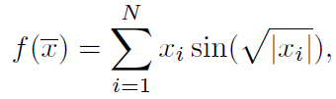
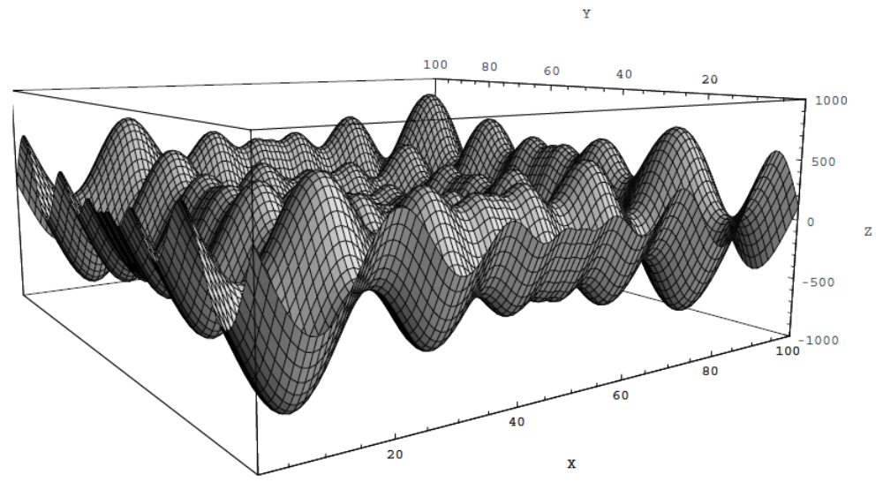
Schwefel’s Function

Slide 26
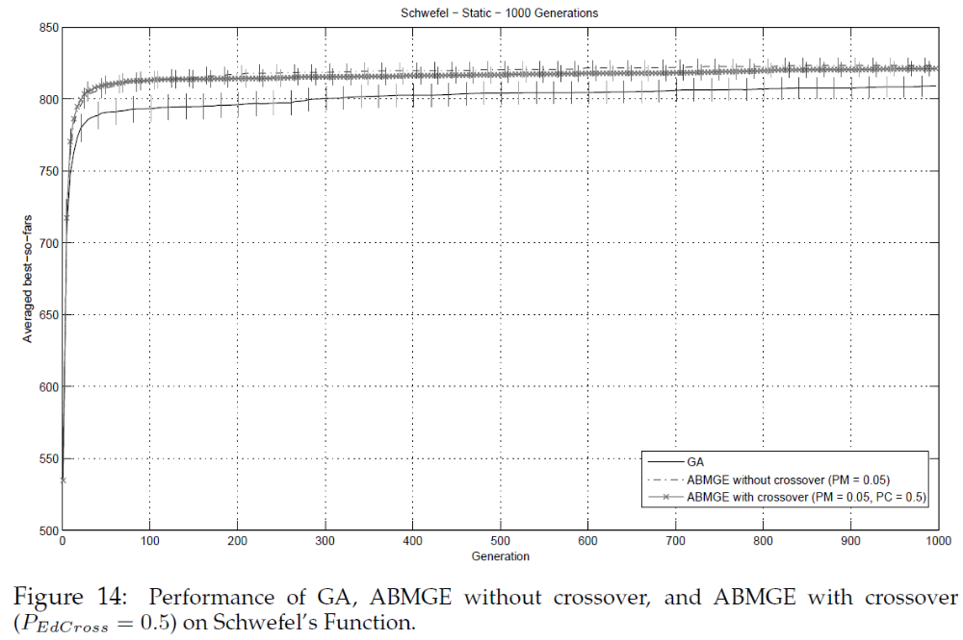
Result—Schwefel’s Function

Slide 27
Dynamic Environments
The optimal solutions will change for every p generations.
Focus on adaptation rather than optimization.
  Oscillatory Small Royal Road
  Dynamic Schaffer’s function DF₇
  Dynamic optimal control test problem
  Dynamic Schwefel’s function

Slide 28
Oscillatory Small Royal Road
The masks will change between 0 and 1 for every p generations.

Slide 29
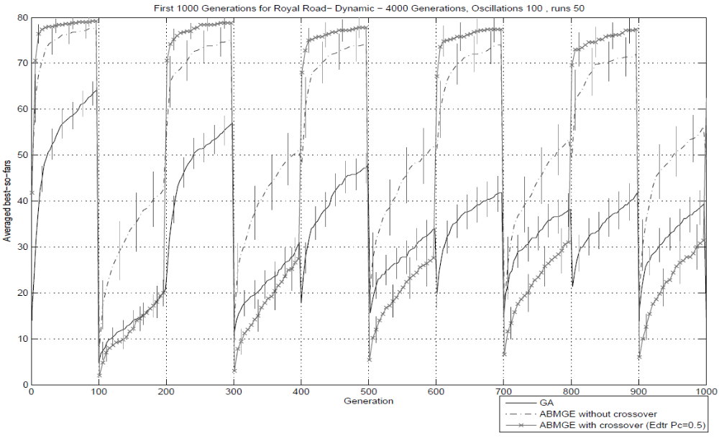
Result—Oscillatory Small Royal Road (1/2)

Slide 30
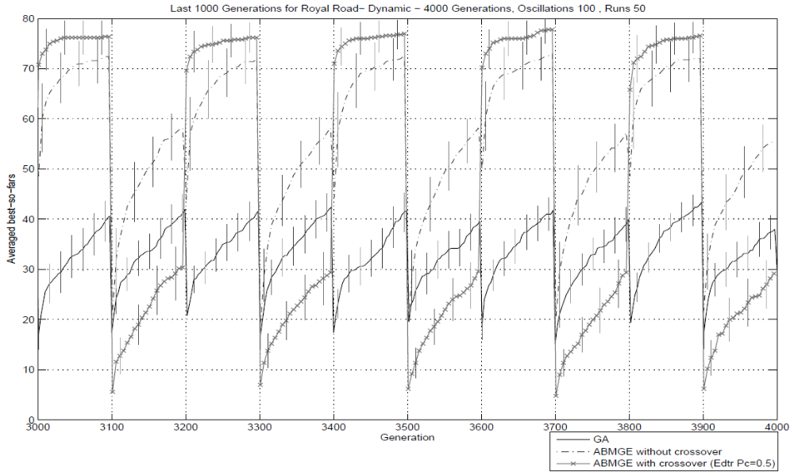
Result—Oscillatory Small Royal Road (2/2)

Slide 31
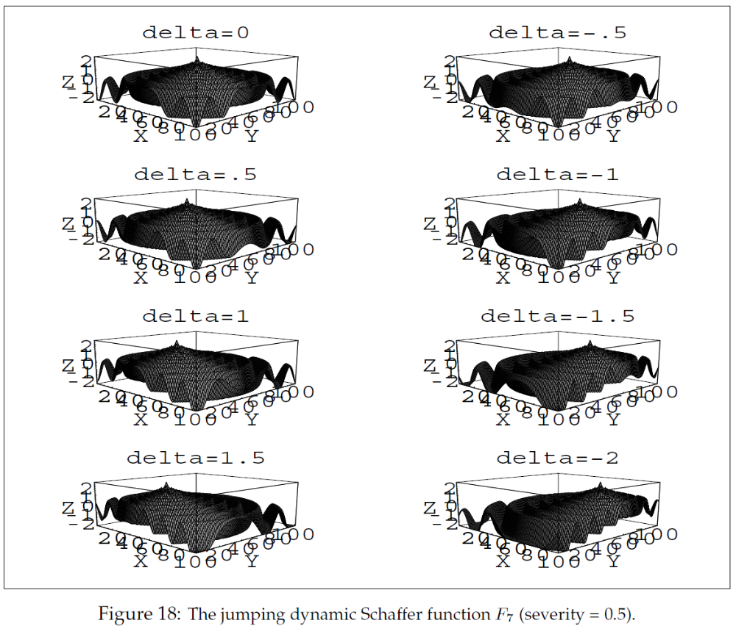
Dynamic Schaffer’s Function DF₇

Slide 32
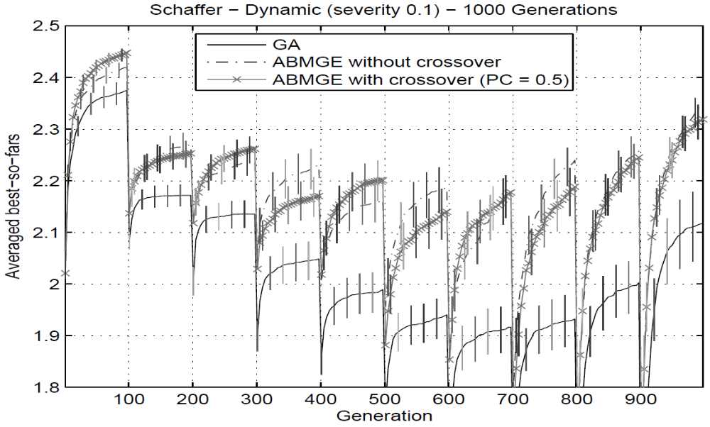
Result—Dynamic Schaffer’s Function DF₇

Slide 33
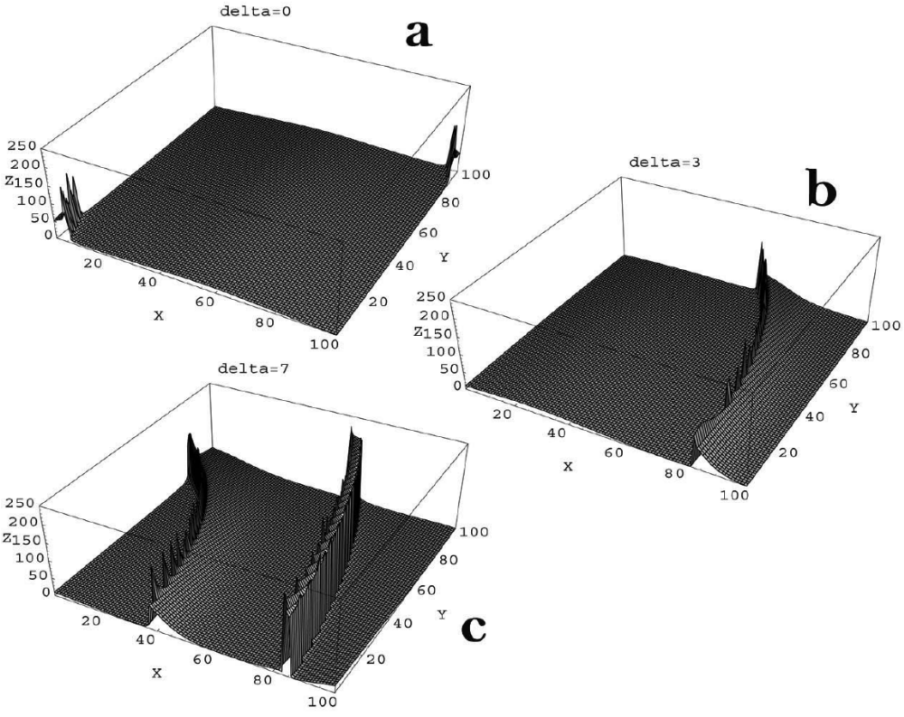
Dynamic Optimal Control Test Problem

Slide 34
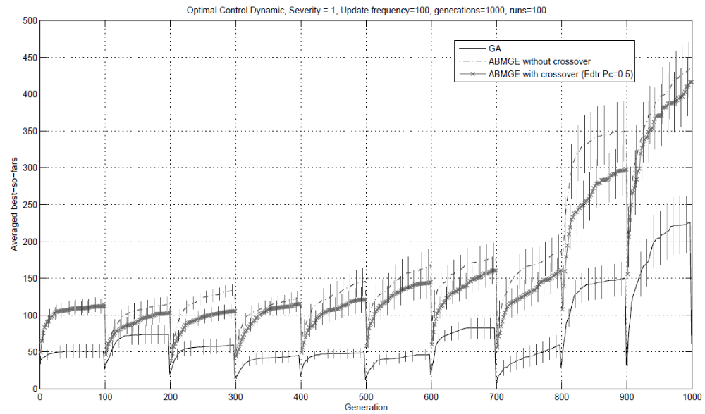
Result—Dynamic Optimal Control Test Problem

Slide 35
Dynamic Schwefel’s Function

Slide 36
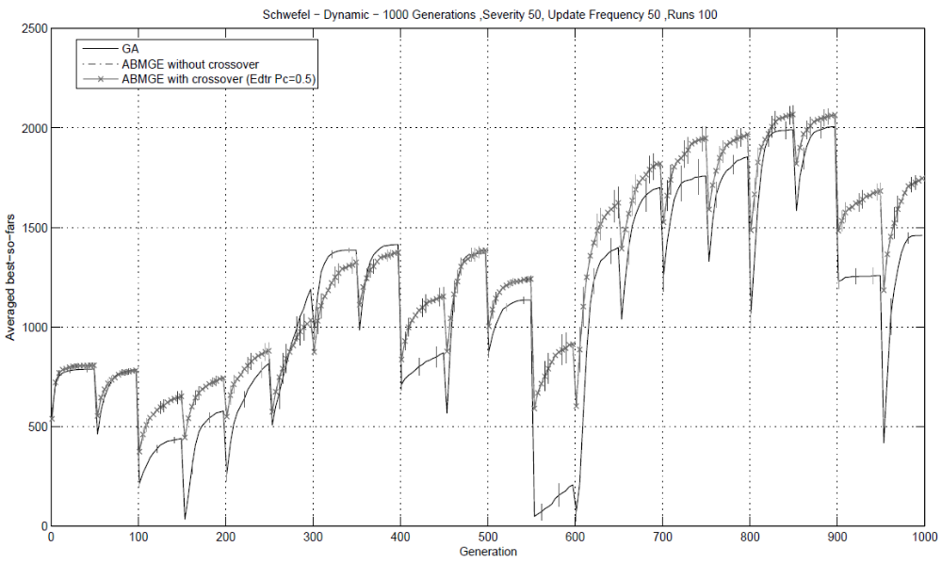
Result—Dynamic Schwefel’s Function

Slide 37
Discussion
The goal of this paper is to understand how genotype editing works and what kind of search process it leads to.
Both in static and dynamic environments, the ABMGE outperformed the GA in every function tested.
The ABMGE with editype crossover seems to remain the excellence in the first fitness environment encountered.

