Slide 1
An Algorithm for Solving the Longest Increasing Circular Subsequence Problem
Information Processing Letters, Vol. 109, pp. 630-634, 2009
Sebastian Deorowicz
Presenter: Chiou-Ting Tseng
Date: Apr. 29, 2009

Slide 2
Longest Increasing Circular Subsequence
S=4 6 2 8 1 3 12 9 5 7 11 10
S=10 4 6 2 8 1 3 12 9 5 7 11
S=11 10 4 6 2 8 1 3 12 9 5 7
…
S= 12 9 5 7 11 10 4 6 2 8 1 3
…
S=6 2 8 1 3 12 9 5 7 11 10 4

Slide 3
Previous Methods
LIS in sliding windows, S_{new}=SS, window size = n. O(n log log n+nl) time [Albe04] or O(nl) [Chen07] time.
O(n^{1.5}) time [Tisk08].

Slide 4
Transformation
It is convenient to assume that sequence S is a permutation of all integers from the range [1,n]. The general problem can be transformed to fit this assumption by relabeling the elements of S in such a way that each element is replaced by its position in a sorted sequence of S. This relabeling can be done in O(n logn) time and is neglected in further calculations.

Slide 5
Longest Increasing Subsequence
S=4 6 2 8 1 3 12 9 5 7 11 10
4
4
6
4
6
4
6
8
4
6
8
2
2
2
1
4
6
8
4
6
8
12
4
6
8
12
2
3
2
3
2
3
9
1
1
1

Slide 6
Longest Increasing Subsequence
S=4 6 2 8 1 3 12 9 5 7 11 10
4
6
8
12
4
6
8
12
4
6
8
12
2
3
9
2
3
5
9
2
3
5
9
1
1
1
7
4
6
8
12
11
4
6
8
12
11
2
3
5
9
2
3
5
9
10
1
7
1
7

Slide 7
Lemma1
S= 4 6 2 8 1 3 12 9 5 7 11 10
S’=4 6 2 8 1 3
S’’=12 9 5 7 11 10
4
6
8
12
7
11
2
3
9
10
1
5
R(S’)=4 2 1 6 3 8
R(S’’)=12 9 5 7 11 10

Slide 8
Lemma 1
C(S)
C(S’)=C(R(S’))
4
6
8
12
11
4
6
8
2
3
5
9
10
2
3
1
7
1
R(S’’)=12 9 5 7 11 10

Slide 9
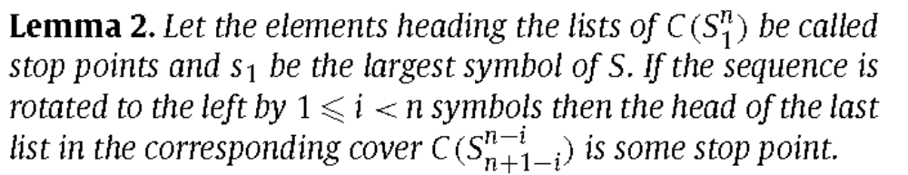
S=12 9 5 7 11 10 4 6 2 8 1 3
12
7
11
S_{rot}=4 6 2 8 1 3 12 9 5 7 11 10
9
6
10
4
6
8
12
11
5
3
8
2
3
5
9
10
4
1
7
2
1

Slide 10
Lemma 3
The LLICS(S) is equal to the maximal value of LLIS for rotations of S (s₁ is the largest symbol of S) ending at stop points.

Slide 11
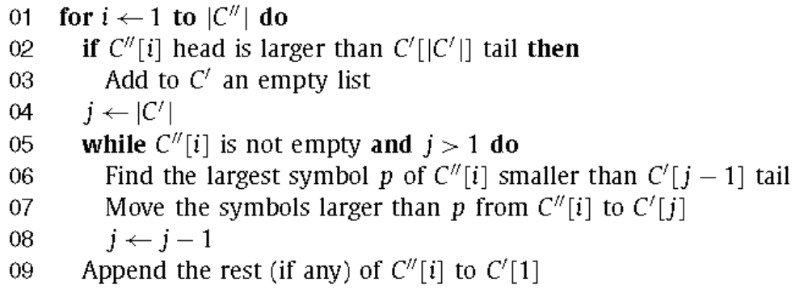
Algorithm 1
The cover merging algorithm computes the cover of S’S’’, where C’ = C(S’) and C’’ = C(S’’) are given.

Slide 12
Algorithm 1 – Example
S= 4 6 2 8 1 3 12 9 5 7 11 10
S’=4 6 2 8 1 3
S’’=12 9 5 7 11 10
4
6
8
12
7
11
2
3
9
10
1
5

Slide 13
Algorithm 1 – Example
S= 4 6 2 8 1 3 12 9 5 7 11 10
S’=4 6 2 8 1 3
S’’=12 9 5 7 11 10
4
6
8
12
7
11
2
3
9
10
1
5

Slide 14
Algorithm 1 – Example
S= 4 6 2 8 1 3 12 9 5 7 11 10
S’=4 6 2 8 1 3
S’’=12 9 5 7 11 10
4
6
8
12
7
11
2
3
5
9
10
1

Slide 15
Algorithm 1 – Example
S= 4 6 2 8 1 3 12 9 5 7 11 10
S’=4 6 2 8 1 3
S’’=12 9 5 7 11 10
4
6
8
12
11
2
3
5
9
10
1
7

Slide 16
Algorithm 1– Example
S= 4 6 2 8 1 3 12 9 5 7 11 10
S’=4 6 2 8 1 3
S’’=12 9 5 7 11 10
4
6
8
12
11
2
3
5
9
10
1
7

Slide 17
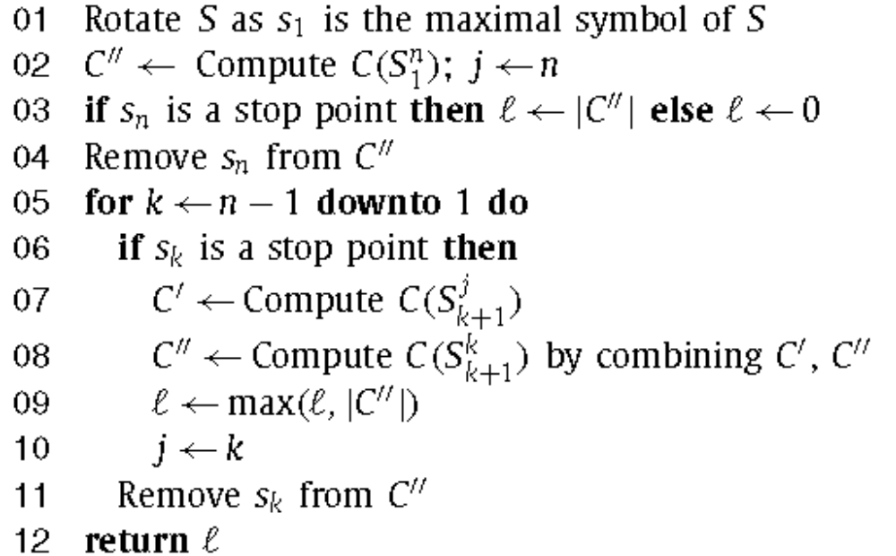
Algorithm 2

Slide 18
Algorithm 2 - Example
S= 4 6 2 8 1 3 12 9 5 7 11 10
S_{rot}= 12 9 5 7 11 10 4 6 2 8 1 3
12
7
11
12
7
11
12
7
11
9
6
10
9
6
10
9
6
10
5
3
8
5
8
5
8
→
→
→ … →
4
4
4
2
2
2
1
1

Slide 19
Algorithm 2 - Example
S’’= 12 9 5 7 11, S’= 10 4 6 2 8 1 3
12
7
11
10
6
8
9
4
3
5
2
1
S= 10 4 6 2 8 1 3 12 9 5 7 11

Slide 20
Algorithm 2 - Example
S’= 10 4 6 2 8 1 3, S’’= 12 9 5 7 11
10
6
8
12
7
11
4
3
9
2
5
1

Slide 21
Algorithm 2 - Example
S’= 10 4 6 2 8 1 3, S’’= 12 9 5 7 11
10
6
8
12
7
11
4
3
9
2
5
1

Slide 22
Algorithm 2 - Example
S’= 10 4 6 2 8 1 3, S’’= 12 9 5 7 11
10
6
8
12
7
11
4
3
5
9
2
1

Slide 23
Algorithm 2 - Example
S’= 10 4 6 2 8 1 3, S’’= 12 9 5 7 11
10
6
8
12
7
11
4
3
5
9
2
1

Slide 24
Algorithm 2 - Example
S’= 10 4 6 2 8 1 3, S’’= 12 9 5 7 11
10
6
8
12
11
4
3
5
9
2
7
1

Slide 25
Algorithm 2 - Example
S’= 10 4 6 2 8 1 3, S’’= 12 9 5 7 11
10
6
8
12
11
4
3
5
9
2
7
1
L=5

Slide 26
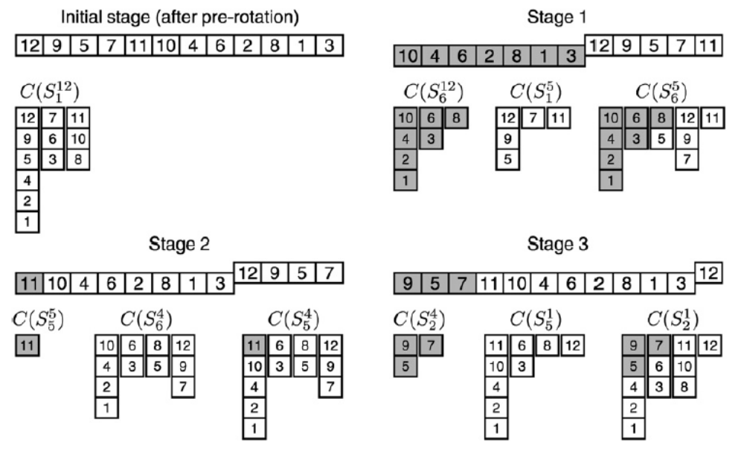
Algorithm 2 - Example

Slide 27
Time Complexity – List
Find C(S), O(n log l).
Maintain n pointers to the elements in the cut.
For each stop symbol
  Remove m_{i} symbols to get C(S’’), O(m_{i}).
  Construct C(S’), O(m_{i} log l ).
  Merge C(S’) and C(S’’), O(m_{i} l + n).
Totally O(nl).

Slide 28
Time Complexity – Red-Black Tree
Maintain each column in a red-black tree.
Find C(S), O(n log n).
Find p and move both take O(log n).
Each column take O(l logn).
Each stop point take O(m_{i} l logn)=O(l² logn).
All stop point take O(l³ logn).
Totally: O((n+l³⁾ logn).

Slide 29
Conclusion
Since LLICS(S) ≤2 LLIS(S), one can choose, according to LLIS(S) the cover merging procedure. This hybrid algorithm works in O(min(nl,n logn + l³ logn)) worst-case time
This is better than the complexity of the fastest known algorithms if both l = ω(logn) and l =o(n^{1/2}/ log^{1/2} n), and not worse when = O(n^{1/2}).

Slide 30
End

Slide 31
S’=4 6 2 8 1 3
4
4
6
4
6
4
6
8
4
6
8
4
6
8
2
2
2
2
3
1
1
S’’=12 9 5 7 11 10
12
12
12
12
7
12
7
11
12
7
11
9
9
9
9
9
10
5
5
5
5

Slide 32
Algorithm 2 - Example
S’’= 12 9 5 7, S’= 11 10 4 6 2 8 1 3
10
6
8
12
11
11
6
8
12
4
3
5
9
10
3
5
9
2
7
4
7
1
2
1
L=4

Slide 33
Algorithm 2 - Example
S’’= 12, S’= 9 5 7 11 10 4 6 2 8 1 3
12
9
7
11
9
7
11
12
5
6
10
5
6
10
4
3
8
4
3
8
2
2
1
1
L=4

