Slide 1
The Composition Problem
J. J. Liu, Y. L. Wang, C. J. Hsu, and S. F. Yu
The 26th Workshop on Combinatorial Mathematics and Computation Theory
Presenter: Chiou-Timg Tseng
Date: June 9, 2009

Slide 2
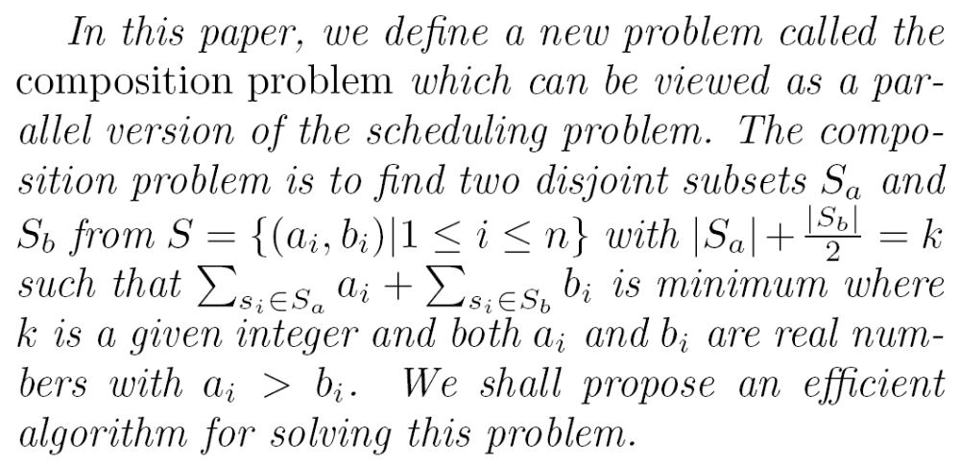
Abstract

Slide 3
Problem
給定下表與k, 在A裡面取m個，在B裡面取n個，一個東西只能取A或取B，滿足m+n/2=k，取出來的數字和最小
 | s1 | s2 | s3 | s4 | s5 | s6 | s7 | s8 | s9 | s10
A | 9 | 13 | 19 | 8 | 18 | 11 | 21 | 10 | 21 | 17
B | 4 | 6 | 8 | 2 | 14 | 9 | 10 | 9 | 6 | 12

Slide 4
Example
k=3
 | s1 | s2 | s3 | s4 | s5 | s6 | s7 | s8 | s9 | s10
A | 9 | 13 | 19 | 8 | 18 | 11 | 21 | 10 | 21 | 17
B | 4 | 6 | 8 | 2 | 14 | 9 | 10 | 9 | 6 | 12
sum=27
 | s1 | s2 | s3 | s4 | s5 | s6 | s7 | s8 | s9 | s10
A | 9 | 13 | 19 | 8 | 18 | 11 | 21 | 10 | 21 | 17
B | 4 | 6 | 8 | 2 | 14 | 9 | 10 | 9 | 6 | 12
sum=29

Slide 5
Initial
2k minimal b-value elements.
 | s1 | s2 | s3 | s4 | s5 | s6 | s7 | s8 | s9 | s10
A | 9 | 13 | 19 | 8 | 18 | 11 | 21 | 10 | 21 | 17
B | 4 | 6 | 8 | 2 | 14 | 9 | 10 | 9 | 6 | 12
S_{a}=∅, S_{b}={s1, s2, s3, s4, s8, s9}

Slide 6
S_{b} Candidate
 | s1 | s2 | s3 | s4 | s5 | s6 | s7 | s8 | s9 | s10
A | 9 | 13 | 19 | 8 | 18 | 11 | 21 | 10 | 21 | 17
B | 4 | 6 | 8 | 2 | 14 | 9 | 10 | 9 | 6 | 12
sum=35
 | s1 | s2 | s3 | s4 | s5 | s6 | s7 | s8 | s9 | s10
A | 9 | 13 | 19 | 8 | 18 | 11 | 21 | 10 | 21 | 17
B | 4 | 6 | 8 | 2 | 14 | 9 | 10 | 9 | 6 | 12
sum=31

Slide 7
S_{b} Candidate
 | s1 | s2 | s3 | s4 | s5 | s6 | s7 | s8 | s9 | s10
A | 9 | 13 | 19 | 8 | 18 | 11 | 21 | 10 | 21 | 17
B | 4 | 6 | 8 | 2 | 14 | 9 | 10 | 9 | 6 | 12
S_{b}={s1, s2, s3, s4, s8, s9} , S_{b}-max=9
s1:4+9>9
s2: 6+9>13
s3: 8+9<19
s4: 2+9>8
s8: 9+8>10
s9: 6+9<21
S_{b}-candidate={s1, s2, s4, s8}

Slide 8
S_{b}-forbidden Element
An S_{b}-candidate s_{x} ∈ S_{b} is called an S_{b}-forbidden element if there exist another two distinct s_{i} and s_{j} ∈ S_{b} and none of them equal to Max(S_{b} − s_{x}, b, 1) such that max{a_{i}, a_{j}} < a_{x} and c_{i} + c_{j} < a_{x}.
把{b_{i}, b_{j}, b_{x}, b_{max}}換成{a_{i}, a_{j}}賺的比把{b_{x}, b_{max}}換成{a_{x}}多則b_{x}是S_{b}-forbidden Element 。

Slide 9
S_{b}-forbidden Element
 | s1 | s2 | s3 | s4 | s5 | s6 | s7 | s8 | s9 | s10
A | 9 | 13 | 19 | 8 | 18 | 11 | 21 | 10 | 21 | 17
B | 4 | 6 | 8 | 2 | 14 | 9 | 10 | 9 | 6 | 12
sum=35
 | s1 | s2 | s3 | s4 | s5 | s6 | s7 | s8 | s9 | s10
A | 9 | 13 | 19 | 8 | 18 | 11 | 21 | 10 | 21 | 17
B | 4 | 6 | 8 | 2 | 14 | 9 | 10 | 9 | 6 | 12
sum=34
 | s1 | s2 | s3 | s4 | s5 | s6 | s7 | s8 | s9 | s10
A | 9 | 13 | 19 | 8 | 18 | 11 | 21 | 10 | 21 | 17
B | 4 | 6 | 8 | 2 | 14 | 9 | 10 | 9 | 6 | 12
sum=31

Slide 10
S_{r} Candidate
在沒被選到的東西裡面找A值最小的，若是把S_{b}裡面B值最大的兩個換過去會賺，則是S_{r} candidate
 | s1 | s2 | s3 | s4 | s5 | s6 | s7 | s8 | s9 | s10
A | 9 | 13 | 19 | 8 | 18 | 11 | 21 | 10 | 21 | 17
B | 4 | 6 | 8 | 2 | 14 | 9 | 10 | 9 | 6 | 12
sum=35
 | s1 | s2 | s3 | s4 | s5 | s6 | s7 | s8 | s9 | s10
A | 9 | 13 | 19 | 8 | 18 | 11 | 21 | 10 | 21 | 17
B | 4 | 6 | 8 | 2 | 14 | 9 | 10 | 9 | 6 | 12
sum=29

Slide 11
S_{r}-forbidden Element
An S_{r}-candidate s_{δ} is called an S_{r}-forbidden element if there exist two distinct elements s_{i}, s_{j} ∈ S_{b} \ {s_{β1} , s_{β2}} such that max{a_{i}, a_{j}} < a_{x} and c_{i} + c_{j} < a_{x}. x是δ?
把{b_{i}, b_{j}, b_{β1}, b_{β2}}換成{a_{i}, a_{j}}賺的比把{b_{β1}, b_{β2} }換成{a_{x}}多則s_{δ}是S_{r}-forbidden Element 。

Slide 12
S_{r}-forbidden Element
 | s1 | s2 | s3 | s4 | s5 | s6 | s7 | s8 | s9 | s10
A | 9 | 13 | 19 | 8 | 18 | 16 | 21 | 10 | 21 | 17
B | 4 | 6 | 8 | 2 | 14 | 9 | 10 | 9 | 6 | 12
sum=35
 | s1 | s2 | s3 | s4 | s5 | s6 | s7 | s8 | s9 | s10
A | 9 | 13 | 19 | 8 | 18 | 16 | 21 | 10 | 21 | 17
B | 4 | 6 | 8 | 2 | 14 | 9 | 10 | 9 | 6 | 12
sum=34
 | s1 | s2 | s3 | s4 | s5 | s6 | s7 | s8 | s9 | s10
A | 9 | 13 | 19 | 8 | 18 | 16 | 21 | 10 | 21 | 17
B | 4 | 6 | 8 | 2 | 14 | 9 | 10 | 9 | 6 | 12
sum=30

Slide 13
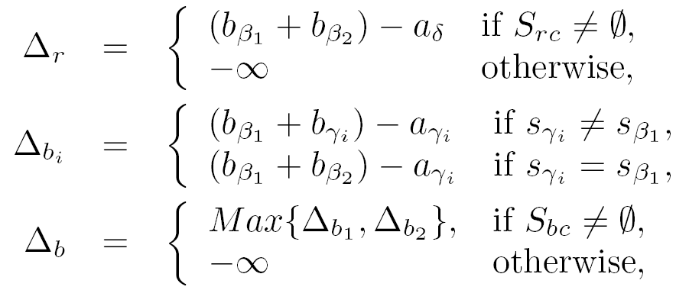
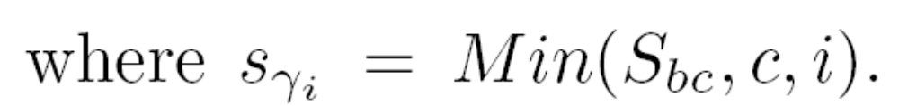
Algorithm
對於non-forbidden S_{b} candidates及non-forbidden S_{r} candidates用賺最多的greedy

Slide 14
Algorithm(1)
Initial: S_{a}=∅, S_{b}={s1, s2, s3, s4, s8, s9}
 | s1 | s2 | s3 | s4 | s5 | s6 | s7 | s8 | s9 | s10
A | 9 | 13 | 19 | 8 | 18 | 11 | 21 | 10 | 21 | 17
B | 4 | 6 | 8 | 2 | 14 | 9 | 10 | 9 | 6 | 12
C | 5 | 7 | 11 | 6 | 4 | 2 | 11 | 1 | 15 | 5
S_{b} candidate={s1, s2, s4, s8}
S_{bc}={s1, s4, s8}, b₁=8, b₂=1, b₃=4
Δ_{b1}=(9+8)-10=7, Δ_{b2}=(9+4)-9=4, Δ_{b3}=(9+2)-8=3
Δ_{b}=Max(7,4)=7
S_{rc}={s6}, Δ_{r}=(9+8)-11=6
∴選b來換，A加入{s8}，B去掉{s3, s8}

Slide 15
Algorithm(2)
 | s1 | s2 | s3 | s4 | s5 | s6 | s7 | s8 | s9 | s10
A | 9 | 13 | 19 | 8 | 18 | 11 | 21 | 10 | 21 | 17
B | 4 | 6 | 8 | 2 | 14 | 9 | 10 | 9 | 6 | 12
C | 5 | 7 | 11 | 6 | 4 | 2 | 11 | 1 | 15 | 5
S_{b} candidate={s1}
S_{bc}={s1}, b₁=1
Δ_{b1}=(6+4)-9=1→Δ_{b}=1
S_{rc}={s6}, Δ_{r}=(6+6)-11=1
∴選r來換，A加入{s6}，B去掉{s2, s9}

Slide 16
Algorithm(3)
 | s1 | s2 | s3 | s4 | s5 | s6 | s7 | s8 | s9 | s10
A | 9 | 13 | 19 | 8 | 18 | 11 | 21 | 10 | 21 | 17
B | 4 | 6 | 8 | 2 | 14 | 9 | 10 | 9 | 6 | 12
C | 5 | 7 | 11 | 6 | 4 | 2 | 11 | 1 | 15 | 5
S_{b} candidate= ∅
S_{bc}= ∅
S_{rc}= ∅ ∴結束

Slide 17
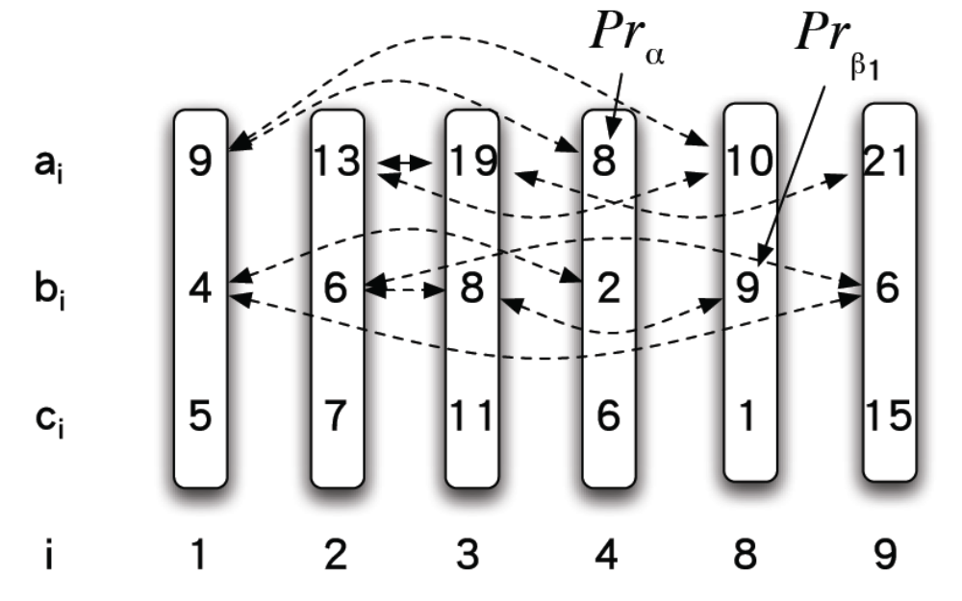
Selecting Non-forbidden Elements
Construct an array C in which index i corresponds to the element Min{S_{b}, a, i} and C[i] contains its c-value

Slide 18
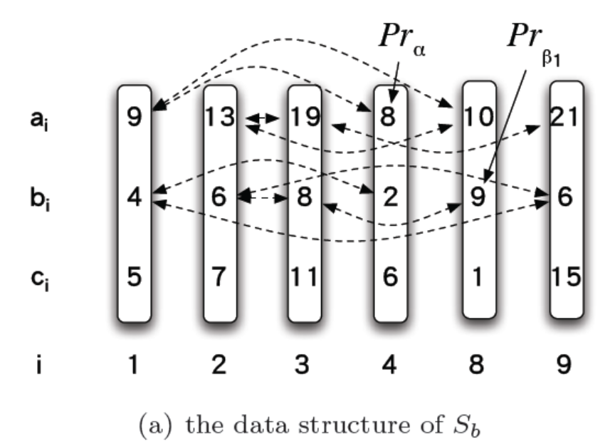
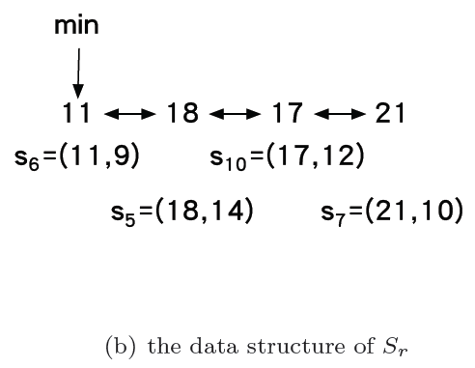
Data Structure
 | s1 | s2 | s3 | s4 | s5 | s6 | s7 | s8 | s9 | s10
A | 9 | 13 | 19 | 8 | 18 | 11 | 21 | 10 | 21 | 17
B | 4 | 6 | 8 | 2 | 14 | 9 | 10 | 9 | 6 | 12
C | 5 | 7 | 11 | 6 | 4 | 2 | 11 | 1 | 15 | 5
Fibonacci Heap

Slide 19
Selecting Non-forbidden Elements
 | s1 | s2 | s3 | s4 | s5 | s6 | s7 | s8 | s9 | s10
A | 9 | 13 | 19 | 8 | 18 | 11 | 21 | 10 | 21 | 17
B | 4 | 6 | 8 | 2 | 14 | 9 | 10 | 9 | 6 | 12
C | 5 | 7 | 11 | 6 | 4 | 2 | 11 | 1 | 15 | 5
S_{b} candidate={s1, s2, s4, s8},
S_{r} candidate={s6}
6 | 5 | 1 | 7

Slide 20
Selecting S_{bc}
在array中s_{x}的前面找最小的三個。
若是S_{b} − s_{x}中b最大的在裡面就去掉。
若是最小的兩個c₁+c₂<a_{x}就把s_{x}加進s_{bc}
 | s1 | s2 | s3 | s4 | s5 | s6 | s7 | s8 | s9 | s10
A | 9 | 13 | 19 | 8 | 18 | 11 | 21 | 10 | 21 | 17
B | 4 | 6 | 8 | 2 | 14 | 9 | 10 | 9 | 6 | 12
C | 5 | 7 | 11 | 6 | 4 | 2 | 11 | 1 | 15 | 5
6 | 5 | 1 | 7
S_{b} candidate={s1, s2, s4, s8},

Slide 21
Selecting S_{rc}
在array中找最小的四個。
若是S_{b}中b前兩大的在裡面就去掉。
若是最小的兩個c₁+c₂<a_{x}就把s_{x}加進s_{rc}。
 | s1 | s2 | s3 | s4 | s5 | s6 | s7 | s8 | s9 | s10
A | 9 | 13 | 19 | 8 | 18 | 11 | 21 | 10 | 21 | 17
B | 4 | 6 | 8 | 2 | 14 | 9 | 10 | 9 | 6 | 12
C | 5 | 7 | 11 | 6 | 4 | 2 | 11 | 1 | 15 | 5
8 | 9 | 10 | 13
2 | 4 | 9 | 6
6 | 5 | 1 | 7

Slide 22
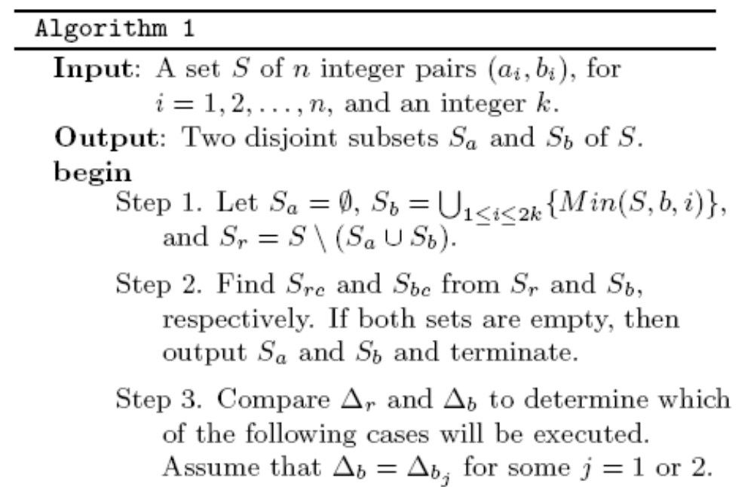
Time Complexity
O(nlogn)
O(k)

Slide 23
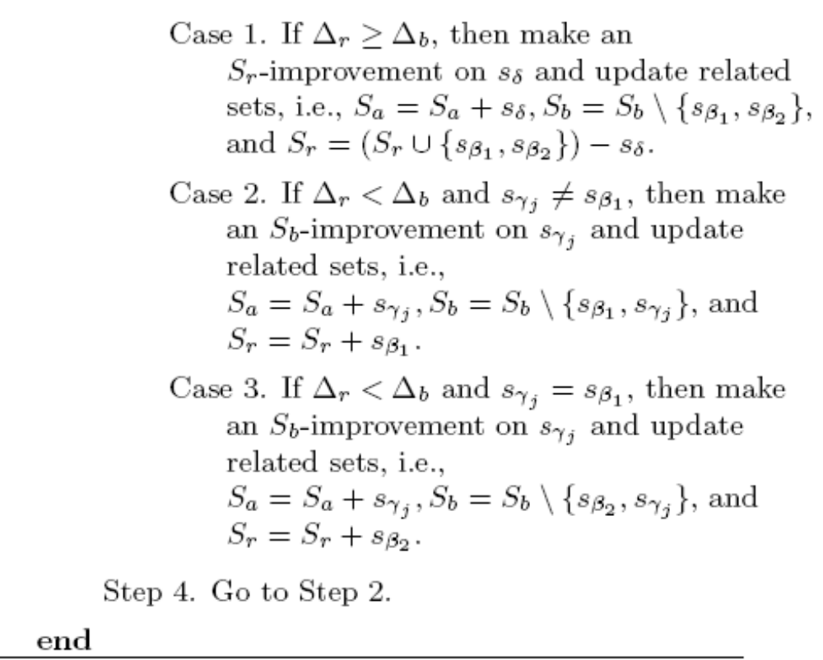
Time Complexity
O(logk)

Slide 24
End

Slide 25
Algorithm

Slide 26
Algorithm

