Slide 1
Improving multikey Quicksort for sorting strings with many equal elements
Eunsang Kim, Kunsoo Park
Information Processing Letters 109 (2009) 454–459
Presenter: Chu-Kai Liu
Date: June 23, 2009

Slide 2
Abstract (1/2)
Bentley and Sedgewick proposed multikey Quicksort with ‘split-end’ partitioning for sorting strings. But it can be slow in case of many equal elements because it adopted ‘split-end’ partitioning that moves equal elements to the ends and swaps back to the middle. We present ‘collect-center’ partitioning to improve multikey Quicksort in that case.

Slide 3
Abstract (2/2)
It moves equal elements to the middle directly like the ‘Dutch National Flag Problem’ partitioning approach and it uses two inner loops like Bentley and McIlroy’s. In case of many equal elements such as DNA sequences, HTML files, and English texts, multikey Quicksort with ‘collect-center’ partitioning is faster than multikey Quicksort with ‘split-end’ partitioning.

Slide 4
1. Multikey quicksort
Example:
  Input: be by it or on of in he to at as
  Output: as at be by he in is it of on or to
is
is
1st char
be by he at as
is it in
or on of to
<
=
>
1st char
2nd char
1st char
at as be by he
in is it
on of or to
<
=
>
=
>
as at be by he
in is it
of on or to

Slide 5
2.1 Bentley and McIlroy’s ‘split-end’ partitioning
=
<
?
>
=
a
b
c
d
=
<
>
=
a
c
b
d
<
=
>

Slide 6

2.2 ‘Dutch National Flag Problem’ partitioning
<
=
?
>
a
b
c
<
=
>
Dutch flag

Slide 7
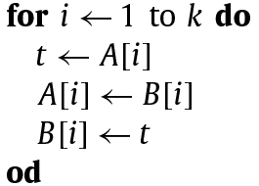
3 An improved ‘split-end’ partitioning (1/2)
A be an array of equal elements at the left or right end and B be an array of smaller or greater elements in the middle.
Need 3 movements

Slide 8
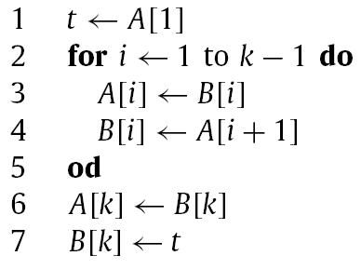
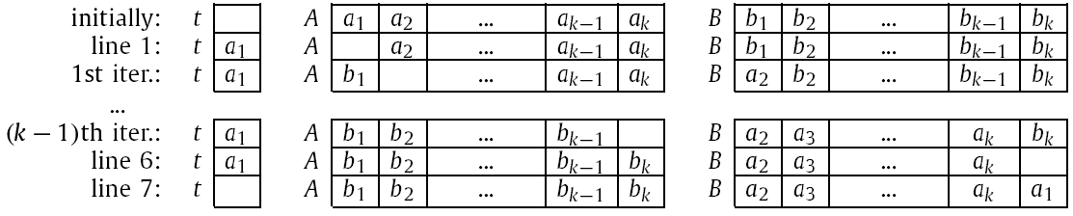
3 An improved ‘split-end’ partitioning (2/2)
New method: batch-swap
Only need 2k+1 movements

Slide 9
4 ‘Collect-center’ partitioning (1/2)
<
=
?
=
>
a
b
c
d
<
=
?
=
>
a
b
c
d
<
=
?
=
>
a
b
c
d

Slide 10
4 ‘Collect-center’ partitioning (2/2)
<
=
?
=
>
a
b
c
d
<
=
?
=
>
a
b
c
d
<
=
?
=
>
a
b
c
d

Slide 11
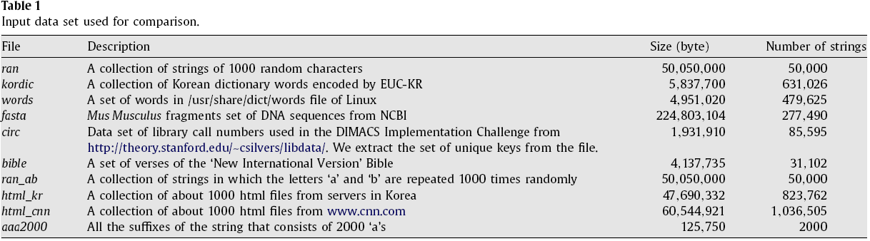
5. Experimental results (1/3)

Slide 12
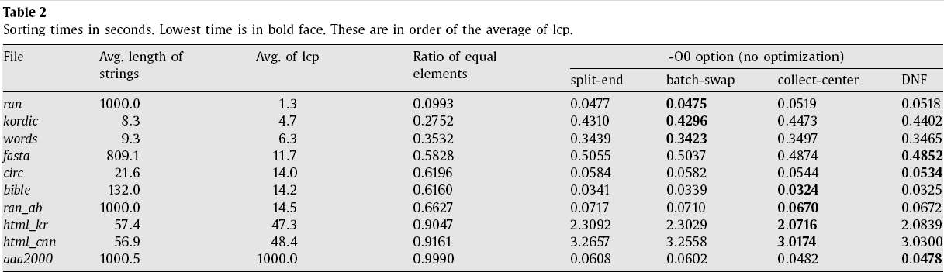
5. Experimental results (2/3)

Slide 13
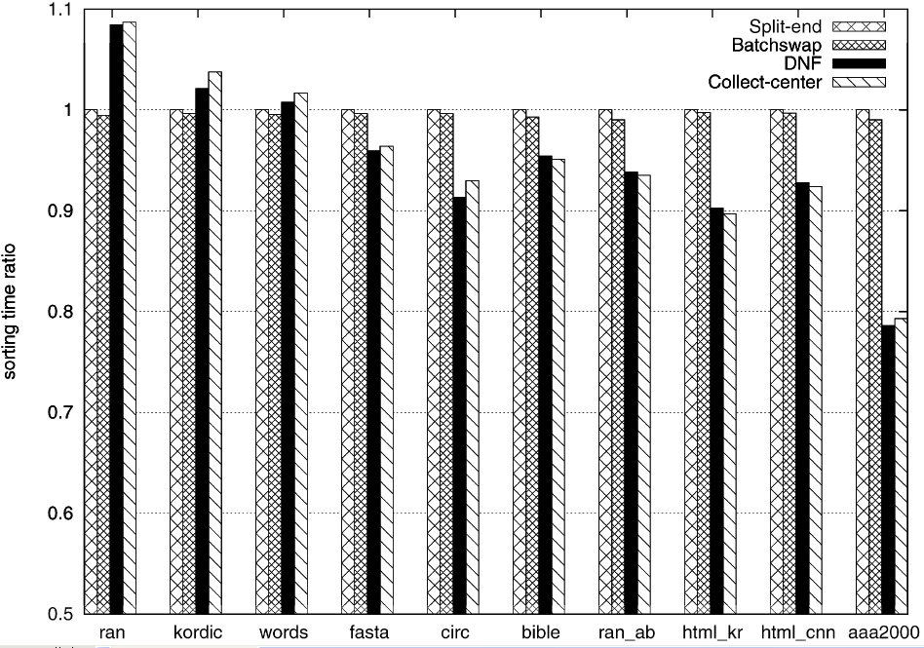
5. Experimental results (3/3)

