Slide 1
Fuzzy Versus Nonfuzzy in Combining Classifiers Designed by Boosting
Ludmila I. Kuncheva
IEEE TRANSACTIONS ON FUZZY SYSTEMS,
VOL. 11, NO. 6, Dec. 2003

Slide 2
Abstract
Boosting is recognized as one of the most successful techniques for generating classifier ensembles. Typically, the classifier outputs are combined by the weighted majority vote. The purpose of this study is to demonstrate the advantages of some fuzzy combination methods for ensembles of classifiers designed by Boosting. We ran two-fold cross-validation experiments on six benchmark data sets to compare the fuzzy and nonfuzzy combination methods. On the “fuzzy side” we used the fuzzy integral and the decision templates with different similarity measures.

Slide 3
Abstract
On the “nonfuzzy side” we tried the weighted majority vote as well as simple combiners such as the majority vote, minimum, maximum, average, product, and the Naive–Bayes combination. In our experiments, the fuzzy combination methods performed consistently better than the nonfuzzy methods. The weighted majority vote showed a stable performance, though slightly inferior to the performance of the fuzzy combiners.

Slide 4
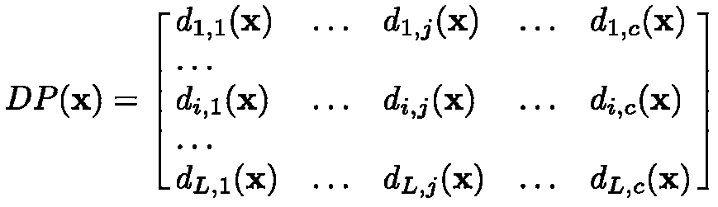

Decision profile
Classes
Classifiers
where dij(x) is the degree of support given by classifier i to the hypothesis that comes from class j

Slide 5
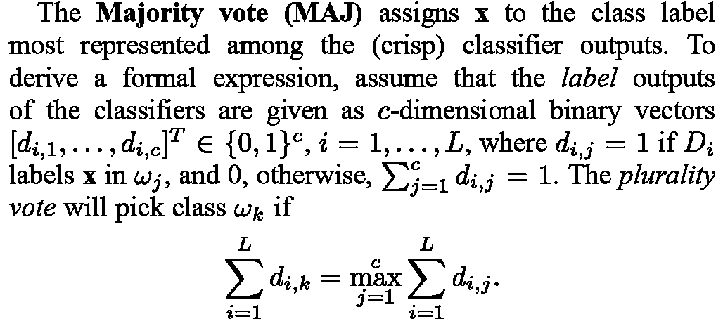
Majority vote
Ludmila I. Kuncheva, "Combining Pattern Classifiers"

Slide 6
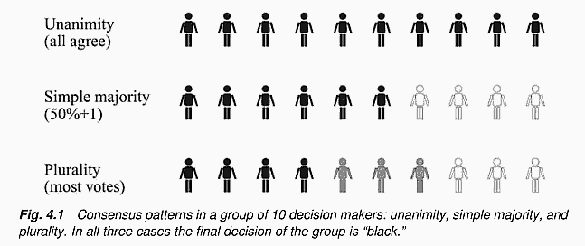
Majority vote
Ludmila I. Kuncheva, "Combining Pattern Classifiers"

Slide 7
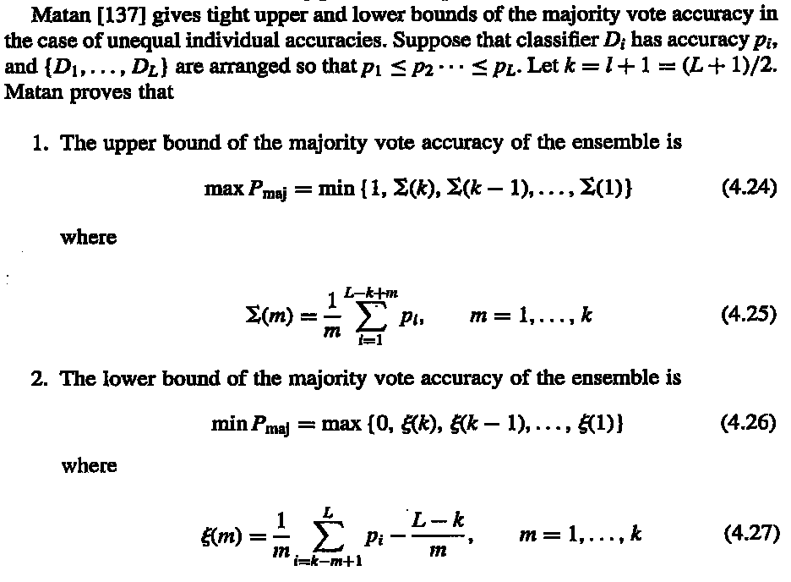
Error limit of majority vote
Ludmila I. Kuncheva, "Combining Pattern Claqssifiers"

Slide 8
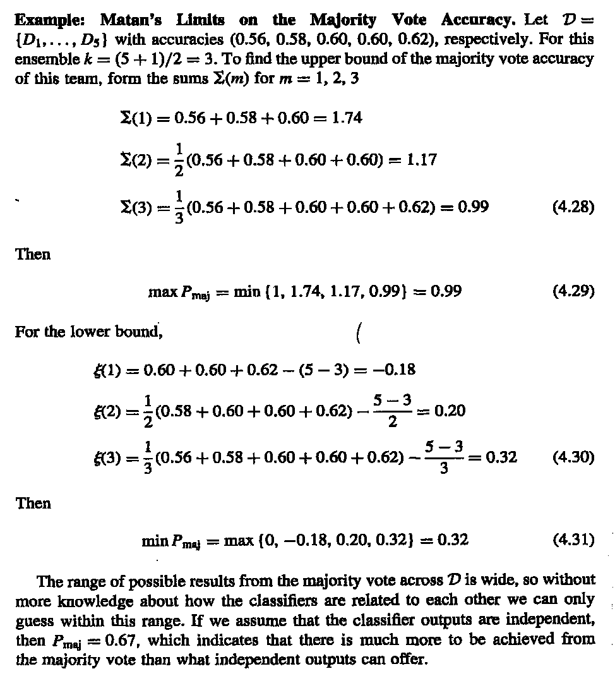
Error limit of majority vote
Ludmila I. Kuncheva, "Combining Pattern Claqssifiers"

Slide 9
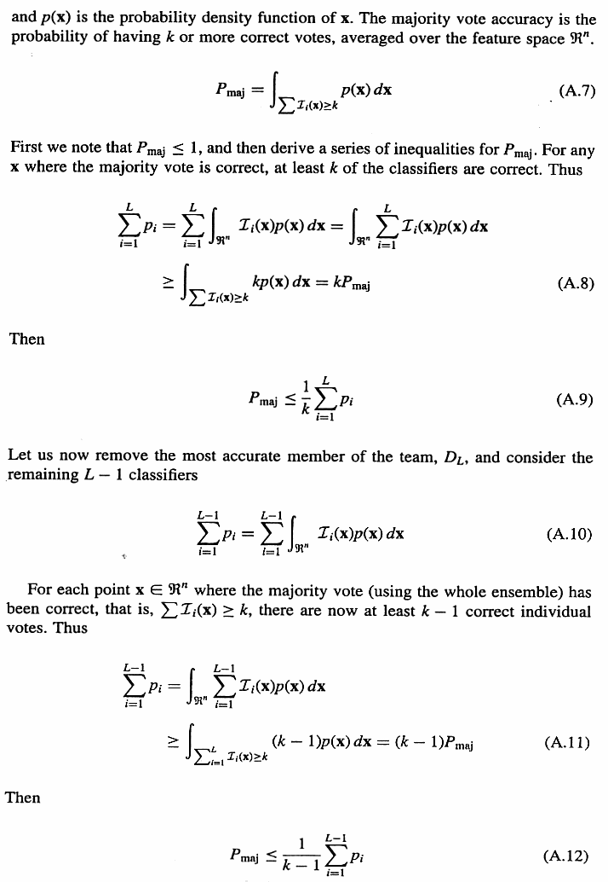
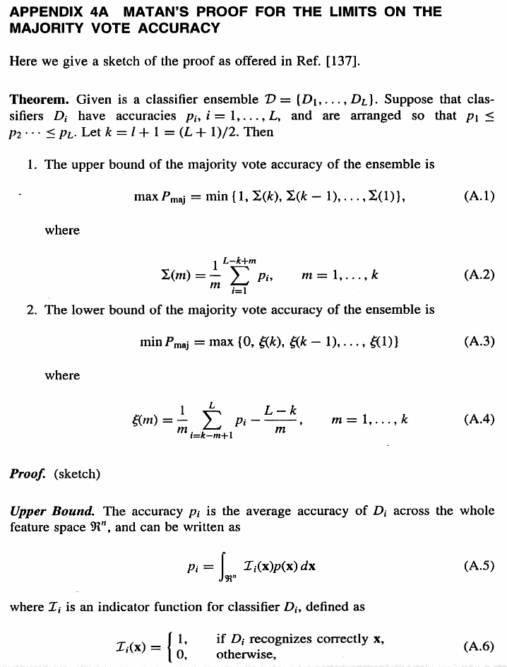
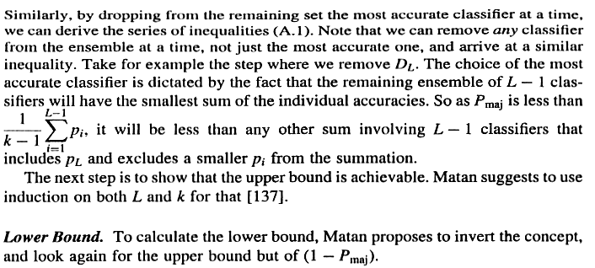
Ludmila I. Kuncheva, "Combining Pattern Classifiers"

Slide 10
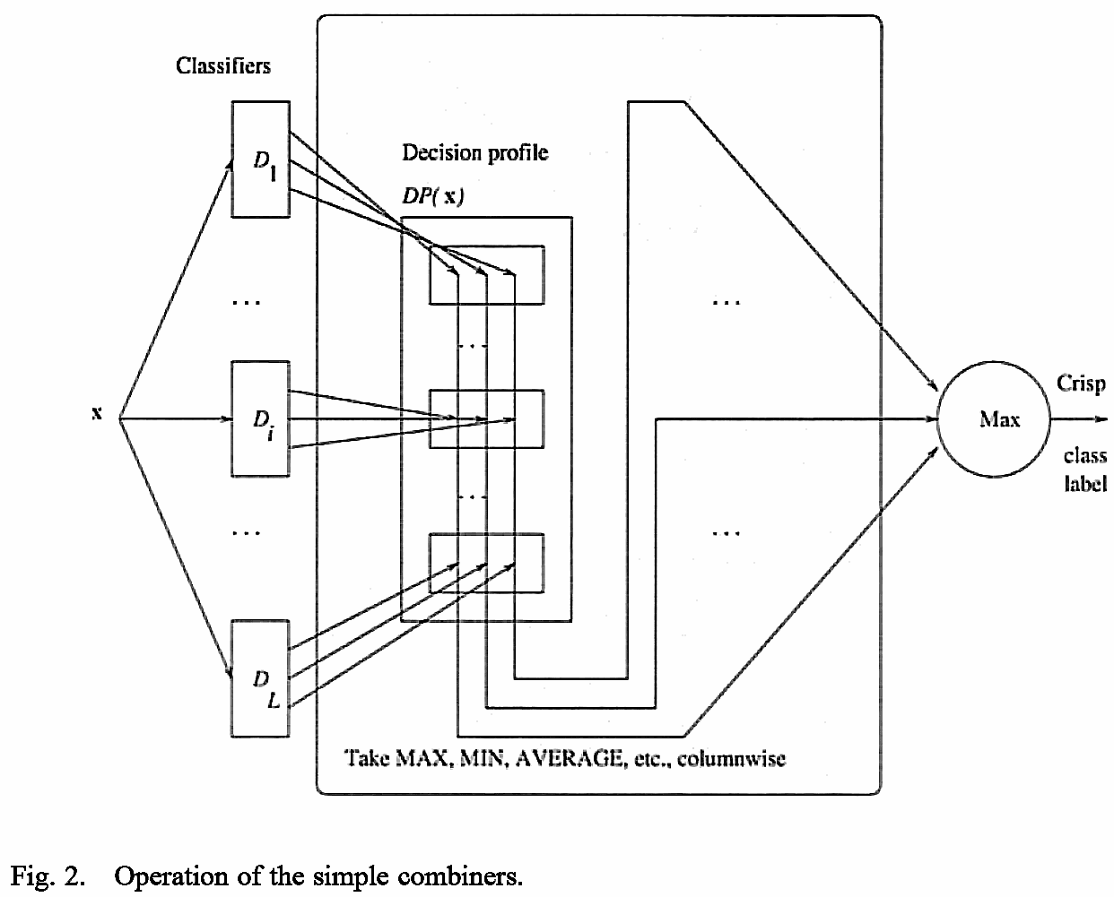
Simple combiners
The class support is calculated from the decision profile taking Maximum, Average and Product separately for each column.

Slide 11
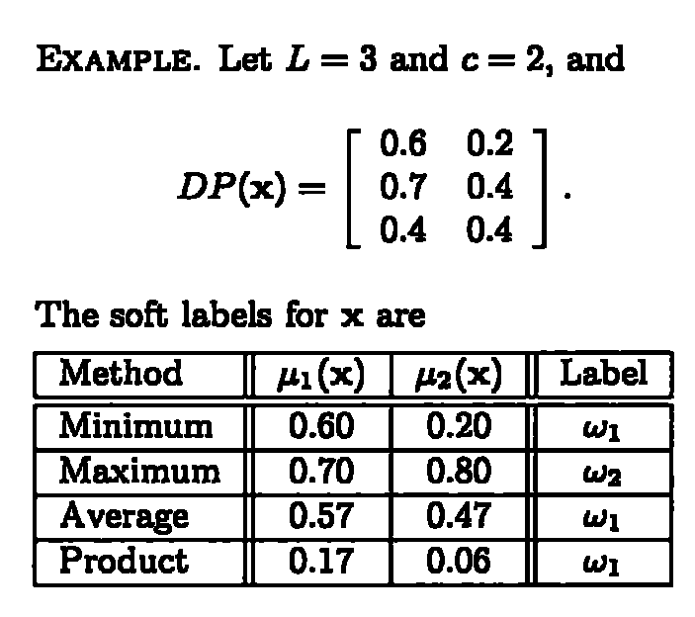
Example of Simple combiners
0.8

Slide 12

Bayes theorem
P(h): prior probability of hypothesis h, may reflect any background knowledge that h holds
P(D): prior probability of training data D is observed
P(D|h): the probability of observing D given that h holds
P(h|D): posterior probability that h holds after observing D
Tom M. Mitchell, "Machine Learning"

Slide 13
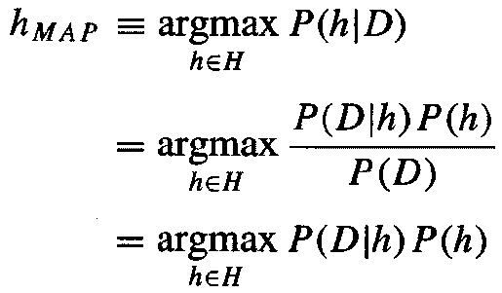
Maximum a posterior (MAP)
P(h|D): maximum posterior probability that h holds after observing D
Tom M. Mitchell, "Machine Learning"

Slide 14
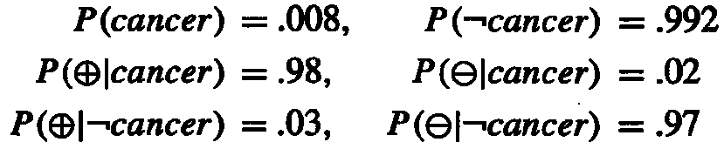
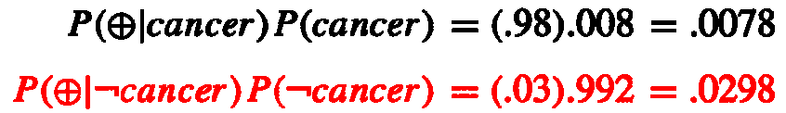
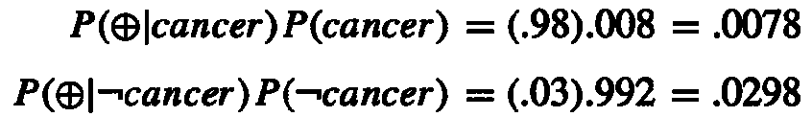
Bayes theorem example
P(cancer): the probability of the entire population that have cancer
P(⊕): the probability of laboratory test that shows positive outcome
Question: suppose we observe a person whose laboratory test is positive, should we diagnose him as have cancer or not?
Tom M. Mitchell, "Machine Learning"

Slide 15

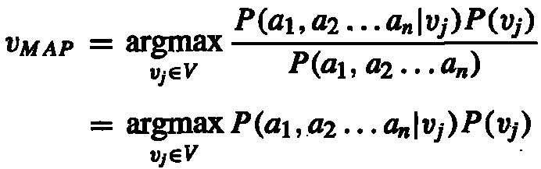
Navie Bayes classifier
Maximum a posterior (MAP)
Rewritten MAP
Tom M. Mitchell, "Machine Learning"

Slide 16
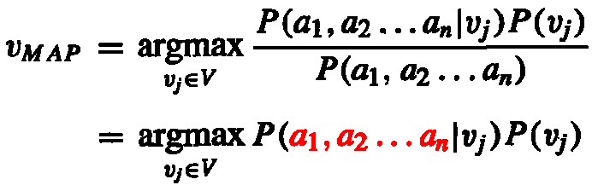
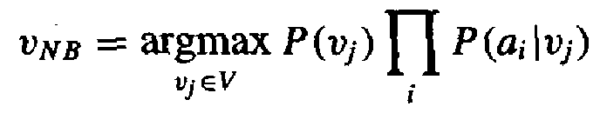
Navie Bayes classifier
It is impossible to enumerate all possible (a₁,a₂,...,a_{n}) combinations. Hence, we assume each attribute (feature) is indepedent. That is
The Navie Bayes classifier is
Tom M. Mitchell, "Machine Learning"

Slide 17
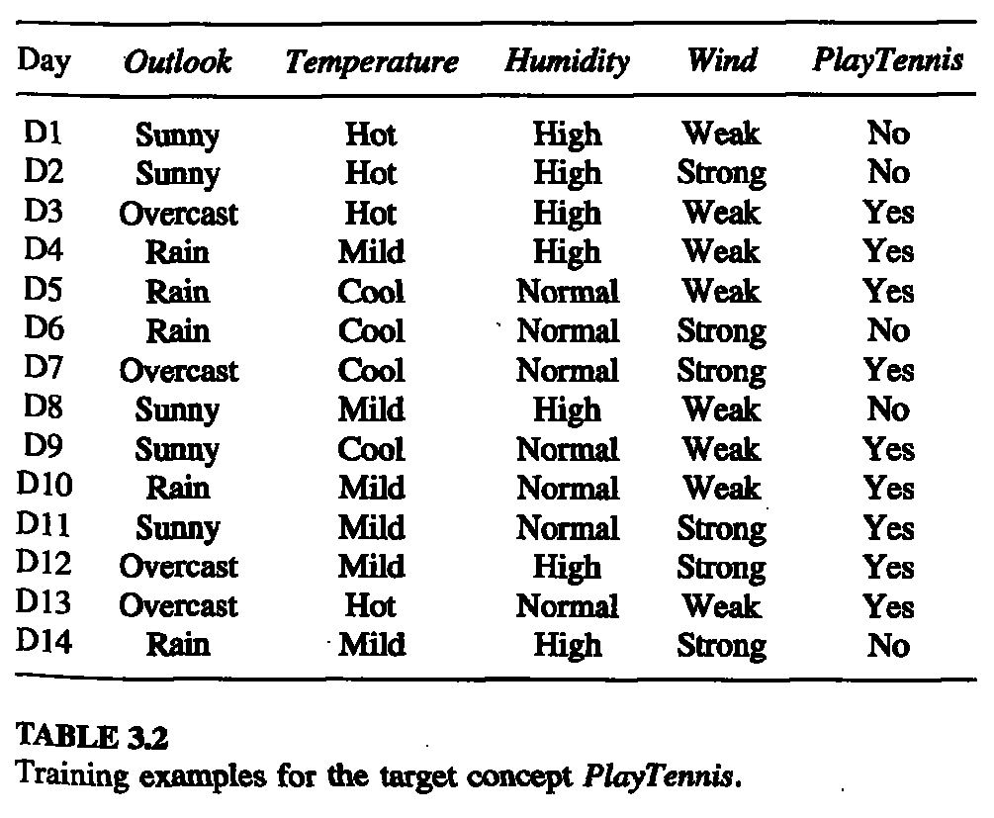
Navie Bayes classifier example
--Features, --Labels

Slide 18
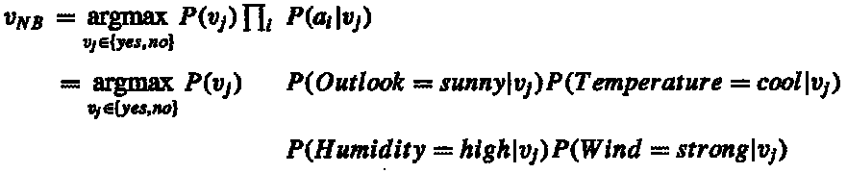
Navie Bayes classifier example
What we want to predict is: whether someone will play tennisthe given the following condition?
According to NB rule, the target value v_{NB} is:
Tom M. Mitchell, "Machine Learning"

Slide 19



Navie Bayes classifier example
P(Humidity=high|PlayTennis=yes)=3/9
P(Humidity=high|PlayTennis=no)=4/5
P(Temperature=cool|PlayTennis=yes)=3/9
P(Temperature=cool|PlayTennis=no)=1/5
P(Outlook=sunny|PlayTennis=yes)=2/9
P(Outlook=sunny|PlayTennis=no)=3/5
Tom M. Mitchell, "Machine Learning"

Slide 20
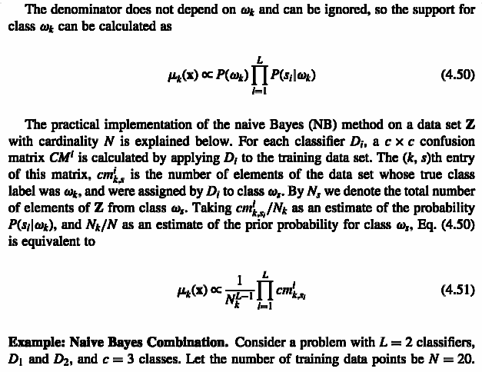
Navie Bayes combination
Ludmila I. Kuncheva, "Combining Pattern Classifiers"

Slide 21
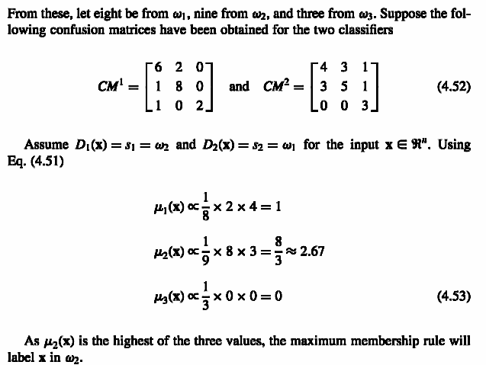
Navie Bayes combination
Ludmila I. Kuncheva, "Combining Pattern Classifiers"

Slide 22
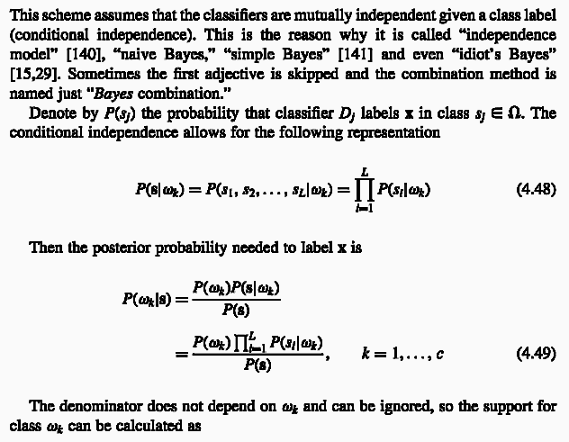
Navie Bayes combination
Ludmila I. Kuncheva, "Combining Pattern Classifiers"

Slide 23
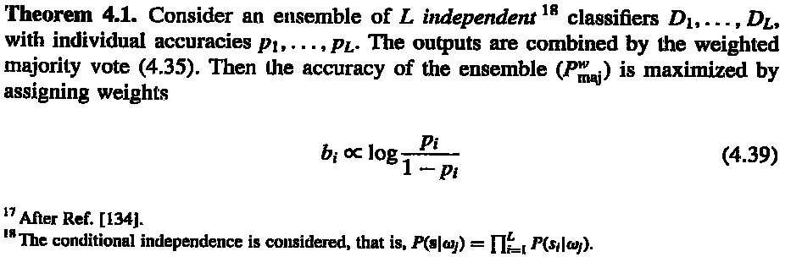
Weighted majority vote αm = log((1-e)/e)
Ludmila I. Kuncheva, "Combining Pattern Classifiers"
Notes:
x <- cbind(rep(seq(0,10,.2),each=51),rep(seq(0,10,.2),51))
cl <- apply(x,1,function(x) if((x[1]-x[2])>=0) "C1" else "C2")
col <- rep("blue",dim(x)[1])
col[which(cl=="C1")] <- "red"
plot(x,type='p',xlab="x1",ylab="x2",col=col,main="Original data")
x<-data.frame(x1=x[,1],x2=x[,2],class=cl)
ad <- adaboost.M1(class~.,x,mfinal=10)
for(i in 1:length(ad$trees)){
pred <- predict(ad$trees[[i]],x,type="class")
col <- rep("blue",dim(x)[1])
col[which(pred=="C1")] <- "red"
str <- sprintf("Classifier %i output, error: %f, weight: %f",
i,sum(pred!=x[,3])/dim(x)[1],ad$weights[i])
print(str)
x11()
plot(x[,1:2],type='p',xlab="x1",ylab="x2",col=col,main=str)
}
pred <- predict(ad,x)$class
col <- rep("blue",dim(x)[1])
col[which(pred=="C1")] <- "red"
str <- sprintf("Classifier 1~%i output, error: %f",
length(ad$trees),sum(pred!=x[,3])/dim(x)[1])
print(str)
x11()
plot(x[,1:2],type='p',xlab="x1",ylab="x2",col=col,main=str)

Slide 24
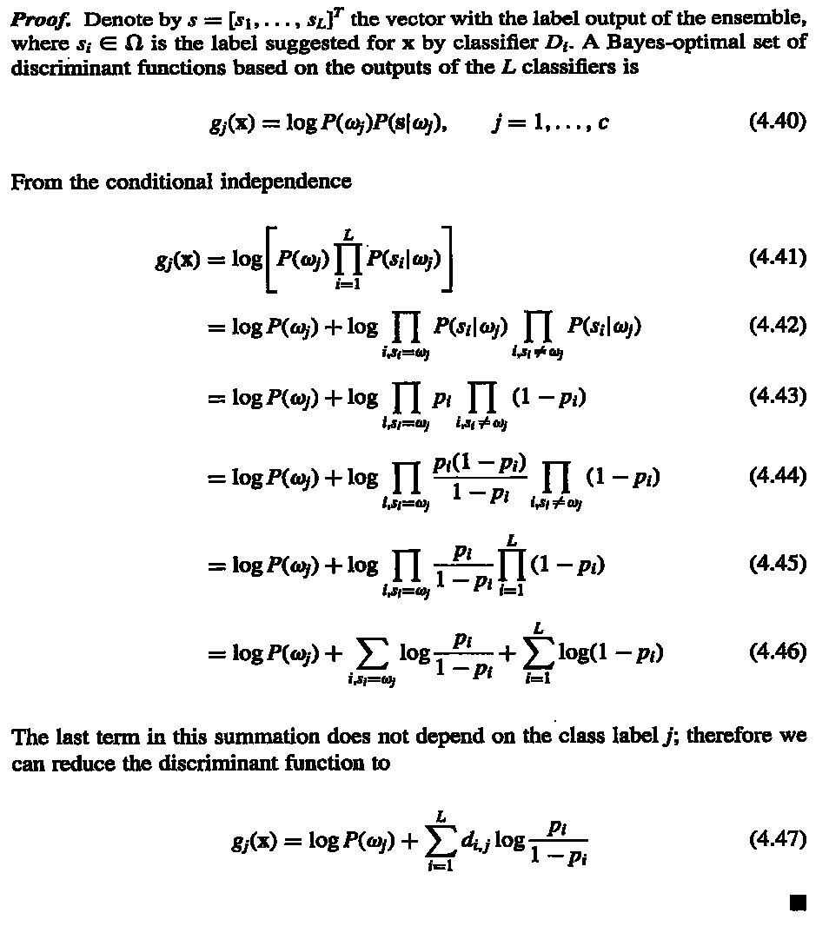
Ludmila I. Kuncheva, "Combining Pattern Classifiers"

Slide 25
Example
125特徵(CSHVPZ)，訓練資料311筆分四類，CSHVPZ各用訓練25隱藏神經元神經網路，驗證正確率分別為：0.84、0.87、0.61、0.58、0.59及0.59。，因此，分類器權重為：1.65、1.93、0.45、0.30、0.34及0.34。
測試資料383筆，正確率分別為：0.68、0.77、0.66、0.63、0.62及0.62。
合併後測試正確率為0.81。
http://ranger.uta.edu/~chqding/protein/

Slide 26
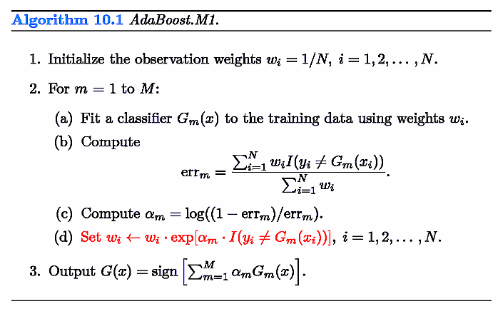
Adaboost
觀察某一訓練資料在adaboost訓練時出現狀況
第一輪0個，第一輪錯
第二輪2個，第二輪錯
第三輪6個，第三輪錯
第四輪11個，第四輪對
第五輪4個，第五輪錯
第六輪6個，第六輪錯
第七輪10個，第七輪對
第八輪8個，第八輪對
第九輪3個，第九輪錯
About the reason to set αm, see the following pages.
Trevor Hastie et al., "The Elements of Statistical Learning"
Notes:
x <- cbind(rep(seq(0,10,.2),each=51),rep(seq(0,10,.2),51))
cl <- apply(x,1,function(x) if((x[1]-x[2])>=0) "C1" else "C2")
col <- rep("blue",dim(x)[1])
col[which(cl=="C1")] <- "red"
plot(x,type='p',xlab="x1",ylab="x2",col=col,main="Original data")
x<-data.frame(x1=x[,1],x2=x[,2],class=cl)
ad <- adaboost.M1(class~.,x,mfinal=10)
for(i in 1:length(ad$trees)){
pred <- predict(ad$trees[[i]],x,type="class")
col <- rep("blue",dim(x)[1])
col[which(pred=="C1")] <- "red"
str <- sprintf("Classifier %i output, error: %f, weight: %f",
i,sum(pred!=x[,3])/dim(x)[1],ad$weights[i])
print(str)
x11()
plot(x[,1:2],type='p',xlab="x1",ylab="x2",col=col,main=str)
}
pred <- predict(ad,x)$class
col <- rep("blue",dim(x)[1])
col[which(pred=="C1")] <- "red"
str <- sprintf("Classifier 1~%i output, error: %f",
length(ad$trees),sum(pred!=x[,3])/dim(x)[1])
print(str)
x11()
plot(x[,1:2],type='p',xlab="x1",ylab="x2",col=col,main=str)

Slide 27
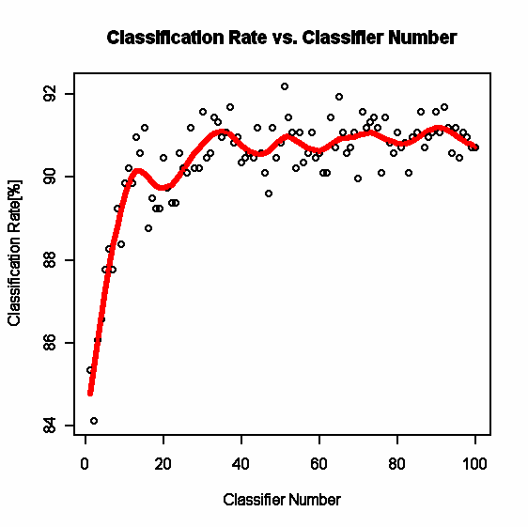
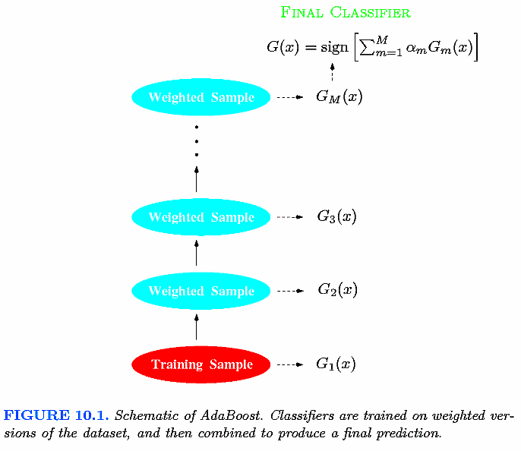
Adaboost
Trevor Hastie et al., "The Elements of Statistical Learning"

Slide 28
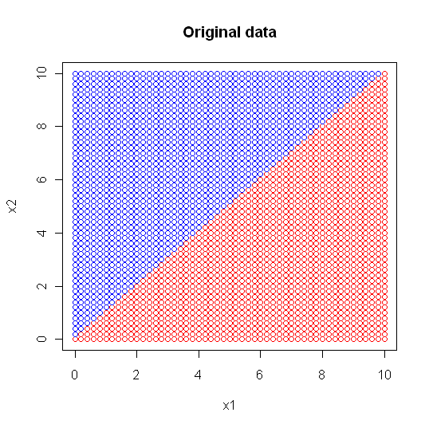
Adaboost
"Classifier 1 output, error: 0.132257, weight: 0.940575"
"Classifier 2 output, error: 0.217993, weight: 0.638700"
"Classifier 3 output, error: 0.129950, weight: 0.950700"
"Classifier 4 output, error: 0.129950, weight: 0.950700"
"Classifier 5 output, error: 0.190311, weight: 0.723994"
"Classifier 6 output, error: 0.259516, weight: 0.524244"
"Classifier 7 output, error: 0.348328, weight: 0.313199"
"Classifier 8 output, error: 0.328335, weight: 0.357862"
"Classifier 9 output, error: 0.384083, weight: 0.236127"
"Classifier 10 output, error: 0.209919, weight: 0.662706"
Notes:
[1] "Classifier 1 output, error: 0.132257, weight: 0.940575"
[1] "Classifier 2 output, error: 0.217993, weight: 0.638700"
[1] "Classifier 3 output, error: 0.129950, weight: 0.950700"
[1] "Classifier 4 output, error: 0.129950, weight: 0.950700"
[1] "Classifier 5 output, error: 0.190311, weight: 0.723994"
[1] "Classifier 6 output, error: 0.259516, weight: 0.524244"
[1] "Classifier 7 output, error: 0.348328, weight: 0.313199"
[1] "Classifier 8 output, error: 0.328335, weight: 0.357862"
[1] "Classifier 9 output, error: 0.384083, weight: 0.236127"
[1] "Classifier 10 output, error: 0.209919, weight: 0.662706"

Slide 29
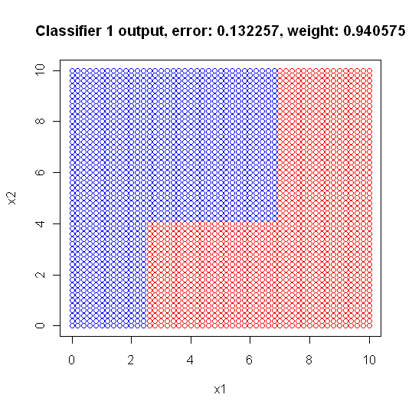
Adaboost
1) root 2601 1300 C1 (0.50019223 0.49980777)
2) x2< 4.1 1041 187 C1 (0.82036503 0.17963497)
4) x1>=2.5 801 30 C1 (0.96254682 0.03745318) *
5) x1< 2.5 240 83 C2 (0.34583333 0.65416667) *
3) x2>=4.1 1560 447 C2 (0.28653846 0.71346154)
6) x1>=6.9 495 130 C1 (0.73737374 0.26262626) *
7) x1< 6.9 1065 82 C2 (0.07699531 0.92300469) *
"

Slide 30
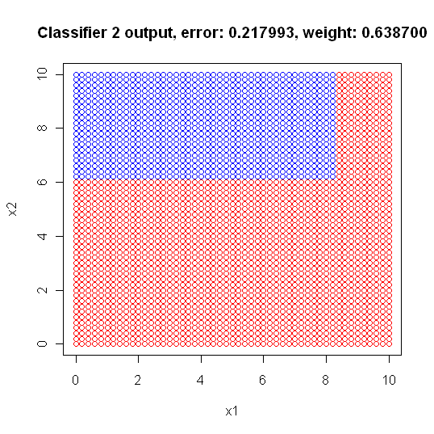
Adaboost
1) root 2601 1276 C1 (0.50941945 0.49058055)
2) x2< 6.1 1557 405 C1 (0.73988439 0.26011561) *
3) x2>=6.1 1044 173 C2 (0.16570881 0.83429119)
6) x1>=8.3 188 75 C1 (0.60106383 0.39893617) *
7) x1< 8.3 856 60 C2 (0.07009346 0.92990654) *

Slide 31
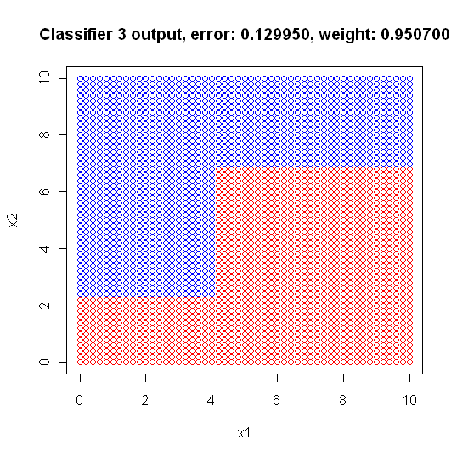
Adaboost
1) root 2601 1181 C2 (0.45405613 0.54594387)
2) x1>=4.1 1461 516 C1 (0.64681725 0.35318275)
4) x2< 6.9 936 83 C1 (0.91132479 0.08867521) *
5) x2>=6.9 525 92 C2 (0.17523810 0.82476190) *
3) x1< 4.1 1140 236 C2 (0.20701754 0.79298246)
6) x2< 2.3 286 81 C1 (0.71678322 0.28321678) *
7) x2>=2.3 854 31 C2 (0.03629977 0.96370023) *

Slide 32
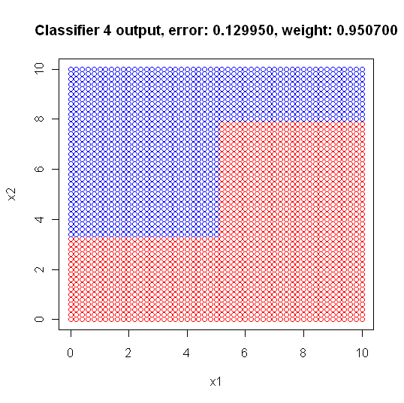
Adaboost
1) root 2601 1185 C2 (0.45559400 0.54440600)
2) x1>=5.1 1207 359 C1 (0.70256835 0.29743165)
4) x2< 7.9 840 97 C1 (0.88452381 0.11547619) *
5) x2>=7.9 367 105 C2 (0.28610354 0.71389646) *
3) x1< 5.1 1394 337 C2 (0.24175036 0.75824964)
6) x2< 3.3 557 254 C1 (0.54398564 0.45601436) *
7) x2>=3.3 837 34 C2 (0.04062127 0.95937873) *

Slide 33
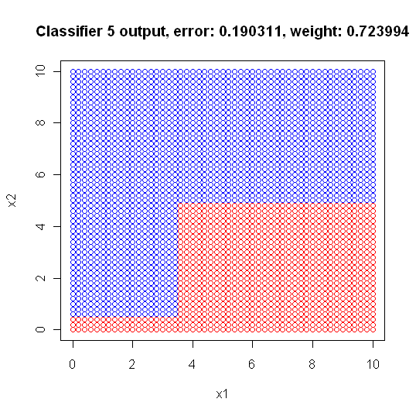
Adaboost
1) root 2601 1085 C2 (0.41714725 0.58285275)
2) x1>=3.5 1518 574 C1 (0.62187088 0.37812912)
4) x2< 4.9 496 26 C1 (0.94758065 0.05241935) *
5) x2>=4.9 1022 474 C2 (0.46379648 0.53620352) *
3) x1< 3.5 1083 141 C2 (0.13019391 0.86980609)
6) x2< 0.5 68 21 C1 (0.69117647 0.30882353) *
7) x2>=0.5 1015 94 C2 (0.09261084 0.90738916) *

Slide 34
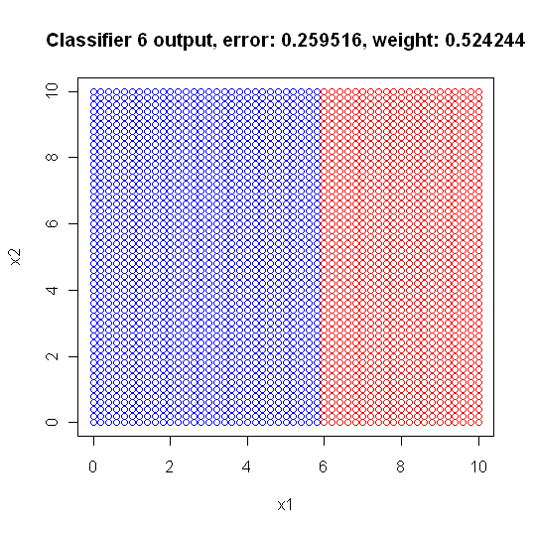
Adaboost
1) root 2601 1268 C1 (0.5124952 0.4875048)
2) x1>=5.9 1105 206 C1 (0.8135747 0.1864253) *
3) x1< 5.9 1496 434 C2 (0.2901070 0.7098930) *

Slide 35
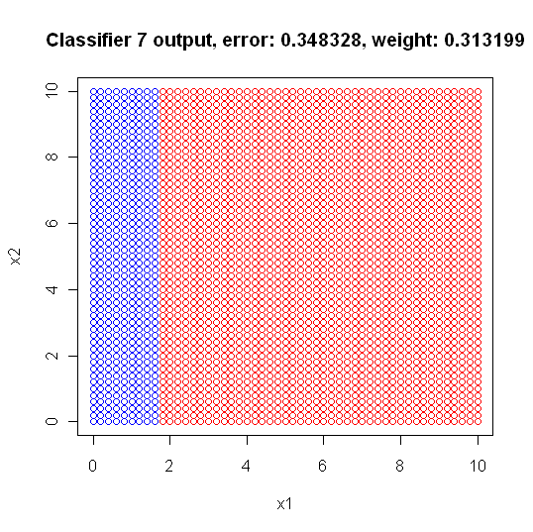
Adaboost
1) root 2601 1240 C1 (0.5232603 0.4767397)
2) x1>=1.7 2067 787 C1 (0.6192550 0.3807450) *
3) x1< 1.7 534 81 C2 (0.1516854 0.8483146) *

Slide 36
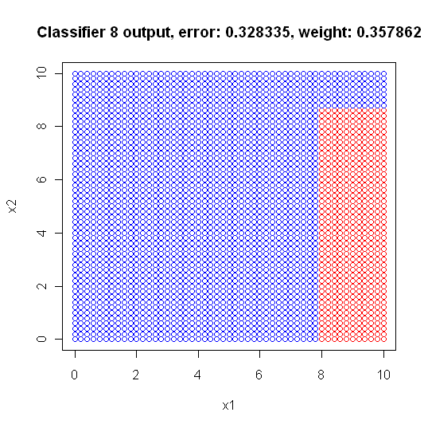
Adaboost
1) root 2601 1254 C2 (0.48212226 0.51787774)
2) x1>=7.9 619 141 C1 (0.77221325 0.22778675)
4) x2< 8.7 391 13 C1 (0.96675192 0.03324808) *
5) x2>=8.7 228 100 C2 (0.43859649 0.56140351) *
3) x1< 7.9 1982 776 C2 (0.39152371 0.60847629) *

Slide 37
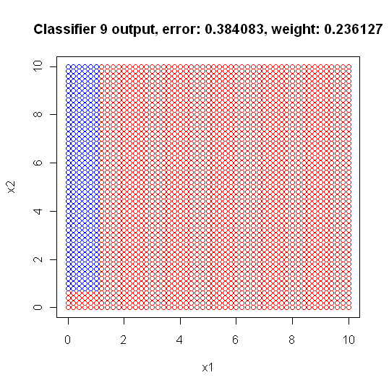
Adaboost
1) root 2601 1144 C1 (0.56016917 0.43983083)
2) x1>=1.1 2296 892 C1 (0.61149826 0.38850174) *
3) x1< 1.1 305 53 C2 (0.17377049 0.82622951)
6) x2< 0.7 63 23 C1 (0.63492063 0.36507937) *
7) x2>=0.7 242 13 C2 (0.05371901 0.94628099) *

Slide 38
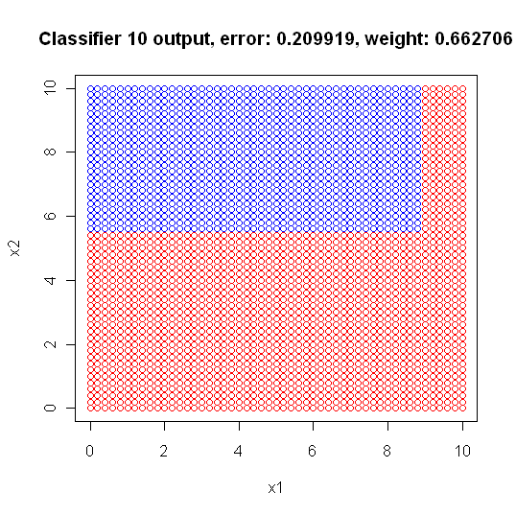
Adaboost
1) root 2601 1253 C1 (0.5182622 0.4817378)
2) x1>=8.9 335 35 C1 (0.8955224 0.1044776) *
3) x1< 8.9 2266 1048 C2 (0.4624890 0.5375110)
6) x2< 5.5 1302 503 C1 (0.6136713 0.3863287) *
7) x2>=5.5 964 249 C2 (0.2582988 0.7417012) *

Slide 39
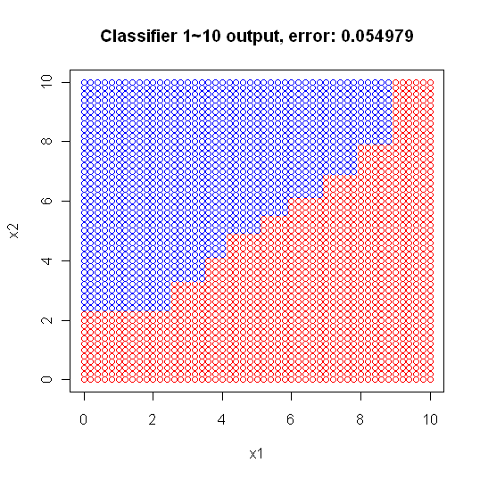
Adaboost - how to classify
input (6.6,6.6)
Classifier 1 output C2, weight: 0.940575
Classifier 2 output C2, weight: 0.638700
Classifier 3 output C1, weight: 0.950700
Classifier 4 output C1, weight: 0.950700
Classifier 5 output C2, weight: 0.723994
Classifier 6 output C1, weight: 0.524244
Classifier 7 output C1, weight: 0.313199
Classifier 8 output C2, weight: 0.357862
Classifier 9 output C1, weight: 0.236127
Classifier 10 output C2, weight: 0.662706
---------------------------------------------
C2:0.940575+0.638700+0.723994+0.357862+0.662706
=3.323837
C1:0.950700+0.950700+0.524244+0.313199+0.236127
2.97497
➔C2

Slide 40
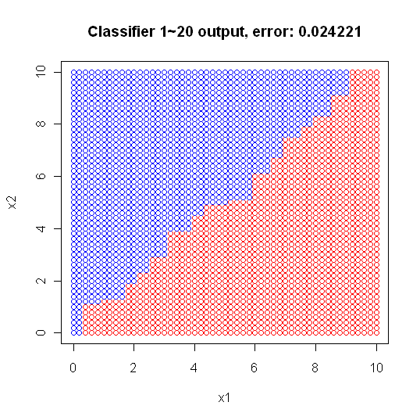
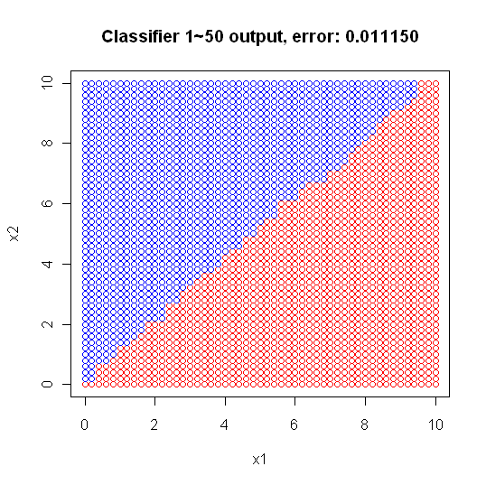
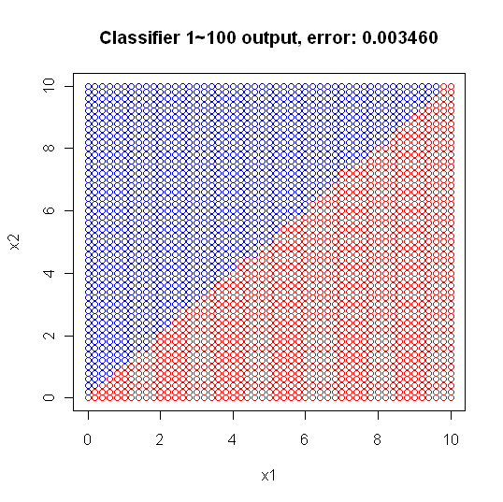
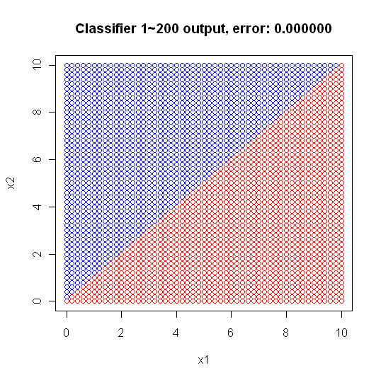
Adaboost

Slide 41
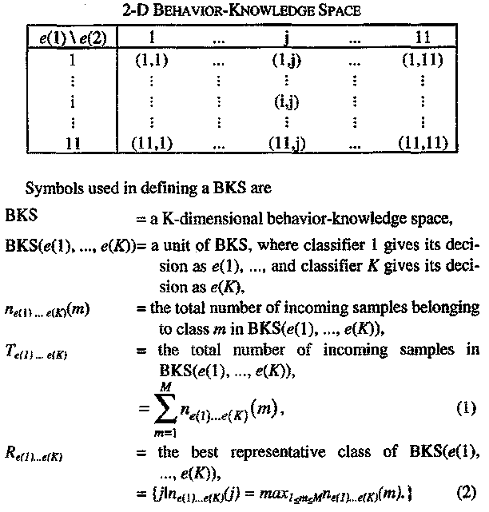
Behavior knowledge space (BKS)
IEEE TRANSACTIONS ON PATERN ANALYSIS AND MACHINE INTELLIGENCE, VOL. 17, NO. 1, JANUARY 1995

Slide 42
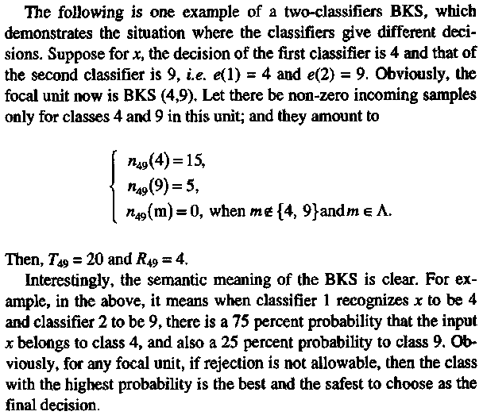
Behavior knowledge space (BKS)
IEEE TRANSACTIONS ON PATERN ANALYSIS AND MACHINE INTELLIGENCE, VOL. 17, NO. 1, JANUARY 1995

Slide 43
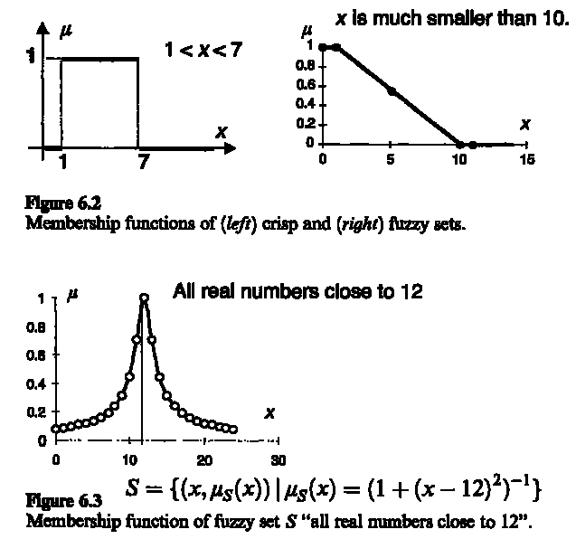
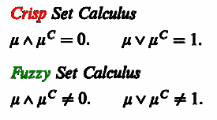
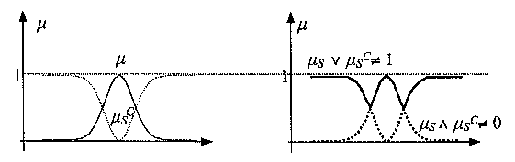
Crisp[清楚的; 明晰的] and fuzzy sets
Vojislav Kecman, "Learning and Soft Computing"

Slide 44
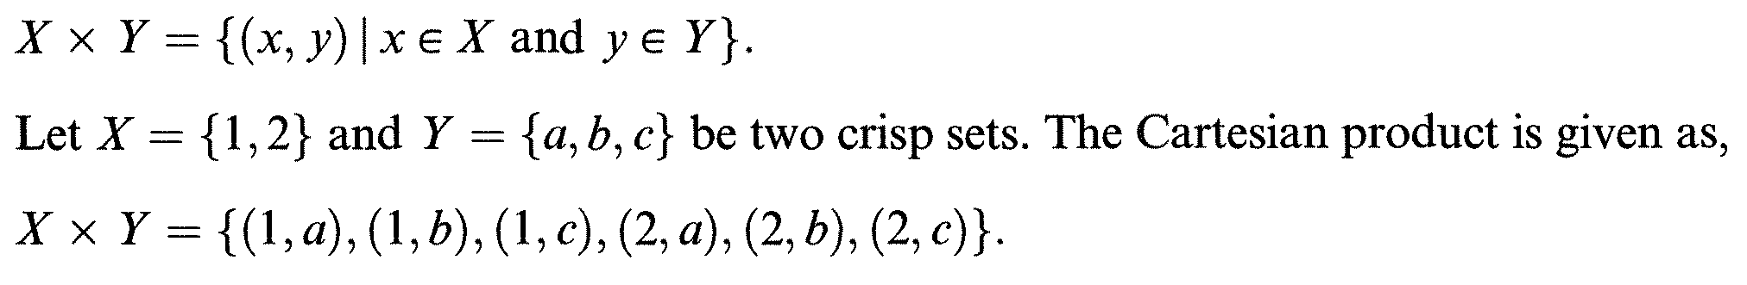
Fuzzy relation
Ordered pairs: A pair of elements that occur in a specified order
Relation is a set of ordered pairs. Relations are also subsubsets of a Cartesian product, or simply of a product set. In other words, relations are defined over Cartesian products or product sets.
Vojislav Kecman, "Learning and Soft Computing"

Slide 45
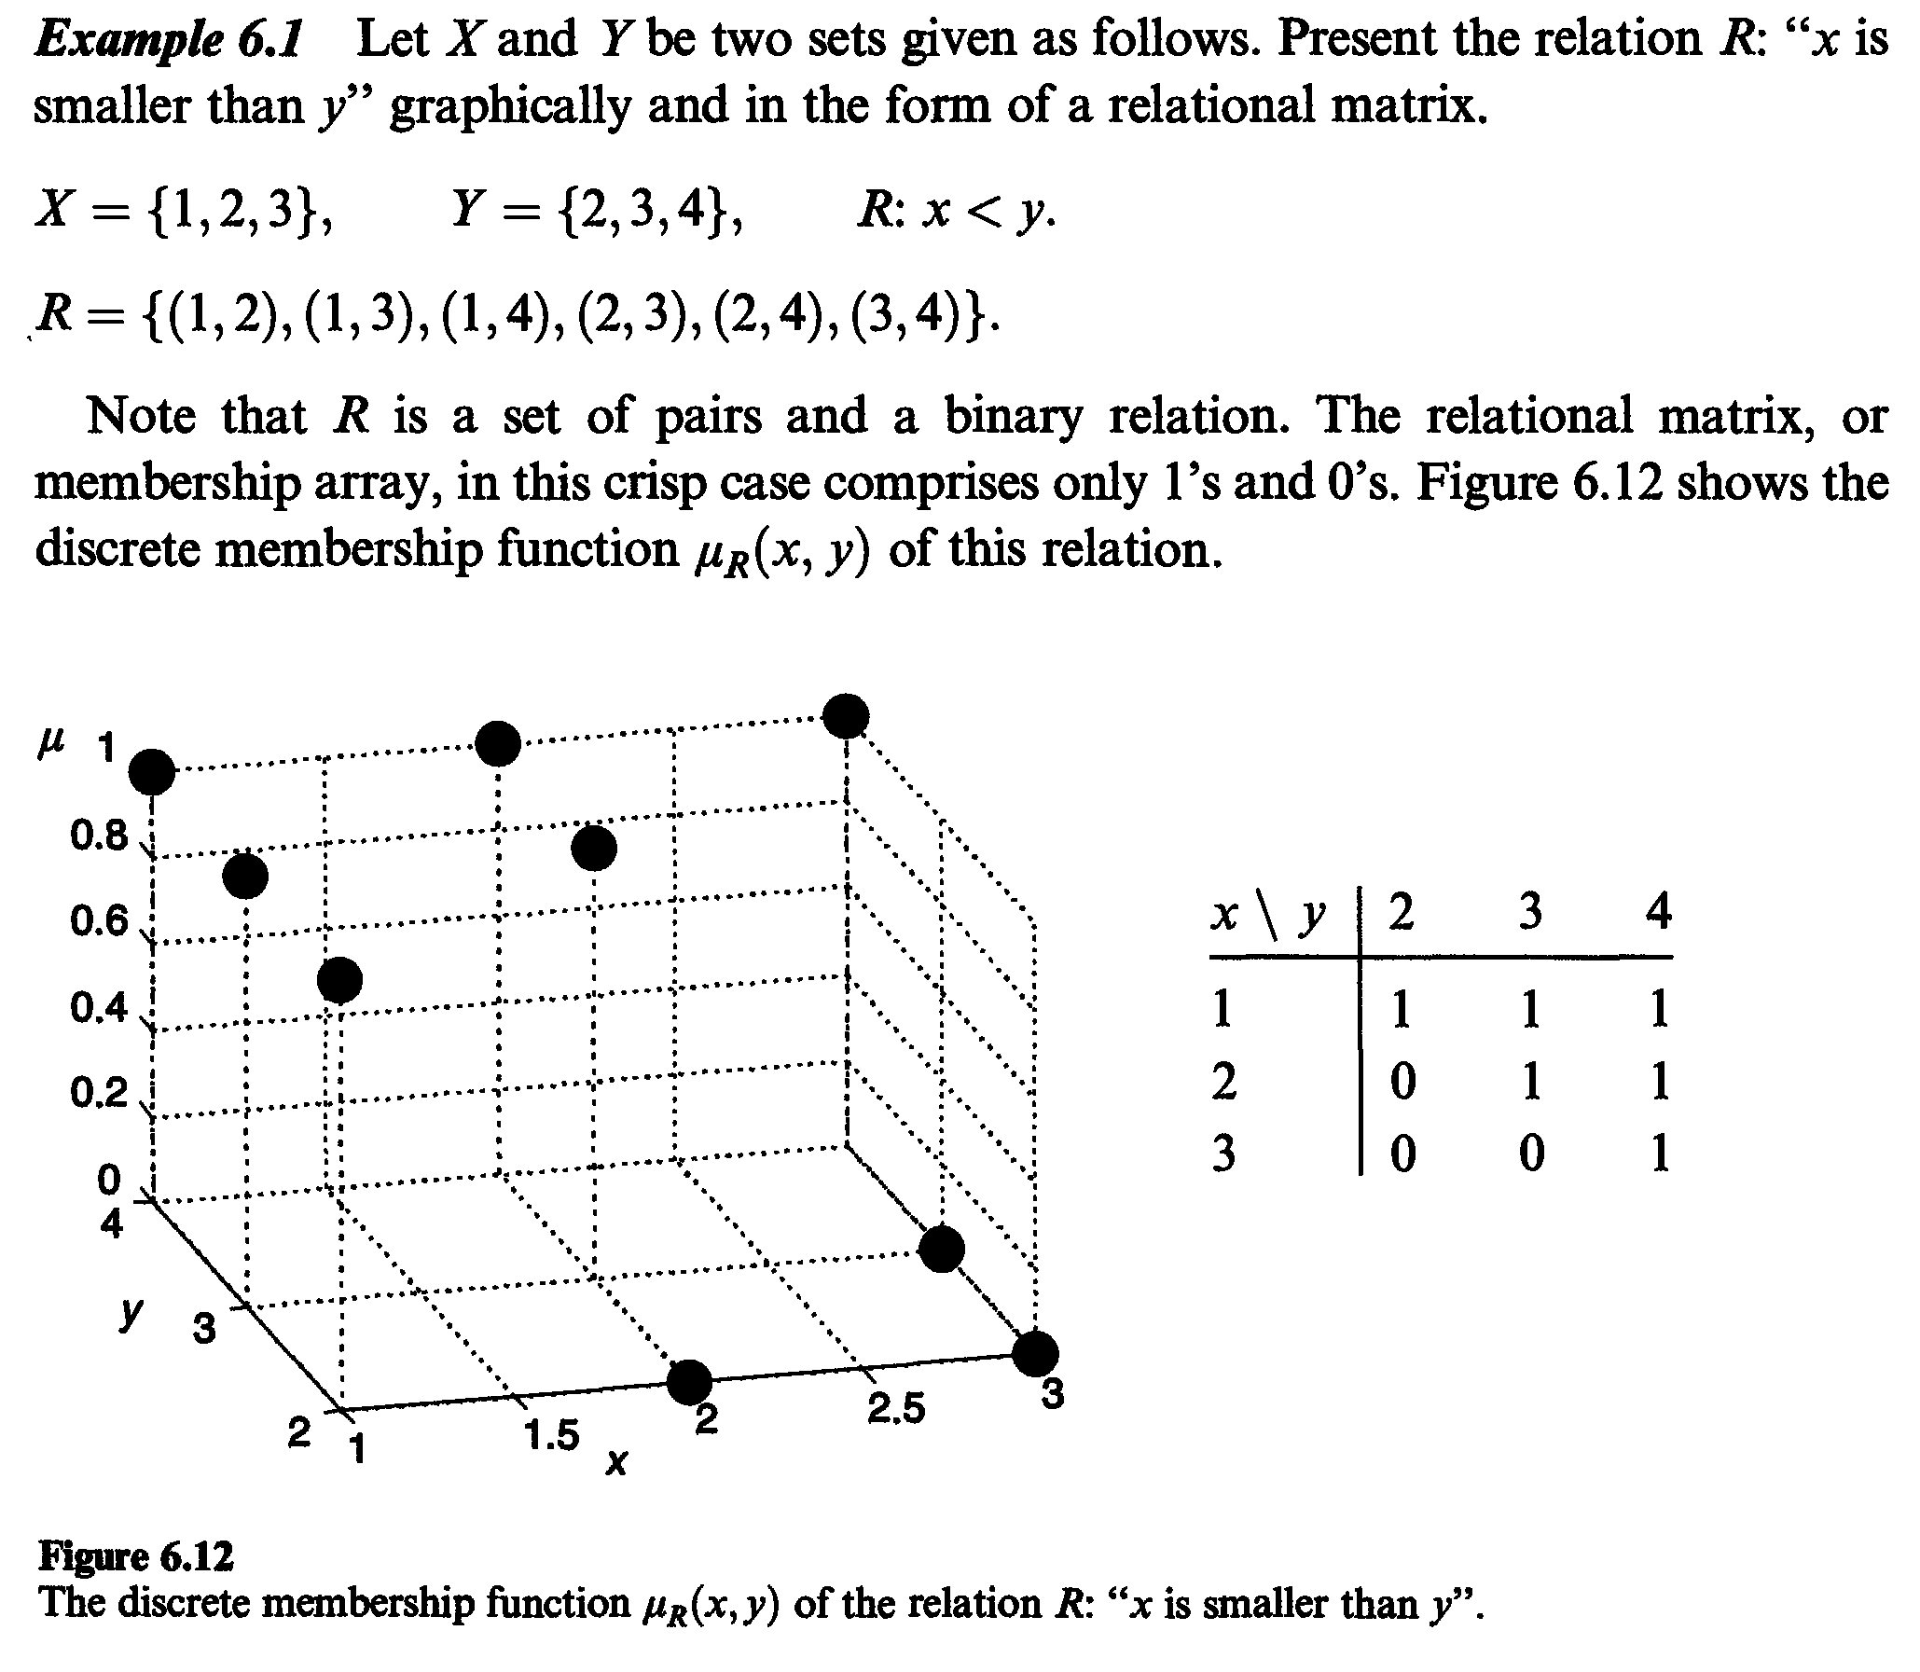
Fuzzy relation example 1

Slide 46

Fuzzy relation example 2
Vojislav Kecman, "Learning and Soft Computing"

Slide 47

Fuzzy relation example 3
Relation ►Inference
Vojislav Kecman, "Learning and Soft Computing"

Slide 48
Composition of Fuzzy Relations
Fuzzy relations in different product spaces can be combined with each other by composition.
The way to combine is implicitly used with "AND" concept. In fuzzy terminology, the "AND" can be "MIN" or "PROD".
For example, when we call "a young tall man", it implicitly means that "a young AND tall man".
Vojislav Kecman, "Learning and Soft Computing"

Slide 49

Composition of Fuzzy Relations
Vojislav Kecman, "Learning and Soft Computing"

Slide 50

Composition of Fuzzy Relations example
已知顏色與成熟度關係
已知酸甜與成熟度關係
推論顏色與酸甜關係
►Fuzzy Inference

Slide 51
Fuzzy inference
Zadeh's Compositional Rule of Inference
If R is a fuzzy relation from the universe of discourse X to the universe of discourse Y, and x is a fuzzy subset of X, then the fuzzy subset у of Y, which is induced by x, is given by the composition
у = xo R
As mentioned earlier, the operator of this composition is MAX-MIN, with alternatives MAX-PROD or MAX-AVE.

Slide 52

Sugeno fuzzy integral
Let H be a fuzzy set on D expressing the support for class ω_{j}. We use a fuzzy measure to take into account the importance of any subset of classifiers from D with respect to ω_{j}. The Sugeno fuzzy integral with respect to a fuzzy measure is obtained by

Slide 53


Sugeno fuzzy integral example

Slide 54


Sugeno fuzzy integral for classifier fusion
The g^{i} can be sujectively assigned by an expert or induced from the data.
Solve
to get λ

Slide 55

Sugeno fuzzy integral for classifier fusion example
Define (g¹,g²,g³) as (0.34,0.32,0.33)
Solve
to get λ
λ+1=(1+0.34λ)(1+0.32λ)(1+0.33λ)►λ=0.0305
SB Cho, JH Kim - IEEE Transactions on Neural Networks, 1995,"Multiple network fusion using fuzzy logic"

Slide 56

Sugeno fuzzy integral for classifier fusion example
Given (g¹,g²,g³) = (0.34,0.32,0.33), λ=0.0305
For class1: h(y1)=0.6, h(y2)=0.7,h(y3)=0.1
For class1: h(y1)=0.8, h(y2)=0.3,h(y3)=0.4
SB Cho, JH Kim - IEEE Transactions on Neural Networks, 1995,"Multiple network fusion using fuzzy logic"

Slide 57
Decision templates (DT)
The idea of the decision templates (DTs) model is to "remember" the most typical decision profile for each class, called the decision template, , for that class, and then compare it with the current decision profile . The closest match will label x.把DP當成一向量，與類別之DT比較(計算similarity)。
Decision profile

Slide 58

Fusion with DT & DP
Notes:
(dt1=matrix(c(.6,.8,.5,.4,.2,.5),nrow=3))
(dp=matrix(c(.3,.6,.5,.7,.4,.5),nrow=3))
(dt_e=1-sum((dt1-dp)^2)/length(dt1))
(dt_s1 = sum(c(.3,.6,.5,.4,.2,.5))/sum(c(.6,.8,.5,.7,.4,.5)))
(dt_s2=1-sum(abs(dt1-dp))/length(dt1))

Slide 59


Fusion with DT & DP example
Notes:
(dt1=matrix(c(.6,.8,.5,.4,.2,.5),nrow=3))
(dp=matrix(c(.3,.6,.5,.7,.4,.5),nrow=3))
(dt_e=1-sum((dt1-dp)^2)/length(dt1))
(dt_s1 = sum(c(.3,.6,.5,.4,.2,.5))/sum(c(.6,.8,.5,.7,.4,.5)))
(dt_s2=1-sum(abs(dt1-dp))/length(dt1))

Slide 60


Similarity between DT & DP
- Euclidean distance (E)
Notes:
DT(E)={1-{1 over 6}* left(left [ matrix{0.6 # 0.4 ## 0.8 # 0.2 ## 0.5 # 0.5} right ] -left [ matrix{0.3 # 0.7 ## 0.6 # 0.4 ## 0.5 # 0.5} right ]right)^2}
newline
"="1-{1 over 6}*left(left [ matrix{0.3 # -0.3 ## 0.2 # -0.2 ## 0 # 0} right ]right)^2
newline
"="1-{1 over 6}*(0.3^2+0.3^2+0.2^2+0.2^2)=0.9567

Slide 61


Similarity between DT & DP
- fuzzy similarity (S1)
Notes:
DT(S1)={left lline left [ matrix{0.6 # 0.4 ## 0.8 # 0.2 ## 0.5 # 0.5} right ] intersection left [ matrix{0.3 # 0.7 ## 0.6 # 0.4 ## 0.5 # 0.5} right ]right rline } /
{left lline left [ matrix{0.6 # 0.4 ## 0.8 # 0.2 ## 0.5 # 0.5} right ] union left [ matrix{0.3 # 0.7 ## 0.6 # 0.4 ## 0.5 # 0.5} right ]right rline}
newline
"=" left lline left [ matrix{0.3 # 0.4 ## 0.6 # 0.2 ## 0.5 # 0.5} right ] right rline /
left lline left [ matrix{0.6 # 0.7 ## 0.8 # 0.4 ## 0.5 # 0.5} right ] right rline
={2.5} over {3.5} =0.7143

Slide 62


Similarity between DT & DP
- fuzzy similarity (S2)
Notes:
DT(S2)=1-{1 over 6}* left lline left [ matrix{0.6 # 0.4 ## 0.8 # 0.2 ## 0.5 # 0.5} right ] -left [ matrix{0.3 # 0.7 ## 0.6 # 0.4 ## 0.5 # 0.5} right ] right rline
newline
"=" 1-{1 over 6}* left lline left [ matrix{0.3 # 0.3 ## 0.2 # 0.2 ## 0.0 # 0.0} right ] right rline
=0.8333

Slide 63


Similarity between DT & DP
- fuzzy similarity (S3)
Notes:
DT1 intersection overline {DP} = left [matrix{0.6 # 0.4 ## 0.8 # 0.2 ## 0.5 # 0.5} right] intersection
{left [ matrix{1-0.3 # 1-0.7 ## 1-0.6 # 1-0.4 ## 1-0.5 # 1-0.5} right ]}
=left [ matrix{0.6 # 0.3 ## 0.4 # 0.2 ## 0.5 # 0.5} right ]
newline
overline DT1 intersection DP = left [matrix{1-0.6 # 1-0.4 ## 1-0.8 # 1-0.2 ## 1-0.5 # 1-0.5} right] intersection
{left [ matrix{0.3 # 0.7 ## 0.6 # 0.4 ## 0.5 # 0.5} right ]}
=left [ matrix{0.3 # 0.6 ## 0.2 # 0.4 ## 0.5 # 0.5} right ]
newline
DT(S3)=1-{1 over 6}* left lline
left [ matrix{0.6 # 0.3 ## 0.4 # 0.2 ## 0.5 # 0.5} right ] union
left [ matrix{0.3 # 0.6 ## 0.2 # 0.4 ## 0.5 # 0.5} right ]
right rline
newline
"="1-{1 over 6}* left lline
left [ matrix{0.6 # 0.6 ## 0.4 # 0.4 ## 0.5 # 0.5} right ]
right rline=0.5

Slide 64


Similarity between DT & DP
- fuzzy similarity (I1)
Notes:
DT(I1)= left lline
left [ matrix{0.6 # 0.4 ## 0.8 # 0.2 ## 0.5 # 0.5} right ] intersection
left [ matrix{0.3 # 0.7 ## 0.6 # 0.4 ## 0.5 # 0.5} right ]
right rline /
left lline
left [ matrix{0.6 # 0.4 ## 0.8 # 0.2 ## 0.5 # 0.5} right ]
right rline
newline
"="left lline
left [ matrix{0.3 # 0.4 ## 0.6 # 0.2 ## 0.5 # 0.5} right ]
right rline /
left lline
left [ matrix{0.6 # 0.4 ## 0.8 # 0.2 ## 0.5 # 0.5} right ]
right rline=2.5 over 3.0=0.8333

Slide 65


Similarity between DT & DP
- fuzzy similarity (I2)
Notes:
I2_1= {1 over 6} *left lline Max left lbrace
left [ matrix{0 # 0 ## 0 # 0 ## 0 # 0} right ] ,
left [ matrix{0.4 # 0.4 ## 0.8 # 0.2 ## 0.5 # 0.5} right ]-
left [ matrix{0.3 # 0.7 ## 0.6 # 0.4 ## 0.5 # 0.5} right ]
right rbrace right rline
NEWLINE
"="
{1 over 6} *left lline Max left lbrace
left [ matrix{0 # 0 ## 0 # 0 ## 0 # 0} right ] ,
left [ matrix{0.1 # -0.3 ## 0.2 # -0.2 ## 0.0 # 0.0} right ]
right rbrace right rline
=0.05
newline
I2_2= {1 over 6} *left lline Max left lbrace
left [ matrix{0 # 0 ## 0 # 0 ## 0 # 0} right ] ,
left [ matrix{0.3 # 0.7 ## 0.6 # 0.4 ## 0.5 # 0.5} right ]-
left [ matrix{0.4 # 0.4 ## 0.8 # 0.2 ## 0.5 # 0.5} right ]
right rbrace right rline
NEWLINE
"="{1 over 6} *left lline Max left lbrace
left [ matrix{0 # 0 ## 0 # 0 ## 0 # 0} right ] ,
left [ matrix{-0.1 # 0.3 ## -0.2 # 0.2 ## 0.0 # 0.0} right ]
right rbrace right rline=0.0833
newline
DT(I2)=1-Max left lbrace 0.05,0.0833 right rbrace=0.9167

Slide 66

Experiments – datasets & setup
Missing attributes are replaced by average value
Two-fold cross validation
Adaboost contains 15 classifiers
2-layer MLP with 15 hidden nodes is trained for 300 epoches

Slide 67




Testing accuracy vs. # of classifiers

Slide 68

Testing accuracy at 15 classifiers

Slide 69

Testing ranks at 15 classifiers

Slide 70

Pairwise comparisons at 15 classifiers

Slide 71

Testing accuracy at 3 classifiers

Slide 72

Testing ranks at 3 classifiers

Slide 73

Pairwise comparisons at 3 classifiers

Slide 74


Fuzzy vs. Adaboost for fusing 15 or 3 classifiers

