Slide 1
An Aggressive Algorithm for Multiple String Matching
Information Processing Letters, Vol. 109, pp. 553–559, 2009
Presenter: Chiou-Ting Tseng
Date: July 21, 2009

Slide 2
Abstract
A new algorithm based on the Wu–Manber algorithm for multiple string matching is presented in this paper. The algorithm eliminates the functional overlap of the table HASH and SHIFT, and computes the shift distances in an aggressive manner. After each test, the algorithm examines the character next to the scan window to maximize the shift distance. This idea is consistent with that of the quick-search (QS) algorithm. Experimental results on four alphabets show that the new algorithm is more efficient than Wu–Manber and other recent algorithms, particularly on short pattern sets and large alphabet.

Slide 3
Boyer-Moore Algorithm – 1
Good suffix rule
T = GCATCGAGGAGAGTATACAGTACG
P = GGAGCCGAG
∵P(2, 4) = ‘GAG’
Slide the window by 5.
T = GCATCGAGGAGAGTATACAGTACG
P = GGAGCCGAG

Slide 4
Boyer-Moore Algorithm – 2
Bad character rule
T = GCATCGAGGAGCGTATACAGTACG
P = GAGGCCGCG
∵p₂ = ‘A’,
slide the window by 4.
T = GCATCGAGGAGCGTATACAGTACG
P = GAGGCCGCG

Slide 5
Wu-Manber Algorithm
Multiple pattern matching
Bad character rule is not so easily applied.
Use three tables: SHIFT, HASH, PREFIX.
SHIFT is similar to BM except that it is using block instead of char.
HASH and PREFIX is used when SHIFT=0 to determine which pattern is the candidate.

Slide 6
SHIFT Table
Pattern Set {
cat, car, bar, foo, for
}
te
2
at
0
ic
2
ar
0
ba
1
oo
0
or
0
Shift Table
(Partial)

Slide 7
HASH & PREFIX Table
Pattern Set {
cat, car, bar, foo, for
}
ca
at
cat(1)
ar
bar(4)
car(1)
ba
oo
foo(6)
fo
or
for(6)
Hash Table

Slide 8
Example
P={cat, car, bar, foo, for}
T=tacatbaror
te
2
ca
at
0
at
cat(1)
ic
2
ar
0
ar
bar(4)
car(1)
ba
ba
1
oo
0
oo
foo(6)
fo
or
0
or
for(6)
Shift Table
(Partial)
Hash Table

Slide 9
Observation
The character immediately after the scan window will always be considered in the next test.
There is a functional overlap between HASH and SHIFT.

Slide 10
Data Structure
The purpose and initialization of HASH and PREFIX are exactly the same as their counterparts in the Wu–Manber algorithm.
SHIFT is constructed in an aggressive manner to get larger shift distances.

Slide 11
Hash Tables
If m is 2 or the product of m and N is less than 500, we set the size of HASH and SHIFT as 32,678 and B as 2. The table PREFIX is not used under such circumstance. Given block-character BC of length 2, the hash function is defined as:
h(BC) = (BC[0] << 8 + BC[1])%32678.
If m is larger than 5 or the product of m (2 < m < 5) and N is larger than 500, then we set the size of HASH and SHIFT as 65,536 and B as 3. The table PREFIX is used to accelerate matching. Given block-character BC of length 3, the hash function is defined as:
h(BC) =(BC[0] << 16 + BC[1] << 8 + BC[2])%65536.

Slide 12
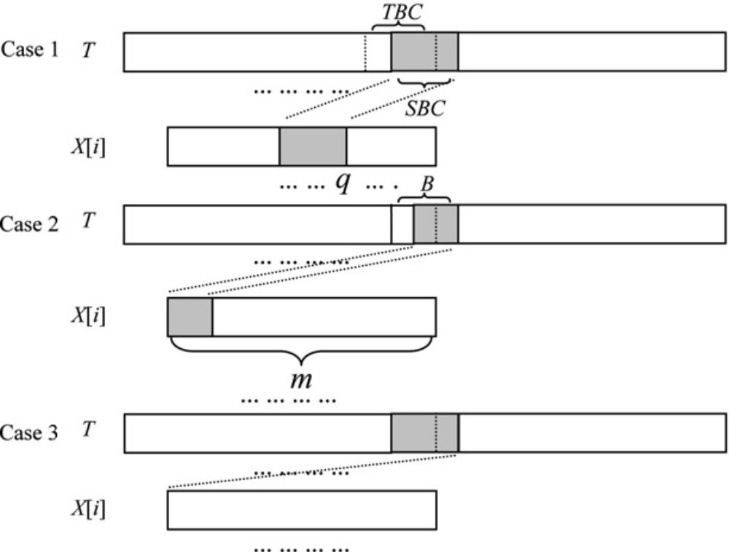
Shift Table

Slide 13
Shift Table
P={attta, atgta, cgtac, cgacc, gatac, atgac}
at | 6
ac | 6
cg | 6
cc | 6
ct | 6
ta | 6
tt | 6
tc | 6
tg | 6
gt | 6
ga | 6
at | 4
ac | 6
cg | 6
cc | 6
ct | 6
ta | 1
tt | 2
tc | 6
tg | 6
gt | 6
ga | 6
at | 4
ac | 6
cg | 6
cc | 6
ct | 6
ta | 1
tt | 2
tc | 6
tg | 3
gt | 2
ga | 6
at | 4
ac | 1
cg | 4
cc | 6
ct | 6
ta | 1
tt | 2
tc | 6
tg | 3
gt | 2
ga | 6
at | 4
ac | 1
cg | 4
cc | 1
ct | 6
ta | 1
tt | 2
tc | 6
tg | 3
gt | 2
ga | 3
at | 3
ac | 1
cg | 4
cc | 1
ct | 6
ta | 1
tt | 2
tc | 6
tg | 3
gt | 2
ga | 3
at | 3
ac | 1
cg | 4
cc | 1
ct | 6
ta | 1
tt | 2
tc | 6
tg | 3
gt | 2
ga | 2
aa | 5
ag | 5
ca | 5
ct | 6
tc | 5
gc | 5
gg | 5

Slide 14
Matching Algorithm
Compute the hash value ht of TBC of the scan window;
Check HASH[ht], if HASH[ht] is null, go to 5;
Compute the hash value hp of the prefix of the scan window;
Iterate each pattern p stored in HASH[ht]. Check whether PREFIX[p] is equal to hp. If it is true, compare p with the text character-by-character to p’s actual length. If there is a successful match, report it;
Compute the hash value hs of SBC of the scan window. Shift the scan window by SHIFT[hs] characters forward. Loop to 1 until reaching the end of text T .

Slide 15
Matching Example -1
T=agatctcatttagatac
P={attta, atgta, cgtac, cgacc, gatac, atgac}
SHIFT
PREFIX
HASH
at | 3 | aa | 5
ac | 1 | ag | 5
cg | 4 | ca | 5
cc | 1 | ct | 6
ta | 1 | tc | 5
tt | 2 | gc | 5
tg | 3 | gt | 2
ga | 2 | gg | 5
at
ac
cgtac(4)
gatac(6)
atgac(1)
cc
cgacc(4)
cg
ga
ta
attta(1)
atgta(1)

Slide 16
Matching Example - 2
P={attta, atgta, cgtac, cgacc, gatac, atgac}
T=agatctcatttagatac
tc is not in HASH
SHIFT(ct)=6

Slide 17
Matching Example - 3
P={attta, atgta, cgtac, cgacc, gatac, atgac}
T=agatctcatttagatac
tt is not in HASH
SHIFT(ta)=1

Slide 18
Matching Example - 4
P={attta, atgta, cgtac, cgacc, gatac, atgac}
T=agatctcatttagatac
ta is in HASH
HASH(at)=1 is in PREFIX, compare char by char.
SHIFT(ag)=5

Slide 19
Matching Example - 5
P={attta, atgta, cgtac, cgacc, gatac, atgac}
T=agatctcatttagatac
ac is in HASH
HASH(ga)=6 is in PREFIX, compare char by char.

Slide 20
Test Case 1
DNA Nucleotide
Alphabet size: 4 (AGCT)
Text length: 4M
Pattern set: randomly generated.

Slide 21
Test Case 2
Alphabet size: 16 (A-P)
Text length: 10M (Randomly generated)
Pattern set: randomly generated.

Slide 22
Test Case 3
Reuters corpus (English Text)
Alphabet size: 79
Text length: 27,636,766 Bytes
Pattern set: randomly generated from a dictionary with 25,481 words.

Slide 23
Test Case 4
Chinese corpus
Alphabet size: 162
Text length: 52,277,012 Bytes
Pattern set: randomly generated from a dictionary with 79,570 words.

Slide 24
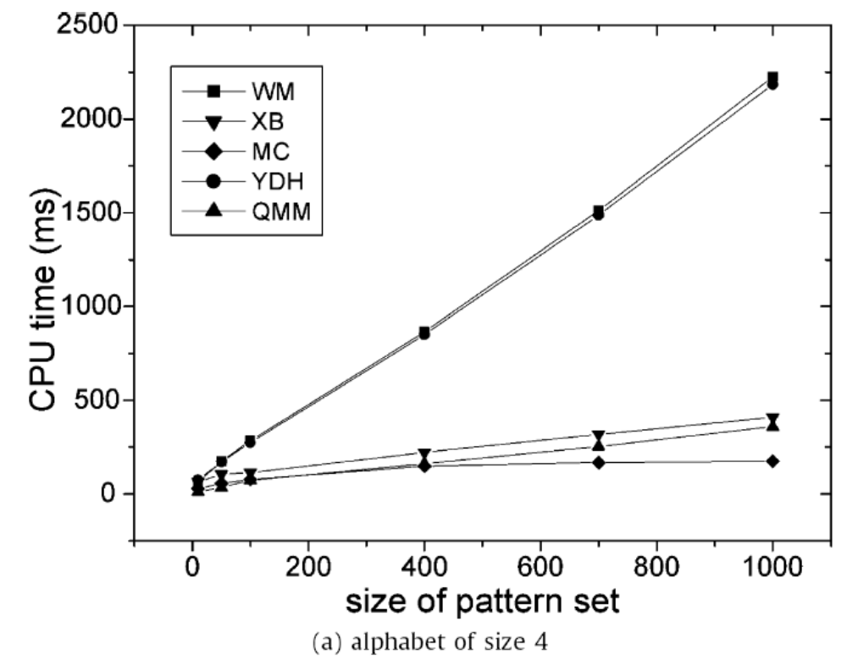
Result 1-1

Slide 25
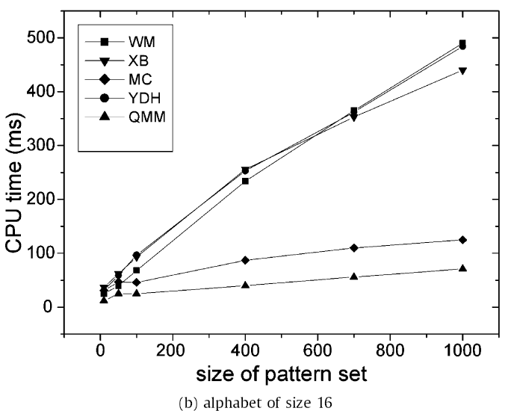
Result 2-1

Slide 26
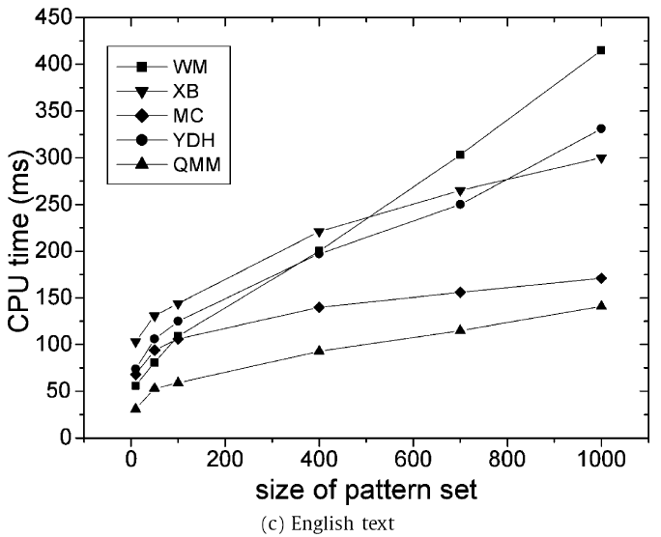
Result 3-1

Slide 27
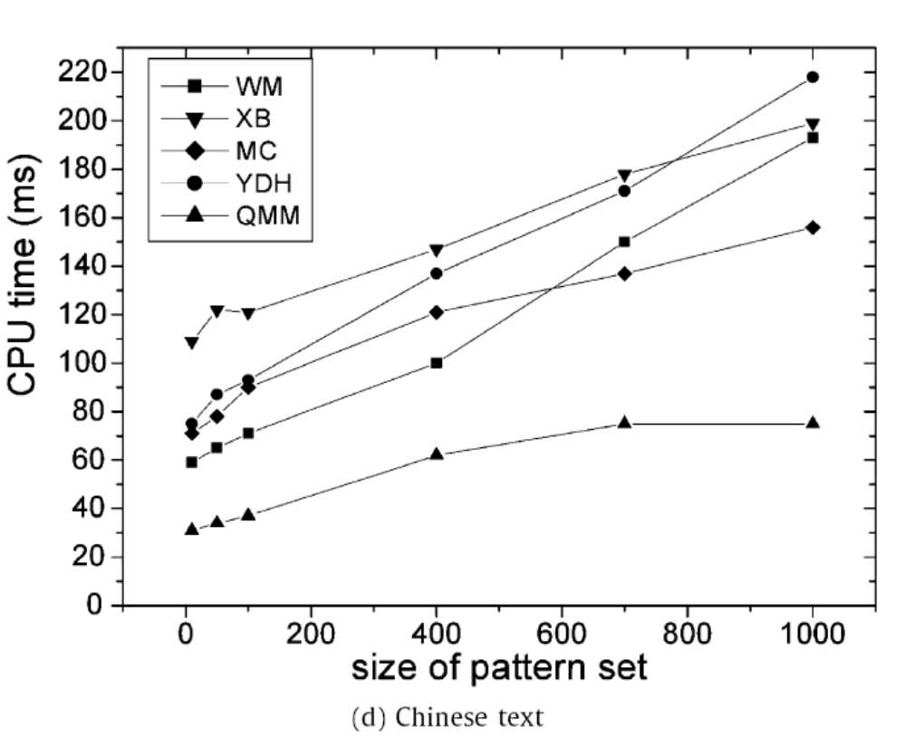
Result 4-1

Slide 28
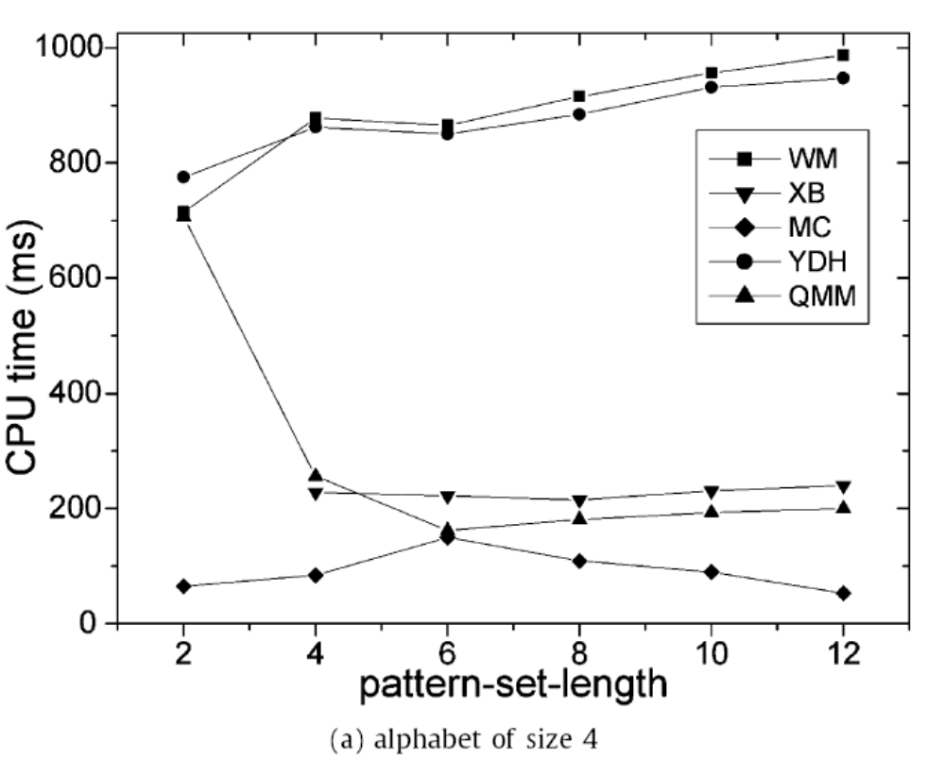
Result 1-2
Number of pattern: 400

Slide 29
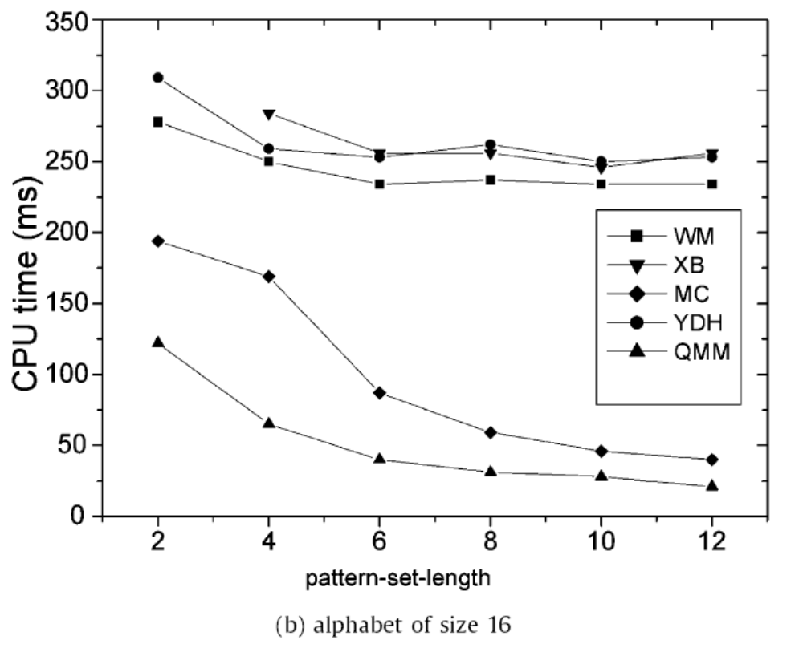
Result 2-2

Slide 30
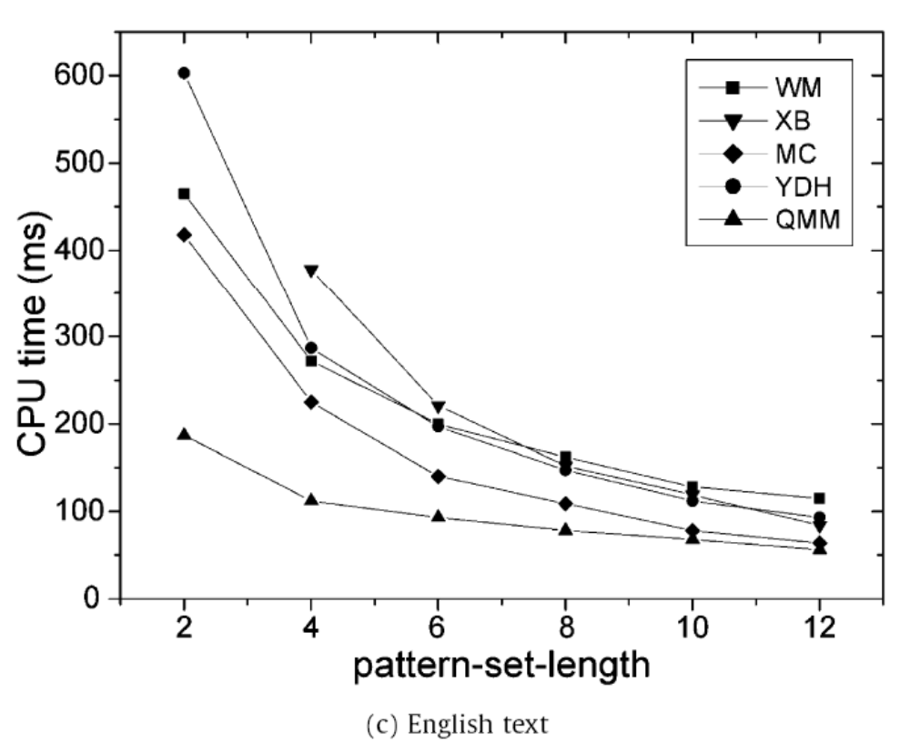
Result 3-2

Slide 31
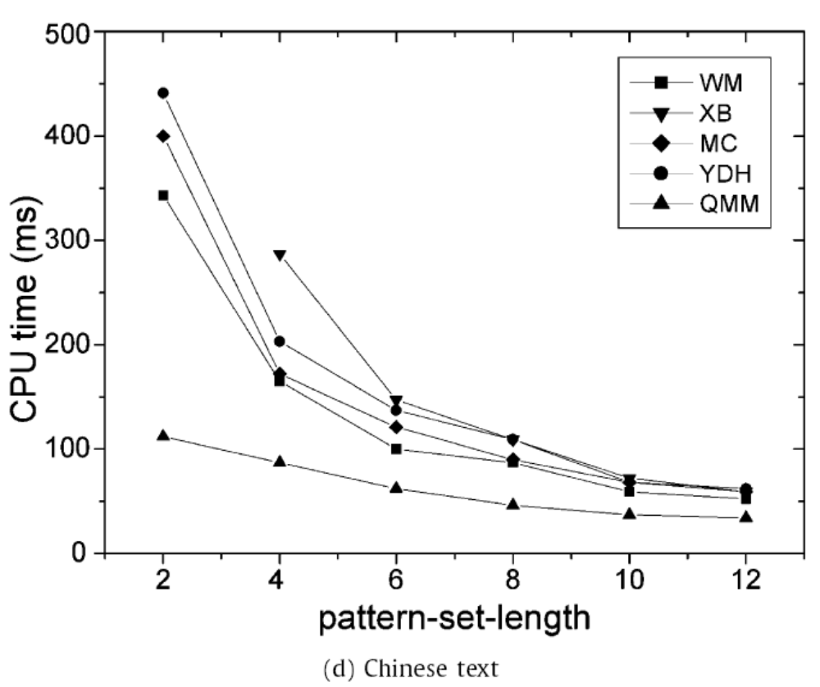
Result 4-2

Slide 32
Conclusion
Scanning time of algorithms increases when the size of pattern set increases. In contrast, when the pattern-set-length increases, scanning time decreases. And algorithms run faster on larger alphabet.
We conclude that under the circumstances of shorter pattern-set-length, smaller pattern-set size and larger alphabet, our algorithm will be more predominant when compared with the other 4 algorithms.

Slide 33
SHIFT table
HASH table
PREFIX table
SHIFT[i]
SHIFT[i+1]
Pattern pointer list
Hash = i
Hash = i+1

Slide 34
Shift Example
xxxxattta xxxgatac
xxxxa xxxxa
attta gatac
xxxxtcgtac
xxxxx
cgtac

