Slide 1
Sensitivity and specificity based multiobjective approach for feature selection
J. Garcia-Nieto , E. Alba, L. Jourdan, E.Talbi
Information Processing Letters 109 (2009) 887–896
Presenter: Chu-Kai Liu
Date: Aug. 28, 2009

Slide 2
Abstract (1/3)
The study of the sensitivity and the specificity of a classification test constitute a powerful kind of analysis since it provides specialists with very detailed information useful for cancer diagnosis. In this work, we propose the use of a multiobjective genetic algorithm for gene selection of Microarray datasets. This algorithm performs gene selection from the point of view of the sensitivity and the specificity, both used as quality indicators of the classification test applied to the previously selected genes.

Slide 3
Abstract (2/3)
In this algorithm, the classification task is accomplished by Support Vector Machines; in addition a 10-Fold Cross-Validation is applied to the resulting subsets. The emerging behavior of all these techniques used together is noticeable, since this approach is able to offer, in an original and easy way, a wide range of accurate solutions to professionals in this area. The effectiveness of this approach is proved on public cancer datasets by working out new and promising results.

Slide 4
Abstract (3/3)
A comparative analysis of our approach using two and three objectives, and with other existing algorithms, suggest that our proposal is highly appropriate for solving this problem.

Slide 5
1. Basic concepts
1-1. Feature selection
Wrapper model – performs feature subset selection and classification in the same single process, internally uses a learning algorithm to measure the accuracy
Filter model – carries out the selection and classification regardless of the learning algorithm used.

Slide 6
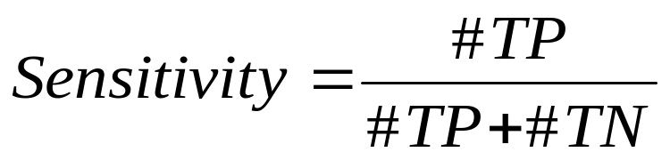
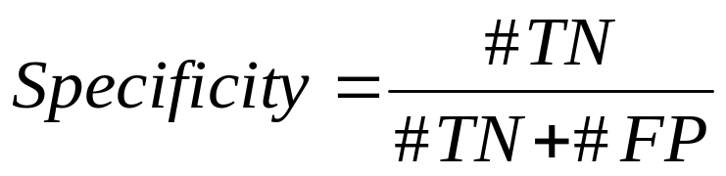
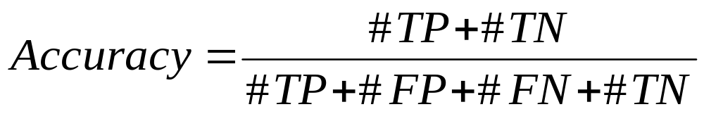
1-2. Sensitivity and specificity
Sensitivity - is the proportion of true positives of all diseased cases in the entire population.
Specificity – is the proportion of true negatives of all negative cases in the population.
 |  | Acutual condition
 |  | Present | Absent
Test result | Positive | True Positive | False Positive
 | Negative | False Negative | True Negative

Slide 7
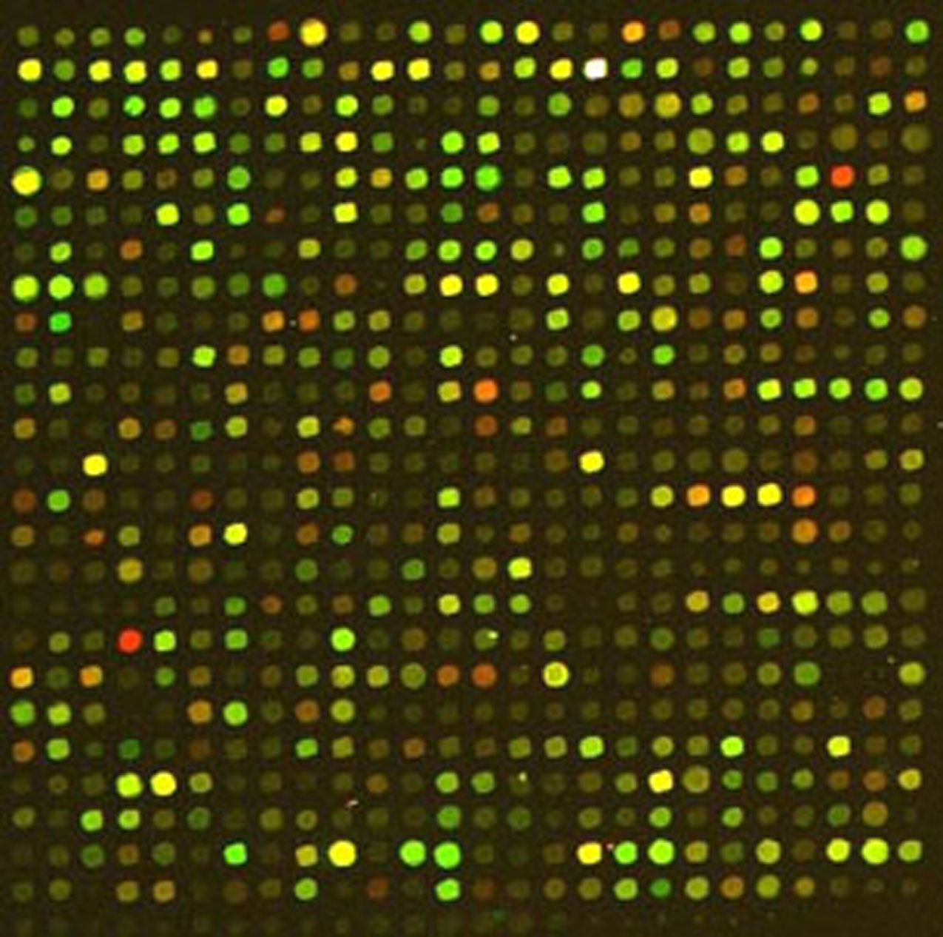
1-3. Microarrays and gene expression

Slide 8
2. Gene selection and classification by MOGA
MOEAs(MultiObjective Evolutionary Algorithms)
The optimized function is computed using two main objectives:
  The classification accuracy.
  The number of genes.
MOGA(MultiObjective Gentic Algorithm)
  The classification sensitivity.
  The classification specificity.
  The number of genes.

Slide 9
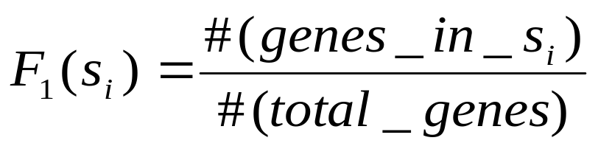
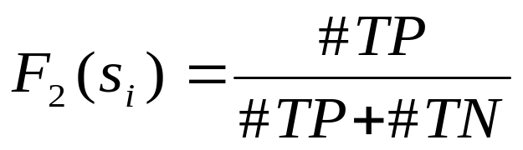
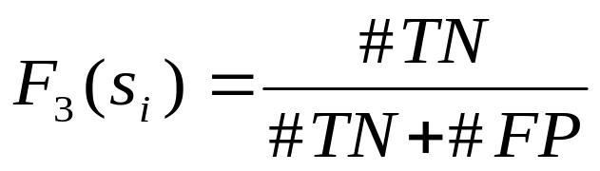
2.1. The multiobjective approach(1/2)
F (s_{i}) = ‹F₁(s_{i}), F₂(s_{i}), F₃(s_{i})›
(minimize #genes)
(maximize sensitivity)
(maximize specificity)

Slide 10
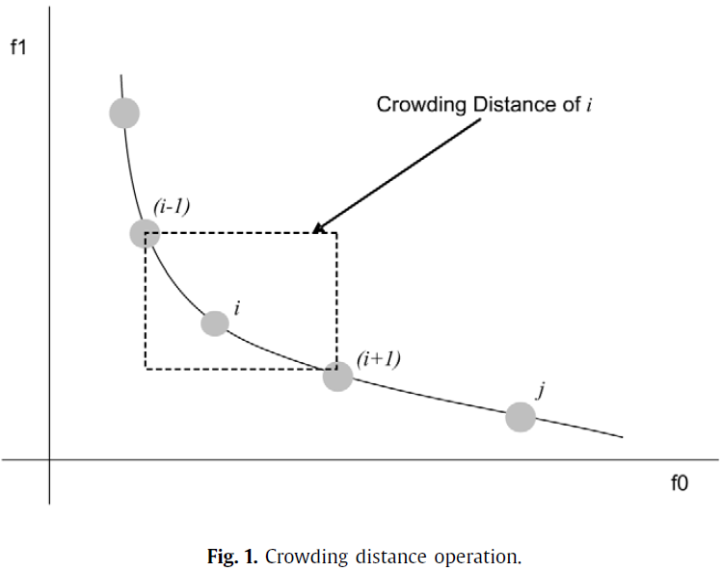
2.1. The multiobjective approach(2/2)
The “Pareto front” is defined as the set of nondominated gene subsets which constitutes the best solutions.

Slide 11
2.2. Adapted crossover and mutation operators (1/3)
Subset Size-Oriented Common Feature crossover (SSOCF).
The common features (bits ‘1’) are kept by offspring and each non-shared feature is inherited from the ith parent (feature) with a probability
(n_{i} − n_{c}/n_{u}).
  n_{i} is the number of selected features of the ith parent.
  n_{c} is the number of commonly selected features from the mating parents.
  n_{u} is the number of non-shared selected features.

Slide 12
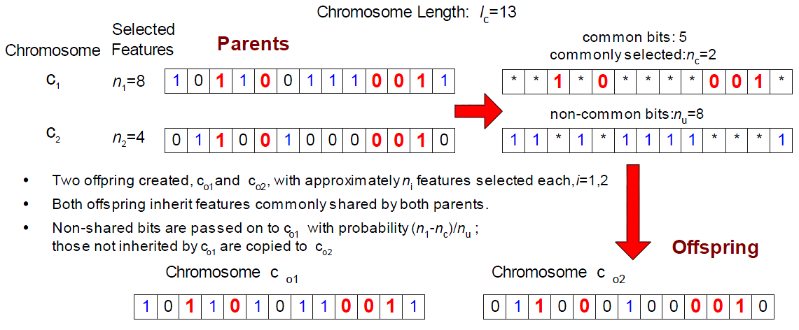
2.2. Adapted crossover and mutation operators (2/3)
Example:

Slide 13
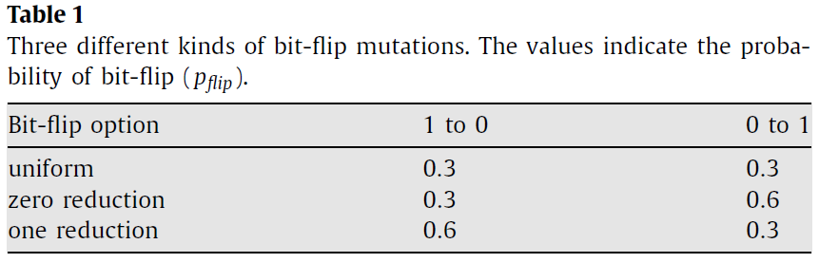
2.2. Adapted crossover and mutation operators (3/3)
Weighted mutation.
Sensitivity 65%
Specificity 60%
Sensitivity 85%
Specificity 81%

Slide 14
3. Experiments
3.1. Datasets
The ALL-AML Leukemia(白血病) dataset.
The Colon tumor dataset.
Types of Diffuse Large B-cell Lymphoma(淋巴瘤) dataset.
3.2. Experimental setting
The SVMs classifier and 10-fold cross-validation. At each iteration, the dataset is divided into ten subsets, nine of them constitute the training set and the remaining one is the test set.

Slide 15
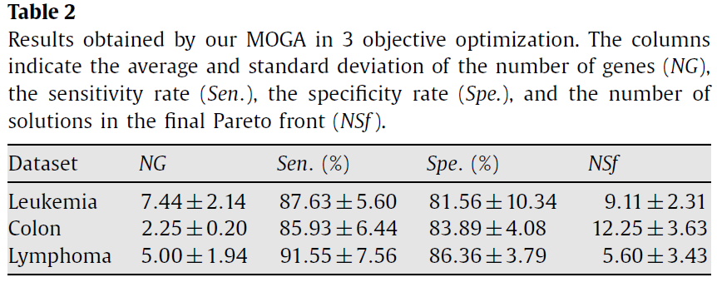
3.3. Results
The number of solutions that constitute the final “Pareto front” is reported in the last column.

Slide 16
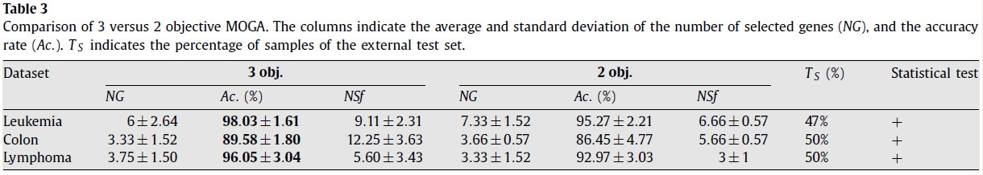
3.4. 3-objective versus 2-objective approaches
Comparison of 3 versus 2 objective MOGA. The columns indicate the average and standard deviation of the number of selected genes (NG), and the accuracy rate (Ac.). T_{S} indicates the percentage of samples of the external test set.

Slide 17
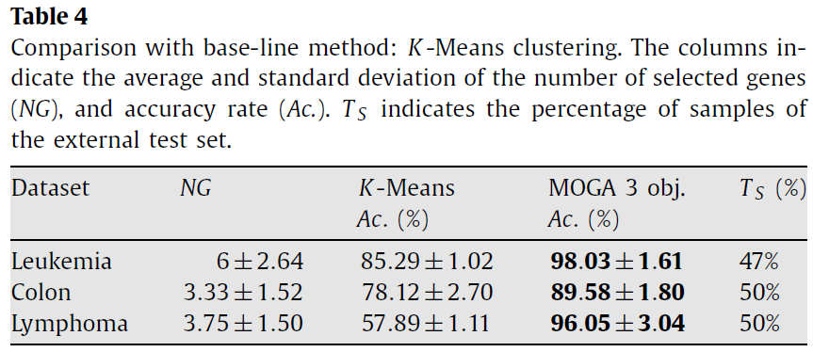
3.5. Comparison with other approaches (1/2)

Slide 18
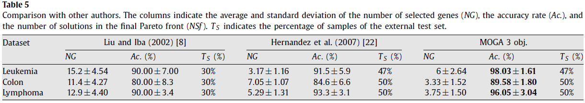
3.5. Comparison with other approaches (2/2)
The columns indicate the average and standard deviation of the number of selected genes (NG), the accuracy rate (Ac.), and the number of solutions in the final Pareto front (NSf ). T_{S} indicates the percentage of samples of the external test set.

