Slide 1
Motif Patterns in 2D
Theoretical Computer Science Vol. 390, pp. 40–55, 2008
Presenter: Chiou-Ting Tseng
Date: Sept. 8, 2009

Slide 2
Abstract
Motif patterns consisting of sequences of intermixed solid and don’t-care characters have been introduced and studied in connection with pattern discovery problems of computational biology and other domains. In order to alleviate the exponential growth of such motifs, notions of maximal saturation and irredundancy have been formulated, whereby more or less compact subsets of the set of all motifs can be extracted, that are capable of expressing all others by suitable combinations. In this paper, we introduce the notion of maximal irredundant motifs in a two-dimensional array and develop initial properties and a combinatorial argument that poses a linear bound on the total number of such motifs. The remainder of the paper presents approaches to the discovery of irredundant motifs both by offline and incremental algorithms.

Slide 3
Problem Definition
Input: A two-dimensional array.
Output: The bases of the irredundant motifs of the input array.

Slide 4
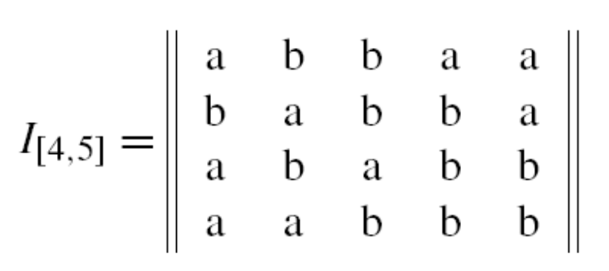
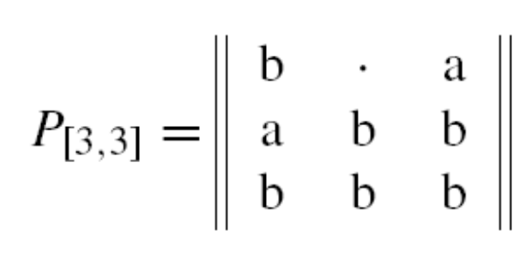
Occurrence

Slide 5
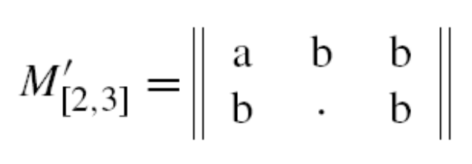
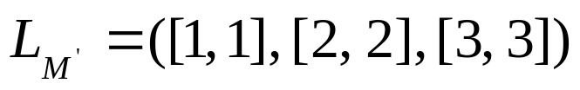
k-Motif
四邊都至少一個solid character
出現k次以上

Slide 6
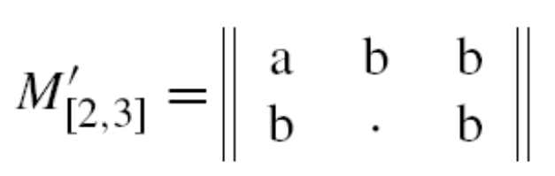
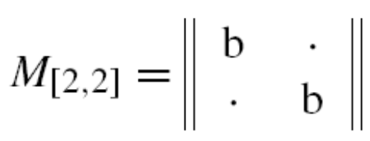
Sub-motif
A是B的sub-motif代表A是B的一部份，換句話說，每次B match的地方A一定也會match

Slide 7
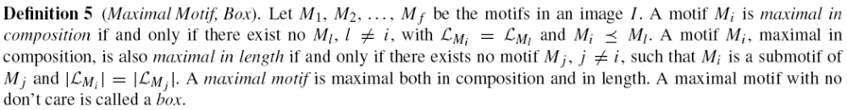

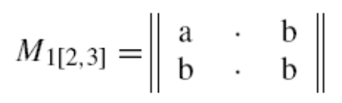
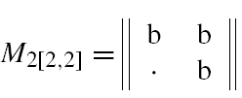



Maximal Motif

Slide 8
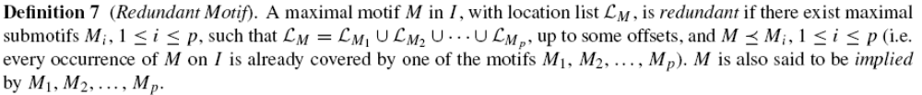
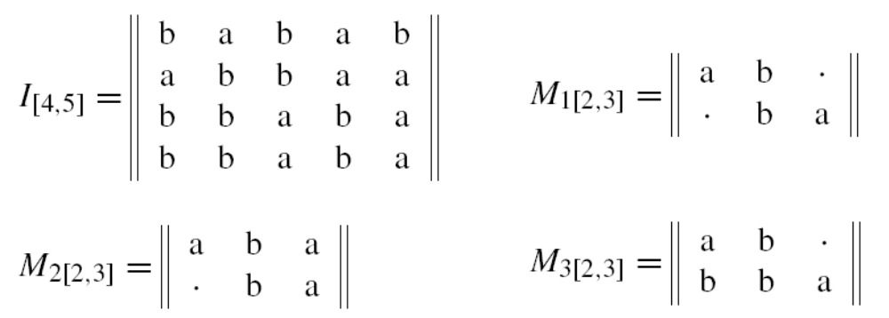



Redundant Motif

Slide 9
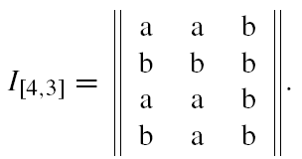
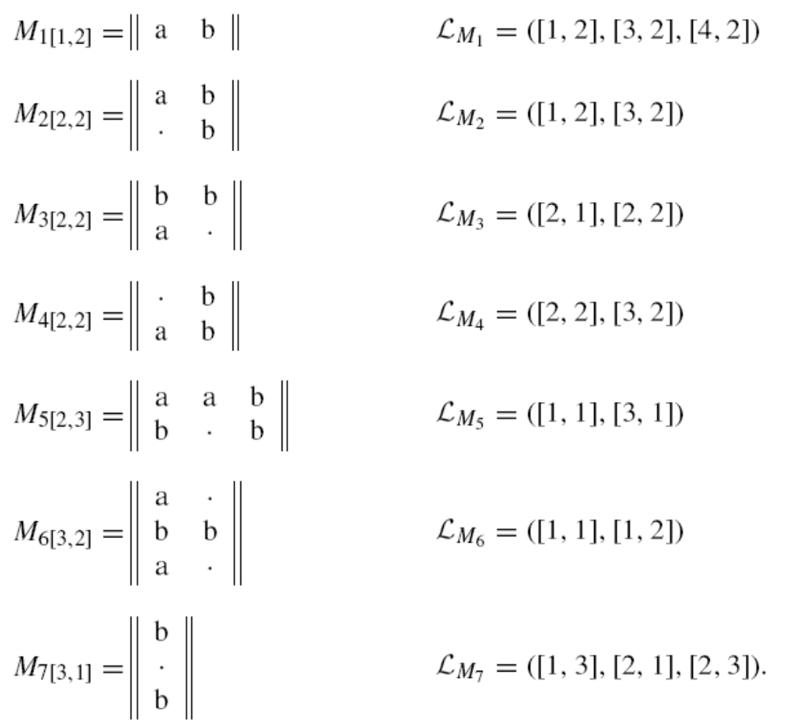
Base

Slide 10
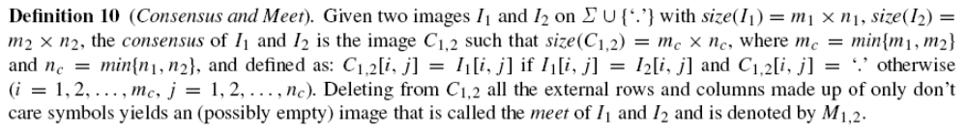
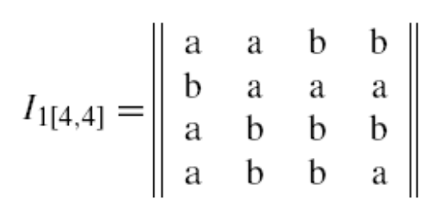
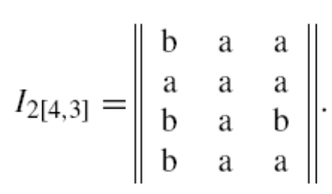
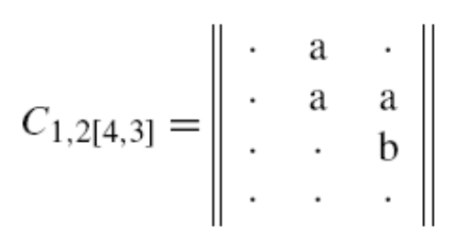
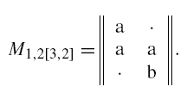
Consensus and Meet

