Slide 1
Predicting rRNA-, RNA-, and DNA-binding proteins from primary structure with support vector machines
Xiaojing Yu, Jianping Cao, Yudong Cai,
Tieliu Shi, Yixue Li.
Journal of Theoretical Biology 240 (2006) 175–184
Presenter: Chu-Kai Liu
Date: Sept. 08, 2009

Slide 2
Abstract (1/3)
In the post-genome era, the prediction of protein function is one of the most demanding tasks in the study of bioinformatics. Machine learning methods, such as the support vector machines (SVMs), greatly help to improve the classification of protein function.
In this work, we integrated SVMs, protein sequence amino acid composition, and associated physico-chemical properties into the study of nucleic-acid-binding proteins prediction.

Slide 3
Abstract (2/3)
We developed the binary classifications for rRNA-, RNA-, DNA-binding proteins that play an important role in the control of many cell processes. Each SVM predicts whether a protein belongs to rRNA-, RNA-, or DNA-binding protein class. Self-consistency and jackknife tests were performed on the protein data sets in which the sequences identity was < 25%. Test results show that the accuracies of rRNA-, RNA-, DNA-binding SVMs predictions are ~84%, ~78%, ~72%, respectively.

Slide 4
Abstract (3/3)
The predictions were also performed on the ambiguous and negative data set. The results demonstrate that the predicted scores of proteins in the ambiguous data set by RNA- and DNA-binding SVM models were distributed around zero, while most proteins in the negative data set were predicted as negative scores by all three SVMs. The score distributions agree well with the prior knowledge of those proteins and show the effectiveness of sequence associated physicochemical properties in the protein function prediction. The software is available from the author upon request.

Slide 5
1. Data sets
Swiss-Port database.
Threshold of 25%.
88 rRNA-binding, 377 RNA-binding, 1153 DNA-binding.
Add the same number of proteins from the ‘‘negative’’ data set.
176 rRNA-binding, 754 RNA-binding, 2306 DNA-binding.

Slide 6
2. Feature vector (1/8)
Hydrophobicity(疏水性).
Predicted secondary structure.
  Helix(螺旋), Strand(股) and Coil(捲曲).
Predicted solvent accessibility(溶劑可接觸性).
  Buried(埋藏) or Exposed(暴露).
Normalized Van Der Waals volume.
Polarity.
Polarizability(極化).

Slide 7
2. Feature vector (2/8)
Three descriptors:
Composition (C): is the percent of amino acids of certain properties.
Transition (T): is the frequency of which amino acids of a certain property is followed by amino acids of a different property.
Distribution (D): measures the percent of sequence length within which the first, 25%, 50%, 75% and 100% of the amino acids of a certain property, such as polar, is located, respectively.

Slide 8
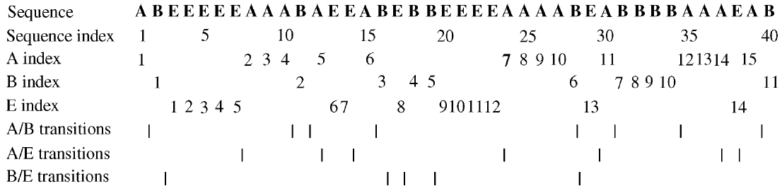
2. Feature vector (3/8)
Example: Descriptor C.
  As: 15/40 = 37.5% .
  Bs: 11/40 = 27.5%.
  Es: 14/40 = 35.0%.

Slide 9
2. Feature vector (4/8)
Example: Descriptor T.
  Between A and B: 8/39 = 20.5%
  Between A and E: 7/39 = 17.9%
  Between B and E: 5/39 = 12.8%
8
7
5

Slide 10
2. Feature vector (5/8)
Example: Descriptor D of As.
  First, 3.75(25%), 7.5(50%), 11.25(75%), 15(100%)
  As is 1/40 = 2.5%, 10/40 = 25%, 25/40 = 62.5%, 30/40 = 75.0%, 39/40 = 97.5%.

Slide 11
2. Feature vector (6/8)
Example: Descriptor D of Bs.
  First, 2.75(25%), 5.5(50%), 8.25(75%), 11(100%)
  Bs is 2/40 = 5.0%, 15/40 = 37.5%, 29/40 = 72.5%, 33/40 = 82.5%, 40/40 = 100.0%.
16
28

Slide 12
2. Feature vector (7/8)
Example: Descriptor D of Es.
  First, 3.5(25%), 7(50%), 10.5(75%), 14(100%)
  Bs is 3/40 = 7.5%, 4/40 = 10.0%, 14/40 = 35.0%, 24/40 = 60.0%, 38/40 = 95.0%.
6
22

Slide 13
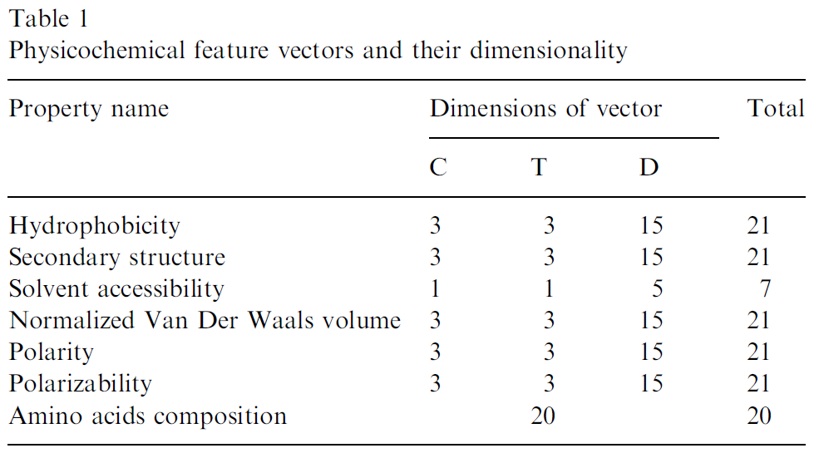
2. Feature vector (8/8)
A protein sequence is represented by a 132-dimensional feature vector.

Slide 14
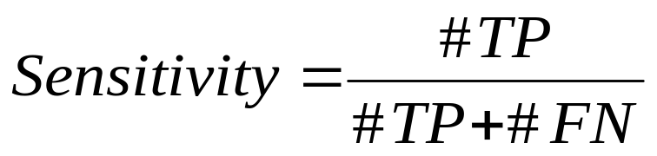
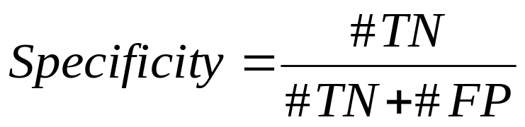
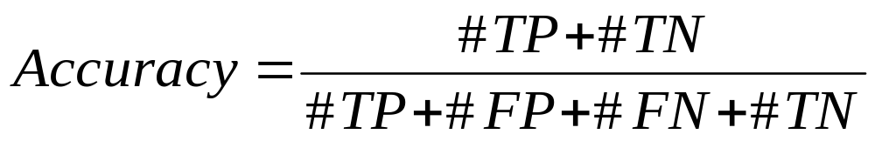
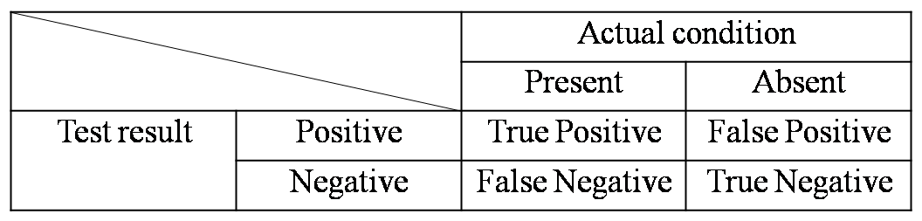
3. Accuracy measure
Sensitivity, Specificity and Accuracy.

Slide 15
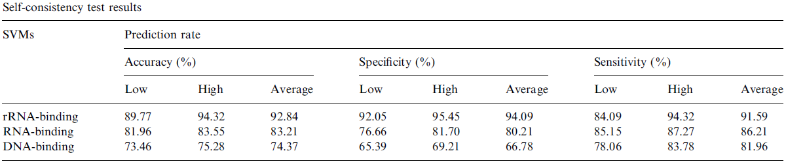
4. Results (1/3)
Self-consistency test: An SVM was trained and tested with the same data set.

Slide 16
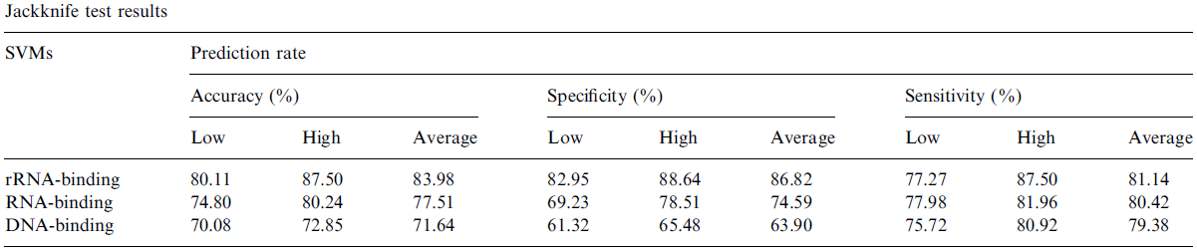
4. Results (2/3)
Jackknife test: Cross-validation. Every data in the training data set is taken out one by one for prediction, and the remaining data is used to train the model.

Slide 17
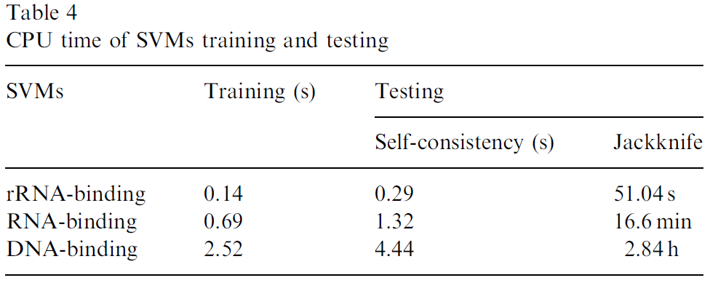
4. Results (3/3)
Dell OptiPlex GX260 computer with an Intel Pentium4 2.40GHz CPU.

Slide 18
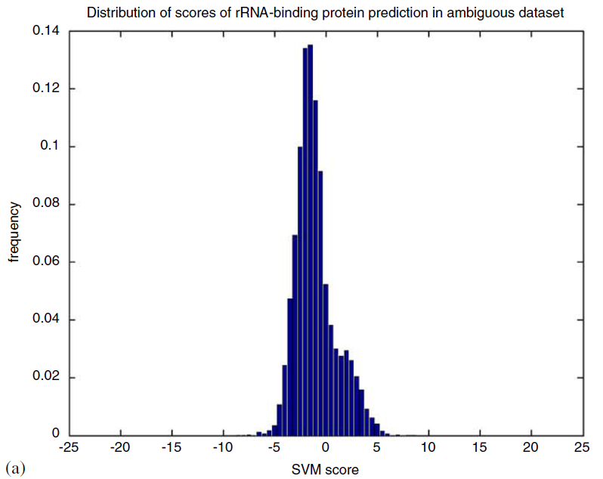
5. Discussion (1/7)
rRNA-binding protein prediction in the ambiguous set.

Slide 19
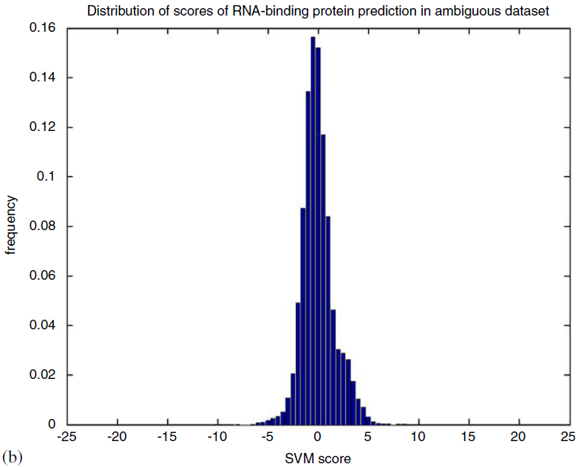
5. Discussion (2/7)
RNA-binding protein prediction in the ambiguous set.

Slide 20
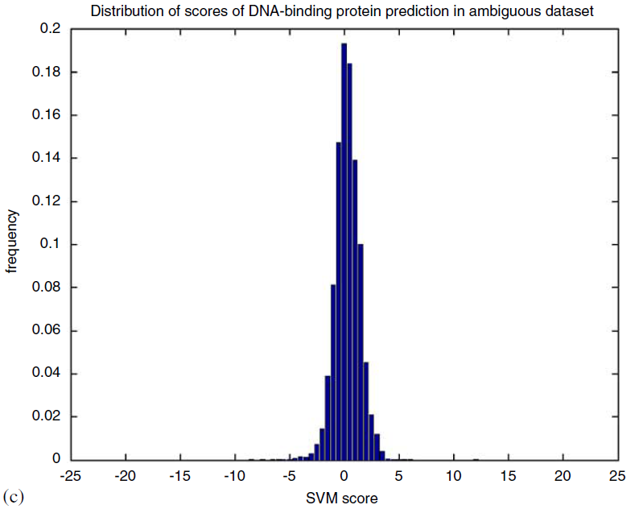
5. Discussion (3/7)
DNA-binding protein prediction in the ambiguous set.

Slide 21
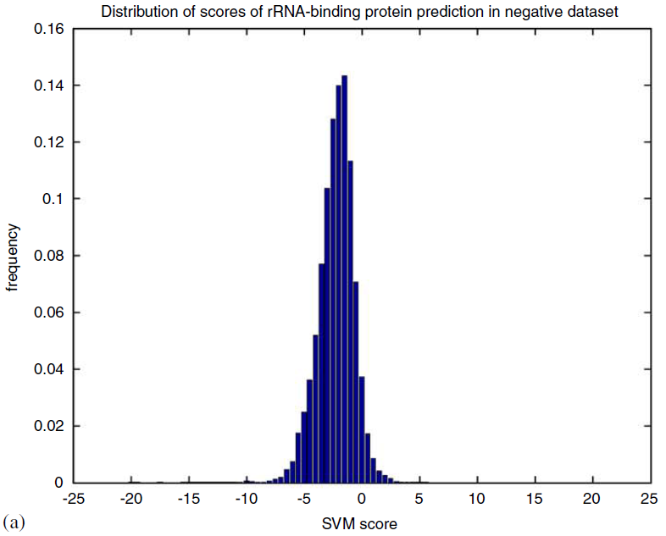
5. Discussion (4/7)
rRNA-binding protein prediction in the negative set.

Slide 22
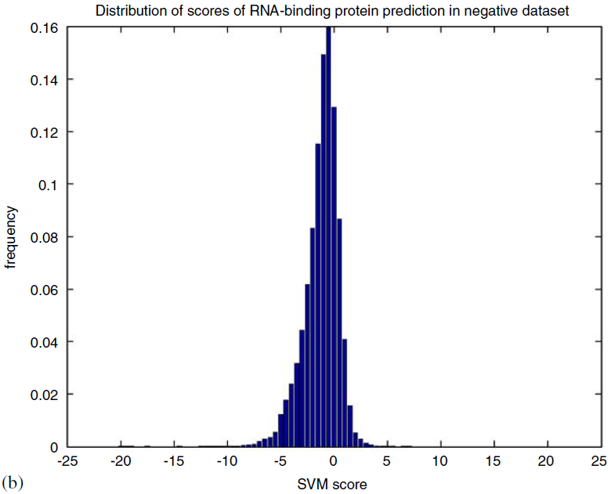
5. Discussion (5/7)
RNA-binding protein prediction in the negative set.

Slide 23
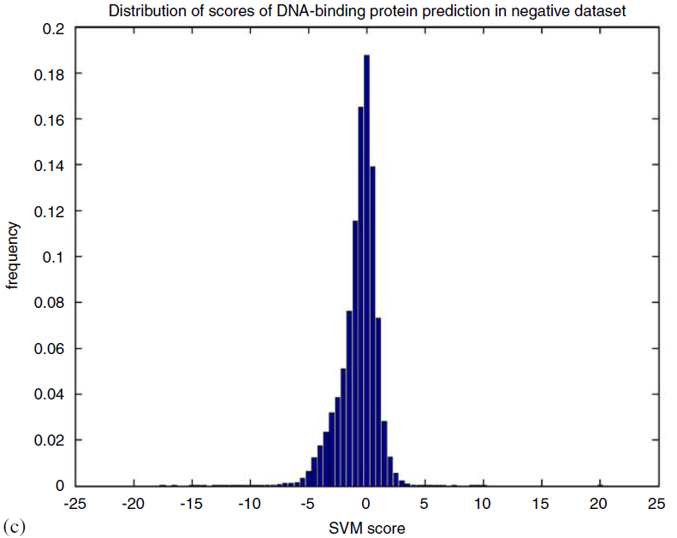
5. Discussion (6/7)
DNA-binding protein prediction in the negative set.

Slide 24
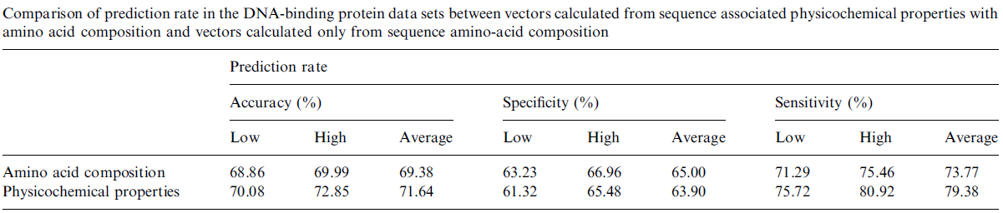
5. Discussion (7/7)
Comparison:

