Slide 1
Predicting Gene Ontology functions based on support vector machines and statistical significance estimation
Ran Bi, Yanhong Zhou, Feng Lu, Weiqiang Wang
Neurocomputing 70 (2007) 718–725
Presenter: Chu-Kai Liu
Date: Sept. 29, 2009

Slide 2
Abstract (1/3)
Gene Ontology (GO) is a common language for the functional annotation of gene products. We have developed a computational tool, GOKey, to predict the GO function of proteins based on their sequence features and the support vector machine (SVM) method. Several measures, including improved handling of the problem caused by unbalanced positive and negative training data and postprocessing strategies to evaluate the posterior probability and statistical significance of SVM outputs,

Slide 3
Abstract (2/3)
have been adopted to improve the prediction performance of GOKey. The GOKey has been trained to predict the 36 GO categories of the ‘molecular function’ of GO slims, and could be easily extended to other GO categories. The results of 5-fold cross validation with 10,603 GO-mapped proteins demonstrate that the performance of GOKey is better than that of standard SVMs. Comparisons with other computational tools for GO function prediction also show that the performance of GOKey is satisfactory.

Slide 4
Abstract (3/3)
Further, GOKey has been applied to predict the GO functions for 5381 novel human proteins in the Ensembl database. The results show that 93% of the novel proteins can be assigned one or more GO terms, and some evidences supporting the predictions have been found.

Slide 5
1. Gene Ontology(GO) (1/2)
GO is a major bioinformatics initiative to unify the representation of gene and gene product attributes across all species.
1st: develop its controlled vocabulary.
2nd: annotate genes and gene products.
3rd: provide tools to facilitate access to all aspects of the data .

Slide 6
1. Gene Ontology(GO) (2/2)
The ontology covers three domains:
1st: Molecular Function(分子功能):描述了在分子水平的活動性(activities),例如接觸反應的或捆綁的活動性的。
2nd: Biological Process(生物過程): 描述一個或多個有序的分子功能集結的生物目標。
3rd: Cellular Component(細胞成分): 以子細胞結構和維分子聯合體水平描述位置。
Example: GO:0005488, GO:0000217.

Slide 7
2. Materials
Adopt the molecular function of the GO slims (updated on 7 December 2004).
40 nodes in molecular function of GO slims.
The GOKey predict the remaining 36 GO terms.
The positive and negative samples are extracted from SWISS-PROT database.

Slide 8
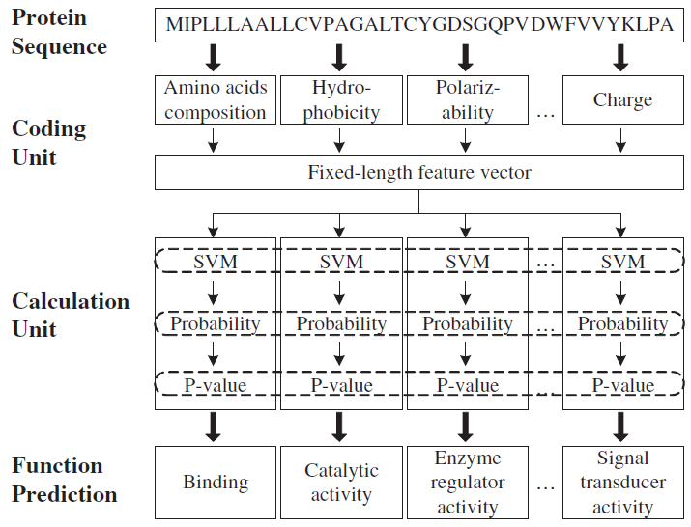
3. The configuration of GOKey
Consists of a coding unit and a calculation unit.

Slide 9
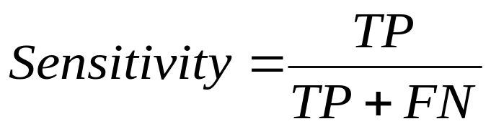
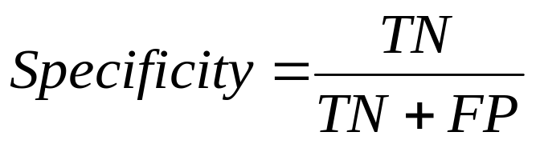
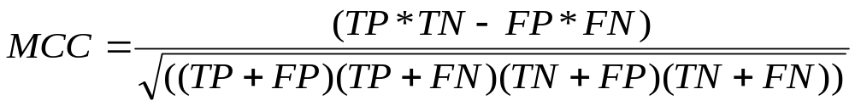
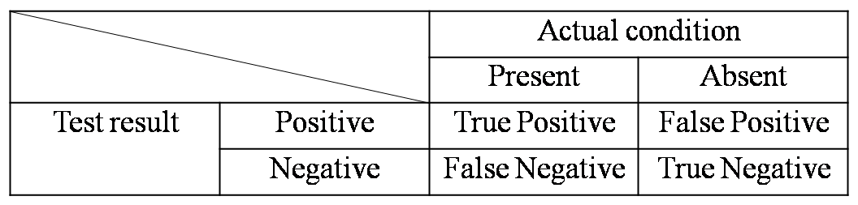
4. Cross-validation results(1/2)
5-fold cross-validation method.
Matthews correlation coefficient(MCC).

Slide 10
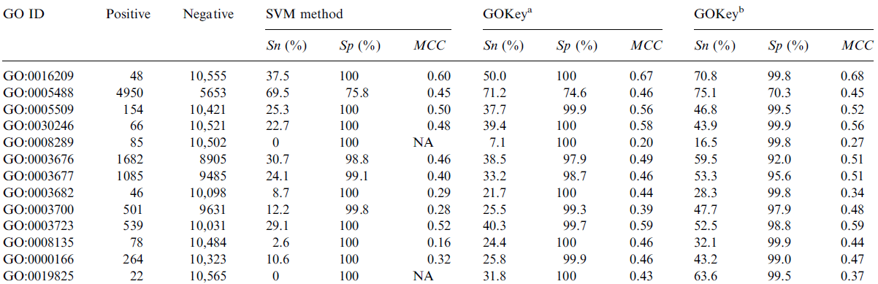
4. Cross-validation results(2/2)
ªPosterior probability 0.5 is used as cutoff.
^{b}P-value 0.005 is used as cutoff.

Slide 11
5. GO function prediction for novel proteins
In Ensembl, protein models that cannot be mapped to species-specific entries in SWISS-PROT, RefSeq or TrEMBL are referred to as novel proteins.
The results show that 5004 out of the 5381 novel proteins (93%) can be assigned one or more GO terms by GOKey (P-value < 0.005).

Slide 12
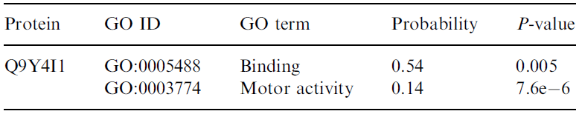
6. Strenghts of the method used in GOKey(1/2)
The method used in GOKey differs from standard SVMs in two major aspects:
1st: the postprocessing measures to evaluate the statistical significance of SVM outputs.

Slide 13
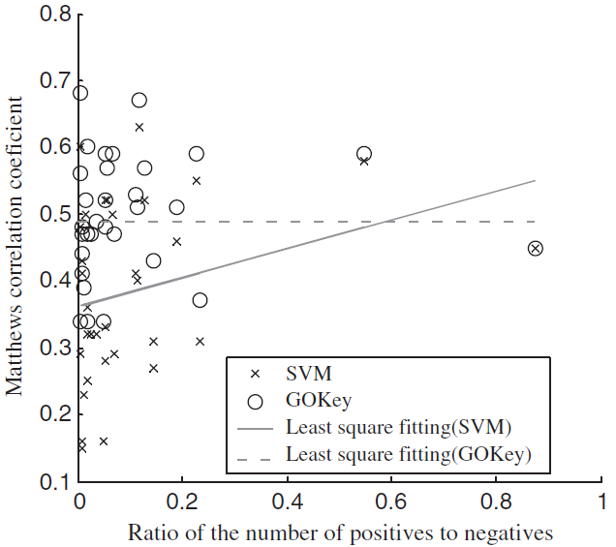
6. Strenghts of the method used in GOKey(2/2)
2nd: the improved handling of the problem caused by unbalanced positive and negative training data.

