Slide 1
A Geometric Shortest Path Problem with Application to Computing a Longest Common Subsequence in Run-Length Encoded Strings
Joseph S. B. Mitchell
Technical Report,
Dept. of Applied Mathematics, SUNY Stony Brook,
pp. 1-3, 1997.
Date: Oct. 6, 2009
Introducer: Hsing-Yen Ann

Slide 2
The LCS Problem
Given two sequences X and Y
  X = TAGTCACG
  Y = AGACTGTC
Longest common subsequence (LCS)
  LCS(X, Y) = AGACG
TAGTCACG
AGACTGTC
Notes:
Our research topic is about the comparison of sequences. For example.
Given two sequences X and Y. An interesting question is how similar X and Y are?
To answer this question, a famous is the LCS, the longest common subsequence.
Here we show an example of LCS of X and Y. That is AGACG.
We draw a red line between two symbols if they are matched.

Slide 3
Goal of This Paper
Solve the LCS problem where the sequences are run-length encoded.
  X = T²A⁸G³T³C⁴A²C¹G⁵
  Y = A⁴G⁴A⁵C²T³G⁴T⁴C³A³C²
  LCS(X, Y) = A⁸G³T³C³A²C¹
  X: length n, encoded into N runs
  Y: length m, encoded into M runs
Notes:
Now, we can formally address the goal of this paper.
(第一點)
We should also note that if the input sequences are in plain text, i.e. they are not compressed.
It is OK! We can compress them before applying our algorithm.
And it will not increase the overall time complexity.

Slide 4
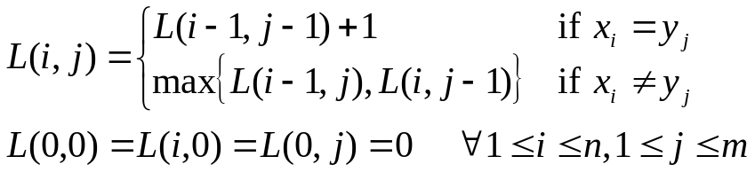
Previous Work — by DP (1/2)
DP lattice (matrix) for computing LCS
-
A
G
A
C
T
G
T
C
-
0
0
0
0
0
0
0
0
0
T
0
0
0
0
0
1
1
1
1
A
0
1
1
1
1
1
1
1
1
G
0
1
2
2
2
2
2
2
2
T
0
1
2
2
2
3
3
3
3
C
0
1
2
2
3
3
3
3
4
A
0
1
2
3
3
3
3
3
4
C
0
1
2
3
4
4
4
4
4
G
0
1
2
3
4
4
5
5
5
Notes:
The computation can be done in a tabular form. After the computation, we can trace back the answer of the longest common subsequence.

Slide 5
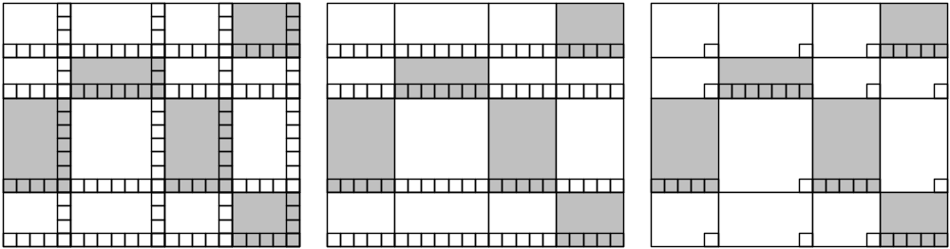
Previous Work — by DP (2/2)
Ann’s result: only the lower right corners and bottom walls of matched blocks are needed.
Time complexity of Ann’s result: O(NM + min{p₁, p₂})
Time complexity of this paper : O( (N+M+q) log(N+M+q) )
q is the number of matched blocks
[Bunke and Csirik, 1995] [Liu et al., 2008] [Ann et al., 2008]

Slide 6

Idea: Tsunami (海嘯)

Slide 7
Tsunami — Edit Distance
Computing the length of LCS from edit distance

Slide 8
Matched Blocks
A magic movement inside the matched block.

Slide 9
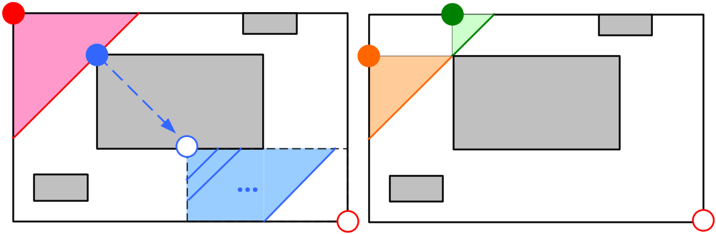
Events of Dragged Segments ??

Slide 10
未完待續…
For each dragged segment, the nearest blocks can be found in O(log q) time.
There are O(q) dragged segments.
Overall time complexity: O((N+M+q) log(N+M+q))
Joseph S. B. Mitchell, “L₁ Shortest Paths among Polygonal Obstacles in the Plane”, Algorithmica,
Vol. 8, pp. 55-88, 1992.

