Slide 1
Efficient de novo assembly of large genomes using compressed data structures elements
Jared T. Simpson and Richard Durbin
Genome Research 22:549–556
Speaker: Kuan-Chih Chen
Date: 2018.01.30
Notes:
作者:
劍橋大學博士生
貌似是博士論文

Slide 2
Abstract(1/2)
De novo genome sequence assembly is important both to generate new sequence assemblies for previously uncharacterized genomes and to identify the genome sequence of individuals in a reference-unbiased way. We present memory efficient data structures and algorithms for assembly using the FM-index derived from the compressed Burrows-Wheeler transform, and a new assembler based on these called SGA (String Graph Assembler). We describe algorithms to error-correct, assemble, and scaffold large sets of sequence data. SGA uses the overlap-based string graph model of assembly, unlike most de novo assemblers that rely on de Bruijn graphs, and is simply parallelizable.
Notes:
FM-index : a compressed full-text substring index based on the Burrows-Wheeler transform

Slide 3
Abstract(2/2)
We demonstrate the error correction and assembly performance of SGA on 1.2 billion sequence reads from a human genome, which we are able to assemble using 54 GB of memory. The resulting contigs are highly accurate and contiguous, while covering 95% of the reference genome (excluding contigs < 200 bp in length). Because of the low memory requirements and parallelization without requiring inter-process communication, SGA provides the first practical assembler to our knowledge for a mammalian-sized genome on a low-end computing cluster.

Slide 4
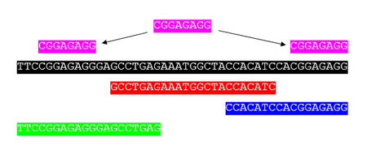
Sequence assembly
DNA fragment
Sequence merging/
Sequence alignment
longer DNA sequence
Bioinformatics的分析方法
依Reference Sequence的有無，分成:
de-novo(新的): 沒有參考序列，僅用fragment本身的資訊進行組裝
mapping: 有參考序列，將fragment align/map至參考序列上
Repeats Problem

Slide 5
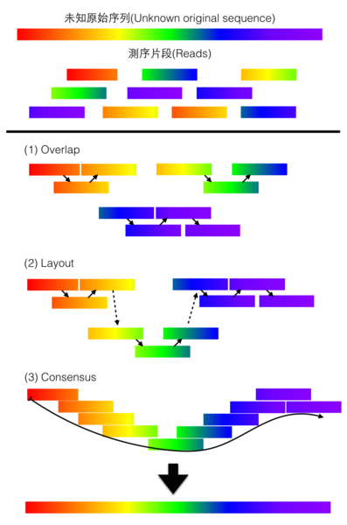
De novo assembly(1/3)
Overlap-layout-consensus(OLC)
將reads兩兩比對, 找出重疊(overlap)區域，以圖學的方式呈現(layout)重疊的關係，最後從這些片段中找出一致(consensus)的序列
運算量較大，通常用在資料量不大而測序長度較長的資料
OLC Method

Slide 6
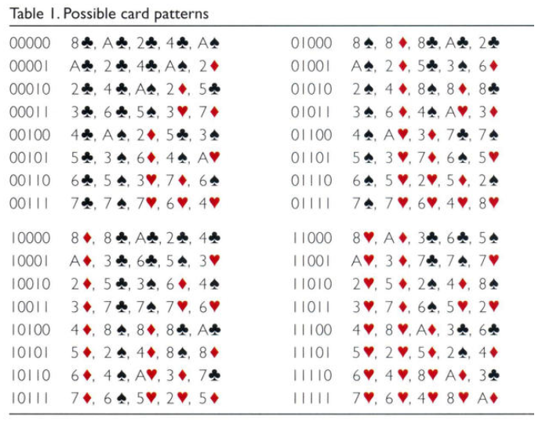


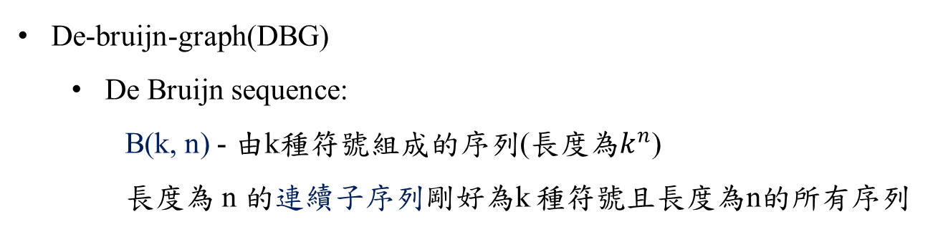
De novo assembly(2/3)
De-bruijn-graph(DBG)
De Bruijn sequence:
B(k, n) - 由k種符號組成的序列(長度為$k^{n}$)
長度為 n 的連續子序列剛好為k 種符號且長度為n的所有序列
Magic show
?
B(2, 2) = 0011 {00, 01, 11, 10}
B(2, 3) = 00010111 {000, 001, 010, 101, 011, 111, 110, 100}
0,0,0,0,0,1,0,0,1,0,1,1,0,0,1,1,1,1,1,0,0,0,1,1,0,1,1,1,0,1,0,1

Slide 7

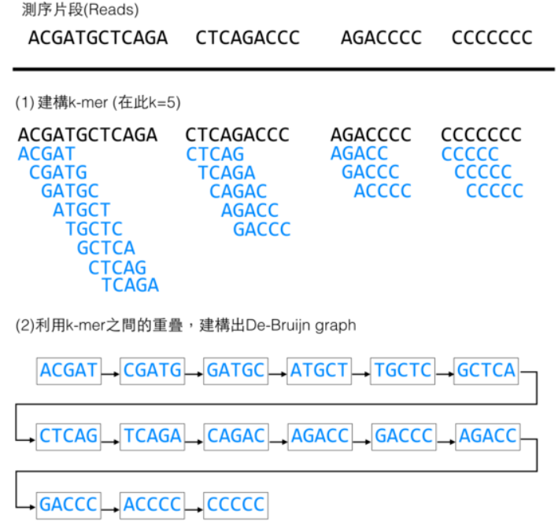
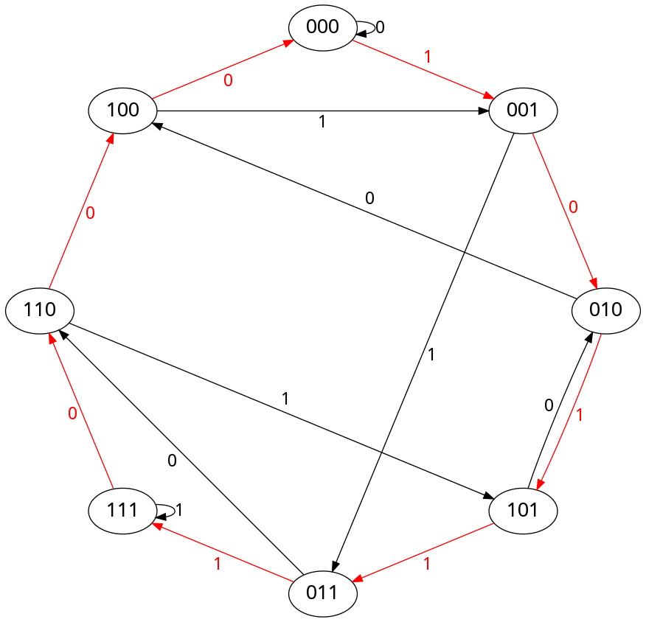
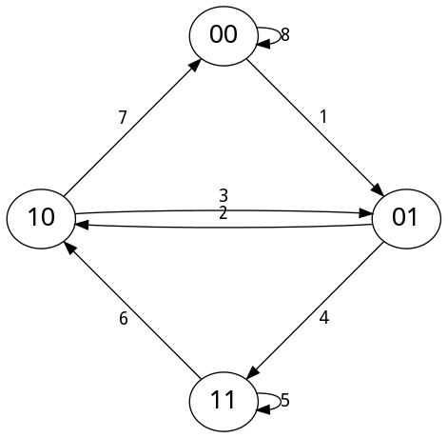
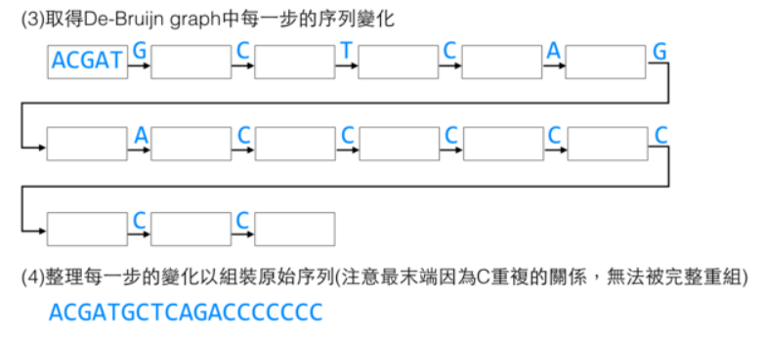
De novo assembly(2/2)
De-bruijn-graph(DBG)
De Bruijn graph:
G(k, n) – k 種符號組成，長度為 n 的所有序列為頂點形成的有向圖
G(2, 3)
10111000
G(2, 2)

Slide 8
Burrows-Wheeler transform(BWT)
FM-index
Also called block-sorting compression
Rearranging a character string into runs of similar characters
Easy to compress a string that has runs of repeated characters
Input: banana
$ b a n a n a a $ b a n a n n a $ b a n a a n a $ b a n n a n a $ b a a n a n a $ b b a n a n a $
$ b a n a n a a $ b a n a n a n a $ b a n a n a n a $ b b a n a n a $ n a $ b a n a n a n a $ b a
Sort
Output
annb$aa

Slide 9
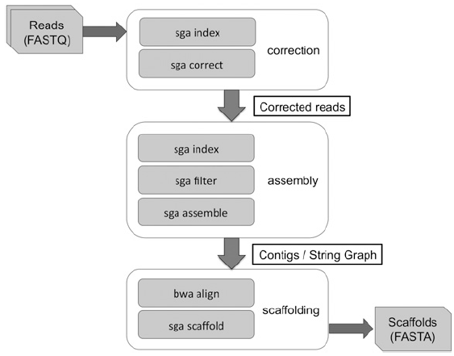
Overview
Error correction → Contig assembly → Scaffolding
FM-index
Error Correction
Remove duplicate and low-quality reads
construct contigs
align original reads and contigs by BWA
SGA assembly pipeline

Slide 10
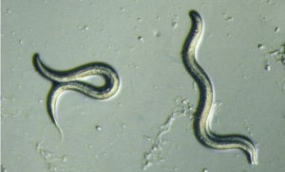
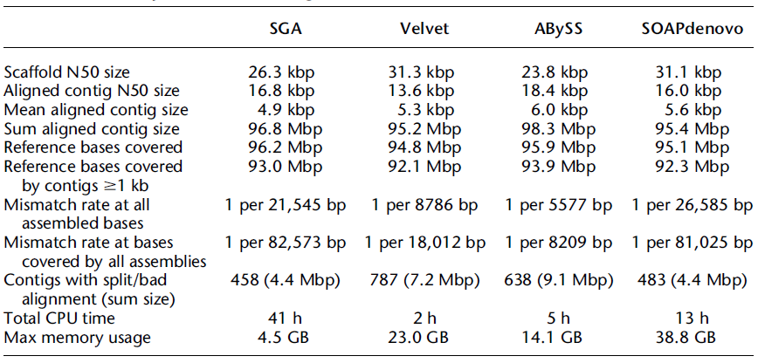
秀麗隱桿線蟲
C. elegans data set (100Mbp)
from the NCBI SRA (accession SRX026594)
Assembly statistics for C. elegans data set
Notes:
秀麗隱桿線蟲
它具有完整和準確的參考序列
它以雌雄同體的形式繁殖，所以個體（或株系）的基因組是純合的，
基本上沒有SNP和結構變異，而且基因組是一個合理的評估尺寸（100 Mbp）
N50: 用來評估de novo assembly效果好壞的方法之一。
當contig或scaffold從大到小排列後，從最大的contig進行長度的累加，累加到全部總長度的50%時，此時所加上的長度，即為N50。數字越大，則評估條件越嚴苛。
Velvet assembler : 第一個基於de Bruijn graph的assemblers (for short reads )，已經成為組裝中小型基因組的標準工具
ABySS assembler為了處理大型的基因組，通過在計算機集群上分佈de Bruijn graph
SOAPdenovo也基於de Bruijn graph並被設計來組裝大型基因組

Slide 11
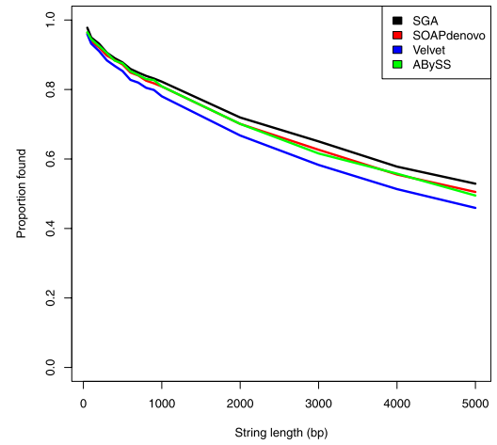
Substring coverage
Testing whether strings from the consensus sequence were exactly present in the contigs
Contigs must be:
Accurate
Complete
Contiguous

Slide 12
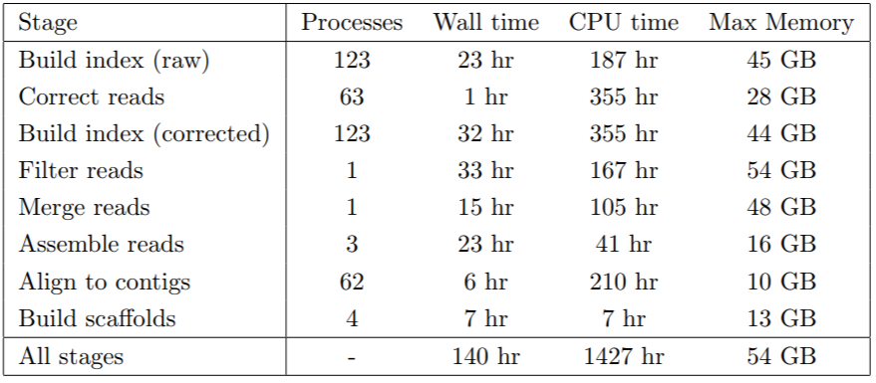
Running time and memory summary
for SGA human genome assembly
SOAPdenovo
121hr
479hr
118 GB
Notes:
針對人體: 1.2 billion sequence reads

Slide 13
Reference
https://en.wikipedia.org/wiki/Sequence_assembly
https://zhouer.org/DeBruijn/
ftp://ftp.sanger.ac.uk/pub/resources/theses/js18/chapter3.pdf
https://github.com/jts/sga
Sequence assembly
De Bruijn sequence
The SGA Assembler
SGA – Github(Software)

