Slide 1
An Efficient Algorithm for Computing Non-overlapping Inversion and Transposition Distance
Toan Thang Ta, Cheng-Yao Lin, and Chin Lung Lu
Information Processing Letters, Vol. 116, No. 12, pp. 744-749, July, 2016.
Presenter : Shie-Yan Lee
2018/2/13

Slide 2
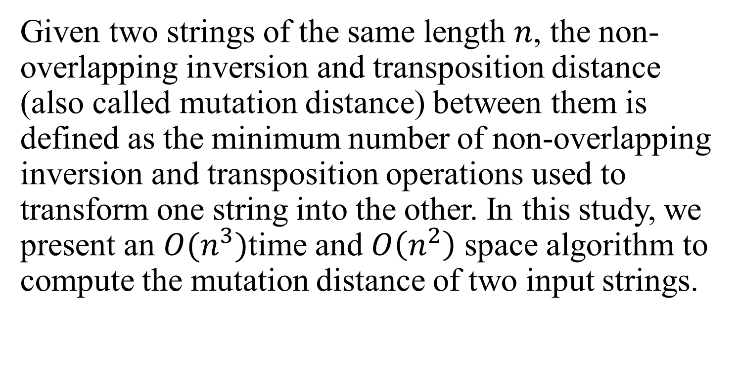
Abstract
Given two strings of the same length $n$, the non-overlapping inversion and transposition distance (also called mutation distance) between them is defined as the minimum number of non-overlapping inversion and transposition operations used to transform one string into the other. In this study, we present an $O(n^{3})$time and $O\left(n^{2}\right)$ space algorithm to compute the mutation distance of two input strings.

Slide 3
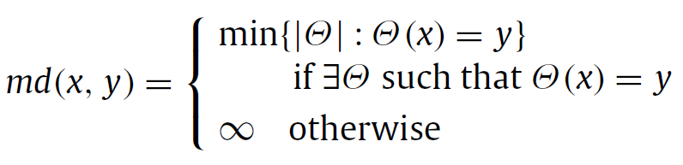

















Problem definition
$$1$$
$$i$$
$$j$$
$$p$$
$$q$$
$$r$$
$$n$$
$$x$$
inversion
transposition
$$1$$
$$i$$
$$j$$
$$p$$
$$r$$
$$n$$
$$y$$
$$θ_{i,j}$$
$$τ_{p,r,q}$$

Slide 4




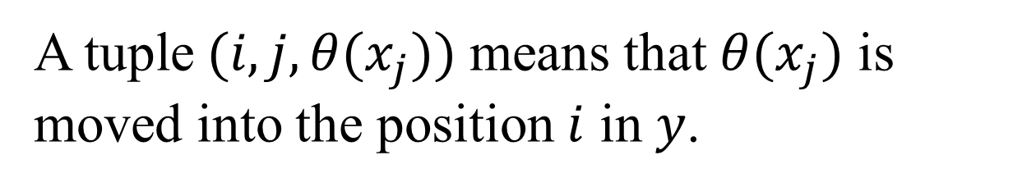






Mutation fragment
A tuple$(i,j,θ(x_{j}))$ means that $θ(x_{j})$ is moved into the position $i$ in $y$.
$$1$$
$$i$$
$$j$$
$$n$$
$$x$$
$$1$$
$$i$$
$$j$$
$$n$$
$$y$$

Slide 5

Mutation fragment
A tuple$(i,j,x_{j})$ means that $x_{j}$ is moved into the position $i$ in $y$.
$$1$$
$$i$$
$$j$$
$$n$$
$$x$$
$$1$$
$$i$$
$$j$$
$$n$$
$$y$$

Slide 6
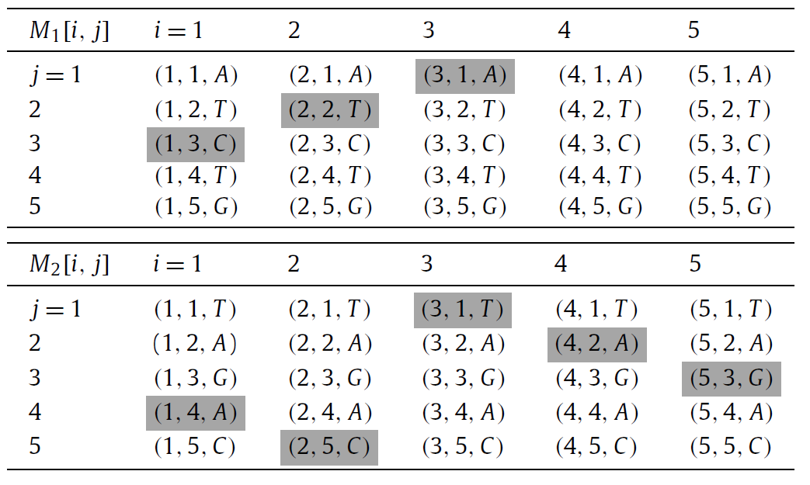



Mutation tables $M_{1}$ and $M_{2}$
$$x=TAGAC$$
$$θ_{1,3}\left(x\right)=CTA$$

Slide 7

Mutation tables $M_{1}$ and $M_{2}$
$$x=TAGAC$$
$$τ_{1,5,4}\left(x\right)=ACTAG$$

Slide 8


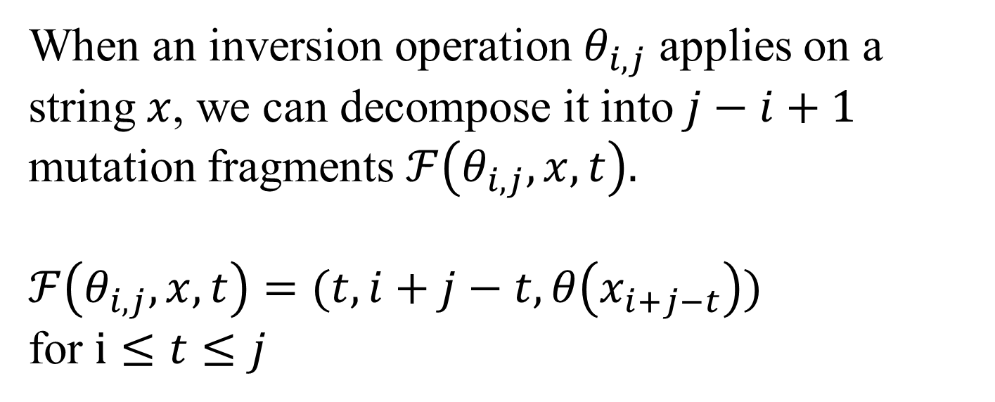



Decompose the inversion operation
When an inversion operation $θ_{i,j}$ applies on a string $x$, we can decompose it into $j−i+1$ mutation fragments $ℱ\left(θ_{i,j},x,t\right).$
$ℱ\left(θ_{i,j},x,t\right)=(t,i+j−t,θ\left(x_{i+j−t}\right))$
for $i≤t≤j$
$$i$$
$$j$$
$$i$$
$$t$$
$$j$$

Slide 9
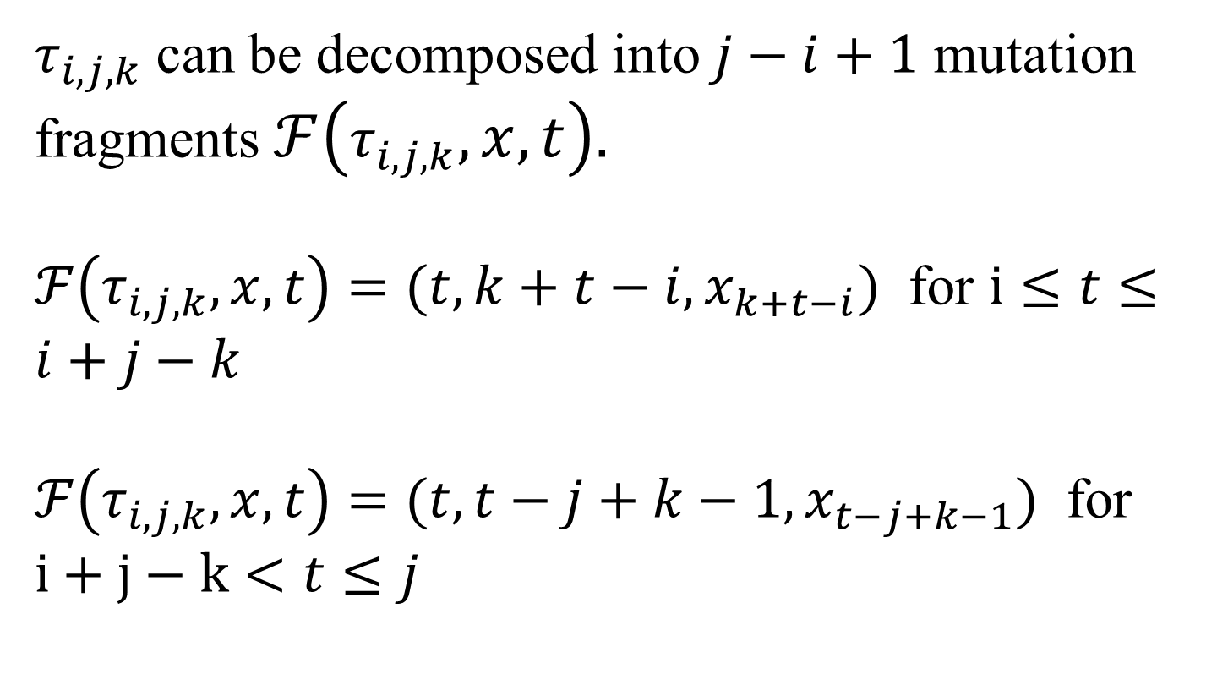
Decompose the transposition operation
$τ_{i,j,k}$ can be decomposed into $j−i+1$ mutation fragments $ℱ\left(τ_{i,j,k},x,t\right).$
$ℱ\left(τ_{i,j,k},x,t\right)=(t,k+t−i,x_{k+t−i})$ for $i≤t≤i+j−k$
$ℱ\left(τ_{i,j,k},x,t\right)=(t,t−j+k−1,x_{t−j+k−1})$ for $i+j−k<t≤j$

Slide 10






Decompose the transposition operation
$ℱ\left(τ_{i,j,k},x,t\right)=(t,k+t−i,x_{k+t−i})$ for $i≤t≤i+j−k=τ_{i,j,k}(x,1)$
$ℱ\left(τ_{i,j,k},x,t\right)=(t,t−j+k−1,x_{t−j+k−1})$ for $i+j−k<t≤j=τ_{i,j,k}(x,2)$
$$i$$
$$k$$
$$j$$
$$i$$
$$j$$

Slide 11
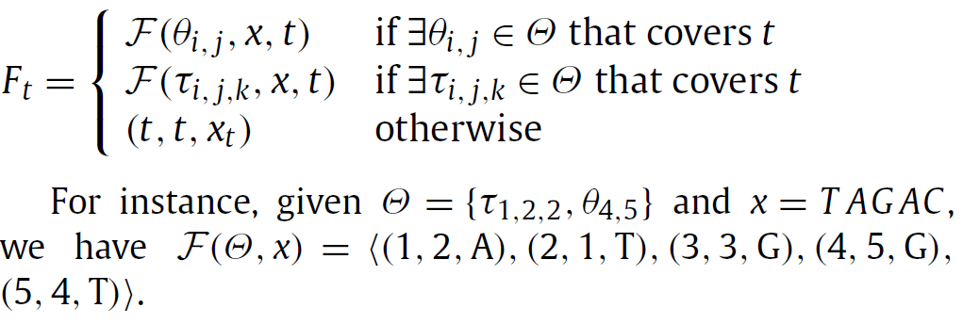
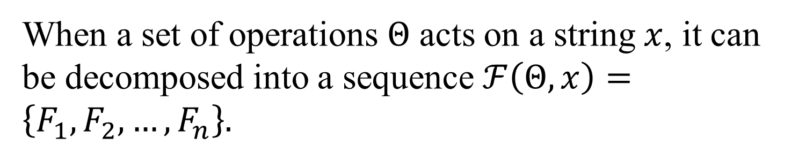
Decompose the operations
When a set of operations $Θ$ acts on a string $x$, it can be decomposed into a sequence $ℱ\left(Θ,x\right)=\left\{F_{1},F_{2},…,F_{n}\right\}.$

Slide 12
The Algorithm
1. Construct all legal sequences of length 1.
2. Produce all possible legal sequences of length i+1, which can be obtained from previously created legal sequences of length i.
3. If there exists a legal sequence of length n, return the minimum number of the used operations. Otherwise, return infinity.

Slide 13
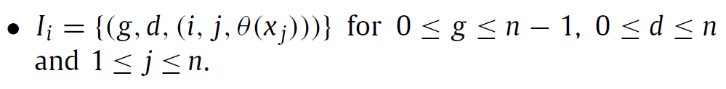
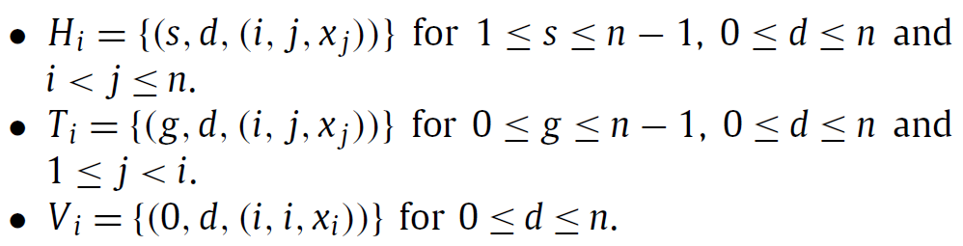
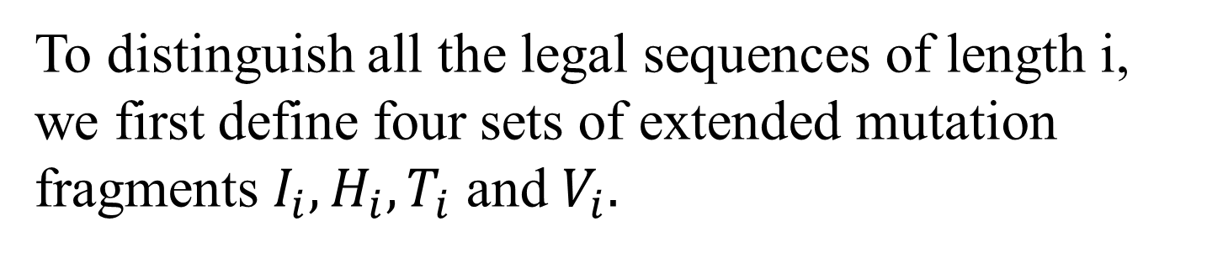
Extended mutation fragments
To distinguish all the legal sequences of length i,
we first define four sets of extended mutation fragments $I_{i},H_{i},T_{i}$ and $V_{i}.$

Slide 14
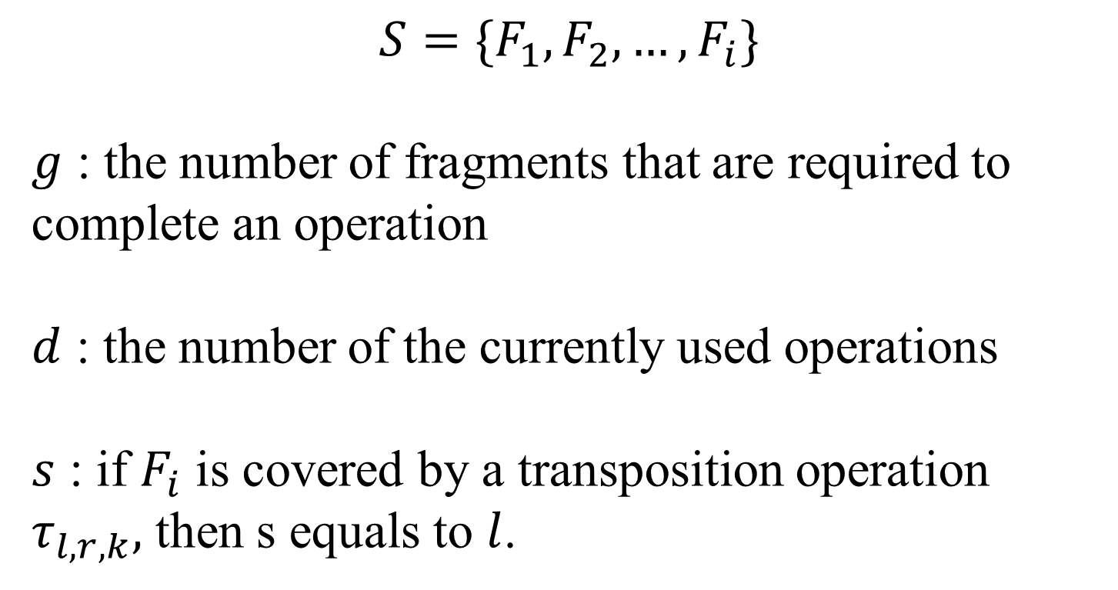
Extended mutation fragments
$$S=\{F_{1},F_{2},…,F_{i}\}$$
$g$ : the number of fragments that are required to complete an operation
$d$ : the number of the currently used operations
$s$ : if $F_{i}$ is covered by a transposition operation $τ_{l,r,k},$ then s equals to $l$.

Slide 15

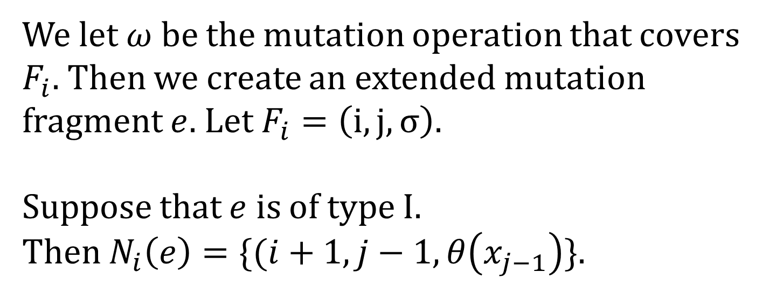

Extended mutation fragments
We let $ω$ be the mutation operation that covers $F_{i}.$ Then we create an extended mutation fragment $e$. Let $F_{i}=\left(i,j,σ\right).$
Suppose that $e$ is of type I.
Then $N_{i}\left(e\right)=\{(i+1,j−1,θ\left(x_{j−1}\right)\}$.
$$j$$
$$i$$

Slide 16

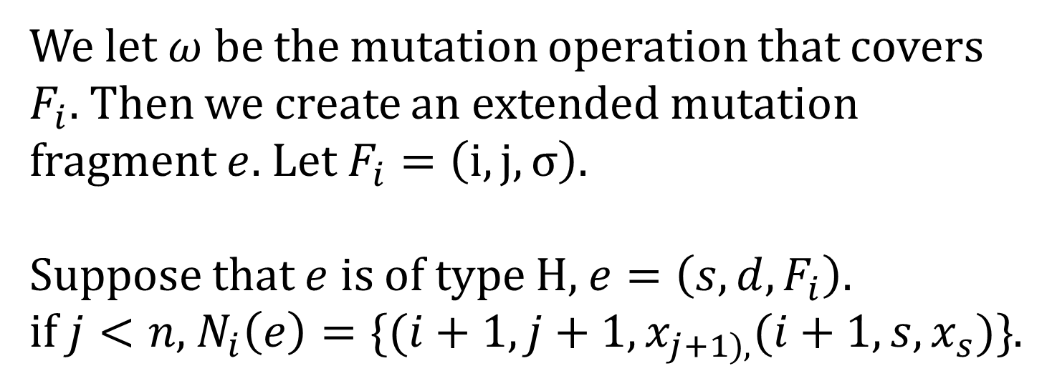


Extended mutation fragments
We let $ω$ be the mutation operation that covers $F_{i}.$ Then we create an extended mutation fragment $e$. Let $F_{i}=\left(i,j,σ\right).$
Suppose that $e$ is of type H, $e=\left(s,d,F_{i}\right).$
if $j<n,$ $N_{i}\left(e\right)=\{(i+1,j+1,x_{j+1),}(i+1,s,x_{s})\}$.
$$s$$
$$j$$
$$i$$

Slide 17
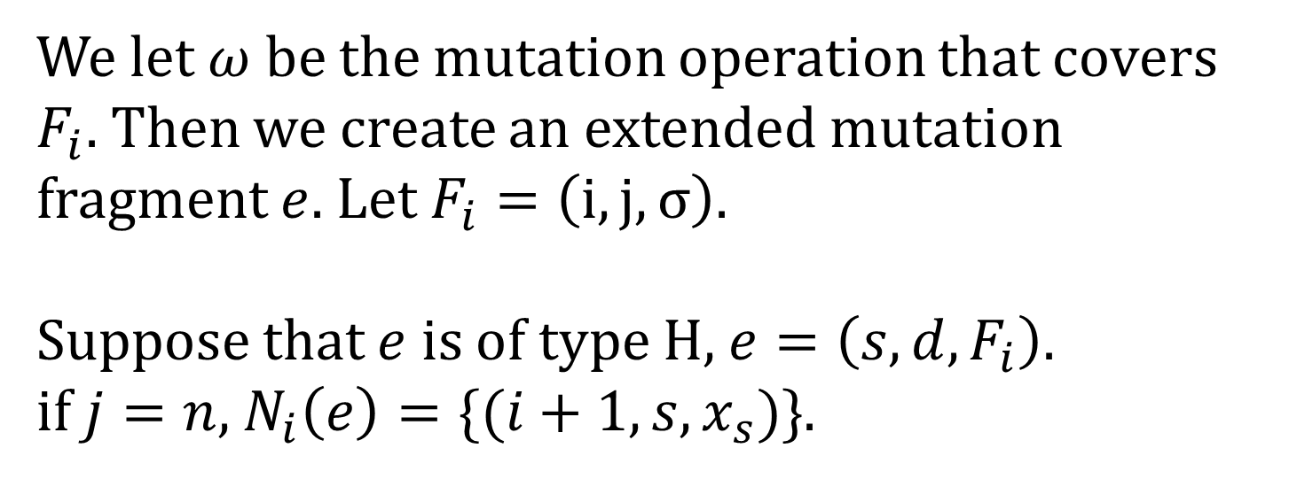
Extended mutation fragments
We let $ω$ be the mutation operation that covers $F_{i}.$ Then we create an extended mutation fragment $e$. Let $F_{i}=\left(i,j,σ\right).$
Suppose that $e$ is of type H, $e=\left(s,d,F_{i}\right).$
if $j=n,$ $N_{i}\left(e\right)=\{(i+1,s,x_{s})\}$.
$$s$$
$$j$$
$$i$$

Slide 18

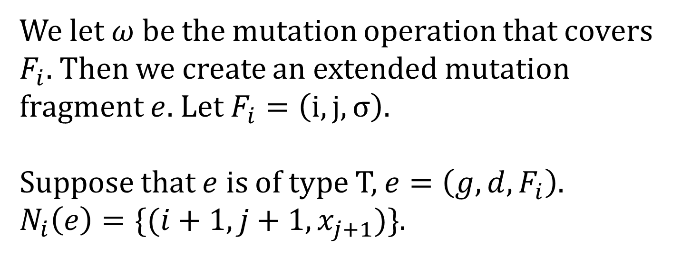

Extended mutation fragments
We let $ω$ be the mutation operation that covers $F_{i}.$ Then we create an extended mutation fragment $e$. Let $F_{i}=\left(i,j,σ\right).$
Suppose that $e$ is of type T, $e=\left(g,d,F_{i}\right).$
$N_{i}\left(e\right)=\{(i+1,j+1,x_{j+1})\}$.
$$j$$
$$i$$

Slide 19
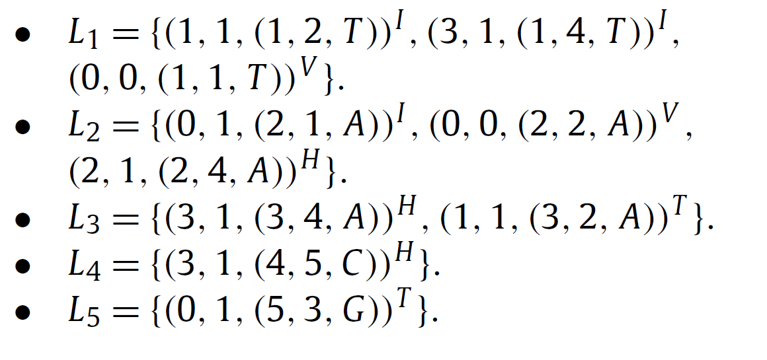
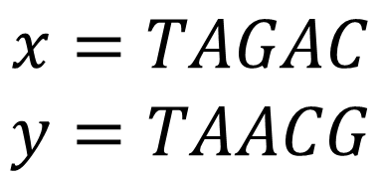
$$x=TAGAC$$
$$y=TAACG$$

Slide 20

Time and space complexity
Time complexity : $O(n^{3})$
Space complexity : $O(n^{2})$

