Slide 1
Wavelet Neural Network Prediction Method of Stock Price Trend Based on Rough Set Attribute Reduction
Lei Lei
School of Business Administration, Henan University of Economics and Law, Zhengzhou, Henan 450046, China
Applied Soft Computing, Volume 62, January 2018, Pages 923-932
Presenter: Cheng-Han Wu
Date:2018/2/13

Slide 2
Abstract
To improve the prediction capacity of stock price trend, an integrated prediction method is proposed based on Rough Set (RS) and Wavelet Neural Network (WNN). RS is firstly introduced to reduce the feature dimensions of stock price trend. On this basis, RS is used again to determine the structure of WNN, and to obtain the prediction model of stock price trend. Finally, the model is applied to prediction of stock price trend. The simulation results indicate that, through RS attribute reduction, the structure of WNN prediction model can be simplified significantly with the improvement of model performance. The directional symmetry values of prediction, corresponding to SSE Composite Index, CSI 300 Index, All Ordinaries Index, Nikkei 225 Index and Dow Jones Index, are 65.75%, 66.37%, 65.97%, 65.52% and 66.75%,respectively. The prediction results are better than those obtained by other neural networks, SVM, WNN and RS-WNN, which verifies the feasibility and effectiveness of the proposed method of predicting stock price trend.

Slide 3
Selection of experimental data
SSE Composite Index (China)
CSI 300 Index (China)
All Ordinaries Index (Australian)
Nikkei 225 Index (Japan)
Dow Jones Index (USA)

Slide 4
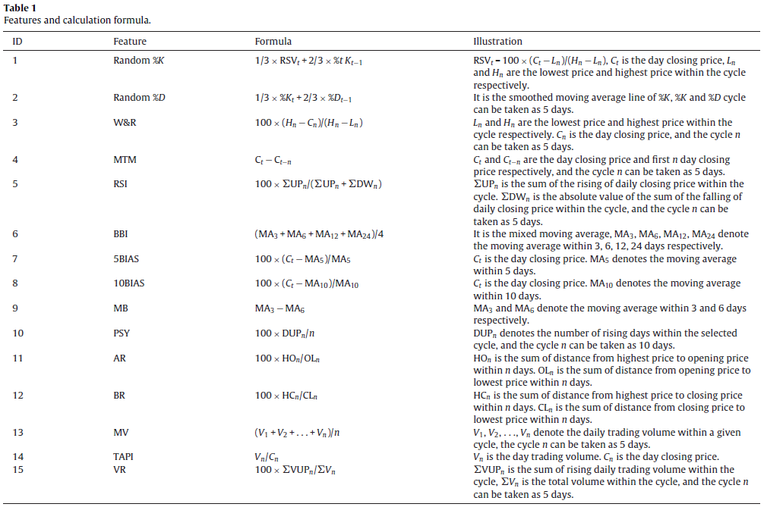
Notes:
粗糙集最主要的特點是：它無需提供對知識或數據的主觀評價，僅根據觀測數據就能達到刪除冗餘信息，比較不完備知識的程度-粗糙度，界定屬性間的依賴性和重要性的目的。

Slide 5
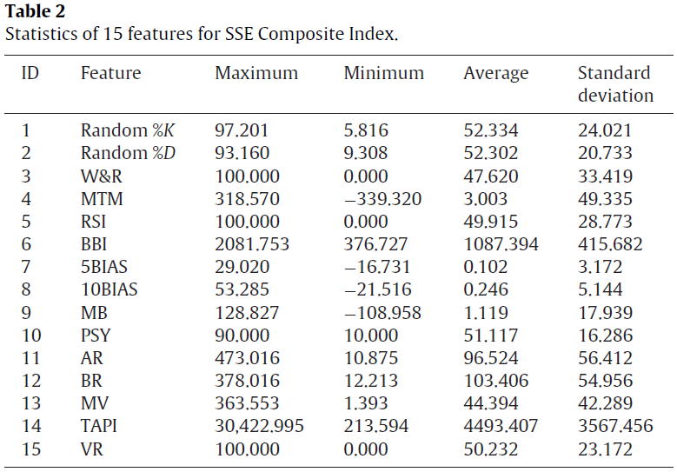
Notes:
粗糙集最主要的特點是：它無需提供對知識或數據的主觀評價，僅根據觀測數據就能達到刪除冗餘信息，比較不完備知識的程度-粗糙度，界定屬性間的依賴性和重要性的目的。

Slide 6
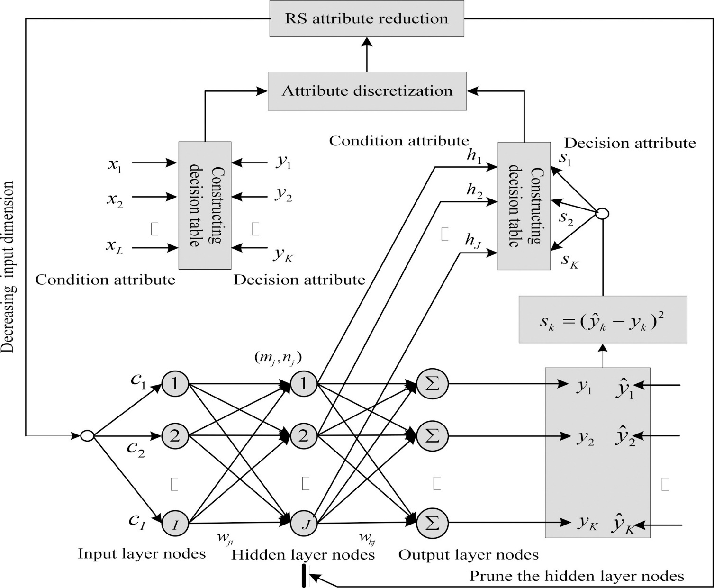
Integrating principle of 2RS-WNN
Notes:
粗糙集最主要的特點是：它無需提供對知識或數據的主觀評價，僅根據觀測數據就能達到刪除冗餘信息，比較不完備知識的程度-粗糙度，界定屬性間的依賴性和重要性的目的。

Slide 7
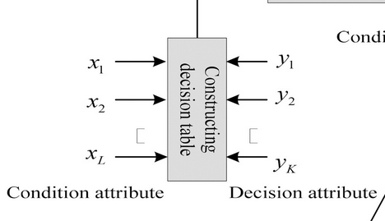

Condition attributes : feature $x_{1}, x_{2}, …, x_{15}$ of stock price trend
Decision attributes : stock price trend T

Slide 8
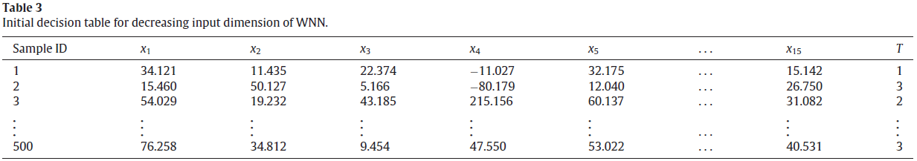

Slide 9
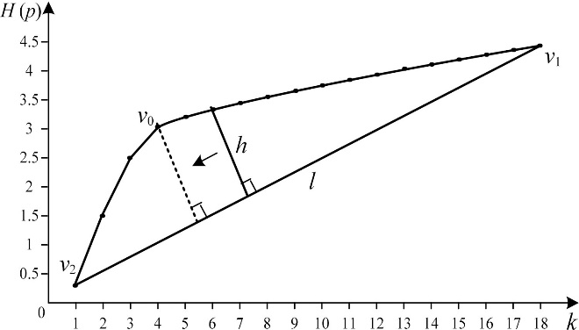
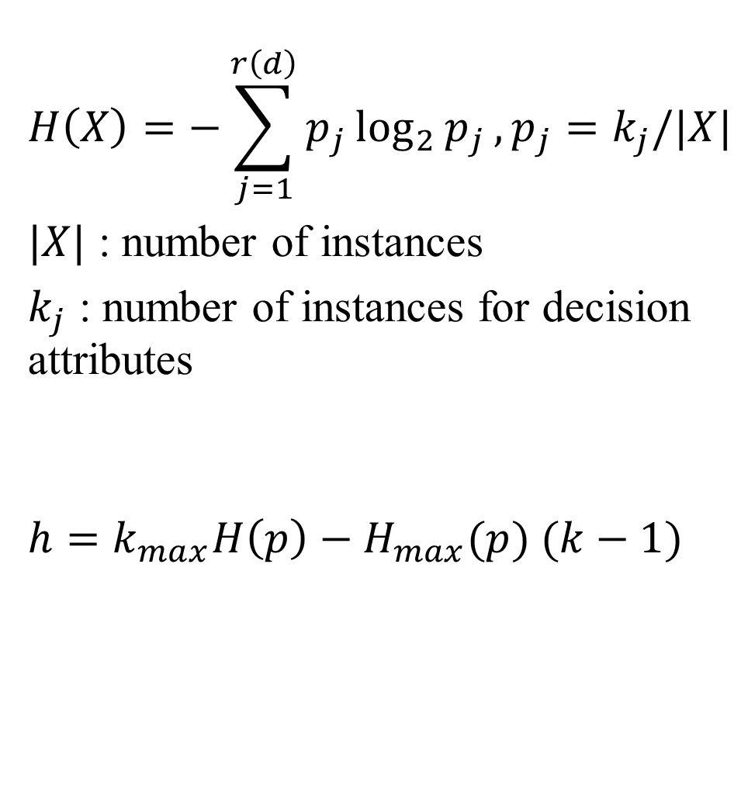
$$H\left(X\right)=−\sum_{j=1}^{r\left(d\right)}{p_{j}\log_{2}{p_{j}},}p_{j}=k_{j}/|X|$$
$|X|$ : number of instances
$k_{j}$ : number of instances for decision attributes
$$h=k_{max}H\left(p\right)−H_{max}(p) (k−1)$$
Notes:
Best balance is achieved between loss of entropy and moderate interval number 亂度
連續->離散 區間

Slide 10
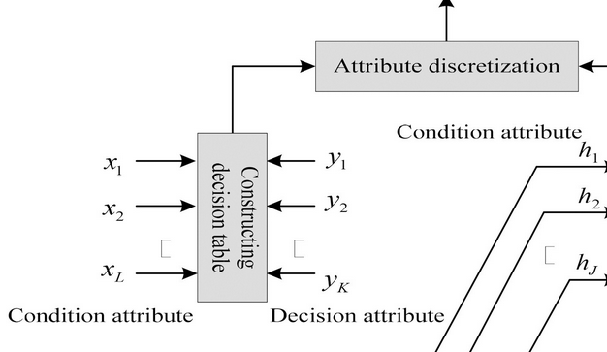
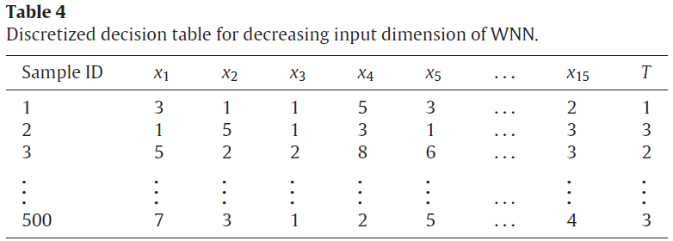
Notes:
T=decision attribute

Slide 11
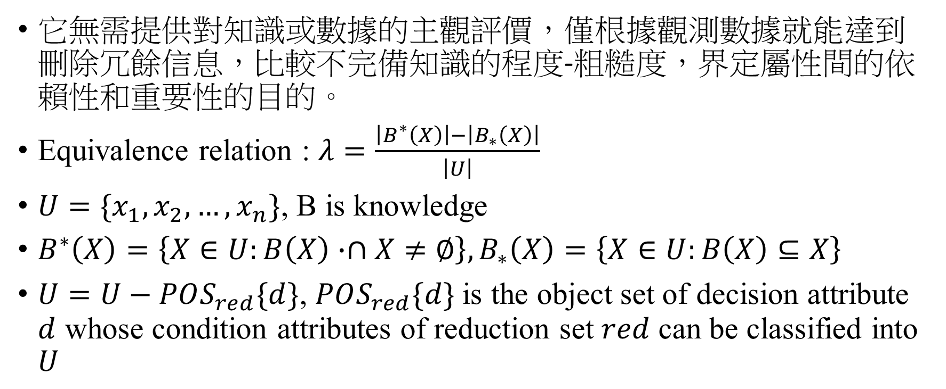
RS attribute reduction
它無需提供對知識或數據的主觀評價，僅根據觀測數據就能達到刪除冗餘信息，比較不完備知識的程度-粗糙度，界定屬性間的依賴性和重要性的目的。
Equivalence relation : $λ=\frac{\left|B^{∗}\left(X\right)\right|−\left|B_{∗}\left(X\right)\right|}{\left|U\right|}$
$U=\{x_{1}, x_{2}, …, x_{n}\}$, B is knowledge
$B^{∗}\left(X\right)=\left\{X∈U:B\left(X\right)∙∩X≠∅\right\},B_{∗}\left(X\right)=\left\{X∈U:B\left(X\right)⊆X\right\}$
$U=U−POS_{red}\{d\}$, $POS_{red}\{d\}$ is the object set of decision attribute $d$ whose condition attributes of reduction set $red$ can be classified into $U$
Notes:
粗糙集最主要的特點是：它無需提供對知識或數據的主觀評價，僅根據觀測數據就能達到刪除冗餘信息，比較不完備知識的程度-粗糙度，界定屬性間的依賴性和重要性的目的。

Slide 12
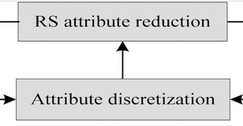
Notes:
3,4,6,8,9,12,14

Slide 13
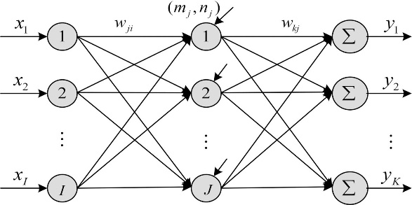
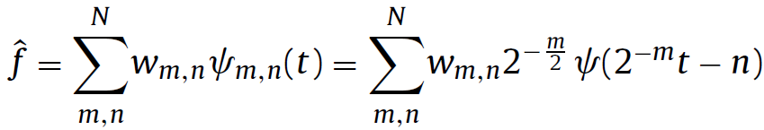
Wavelet Neural Network
Notes:
Trained by BP algo.

Slide 14
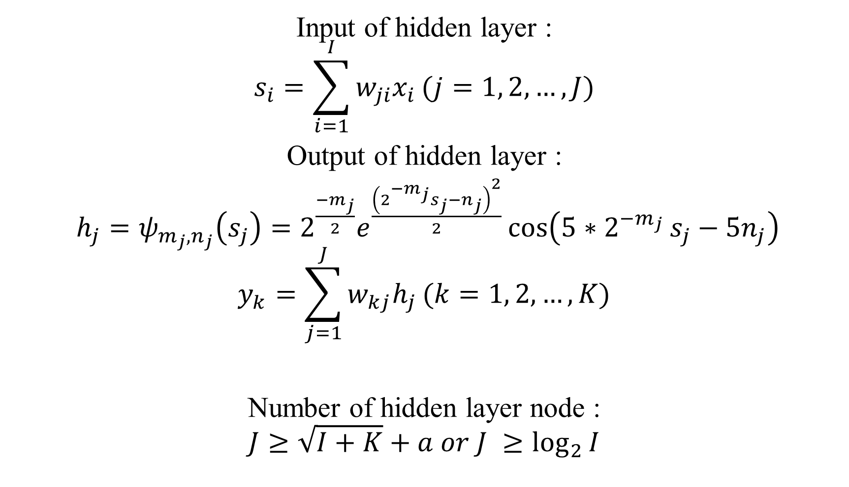
Input of hidden layer :
$$s_{i}=\sum_{i=1}^{I}{w_{ji}x_{i}}(j=1, 2, …, J)$$
Output of hidden layer :
$h_{j}=ψ_{m_{j},n_{j}}\left(s_{j}\right)=2^{\frac{−m_{j}}{2}}e^{\frac{{\left(2^{−m_{j}}s_{j}−n_{j}\right)}^{2}}{2}}\cos\left(5∗2^{−m_{j} }s_{j}−5n_{j}\right)$
$$y_{k}=\sum_{j=1}^{J}{w_{kj}h_{j}}(k=1, 2, …, K)$$
Number of hidden layer node :
$$J≥\sqrt{I+K}+a or J ≥\log_{2}{I}$$
Notes:
N is the number of learning sample, hidden layer node 10

Slide 15
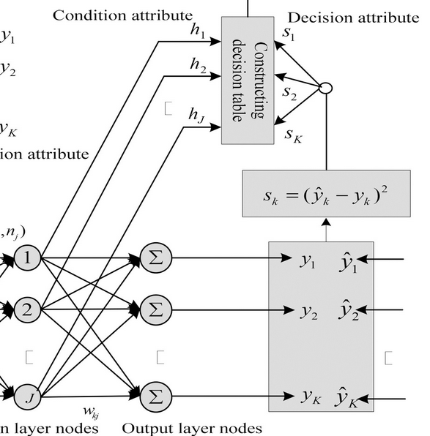
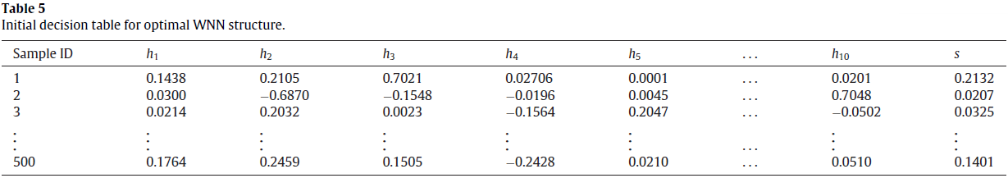

Slide 16
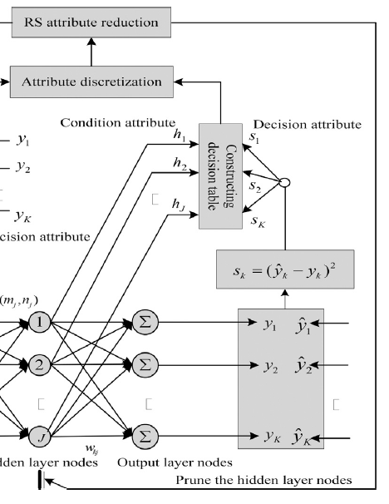
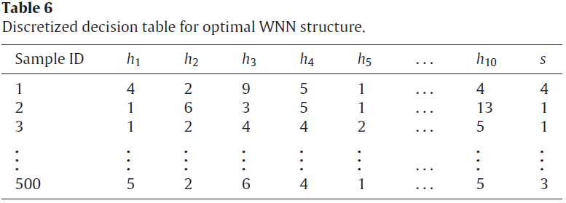
Notes:
Prune 4 7 8 10

Slide 17
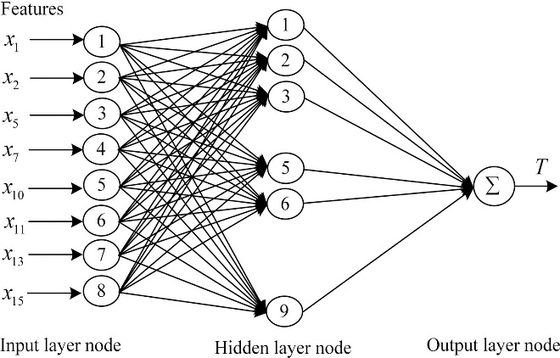
Notes:
股價走勢

Slide 18
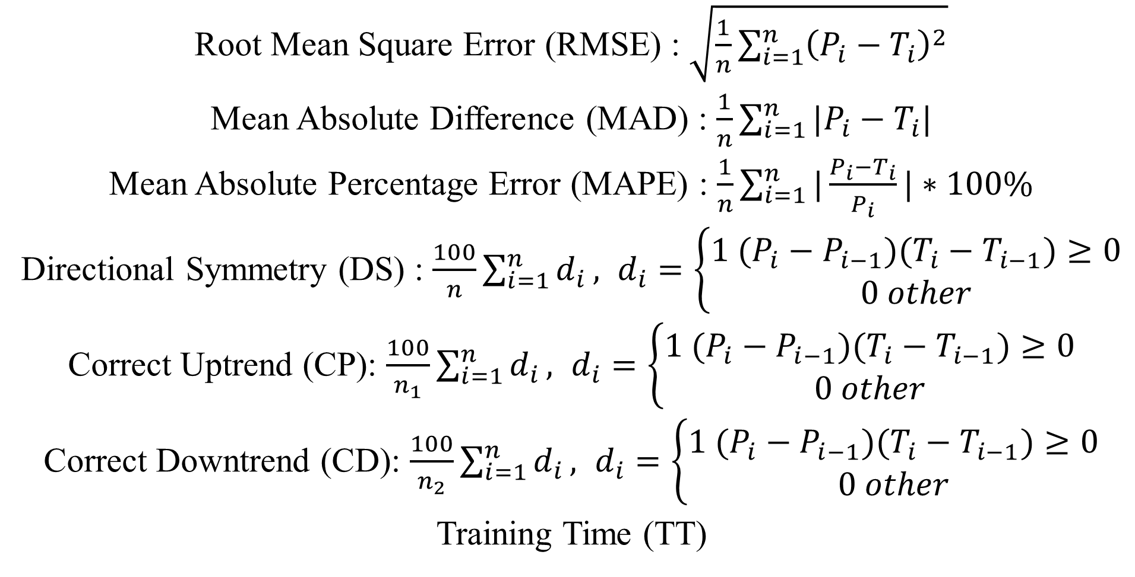
Root Mean Square Error (RMSE) : $\sqrt{\frac{1}{n}\sum_{i=1}^{n}{{\left(P_{i}−T_{i}\right)}^{2}}}$
Mean Absolute Difference (MAD) : $\frac{1}{n}\sum_{i=1}^{n}{|P_{i}−T_{i}|}$
Mean Absolute Percentage Error (MAPE) : $\frac{1}{n}\sum_{i=1}^{n}{|\frac{P_{i}−T_{i}}{P_{i}}}|∗100\%$
Directional Symmetry (DS) : $\frac{100}{n}\sum_{i=1}^{n}{d_{i}}, d_{i}=\left\{\begin{aligned}1 (P_{i}−P_{i−1})(T_{i}−T_{i−1})≥0 \\ 0 other\end{aligned}\right.$
Correct Uptrend (CP): $\frac{100}{n_{1}}\sum_{i=1}^{n}{d_{i}}, d_{i}=\left\{\begin{aligned}1 (P_{i}−P_{i−1})(T_{i}−T_{i−1})≥0 \\ 0 other\end{aligned}\right.$
Correct Downtrend (CD): $\frac{100}{n_{2}}\sum_{i=1}^{n}{d_{i}}, d_{i}=\left\{\begin{aligned}1 (P_{i}−P_{i−1})(T_{i}−T_{i−1})≥0 \\ 0 other\end{aligned}\right.$
Training Time (TT)
Notes:
N is the number of learning sample, hidden layer node 10

Slide 19
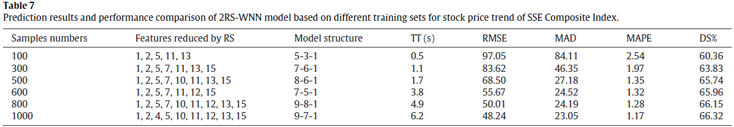
Notes:
股價走勢

Slide 20
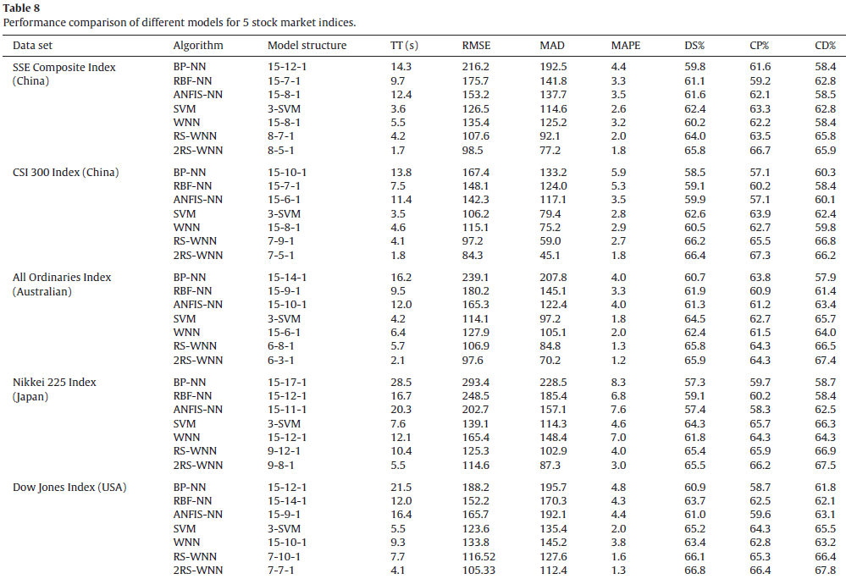
Notes:
股價走勢

