Slide 1
A Shape Based Similarity Measure for Time Series Classification with Weighted Dynamic Time Warping Algorithm
Yanqing Ye, Caiyun Niu, Jiang Jiang, Bingfeng Ge, Kewei Yang
Information Science and Control Engineering (ICISCE), Changsha China, 2017 4th International Conference
Presenter : Bo-Xian Chen
Date : 2018/3/6
Notes:
College of Information System and Management
National University of Defense Technology
國防科技大學 資訊系統與管理學系
頁岩清，牛彩雲、將江、葛冰封、楊凱偉

Slide 2
Abstract(1/1)
Time series similarity measure is an essential issue in time series data mining, which can be widely used in various applications. With an eye to the fact that most current measures neglect the shape characteristic of time series, this paper proposes a shape based similarity measure. By introducing a shape coefficient into the traditional weighted dynamic time warping algorithm, an improved version, shape based weighted dynamic time warping (SWDTW) algorithm is proposed. Specifically, the ways to measure univariate and multivariate time series similarity with SWDTW are presented. Finally, in order to verify the effectiveness of the proposed similarity measure, both 1NN classification and similarity search experiments are carried out using datasets derived from UCR Time Series Classification Homepage. By comparing the SWDTW similarity measure with other measures, the results show that the proposed SWDTW measure is more of accuracy and robust.
Notes:
Neighbour
【英】= neighbor

Slide 3
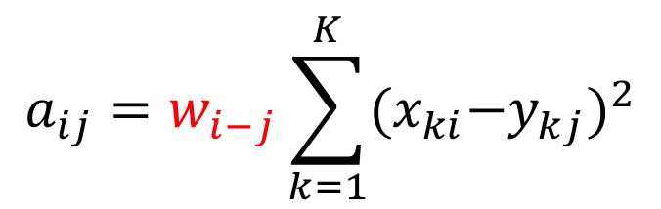
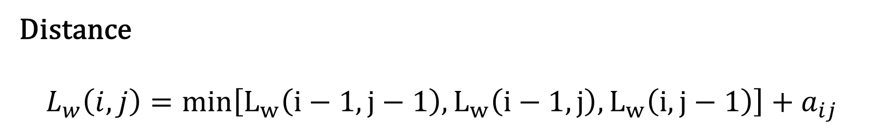
SWDTW algorithm(1/3)
Distance
$$L_{w}\left(i,j\right)=min\left[L_{w}\left(i−1,j−1\right),L_{w}\left(i−1,j\right),L_{w}\left(i,j−1\right)\right]+a_{ij}$$
$$a_{ij}=w_{i−j}\sum_{k=1}^{K}{{{(x}_{ki}−y_{kj})}^{2}}$$
$$w_{i−j}=w_{max}/(1+\exp\left(−g×\left(c×R−m_{c}×K\right)\right))$$

Slide 4
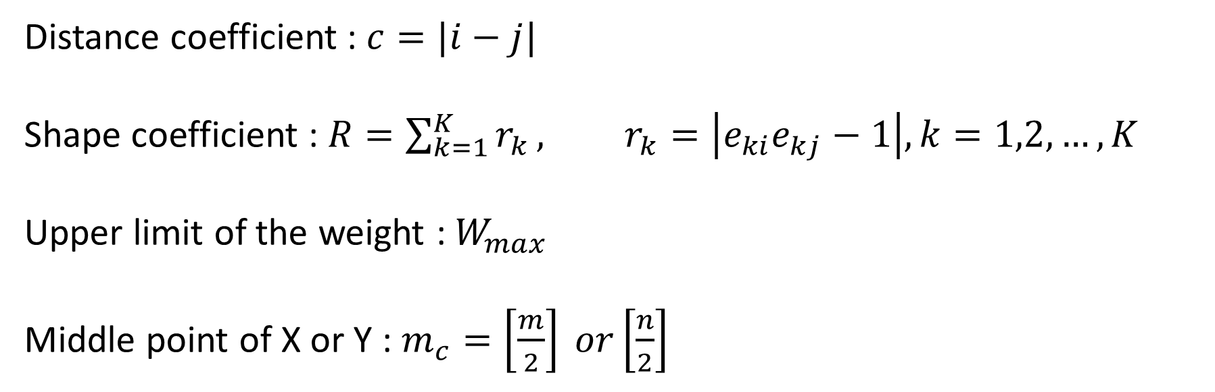
SWDTW algorithm(2/3)
$$w_{i−j}=w_{max}/(1+\exp\left(−g×\left(c×R−m_{c}×K\right)\right))$$
Distance coefficient :$c=|i−j|$
Shape coefficient : $R=\sum_{k=1}^{K}{r_{k}}, r_{k}=\left|e_{ki}e_{kj}−1\right|, k=1,2,…,K$
Upper limit of the weight : $W_{max}$
Middle point of X or Y : $m_{c}=\left[\frac{m}{2}\right] or\left[\frac{n}{2}\right]$

Slide 5
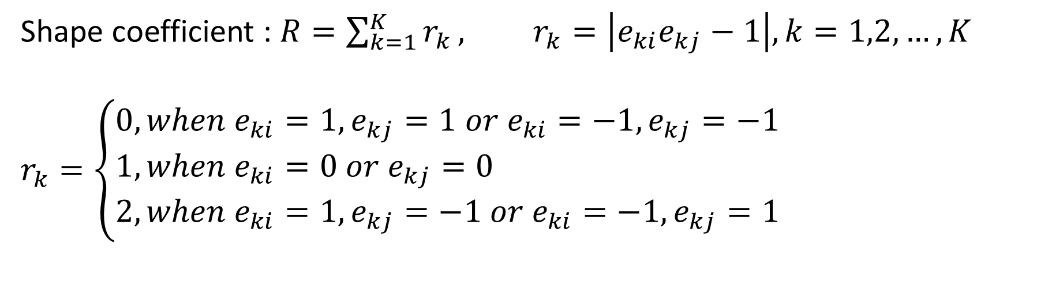
SWDTW algorithm(3/3)
$$w_{i−j}=w_{max}/(1+\exp\left(−g×\left(c×R−m_{c}×K\right)\right))$$
Shape coefficient : $R=\sum_{k=1}^{K}{r_{k}}, r_{k}=\left|e_{ki}e_{kj}−1\right|, k=1,2,…,K$
$$r_{k}=\left\{\begin{aligned}&0, when e_{ki}=1, e_{kj}=1 or e_{ki}=−1, e_{kj}=−1 \\ &1, when e_{ki}=0 or e_{kj}=0 \\ &2, when e_{ki}=1, e_{kj}=−1 or e_{ki}=−1, e_{kj}=1\end{aligned}\right.$$
$$w_{min}=w_{max}/(1+\exp\left(g×\left(m_{c}×K\right)\right))$$

Slide 6
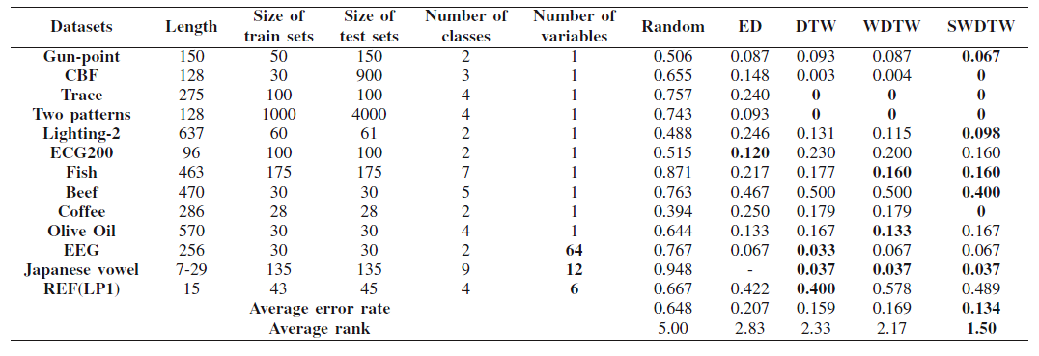
Experiment

