Slide 1
Improvised divide and conquer approach for the LIS problem
Seema Rani and Dharmveer Singh Rajpoot
Journal of Discrete Algorithms 48 (2018) 17–26
Speaker: Kuan-Chih Chen
Date: 2018.03.06
Notes:
作者:
印度作者

Slide 2
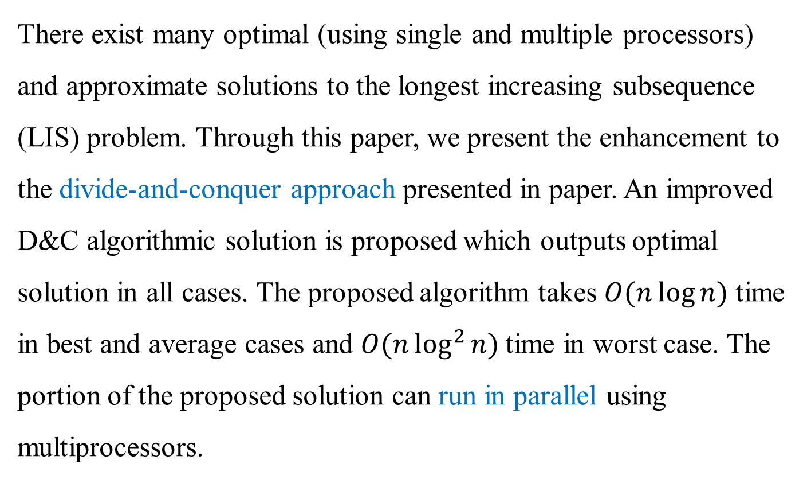
Abstract
There exist many optimal (using single and multiple processors) and approximate solutions to the longest increasing subsequence (LIS) problem. Through this paper, we present the enhancement to the divide-and-conquer approach presented in paper. An improved D&C algorithmic solution is proposed which outputs optimal solution in all cases. The proposed algorithm takes $O(n\log{n)}$ time in best and average cases and $O(n\log^{2}{n)}$time in worst case. The portion of the proposed solution can run in parallel using multiprocessors.
Divide-and-Conquer (D&C)
Longest Increasing Subsequence (LIS)
Principal Row of Young Tableaux (PRYT)

Slide 3
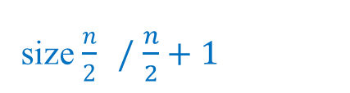

D&C Approach
original problem
X
size n
sub problem
size $\frac{n}{2} /$ $\frac{n}{2}+1$
X1
X2
Divide
X11
X12
X21
X22
…
size $1$
sub answer
sub answer
sub answer
Combine
final answer

Slide 4
Principal row of Young tableaux(PRYT)
X = <2, 9, 6, 8, 3, 4, 7, 10>
Y(PRYT) = <2>
Y= <2, 9>
Y= <2, 6>
Y= <2, 6, 8>
Y= <2, 3, 8>
Y= <2, 3, 4>
Y= <2, 3, 4, 7>
Y= <2, 3, 4, 7, 10>

Slide 5

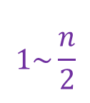





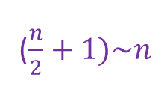

D&C - Divide
Dataset
$$1\sim \frac{n}{2}$$
($\frac{n}{2}+1)\sim n$
1. Permutation of elements in the range [1 ...n]
$$<1, 3, 5, 2, 4>$$
$$<1, 2>$$
$$<3, 5, 4>$$
sort and get middle value to divide
2. Not Permutation
$$<12, 1000, 315, 5000>$$
$$<299 302, 301, 300>$$
1. Middle element has multiple occurrences
$$<1, 2, 2, 2, 2, 6, 10>$$
$$<1, 2, 2,> <2, 2, 6, 10>$$

Slide 6
D&C - Divide
<8, 9, 5, 2, 3, 7, 10, 4, 1, 6>
<5, 2, 3, 4, 1>
<8, 9, 7, 10, 6>
<2, 1>
<5, 3, 4>
<7, 6>
<8, 9, 10>
<1>
<2>
<3>
<5, 4>
<6>
<7>
<8>
<9, 10>
Pred[9]=0
Pred[4]=0
Pred[5]=0
Pred[10]=0
Pred[6]=0
Pred[1]=0
<4>
<5>
<9>
<10>
Pred[8]=0
Pred[3]=0
Pred[2]=0
Pred[7]=0
Pred[1, 2, … , 10] = 0

Slide 7
D&C - Combine
<8, 9, 5, 2, 3, 7, 10, 4, 1, 6>
<2, 1>
Pred[9]=0
Pred[4]=0
<1>
<2>
2
PRYT = <(2, 4)>
1
PRYT = <(1, 9)>

Slide 8
D&C - Combine
<8, 9, 5, 2, 3, 7, 10, 4, 1, 6>
<5, 2, 3, 4, 1>
<8, 9, 7, 10, 6>
<2, 1>
<5, 3, 4>
<7, 6>
<8, 9, 10>
<1>
<2>
<3>
<5, 4>
<6>
<7>
<8>
<9, 10>
<2, 1>
<4>
<5>
<9>
<10>
PRYT = <(1, 9)>

Slide 9
D&C - Combine
<8, 9, 5, 2, 3, 7, 10, 4, 1, 6>
<5, 2, 3, 4, 1>
<8, 9, 7, 10, 6>
<2, 1>
<5, 3, 4>
<7, 6>
<8, 9, 10>
<1>
<2>
<3>
<5, 4>
<6>
<7>
<8>
<9, 10>
<2, 1>
<4>
<5>
<9>
<10>
<5, 4>
PRYT = <(4, 8)>

Slide 10
D&C - Combine
<8, 9, 5, 2, 3, 7, 10, 4, 1, 6>
<5, 3, 4>
<3>
<5, 4>
5
PRYT = <(5, 3)>
3
PRYT = <(3, 5)>
4
PRYT = <(3, 5), (4, 8)>
Pred[8]=5

Slide 11
D&C - Combine
<8, 9, 5, 2, 3, 7, 10, 4, 1, 6>
<2, 1>
<5, 3, 4>
<7, 6>
<8, 9, 10>
<1>
<2>
<3>
<5, 4>
<6>
<7>
<8>
<9, 10>
<2, 1>
<4>
<5>
<9>
<10>
<5, 4>
<3, 5, 4>
Pred[3, 5, 8]=[0, 0, 5]

Slide 12
D&C - Combine
<8, 9, 5, 2, 3, 7, 10, 4, 1, 6>
<5, 2, 3, 4, 1>
<2, 1>
<5, 3, 4>
5
PRYT = < (5, 3) >
2
PRYT = < (2, 4) >
Pred[5]=4
3
PRYT = < (2, 4), (3, 5) >
4
PRYT = < (2, 4), (3, 5), (4, 8) >
1
PRYT = < (1, 9), (3, 5), (4, 8) >
Pred[3, 4, 5, 8, 9]=[0, 0, 4, 5, 0]

Slide 13
D&C - Combine
<8, 9, 5, 2, 3, 7, 10, 4, 1, 6>
<5, 2, 3, 4, 1>
<8, 9, 7, 10, 6>
…
Pred[3, 4, 5, 8, 9]=[0, 0, 4, 5, 0]
Pred[1, 2, 6, 7, 10]=[0, 1, 0, 2, 0]
<5, 2, 3, 4, 1>
<8, 9, 7, 10, 6>
?

Slide 14
D&C - Combine
<8, 9, 5, 2, 3, 7, 10, 4, 1, 6>
PRYT = < (8, 1) >
9 PRYT = < (8, 1), (9, 2) >
5 PRYT = < (5, 3), (9, 2) >
2 PRYT = < (2, 4), (9, 2) >
PRYT = < (2, 4), (3, 5) >
7 PRYT = < (2, 4), (3, 5), (7, 6) >
10 PRYT = < (2, 4), (3, 5), (7, 6), (10, 7) >
4 PRYT = < (2, 4), (3, 5), (4, 8), (10, 7) >
1 PRYT = < (1, 9), (3, 5), (4, 8), (10, 7) >
6 PRYT = < (1, 9), (3, 5), (4, 8), (6, 10) >
LIS =
Pred[6]=5
Pred[7]=6
Pred[10]=8
Pred[1~10]=[0, 1, 0, 0, 4, 0, 2, 5, 0, 0]
5
6
8

Slide 15
Reference
Young tableaus(杨氏矩阵)的分析
http://shmilyaw-hotmail-com.iteye.com/blog/1721524

