Slide 1
Stock market index prediction using artificial neural network
Amin Hedayati Moghaddama, Moein Hedayati Moghaddamb, Morteza Esfandyaric
Journal of Economics, Finance and Administrative Science Volume 21, Issue 41, December 2016, Pages 89-93
Presenter: Cheng-Han Wu
Date:2018/3/21

Slide 2
Abstract
In this study the ability of artificial neural network (ANN) in forecasting the daily NASDAQ stock exchange rate was investigated. Several feed forward ANNs that were trained by the back propagation algorithm have been assessed. The methodology used in this study considered the short-term historical stock prices as well as the day of week as inputs. Daily stock exchange rates of NASDAQ from January 28, 2015 to 18 June, 2015 are used to develop a robust model. First 70 days (January 28 to March 7) are selected as training dataset and the last 29 days are used for testing the model prediction ability. Networks for NASDAQ index prediction for two type of input dataset (four prior days and nine prior days) were developed and validated.

Slide 3
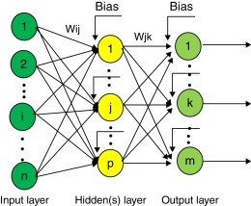
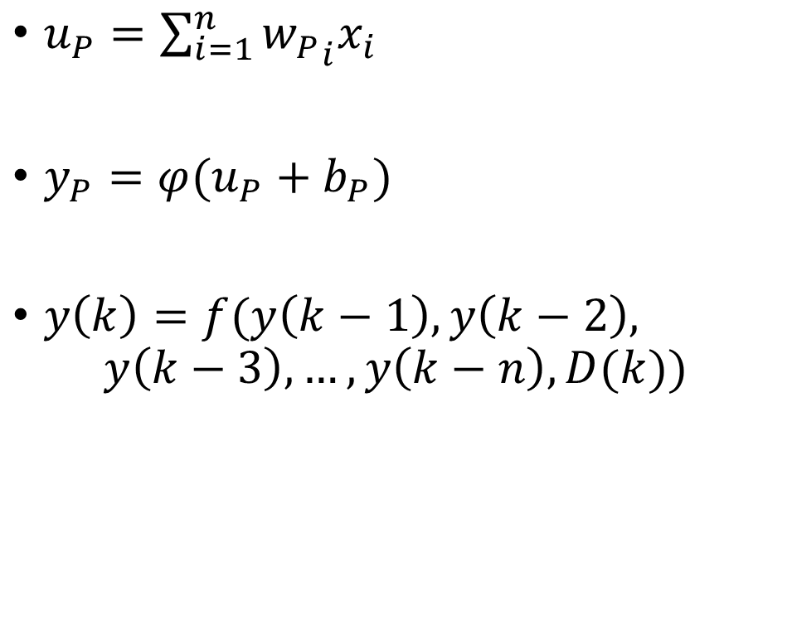
Artificial neural network
$u_{P}=\sum_{i=1}^{n}{{w_{P}}_{i}x_{i}}$
$y_{P}=φ(u_{P}+b_{P})$
$y\left(k\right)=f(y\left(k−1\right),y\left(k−2\right),$
$$y\left(k−3\right),…,y\left(k−n\right),D(k))$$
Notes:
D(k) is the day of week, y(k) is the stock price at time k
輸入是多少?多少個? 輸出是多少個 PRIOR到底是幾天

Slide 4

Predicting NASDAQ index
Determination coefficient : $R^{2}=1−\frac{\sum{{\left(y_{exp.}−y_{pred.}\right)}^{2}}}{\sum{{\left(y_{exp.}−\overline{y}\right)}^{2}}}$
Mean square error : $MSE=\frac{\sum{{\left(y_{pred.}{−y}_{exp.}\right)}^{2}}}{M}$, $M$ is total number of data

Slide 5
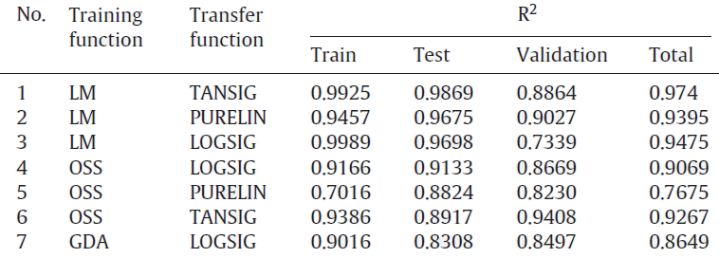
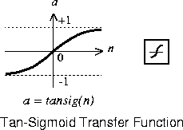
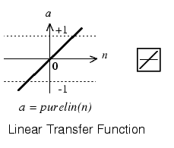
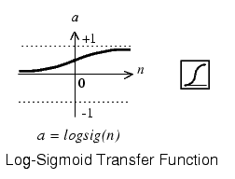
Result
Levenberg-Marquardt (LM)
One Step Secant (OSS)
Gradient Descent with- adaptive learning rate (GDA)

Slide 6
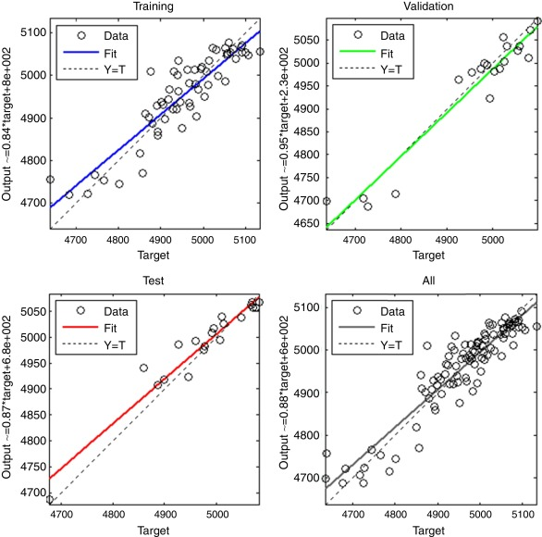

Slide 7
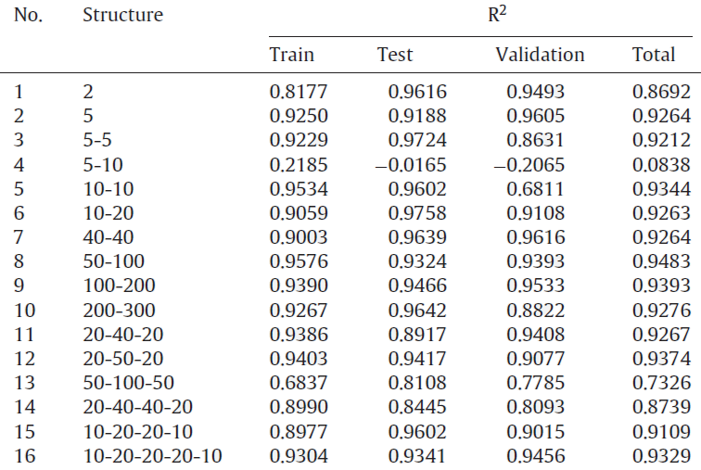
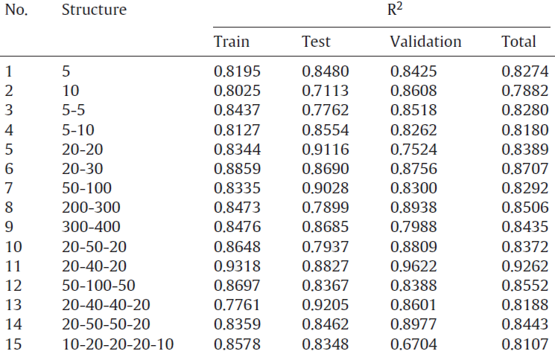
Result
Four prior days
Nine prior days
Notes:
Validation was considered to select the optimized architecture of network

Slide 8
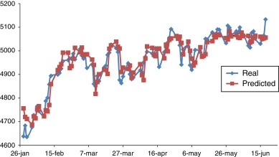
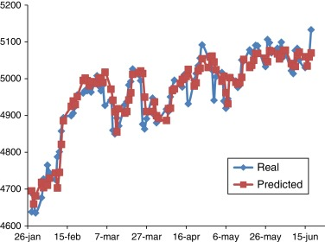
Four prior days
Nine prior days

