Slide 1
Efficient Classification of Long Time Series by 3-D Dynamic Time Warping
Anooshiravan Sharabiani, Houshang Darabi, Ashkan Rezaei, Samuel Harford, Hereford Johnson, and Fazle Karim
IEEE Transactions on Systems, Man, and Cybernetics: Systems
Vol. 47, Oct, 2017, Pages 2688-2703
Presenter: Shan-Ru Liu
Date: 2018/04/10

Slide 2
Abstract (1/2)
Throughout recent years, dynamic time warping (DTW) has remained as a robust similarity measure in time series classification (TSC). 1-nearest neighbor (1-NN) algorithm with DTW is the most widely used classification method on time series serving as a benchmark. With the increasing demand for TSC on low-resource devices and the widespread of wearable devices, the need for a efficient and accurate time series classifier has never been higher. Although 1-NN DTW attains accurate results, it highly falls back on efficiency due to its quadratic complexity in the length of time series. In this paper, we propose a new approximation method for reducing the length of the time series as the input of DTW. We call it control chart approximation (CCA), after a similar concept used in statistical quality control processing.

Slide 3
Abstract (2/2)
CCA representation approximates raw time series by transforming them into a set of segments with aggregated values and durations forming a reduced 3-D vector. We also propose an adaptation of DTW in 3-D space as a distance measure for 1-NN classifier, and denote the method as 1-NN 3-D DTW. Our experiments on 85 datasets from UCR archive—including 28 long-length (>500 points) time series datasets—show up to two orders of magnitude performance gain in running time compared to the state-of-the-art 1-NN DTW implementation. Moreover, it shows similar or better accuracy on the long time series in the experiment.

Slide 4
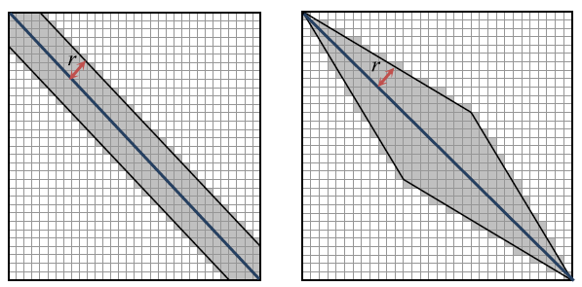
DTW
Global Warping Constraints:
Sakoe-Chiba band, Itakura parallelogram
Lower Bounding:
LB_Kim, LB_Yi, LB_Keogh
Early Abandoning:
Time Series Representation:
Piecewise aggregate approximation (PAA)
Adaptive piecewise constant approximation (APCA)

Slide 5
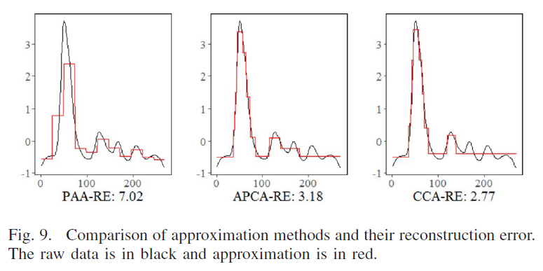
PAA, APCA, CCA

Slide 6
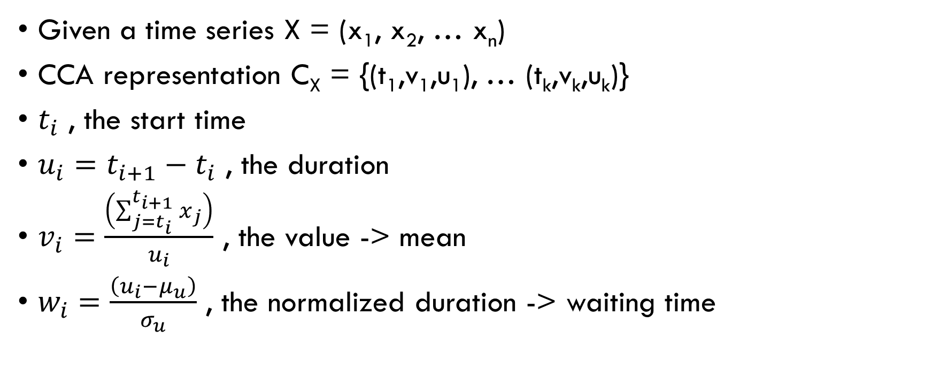
Control Chart Approximation (CCA) (1/5)
Given a time series X = (x₁, x₂, … x_{n})
CCA representation C_{X} = {(t₁,v₁,u₁), … (t_{k},v_{k},u_{k})}
$t_{i}$ , the start time
$u_{i}=t_{i+1}−t_{i}$ , the duration
$v_{i}=\frac{\left(\sum_{j=t_{i}}^{t_{i+1}}{x_{j}}\right)}{u_{i}}$ , the value -> mean
$w_{i}=\frac{\left(u_{i}−μ_{u}\right)}{σ_{u}}$ , the normalized duration -> waiting time

Slide 7
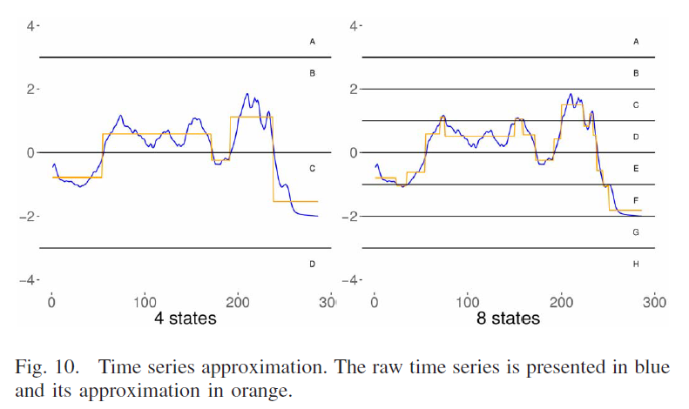
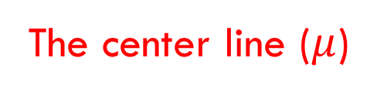
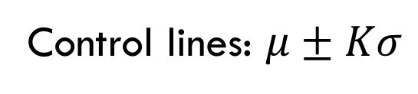
Control Chart Approximation (CCA) (2/5)
Parameter:
K , control limit (default is 3)
S , the distance between control limits
The center line ($μ$)
Control lines: $μ±Kσ$

Slide 8
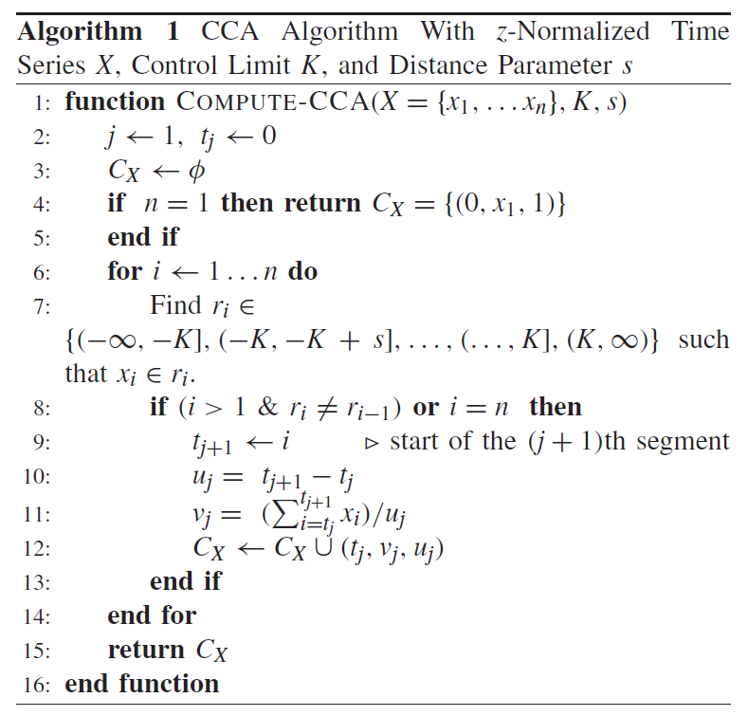
Control Chart Approximation (CCA) (3/5)
The final result of CCA:
Sequential normalized segment values (v)
and waiting times (w)
C_{X} = {(t₁,v₁,w₁), … (t_{k},v_{k},w_{k})}

Slide 9
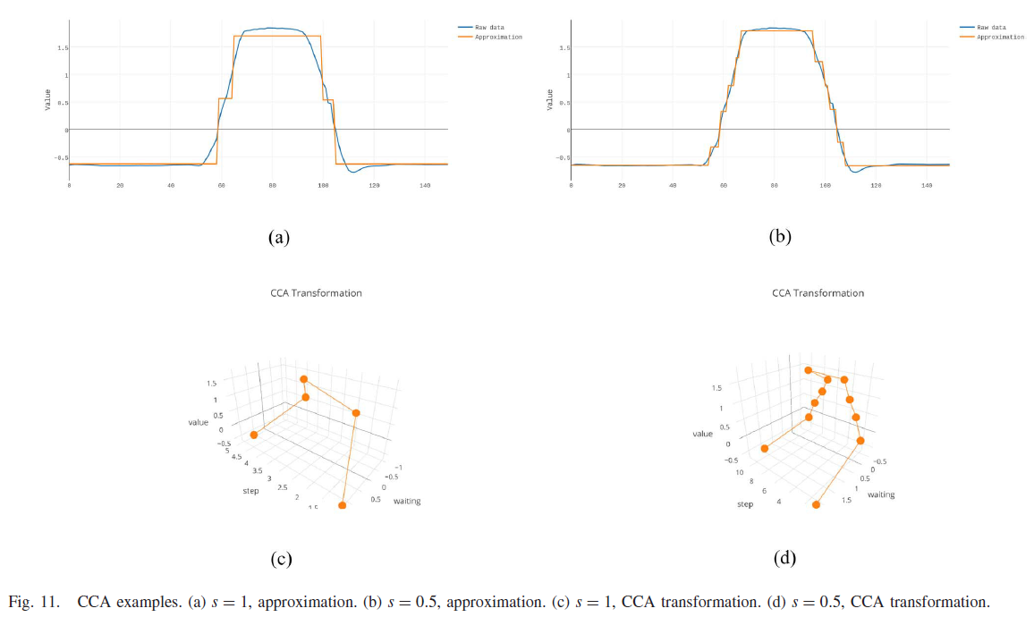
Control Chart Approximation (CCA) (4/5)
S = 1

Slide 10
Control Chart Approximation (CCA) (5/5)
S = 0.5

Slide 11


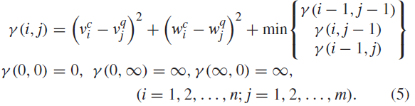
Three-Dimensional DTW Distance (1/3)

Slide 12
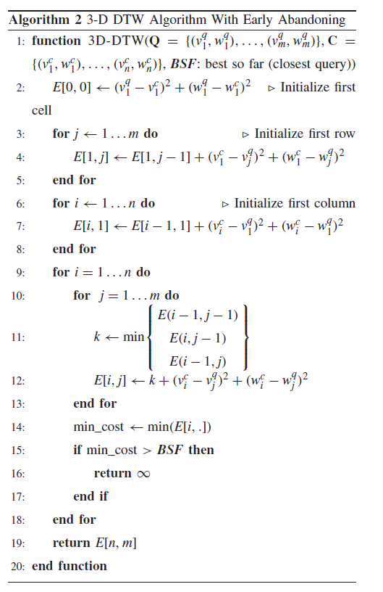
Three-Dimensional DTW Distance (2/3)
Early Abandoning

Slide 13
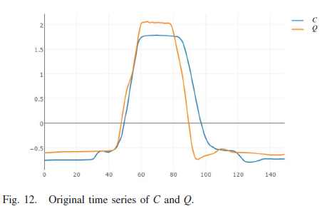
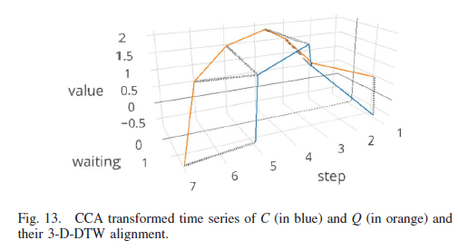
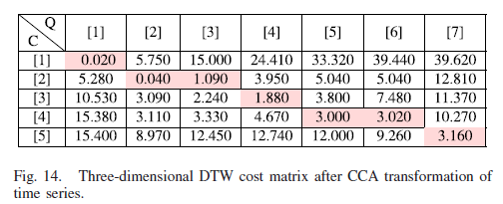
Three-Dimensional DTW Distance (3/3)

Slide 14
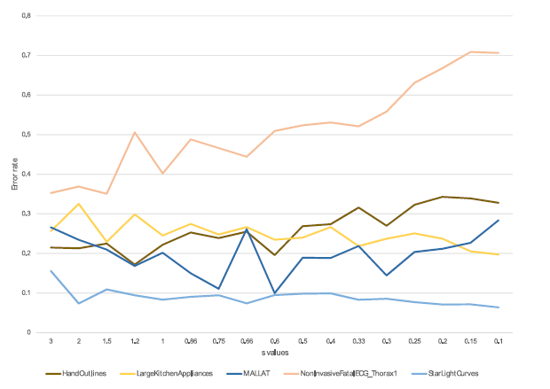
Experimental Result (1/2)
S = 0.6

Slide 15
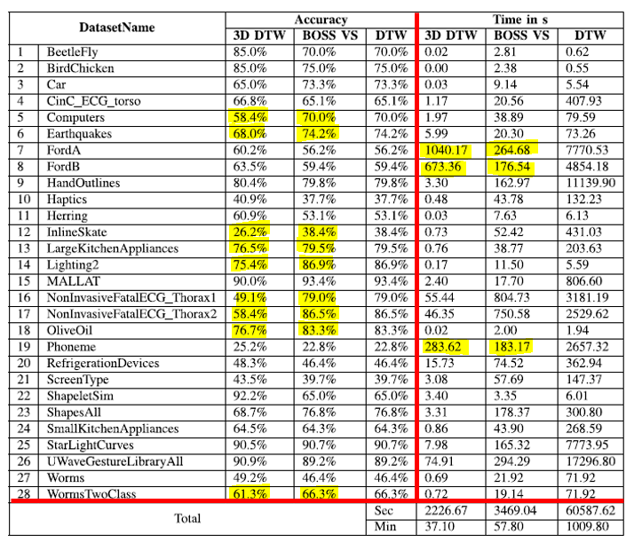
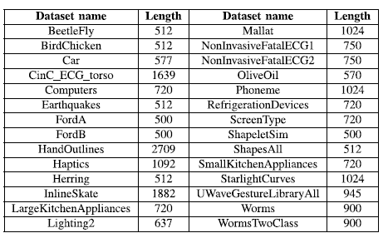
Experimental Result (2/2)

