Slide 1
A faster and more accurate heuristic for cyclic edit distance computation
Lorraine A.K. Ayad , Carl Barton , Solon P. Pissis
Pattern Recognition Letters Volume 88, 1 March 2017, Pages 81-87
Presenter: Tse-Ying Huang
Date: Jan. 21, 2025
1

Slide 2
Abstract
Sequence comparison is the core computation of many applications involving textual representations of data. Edit distance is the most widely used measure to quantify the similarity of two sequences. Edit distance can be defined as the minimal total cost of a sequence of edit operations to transform one sequence into the other; for a sequence x of length m and a sequence y of length n, it can be computed in time O(mn). In many applications, it is common to consider sequences with circular structure: for instance, the orientation of two images or the leftmost position of two linearised circular DNA sequences may be irrelevant. To this end, an algorithm to compute the cyclic edit distance in time O(mn log m) was proposed (Maes, 2003 [18]) and several heuristics have been proposed to speed up this computation. Recently, a new algorithm based on q-grams was proposed for circular sequence comparison (Grossi et al., 2016 [13]). We extend this algorithm for cyclic edit distance computation and show that this new heuristic is faster and more accurate than the state of the art. The aim of this letter is to give visibility to this idea in the pattern recognition community.
2

Slide 3
Stage 1: circular sequence comparison with q-grams
N-Gram | Gq(x) | Gq(y) | Dq(x, y)
AAA | 0 | 0 | 0
AGC | 0 | 1 | 1
AGT | 1 | 0 | 1
CCC | 0 | 0 | 0
CTA | 1 | 1 | 0
GAG | 1 | 0 | 1
GCG | 0 | 1 | 1
GGA | 1 | 0 | 1
GGG | 0 | 0 | 0
GTC | 1 | 0 | 1
TAG | 0 | 1 | 1
TCT | 1 | 1 | 0
TTC | 0 | 1 | 1
TTT | 0 | 0 | 0
X:GGAGTCTA Y:TTCTAGCG
β=2 q=3
X1=GGAG X2=TCTA
Y1=TTCT Y2=AGCG
3
Notes:
該演算法基於為字串 xxy 構造後綴陣列 ，並根據其在後綴陣列中的順序，為每個長度至少為 q 的後綴的長度為 q 的前綴分配一個等級。該演算法找到 x 的旋轉 i，使得 x 和 y 之間的 β 塊 q-gram 距離最小

Slide 4
Stage 1: circular sequence comparison with q-grams
X:GGAGTCTA Y:TTCTAGCG
β=2 q=3
X1=GGAG X2=TCTA
Y1=TTCT Y2=AGCG
N-Gram | Gq(x₁) | Gq(y₁) | Dq(x₁, y₁)
AAA | 0 | 0 | 0
AGC | 0 | 0 | 0
AGT | 0 | 0 | 0
CCC | 0 | 0 | 0
CTA | 0 | 0 | 0
GAG | 1 | 0 | 1
GCG | 0 | 0 | 0
GGA | 1 | 0 | 1
GGG | 0 | 0 | 0
GTC | 0 | 0 | 0
TAG | 0 | 0 | 0
TCT | 0 | 1 | 1
TTC | 0 | 1 | 1
TTT | 0 | 0 | 0
3
Notes:
該演算法基於為字串 xxy 構造後綴陣列 ，並根據其在後綴陣列中的順序，為每個長度至少為 q 的後綴的長度為 q 的前綴分配一個等級。該演算法找到 x 的旋轉 i，使得 x 和 y 之間的 β 塊 q-gram 距離最小

Slide 5
Stage 1: circular sequence comparison with q-grams
N-Gram | Gq(x₂) | Gq(y₂) | Dq(x₂, y₂)
AAA | 0 | 0 | 0
AGC | 0 | 1 | 1
AGT | 0 | 0 | 0
CCC | 0 | 0 | 0
CTA | 1 | 0 | 1
GAG | 0 | 0 | 0
GCG | 0 | 1 | 1
GGA | 0 | 0 | 0
GGG | 0 | 0 | 0
GTC | 0 | 0 | 0
TAG | 0 | 0 | 0
TCT | 1 | 0 | 1
TTC | 0 | 0 | 0
TTT | 0 | 0 | 0
X:GGAGTCTA Y:TTCTAGCG
β=2 q=3
X1=GGAG X2=TCTA
Y1=TTCT Y2=AGCG
D β,q(x,y)=Dq(x1,y1)+Dq(x2,y2)
3
Notes:
該演算法基於為字串 xxy 構造後綴陣列 ，並根據其在後綴陣列中的順序，為每個長度至少為 q 的後綴的長度為 q 的前綴分配一個等級。該演算法找到 x 的旋轉 i，使得 x 和 y 之間的 β 塊 q-gram 距離最小

Slide 6

Stage 1: circular sequence comparison with q-grams
x = GAGTCTA, y = TCTAGCG, q = 3, and z = xxy
x’ length=2m − q + 1
y’ length=n − q + 1
ax:every letter of x′ that does not occur in y′
ay: every letter of y′ that does not occur in x′ .
3
Notes:
該演算法基於為字串 xxy 構造後綴陣列 ，並根據其在後綴陣列中的順序，為每個長度至少為 q 的後綴的長度為 q 的前綴分配一個等級。該演算法找到 x 的旋轉 i，使得 x 和 y 之間的 β 塊 q-gram 距離最小

Slide 7
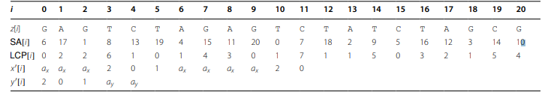
Stage 1: circular sequence comparison with q-grams
x = GAGTCTA, y = TCTAGCG, q = 3, and z = xxy
x’ length=2m − q + 1
y’ length=n − q + 1
ax:every letter of x′ that does not occur in y′
ay: every letter of y′ that does not occur in x′ .
3
Notes:
該演算法基於為字串 xxy 構造後綴陣列 ，並根據其在後綴陣列中的順序，為每個長度至少為 q 的後綴的長度為 q 的前綴分配一個等級。該演算法找到 x 的旋轉 i，使得 x 和 y 之間的 β 塊 q-gram 距離最小

Slide 8
Stage 2: refinement
New input parameter
0<P<= β/3
L=|P*m/β|
β=3 P=1 m=6 L=2
Xi=nabana
y=nabana
X’= L(Xi prefix) + L($) +L(Xi suffix)
Y’=L(Y prefix) + L($) +L(Y suffix)
X’=na$$na
y’=na$$na
score = 4
Xr=na$$na
Notes:
x'會rotation一輪並找到最大的分數為xr

Slide 9
Stage 3: edit distance computation
Myers algorithm runs in time O(⌈mw⌉ n), where w is the word size of the machine.

Slide 10
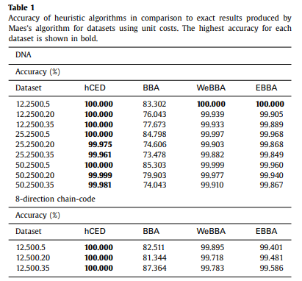
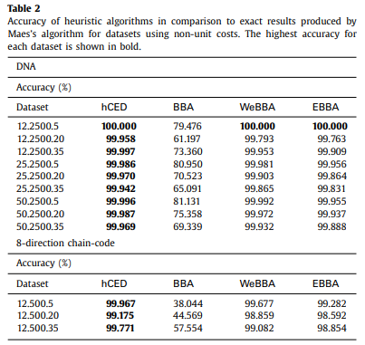
Result

Slide 11
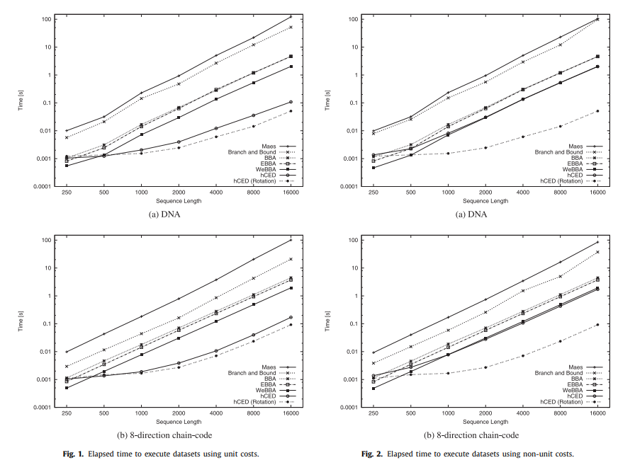
Result

