Slide 1
A data structure for substring-substring LCS length queries
Yoshifumi Sakai
Theoretical Computer Science 911 (2022) 41–54
Presenter: Pei-Chian Lee
Date: Jan. 21, 2025

Slide 2
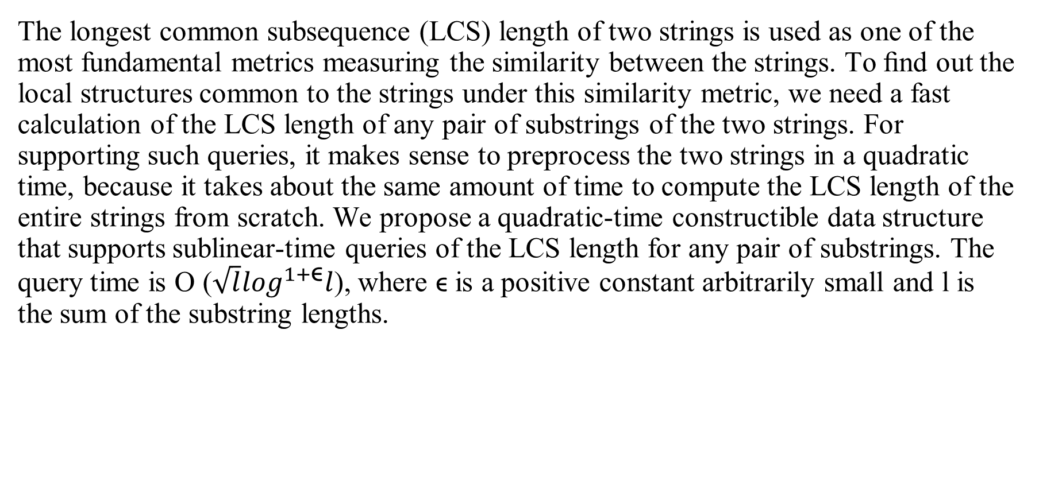
Abstract
The longest common subsequence (LCS) length of two strings is used as one of the most fundamental metrics measuring the similarity between the strings. To ﬁnd out the local structures common to the strings under this similarity metric, we need a fast calculation of the LCS length of any pair of substrings of the two strings. For supporting such queries, it makes sense to preprocess the two strings in a quadratic time, because it takes about the same amount of time to compute the LCS length of the entire strings from scratch. We propose a quadratic-time constructible data structure that supports sublinear-time queries of the LCS length for any pair of substrings. The query time is O ($\sqrt{l}\log^{1+\text{ϵ}}l$), where ϵ is a positive constant arbitrarily small and l is the sum of the substring lengths.

Slide 3
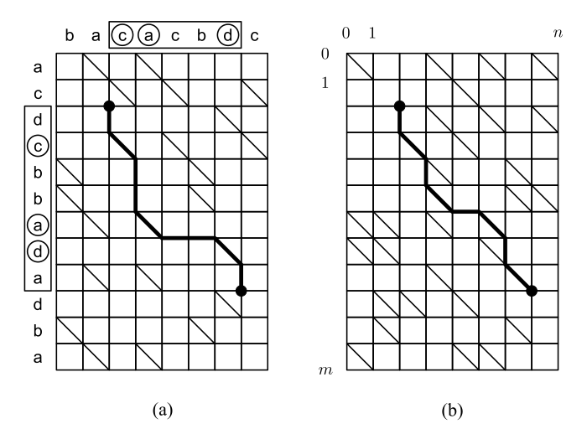
Reducing LCS Length Problem to Shortest Path Computation in a Grid Graph
Notes:
3b

Slide 4
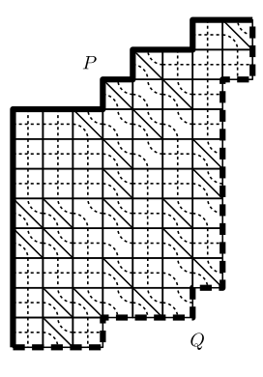
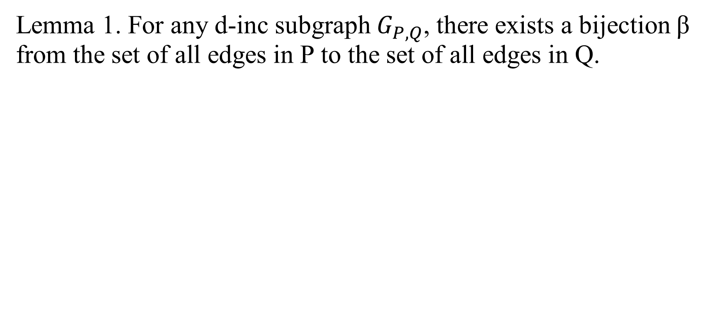
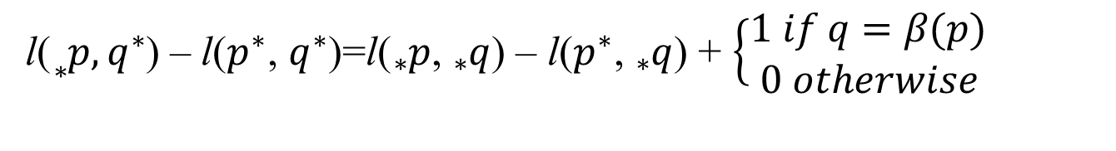
Semi-local LCS length technique of Tiskin
Lemma 1. For any d-inc subgraph $G_{P,Q}$, there exists a bijection β from the set of all edges in P to the set of all edges in Q.
l(${}_{∗}^{}p,q^{∗}$) – l($p^{∗}$, $q^{∗}$)=l(${}_{∗}^{}p$, ${}_{∗}^{}q$) – l($p^{∗}$, ${}_{∗}^{}q$) + $\left\{\begin{aligned}1 if q=β(p) \\ 0 otherwise\end{aligned}\right.$
Notes:
3b

Slide 5
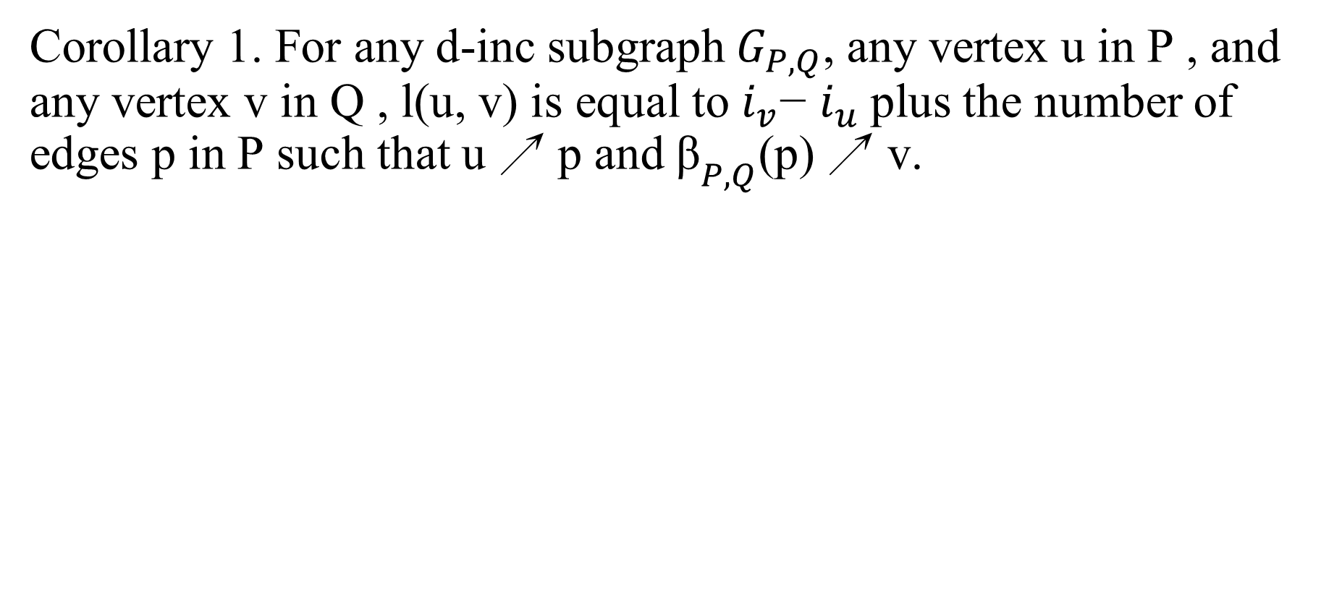
Semi-local LCS length technique of Tiskin
Corollary 1. For any d-inc subgraph $G_{P,Q}$, any vertex u in P , and any vertex v in Q , l(u, v) is equal to $i_{v}$− $i_{u}$plus the number of edges p in P such that u ↗ p and ${\text{β}}_{P,Q}$(p) ↗ v.
Notes:
3b

Slide 6
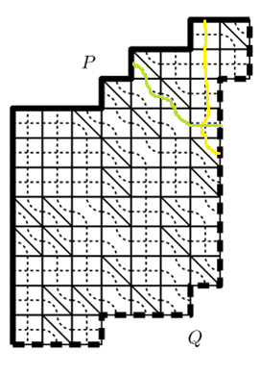

Semi-local LCS length technique of Tiskin
l(u,v)= $i_{v}$− $i_{u}$+ #edges
P such in P such that u ↗ p
and ${\text{β}}_{P,Q}$(p) ↗ v
Notes:
3b

Slide 7
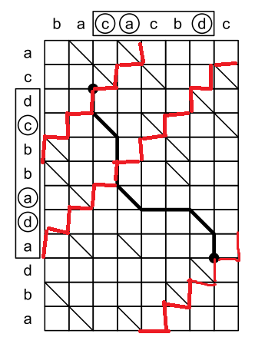

Basic data structure supporting linear-time queries
O(l)-time queries
Let ${\text{a}}_{w}$ denote the even integer
2$\left\lfloor {\text{(}\text{i}}_{w}+{\text{j}}_{w})/2\right\rfloor ,{\text{(}\text{i}}_{w},{\text{j}}_{w})$.
4
8
16
Notes:
3b

Slide 8
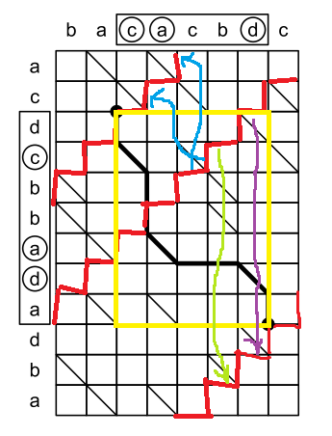
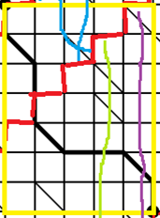

Basic data structure supporting linear-time queries
π= 2
l(u,v)= $i_{v}$− $i_{u}$+ π
= 9 -2 + 2
= 9
Lcs = 7 + 5 - l(u,v)
= 3
Notes:
3b

Slide 9
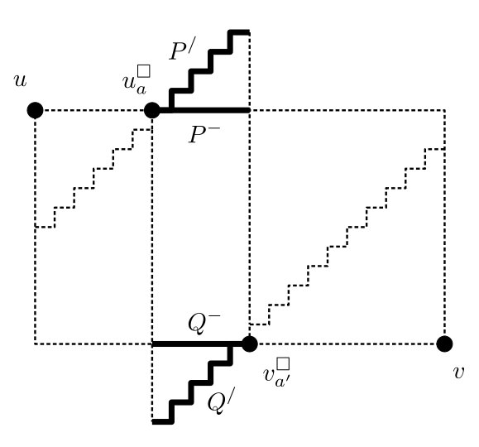
Basic data structure supporting linear-time queries
Notes:
3b

Slide 10
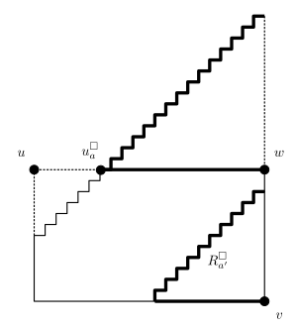
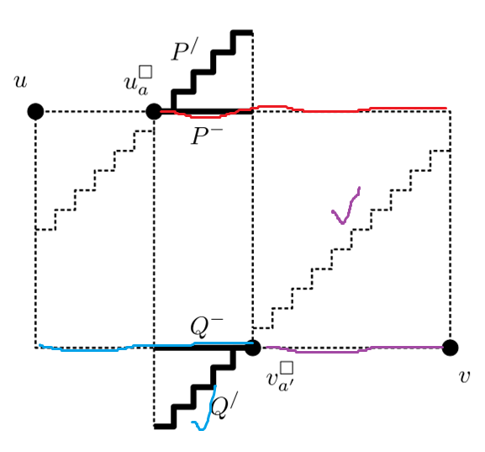
Basic data structure supporting linear-time queries
Notes:
3b

Slide 11
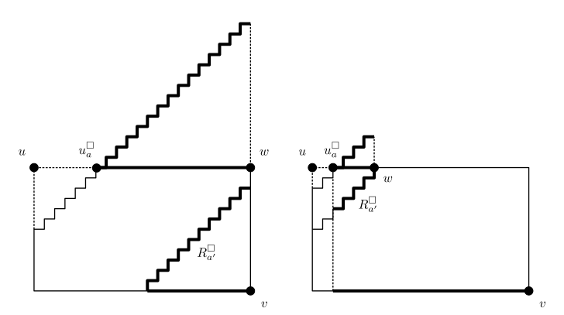

Slide 12
Basic data structure supporting linear-time queries
π= 2
l(u,v)= $i_{v}$− $i_{u}$+ π
= 9 -2 + 2
= 9
Lcs = 7 + 5 - l(u,v)
= 3
Notes:
3b

Slide 13
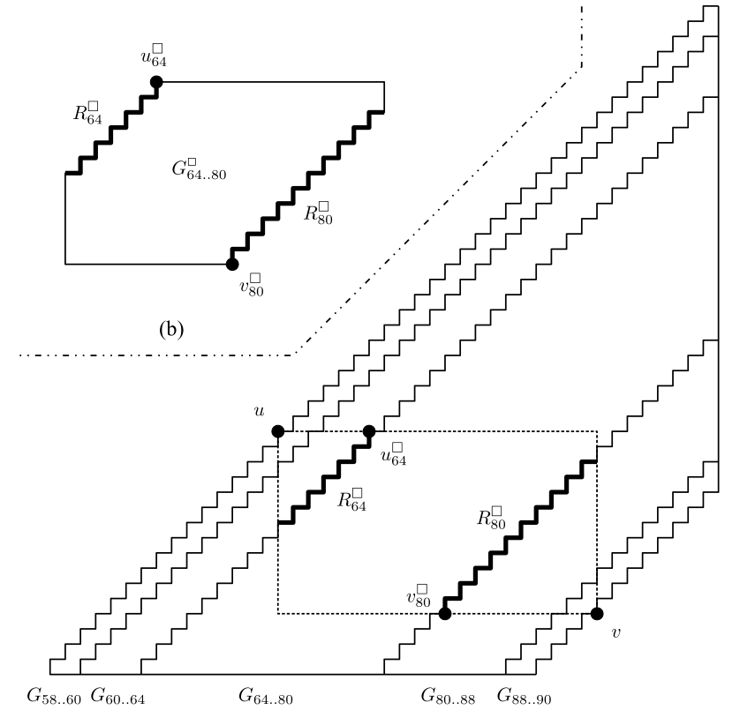
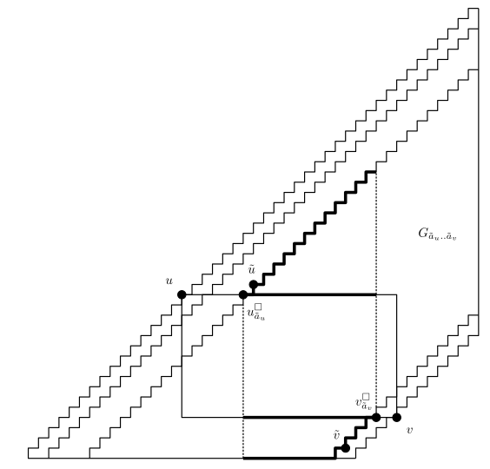
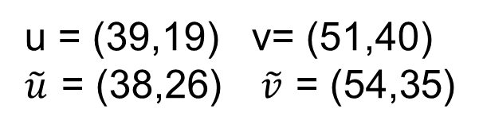
Proposed data structure, supporting fast queries
限制(u,v)-ralated a-strips寬度，達到O ($\sqrt{{\text{a}}_{v}−{\text{a}}_{u}}\log^{1+\text{ϵ}}({\text{a}}_{v}−{\text{a}}_{u}$))
u = (39,19) v= (51,40)
$\tilde{u}$ = (38,26) $\tilde{v}$ = (54,35)
Notes:
Sub
先綠再紅

Slide 14
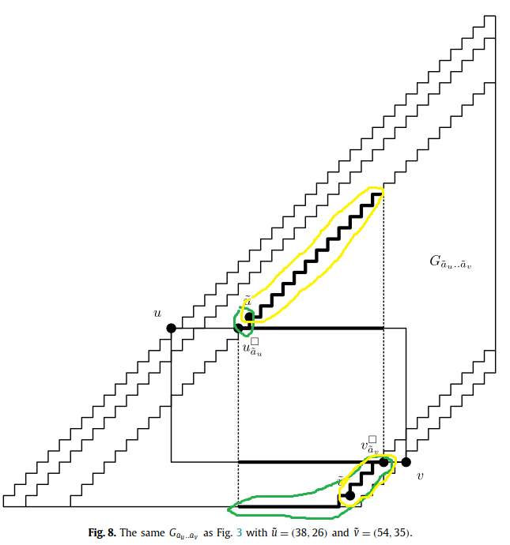
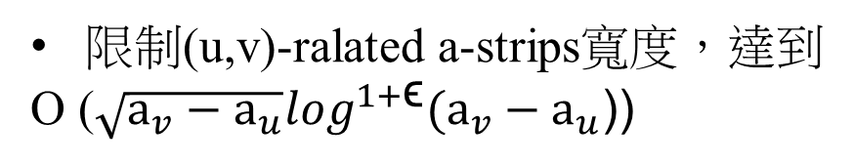
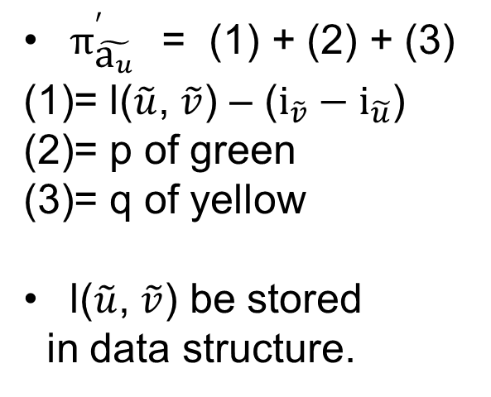
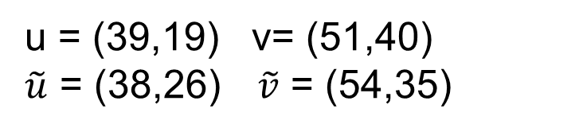
Proposed data structure, supporting fast queries
限制(u,v)-ralated a-strips寬度，達到
O ($\sqrt{{\text{a}}_{v}−{\text{a}}_{u}}\log^{1+\text{ϵ}}({\text{a}}_{v}−{\text{a}}_{u}$))
u = (39,19) v= (51,40)
$\tilde{u}$ = (38,26) $\tilde{v}$ = (54,35)
$π_{\tilde{{\text{a}}_{u}}}^{′}$ = (1) + (2) + (3)
= l($\tilde{u}$, $\tilde{v}$) – (${\text{i}}_{\tilde{v}}−{\text{i}}_{\tilde{u}}$)
= p of green
= q of yellow
l($\tilde{u}$, $\tilde{v}$) be stored
in data structure.
Notes:
Sub
先綠再紅

Slide 15
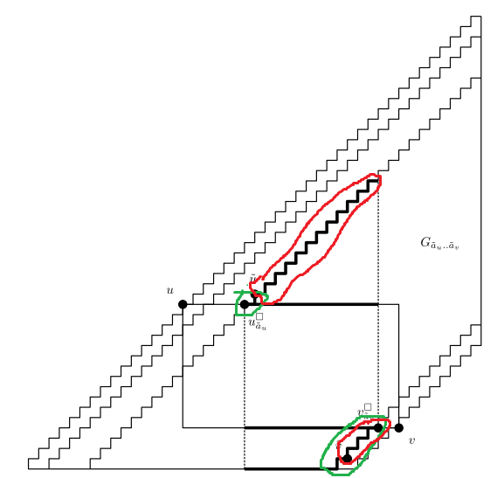
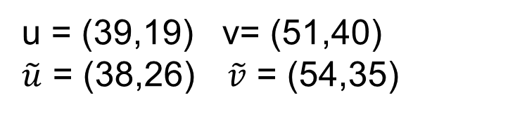
Proposed data structure, supporting fast queries
限制(u,v)-ralated a-strips寬度，達到
O ($\sqrt{{\text{a}}_{v}−{\text{a}}_{u}}\log^{1+\text{ϵ}}({\text{a}}_{v}−{\text{a}}_{u}$))
u = (39,19) v= (51,40)
$\tilde{u}$ = (38,26) $\tilde{v}$ = (54,35)
Notes:
Sub
先綠再紅

Slide 16

Conclusions
Size: O(mn)
Construction time: O(mn)
Query: O($\sqrt{m^{′}+n^{′}}\log^{1+\text{ϵ}}(m^{′}+n′))$
Notes:
Size:O(mn)
construction time:O(mn)
Query:O($\sqrt{m^{′}+n^{′}}\log^{1+\text{ϵ}}(m^{′}+n′))$

