Slide 1
A dynamic threshold decision system for stock trading signal detection
Chang, P. C., Liao, T. W., Lin, J. J., & Fan, C. Y. (2011)
Applied soft computing, 11(5), 3998-4010.
Presenter : Jing-Xiang Yang
Date : Feb. 11, 2025

Slide 2
ABSTRACT
Trading signal detection has become a very popular research topic in the financial investment area. This paper develops a model using the Piecewise Linear Representations (PLR) and Artificial Neural Networks (ANNs) to analyze the nonlinear relationships between the stock closed price and various technical indexes, and uncovering the knowledge of trading signals hidden in historical data. Piecewise Linear Representation tools are applied to find the best stock turning points (trading signals) based on the historical data. These turning points represent short-term trading signals for selling or buying stocks from the market. This study further applies an Artificial Neural Network model to learn the connection weights from these historical turning points, and afterwards, an exponential smoothing-based dynamic threshold model is used to forecast the future trading signals. The stock trading signal is predicted using the neural network on a daily basis. The dynamic threshold bounds generated provide a guide for triggering a buy or sell decision when the ANN-predicted trading signal goes above or under the threshold bounds.Through a series of experiments, this research shows superior results than our previous research (Chang et al., 2009 [1]) and other benchmark researches.

Slide 3
Contribution
Exponential smoothing-based dynamic threshold as a filter for ANN-predicted output to produce better trading signals.
buy
ANN
signal
Filter
trigger
sell
Exponential smoothing
hold

Slide 4
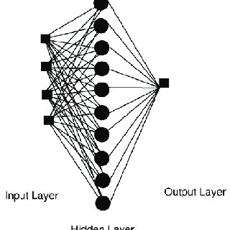
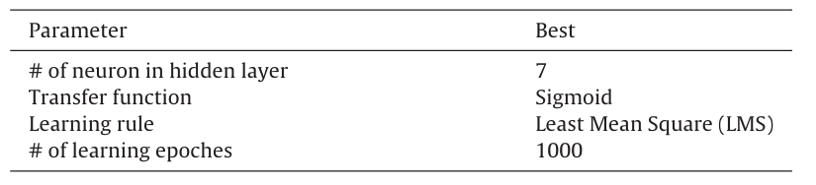
Model Training
Regression ANN

Slide 5
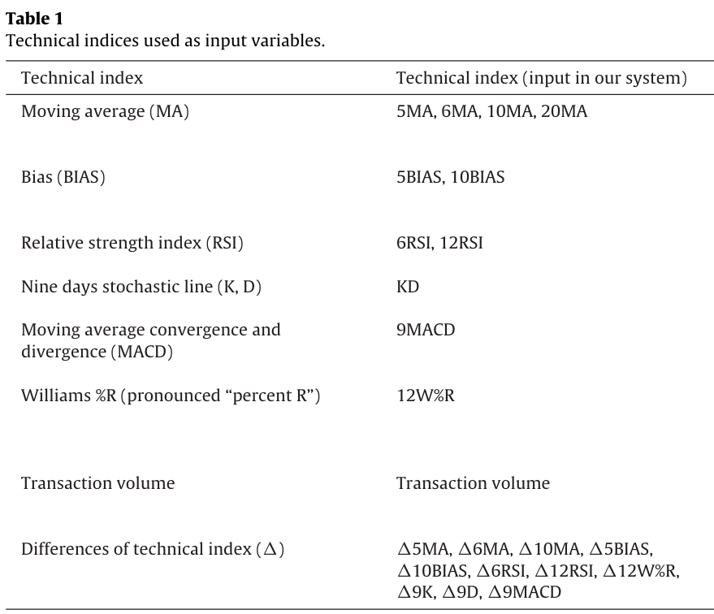
Feature

Slide 6
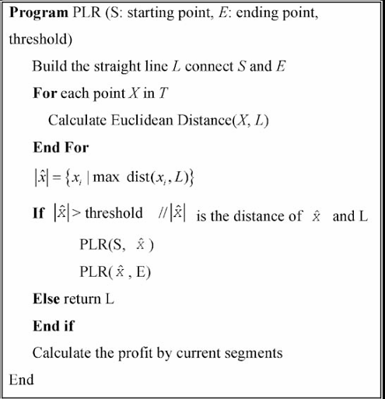
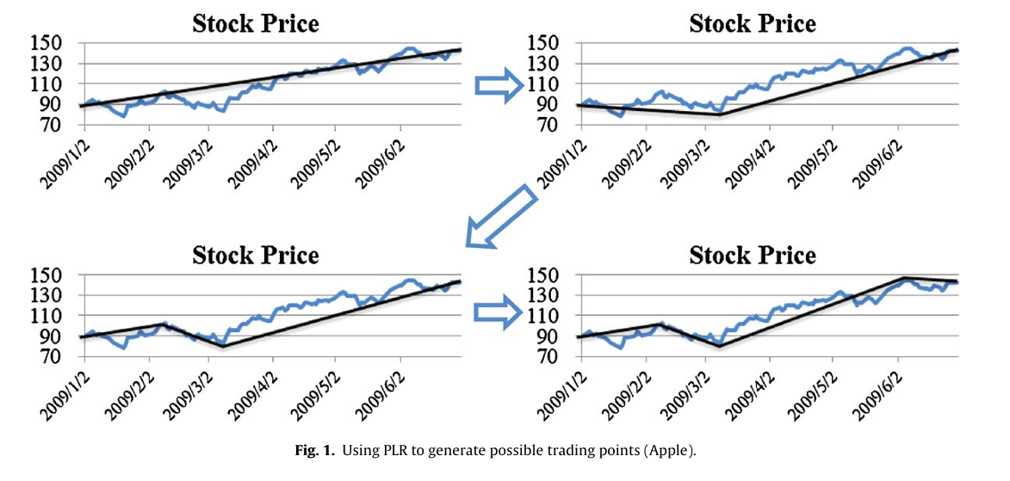
Labeling Method
Piecewise Linear Representations (PLR)
Larger will create long trend patterns

Slide 7
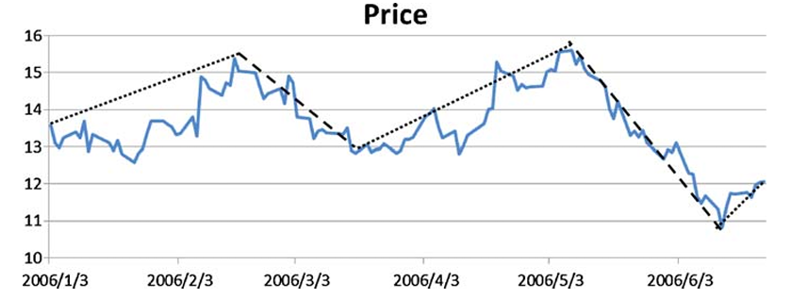
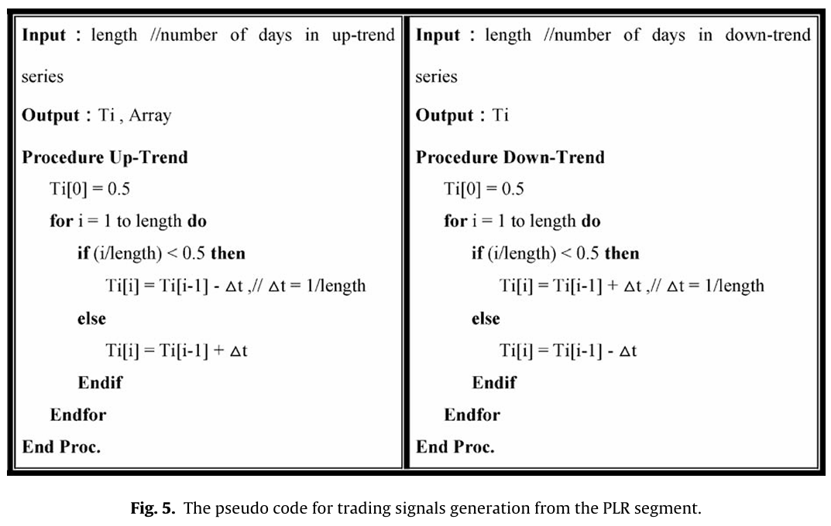
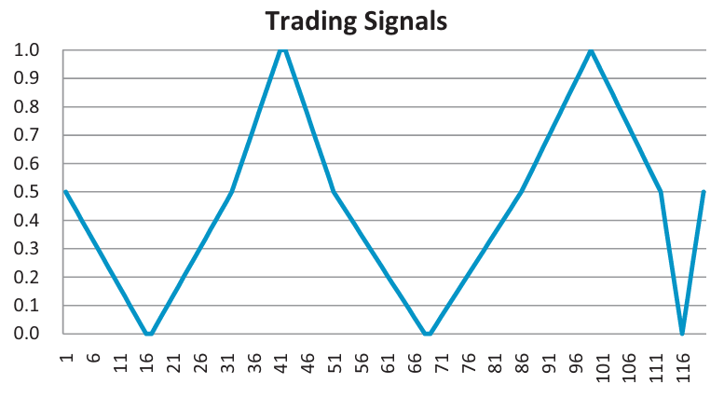
Labeling Method
Generate trading signals from PLR

Slide 8
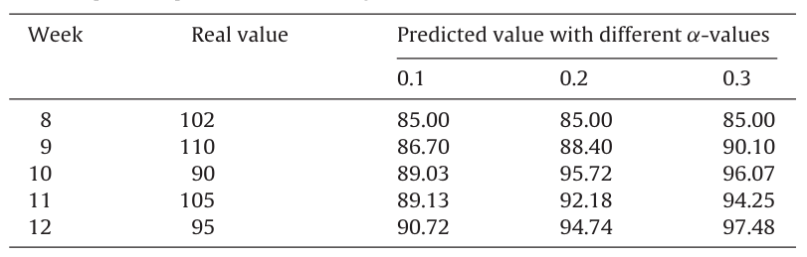
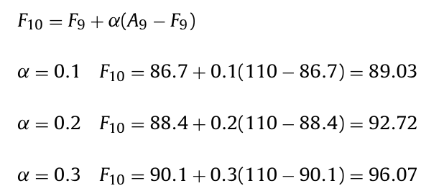
Dynamic threshold bounds
Use Exponential Smoothing
Predict Value
Actual Value

Slide 9
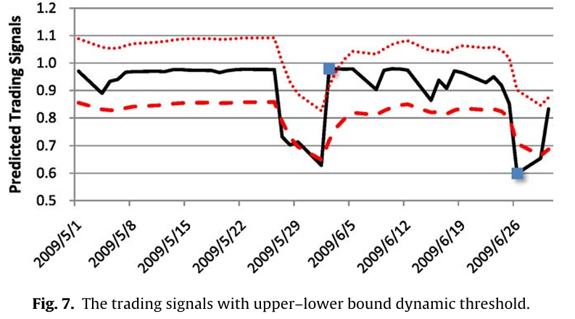
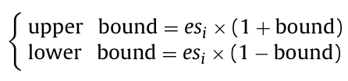
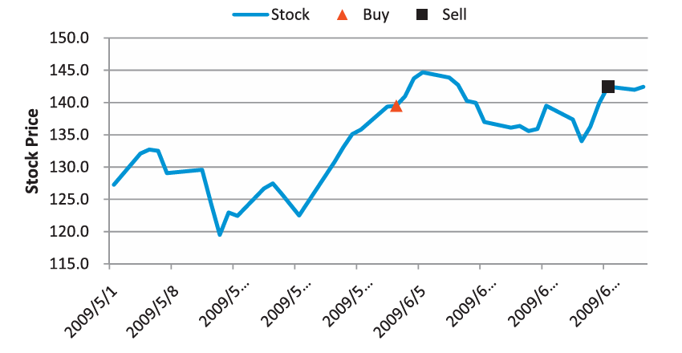
Dynamic threshold bounds
Notes:
ES 估計得出的上下限本身配合 ES 已經可以有初步策略

Slide 10
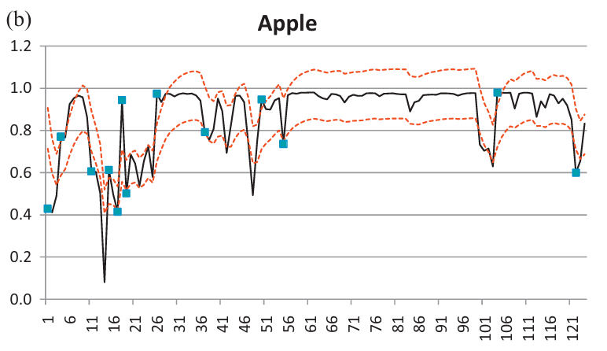
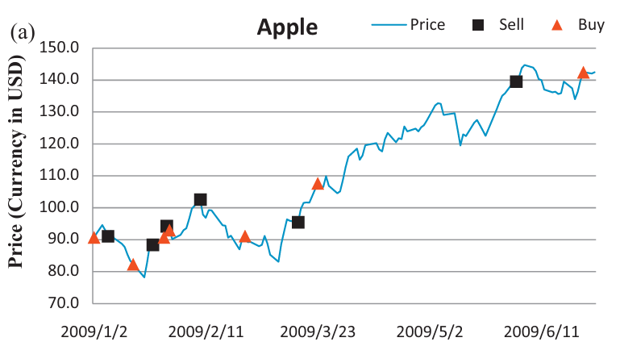
ANN + Dynamic threshold bounds
ANN Predict
Notes:
保留由ES建構出來的 bound 中間預測的部分改成 ANN 的輸出

Slide 11
Experiment
Training Period
Testing Period
Apple | 2008/01/02 to 2008/12/30 | 2009/1/2to2009/6/30
Boeing Aerospace | 2008/01/02 to 2008/12/30 | 2009/1/2 to 2009/6/30
Verizon Communications | 2008/01/02 to 2008/12/30 | 2009/1/2 to 2009/6/30
Training Period
Testing Period
AUO | 2006/1/2 to 2008/10/14 | 2008/10/15 to 2009/4/9
EPISTAR | 2006/1/2 to 2008/10/14 | 2008/10/15 to 2009/4/9
UMC | 2006/1/2 to 2008/10/14 | 2008/10/15 to 2009/4/9

Slide 12
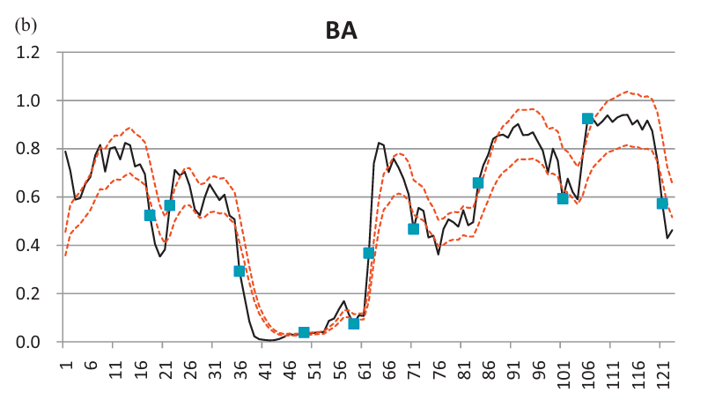
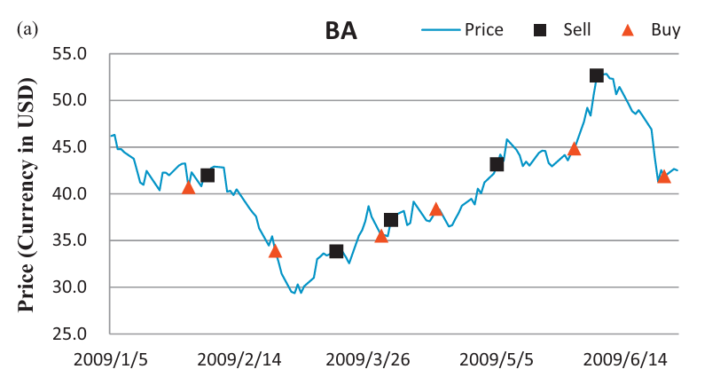
Experiment

Slide 13
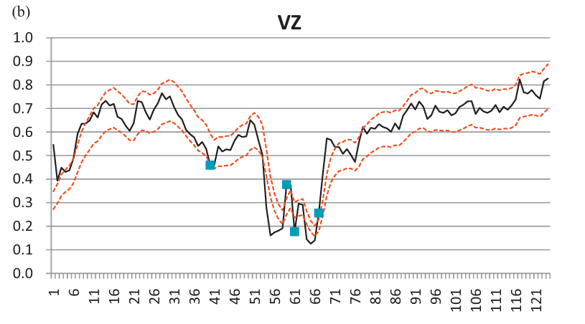
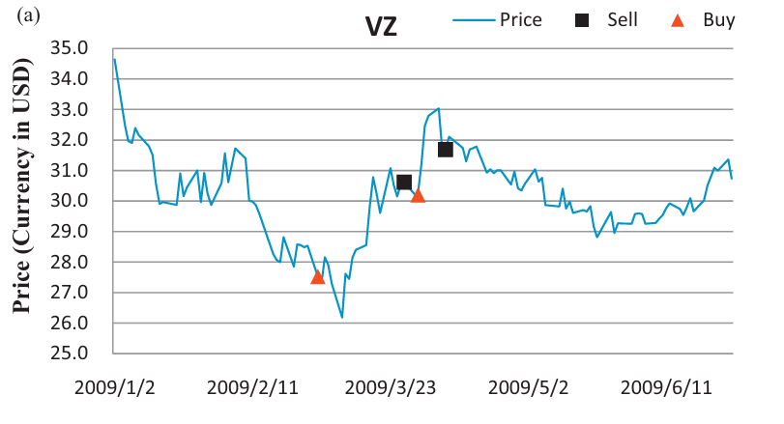
Experiment

Slide 14
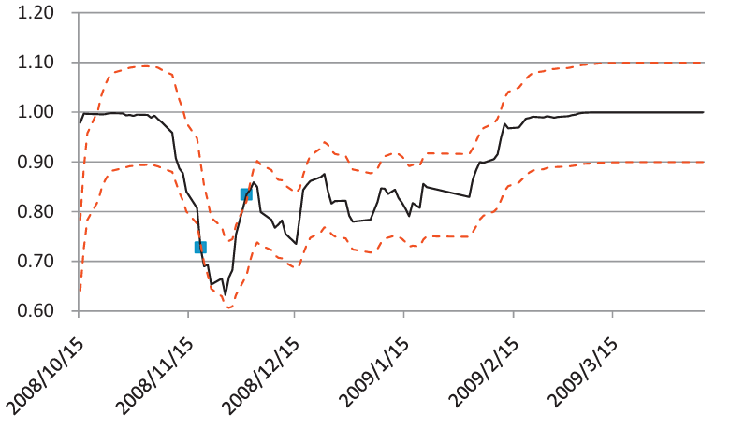
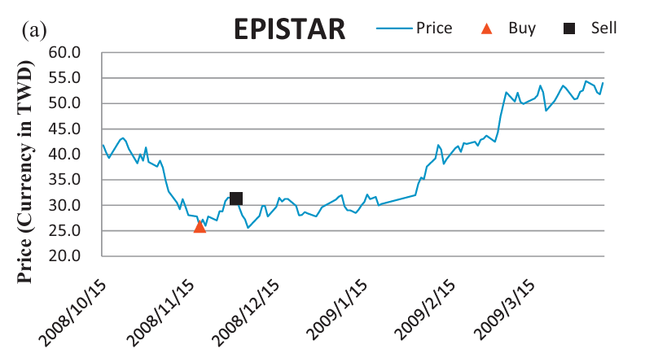
Experiment

Slide 15
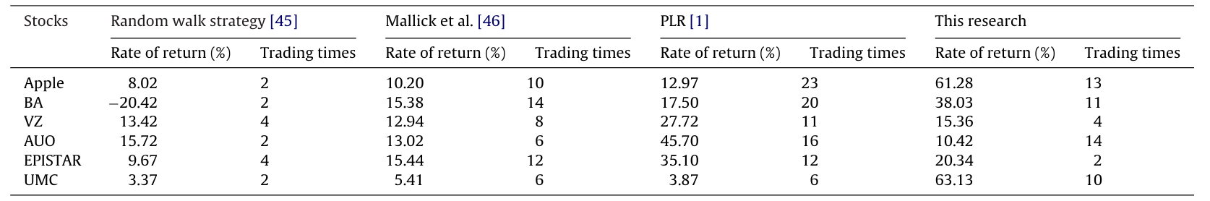
Experiment

Slide 16
A hyperparameter optimization framework
Optuna

Slide 17
Thanks

