Slide 1
SUFFIX ARRAYS: A NEW METHOD FOR ON-LINE STRING SEARCHES
Udi Manber, Gene Myers
SIAM J. COMPUT.
Vol. 22, No. 5, pp. 935-948, October 1993
Presenter: Yi-Sheng Chen
Date: Feb. 25, 2025

Slide 2
Abstract(1/2)
A new and conceptually simple data structure, called a suffix array, for on-line string searches is introduced in this paper. Constructing and querying suffix arrays is reduced to a sort and search paradigm that employs novel algorithms. The main advantage of suffix arrays over suffix trees is that, in practice, they use three to five times less space. From a complexity standpoint, suffix arrays permit on-line string searches of the type, "Is W a substring of A?" to be answered in time O(P + log N), where P is the length of W and N is the length of A, which is competitive with (and in some cases slightly better than) suffix trees.

Slide 3
Abstract (2/2)
The only drawback is that in those instances where the underlying alphabet is finite and small, suffix trees can be constructed in O (N) time in the worst case, versus O (N log N) time for suffix arrays. However, an augmented algorithm is given that, regardless of the alphabet size, constructs suffix arrays in O (N) expected time, albeit with lesser space efficiency. It is believed that suffix arrays will prove to be better in practice than suffix trees for many applications.

Slide 4
Suffix Array
S=“banana$”, Suffix Array =
7 | 6 | 4 | 2 | 1 | 5 | 3
S1 | banana$
S2 | anana$
S3 | nana$
S4 | ana$
S5 | na$
S6 | a$
S7 | $
S7 | $
S6 | a$
S4 | ana$
S2 | anana$
S1 | banana$
S5 | na$
S3 | nana$
lexicographical order

Slide 5
Longest Common Prefix
S=“banana$”, Suffix Array =
LCP =
7 | 6 | 4 | 2 | 1 | 5 | 3
0 | 1 | 3 | 0 | 0 | 2
SA[i] | substring | SA[i-1] | substring | Common Prefix | LCP(SA[i], SA[i-1])
7 | $
6 | a$ | 7 | $ |  | 0
4 | ana$ | 6 | a$ | a | 1
2 | anana$ | 4 | ana$ | ana | 3
1 | banana$ | 2 | anana$ |  | 0
5 | na$ | 1 | banana$ |  | 0
3 | nana$ | 5 | na$ | na | 2

Slide 6
Binary search W in A with lcp
Initial :
l = lcp (SArray[0], W) =0
r = lcp (Sarray[N-1], W) =2
L=0, R=6, M=3
S7 | $
S6 | a$
S4 | ana$
S2 | anana$
S1 | banana$
S5 | na$
S3 | nana$
If W=“ana”, A=“banana$”
Iterate | 0 | 1 | 2 | 3
l | 0 | 0 | 1 | 1
r | 0 | 3 | 3 | 3
L | 0 | 0 | 1 | 1
R | 6 | 3 | 3 | 2
M | 3 | 1 | 2
→ Lw

Slide 7
S7 | $
S6 | a$
S4 | ana$
S2 | anana$
S1 | banana$
S5 | na$
S3 | nana$
W= ana
0
1
2
3
4
5
6
7 | 6 | 4 | 2 | 1 | 5 | 3
L
M
R
Iterate | 0 | 1 | 2 | 3
l | 0
r | 0
m | 3

Slide 8
S7 | $
S6 | a$
S4 | ana$
S2 | anana$
S1 | banana$
S5 | na$
S3 | nana$
W= ana
0
1
2
3
7 | 6 | 4 | 2
L
M
R
Iterate | 0 | 1 | 2 | 3
l | 0 | 0
r | 0 | 3
m | 3 | 1

Slide 9
S7 | $
S6 | a$
S4 | ana$
S2 | anana$
S1 | banana$
S5 | na$
S3 | nana$
W= ana
1
2
3
6 | 4 | 2
L
M
R
Iterate | 0 | 1 | 2 | 3
l | 0 | 0 | 1
r | 0 | 3 | 3
m | 3 | 1 | 3
L_W = R = 2

Slide 10
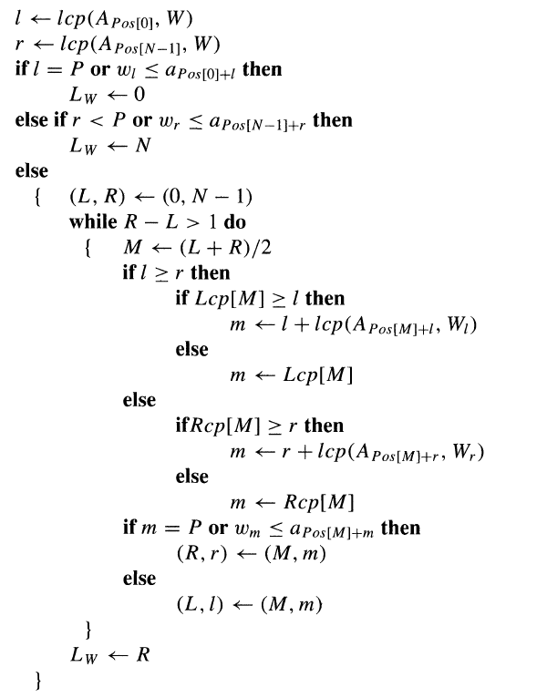
Algorithm(Lw)

Slide 11
Improvement
Time complexity:
O(PlogN) (only binary search)→ O(P+logN) (with the lcp information)
since each comparison either halves the searching range, or consumes one letter in W.

Slide 12
H-buckets
An H-Bucket store the set of suffixes, where the lcp value of these suffixes is at least H.
The sorting is accomplished by constructing 1-buckets, 2-buckets, 4-buckets,…, 2^{logn}-buckets. (This takes O(logN) stages)

Slide 13
H-buckets
1-buckets
S1 | banana$
S2 | anana$
S3 | nana$
S4 | ana$
S5 | na$
S6 | a$
S7 | $
S0 | banana
S1 | anana
S2 | nana
S3 | ana
S4 | na
S5 | a
$
a
b
n
7 | 2, 4, 6 | 1 | 3, 5

Slide 14
1-buckets
$
a
b
n
7 | 2, 4, 6 | 1 | 3, 5
2-buckets
a
b
n
a
an
ba
na
6 |  | 1 | 3, 5
a
b
n
a
an
ba
na
6
6 | 2 | 1 | 3, 5
a
ba
n
a
an
ba
na
6 |  | 1
6 | 2, 4 | 1 | 3, 5
▪
▪
▪
a
ba
na
4, 8,… 2^{logn}-buckets
6 |  | 1 | 3
7 | 6 | 4 | 2 | 1 | 5 | 3

Slide 15
Time complexity
Total O(logN) stages and each takes O(N) time to complete → Time complexity O(NlogN)

Slide 16
Lcp
Suffix Array
S7 | $
S6 | a$
S4 | ana$
S2 | anana$
S1 | banana$
S5 | na$
S3 | nana$
7 | 6 | 4 | 2 | 1 | 5 | 3
Lcp
(computed during the sorting)
- | 0 | 1 | 3 | 0 | 0 | 2

Slide 17
Computing lcp
$
a
b
n
1-buckets
$ | 1, 3, 5 | 0 | 2, 4
- | 0 |  |  | 0 | 0
a
an
ba
na
2-buckets
$ | 5 | 1, 3 | 0 | 2, 4
- | 0 | 1 |  | 0 | 0

Slide 18
Non-adjacent lcp
Suffix Array
S7 | $
S6 | a$
S4 | ana$
S2 | anana$
S1 | banana$
S5 | na$
S3 | nana$
7 | 6 | 4 | 2 | 1 | 5 | 3
Lcp
(computed during the sorting)
- | 0 | 1 | 3 | 0 | 0 | 2
lcp(S6, S2) = 1, min{1, 3} = 1
lcp(S4, S3) = 1, min{3, 0, 0, 2} = 0

Slide 19
Interval Tree
lcp(S6, S2) = 1, min{1, 3} = 1
0
Constructed:O(N)
Find the smallest element in given interval :O(logN).
0
0
1
0
0 | 1 | 3 | 0 | 0 | 2

Slide 20
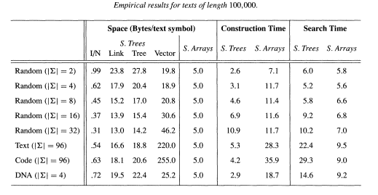
Conclusion

Slide 21
Thanks

