Slide 1
Simple Linear Work Suﬃx Array Construction
Juha Karkkainen and Peter Sanders
Proceedings of the 30th international conference on Automata, languages and programming. pp. 943–955, 2003.
Presenter: Pei-Chian Lee
Date: Feb. 25, 2025

Slide 2
Abstract
A suﬃx array represents the suﬃxes of a string in sorted order. Being a simpler and more compact alternative to suﬃx trees, it is an important tool for full text indexing and other string processing tasks. We introduce the skew algorithm for suﬃx array construction over integer alphabets that can be implemented to run in linear time using
integer sorting as its only nontrivial subroutine:
1. recursively sort suﬃxes beginning at positions i mod 3 = 0.
2. sort the remaining suﬃxes using the information obtained in step one.
3. merge the two sorted sequences obtained in steps one and two.
The algorithm is much simpler than previous linear time algorithms that are all based on the more complicated suﬃx tree data structure.Since sorting is a well studied problem, we obtain optimal algorithms for several other models of computation, e.g. external memory with parallel disks, cache oblivious, and parallel. The adaptations for BSP and EREW-PRAM are asymptotically faster than the best previously known
algorithms.

Slide 3
Suffix Array
s = mississippi
10:i
7:ippi
4:issippi
1:ississippi
0:mississippi
9:pi
8:ppi
6:sippi
3:sissippi
5:ssipi
2:ssissippi
SA = {10,7,4,1,0,9,8,6,3,5,2}
Notes:
Suffix（字尾） 指的是一個字串的某個子串，這個子串從某個位置開始直到字串的末尾。

Slide 4
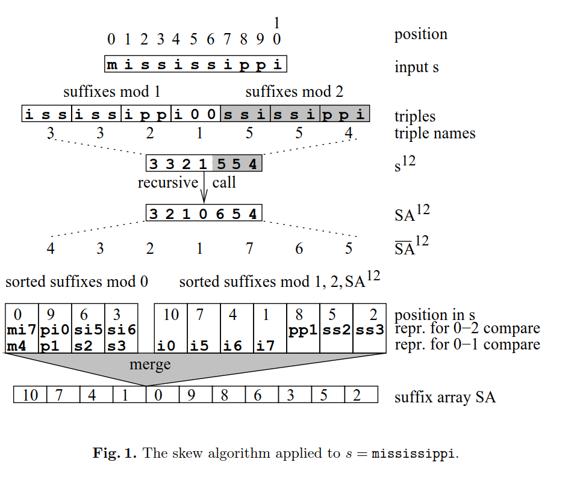
The Skew Algorithm
recursively sort suﬃxes beginning at positions i mod 3 ≠ 0.
sort the remaining suﬃxes using the information obtained in step one.
merge the two sorted sequences obtained in steps one and two.
Notes:
3b

Slide 5
The Skew Algorithm…..Step 1
recursively sort suﬃxes beginning
at positions i mod 3 ≠ 0.
radix sort
Notes:
3b

Slide 6
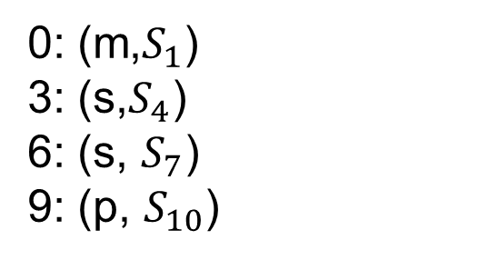
The Skew Algorithm…..Step 2
2. sort the remaining suﬃxes using the information obtained in step one.
radix sort
0: (m,$S_{1}$)
3: (s,$S_{4}$)
6: (s, $S_{7}$)
9: (p, $S_{10}$)
Notes:
3b

Slide 7
The Skew Algorithm…..Step 3
3. merge the two sorted sequences obtained in steps one and two.
Notes:
3b

Slide 8
The Skew Algorithm…..Step 3
3. merge the two sorted sequences obtained in steps one and two.
Notes:
3b

Slide 9
The Skew Algorithm…..Step 3
3. merge the two sorted sequences obtained in steps one and two.
Notes:
3b

Slide 10
The Skew Algorithm…..Step 3
3. merge the two sorted sequences obtained in steps one and two.
Notes:
3b

Slide 11
The Skew Algorithm…..Step 3
3. merge the two sorted sequences obtained in steps one and two.
Notes:
3b

Slide 12
The Skew Algorithm…..Step 3
3. merge the two sorted sequences obtained in steps one and two.
Notes:
3b

Slide 13
The Skew Algorithm…..Step 3
3. merge the two sorted sequences obtained in steps one and two.
Notes:
3b

Slide 14
The Skew Algorithm…..Step 3
3. merge the two sorted sequences obtained in steps one and two.
Notes:
3b

Slide 15
The Skew Algorithm…..Step 3
3. merge the two sorted sequences obtained in steps one and two.
Notes:
3b

Slide 16
The Skew Algorithm…..Step 3
3. merge the two sorted sequences obtained in steps one and two.
Notes:
3b

Slide 17
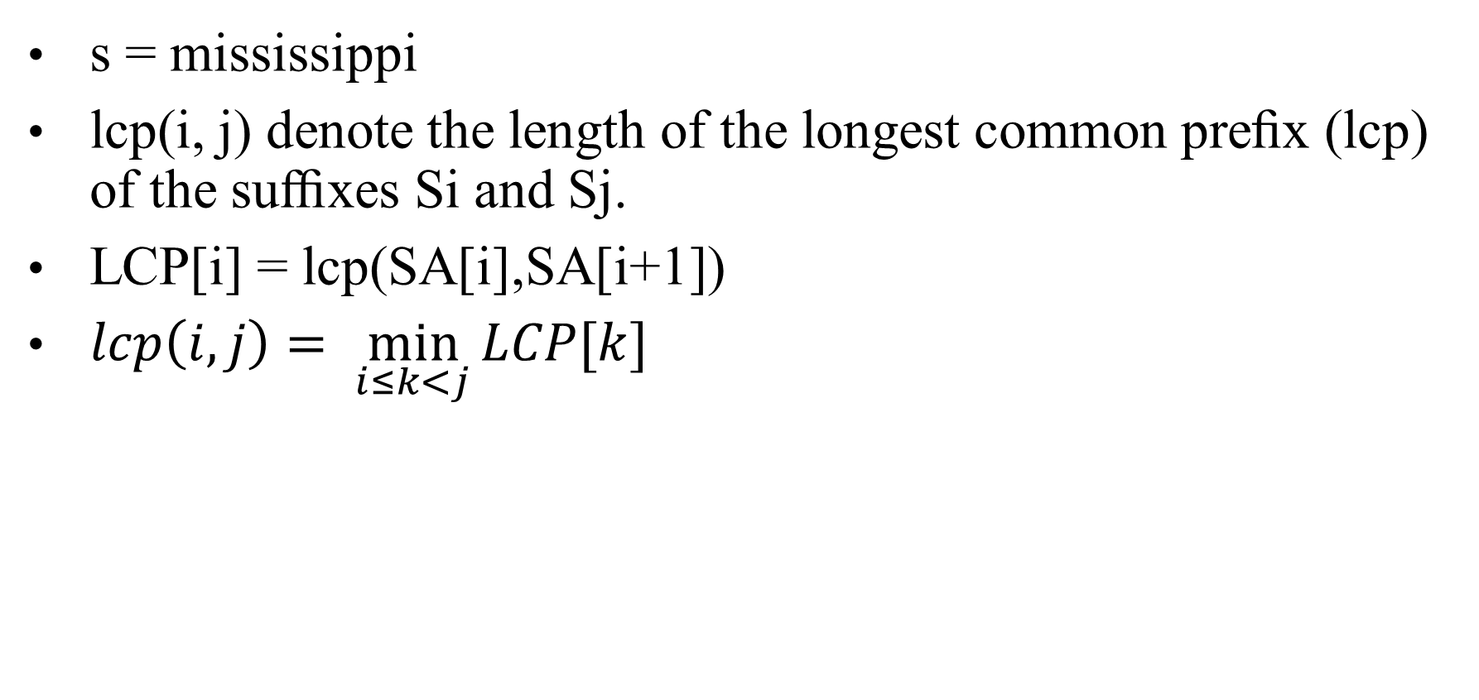
Longest Common Prefix
s = mississippi
lcp(i, j) denote the length of the longest common preﬁx (lcp) of the suﬃxes Si and Sj.
LCP[i] = lcp(SA[i],SA[i+1])
$lcp\left(i,j\right)= \min_{i≤k<j}{LCP[k]}$
10:i
7:ippi
4:issippi
1:ississippi
0:mississippi
9:pi
8:ppi
6:sippi
3:sissippi
5:ssipi
2:ssissippi
SA = {10,7,4,1,0,9,8,6,3,5,2}
Notes:
LCP 是用來表示兩個字尾（suffixes）從開頭開始相同的最長部分。
LCP 陣列（LCP Array） 則是記錄字尾陣列（Suffix Array, SA）中相鄰兩個字尾的 LCP 值。 若 SA[i] 和 SA[i+1] 是字尾陣列中的兩個相鄰字尾，則：
LCP[i]=lcp(SA[i],SA[i+1])LCP[i] = lcp(SA[i], SA[i+1])LCP[i]=lcp(SA[i],SA[i+1])

Slide 18
Longest Common Prefix
LCP¹² = [0,0,1,0,0,1,0 ]
LCP = [1,1,4,0,0,1,0,2,1,3,0]
Notes:
3b

Slide 19
Time Complexity
O(n)
Notes:
3b

