Slide 1
Internal Pattern Matching Queries in a Text and Applications
Tomasz Kociumaka, Jakub Radoszewski, Wojciech Rytter and Tomasz Waleń
SIAM Journal on Computing (2024), 53(5), 1524-1577.
Presenter: Hsin-Chang Yu
Date: Feb. 25, 2025

Slide 2
Abstract
We consider several types of internal queries, that is, questions about fragments of a given text T specified in constant space by their locations in T. Our main result is an optimal data structure for internal pattern matching (IPM) queries, which, given two fragments x and y, ask for a representation of all fragments contained in y and matching x exactly. This problem can be viewed as an internal version of the fundamental exact pattern matching problem: We are looking for exact occurrences of one substring of T within another substring of T.

Slide 3
Abstract
Our data structure answers IPM queries in time proportional to the quotient |y|/|x| of fragments‘ lengths, which is required due to the worst-case information content of the output. If T is a text of length n over an integer alphabet of size σ, then our data structure occupies O(n/log_{σ}n) machine words (that is, O(nlogσ) bits) and admits an O(n/log_{σ}n)-time construction algorithm. We also show how to use IPM queries for answering internal queries corresponding to other classic string processing problems.

Slide 4
Abstract
Among others, we derive optimal data structures reporting the periods of a fragment and testing the cyclic equivalence of two fragments. Since the publication of the conference version of this paper [Kociumaka et al., Internal pattern matching queries in a text and applications, SODA 2015], IPM queries have found numerous further applications, following the path paved by the classic longest common extension (LCE) queries of Landau and Vishkin [J. Comput. System Sci., 37 (1988), pp. 63-78].

Slide 5
Abstract
In particular, IPM queries have been implemented in grammar-compressed and dynamic settings and, along with LCE queries, constitute elementary operations of the PILLAR model, developed by Charalampopoulos, Kociumaka, and Wellnitz [Faster approximate pattern matching: A unified approach, FOCS 2020] to design approximate pattern matching algorithms that work in multiple settings. All our algorithms are deterministic, whereas the data structure in the conference version of the paper only admits a randomized construction in O(n) expected time.

Slide 6
Abstract
To achieve this, we provide a novel construction of string synchronizing sets of Kempa and Kociumaka [String synchronizing sets: Sublinear-time BWT construction and optimal LCE data structure, STOC 2019]. Our method, based on a new restricted version of the recompression technique of Jeż [J. ACM, 63 (2016), pp. 4:1-4:51], yields a hierarchy of O(logn) string synchronizing sets covering the whole spectrum of the fragments' lengths.

Slide 7

看不懂

Slide 8
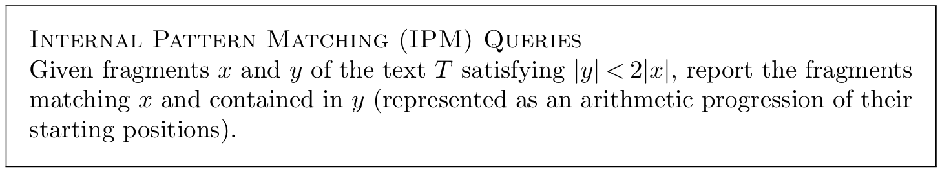
Internal Pattern Matching (IPM) Queries

Slide 9
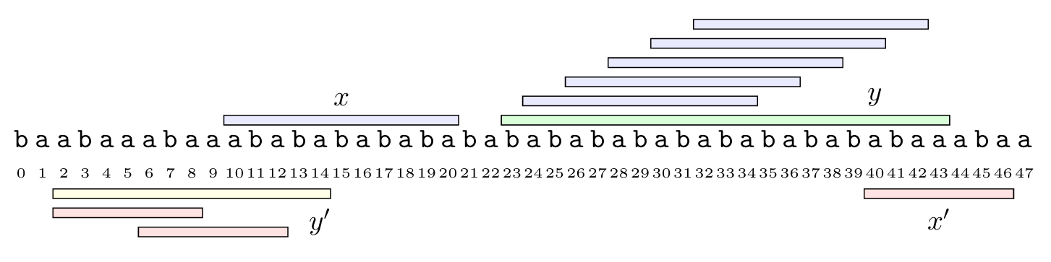
Internal Pattern Matching (IPM) Queries

Slide 10
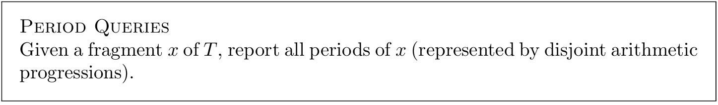
Period Queries

Slide 11
Period Queries
T = abbabbabbabb
Period 2 abb
Period 4 abbabb

Slide 12
2-Period Queries
T = abbabbabbabb
2-Period abb

Slide 13
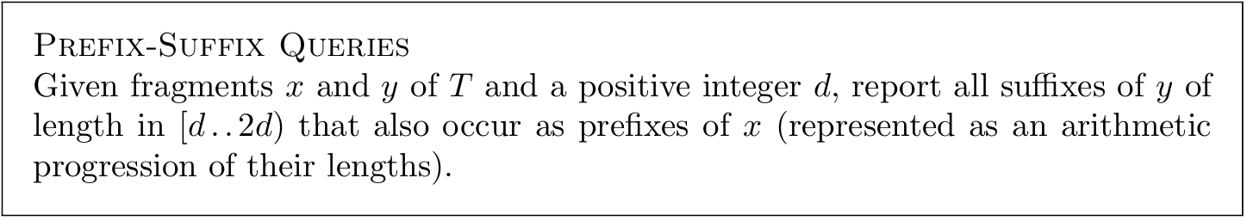
Prefix-Suffix Queries

Slide 14
Prefix-Suffix Queries
x = abababababa
y = bababababababbabababa
Answers: abababa

Slide 15
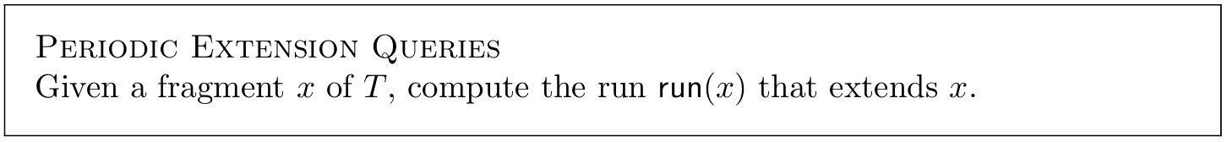
Periodic Extension Queries

Slide 16
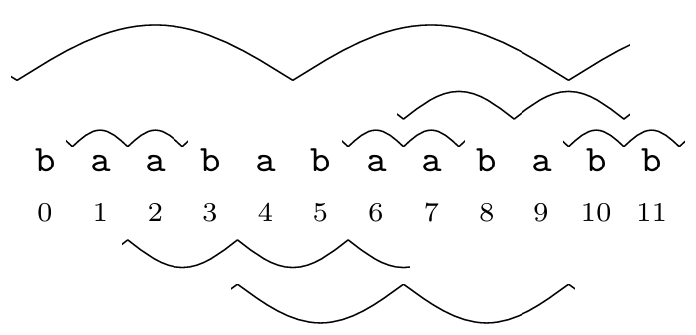
Periodic Extension Queries

Slide 17
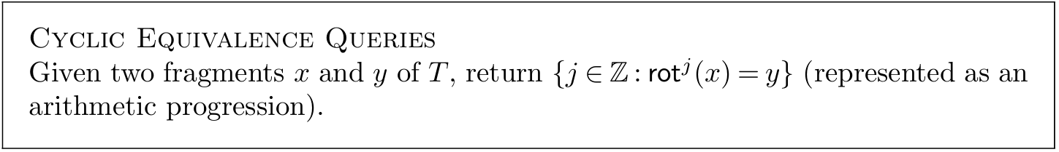
Cyclic Equivalence Queries
rot¹
abababababa aababababab

Slide 18
Cyclic Equivalence Queries
x = ababababab
y = bababababa

Slide 19
Thanks
Notes:
Given a string S of length n, an integer p ∈ [1..n] is a period of S if S[i] = S[i + p] for all i ∈ [1..n − p].
S[|S| − p + 1] = c

