Slide 1
Space-Efficient Algorithms for Longest Increasing Subsequence
I-Hsuan Yang, Chien-Pin Huang, and Kun-Mao Chao
Information Processing Letters, 2005, 93.5: 249-253.
Presenter: Shih-Hong Lee
Date: Mar. 19, 2025
Notes:
楊宜軒
黃建斌
趙坤茂

Slide 2
Abstract
Given a sequence of integers, we want to find a longest increasing subsequence of the sequence. It is known that this problem can be solved in O(n log n) time and space. Our goal in this paper is to reduce the space consumption while keeping the time complexity small. For √ n ≤ s ≤ n, we present algorithms that use O(s log n) bits and O( 1/s · n ² · log n) time for computing the length of a longest increasing subsequence, and O(1/s · n ² · log² n) time for finding an actual subsequence. We also show that the time complexity of our algorithms is optimal up to polylogarithmic factors in the framework of sequential access algorithms with the prescribed amount of space.

Slide 3
Longest Increasing Subsequence
Given a sequence A = <1,5,3,7,6>
LIS of A = <1,3,6>, <1,5,7>, <1,5,6>

Slide 4
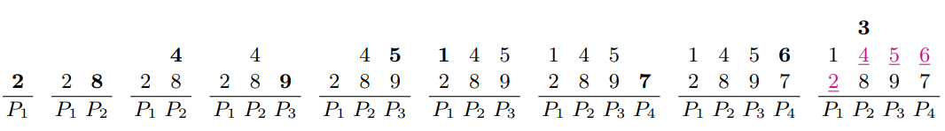
Patience Sorting
Given a sequence A = <2, 8, 4, 9, 5, 1, 7, 6, 3>
LIS(A) = 4

Slide 5
Time & Space Complexity
Time: O(nlogn)
Space: O(nlogn) bits of working space

Slide 6
Observation

Slide 7
A simple O(n)-bits algorithm
Given a sequence A = <2, 8, 4, 9, 5, 1, 7, 6, 3>
element | 2 | 8 | 4 | 9 | 5 | 1 | 7 | 6 | 3
used | 1 | 0 | 0 | 0 | 0 | 1 | 0 | 0 | 0
1
2
P₁ | P₂ | P₃ | P₄

Slide 8
A simple O(n)-bits algorithm
Given a sequence A = <2, 8, 4, 9, 5, 1, 7, 6, 3>
element | 2 | 8 | 4 | 9 | 5 | 1 | 7 | 6 | 3
used | 1 | 1 | 1 | 0 | 0 | 1 | 0 | 0 | 1
 | 3
1 | 4
2 | 8
P₁ | P₂ | P₃ | P₄

Slide 9
A simple O(n)-bits algorithm
Given a sequence A = <2, 8, 4, 9, 5, 1, 7, 6, 3>
element | 2 | 8 | 4 | 9 | 5 | 1 | 7 | 6 | 3
used | 1 | 1 | 1 | 1 | 1 | 1 | 0 | 0 | 1
 | 3
1 | 4 | 5
2 | 8 | 9
P₁ | P₂ | P₃ | P₄

Slide 10
A simple O(n)-bits algorithm
Given a sequence A = <2, 8, 4, 9, 5, 1, 7, 6, 3>
element | 2 | 8 | 4 | 9 | 5 | 1 | 7 | 6 | 3
used | 1 | 1 | 1 | 1 | 1 | 1 | 1 | 1 | 1
 | 3
1 | 4 | 5 | 6
2 | 8 | 9 | 7
P₁ | P₂ | P₃ | P₄

Slide 11
Time & Space complexity
Time: O(n²)
Space: O(nlogn) bits for working space

Slide 12
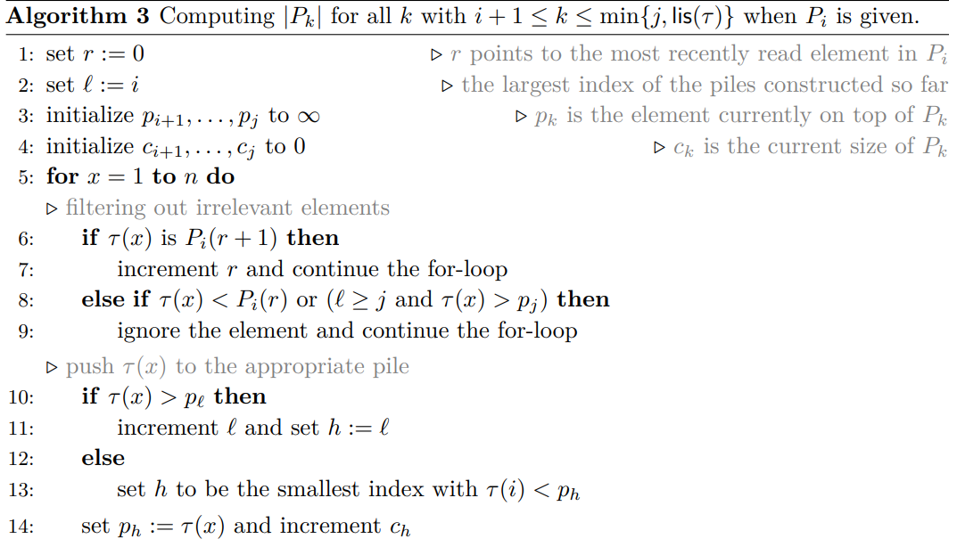
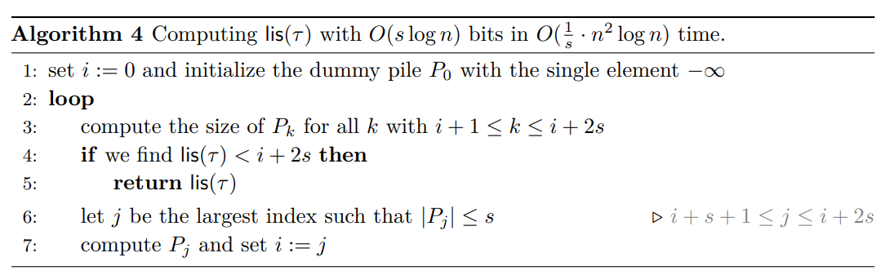
Main Algorithm for computing LIS length
Given an integer s satisfying n^{1/2} <= s <= n
It scans over the input O(n/s) times

Slide 13
γ = < 2, 6, 4, 7, 5, 1, 8, 9, 3, 10, 11, 12, 13, 14, 17>
p₁ to p_{1+2s} = p₉
2
P₁ | P₂ | P₃ | P₄ | P₅ | P₆ | P₇ | P₈ | P₉

Slide 14
γ = < 2, 6, 4, 7, 5, 1, 8, 9, 3, 10, 11, 12, 13, 14, 17>
p₁ to p_{1+2s} = p₉
2 | 6
P₁ | P₂ | P₃ | P₄ | P₅ | P₆ | P₇ | P₈ | P₉

Slide 15
γ = < 2, 6, 4, 7, 5, 1, 8, 9, 3, 10, 11, 12, 13, 14, 17>
p₁ to p_{1+2s} = p₉
 | 4
2 | 6
P₁ | P₂ | P₃ | P₄ | P₅ | P₆ | P₇ | P₈ | P₉

Slide 16
γ = < 2, 6, 4, 7, 5, 1, 8, 9, 3, 10, 11, 12, 13, 14, 17>
p₁ to p_{1+2s} = p₉
 | 4
2 | 6 | 7
P₁ | P₂ | P₃ | P₄ | P₅ | P₆ | P₇ | P₈ | P₉

Slide 17
γ = < 2, 6, 4, 7, 5, 1, 8, 9, 3, 10, 11, 12, 13, 14, 17>
p₁ to p_{1+2s} = p₉
 | 4 | 5
2 | 6 | 7
P₁ | P₂ | P₃ | P₄ | P₅ | P₆ | P₇ | P₈ | P₉

Slide 18
γ = < 2, 6, 4, 7, 5, 1, 8, 9, 3, 10, 11, 12, 13, 14, 17>
p₁ to p_{1+2s} = p₉
ignore because 2 > 1
 | 4 | 5
2 | 6 | 7
P₁ | P₂ | P₃ | P₄ | P₅ | P₆ | P₇ | P₈ | P₉

Slide 19
γ = < 2, 6, 4, 7, 5, 1, 8, 9, 3, 10, 11, 12, 13, 14, 17>
p₁ to p_{1+2s} = p₉
 | 4 | 5
2 | 6 | 7 | 8
P₁ | P₂ | P₃ | P₄ | P₅ | P₆ | P₇ | P₈ | P₉

Slide 20
γ = < 2, 6, 4, 7, 5, 1, 8, 9, 3, 10, 11, 12, 13, 14, 17>
p₁ to p_{1+2s} = p₉
 | 4 | 5
2 | 6 | 7 | 8 | 9
P₁ | P₂ | P₃ | P₄ | P₅ | P₆ | P₇ | P₈ | P₉

Slide 21
γ = < 2, 6, 4, 7, 5, 1, 8, 9, 3, 10, 11, 12, 13, 14, 17>
p₁ to p_{1+2s} = p₉
 | 3
 | 4 | 5
2 | 6 | 7 | 8 | 9
P₁ | P₂ | P₃ | P₄ | P₅ | P₆ | P₇ | P₈ | P₉

Slide 22
γ = < 2, 6, 4, 7, 5, 1, 8, 9, 3, 10, 11, 12, 13, 14, 17>
p₁ to p_{1+2s} = p₉
 | 3
 | 4 | 5
2 | 6 | 7 | 8 | 9 | 10
P₁ | P₂ | P₃ | P₄ | P₅ | P₆ | P₇ | P₈ | P₉

Slide 23
γ = < 2, 6, 4, 7, 5, 1, 8, 9, 3, 10, 11, 12, 13, 14, 17>
p₁ to p_{1+2s} = p₉
 | 3
 | 4 | 5
2 | 6 | 7 | 8 | 9 | 10 | 11
P₁ | P₂ | P₃ | P₄ | P₅ | P₆ | P₇ | P₈ | P₉

Slide 24
γ = < 2, 6, 4, 7, 5, 1, 8, 9, 3, 10, 11, 12, 13, 14, 17>
p₁ to p_{1+2s} = p₉
 | 3
 | 4 | 5
2 | 6 | 7 | 8 | 9 | 10 | 11 | 12
P₁ | P₂ | P₃ | P₄ | P₅ | P₆ | P₇ | P₈ | P₉

Slide 25
γ = < 2, 6, 4, 7, 5, 1, 8, 9, 3, 10, 11, 12, 13, 14, 17>
p₁ to p_{1+2s} = p₉
 | 3
 | 4 | 5
2 | 6 | 7 | 8 | 9 | 10 | 11 | 12 | 13
P₁ | P₂ | P₃ | P₄ | P₅ | P₆ | P₇ | P₈ | P₉

Slide 26
γ = < 2, 6, 4, 7, 5, 1, 8, 9, 3, 10, 11, 12, 13, 14, 17>
p₁ to p_{1+2s} = p₉
14 and 17 will increase pile so but it’s will over p9,so it wont increase
 | 3
 | 4 | 5
2 | 6 | 7 | 8 | 9 | 10 | 11 | 12 | 13
P₁ | P₂ | P₃ | P₄ | P₅ | P₆ | P₇ | P₈ | P₉

Slide 27
γ = < 2, 6, 4, 7, 5, 1, 8, 9, 3, 10, 11, 12, 13, 14, 17>
Pick next index 1+4+1<= j <= 1+2*4 which index is maximal
13 index is 13
 | 3
 | 4 | 5
2 | 6 | 7 | 8 | 9 | 10 | 11 | 12 | 13
P₁ | P₂ | P₃ | P₄ | P₅ | P₆ | P₇ | P₈ | P₉
Notes:
令 jjj 成為一個介於 i+s+1\,i+s+1i+s+1 與 i+2si+2si+2s 之間，並且滿足 ∣Pj∣≤s\lvert P_j\rvert \le s∣Pj​∣≤s 的「最大」索引。

Slide 28
γ = < 2, 6, 4, 7, 5, 1, 8, 9, 3, 10, 11, 12, 13, 14, 17>
p13 to p_{i+2s} = p₂₁
_{Compare to 13}
14
P₁₃ | P₁₄ | P₁₅ | P₁₆ | P₁₇ | P₁₈ | P₁₉ | P₂₀ | P₂₁

Slide 29
γ = < 2, 6, 4, 7, 5, 1, 8, 9, 3, 10, 11, 12, 13, 14, 17>
p13 to p_{i+2s} = p₂₁
_{Compare to 13}
14 | 17
P₁₃ | P₁₄ | P₁₅ | P₁₆ | P₁₇ | P₁₈ | P₁₉ | P₂₀ | P₂₁
每一輪都模擬 i+2s 個 pile 但是這輪都沒用完代表實際只需要建到一個比 i+2s 小的 pile，代表整個序列不可能再產生更多的 pile

Slide 30
Time & Space Complexity
Time: each iteration need O(nlogn), it scans input (n/s) time,
so O(nlogn) * (n/s) = O(1/s * n²logn)
Space: O(slogn) bits for working space, because (i+2s) – (i+1) = O(s)

Slide 31
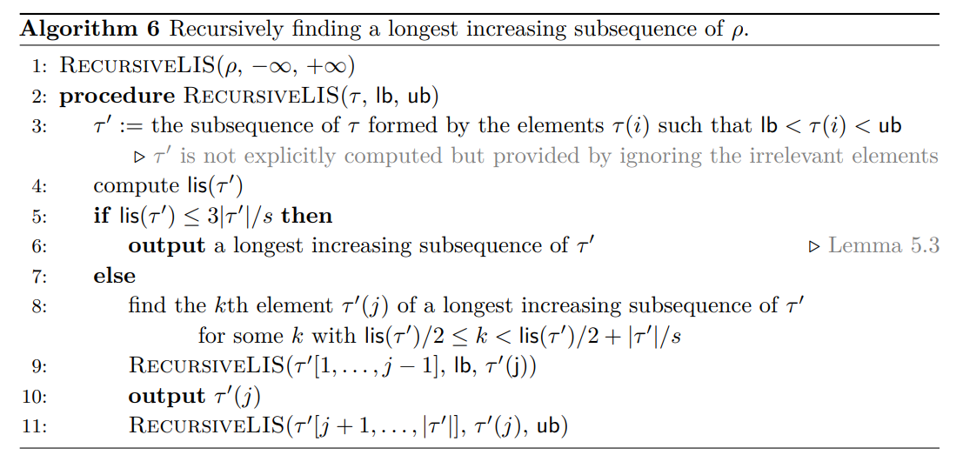
Main Algorithm for computing LIS answer
Use computing LIS length
Use Patience Sorting algo

Slide 32
Time & Space Complexity
Time: O(n²/s log²n)
recursive = O(logn)
computing LIS length = O(n²/s logn)
Patience Sorting = O(klogk)
Space: O(slogn) bits for working space

Slide 33
Thanks

