Slide 1
Computing a Longest Common Almost-Increasing Subsequence of Two Sequences
Toan Thang Ta, Yi-Kung Shieh, Chin Lung Lu
Theoretical Computer Science, Volume 854, 16 January 2021, Pages 44-51
Presenter: Guan-Jie Chen
Date: Feb. 20, 2024

Slide 2
Abstract
Given a positive constant c, a sequence S = <s₁, s₂, …, s_{k}> of k numbers is said to be almost increasing if and only if s_{i} > max_{1≤j<i} s_{j} - c for all 1 < i ≤ k. A longest common almost-increasing subsequence (LCaIS) between two input sequences is a longest common subsequence that is also an almost increasing sequence. We found out that the existing algorithm proposed by Moosa et al. [1] to find an LCaIS of two sequences without repeated elements gives an incorrect result for some instances.

Slide 3
Abstract (cont.)
In this work, we present a dynamic programming algorithm that can correctly compute an LCaIS between any two sequences with repeated elements in O(nml) time and O(nm) space, where n and m are the lengths of two input sequences and l is the length of the output LCaIS.

Slide 4
Algorithm Proposed by Moosa et al.
A = <11, 7, 9, 8, 6> A’ = <11, 7, 9, 8>
B = <9, 8, 11, 7, 6> B’ = <9, 8, 11, 7>
c = 5
length = 1: <9>, <11>
length = 2: <9, 8>, <11, 7>
Cannot construct the true LCaIS: <9, 8, 6>
Notes:
猜是用index做dom

Slide 5
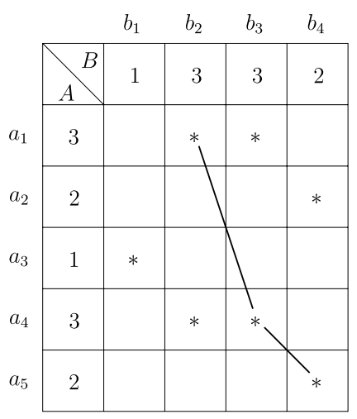
LCaIS (DP)
A = <3, 2, 1, 3, 2>
B = <1, 3, 3, 2>
c = 2

Slide 6
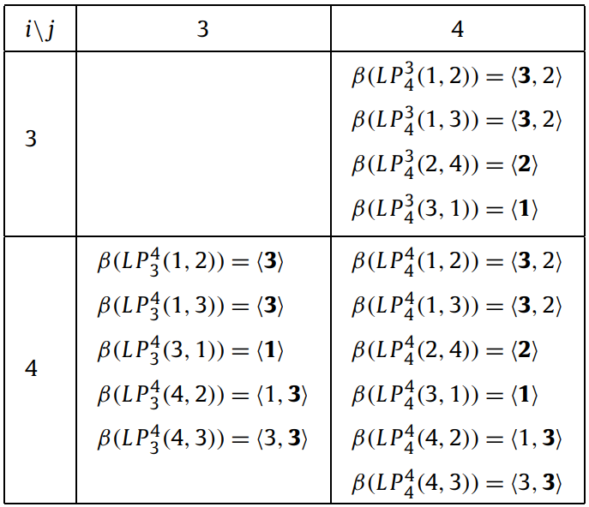
LCaIS (DP) (cont.)
A = <3, 2, 1, 3, 2>
B = <1, 3, 3, 2>
c = 2
case 1: mismatched pair
L(i - 1, j) ∪ L(i, j - 1)

Slide 7
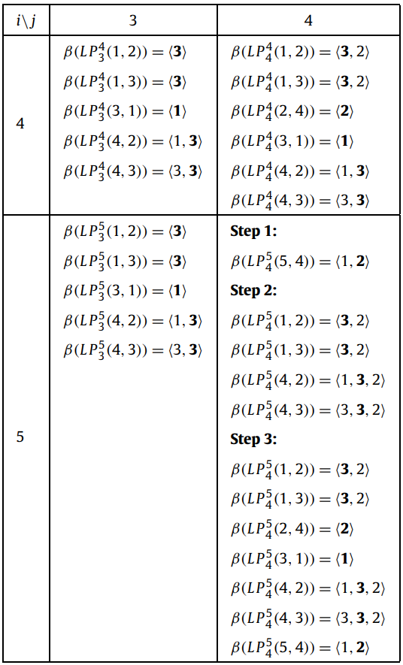
LCaIS (DP) (cont.)
A = <3, 2, 1, 3, 2>
B = <1, 3, 3, 2>
c = 2
case 2: matched pair

Slide 8
Case 2: Matched Pair
a₅ = b₄ = 2
Step 1:
找L(i - 1, j - 1)中maximal < 2且最長

Slide 9
Case 2: Matched Pair (cont.)
a₅ = b₄ = 2
Step 2:
找L(i - 1, j - 1)中maximal - c < 2

Slide 10
Case 2: Matched Pair (cont.)
(Set of step 1) ⋃ (set of step 2)
= L’(i, j)

Slide 11
Case 2: Matched Pair (cont.)
Step 3:
L(i - 1, j) ∪ L(i, j - 1) ∪ L’(i, j)

Slide 12
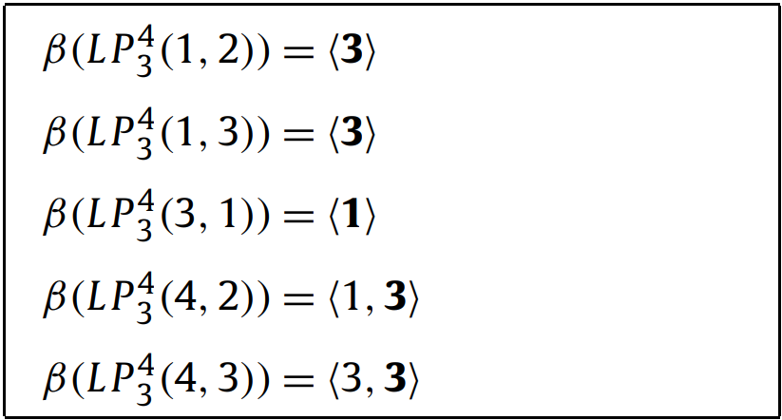
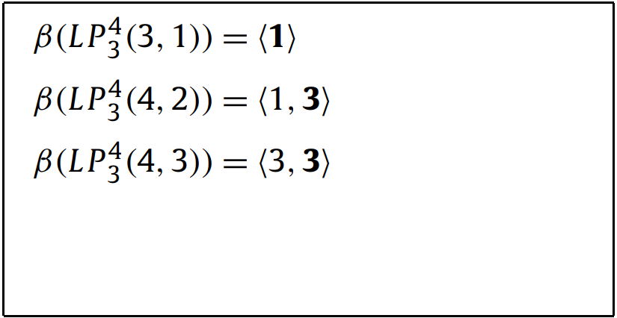
Simplification
Step 1:
Remove dominated paths

Slide 13
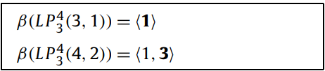
Simplification (cont.)
Step 2:
Remove redundant paths

Slide 14
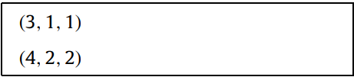
Simplification (cont.)
Step 3:
3-tuple
(maximal在A中的index,
maximal在B中的index,
目前找到的LCaIS長度)

Slide 15
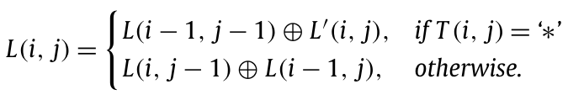
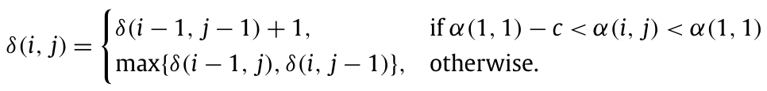
Algorithm

Slide 16
Conclusion
Time complexity: O(nml)
Constructing L: O(nml)
Constructing Prev(backtracking): O(nm)
Space complexity: O(nm)
L: O(ml)
Prev: O(nm)

Slide 17
Thanks for your patience

