Slide 1
Using Dynamic Time Warping to Find Patterns in Time Series
Berndt, D. J., & Clifford, J. (1994, July) In Proceedings of the 3rd international conference on knowledge discovery and data mining (pp. 359-370).
Presenter : Jing-Xiang Yang
Date : Feb. 20, 2024

Slide 2
ABSTRACT
Knowledge discovery in databases presents many interesting challenges within the context of providing computer tools for exploring large data archives. Electronic data .repositories are growing quickly and contain data from commercial, scientific, and other domains. Much of this data is inherently temporal, such as stock prices or NASA telemetry data. Detecting patterns in such data streams or time series is an important knowledge discovery task. This paper describes some preliminary experiments with a dynamic programming approach to the problem. The pattern detection algorithm is based on the dynamic time warping technique used in the speech recognition field.

Slide 3
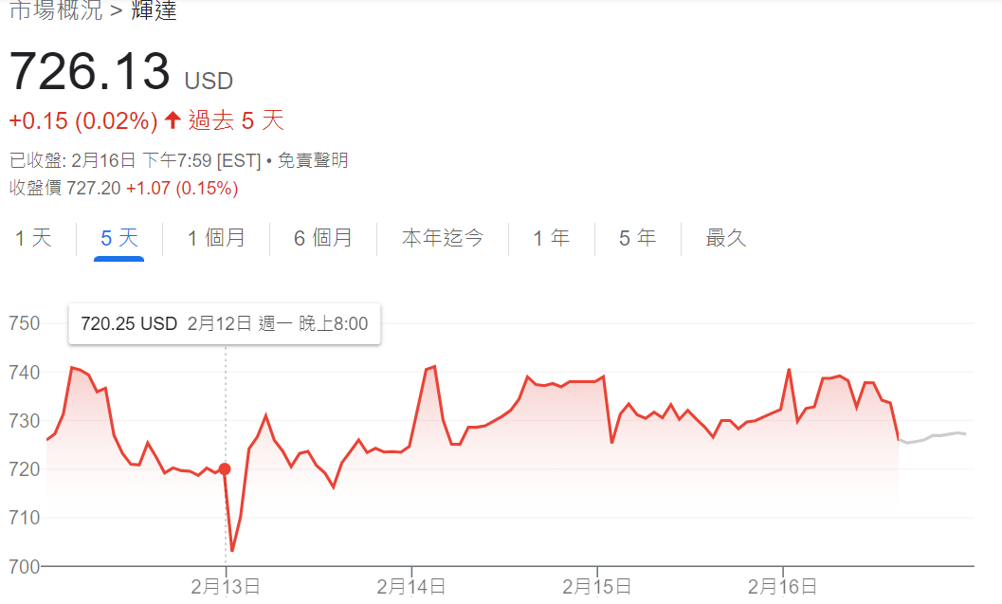
Temporal Data
Data that varies with time (Stock price, NASA telemetry data…)

Slide 4
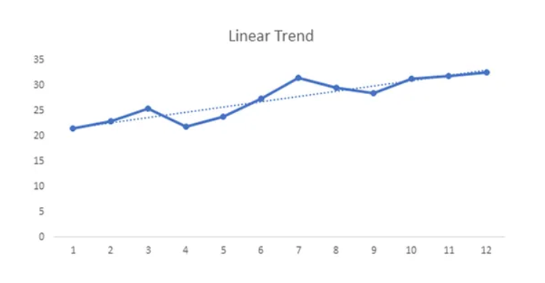
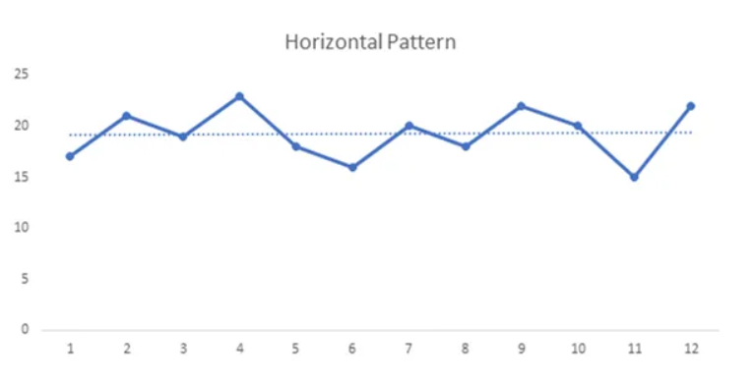
Patterns in Time Series
Horizontal
Trend

Slide 5
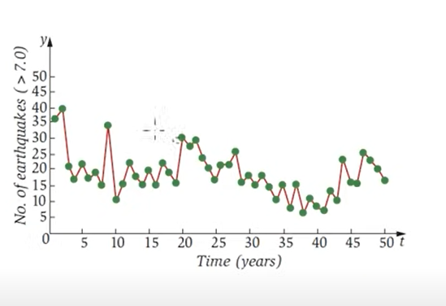
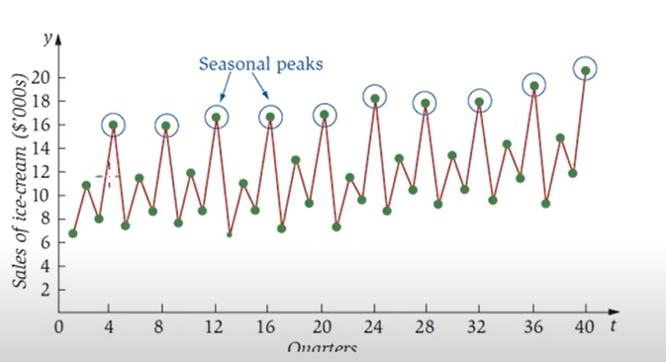
Patterns in Time Series
Seasonal
Cyclical

Slide 6
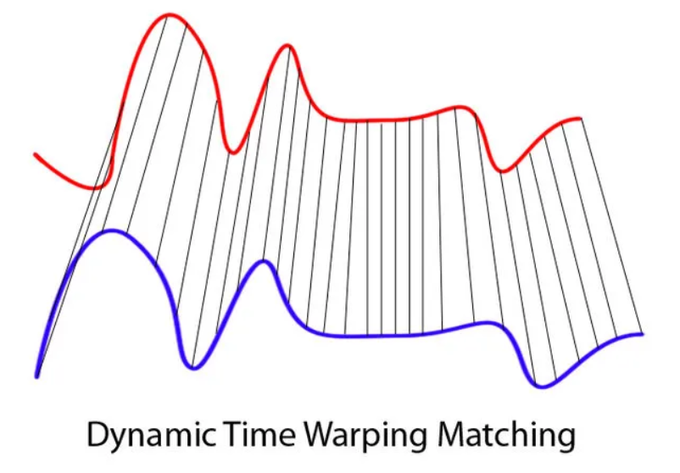
Dynamic Time Warping
Measuring similarity between two time series with different size
speaker recognition, signature recognition

Slide 7
DTW
S = S₁, S₂, ..S_{i}.. S_{n}
T = T₁, T₂, ..T_{j}.. T_{m}
Find a path
W = {(p₁, q₁), (p₂, q₂)….(p_{k}, q_{k})}
With minimum distance

Slide 8
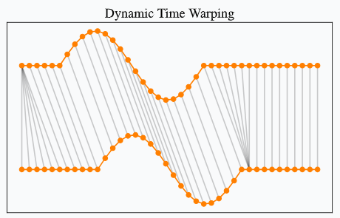


DTW
Boundary Condition
Monotonicity condition
p_{(k)} _{>=} p_{(k-1)}, q_{(k)} _{>=} q_{(k-1)}
Continuity condition
p_{(k)} ₋ p_{(k-1) >= 1}, q_{(k)} ₋ q_{(k-1) >= 1}

Slide 9
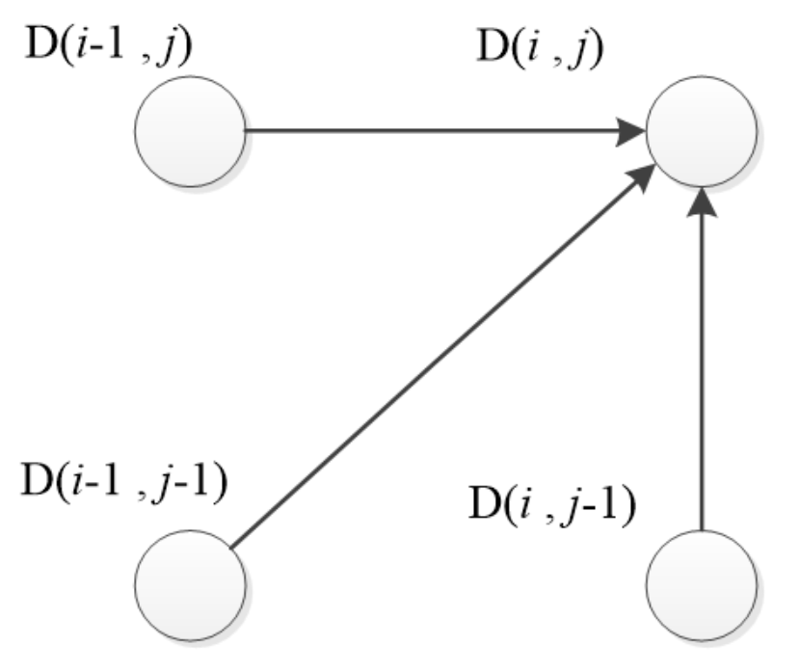
DP
Assuming a point D(i, j) is a point on the optimal warping path.

Slide 10

DP
S = [12, 2, 2, 6, 7]
T = [11, 10, 1, 0]
12
2
2
6
7
1 | 9 | 9 | 5 | 4
2 | 8 | 8 | 4 | 3
11 | 1 | 1 | 5 | 6
12 | 2 | 2 | 6 | 7
11
10
1
0
Distance Matrix

Slide 11
12
2
2
6
7
11
1 | 10 | 19 | 24 | 28
3
10
9
17
21
24
1
14
4
5
10
16
0
26
6
6
11
17

Slide 12
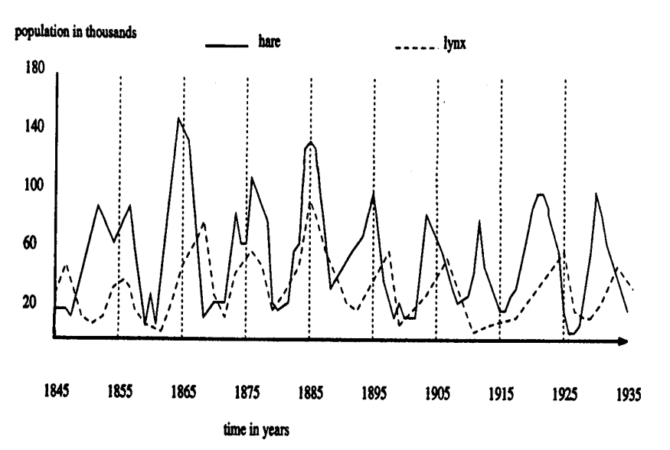

Slide 13
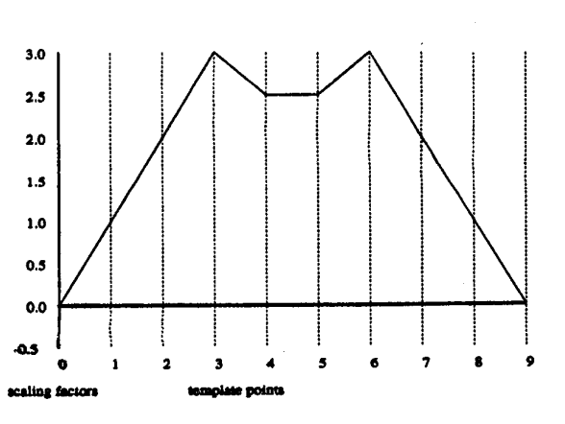
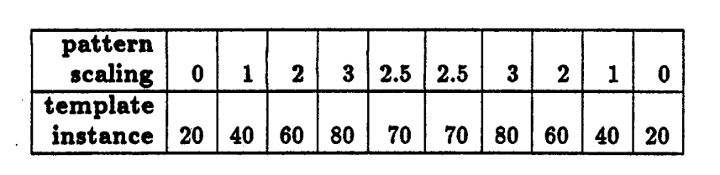

Slide 14
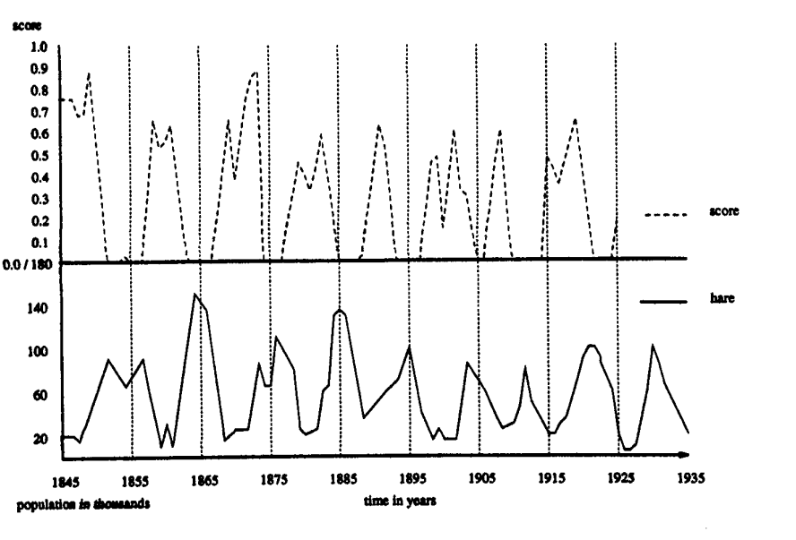

Slide 15
Thanks

