Slide 1
A Linear Time Algorithm for Consecutive Permutation Pattern Matching
M. Kubica, T. Kulczyński, J. Radoszewski, W. Rytter, T. Waleń
Information Processing Letters 113 (2013) 430–433
Presenter: Wen-Yu Chang
Date: Feb. 27, 2024

Slide 2
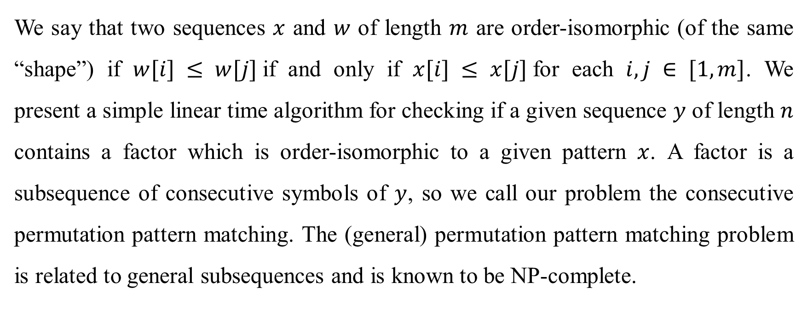
Abstract (1/2)
We say that two sequences $x$ and $w$ of length $m$ are order-isomorphic (of the same “shape”) if $w[i] ≤ w[j]$if and only if $x[i] ≤ x[j]$for each $i, j ∈ [1,m]$. We present a simple linear time algorithm for checking if a given sequence $y$ of length $n$ contains a factor which is order-isomorphic to a given pattern $x$. A factor is a subsequence of consecutive symbols of $y$, so we call our problem the consecutive permutation pattern matching. The (general) permutation pattern matching problem is related to general subsequences and is known to be NP-complete.
Notes:
less than or equal to
belonging to the interval 1 to 𝑚

Slide 3
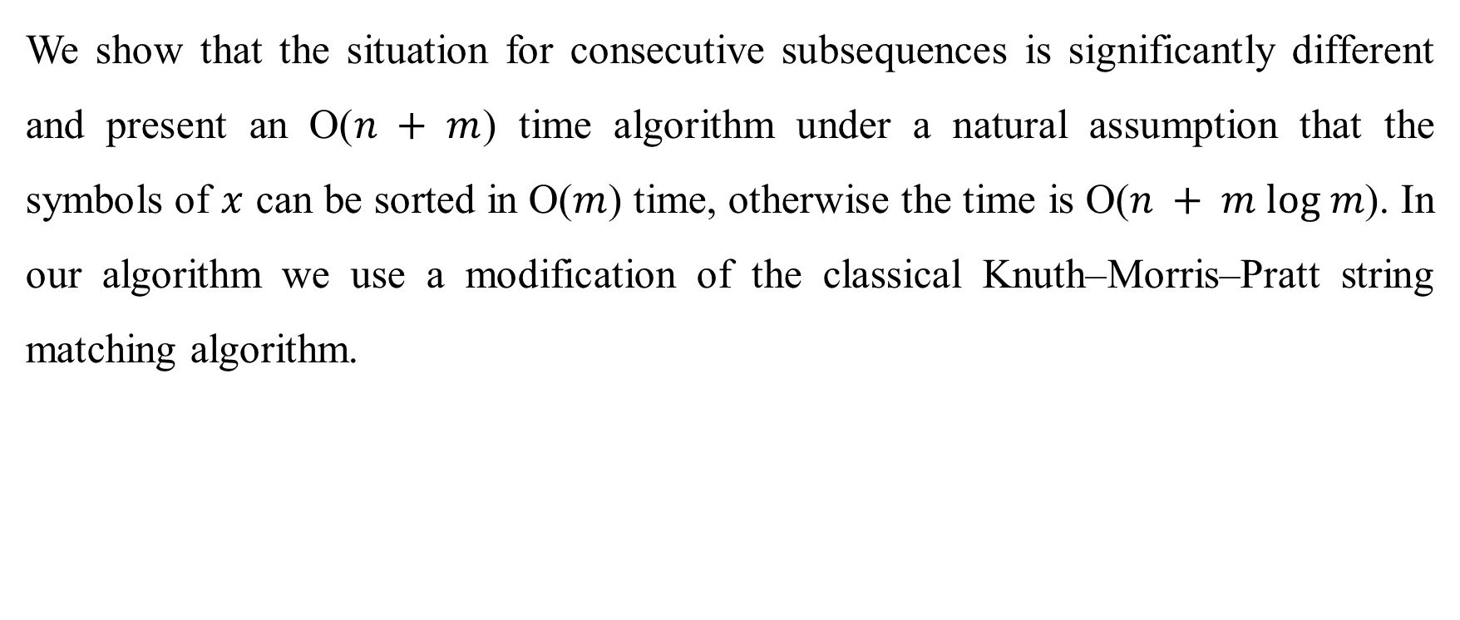
Abstract (2/2)
We show that the situation for consecutive subsequences is significantly different and present an O($n + m$) time algorithm under a natural assumption that the symbols of $x$ can be sorted in O($m$) time, otherwise the time is O($n + m log m$). In our algorithm we use a modification of the classical Knuth–Morris–Pratt string matching algorithm.

Slide 4
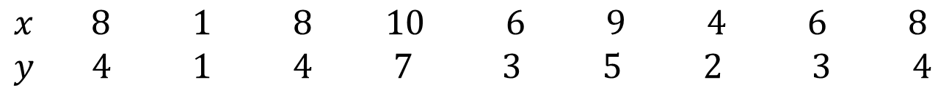
Order-isomorphism
$$x 8 1 8 10 6 9 4 6 8$$
$$y 4 1 4 7 3 5 2 3 4$$

Slide 5
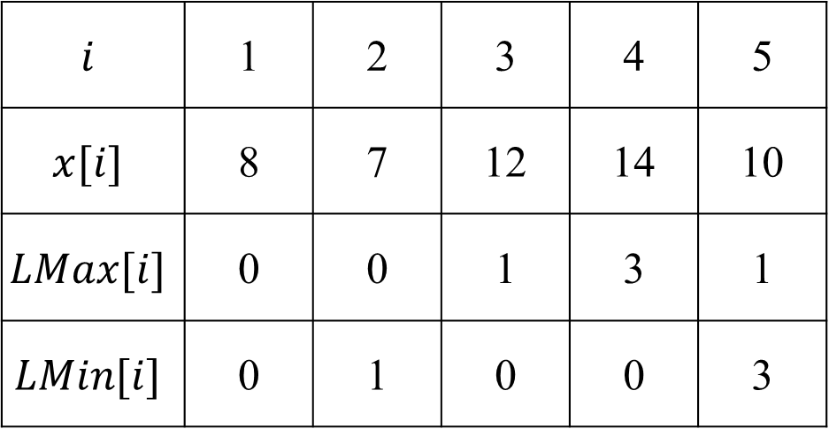
Location Table
pattern $x=8, 7, 12, 14, 10$
$$i$$ | 1 | 2 | 3 | 4 | 5
$$x[i]$$ | 8 | 7 | 12 | 14 | 10
$$LMax[i]$$ | 0 | 0 | 1 | 3 | 1
$$LMin[i]$$ | 0 | 1 | 0 | 0 | 3

Slide 6
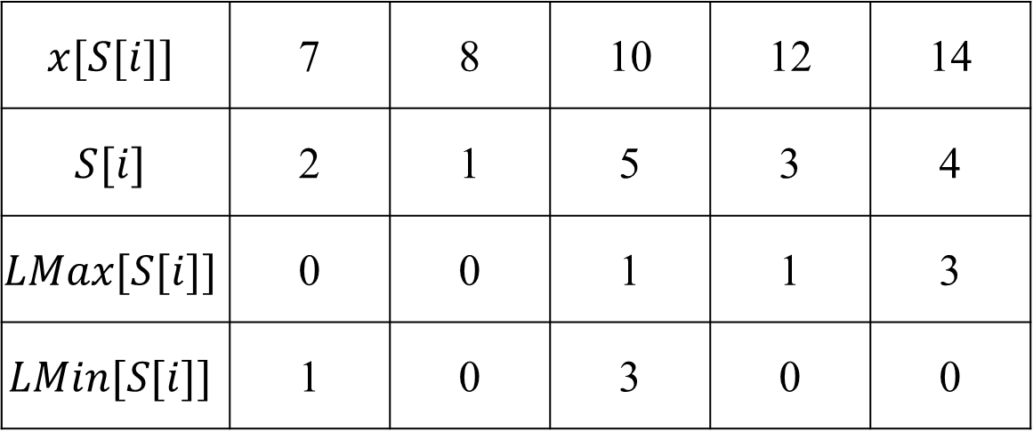
Computation of the Location Table
pattern $x=8, 7, 12, 14, 10$
$$x[S[i]]$$ | 7 | 8 | 10 | 12 | 14
$$S[i]$$ | 2 | 1 | 5 | 3 | 4
$$LMax[S[i]]$$ | 0 | 0 | 1 | 1 | 3
$$LMin[S[i]]$$ | 1 | 0 | 3 | 0 | 0

Slide 7
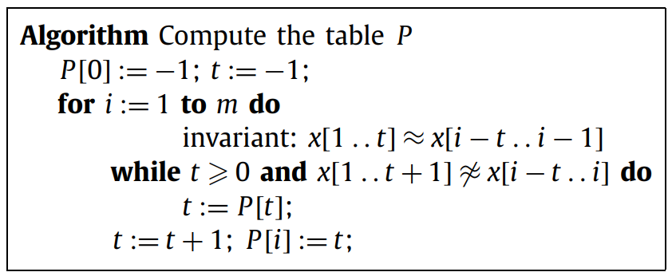
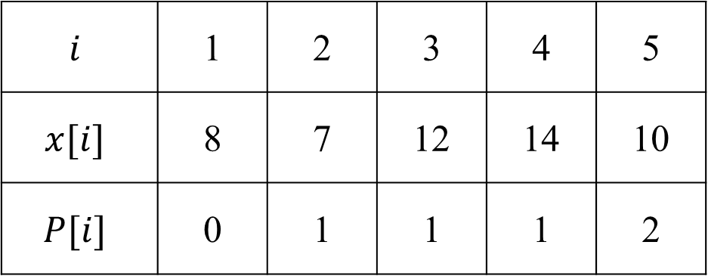
Order-borders Table
pattern $x=8, 7, 12, 14, 10$
$$i$$ | 1 | 2 | 3 | 4 | 5
$$x[i]$$ | 8 | 7 | 12 | 14 | 10
$$P[i]$$ | 0 | 1 | 1 | 1 | 2

Slide 8
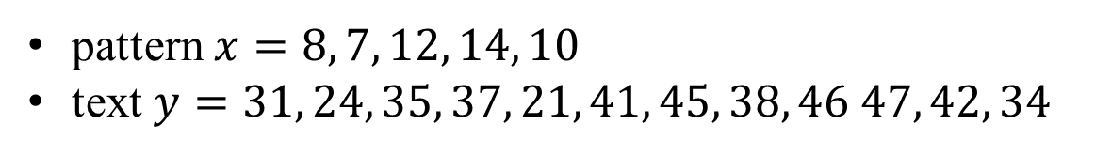
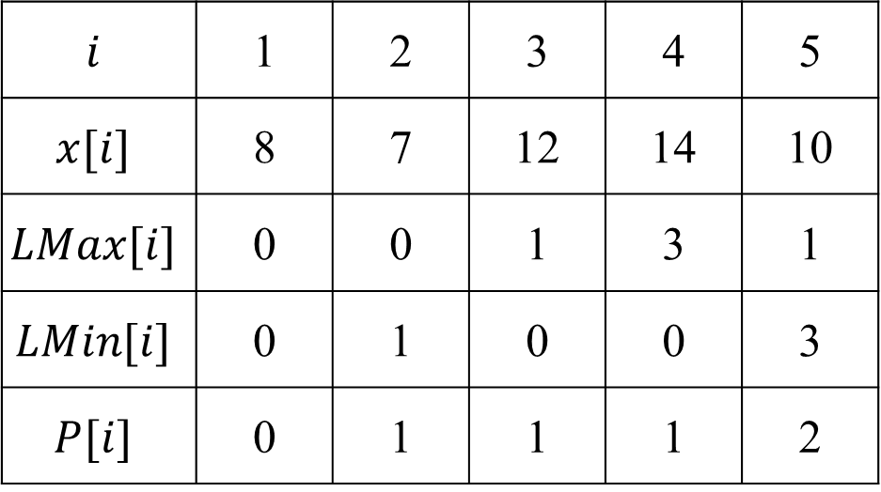
Consecutive permutation pattern matching
pattern $x=8, 7, 12, 14, 10$
text $y=31, 24, 35, 37, 21, 41, 45, 38, 46 47, 42, 34$
$$i$$ | 1 | 2 | 3 | 4 | 5
$$x[i]$$ | 8 | 7 | 12 | 14 | 10
$$LMax[i]$$ | 0 | 0 | 1 | 3 | 1
$$LMin[i]$$ | 0 | 1 | 0 | 0 | 3
$$P[i]$$ | 0 | 1 | 1 | 1 | 2

Slide 9
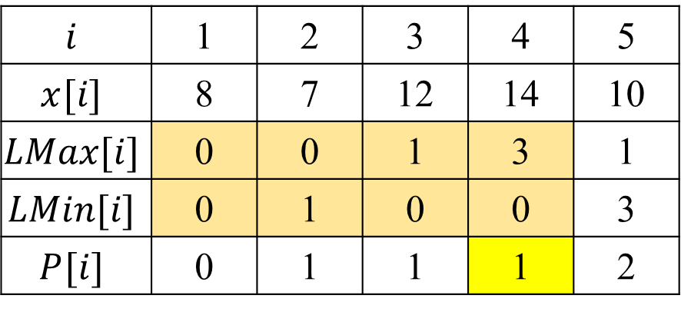
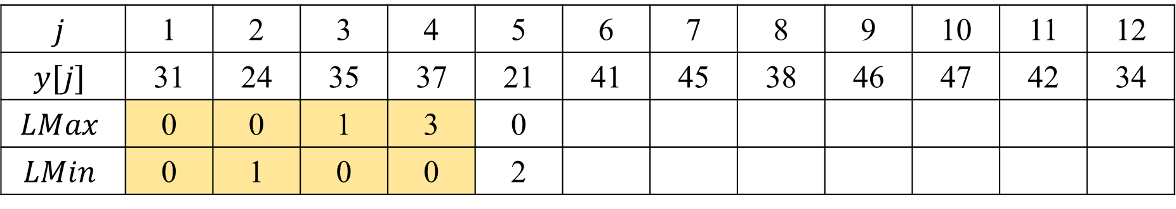
Consecutive permutation pattern matching
$$j$$ | 1 | 2 | 3 | 4 | 5 | 6 | 7 | 8 | 9 | 10 | 11 | 12
$$y[j]$$ | 31 | 24 | 35 | 37 | 21 | 41 | 45 | 38 | 46 | 47 | 42 | 34
$$LMax$$ | 0 | 0 | 1 | 3 | 0
$$LMin$$ | 0 | 1 | 0 | 0 | 2
$$i$$ | 1 | 2 | 3 | 4 | 5
$$x[i]$$ | 8 | 7 | 12 | 14 | 10
$$LMax[i]$$ | 0 | 0 | 1 | 3 | 1
$$LMin[i]$$ | 0 | 1 | 0 | 0 | 3
$$P[i]$$ | 0 | 1 | 1 | 1 | 2

Slide 10
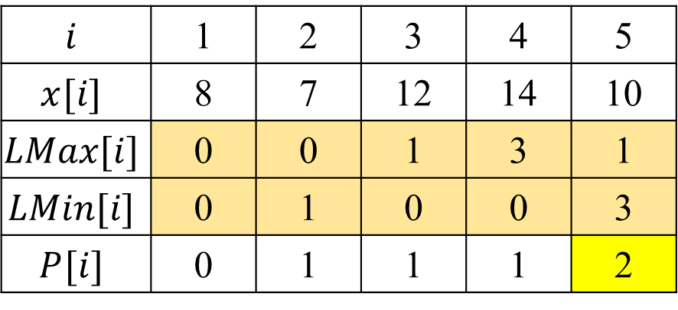
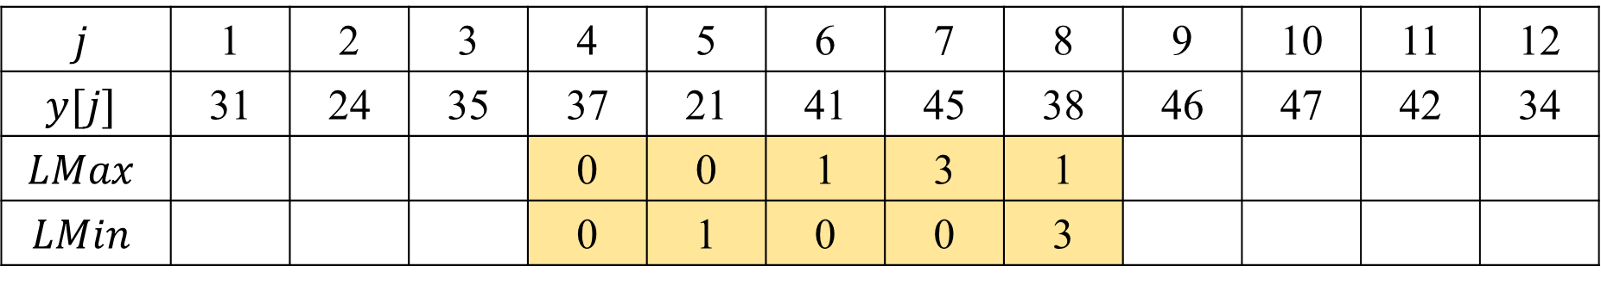
Consecutive permutation pattern matching
$$j$$ | 1 | 2 | 3 | 4 | 5 | 6 | 7 | 8 | 9 | 10 | 11 | 12
$$y[j]$$ | 31 | 24 | 35 | 37 | 21 | 41 | 45 | 38 | 46 | 47 | 42 | 34
$$LMax$$ |  |  |  | 0 | 0 | 1 | 3 | 1
$$LMin$$ |  |  |  | 0 | 1 | 0 | 0 | 3
$$i$$ | 1 | 2 | 3 | 4 | 5
$$x[i]$$ | 8 | 7 | 12 | 14 | 10
$$LMax[i]$$ | 0 | 0 | 1 | 3 | 1
$$LMin[i]$$ | 0 | 1 | 0 | 0 | 3
$$P[i]$$ | 0 | 1 | 1 | 1 | 2

Slide 11
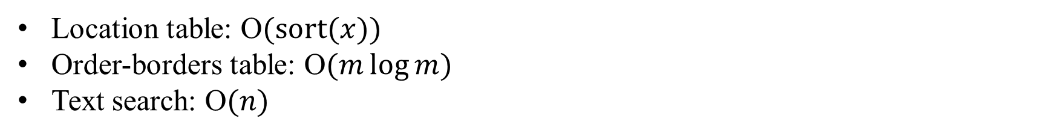
Time Complexity
Location table: O$(sort(x))$
Order-borders table: O$(m\log{m})$
Text search: O$(n)$

