Slide 1
A Trajectory Simplification Method Based on the Clustering of Vessel Speed and Course Segments
Jia Li, Yongjie Zhu, Yi Zuo, Tieshan Li
2020 7th International Conference on Information, Cybernetics, and Computational Social Systems (ICCSS). IEEE. November 2020. Guangzhou, China.
Presenter: Yu-Chen Lin
Date: Feb. 24, 2024

Slide 2
Abstract
Automatic Identification Systems (AIS) can provide massive ship trajectory data that is valuable for mining information in water traffic. However, it is also easy to cause the data redundancy, adding difficulty to the data processing. To address this problem, this paper proposes a trajectory simplification method based on the segmental clustering of the ship's speed and course. Firstly, the maneuver points of a trajectory are determined by the speed and course threshold. The trajectory is divided into segments in accordance with the maneuver points. Then, the feature points of each segment are extracted based on K-medoids clustering method. The maneuver points and feature points of every trajectory segments are combined as trajectory features to achieve the purpose of simplifying the ship's trajectory. The experiment results show that the method can well maintain the feature of original trajectory and eliminate the redundant track points in AIS trajectory. Compared with tradition Douglas-Peuker (DP) algorithm, the distortion rate could be reduced 0.2% with the same simplification.

Slide 3
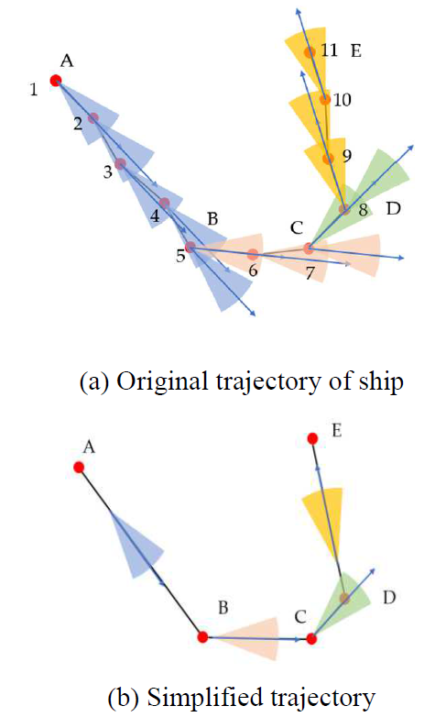
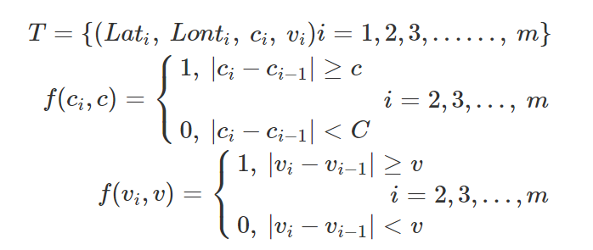
Trajectory Segmentation

Slide 4
Initialize the set of maneuver point set Fea to an empty set.
Place trajectory start point into maneuver point set Fea as feature point 1.
Calculate the course and speed difference between trajectory point 2 and feature point 1. If the course or speed difference is greater than the set course or speed deviation threshold, place this trajectory point into maneuver point set Fea. Otherwise, continue to assess the next trajectory point.
Repeat step (3) until the last trajectory point is assessed.

Slide 5
Feature Extraction Based on K-Medoids Clustering Algorithm
The changing magnitude in course and speed is relatively small between two adjacent trajectory feature points.
The prementioned maneuver point extraction method could not effectively capture the characteristics of this kind of trajectory points.
K-medoids clustering algorithm was adopted.

Slide 6
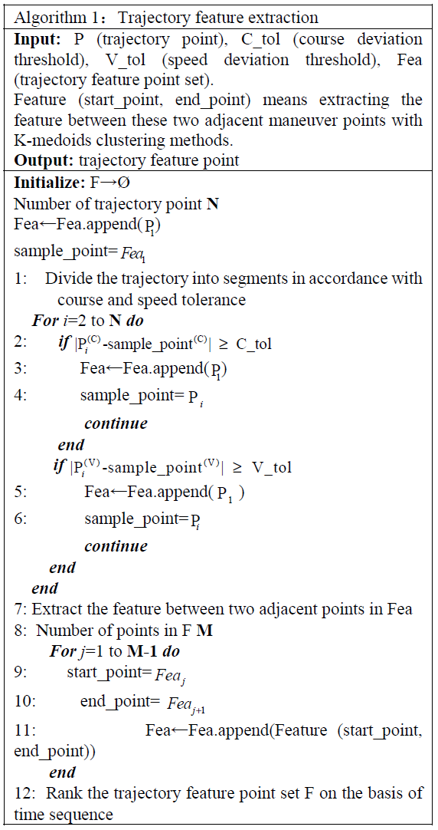

Slide 7
Evaluation Criteria
Simplification Rates
Distortion Rates

Slide 8

Simplification Rates

Slide 9
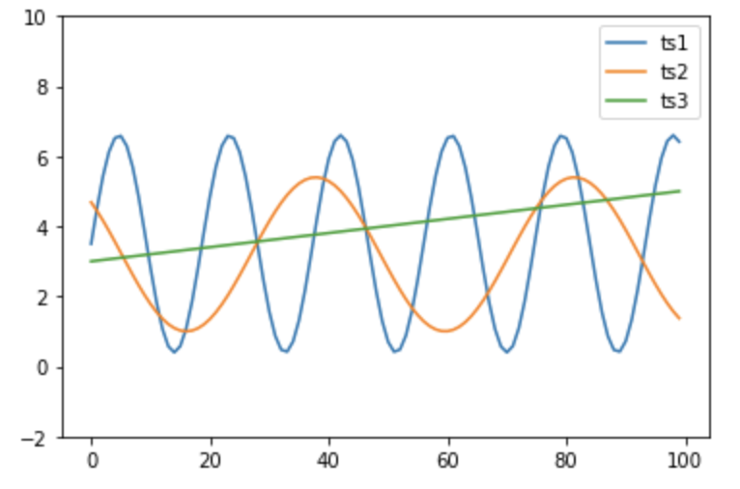
Distortion Rates

Slide 10
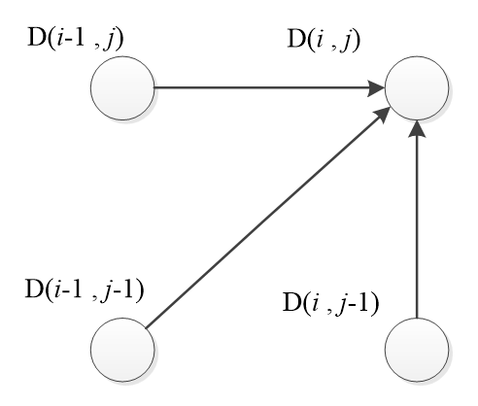
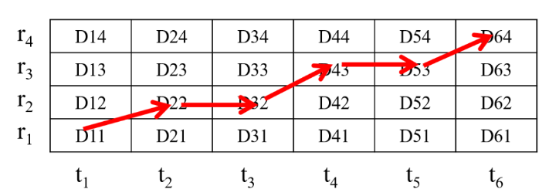
Dynamic Time Warping

Slide 12
Douglas–Peucker algorithm

Slide 13
Experimental Results

Slide 14
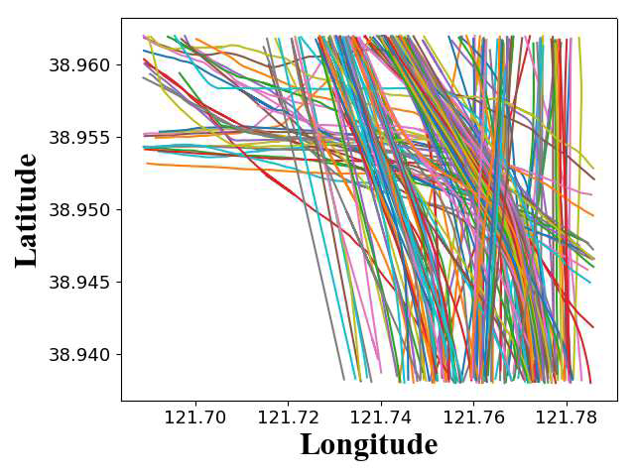

Slide 15
Conclusion
The proposed method mainly consisted of two modules, namely trajectory segmentation and segment feature extraction.
Compared with the DP algorithm, the distortion rate of the compressed trajectory is significantly reduced with the same compression intensity.
The algorithm maintains a good quality of simplification even under high intensity simplification requirements.

