Slide 1
An efficient algorithm for the Knight's tour problem
Ian Parberry
Discrete Applied Mathematics, 73.3 (1997), 251-260.
Presenter: Hsin-Chang Yu
Date: Feb. 27, 2024

Slide 2
Abstract
No abstract

Slide 3
Knight’s Tour
open knight's tour
closed knight's tour

Slide 4
Closed Knight's Tour
Schwenk proved that for any m × n board with m ≤ n
a closed knight's tour is always possible
unless:
m and n are both odd
m = 1, 2, or 4
m = 3 and n = 4, 6, or 8.

Slide 5
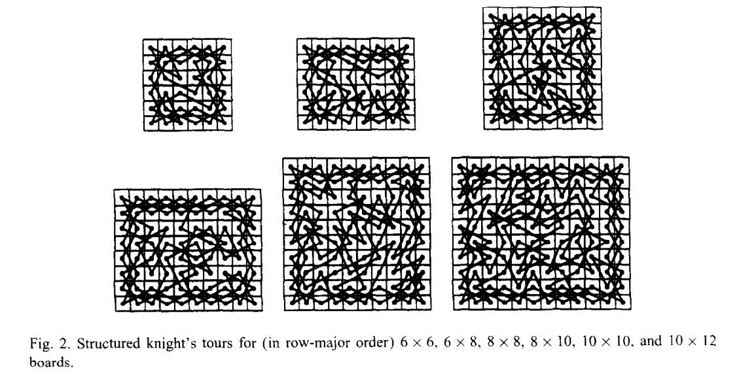
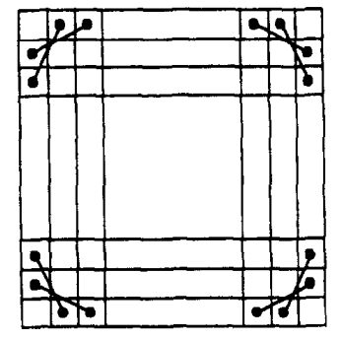
Divide-and-conquer Algorithm
random walk algorithm

Slide 6
Proof
an n x n and an n x (n + 2) board:
n = 4k
n = 4k + 2

Slide 7
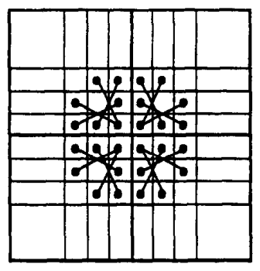
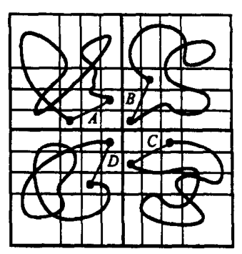
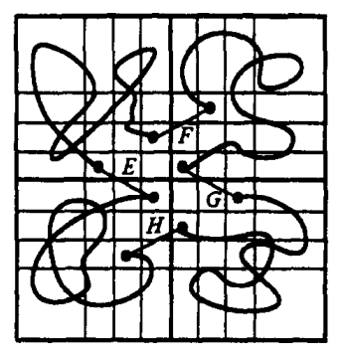
Proof

Slide 8
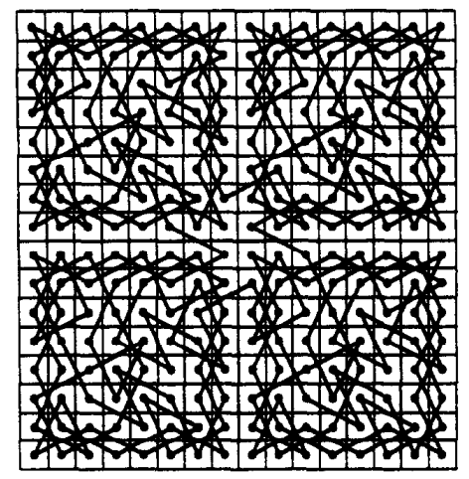
Result

Slide 9
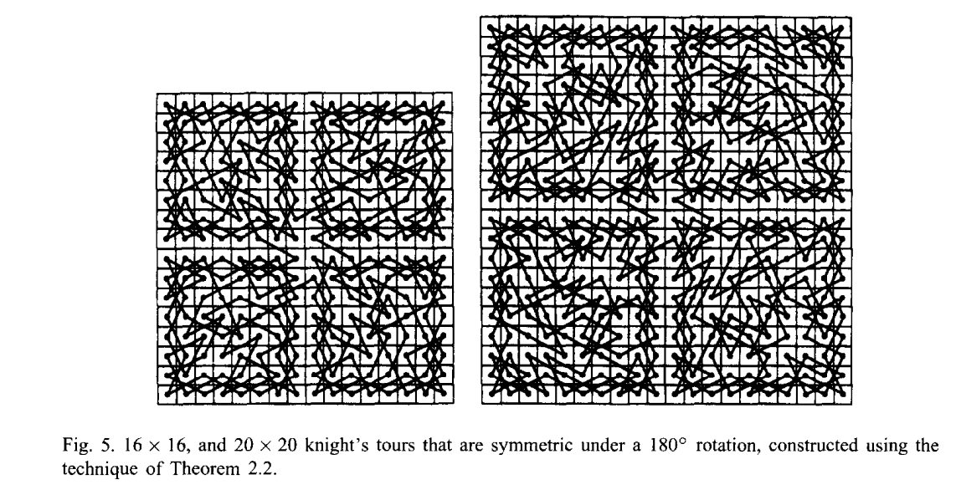
Result

Slide 10
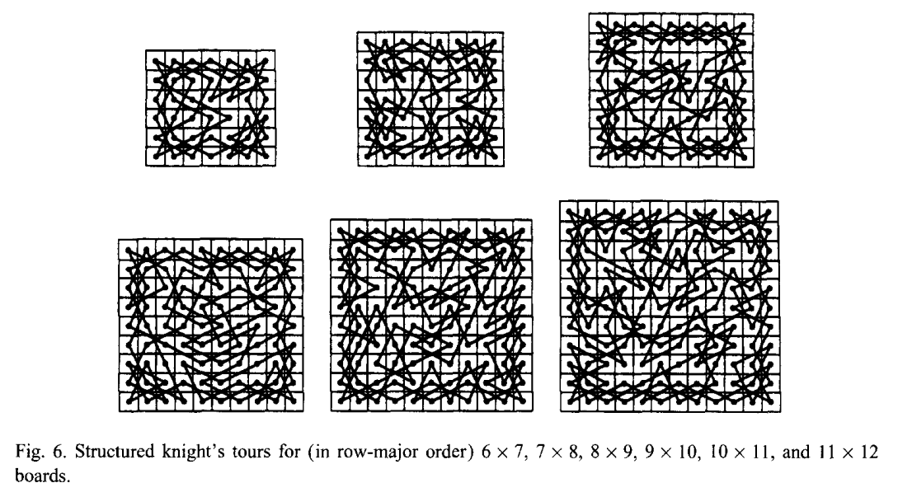
Proof

Slide 11
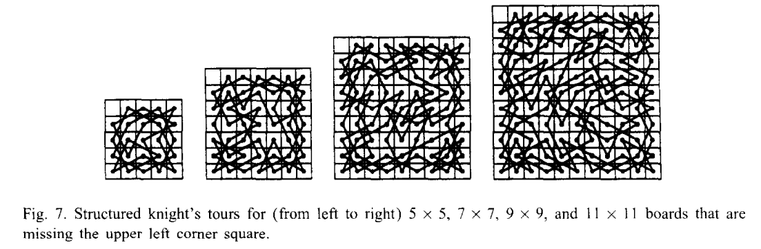
Proof

Slide 12
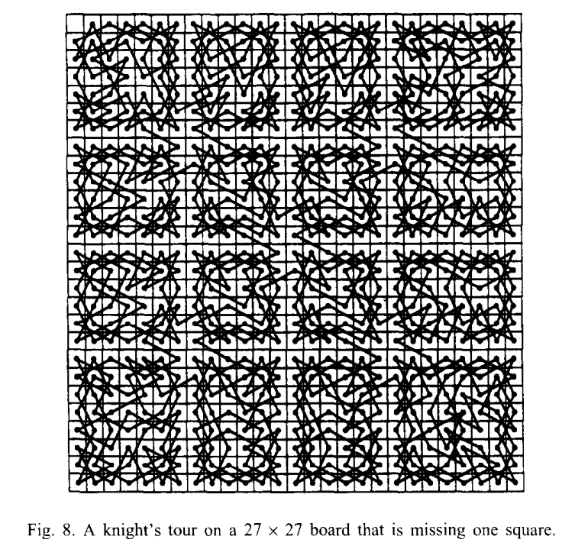
Result

Slide 13
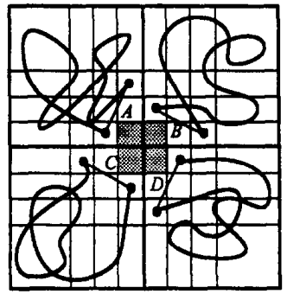
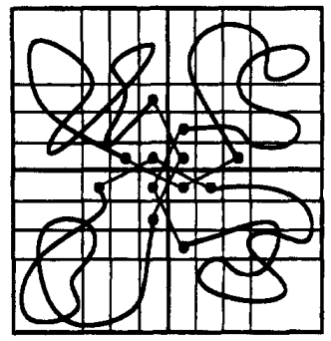
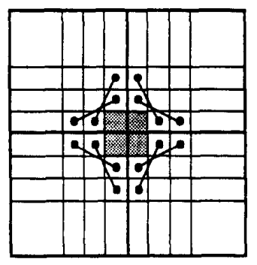
Proof

Slide 14
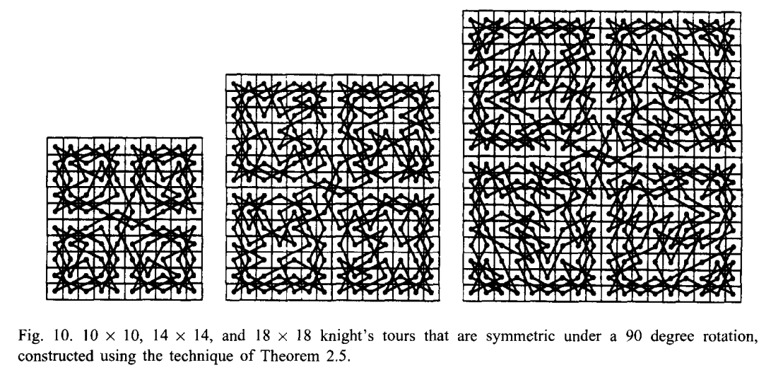
Result

Slide 15
Thanks
Notes:
Given a string S of length n, an integer p ∈ [1..n] is a period of S if S[i] = S[i + p] for all i ∈ [1..n − p].
S[|S| − p + 1] = c

