Slide 1
Rearrangement on lattices with pick-n-swaps: Optimality structures and efficient algorithms
Jingjin Yu
The International Journal of Robotics Research, Volume 42, Issue 10, 2023
Presenter: Guan-Jie Chen
Date: Apr. 9, 2024

Slide 2
Abstract
We study a class of rearrangement problems under a novel pick-n-swap prehensile manipulation model, in which a robotic manipulator, capable of carrying an item and making item swaps, is tasked to sort items stored in lattices of variable dimensions in a time-optimal manner. We systematically analyze the intrinsic optimality structure, which is fairly rich and intriguing, under different levels of item distinguishability (fully-labeled, where each item has a unique label, or partially-labeled, where multiple items may be of the same type) and different lattice dimensions.

Slide 3
Abstract (cont.)
Focusing on the most practical setting of one and two dimensions, we develop low polynomial time cycle-following-based algorithms that optimally perform rearrangements on 1D lattices under both fully- and partially-labeled settings. On the other hand, we show that rearrangement on 2D and higher-dimensional lattices become computationally intractable to optimally solve.

Slide 4
Abstract (cont.)
Despite their NP-hardness, we prove that efficient cycle-following-based algorithms remain optimal in the asymptotic sense for 2D fully- and partially-labeled settings, in expectation, using the interesting fact that random permutations induce only a small number of cycles. We further improve these algorithms to provide 1.x-optimality when the number of items is small. Simulation studies corroborate the effectiveness of our algorithms.

Slide 5
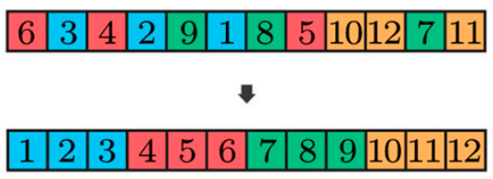
Rearrangement in 1D
Fully-labeled
SWEEPCYCLESLOR
OPTPLANLOR
Partially-labeled
OPTPLANPOR

Slide 6

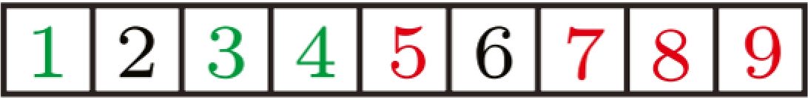
SWEEPCYCLESLOR
cycle: 3 - 4 - 1
cycle: 7 - 9 - 8 - 5

Slide 7
OPTPLANLOR
進入cycle2
cycle1: [1, 4]
cycle2: [3, 5]
cycle1: [1, 3]
cycle2: [5, 6]
3 | 1 | 2 | 4 | 6 | 5
Notes:
如果在reach max時，右邊有"沒相交的"閉環未處理
則暫時break，先處理右邊

Slide 8
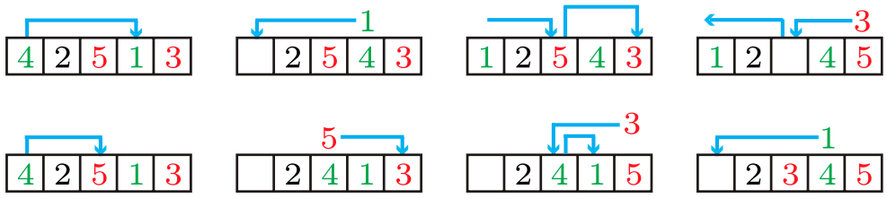
SWEEPCYCLESLOR vs OPTPLANLOR
distance: 14
distance: 10

Slide 9
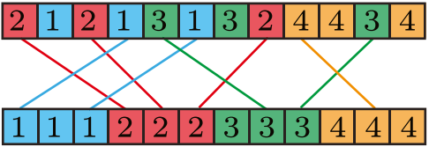
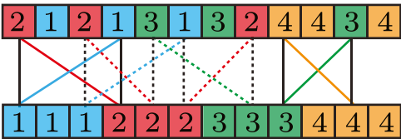
OPTPLANPOR
step1. 初始化

Slide 10
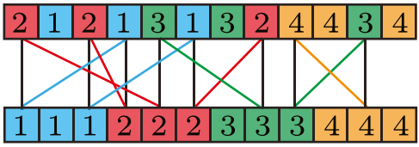
OPTPLANPOR (cont.)
step2. 找同向
Notes:
red line
若兩個不同cycle中的同一種element都往左/右，swap goal，即merge cycle，pick-n-swap次數變少，distance不變

Slide 11
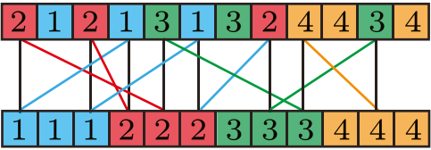
OPTPLANPOR (cont.)
step3. 找反向
by MST
若有k種type，cycle最多k - 1個
Notes:
green line
pick-n-swap次數減少，但distance變大，所以要找minimum spanning tree

Slide 12
Rearrangement in 2D and higher dimensions
Fully-labeled
Partially-labeled

Slide 13
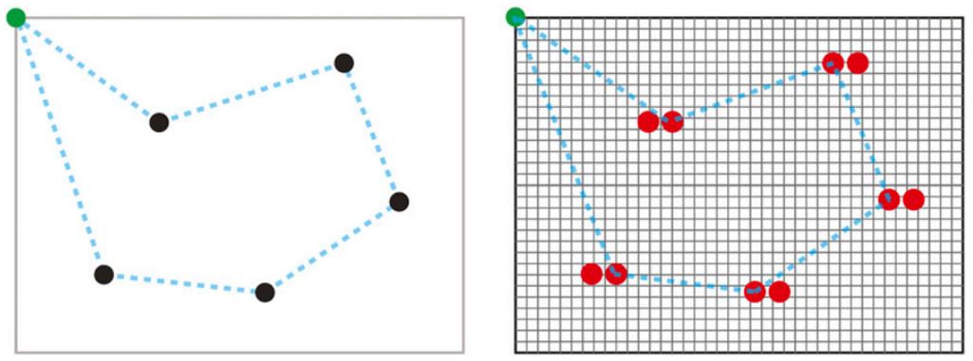
Fully-labeled 2D
MST → directed MST
Notes:
因為在2D時，c1到c2的distance不一定=c2到c1的distance
in the asymptotic sense有最佳解，minimize distance是NP-hard

Slide 14
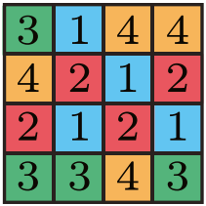
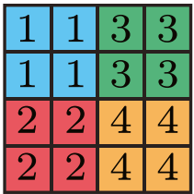
Partially-labeled 2D
step1. construct bipartite graph (based on all applicable initial configurations to all goal configurations; edge: distance between start and goal)
step2. Merge cycles, keep optimal distance by directed MST(edge: additional distance that is incurred for the merge, due to goal swaps)
step3. repeat step2

Slide 15
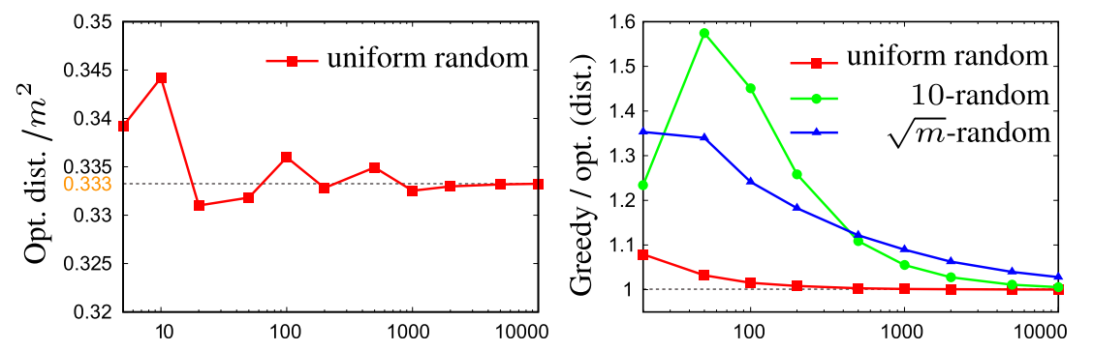
Result
1D
x: the number of items in an instance

Slide 16
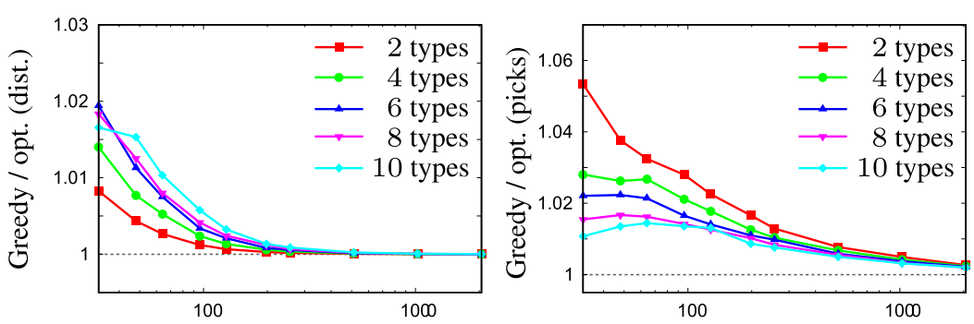
Result (cont.)
1D

Slide 17
Thanks for your patience

