Slide 1
Dude, is my code constant time?
Reparaz, Oscar, Josep Balasch, and Ingrid Verbauwhede.
Design, Automation & Test in Europe Conference & Exhibition (DATE), 2017. IEEE, 2017.
Presenter : Jing-Xiang Yang
Date : Apr. 9, 2024

Slide 2
ABSTRACT
This paper introduces dudect: a tool to assess whether a piece of code runs in constant time or not on a given platform. We base our approach on leakage detection techniques, resulting in a very compact, easy to use and easy to maintain tool. Our methodology fits in around 300 lines of C and runs on the target platform. The approach is substantially different from previous solutions. Contrary to others, our solution requires no modeling of hardware behavior. Our solution can be used in black-box testing, yet benefits from implementation details if available. We show the effectiveness of our approach by detecting several variable-time cryptographic implementations. We place a prototype implementation of dudect in the public domain.

Slide 3
Dudect
Some supposed constant-time implementations turned out not to be.
(This raises the possibility that they may be vulnerable to timing attacks.)
There are several tools already for detection of variable time code
(common drawback : these methods have to model somehow the hardware)
Dudect rely on statistical analysis of execution timing
(Measure execution time for two input data classes, then check their timing distributions)

Slide 4
Step 1: Measure execution time
Tow classes of data
All input data will be set to fixed values
All input data will be generated randomly.
Minimize the effect of environmental => each measurement corresponds to a randomly chosen class

Slide 5
Step 2: Applying post-processing
Cropping
External influences such as system interrupts may affect the recorded time.
can include parts irrelevant to the experiment
Discard measurements that are larger than a fixed
Higher-order preprocessing
Depending on the statistical test, different processing mechanisms can be used.

Slide 6
Step 3: Applying statistical test
Build null hypothesis : the two timing distributions are equal
Use Welch’s t-test : tests for equivalence of means
(Reject the null hypothesis => execution time is not constant. )

Slide 7
Memory comparison
Input
s = “secret”
first class : fixes the input to “s”
second class : uniformly distributed random 16-byte strings
(a) Variable-time implementation
(Based on memcmp function => abort early on mismatch )
(b) Constant-time implementation
(By logical operations => does not abort early on mismatch)

Slide 8
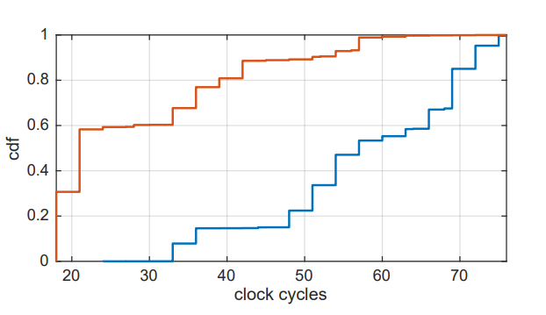
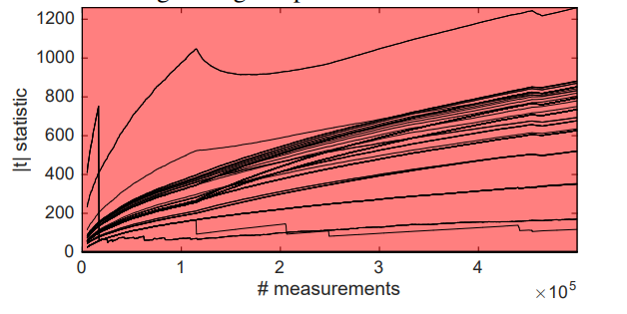
Variable-time implementation
Second time
t value larger than 4.5 => distributions are different

Slide 9
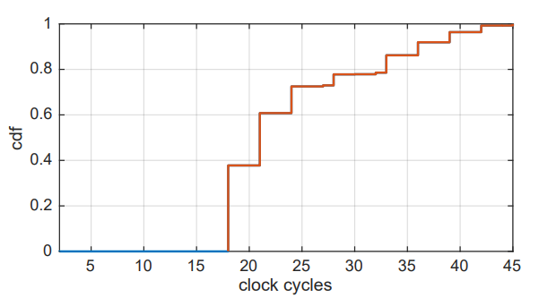
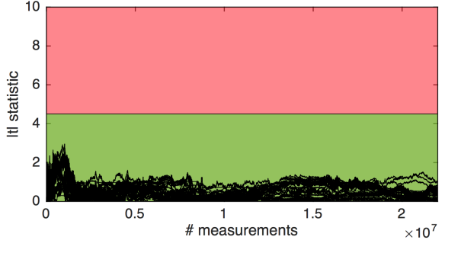
Constant-time implementation

Slide 10
Thanks

