Slide 1
An improved algorithm for string matching using index based shifting approach
Tania Islam and Kamrul Hasan Talukder
2017 20th International Conference of Computer and Information Technology (ICCIT), December 22-24, University of Asia Pacific, Dhaka, Bangladesh
Presenter: Wen-Yu Chang
Date: Apr. 30, 2024

Slide 2
Abstract (1/2)
Bioinformatics is now considered as one of the most studied branches in biological science which deals with the exploring of different kinds of methods for analyzing, storing and retrieving biological data, such as protein sequences and nucleic acid (DNA/RNA), configurations, functions, pathways, and genetic relations. In bioinformatics, genomic sequence analysis has led to the evolution of well-organized pattern discovery algorithms to produce search over large DNA sequences. The most important factor for efficiency of a matching algorithm is depending on the total number of character comparisons.

Slide 3
Abstract (2/2)
Index Based Shift (IBS) algorithm which is the name chosen for our proposed algorithm was tested on different length of DNA sequences data set. The IBS algorithm shows great efficiency in terms of total number of character comparisons it requires than that of ABSBMH algorithm. The experimental result shows that our proposed IBS algorithm works better when length of pattern is increased.

Slide 4
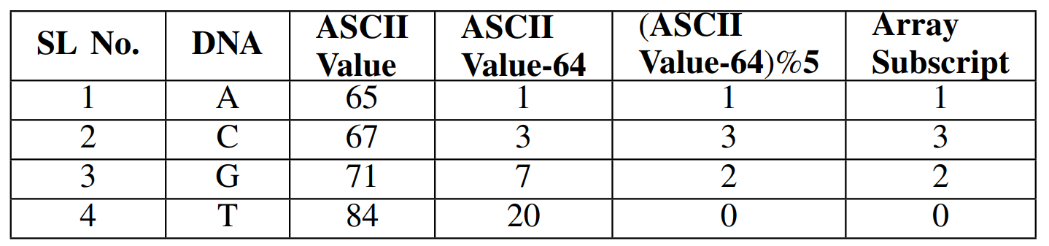
Preprocessing Phase (1/2)

Slide 5
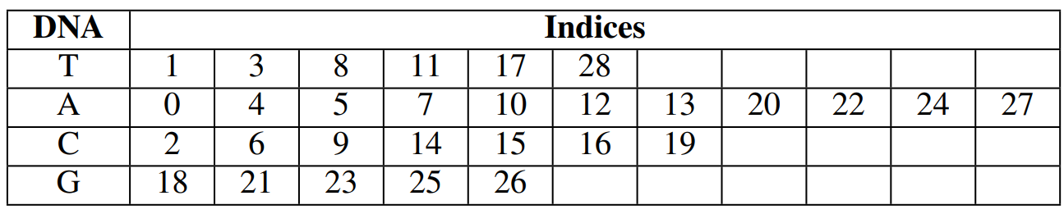
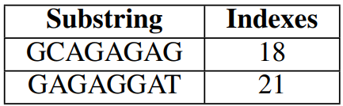
Preprocessing Phase (2/2)
$S=ATCTAACATCATAACCCTGCAGAGAGGAT$
$P=GCAGAGAG$

Slide 6




Searching Phase
First attempt
Second attempt
$$S′$$
G | C | A | G | A | G | A | G
G | C | A | G | A | G | A | G
$$P$$
$$S′$$
G | A | G | A | G | G | A | T
G | C | A | G | A | G | A | G
$$P$$

Slide 7
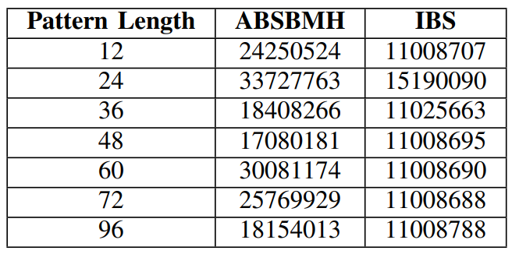
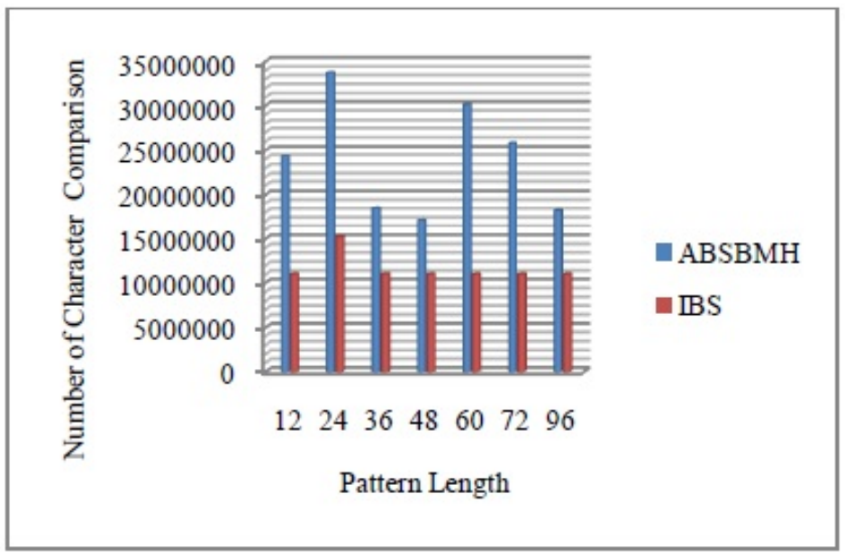
Experiments

Slide 8
An Efficient Hybrid Exact String Matching Algorithm to Minimize the Number of Attempts and Character Comparisons
Prince Mahmud, Md. Sohel Rana and Kamrul Hasan Talukder
2018 21st International Conference of Computer and Information Technology (ICCIT), 21-23 December, 2018, United International University, Dhaka, Bangladesh
Presenter: Wen-Yu Chang
Date: Apr. 30, 2024

Slide 9
Abstract (1/2)
String matching fundamentally is a classical problem of finding occurrence(s) of a pattern string within another string or body of text. String matching problems can be traced into intrusion detection in network, detecting plagiarism, information security, pattern recognition, document matching, text mining, speech analysis, application in bioinformatics and other diversified fields. Two important factors of string matching which are also the challenges of this paper are “number of attempts” and “number of character comparisons”. With these challenges of string matching, we have proposed a hybrid algorithm which is named as MAC (Minimum number of Attempts and Character Comparisons) algorithm.

Slide 10
Abstract (2/2)
We have integrated the concepts of Berry-Ravindran (BR) algorithm and index based shifting approach with our new search technique to build our MAC algorithm. We have evaluated the MAC algorithm to analyze the performance for English text alongside biological data (DNA sequence and Protein sequence). The performance of MAC algorithm has turned out to be better than Maximum-Shift (MS) algorithm and Index Based Shifting (IBS) algorithm. The performance of the MAC algorithm is proficient for exact string matching for both small and large size of pattern length comparing with some existing algorithm to solve the string matching problem.

Slide 11

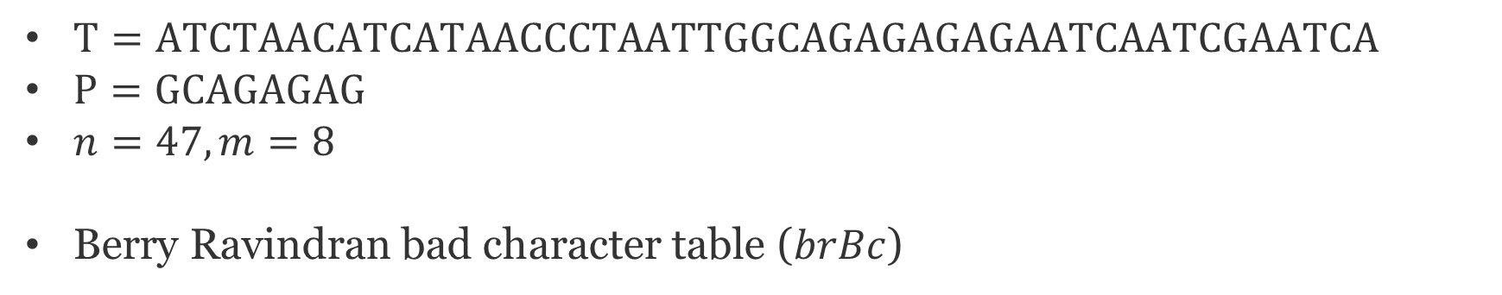
Preprocessing Phase (1/2)
$T=ATCTAACATCATAACCCTAATTGGCAGAGAGAGAATCAATCGAATCA$
$P=GCAGAGAG$
$n=47, m=8$
Berry Ravindran bad character table ($brBc$)
 | A | C | G | T
A | 10 | 10 | 2 | 10
C | 7 | 10 | 9 | 10
G | 1 | 1 | 1 | 1
T | 10 | 10 | 9 | 10

Slide 12
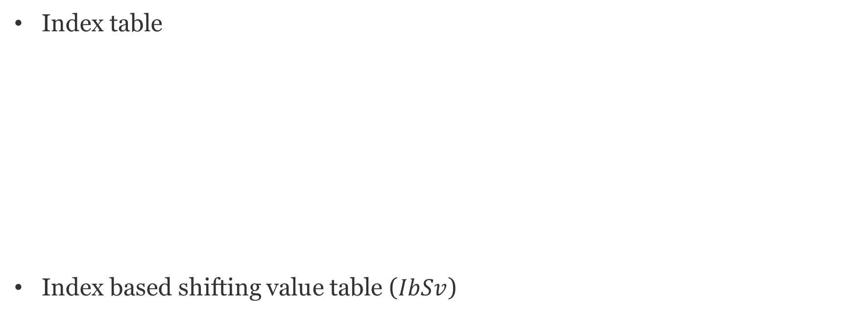
Preprocessing Phase (2/2)
Index table
Index based shifting value table ($IbSv$)
A | 0 | 4 | 5 | 7 | 10 | 12 | 13 | 18 | 19 | 25
 | 27 | 29 | 31 | 33 | 34 | 37 | 38 | 42 | 43 | 46
C | 2 | 6 | 9 | 14 | 15 | 16 | 24 | 36 | 40 | 45
G | 22 | 23 | 26 | 28 | 30 | 32 | 41
T | 1 | 3 | 8 | 11 | 17 | 20 | 21 | 35 | 39 | 44
G | 22 | 23 | 26 | 28 | 30 | 32

Slide 13
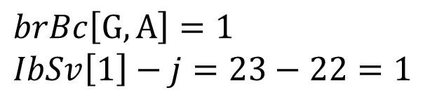




Searching Phase
$$T=ATCTAACATCATAACCCTAATTGGCAGAGAGAGAATCAATCGAATCA$$
$$P=GCAGAGAG$$
$brBc$
$IbSv$
$$j=22$$
 | A | C | G | T
A | 10 | 10 | 2 | 10
C | 7 | 10 | 9 | 10
G | 1 | 1 | 1 | 1
T | 10 | 10 | 9 | 10
$$T$$
… | A | T | T | G | G | C | A | G | A | G | A | G | A | G | …
$$P$$
G | C | A | G | A | G | A | G
$$brBc\left[G, A\right]=1$$
$$IbSv\left[1\right]−j=23−22=1$$
G | 22 | 23 | 26 | 28 | 30 | 32

Slide 14
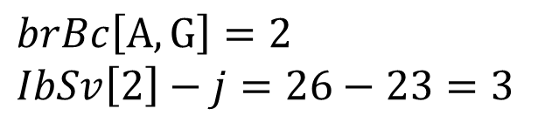

Searching Phase
$$T=ATCTAACATCATAACCCTAATTGGCAGAGAGAGAATCAATCGAATCA$$
$$P=GCAGAGAG$$
$brBc$
$IbSv$
$$j=23$$
 | A | C | G | T
A | 10 | 10 | 2 | 10
C | 7 | 10 | 9 | 10
G | 1 | 1 | 1 | 1
T | 10 | 10 | 9 | 10
$$T$$
… | T | T | G | G | C | A | G | A | G | A | G | A | G | A | …
$$P$$
G | C | A | G | A | G | A | G
$$brBc\left[A, G\right]=2$$
$$IbSv\left[2\right]−j=26−23=3$$
G | 22 | 23 | 26 | 28 | 30 | 32

Slide 15
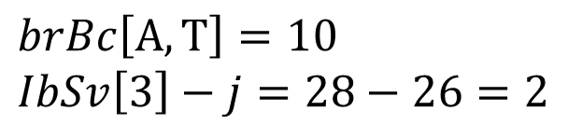

Searching Phase
$$T=ATCTAACATCATAACCCTAATTGGCAGAGAGAGAATCAATCGAATCA$$
$$P=GCAGAGAG$$
$brBc$
$IbSv$
$$j=26$$
 | A | C | G | T
A | 10 | 10 | 2 | 10
C | 7 | 10 | 9 | 10
G | 1 | 1 | 1 | 1
T | 10 | 10 | 9 | 10
$$T$$
… | G | C | A | G | A | G | A | G | A | G | A | A | T | C | …
$$P$$
G | C | A | G | A | G | A | G
$$brBc\left[A, T\right]=10$$
$$IbSv\left[3\right]−j=28−26=2$$
G | 22 | 23 | 26 | 28 | 30 | 32

Slide 16
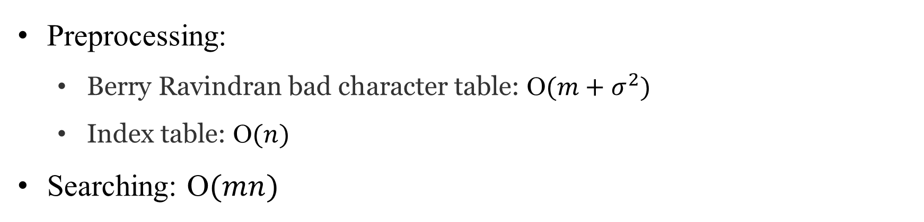
Time Complexity
Preprocessing:
Berry Ravindran bad character table: O$(m+σ^{2})$
Index table: O$(n)$
Searching: O$(mn)$

Slide 17
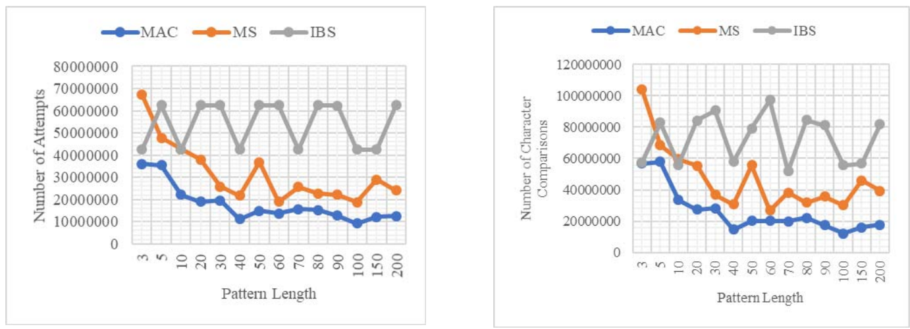
Experiments

