Slide 1
Not Playing With a Full Deck?
D. M. Anderson, T. P. Schulze, and B. N. Wahl
Recreational Mathematics Magazine,(2024) 11(18), 51-64.
Presenter: Hsin-Chang Yu
Date: Apr. 30, 2024

Slide 2
Abstract
A standard deck of 52 playing cards has 4 suits: clubs (♣), spades (♠), hearts (♥) and diamonds (♦). Each suit has 13 denominations, or ranks, 2, 3, 4, 5, 6, 7, 8, 9, 10, J (Jack), Q (Queen), K (King) and A (Ace). But sometimes, a card goes missing – lost between the couch cushions, clothes-pinned in the bike spokes, filched by the cat, eaten by the dog (see Figure 1), or maybe misplaced in a matching deck. You may find yourself not playing with a full deck. Building a house of cards? No problem. Playing poker? Problem. Or is it? Ask yourself the following question:

Slide 3
Abstract
What is the probability of being dealt a Two-Pair hand of five cards from a well-shuffled deck when the Ace of Spades is missing from the deck? Specifically, how does it compare to the probability of being dealt a Two-Pair hand from a standard 52-card deck?

Slide 4
Abstract
What does your ‘probability intuition’ tell you? On the one hand, with a missing Ace of Spades there are fewer Two-Pair hands. On the other hand, there are also fewer total five-card hands. The ratio of these two numbers defines the probability; which way it goes seems unclear. Let’s do the calculation – first for the standard 52-card deck and then for the 51-card deck missing the Ace of Spades.

Slide 5
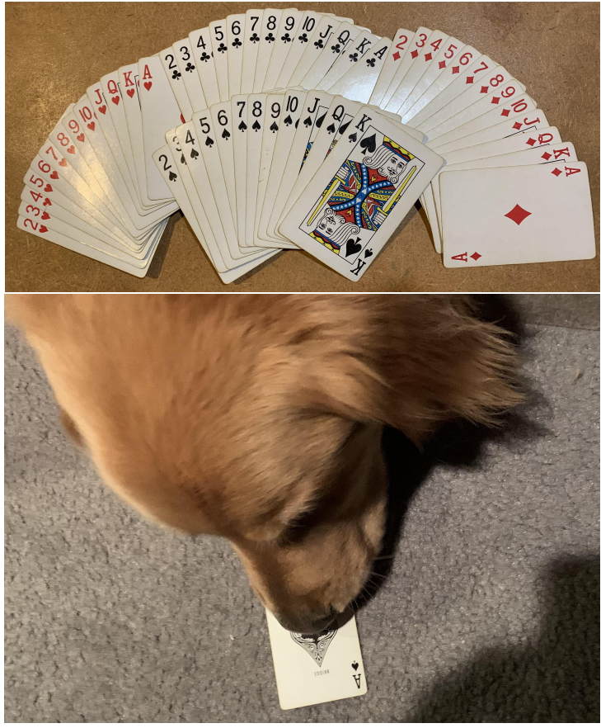
The Missing Card

Slide 6
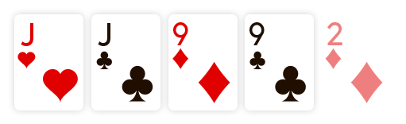

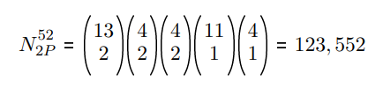

Two-Pair Hands

Slide 7

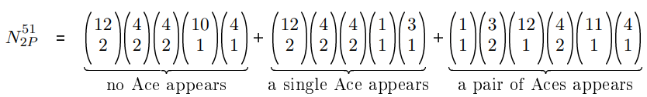



Two-Pair Hands

Slide 8
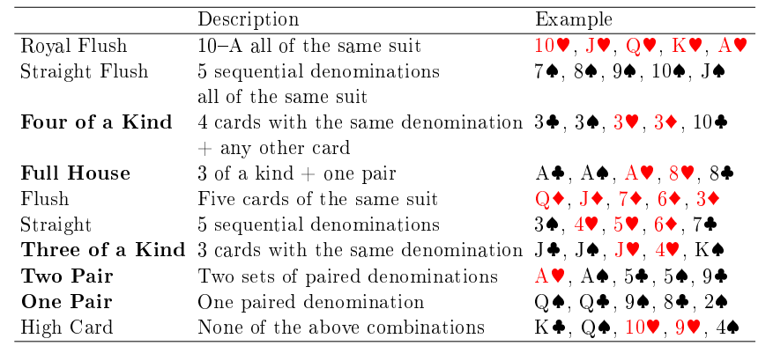

Slide 9
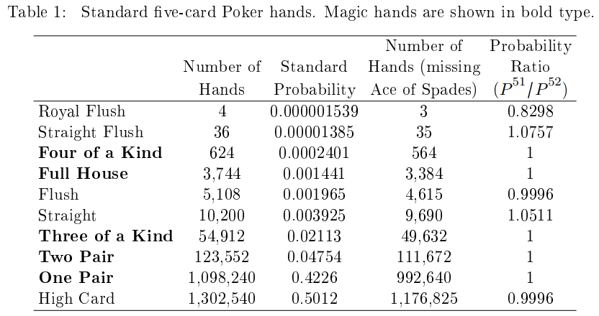

Slide 10
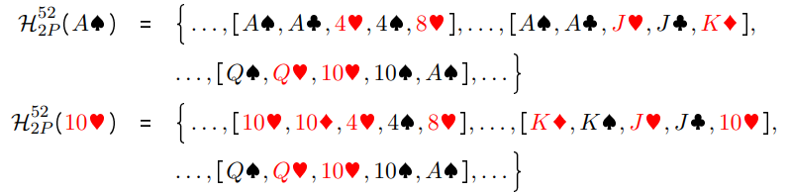


Magic Set

Slide 11
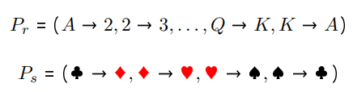


Magic Set

Slide 12








How The Magic Works

Slide 13



How The Magic Works

Slide 14
Other Games
Texas-Hold'em
Heartless Poker
Fat Pack
Double-Deck
Pinochle Deck

Slide 15
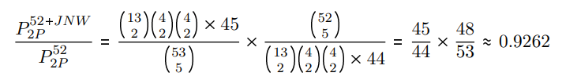
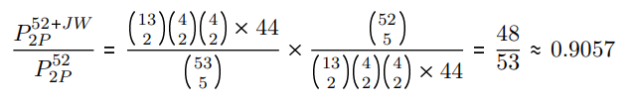
Wild Cards

Slide 16
Some remarks on the Game of Cycles
Robbert Fokkink and Jonathan Zandee
Recreational Mathematics Magazine,(2024) 11(18), 111 - 118.
Presenter: Hsin-Chang Yu
Date: Apr. 30, 2024

Slide 17
The Game of Cycles
Ryan Alvarado, Maia Averett, Benjamin Gaines, Christopher Jackson, Mary Leah Karker, Malgorzata Aneta Marciniak, Francis Su & Shanise Walker
Robbert Fokkink and Jonathan Zandee
The American Mathematical Monthly, (2021)128(10), 868-887.
Presenter: Hsin-Chang Yu
Date: Apr. 30, 2024

Slide 18
Abstract
The Game of Cycles, introduced by Su in 2020, is played on a simple connected planar graph together with its bounded cells, and players take turns marking edges with arrows according to a sink-source rule that gives the game a topological flavor. The object of the game is to produce a cycle cell—a cell surrounded by arrows all cycling in one direction—or to make the last possible move.

Slide 19
Abstract
We analyze the two-player game for various classes of graphs and determine who has a winning strategy. We also establish a topological property of the game: that a board with every edge marked must have a cycle cell.

Slide 20
Definitions
Given a planar graph G, we defined the following on G:
• A planar graph of vertices and edges divides the plane into regions, which we call cells.
• A graph together with its bounded cells is a game board.
• A cycle cell is an enclosed area of a graph with nothing inside of it such that every edge enclosing the area is directed the same direction (either clockwise or counterclockwise).
• A source is a vertex whose edges all point away from it.
• A sink is a vertex whose edges all point towards it.

Slide 21
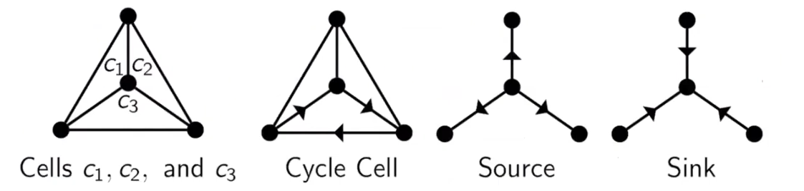
Definitions
• A cycle cell is an enclosed area of a graph with nothing inside of it such that every edge enclosing the area is directed the same direction (either clockwise or counterclockwise).
• A source is a vertex whose edges all point away from it.
• A sink is a vertex whose edges all point towards it.

Slide 22
Rules
• Two players take turns marking one unmarked edge with an arrow pointing in one direction or the other.
• Arrows must obey the sink-source rule: players are not allowed to create a sink or a source.
• Each edge can only admit one arrow. Arrows serve the same function in the game no matter who marks them.
• Player must make a move if they have a move available to them.

Slide 23
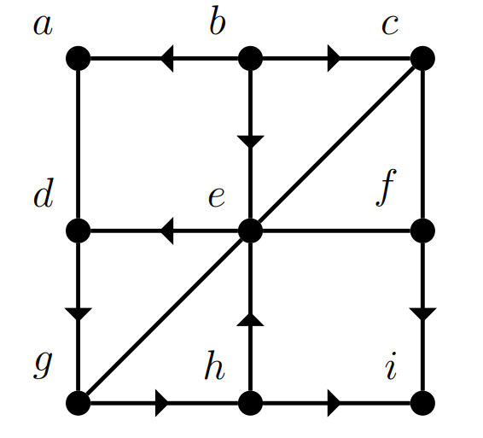
Example

Slide 24
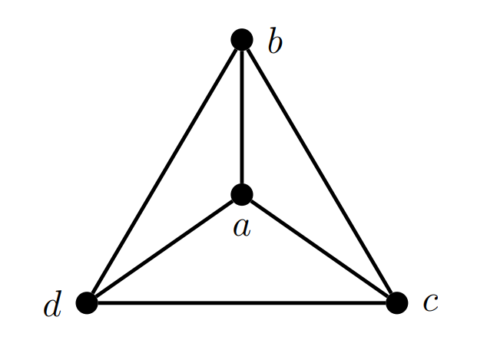

Slide 25
Thanks
Notes:
Given a string S of length n, an integer p ∈ [1..n] is a period of S if S[i] = S[i + p] for all i ∈ [1..n − p].
S[|S| − p + 1] = c

