Slide 1
QSAR study on melanocortin-4 receptors by support vector machine
Eslam Pourbasheer, Siavash Riahi, Mohammad Reza Ganjali, Parviz Norouzi
European Journal of Medicinal Chemistry, Vol. 45, pp. 1087-1093, 2010.
Presenter: Hong-Yu Chen
Date: Feb. 15, 2011

Slide 2
Abstract (1/3)
Quantitative structure activity relationship (QSAR) of the melanocortin-4 receptor (MC4R) binding affinities (Ki) of trans-4-(4-chlorophenyl) pyrrolidine-3-carboxamides of piperazinecyclohexanes was studied. A suitable set of molecular descriptors was calculated and the genetic algorithm (GA) was employed to select those descriptors that resulted in the best-fit models.

Slide 3
Abstract (2/3)
The multiple linear regression (MLR), and the support vector machine (SVM) were utilized to construct the linear and nonlinear QSAR models. The models were validated using Leave-One-Out (LOO) and Leave-Group-Out (LGO) crossvalidation, external test set, and chance correlation. The SVM model generalizes better than the MLR model.

Slide 4
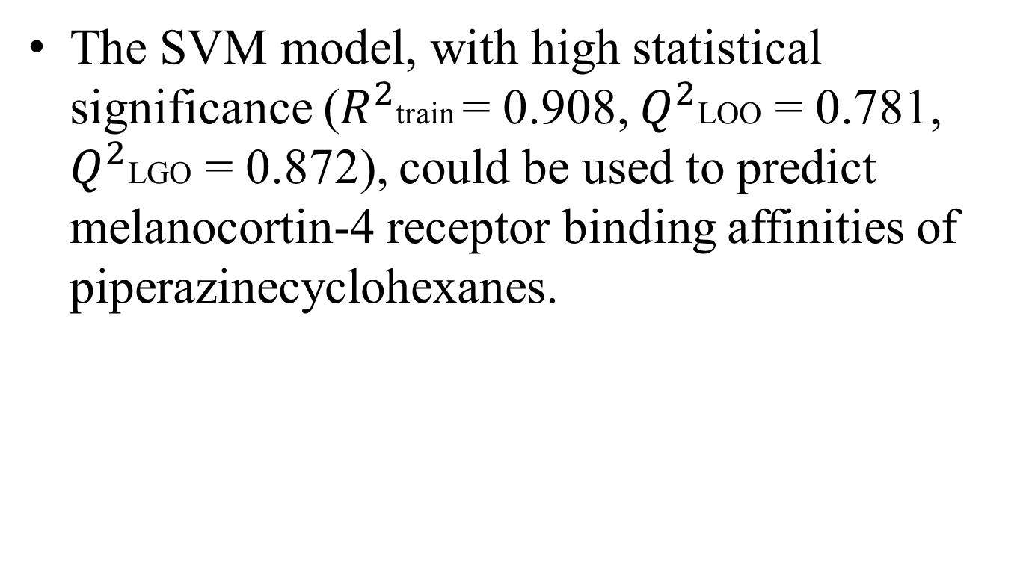
Abstract (3/3)

Slide 5
Melanocortin-4 receptors (MC4R)
黑素皮質素4受體
一種與體重及代謝相關的基因
Mutations in the MC4R are the most common monogenic form of obesity

Slide 6
Quantitative structure activity relationship (QSAR)
定量構效關係
  一種藉助分子的理化性質參數或結構參數，以數學和統計學手段定量研究有機小分子與生物大分子相互作用、有機小分子在生物體內吸收、分布、代謝、排泄等生理相關性質的方法。
二維
  活性參數、結構參數
三維
Notes:
先講動機
1.
2. There are applications where the data items have a small amount of noise.

Slide 7
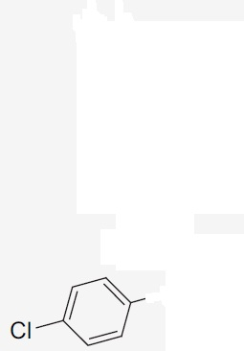
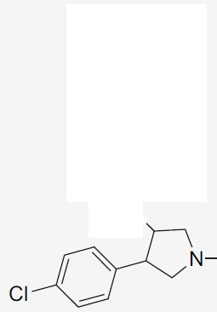
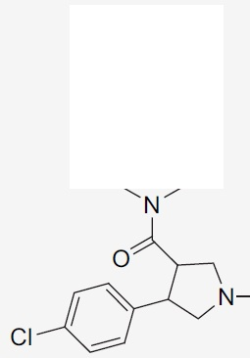
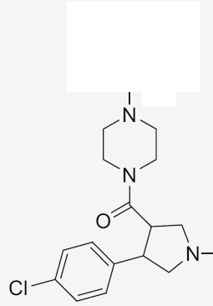
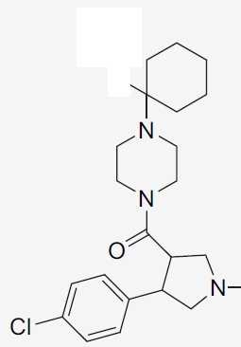
Main aim
To establish a new QSAR model for predicting binding affinity of the trans-4-(4-chlorophenyl) pyrrolidine-3-carboxamides of piperazinecyclohexanes as ligands for the melanocortin-4 receptor.
反- 4 -（4 -氯苯基）吡咯烷- 3 -哌嗪酰胺環己烷
MC4R binding affinities, Ki
  The logarithmic scale: pKi

Slide 8
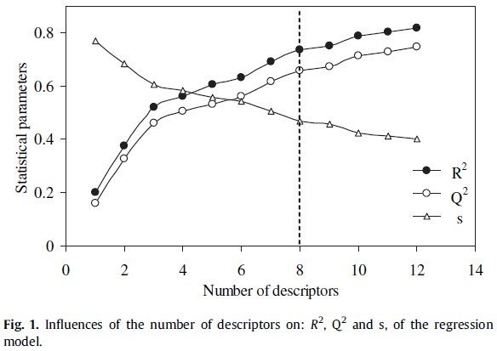
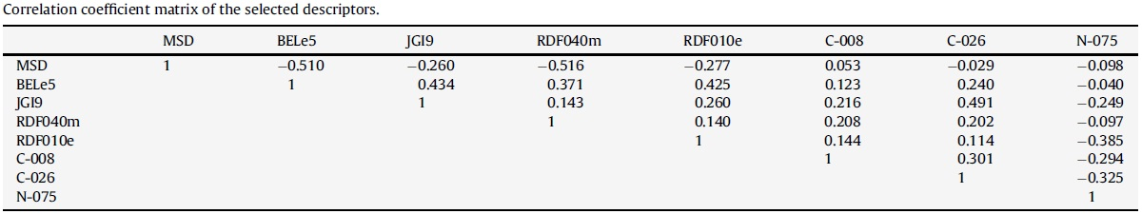
Selection of descriptors

Slide 9
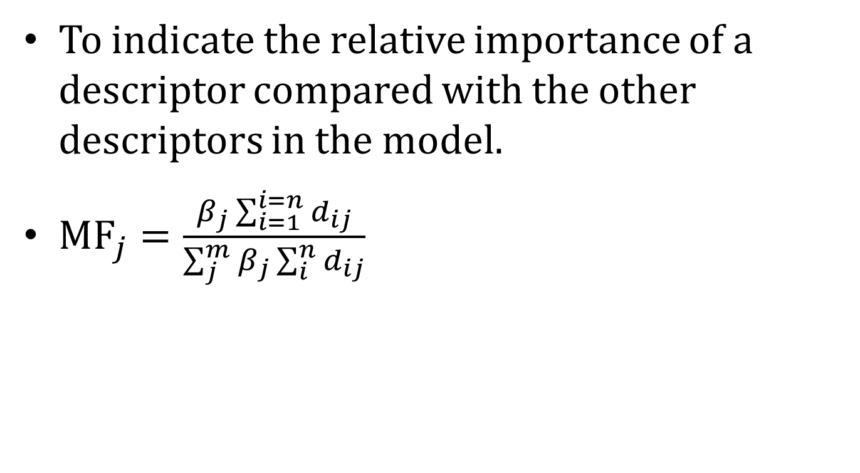
Mean effect (MF) (1/2)

Slide 10
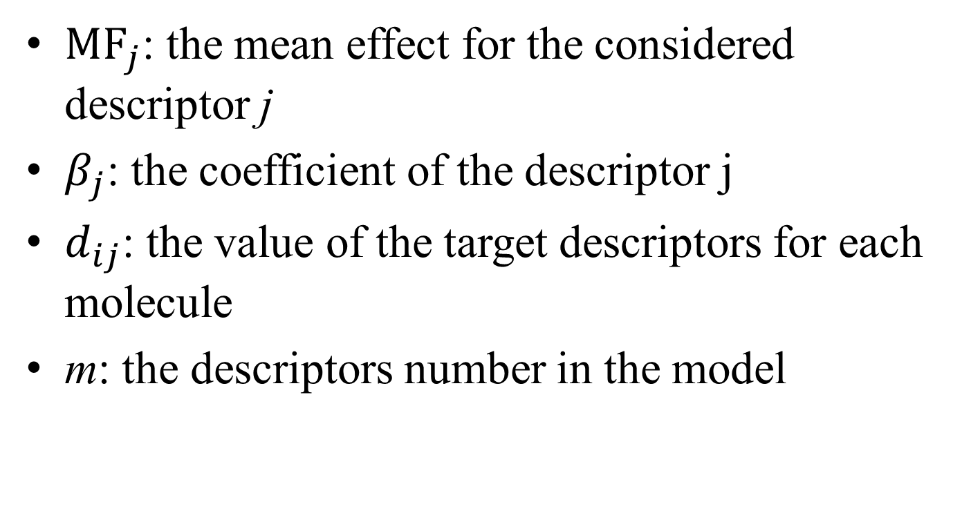
Mean effect (MF) (2/2)

Slide 11
Descriptors (1/2)
MSD 0.454
  By increasing the molecular branch, the pKi value decreases.
BELe5 0.850
  The electro-negativity of molecules is directly related to pKi values.
JGI9 -0.144
  To evaluate the charge transfer between pairs of atoms, and therefore the global charge transfer in the molecule.
  Closely related to the molecular branching.

Slide 12
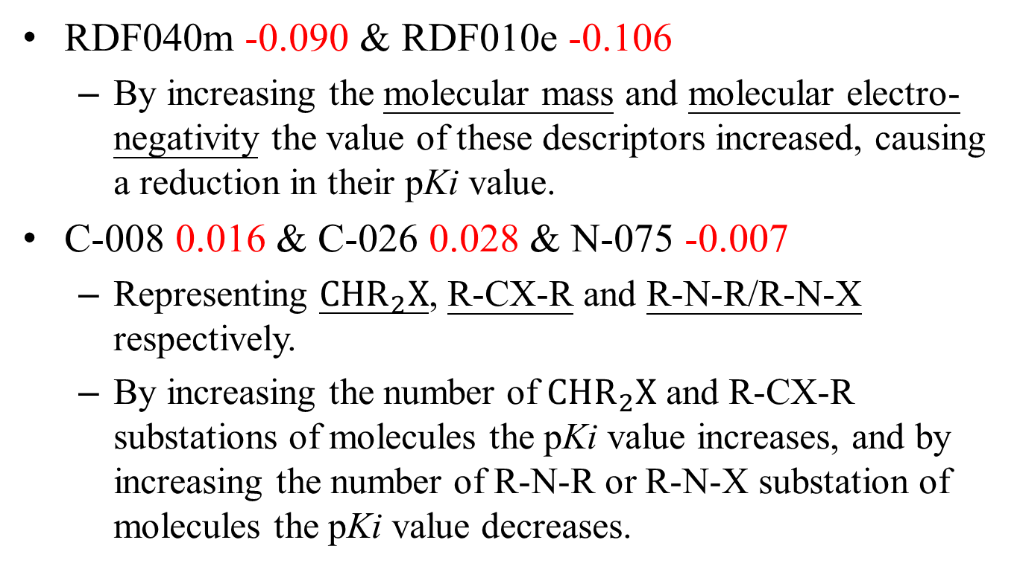
Descriptors (2/2)

Slide 13
Multiple linear regression (MLR)
As a linear technique for the construction of the QSAR models.
pKi = – 16.251(±4.498) + 47.465(±12.437)MSD
+ 12.540(±1.759)BELe5 – 286.790(±64.271)JGI9
– 0.125(±0.027)RDF040m – 0.213(±0.089)RDF010e
+ 0.439(±0.138)C-008 + 0.462(±0.110)C-026
– 0.908(±0.170)N-075

Slide 14
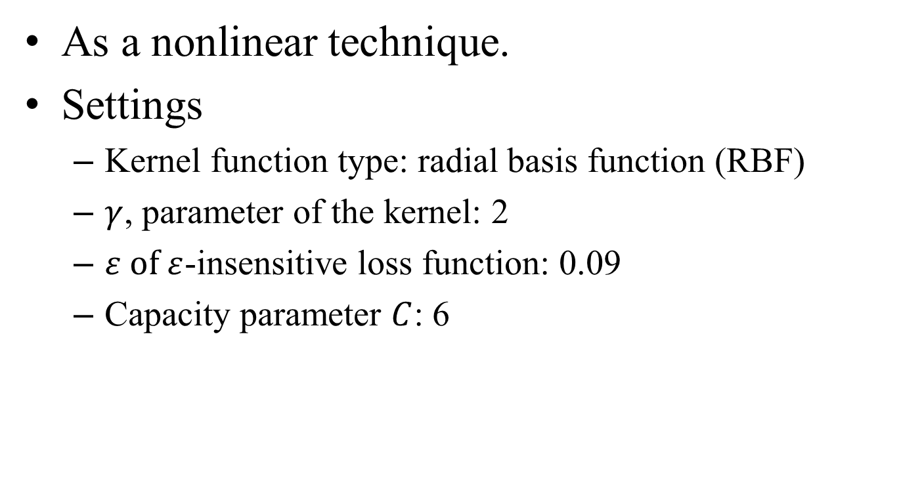
Support vector machine (SVM)
Notes:
1. Find a longest almost-increasing subsequence whose largest element is 𝑥_𝑖.

Slide 15
Validations
Leave-one-out (LOO)
Leave-group-out (LGO)
External test set
Chance correlation procedure

Slide 16
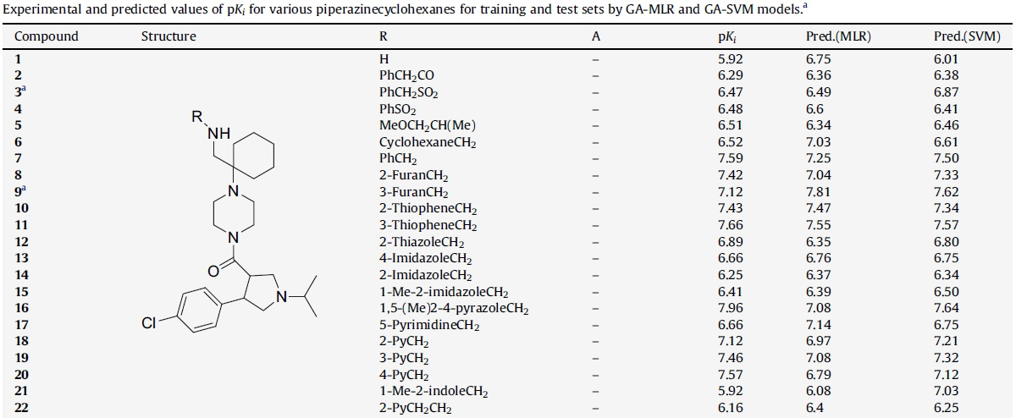
Experiment (1/4)

Slide 17
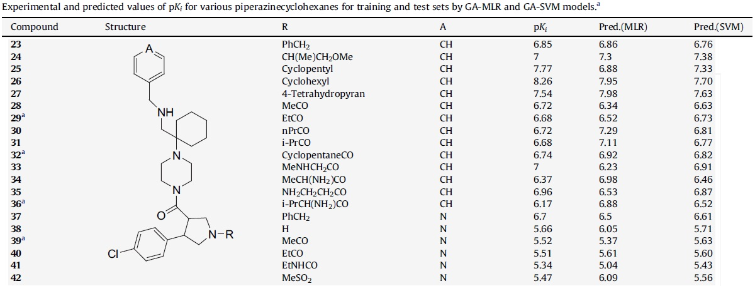
Experiment (2/4)

Slide 18
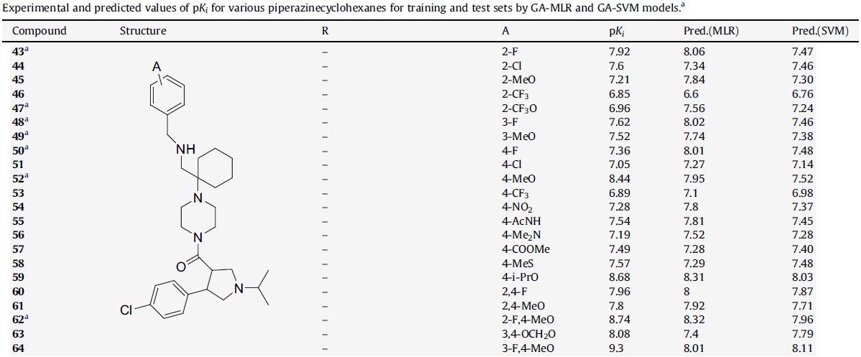
Experiment (3/4)

Slide 19
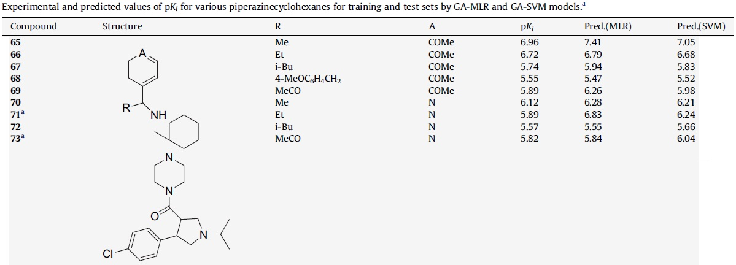
Experiment (4/4)

Slide 20
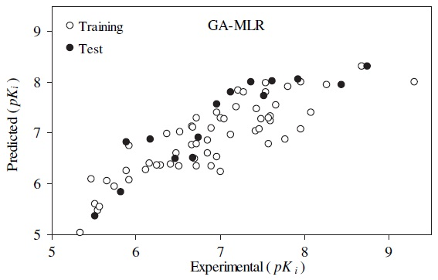
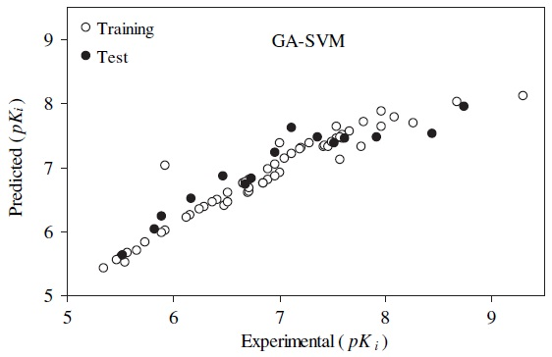
Comparision

Slide 21
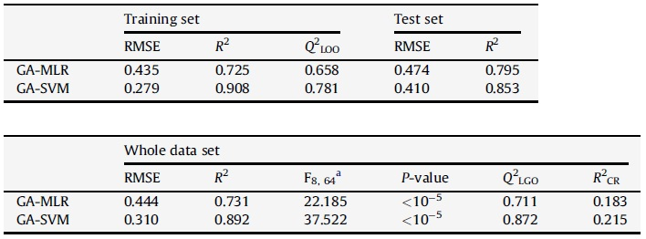
Conclusion

