Slide 1
Molecular modeling studies of vascular endothelial growth factor receptor tyrosine kinase inhibitors using QSAR and docking
Juan Du, Beilei Lei, Jin Qin, Huanxiang Liu, Xiaojun Yao,
Journal of Molecular Graphics and Modelling 27 (2009) 642–654
Date: 2011.02.15
Speaker: Chuang You Chung
2009.05.17

Slide 2
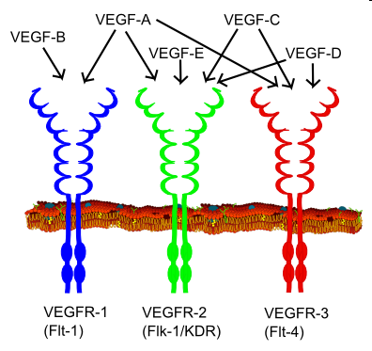
Introduction
Vascular endothelial growth factor (VEGF)
VEGFR-1 (Flt-1)
VEGFR-2 (KDR)
Angiogenesis
http://en.wikipedia.org/wiki/File:VEGF_receptors.png

Slide 3
Introduction
Bevacizumab
Sunitinib and Sorafenib
A novel series of KDR inhibitors:
Harmange et al. [33–35].

Slide 4
Introduction
Compound
Determine the structure of compound
Alignment: co-crystallized conformer
docked conformer
CoMFA & CoMSIA
Combine the contour map with receptor

Slide 5
Computational details
Dataset
KDR inhibitor
82 compounds
(pIC₅₀ = 5.8-9.7)
Training set: 63
Test set: 19*

Slide 6
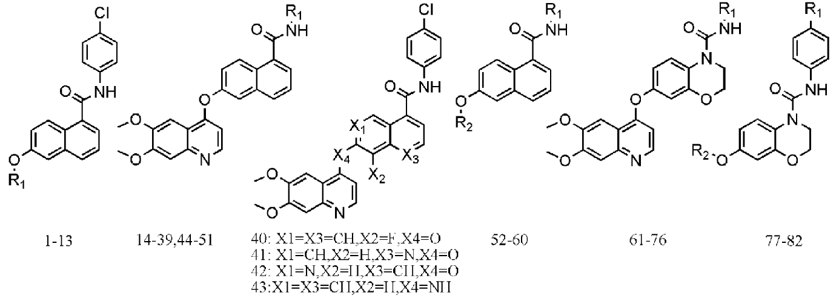
Computational details
Total: 13 38 9 16 6
Train: 10 27 8 13 5
Test : 3 11 1 3 1
No.(t): 3,7,12 16-18,21,22 54 61,71,74 82
29,43,44,46
49,51

Slide 7
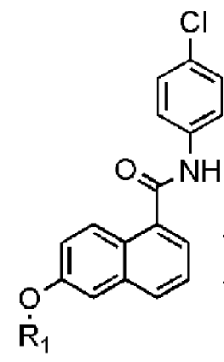
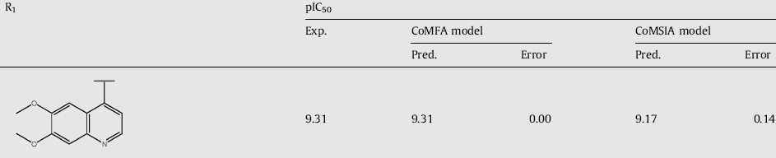
Computational details
Compound-10 (PDB:3B8Q)
co-crystallized conformer-based alignment (CCBA)
docked conformer-based alignment (DCBA)

Slide 8
Computational details
Sybyl 6.9
CCBA: Powell, MMFF94
DCBA: FlexX, 6.5Å radius
Alignment: Database Alignment

Slide 9
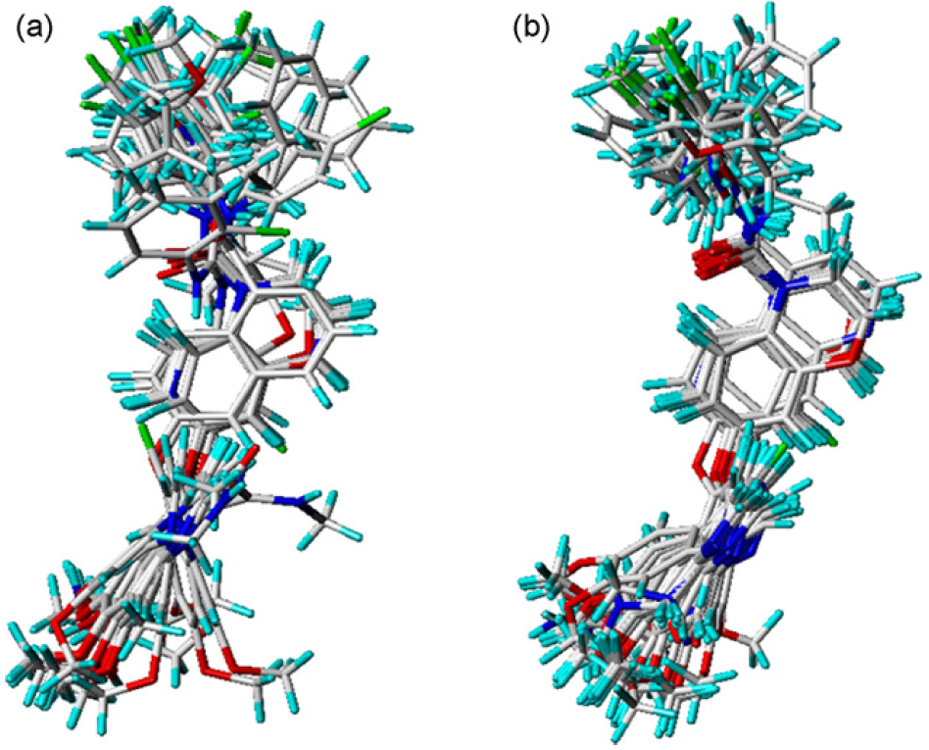
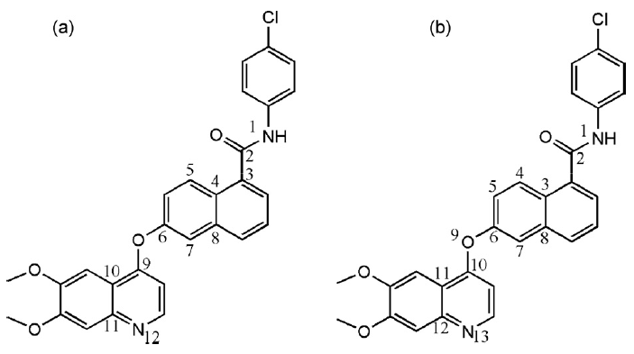
Computational details
CCBA
DCBA
1-60
61-82

Slide 10
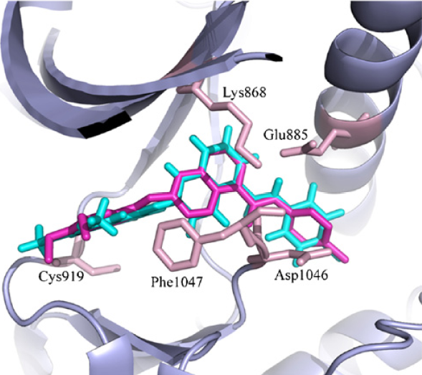
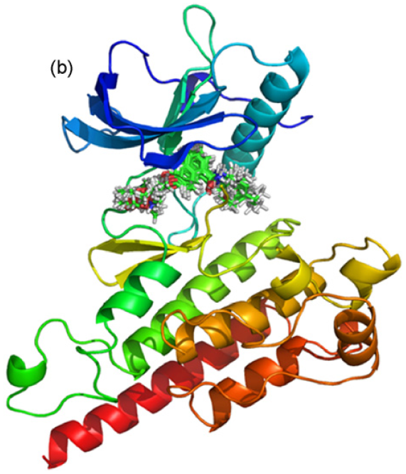
Results
Docking: FlexX
Templete: 3B8Q v.s redocked
➔ RMSD: 0.69Å
Binding conformations

Slide 11
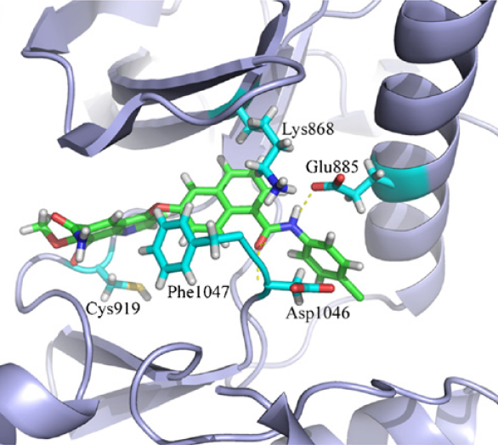
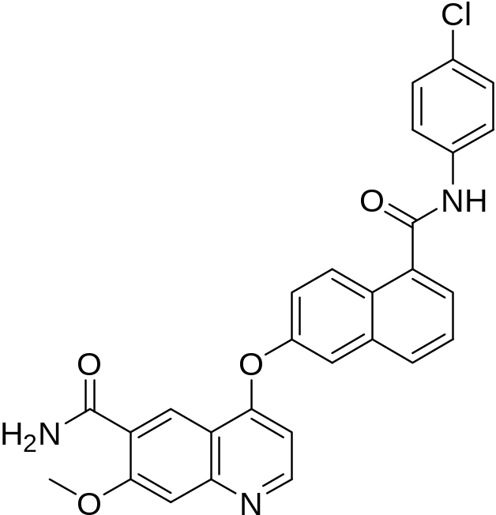
Results and discussion
CPD:12

Slide 12
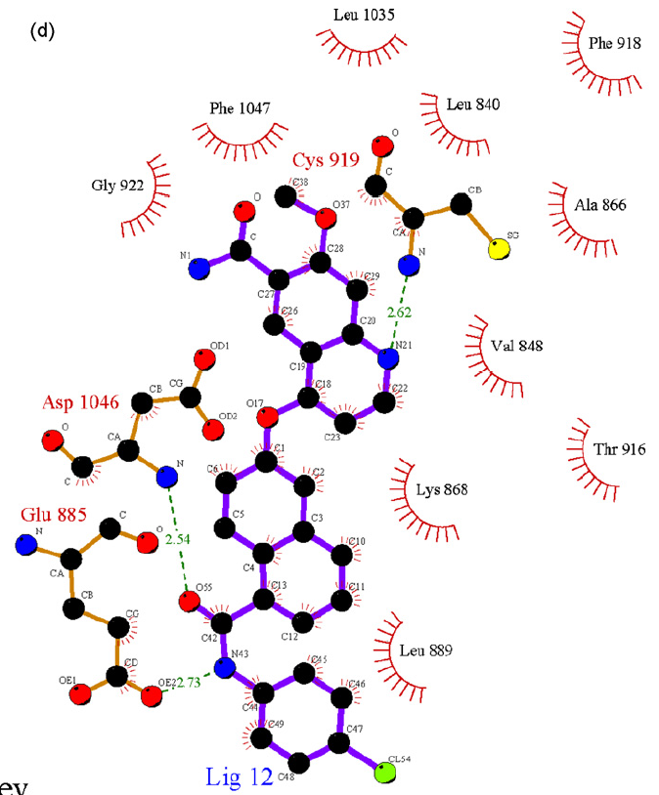
Results and discussion
Hydrophobic interaction

Slide 13


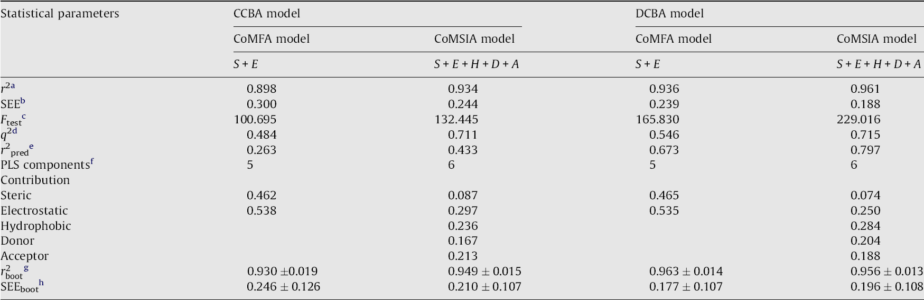
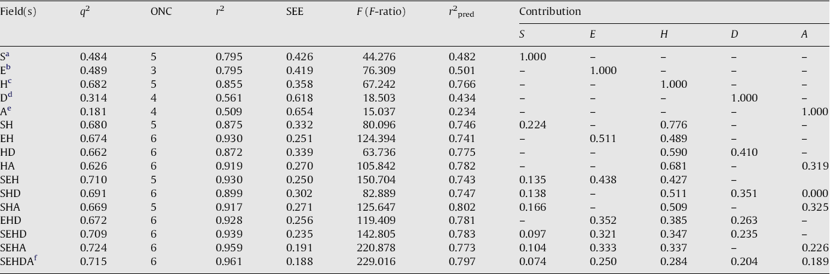
Results
100 runs
F ratio: r²/(1-r²)

Slide 14
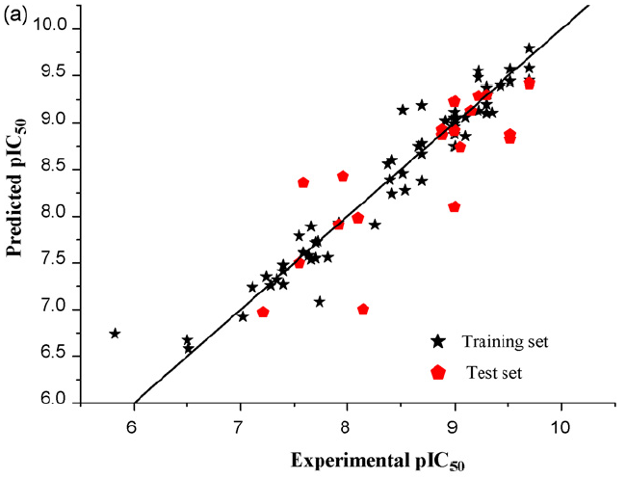
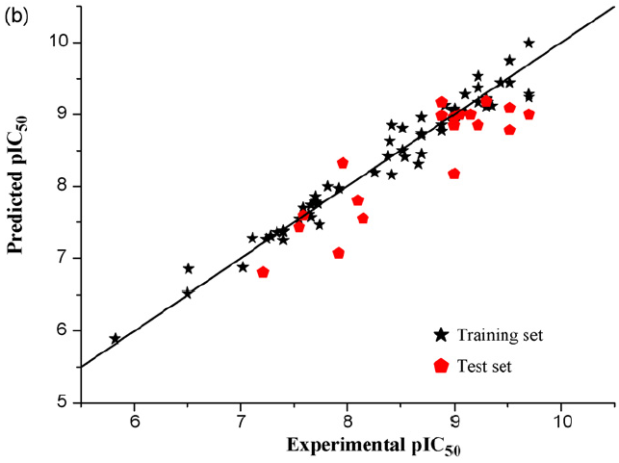
Results-DCBA
CoMFA CoMSIA
q² 0.546
r² 0.936
r²p 0.673
q² 0.715
r² 0.961
r²p 0.797

Slide 15
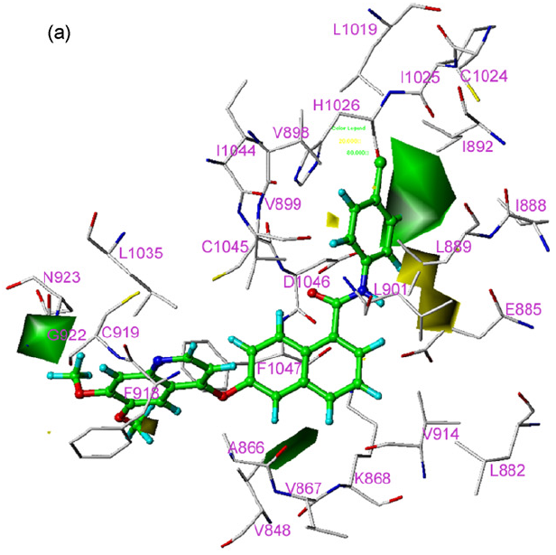
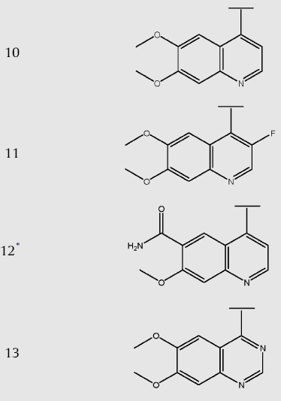
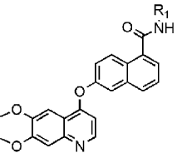

Discussion CoMFA
Green(+) and yellow(-):
Steric field for activity
9.31
7.70
9.70
8.70
9.70
8.70

Slide 16
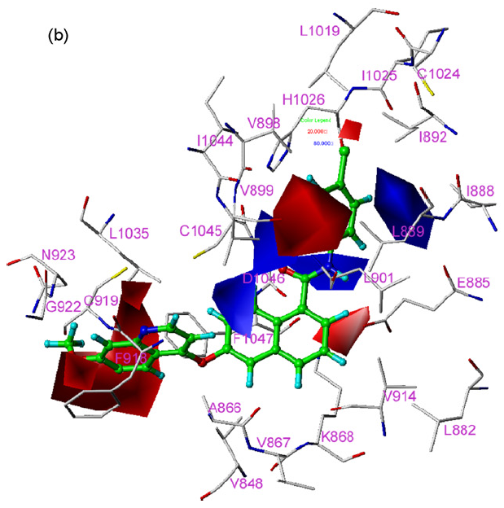
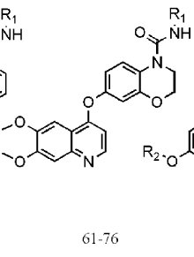
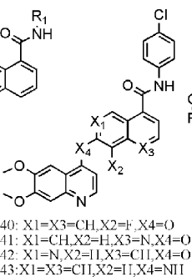
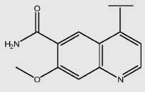
Discussion CoMFA
Blue(+) and red(-):
Electrostatic field for activity
4’
3’
64,67
77, 78

Slide 17
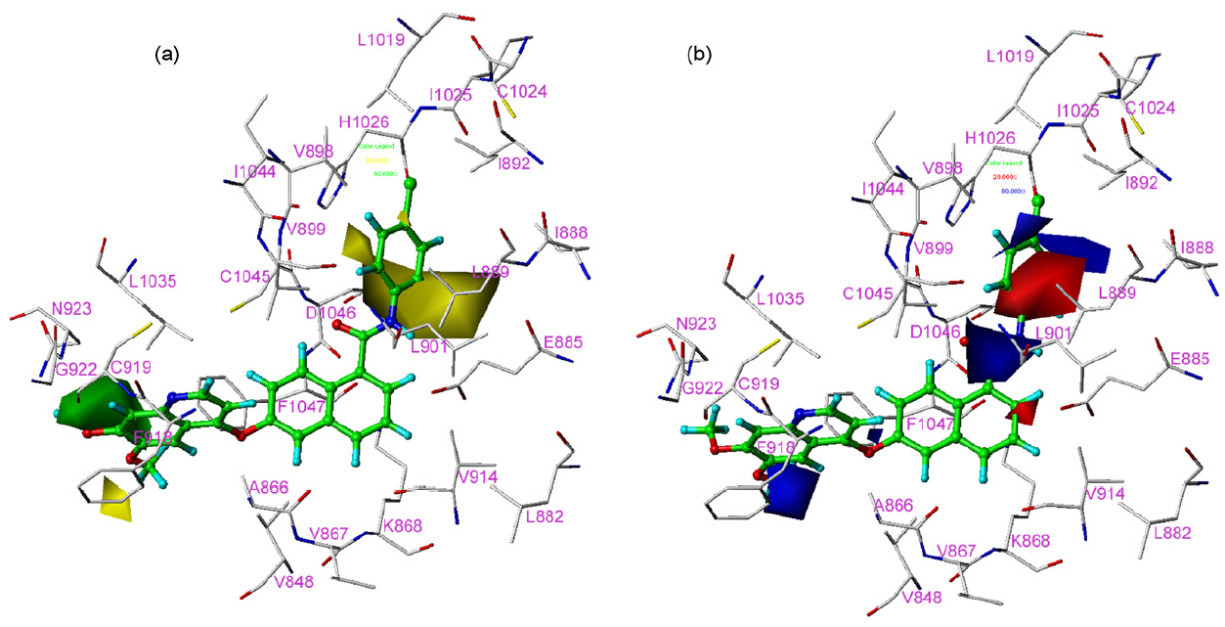
Discussion CoMSIA
Green(+) and yellow(-):
Steric field for activity
Blue(+) and red(-):
Electrostatic field for activity

Slide 18
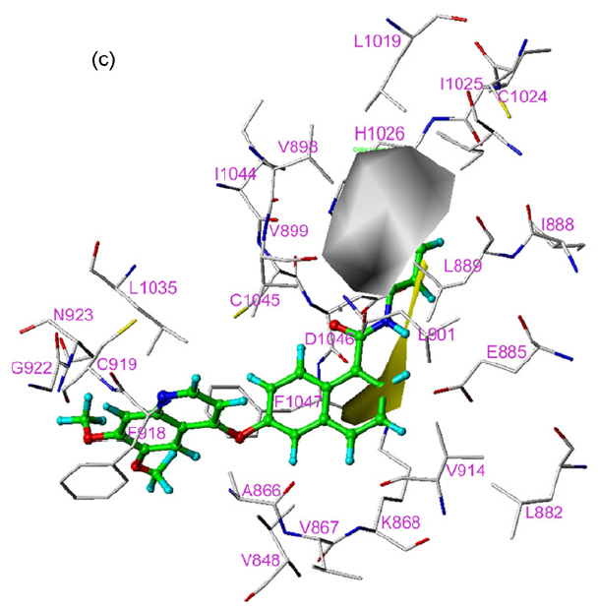
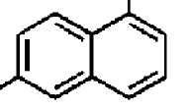
Discussion CoMSIA
Yellow(+) and white(-):
Hydrophobic field for activity
-Cl, -F, -OH
Leu840, Val848, Ala866,
Lys868, Leu889, Thr916,
Phe918, Gly922, Leu1035,
Phe1047

Slide 19
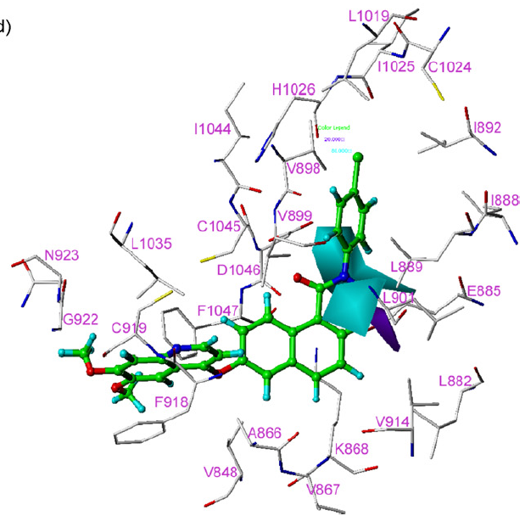

Discussion CoMSIA
Cyan(+) and purple(-):
H.D field for activity
Glu885: COO⁻

Slide 20
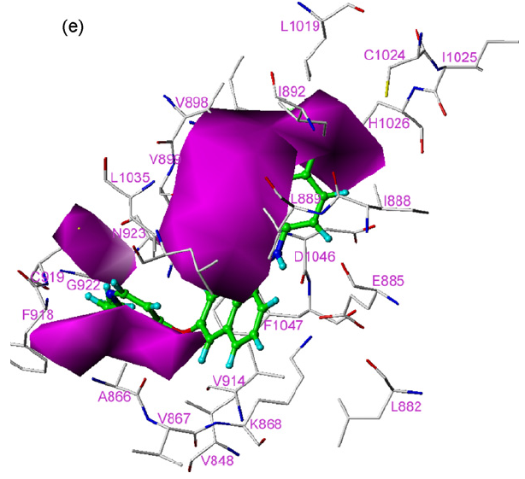
Discussion CoMSIA
Magenta(+) and red(-):
H.A field for activity
Asp1064: B.B -NH
Cys919: B.B -NH

Slide 21
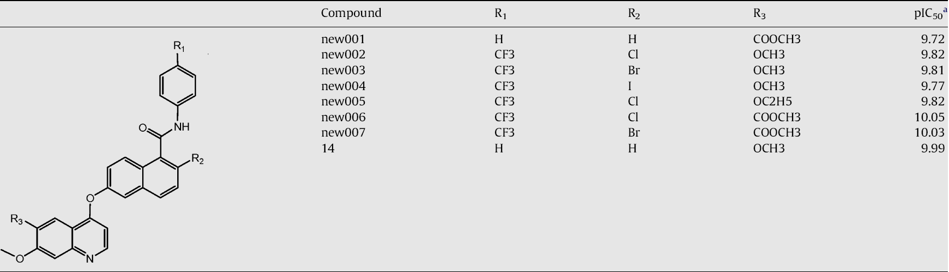
Discussion
Designing of potent analogs
CoMSIA_{p}

Slide 22
Conclusion
DCBA is better than CCBA
Provide useful information
Design novel molecules with desired activity.

Slide 23
THE END

Slide 24
Introduction
CoMFA比較分子力場分析原理
CoMFA的基本步驟：
1.化合物結構活性確定
2.化合物分子疊合
3.空間作用力場確立
4.分析計算
5.模型建立
6.分析

Slide 25
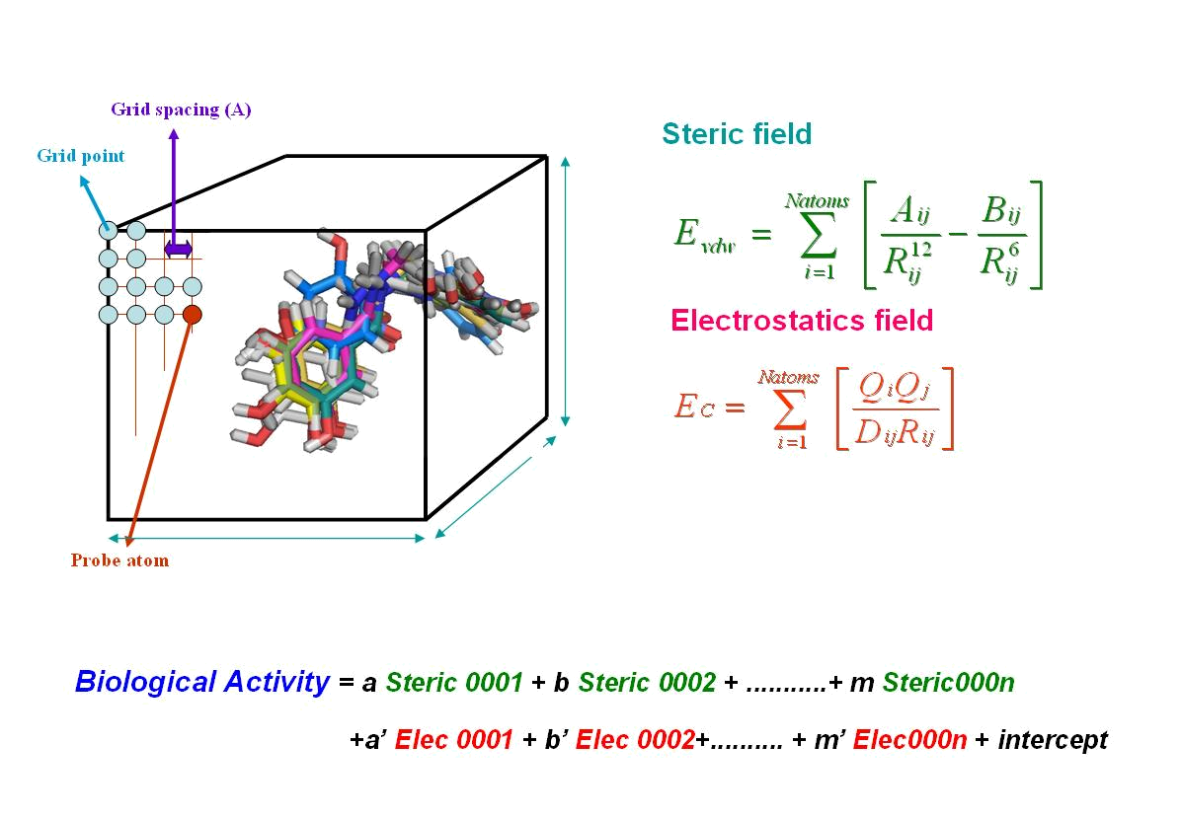
Introduction
Lennard-Jones 6-12勢函公式
Columbic Potential公式
CoMFA比較分子力場分析原理
經過運算後得到下列之式子：
Biological Activity = a Steric 0001 + b Steric 0002 + ...........+ m Steric000n
+a’Elec 0001 + b’Elec 0001+.......... + m’Elec000n + intercept
= aX+B

Slide 26
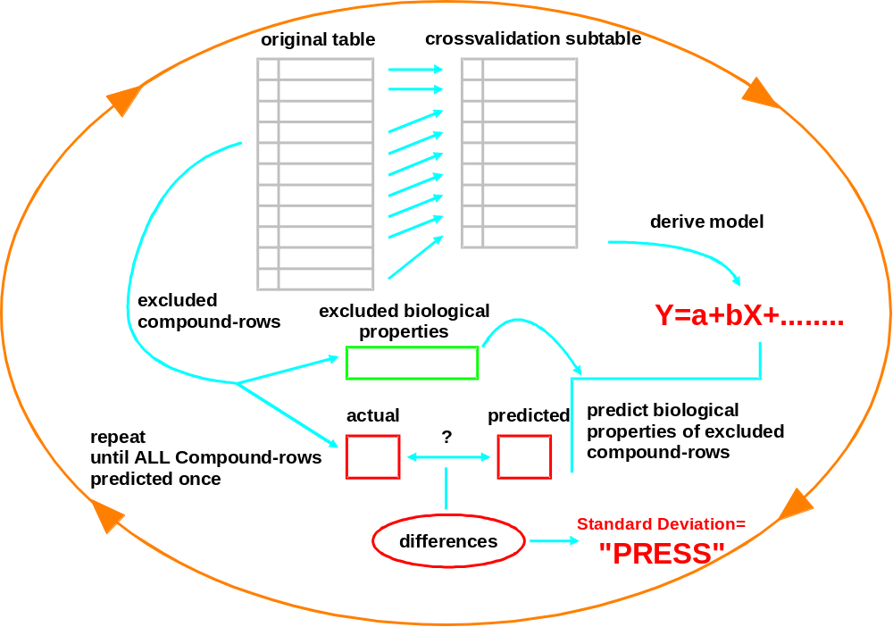
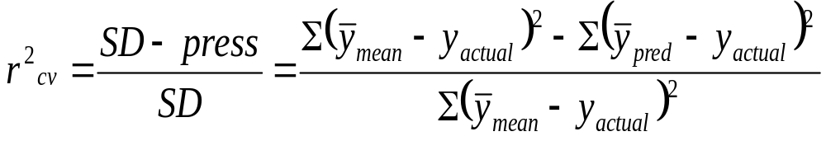
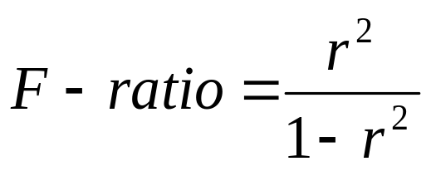
Introduction
CoMFA比較分子力場分析原理

Slide 27
Introduction
CoMSIA比較分子類似指數分析原理
1994年，德國的klebe提出CoMSIA比較分子類似指數分析(Comparative Molecular Similarity Indices Analysis) 。
該方法的基礎與CoMFA類似，操作流程一樣，最大的差異性在於將CoMFA中的分子場能量函數由Lennard-Jones 6-12變為和距離有關的高斯函數(Gaussian-type function)。
CoMSIA中定義了5個分子特徵：空間場、靜電場、疏水場、氫鍵給體、氫鍵受體，分別可由下列式子得到：

Slide 28
Introduction
CoMFA與CoMSIA比較
因為不同的網格點大小以及疊合分子的空間取向定位對於CoMFA的傳統靜電場以及空間場函數有很大的影響，進而造成q²的差異。
所以CoMSIA採用的是與距離相關的高斯函數，對於網格點大小以及疊合分子空間取向的影響要來的穩定。但是也因此失去了對於本質的空間場以及靜電場的的描述。
 | CoMFA | CoMSIA
優 | 真實反應分子整體性質與受 體作用的各種勢能場分布明確 | 較CoMFA有較model
缺 | 對於網格點大小與疊合空間取 向極度敏感 | 失去本質的靜電場與 空間場描述

