Slide 1
Prediction of protein structural class with Rough Sets
Youfang Cao, Shi Liu, Lida Zhang, Jie Qin, Jiang Wang and
Kexuan Tang(唐克軒)
BMC Bioinformatics 2006, 7:20
Speaker: Chong-Jie Wang
Date: February 15, 2011

Slide 2
Abstract
Background: A new method for the prediction of protein structural classes is constructed based on Rough Sets algorithm, which is a rule-based data mining method. Amino acid compositions and 8 physicochemical properties data are used as conditional attributes for the construction of decision system. After reducing the decision system, decision rules are generated, which can be used to classify new objects.

Slide 3
Abstract
Results: In this study, self-consistency and jackknife tests on the datasets constructed by G.P. Zhou (Journal of Protein Chemistry, 1998, 17: 729–738) are used to verify the performance of this method, and are compared with some of prior works. The results showed that the rough sets approach is very promising and may play a complementary role to the existing powerful approaches, such as the component-coupled, neural network, SVM, and LogitBoost approaches.
Conclusion: The results with high success rates indicate that the rough sets approach as proposed in this paper might hold a high potential to become a useful tool in bioinformatics.

Slide 4
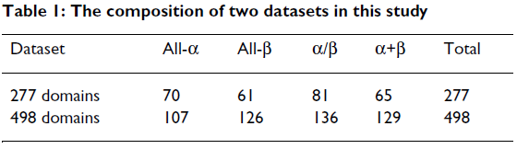
dataset
Extracted from SCOP
Two datasets: the one of 277 domains contains 46651 decision rules and the other 498 domains contains 52474 decision rules

Slide 5
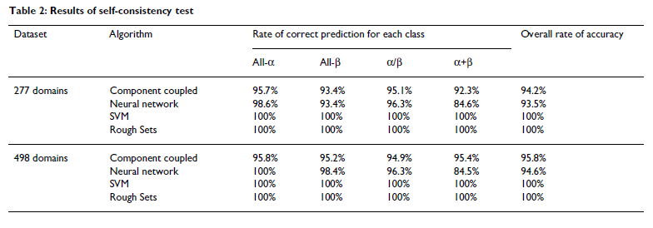
Result : self-consistency

Slide 6
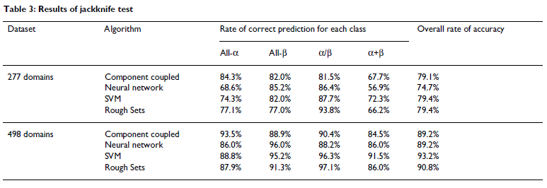
Result : jackknife

Slide 7
Rough sets
construction of decision tables
model induction
model evaluation

Slide 8
construction of decision tables
A = {U, A ∪ {d}}
A: conditional attribute set
d: decision attribute
A is made of 2 parts:
S₁ = {A, R, N, …, Y, V},
S₂ = {KR, ED, AGP, KRED, KR-ED, FIKMNY, LVIFM, ST}

Slide 9
model induction
IND_{A}(A,x,d): the set of objects that are indiscernible from x with respect to the decision attribute d
RED_{A}(x,d): the set of minimal sets of attributes B ⊆ A such that IND_{A} (B,x,d) = IND_{A} (A,x,d)

Slide 10
Thanks for your listening

