Slide 1
The constrained longest common subsequence problem
Yin-Te Tsai(蔡英德)
Information Processing Letters
Vol. 88, pp. 173-176, 2003
Speaker: Kai-Yuan Cheng
Date: July 5, 2011

Slide 2
Abstract
This paper considers a constrained version of longest common subsequence problem for two strings. Given strings S₁, S₂ and P, the constrained longest common subsequence problem for S₁ and S₂ with respect to P is to find a longest common subsequence lcs of S₁ and S₂ such that P is a subsequence of this lcs. An O(r n²m²) time algorithm based upon the dynamic programming technique is proposed for this new problem, where n, m and r are lengths of S₁, S₂ and P, respectively.

Slide 3
LCS and CLCS
Ex:
S₁ = TAGTCACG
S₂ = AGACTGTC
P = ATG
LCS = AGACG
CLCS = AGTG

Slide 4
The LCS algorithm
Let A = a₁ a₂ … a_{m} and B = b₁ b₂ … b_{n}
Let L_{i,j} denote the length of the longest common subsequence of a₁ a₂ … a_{i} and b₁ b₂ … b_{j.}
L_{i,j} = L_{i-1,j-1} + 1 if a_{i}=b_{j}
max{ L_{i-1,j}, L_{i,j-1} } if a_{i}≠b_{j}
L_{0,0} = L_{0,j} = L_{i,0} = 0 for 1≤i≤m, 1≤j≤n.
7 -<number>

Slide 5
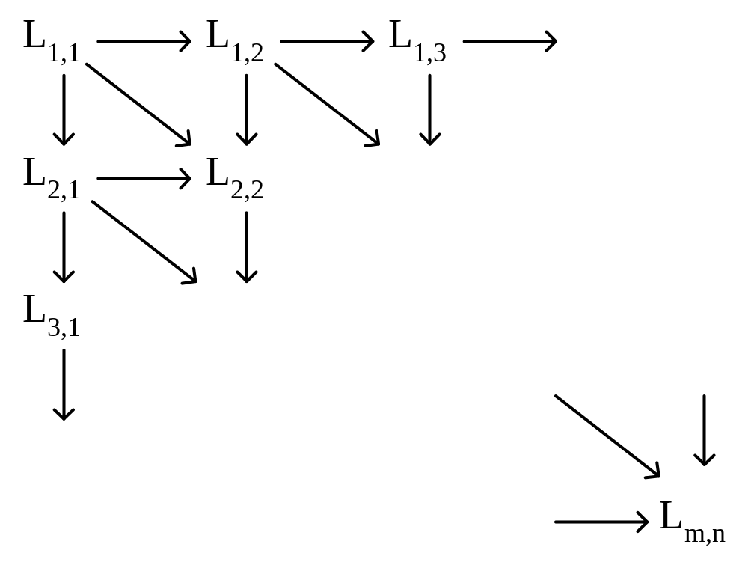
The dynamic programming approach for solving the LCS problem:
Time complexity: O(mn)
7 -<number>

Slide 6
LCS
Ex:
S₁ = TAGTCACG
S₂ = AGACTGTC
LCS = AGACG
 | - | A | G | A | C | T | G | T | C
- | 0 | 0 | 0 | 0 | 0 | 0 | 0 | 0 | 0
T | 0 | 0 | 0 | 0 | 0 | 1 | 1 | 1 | 1
A | 0 | 1 | 1 | 1 | 1 | 1 | 1 | 1 | 1
G | 0 | 1 | 2 | 2 | 2 | 2 | 2 | 2 | 2
T | 0 | 1 | 2 | 2 | 2 | 3 | 3 | 3 | 3
C | 0 | 1 | 2 | 2 | 3 | 3 | 3 | 3 | 4
A | 0 | 1 | 2 | 3 | 3 | 3 | 3 | 3 | 4
C | 0 | 1 | 2 | 3 | 4 | 4 | 4 | 4 | 4
G | 0 | 1 | 2 | 3 | 4 | 4 | 5 | 5 | 5

Slide 7


Lemma 1

Slide 8
S₁ = TAGTCACG
S₂ = AGACTGTC
P = ATG
 | - | A | G | A | C | T | G | T | C
-
T
A |  | 1 |  | 1
G
T
C
A |  | 1 |  | 3
C
G
 | - | A | G | A | C | T | G | T | C
-
T |  |  |  |  |  | - |  | -
A
G
T |  |  |  |  |  | 3 |  | 3
C
A
C
G
 | - | A | G | A | C | T | G | T | C
-
T
A
G |  |  | - |  |  |  | -
T
C
A
C
G |  |  | - |  |  |  | 4

Slide 9
 | -
- | 0
T | 0
S₁ = TAGTCACG
S₂ = AGACTGTC
P = ATG
L₁(2,1) = LCS(T, -) + 1
 | - | A | G | A | C | T | G | T | C
-
T
A |  | 1
G
T
C
A
C
G

Slide 10
 | - | A | G
- | 0 | 0 | 0
T | 0 | 0 | 0
S₁ = TAGTCACG
S₂ = AGACTGTC
P = ATG
L₁(2,3) = LCS(T, AG)+ 1
 | - | A | G | A | C | T | G | T | C
-
T
A |  |  |  | 1
G
T
C
A
C
G

Slide 11
 | -
- | 0
T | 0
A | 0
G | 0
T | 0
C | 0
S₁ = TAGTCACG
S₂ = AGACTGTC
P = ATG
L₁(6,1) = LCS(TAGTC, -) + 1
 | - | A | G | A | C | T | G | T | C
-
T
A
G
T
C
A |  | 1
C
G

Slide 12
 | - | A | G
- | 0 | 0 | 0
T | 0 | 0 | 0
A | 0 | 1 | 1
G | 0 | 1 | 2
T | 0 | 1 | 2
C | 0 | 1 | 2
S₁ = TAGTCACG
S₂ = AGACTGTC
P = ATG
L₁(6,3) = LCS(TAGTC, AG) + 1
 | - | A | G | A | C | T | G | T | C
-
T
A
G
T
C
A |  |  |  | 3
C
G

Slide 13
S₁ = TAGTCACG
S₂ = AGACTGTC
P = ATG
L₂(4,5) = max( L₁(2,1)+LCS(G,GAC), L₁(2,3)+LCS(G,C) )+1
 | - | A | G | A | C | T | G | T | C
-
T |  |  |  |  |  | ☆ |  | ☆
A |  | 1 |  | 1
G
T |  |  |  |  |  | ★
C
A |  | 1 |  | 3
C
G
 | - | A | G | A | C | T | G | T | C
-
T |  |  |  |  |  | - |  | -
A
G
T |  |  |  |  |  | 3 |  | 3
C
A
C
G

Slide 14
S₁ = TAGTCACG
S₂ = AGACTGTC
P = ATG
L₂(4,7) = max( L₁(2,1)+LCS(G,GACTG), L₁(2,3)+LCS(G,CTG) )+1
 | - | A | G | A | C | T | G | T | C
-
T
A |  | 1 |  | 1
G
T |  |  |  |  |  |  |  | ★
C
A |  | 1 |  | 3
C
G
 | - | A | G | A | C | T | G | T | C
-
T |  |  |  |  |  | - |  | -
A
G
T |  |  |  |  |  | 3 |  | 3
C
A
C
G

Slide 15
S₁ = TAGTCACG
S₂ = AGACTGTC
P = ATG
L₃(8,5) = max(L₂(4,5)+LCS(CAC,-))+1
 | - | A | G | A | C | T | G | T | C
-
T |  |  |  |  |  | - |  | -
A
G |  |  | ☆ |  |  |  | ☆
T |  |  |  |  |  | 3 |  | 3
C
A
C
G |  |  | ☆ |  |  |  | ★
 | - | A | G | A | C | T | G | T | C
-
T
A
G |  |  | - |  |  |  | -
T
C
A
C
G |  |  | - |  |  |  | 4

Slide 16
Lemma 2

Slide 17
S₁ = TAGTCACG
S₂ = AGACTGTC
P = ATG
 | - | A | G | A | C | T | G | T | C
-
T
A |  | 1 |  | 1
G
T
C
A |  | 1 |  | 3
C
G
 | - | A | G | A | C | T | G | T | C
-
T |  |  |  |  |  | - |  | -
A
G
T |  |  |  |  |  | 3 |  | 3
C
A
C
G
 | - | A | G | A | C | T | G | T | C
-
T
A
G |  |  | - |  |  |  | -
T
C
A
C
G |  |  | - |  |  |  | 4

Slide 18
Time Complexity
Step 1: build L(x, y, x’, y’)
Step 2: build L₁~L_{r}

Slide 19
L(x, y, x’, y’)
1. n*m tables
2. each table need O(n*m)
Total: O(n²m²)

Slide 20
L(x, y, x’, y’)
S₁ = TAGTCACG
S₂ = AGACTGTC
L(3, 2, 5, 4) = LCS(GTCACG, GAC)
L(3, 2, 4, 5) = LCS(GTCACG, GACT)
L(3, 2, 8, 8) = LCS(GTCACG, GACTGTC)
 | - | G | A | C
- | 0 | 0 | 0 | 0
G | 0 | 1 | 1 | 1
T | 0 | 1 | 1 | 1
C | 0 | 1 | 1 | 2
 | - | G | A | C | T
- | 0 | 0 | 0 | 0 | 0
G | 0 | 1 | 1 | 1 | 1
T | 0 | 1 | 1 | 1 | 2
 | - | G | A | C | T | G | T | C
- | 0 | 0 | 0 | 0 | 0 | 0 | 0 | 0
G | 0 | 1 | 1 | 1 | 1 | 1 | 1 | 1
T | 0 | 1 | 1 | 1 | 2 | 2 | 2 | 2
C | 0 | 1 | 1 | 2 | 2 | 2 | 2 | 2
A | 0 | 1 | 2 | 2 | 2 | 2 | 2 | 2
C | 0 | 1 | 2 | 3 | 3 | 3 | 3 | 3
G | 0 | 1 | 2 | 3 | 3 | 4 | 4 | 4

Slide 21
L₁~L_{r}
1. r tables
2. each table need O(n²m²)
Total: O(r n²m²)

Slide 22
L₁~L_{r}
S₁ = TAGTCACG
S₂ = AGACTGTC
P = ATG
 | - | A | G | A | C | T | G | T | C
-
T
A |  | 1 |  | 1
G
T
C
A |  | 1 |  | 3
C
G
 | - | A | G | A | C | T | G | T | C
-
T |  |  |  |  |  | - |  | -
A
G
T |  |  |  |  |  | 3 |  | 3
C
A
C
G
 | - | A | G | A | C | T | G | T | C
-
T
A
G |  |  | - |  |  |  | -
T
C
A
C
G |  |  | - |  |  |  | 4

Slide 23
A simple algorithm for the constrained sequence problems
Francis Y.L. Chin, Alfredo De Santis, Anna Lisa Ferrara, N.L.Ho, S.K.Kimc
Information Processing Letters
Vol. 90, pp. 175-179, 2004
Speaker: Kai-Yuan Cheng
Date: July 5, 2011

Slide 24
Abstract
In this paper we address the constrained longest common subsequence problem. Given two sequences X, Y and a constrained sequence P, a sequence Z is a constrained longest common subsequence for X and Y with respect to P if Z is the longest subsequence of X and Y such that P is a subsequence of Z.
Recently, Tsai [Inform. Process. Lett. 88 (2003) 173–176] proposed an O(n² · m² · r) time algorithm to solve this problem using dynamic programming technique, where n, m and r are the lengths of X, Y and P, respectively.
In this paper, we present a simple algorithm to solve the constrained longest common subsequence problem in O(n · m · r) time and show that the constrained longest common subsequence problem is equivalent to a special case of the constrained multiple sequence alignment problem which can also be solved with the same time complexity.

Slide 25
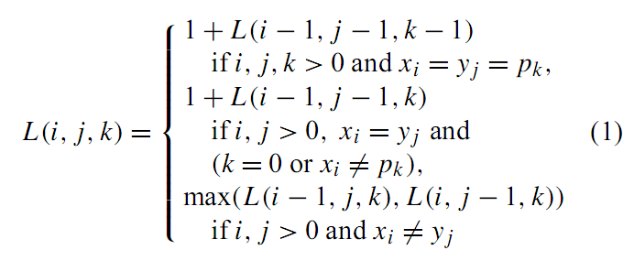
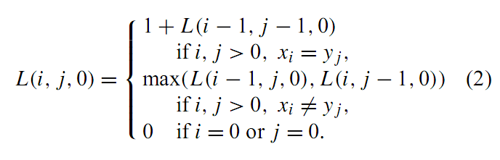
Algorithm

Slide 26
Example for CLCS Algorithm
Input: S₁ = TAGTCACG, S₂ = AGACTGTC and C = AT
CLCS of S₁ and S₂ with constraint C: (X means -∞)
k = 0
k = 1 (constraint A)
k = 2 (constraint T)
 | - | A | G | A | C | T | G | T | C
- | 0 | 0 | 0 | 0 | 0 | 0 | 0 | 0 | 0
T | 0 | 0 | 0 | 0 | 0 | 1 | 1 | 1 | 1
A | 0 | 1 | 1 | 1 | 1 | 1 | 1 | 1 | 1
G | 0 | 1 | 2 | 2 | 2 | 2 | 2 | 2 | 2
T | 0 | 1 | 2 | 2 | 2 | 3 | 3 | 3 | 3
C | 0 | 1 | 2 | 2 | 3 | 3 | 3 | 3 | 4
A | 0 | 1 | 2 | 3 | 3 | 3 | 3 | 3 | 4
C | 0 | 1 | 2 | 3 | 4 | 4 | 4 | 4 | 4
G | 0 | 1 | 2 | 3 | 4 | 4 | 5 | 5 | 5
 | - | A | G | A | C | T | G | T | C
- | X | X | X | X | X | X | X | X | X
T | X | X | X | X | X | X | X | X | X
A | X | 1 | 1 | 1 | 1 | 1 | 1 | 1 | 1
G | X | 1 | 2 | 2 | 2 | 2 | 2 | 2 | 2
T | X | 1 | 2 | 2 | 2 | 3 | 3 | 3 | 3
C | X | 1 | 2 | 2 | 3 | 3 | 3 | 3 | 4
A | X | 1 | 2 | 3 | 3 | 3 | 3 | 3 | 4
C | X | 1 | 2 | 3 | 4 | 4 | 4 | 4 | 4
G | X | 1 | 2 | 3 | 4 | 4 | 5 | 5 | 5
 | - | A | G | A | C | T | G | T | C
- | X | X | X | X | X | X | X | X | X
T | X | X | X | X | X | X | X | X | X
A | X | X | X | X | X | X | X | X | X
G | X | X | X | X | X | X | X | X | X
T | X | X | X | X | X | 3 | 3 | 3 | 3
C | X | X | X | X | X | 3 | 3 | 3 | 4
A | X | X | X | X | X | 3 | 3 | 3 | 4
C | X | X | X | X | X | 3 | 3 | 3 | 4
G | X | X | X | X | X | 3 | 4 | 4 | 4
Following the link, we can obtain the CLCS AGTG

Slide 27
Thank you!!!

