Slide 1
Bayesian model averaging: development of an improved multi-class, gene selection and classification tool for microarray data
BIOINFORMATICS
Vol. 21, No. 10, 2005, pp. 2394–2402
Ka Yee Yeung, Roger E. Bumgarner and Adrian E. Raftery
2011-07-04
何秋誼報告

Slide 2
Abstract
Motivation: Selecting a small number of relevant genes for accurate classification of samples is essential for the development of diagnostic tests. We present the Bayesian model averaging (BMA) method for gene selection and classification of microarray data. Typical gene selection and classification procedures ignore model uncertainty and use a single set of relevant genes (model) to predict the class. BMA accounts for the uncertainty about the best set to choose by averaging over multiple models (sets of potentially overlapping relevant genes).

Slide 3
Abstract
Results: We have shown that BMA selects smaller numbers of relevant genes (compared with other methods) and achieves a high prediction accuracy on three microarray datasets. Our BMA algorithm is applicable to microarray datasets with any number of classes, and outputs posterior probabilities for the selected genes and models. Our selected models typically consist of only a few genes. The combination of high accuracy, small numbers of genes and posterior probabilities for the predictions should make BMA a powerful tool for developing diagnostics from expression data.

Slide 4
Abstract
Availability: The source codes and datasets used are available from our Supplementary website.
Contact: kayee@u.washington.edu
Supplementary information: http://www.expression.washington.edu/publications/kayee/bma

Slide 5
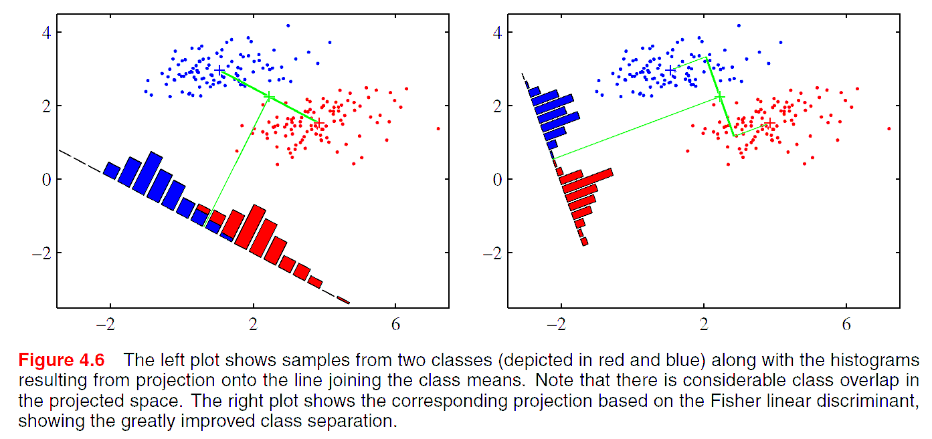

Linear model for classification
The dicriminant function is:
Christopher M. Bishop., “Pattern Recognition and Machine Learning"

Slide 6
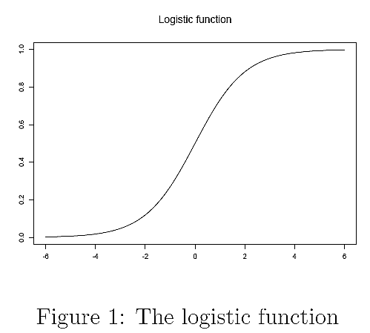
(Binary) Logit regression
The dicriminant score (β^{T}x): -∞~+∞
o (odd): 0~∞
p (probability belonging to class 1): 0~1
p
用(o,p)=(0,0.5)來二分
x^{T}β
Christopher Manning., “Logistic regression"

Slide 7
Logit regression example
A researcher is interested in how variables, such as GRE (Graduate Record Exam scores), GPA (grade point average) and prestige[名望, 威望, 聲望] of the undergraduate institution, effect admission into graduate school.
admit gre gpa rank
0 380 3.61 3
1 660 3.67 3
1 800 4 1
1 640 3.19 4
0 520 2.93 4
1 760 3 2
1 560 2.98 1
…
離散資料
http://www.ats.ucla.edu/stat/R/dae

Slide 8
Logit regression example
admit gre gpa rank
0 380 3.61 3
1 660 3.67 3
1 800 4 1
1 640 3.19 4
0 520 2.93 4
1 760 3 2
1 560 2.98 1
…
admit gre gpa rank)1 rank)2 rank)3 rank)4
0 380 3.61 0 0 1 0
1 660 3.67 0 0 1 0
1 800 4 1 0 0 0
1 640 3.19 0 0 0 1
0 520 2.93 0 0 0 1
1 760 3 0 1 0 0
1 560 2.98 1 0 0 0
...
http://www.ats.ucla.edu/stat/R/dae

Slide 9
Logit regression example
admit gre gpa rank)1 rank)2 rank)3 rank)4
0 380 3.61 0 0 1 0
1 660 3.67 0 0 1 0
1 800 4 1 0 0 0
1 640 3.19 0 0 0 1
0 520 2.93 0 0 0 1
1 760 3 0 1 0 0
1 560 2.98 1 0 0 0
...
Coefficients:
(Intercept)β0 greβ1 gpaβ2 rank)2β3 rank)3 β4 rank)4 β5
-3.989979 0.002264 0.804038 -0.675443 -1.340204 -1.551464
Degrees of Freedom: 399 Total (i.e. Null); 394 Residual
Null Deviance: 500
Residual Deviance: 458.5 AIC: 470.5
http://www.ats.ucla.edu/stat/R/dae

Slide 10
Logit regression example
New data1
gre gpa rank
1 587.7 3.3899 1
2 587.7 3.3899 2
3 587.7 3.3899 3
4 587.7 3.3899 4
Prediction
gre gpa rank Predicted_Probability_of_admit
1 587.7 3.3899 1 0.5166016
2 587.7 3.3899 2 0.3522846
3 587.7 3.3899 3 0.2186120
4 587.7 3.3899 4 0.1846684
New data2
gre gpa rank
1 200 3.3899 2
2 300 3.3899 2
3 400 3.3899 2
4 500 3.3899 2
5 600 3.3899 2
6 700 3.3899 2
7 800 3.3899 2
Prediction
gre gpa rank Predicted_Probability_of_admit
1 200 3.3899 2 0.1843830
2 300 3.3899 2 0.2208900
3 400 3.3899 2 0.2623007
4 500 3.3899 2 0.3084017
5 600 3.3899 2 0.3586658
6 700 3.3899 2 0.4122390
7 800 3.3899 2 0.4679753
http://www.ats.ucla.edu/stat/R/dae

Slide 11
Multinomial logistic regression
Logistic regression can be extended to handle responses that are polychotomous [多叉分枝的], i.e. taking r > 2 categories.
http://www.stat.psu.edu/~jls/stat544/lectures/

Slide 12
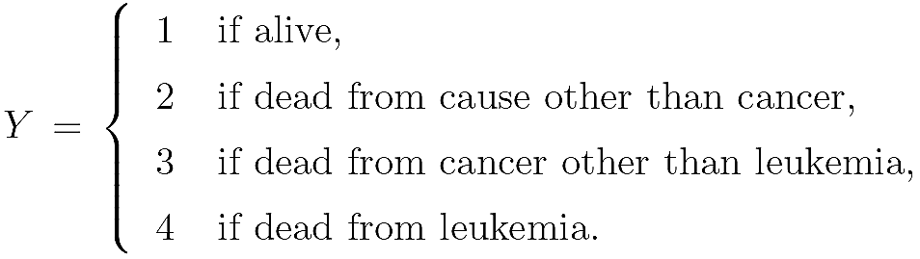
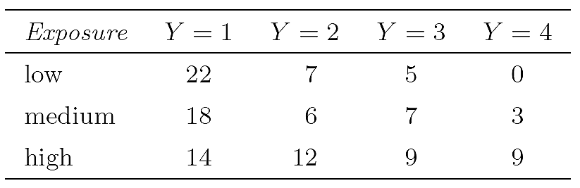
Multinomial logistic regression
Consider a medical study to investigate the long-term effects of radiation exposure on mortality[死亡率].
The main predictor of interest is level of exposure (low, medium, high).
The response variable is
http://www.stat.psu.edu/~jls/stat544/lectures/

Slide 13
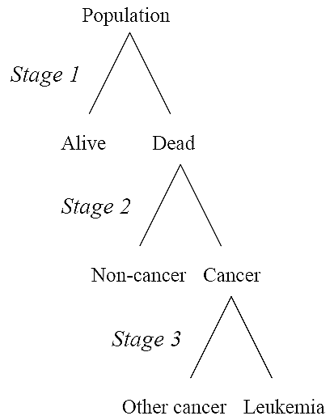
Multinomial logistic regression
In some cases, it makes sense to “factor” the response into a sequence of binary choices and model them with a sequence of ordinary logistic models.
This approach is attractive when the response can be naturally arranged as a sequence of binary choices.
http://www.stat.psu.edu/~jls/stat544/lectures/
白血病

Slide 14
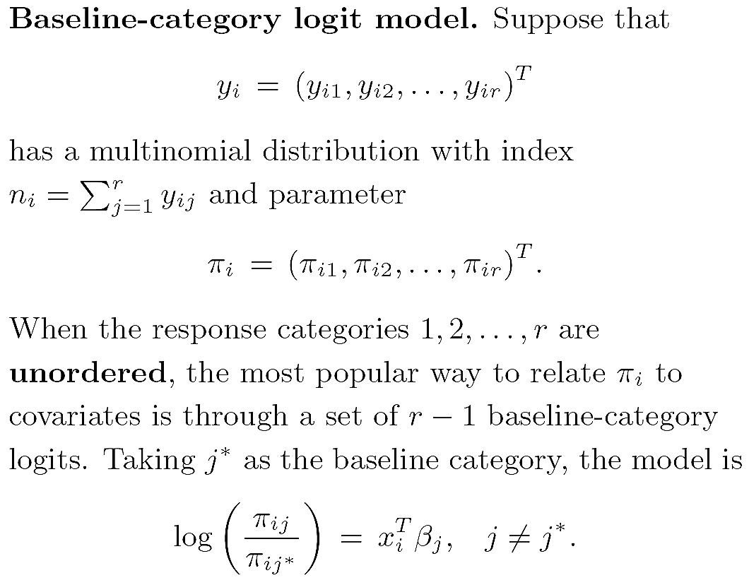
Multinomial logistic regression
j*
1
2
k
假設j*為baseline類別
找j相對於j*之機率
http://www.stat.psu.edu/~jls/stat544/lectures/

Slide 15
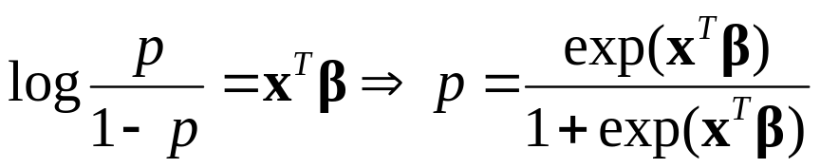
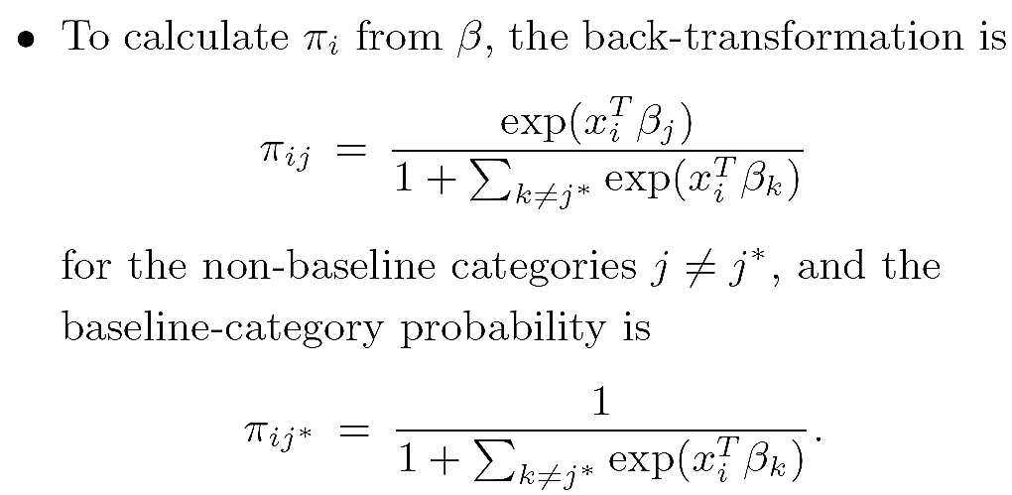
1
分兩類→
2
3
分多類→
log(P(brand=2)/P(brand=1)) = b_10 + b_11*female + b_12*age
log(P(brand=3)/P(brand=1)) = b_20 + b_21*female + b_22*age
分多類→
分多類→
http://www.stat.psu.edu/~jls/stat544/lectures/

Slide 16
Multinomial logistic regression example
Several brands of similar products are on the market, and you want to study brand choices based on gender and age. For example, a recent finding of a market research group claims that among digital camera choices, women prefer Kodak more than men and men prefer Canon more than women.
brand female age
1 1 0 24
2 1 0 26
3 1 0 26
4 1 1 27
5 1 1 27
6 3 1 27
7 1 0 27
8 1 0 27
9 1 1 27
10 1 0 27
...
brand
female 1 2 3
0 92 99 78
1 115 208 143
http://www.stat.psu.edu/~jls/stat544/lectures/

Slide 17
brand female age chid alt
1.1 TRUE 0 24 1 1
1.2 FALSE 0 24 1 2
1.3 FALSE 0 24 1 3
2.1 TRUE 0 26 2 1
2.2 FALSE 0 26 2 2
2.3 FALSE 0 26 2 3
3.1 TRUE 0 26 3 1
3.2 FALSE 0 26 3 2
3.3 FALSE 0 26 3 3
4.1 TRUE 1 27 4 1
4.2 FALSE 1 27 4 2
4.3 FALSE 1 27 4 3
5.1 TRUE 1 27 5 1
5.2 FALSE 1 27 5 2
5.3 FALSE 1 27 5 3
6.1 FALSE 1 27 6 1
6.2 FALSE 1 27 6 2
6.3 TRUE 1 27 6 3
7.1 TRUE 0 27 7 1
7.2 FALSE 0 27 7 2
7.3 FALSE 0 27 7 3
…
brand female age
1 1 0 24
2 1 0 26
3 1 0 26
4 1 1 27
5 1 1 27
6 3 1 27
7 1 0 27
8 1 0 27
9 1 1 27
10 1 0 27
...
表同一筆資料必須被分到不同模型訓練
http://www.ats.ucla.edu/stat/R/dae

Slide 18
brand female age chid alt
1.1 TRUE 0 24 1 1
1.2 FALSE 0 24 1 2
1.3 FALSE 0 24 1 3
2.1 TRUE 0 26 2 1
2.2 FALSE 0 26 2 2
2.3 FALSE 0 26 2 3
3.1 TRUE 0 26 3 1
3.2 FALSE 0 26 3 2
3.3 FALSE 0 26 3 3
4.1 TRUE 1 27 4 1
4.2 FALSE 1 27 4 2
4.3 FALSE 1 27 4 3
5.1 TRUE 1 27 5 1
5.2 FALSE 1 27 5 2
5.3 FALSE 1 27 5 3
6.1 FALSE 1 27 6 1
6.2 FALSE 1 27 6 2
6.3 TRUE 1 27 6 3
7.1 TRUE 0 27 7 1
7.2 FALSE 0 27 7 2
7.3 FALSE 0 27 7 3
…
Coefficients :
Estimate Std. Error t-value Pr(>|t|)
alt2 -11.774655 1.774612 -6.6351 3.244e-11 ***
alt3 -22.721396 2.058028 -11.0404 < 2.2e-16 ***
alt2:female 0.523814 0.194247 2.6966 0.007004 **
alt3:female 0.465941 0.226090 2.0609 0.039315 *
alt2:age 0.368206 0.055003 6.6943 2.167e-11 ***
alt3:age 0.685908 0.062627 10.9524 < 2.2e-16 ***
log(P(brand=2)/P(brand=1)) = b_10 + b_11*female + b_12*age
log(P(brand=3)/P(brand=1)) = b_20 + b_21*female + b_22*age
其中
b_10 -11.774655
b_20 -22.721396
b_11 0.523814
b_21 0.465941
b_12 0.368206
b_22 0.685908
http://www.ats.ucla.edu/stat/R/dae

Slide 19
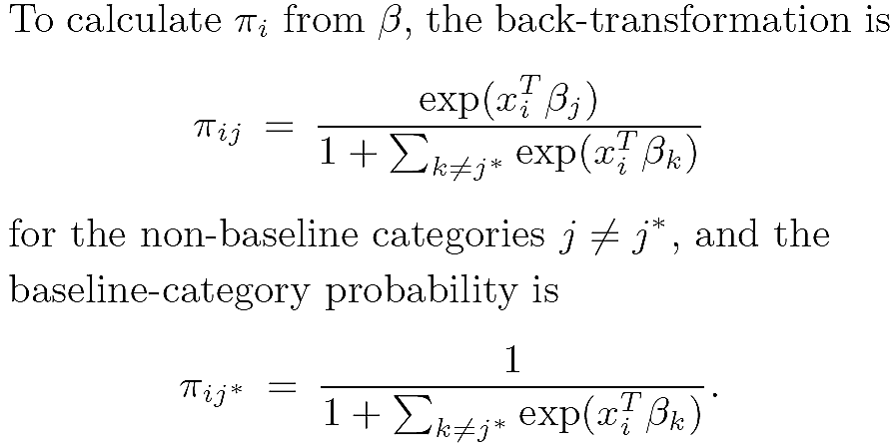
New Data
age female
1 24 0
2 25 0
3 26 0
4 27 0
5 28 0
6 29 0
7 30 0
8 31 0
9 32 0
10 33 0
11 34 0
12 35 0
13 36 0
14 37 0
15 38 0
16 24 1
17 25 1
18 26 1
19 27 1
20 28 1
21 29 1
22 30 1
23 31 1
24 32 1
25 33 1
26 34 1
27 35 1
28 36 1
29 37 1
30 38 1
log(P(brand=2)/P(brand=1)) = b_10 + b_11*female + b_12*age
log(P(brand=3)/P(brand=1)) = b_20 + b_21*female + b_22*age
brand1 brand2 brand3
0.94795816 0.05022934 0.001812499
0.92560894 0.07087706 0.003514003
0.89429648 0.09896224 0.006741277
0.85114671 0.13611383 0.012739463
0.79313274 0.18329623 0.023571034
0.71788189 0.23975656 0.042361548
0.6250737 0.30168836 0.073237938
0.51809923 0.36136835 0.120532423
0.40487478 0.40810106 0.187024165
0.296397 0.43174829 0.271854709
0.20299479 0.42731836 0.369686853
0.13057937 0.39723827 0.47218236
0.07951504 0.34957118 0.57091378
0.0462758 0.29400185 0.659722352
0.02598192 0.23854878 0.735469305
0.91532111 0.08189009 0.002788802
0.88079306 0.11387846 0.005328489
0.83412901 0.15585141 0.010019579
0.7728779 0.20868837 0.018433729
0.69562006 0.27143715 0.032942796
0.60315882 0.34012512 0.056716067
0.49959271 0.40712986 0.093277432
0.39240326 0.46212482 0.145471914
0.29086656 0.49502864 0.2141048
0.20320808 0.49978974 0.297002182
0.13411359 0.47668223 0.389204181
0.08404267 0.43168392 0.484273412
0.05034163 0.37368279 0.575975587
0.02903195 0.31143107 0.659536975
0.01623118 0.25162033 0.732148482
http://www.ats.ucla.edu/stat/R/dae

Slide 20

Bayesian model averaging (BMA)
Typical statistical inference approaches select a model and then proceed as if the selected model has generated the data, which might lead to over-confident inferences.
BMA takes model uncertainty into consideration by averaging over the posterior distributions of multiple models, weighted by their posterior model probabilities.
Posterior
Model prediction

Slide 21
BMA example
ID Model formula Posterior
--------------------------------------------------------------------------------------------------------------------------------------------------------------------------------
1 -22.64+1.48*M+2.22*Ed+0.85*Po1+0.11*NW+0.29*U2+1.24*Ineq-0.31*Prob-0.29*Time 0.088688348
2 -24.38+1.51*M+2.39*Ed+0.91*Po1+0.08*NW+0.32*U2+1.23*Ineq-0.19*Prob 0.067451618
3 -25.95+1.6*M+2*Ed+0.74*Po1+0.11*NW+0.27*U2+0.54*GDP+1.42*Ineq-0.3*Prob-0.3*Time 0.04818464
4 -22.81+1.27*M+2.18*Ed+0.99*Po1-0.06*Pop+0.1*NW+0.28*U2+1.32*Ineq-0.22*Prob 0.046112615
5 -24.5+1.46*M+2.4*Ed+0.91*Po2+0.09*NW+0.33*U2+1.29*Ineq-0.21*Prob 0.041798289
6 -22.85+1.43*M+2.26*Ed+0.84*Po2+0.11*NW+0.3*U2+1.28*Ineq-0.31*Prob-0.26*Time 0.032625739
7 -18.27+1.13*M+1.84*Ed+0.89*Po1+0.12*NW+1.24*Ineq-0.34*Prob-0.33*Time 0.030703796
8 -22.69+1.52*M+2.41*Ed+0.79*Po1+0.1*NW-0.31*U1+0.49*U2+1.24*Ineq-0.31*Prob-0.31*Time 0.029786338
9 -26.29+1.68*M+2.09*Ed+1.15*Po1+0.34*U2+1.58*Ineq-0.17*Prob 0.028249142
10 -26.23+1.38*M+1.93*Ed+0.87*Po1-0.06*Pop+0.1*NW+0.26*U2+0.57*GDP+1.52*Ineq-0.2*Prob 0.027965246
11 -27.53+1.63*M+2.19*Ed+0.8*Po1+0.09*NW+0.31*U2+0.51*GDP+1.4*Ineq-0.18*Prob 0.027827625
...
Output
Posterior
Model prediction
Notes:
fo = sapply(model.fits,function(m){
gsub('[+]-','-',paste(round(m[1,1],2),paste(round(m[-1,1],2),rownames(m)[-1],sep='*',collapse='+'),sep='+'))
})

Slide 22
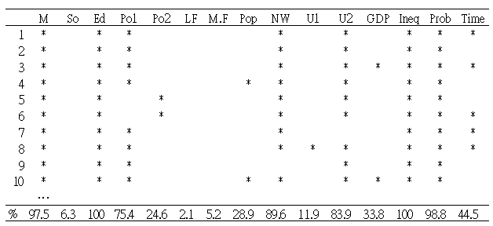
BMA for feature selection
ID Model formula Posterior
--------------------------------------------------------------------------------------------------------------------------------------------------------------------------------
1 -22.64+1.48*M+2.22*Ed+0.85*Po1+0.11*NW+0.29*U2+1.24*Ineq-0.31*Prob-0.29*Time 0.088688348
2 -24.38+1.51*M+2.39*Ed+0.91*Po1+0.08*NW+0.32*U2+1.23*Ineq-0.19*Prob 0.067451618
3 -25.95+1.6*M+2*Ed+0.74*Po1+0.11*NW+0.27*U2+0.54*GDP+1.42*Ineq-0.3*Prob-0.3*Time 0.04818464
4 -22.81+1.27*M+2.18*Ed+0.99*Po1-0.06*Pop+0.1*NW+0.28*U2+1.32*Ineq-0.22*Prob 0.046112615
5 -24.5+1.46*M+2.4*Ed+0.91*Po2+0.09*NW+0.33*U2+1.29*Ineq-0.21*Prob 0.041798289
6 -22.85+1.43*M+2.26*Ed+0.84*Po2+0.11*NW+0.3*U2+1.28*Ineq-0.31*Prob-0.26*Time 0.032625739
7 -18.27+1.13*M+1.84*Ed+0.89*Po1+0.12*NW+1.24*Ineq-0.34*Prob-0.33*Time 0.030703796
8 -22.69+1.52*M+2.41*Ed+0.79*Po1+0.1*NW-0.31*U1+0.49*U2+1.24*Ineq-0.31*Prob-0.31*Time 0.029786338
9 -26.29+1.68*M+2.09*Ed+1.15*Po1+0.34*U2+1.58*Ineq-0.17*Prob 0.028249142
10 -26.23+1.38*M+1.93*Ed+0.87*Po1-0.06*Pop+0.1*NW+0.26*U2+0.57*GDP+1.52*Ineq-0.2*Prob 0.027965246
11 -27.53+1.63*M+2.19*Ed+0.8*Po1+0.09*NW+0.31*U2+0.51*GDP+1.4*Ineq-0.18*Prob 0.027827625
...

Slide 23
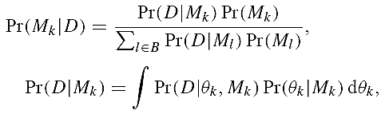
Bayesian model averaging (BMA)
Posterior
Model prediction
參加投票之Model不可太差
由使用者指定，一般為1/|B|
因為非常難算，故在本篇論文用BIC取代
除BIC外，尚可用MCMC(蒙地卡羅法)，或是Laplace approximation近似
例如exp(-BIC)

Slide 24
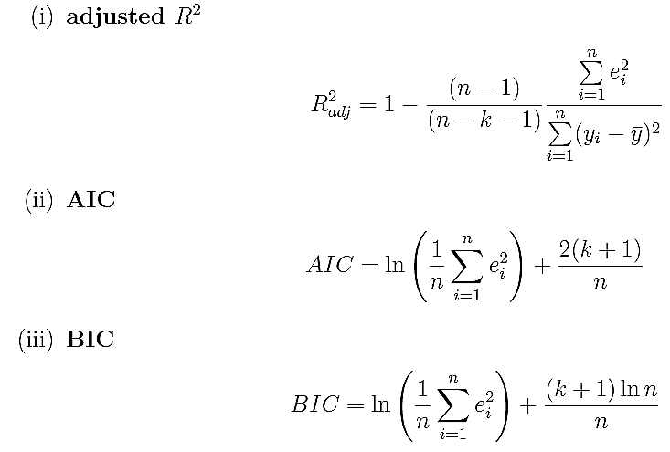
AIC or BIC
Akaike's Information Criterion (AIC)
Bayesian Information Criterion (BIC)
R²描述：
誤差越小越接近1
e:誤差
k:變數#
AIC or BIC描述：
誤差小且使用變數少則值越小
n:資料#
http://www.statoek.wiso.uni-goettingen.de/veranstaltungen/non_semi_models/AkaikeLsg.pdf

Slide 25
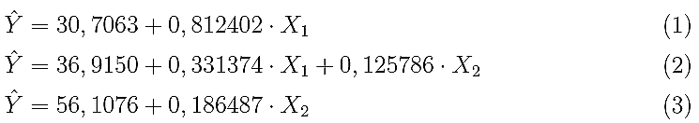
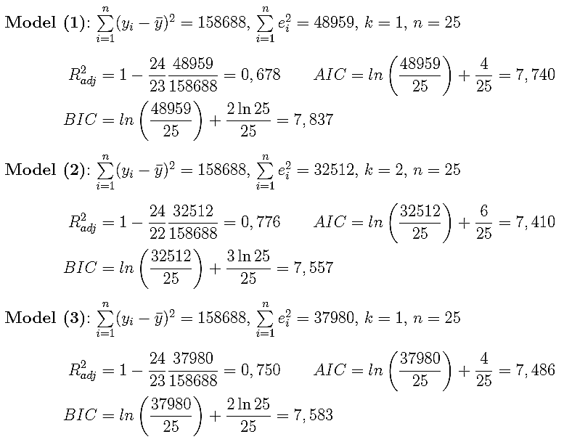
AIC or BIC example
http://www.statoek.wiso.uni-goettingen.de/veranstaltungen/non_semi_models/AkaikeLsg.pdf

Slide 26

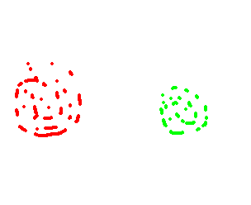



Within & between class scatter
Within-class
Within-class
Class 1
Class 2
Between-class
Within-class scatter指的是同一類別內資料的分散程度
Between-class scatter指的是不同類別間資料的分散程度

Slide 27
Two-Sample t-Test
The two-sample t-test is a hypothesis test for answering about the mean where the data are collected from two random samples of independent observations, each from an underlying normal distribution.
A comparison of this sort is very common in medicine and social science. To evaluate the effects of some intervention, program, or treatment, a group of subjects is divided into two groups. The group receiving the treatment to be evaluated is referred to as the treatment group, while those who do not are referred to as the control or comparison group.
http://ccnmtl.columbia.edu/projects/qmss/the_ttest/twosample_ttest.html

Slide 28
Two-Sample t-Test Example
Hypothesis
  Null hypothesis is that the difference between the two groups is 0.
  Alternative hypothesis - the difference is not 0.
Treatment Control
Average Weight 3100 g 2750 g
SD 420 425
n 75 75
http://ccnmtl.columbia.edu/projects/qmss/the_ttest/twosample_ttest.html

Slide 29
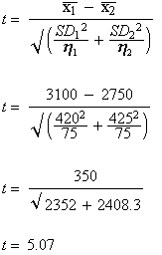
Two-Sample t-Test Example
Treatment Control
Average Weight 3100 g 2750 g
SD 420 425
n 75 75
Having calculated the t-statistic, compare the t-value with a standard table of t-values to determine whether the t-statistic reaches the threshold of statistical significance.
With a t-score so high, the p-value is 0.001, a score that forms our basis to reject the null hypothesis and conclude that the prenatal care program made a difference.
http://ccnmtl.columbia.edu/projects/qmss/the_ttest/twosample_ttest.html

Slide 30
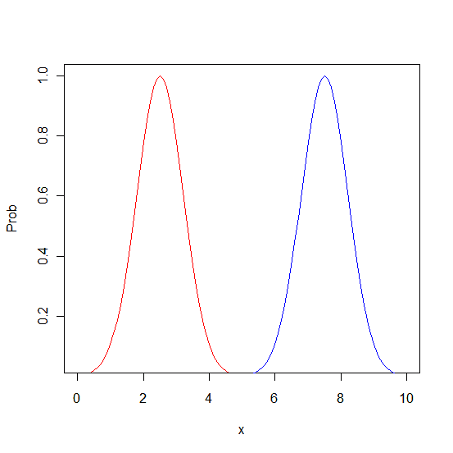



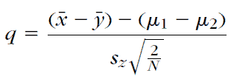
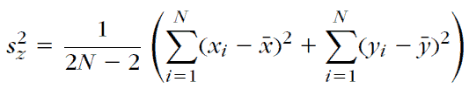
t -Test in Feature Selection
Assume
Sergios Theodridis et al., “Pattern recognition "
Notes:
x1=(0:100)*0.1
y1=exp(-(x1-2.5)^2)
y2=exp(-(x1-7.5)^2)
plot(x1,y1,type='l',col=2,ylim=c(0.05,1),xlab='x',ylab='Prob')
lines(x1,y2,col=4)

Slide 31
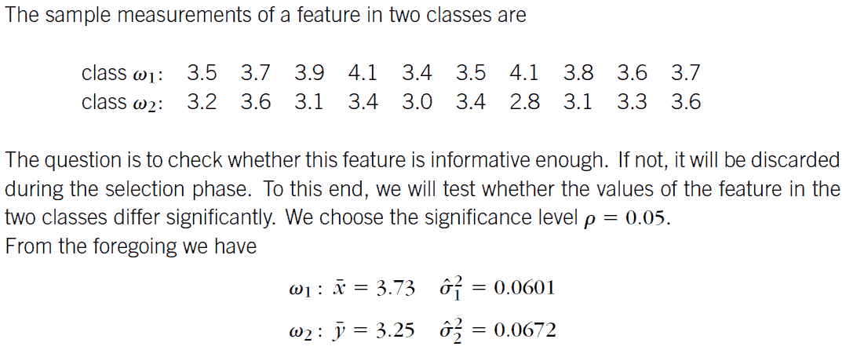
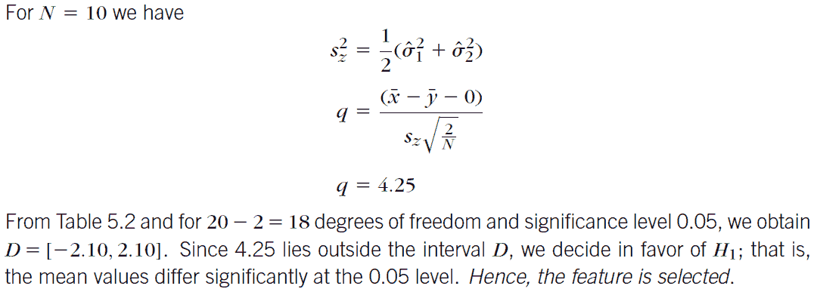
Sergios Theodridis et al., “Pattern recognition "

Slide 32
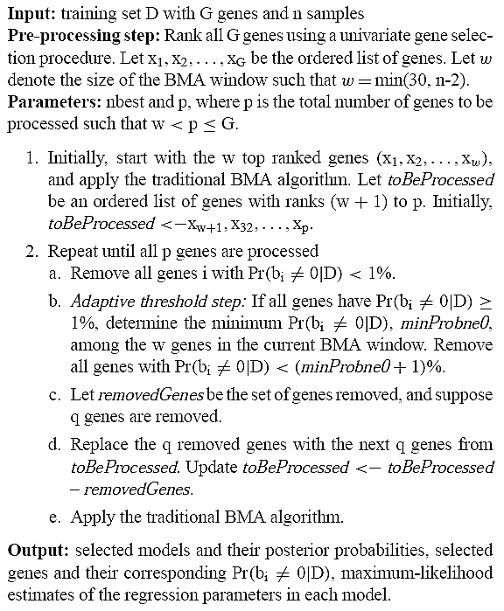
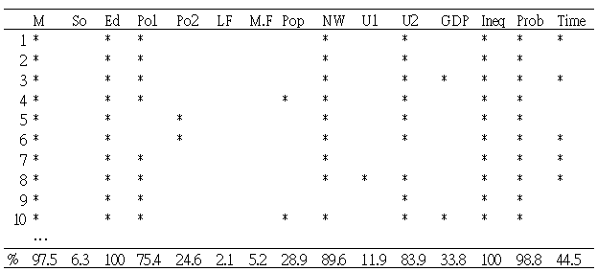
本論文提出Iterative BMA進行特徵選擇
only appliable to the 2-class problem
先以Fisher score選排名前w名之特徵，並進行BMA保留機率大於1%的特徵
逐步把尚未BMA過的特徵加入，並保留機率大於1%的特徵
優先被移除特徵

Slide 33
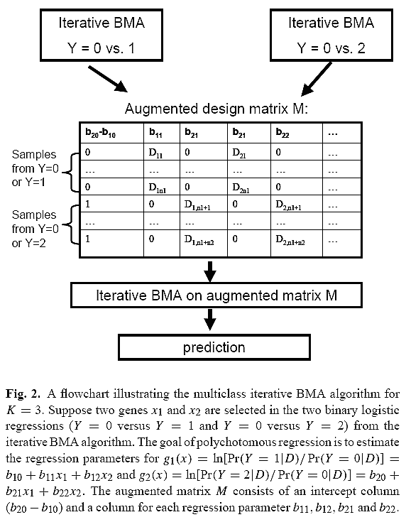
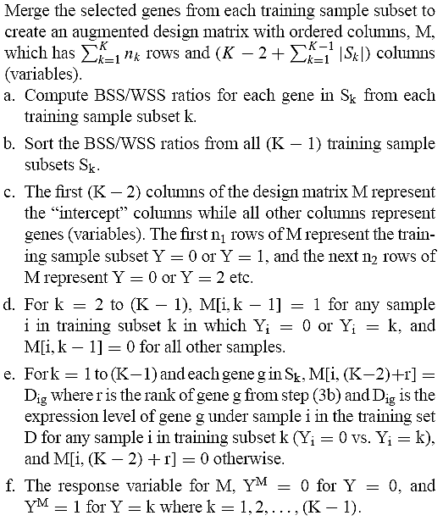
Multiclass iterative BMA
log(P(brand=2)/P(brand=1)) = b_10 + b_11*female + b_12*age
log(P(brand=3)/P(brand=1)) = b_20 + b_21*female + b_22*age
0 or 第i筆資料之b21對應特徵值

Slide 34
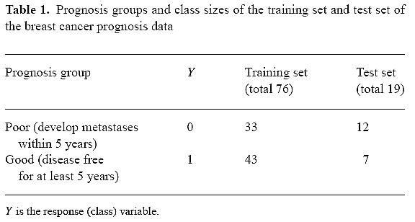
Experiment Data
4919 features

Slide 35
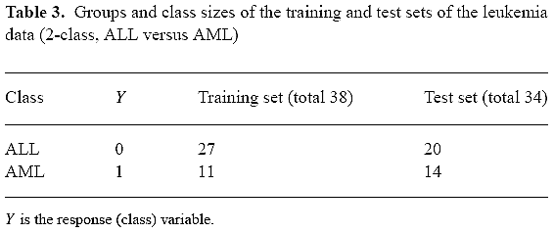
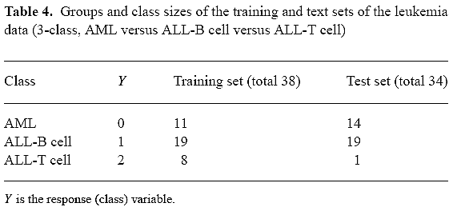
Experiment Data
7129 features

Slide 36
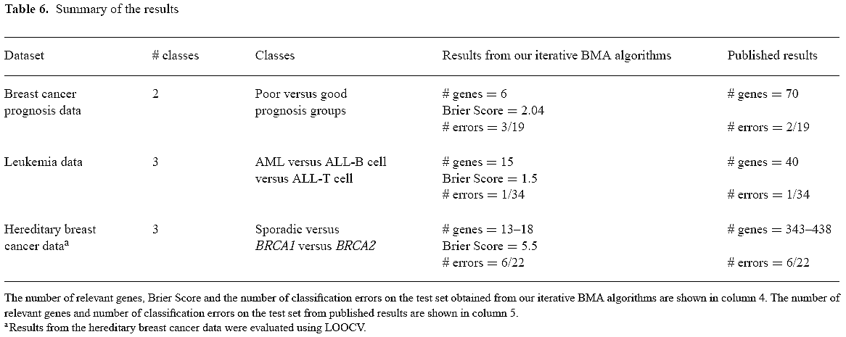
Experiment Results

