Slide 1
String Matching with Inversions and Translocations in Linear Average Time
(Most of the Time)
Szymon Grabowski , Simone Faroz, and Emanuele Giaquintaz
Information Processing Letters
Vol. 111, pp. 516-520, 2011
Speaker: Kai-Yuan Cheng
Date: Aug. 1, 2011

Slide 2
Abstract
We present an efficient algorithm for finding all approximate occurrences of a given pattern p of length m in a text t of length n allowing for translocations of equal length adjacent factors and inversions of factors. The algorithm is based on an efficient filtering method and has an O(nm max(α, β ))-time complexity in the worst case and O(max(α, β , σ ))-space complexity, where α and β are respectively the maximum length of the factors involved in any translocation and inversion, and σ is the alphabet size. Moreover we show that our algorithm has an O(n) average time complexity, whenever σ = Ω (logm/ log log^{1−ε} m), for ε > 0. Experiments show that the proposed algorithm achieves very good results in practical cases.

Slide 3
Approximate string matching
In computing, approximate string matching (often colloquially referred to as fuzzy string searching) is the technique of finding strings that match a pattern approximately (rather than exactly). The problem of approximate string matching is typically divided into two sub-problems: finding approximate substring matches inside a given string and finding dictionary strings that match the pattern approximately.
Ex:
insertion: cot → coat
deletion: coat → cot
substitution: coat → cost

Slide 4
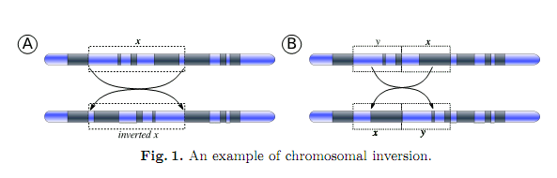

Slide 5
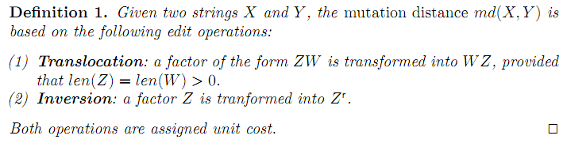
Definition 1
Ex:
Translocation:
S₁ = ABCDEF
S₂ = DEFABC
Inversion:
S₁ = ABCDEF
S₂ = FEDCBA

Slide 6
Counting filter algorithm
Pattern:
frequency
a | b | c
2 | 1 | 1
a | a | b | c
Text:
b | b | a | c | b | a | a | b
a | b | c
1 | 2 | 1
δ₁ = abs(2-1) + abs(1-2) + abs(1-1) = 2
b | b | a | c | b | a | a | b
a | b | c
1 | 2 | 1
δ₂ = 2
b | b | a | c | b | a | a | b
a | b | c
2 | 1 | 1
δ₃ = 0
b | b | a | c | b | a | a | b
a | b | c
2 | 1 | 1
δ₄ = 0

Slide 7
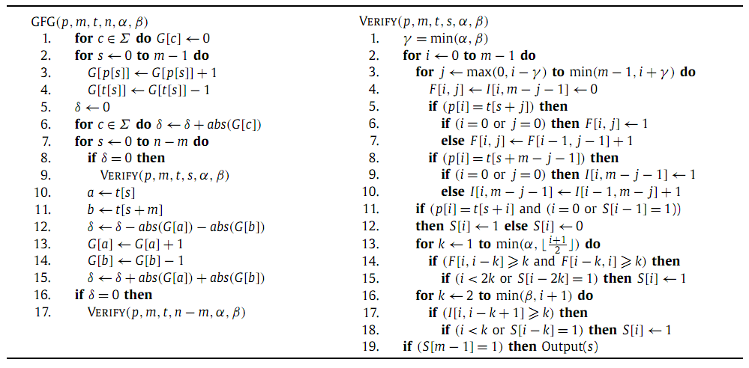
Algorithm

Slide 8

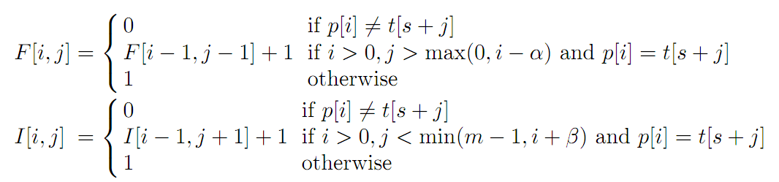
The value of S[i] is set to 1 iff one of the following conditions holds:

Slide 9
 | A | B | C | D | E | F
D |  |  |  | 1
E |  |  |  |  | 2
F |  |  |  |  |  | 3
A | 1
B |  | 2
C |  |  | 3
 | A | B | C | D | E | F
F |  |  |  |  |  | 1
E |  |  |  |  | 1
D |  |  |  | 1
C |  |  | 1
B |  | 1
A | 1
 | C | D | B | A | A | B
D |  | 1
C | 1
A |  |  |  | 1 | 1
B |  |  | 1 |  |  | 2
B |  |  | 1 |  |  | 1
A |  |  |  | 2 | 1
 | A | B | C | D | E | F
D |  |  |  | 1
E |  |  |  |  | 1
F |  |  |  |  |  | 1
A | 1
B |  | 1
C |  |  | 1
 | A | B | C | D | E | F
F |  |  |  |  |  | 1
E |  |  |  |  | 2
D |  |  |  | 3
C |  |  | 4
B |  | 5
A | 6
 | C | D | B | A | A | B
D |  | 1
C | 1
A |  |  |  | 1 | 1
B |  |  | 2 |  |  | 1
B |  |  | 1 |  |  | 1
A |  |  |  | 1 | 2
S |  |  |  |  |  | 1
S |  |  |  | 1 | 1 | 1
S |  | 1 |  | 1 | 1 | 1
Notes:
A
B
C
D
E
F
D
1
E
1
F
1
A
1
B
1
C
1

Slide 10
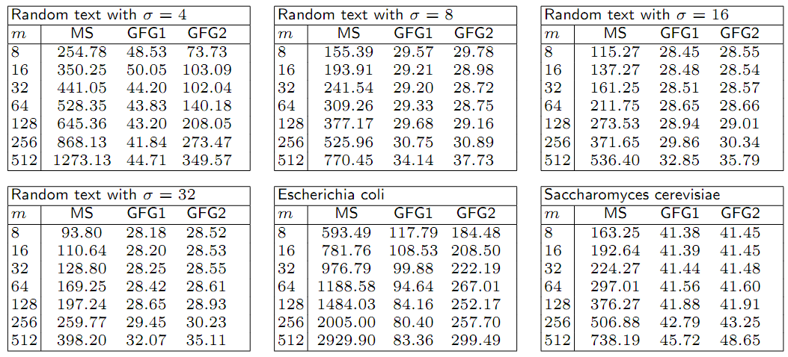
Experimental results

Slide 11
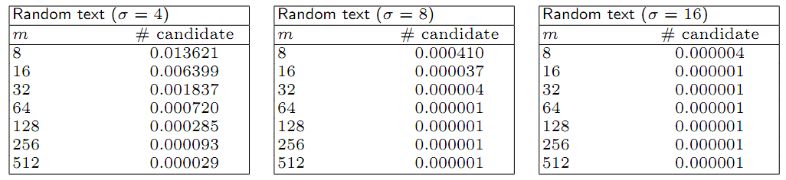
Experimental results

Slide 12
Thank you!!!

