Slide 1
Disulfide Bond Prediction Using Neural Network and Secondary Structure Information Ouyan Shi, Huiyun Yang, Chunquan Cai, Jing Yang, Xin Tian Bioinformatics and Biomedical Engineering, 2008. ICBBE 2008. The 2nd International Conference on.
Presenter: Hong-Yu Chen
Date: Aug. 1, 2011

Slide 2
Abstract (1/2)
In protein-folding prediction, the location of disulfide bonds can strongly reduce the search in the conformational space. Therefore the correct prediction of the disulfide connectivity starting from the protein residue sequence may also help in predicting its 3D structure. In this paper, we describe a method to predict disulfide connectivity in a protein given only the amino acid sequence, using neural network, and given input of symmetric flanking regions of N-terminus and C-terminus cystines augmented with residue secondary structure (helix, sheet, and coil) as well as evolutionary information.

Slide 3
Abstract (2/2)
252 protein sequences were selected from the SWISS-PROT database. From the results of 4-fold cross validation, we find that merging protein secondary structure allows us to obtain significant prediction accuracy improvements.

Slide 4
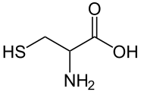
Introduction
Given an even number of cysteines believed to form disulfide bonds, the problem is to determine the correct connectivity pattern among all the possible alternatives.
Cysteine - 半胱氨酸 Cystine - 胱氨酸
Protein-folding

Slide 5
The protein data sets
252 protein sequences from the SWISS-PROT database having at least two and at most five (i.e. 4–10 cysteines in the protein forming disulfide bonds) intra-chain disulfide bonds, and for which structural data were available in the Protein Data Bank (PDB).
4-fold cross validation.

Slide 6
Performance Measures
P and N represent a training file of positive and negative examples, respectively, of sequence length 2w.
e.g. two 15-mers corresponding to the symmetric cystine-centered size w=2n+1=15 window contents of cystines (i.e. the n residues N-terminal and C-terminal to each cystine, where n=7).
P denotes the pairs of window contents for all the cystines involved in an intra-chain bond.
N denote the corresponding set of possible pairs of cystines that are not intra-chain disulfide bonds.
From DSSP files
已知三維結構的蛋白質二級結構

Slide 7
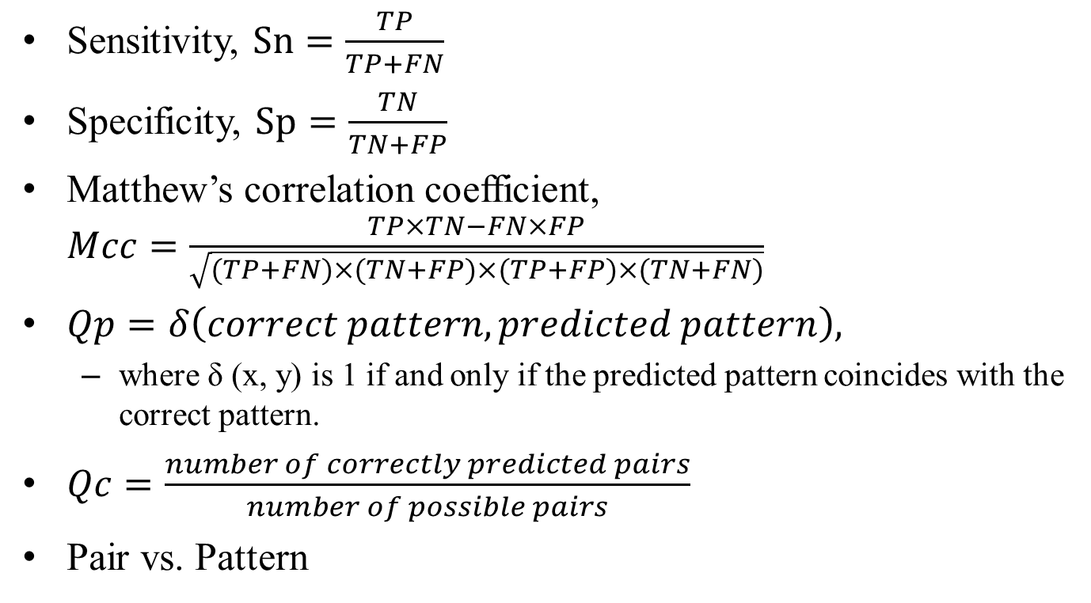
Sensitivity, $Sn=\frac{TP}{TP+FN}$
Specificity, $Sp=\frac{TN}{TN+FP}$
Matthew’s correlation coefficient, $Mcc=\frac{TP×TN−FN×FP}{\sqrt{(TP+FN)×(TN+FP)×(TP+FP)×(TN+FN)}}$
$Qp=δ\left(correct pattern,predicted pattern\right),$
where δ (x, y) is 1 if and only if the predicted pattern coincides with the correct pattern.
$Qc=\frac{number of correctly predicted pairs}{number of possible pairs}$
Pair vs. Pattern

Slide 8
Neural Network Model
The amino acid environment of cystines shows peculiar sequence characteristics that allow the discrimination between cystines and free cysteines using machine learning.
The secondary structure conformation assumed by the cysteines and their neighboring residues is remarkably different when comparing disulfide-bonded versus free cysteines.

Slide 9
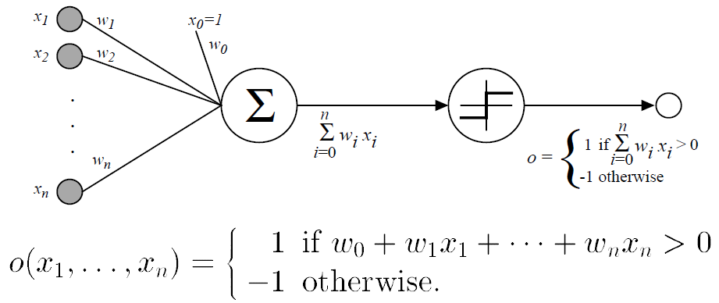
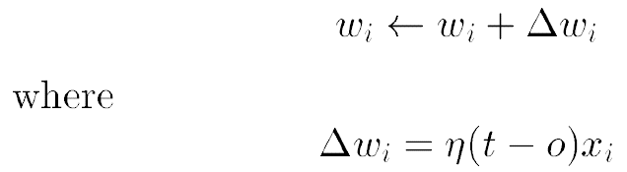
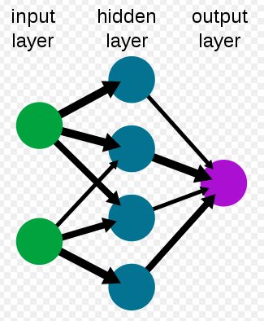
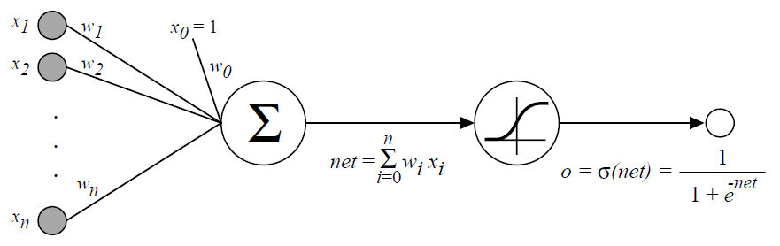
Neural Network Model

Slide 10
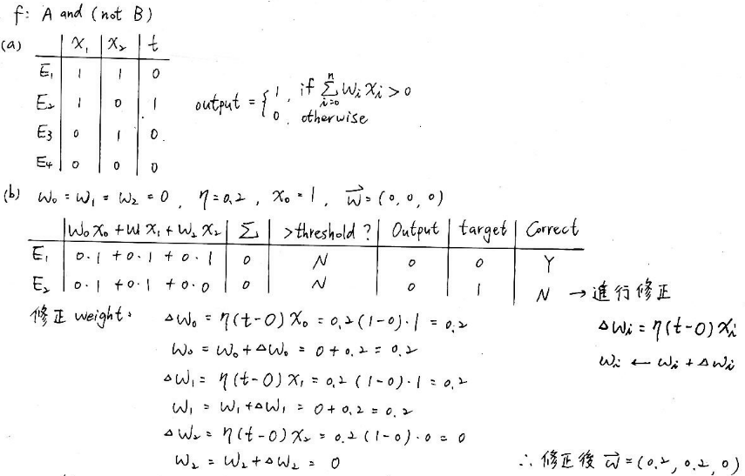
Neural Network Model

Slide 11
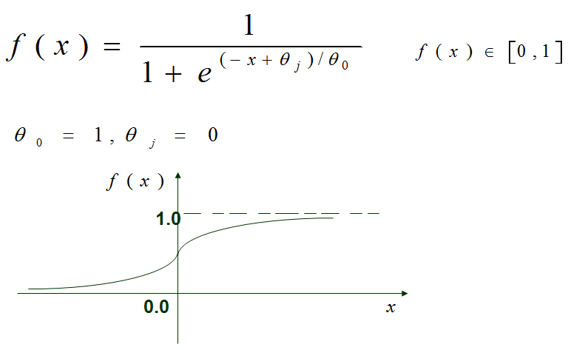
Neural Network Model
Standard feed-forward back-propagation network architecture with a single hidden layer was used.

Slide 12
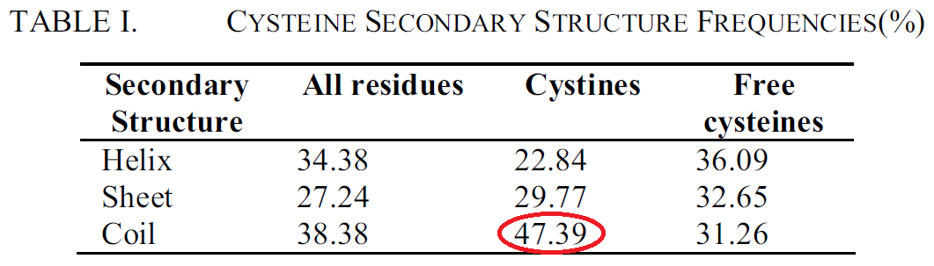
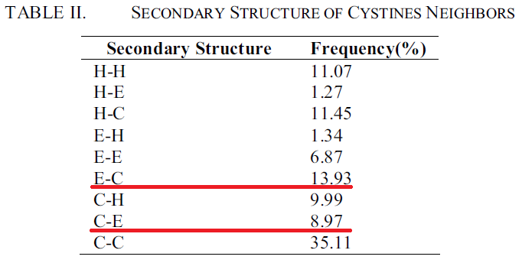
The secondary structure conformation frequencies detected in the dataset and computed using DSSP annotations

Slide 13
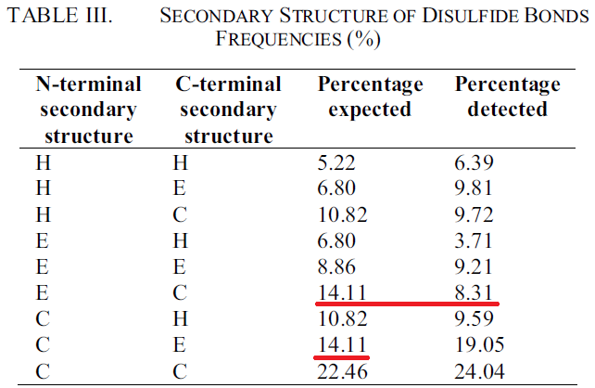

$0.4739×0.2977=0.1411 (14.11\%)$

Slide 14
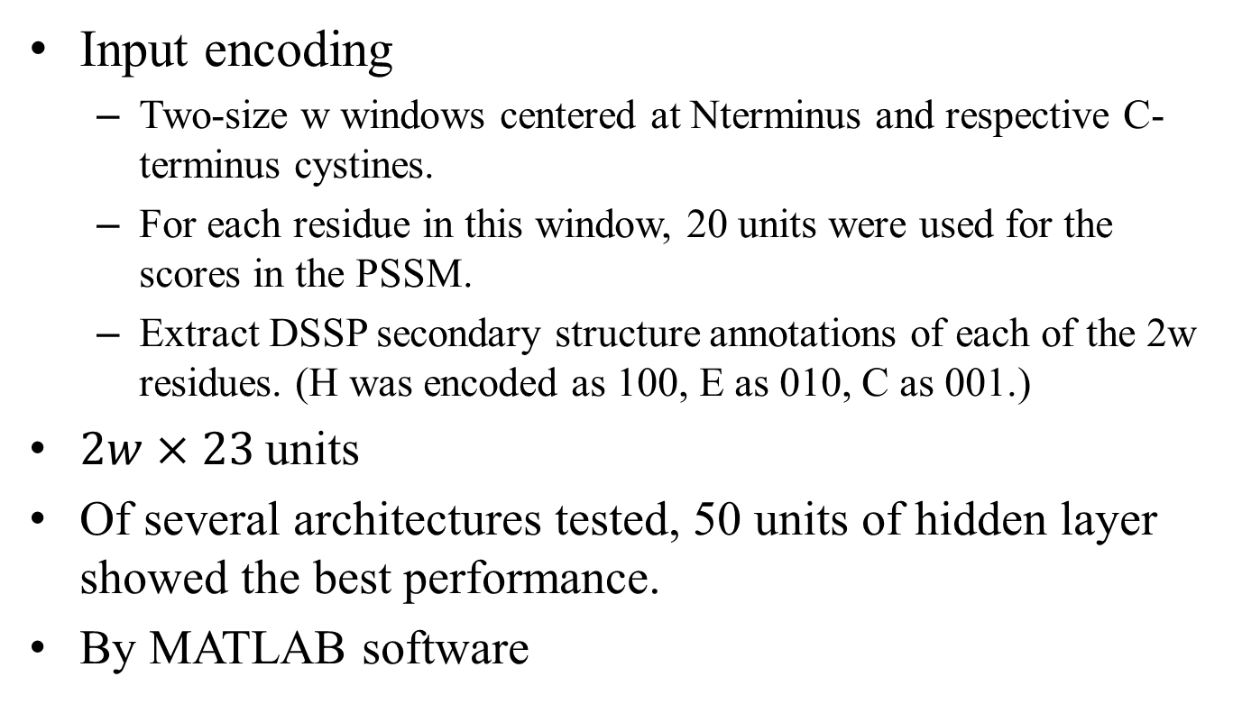
Neural Network
Input encoding
Two-size w windows centered at Nterminus and respective C-terminus cystines.
For each residue in this window, 20 units were used for the scores in the PSSM.
Extract DSSP secondary structure annotations of each of the 2w residues. (H was encoded as 100, E as 010, C as 001.)
$2w×23$units
Of several architectures tested, 50 units of hidden layer showed the best performance.
By MATLAB software

Slide 15
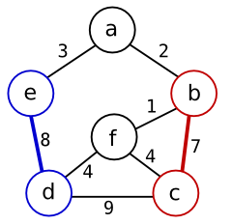
Final disulfide connectivity
Obtained by running the wmatch program.
Maximum Weight Matching

Slide 16
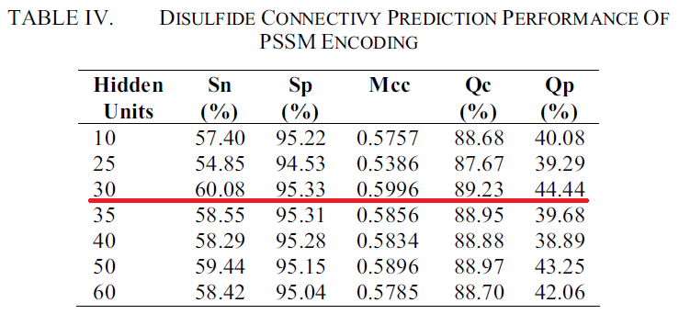
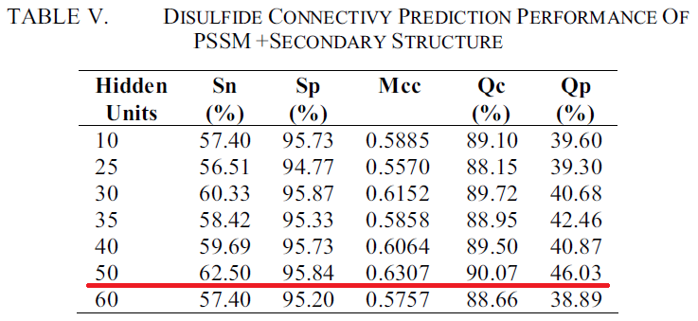
Results and discussion

Slide 17
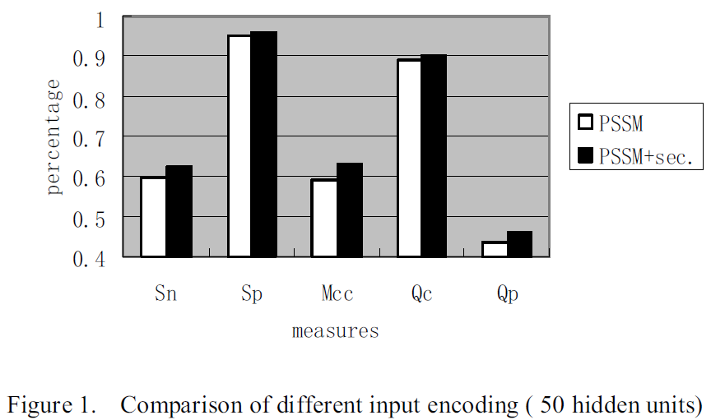

Slide 18
Conclusion
Disulfide bond prediction
Predicting cysteine oxidation state
Training (SVM, NN, …)
Evolutionary information
PSSM
Secondary structure
Maximum Weight Matching

Slide 19
Thank you for listening.
Thank C. J. Wang and K. Y. Chen.

