Slide 1
Structural Alignment of RNA with Complex Pseudoknot Structure
Thomas K.F. Wong, T.W. Lam, Wing-Kin Sung(宋永健), and S.M. Yiu
Journal of Computational Biology, Vol. 18, No. 1, pp. 97-108, 2011
Presenter：Chiou-Ting Tseng
Date: Aug. 1, 2011

Slide 2
Abstract
The secondary structure of an ncRNA molecule is known to play an important role in its biological functions. Aligning a known ncRNA to a target candidate to determine the sequence and structural similarity helps in identifying de novo ncRNA molecules that are in the same family of the known ncRNA. However, existing algorithms cannot handle complex pseudoknot structures which are found in nature. In this paper, we propose algorithms to handle two types of complex pseudoknots: simple non-standard pseudoknots and recursive pseudoknots.

Slide 3
Abstract
Although our methods are not designed for general pseudoknots, it already cover all known ncRNAs in both Rfam and PseudoBase databases. A preliminary evaluation on our algorithms show that it is useful to identify ncRNA molecules in other species which are in the same family of a known ncRNA.

Slide 4
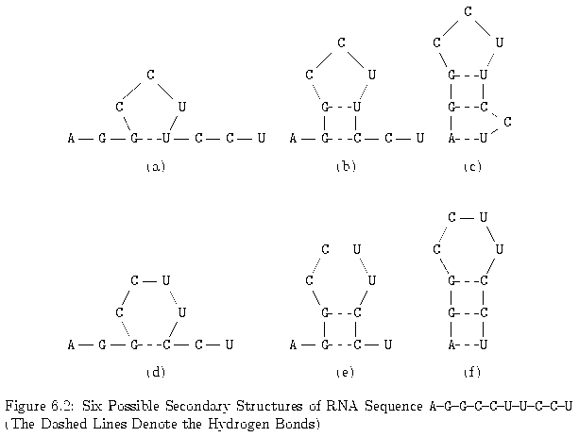
Secondary Structure of RNA

Slide 5
The RNA Maximum Base Pair Matching Problem
Originally, for predicting the secondary structure with minimum free energy, we may assign G≡C, A=U, G−U to –3, -2, -1.
Here, the problem becomes to find the secondary structure with maximum number of base pairs. This problem is called RNA maximum base pair matching problem.

Slide 6
Notations
M _{i,j}: Maximum # of base pairs on R _{i,j}=r_{i}r_{i+1}r_{i+2}…r_{j}
WW = {(A, U), (U, A),(G, C),(C, G),(G, U),(U, G)}.
ρ(r_{i},r_{j}): to indicate whether r_{i} and r_{j} can be a legal base pair:
1 if (r_{i},r_{j}) ∈ WW
ρ(r_{i},r_{j}) =
0 otherwise
M_{i,j} = 0 if j – i ≤ 3, since RNA sequence does not fold too sharply on itself.

Slide 7
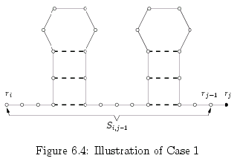
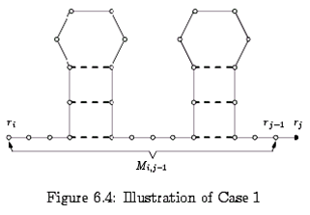
Case 1 of Matching
Case 1: r_{j} is not paired with any other base.
M_{i,j} = M_{i,j-1}.

Slide 8
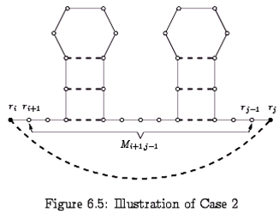
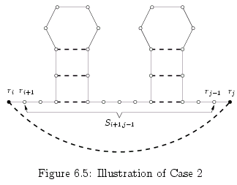
Case 2 of Matching
Case 2: r_{j} is paired with r_{i} and ρ(r_{i},r_{j}) = 1.
M_{i,j}=1+ M_{i+1,j-1}

Slide 9
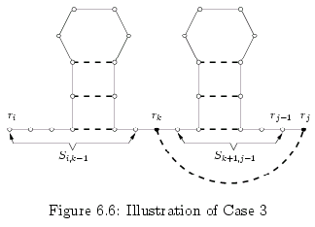
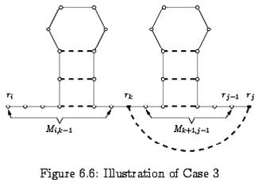
Case 3 of Matching
Case 3: r_{j} is paired with some r_{k}, where i+1 ≤ k ≤ j-4 and ρ(r_{k},r_{j}) = 1

Slide 10
Summary of the Algorithm
If j – i ≤ 3, then M_{i,j} = 0.
If j – i > 3, then
Time complexity: O(n³)

Slide 11
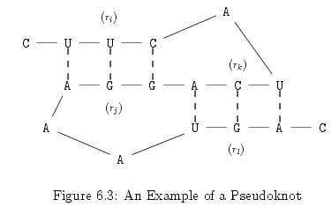
Pseudoknots
Two base pairs (r_{i},r_{j}) and (r_{k},r_{l}) are called a pseudoknot if i < k < j < l.
5
1
2
3
4
8
7
11
6
10
9
12
14
15
16
17
13

Slide 12
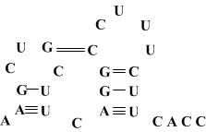
Example

Slide 13
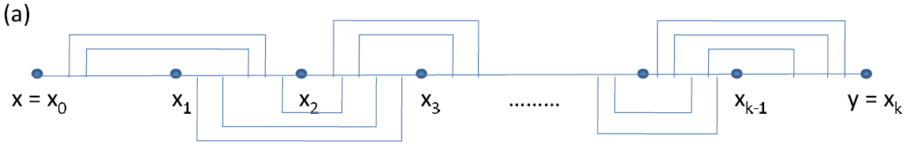
Previous Work
Recently, Han et al. developed PAL to solve the problem that supports secondary structures with standard pseudoknot of degree k and their algorithm runs in O(kmn^{k}) where m is the length of the query sequence and n is the length of the target sequence.

Slide 14
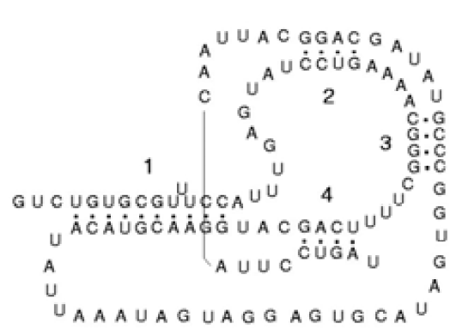
Unhandled Case - 1
Their algorithm cannot handle more complex pseudoknot structures such as one with 3 base pairs mutually crossing each other

Slide 15
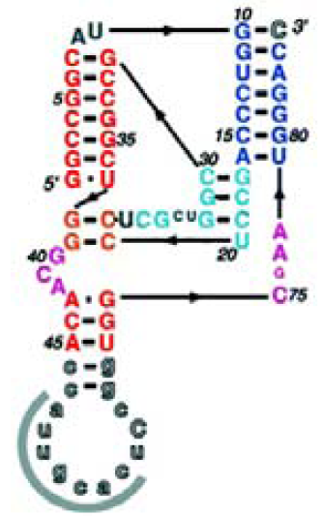
Unhandled Case - 2
The structure allowing recursive pseudoknots (i.e. pseudoknot/regular structures exist within another pseudoknot structure)

Slide 16
Database
In Rfam 9.1 database, among 71 pseudoknotted families, 18 of them have complex pseudoknot structure.
In the PseudoBase database, among 304 pseudoknot RNAs, 8 of them have complex pseudoknot structures.

Slide 17
Classes of Structures
Regular Structure
Standard Pseudoknot
Simple non-standard Pseudoknot
Recursive Pseudoknot

Slide 18
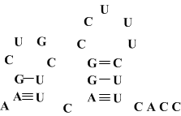
Regular Structure
A regular structure is one without Pseudoknots.

Slide 19
Standard Pseudoknot
A structure is a standard pseudoknot of degree k if the RNA sequence can be divided into k consecutive regions such that base pairs must have end points in adjacent regions and base pairs that are in the same adjacent regions cannot cross each other.

Slide 20
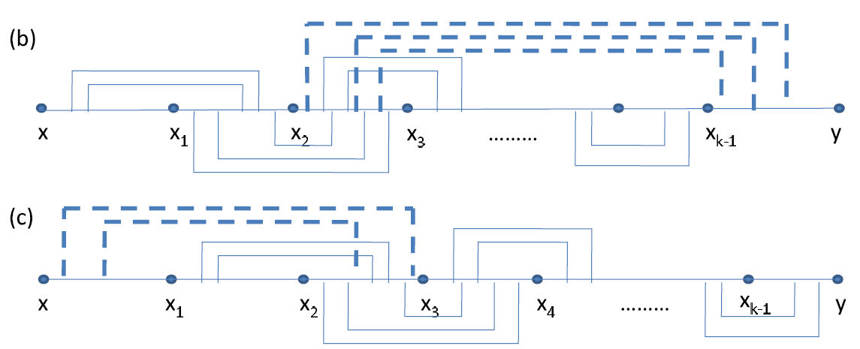
Simple non-standard Pseudoknot

Slide 21
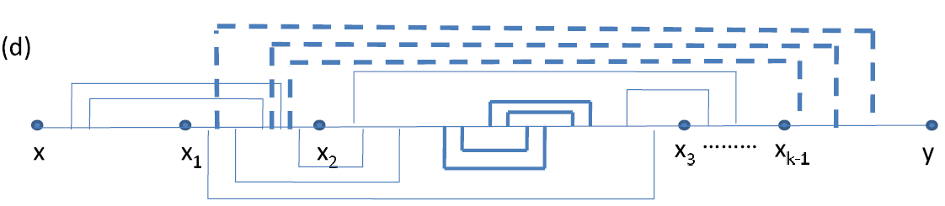
Recursive Pseudoknot
After removing recursive regions either regular structure, standard pseudoknot of degree ≤ k or simple non-standard-pseudoknot of degree ≤ k left.

Slide 22
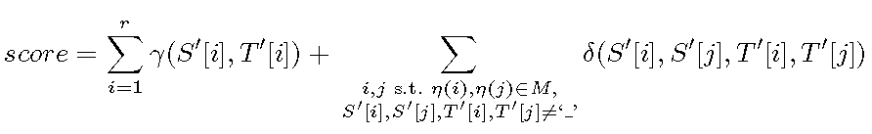
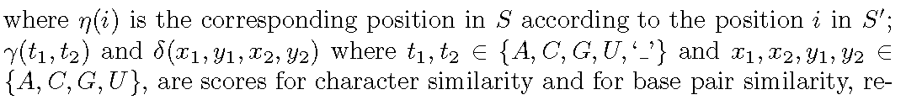
Scoring Function

Slide 23
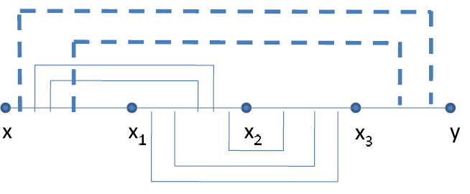
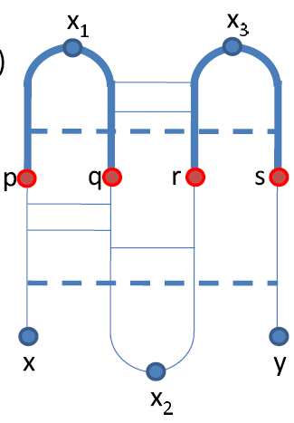
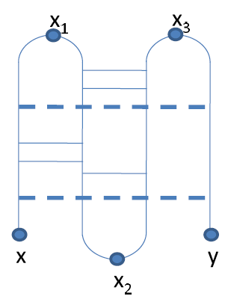
Transformation

Slide 24
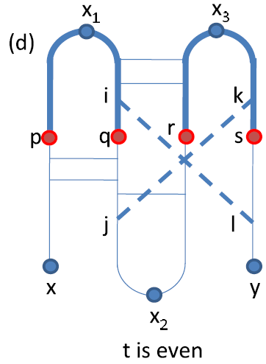
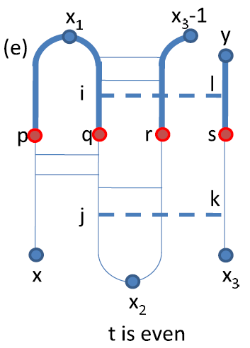
Transformation
x
p
x₁
i
q
j
x₂
r
x₃
k
s
l
y

Slide 25
Substructure
If t is odd, define the subregion R_{odd}(S, v) = [p, q]∪[r, s]. Otherwise, define the subregion R_{even}(S, x₃, v) = [p, q] ∪ [r, x₃ − 1] ∪ [s, y].

Slide 26
Outline
t is odd
(p, q) paired
p is single, q, r, s同理
(q, r), (p, r) are paired/ single 同理
t is even同理
(p, q, r, s)組合的演變

Slide 27
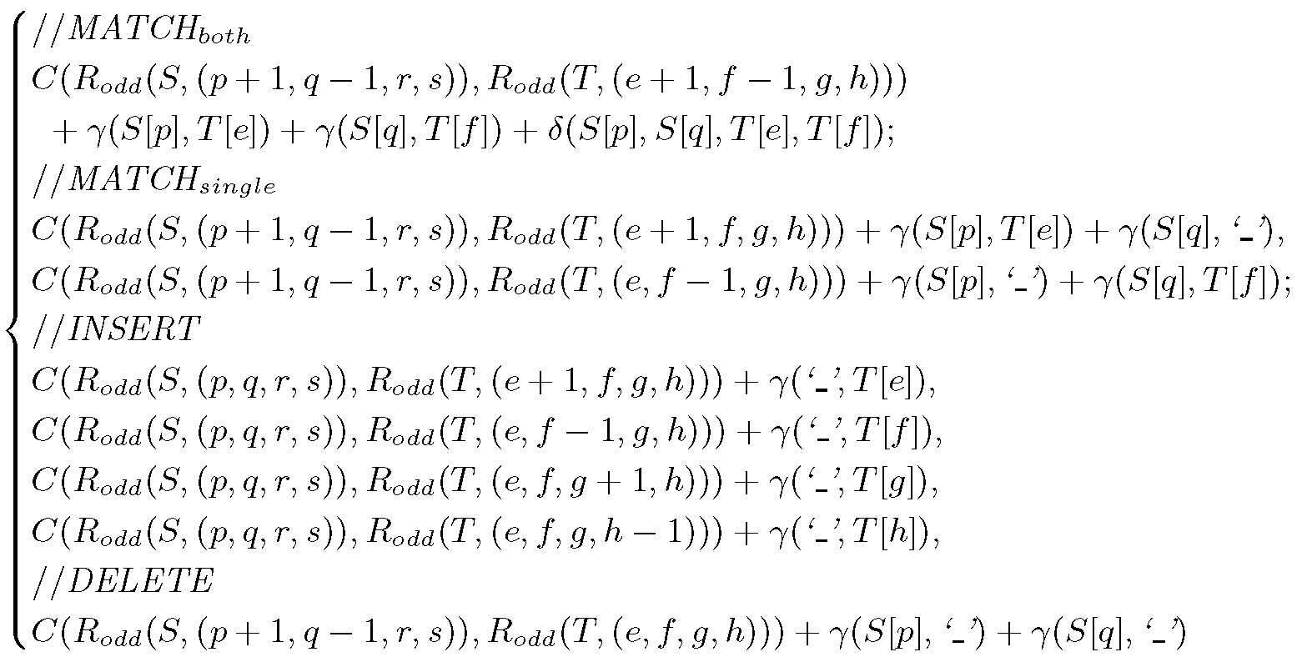
Dynamic Programming

Slide 28
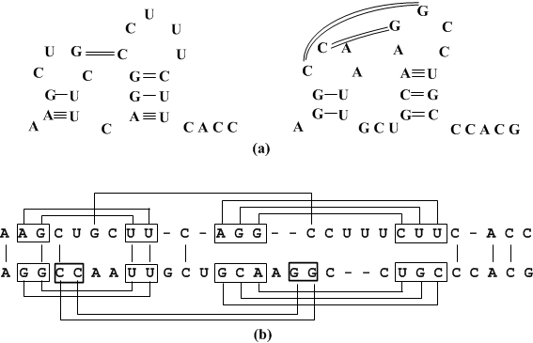
Example
Note: 本頁僅為方便說明各種情形，非本演算法之輸出

Slide 29
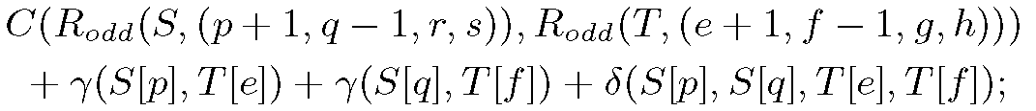
Match Both
p
q
r
s
g
e
f
h

Slide 30
Match Single
p
p+1
q-1
q
e
e+1
f
-
-
e
f-1
f

Slide 31
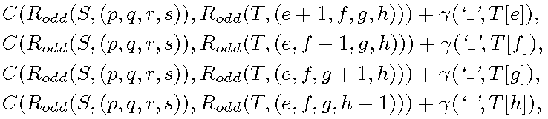
Insert
-
p
p+1
q-1
q
e
e+1
f
p
p+1
q
-
e
f-1
f

Slide 32
Delete
p
p+1
q-1
q
-
e
f
-

Slide 33
The Other Base Pair
The other cases, (q, r) is a base pair or (p, s) is a base pair, are similar.
Note that if more than one such base pair exists (e.g. both (q, r) and (p, s) are base pairs), we only need to follow the recursion on one of the pairs.

Slide 34
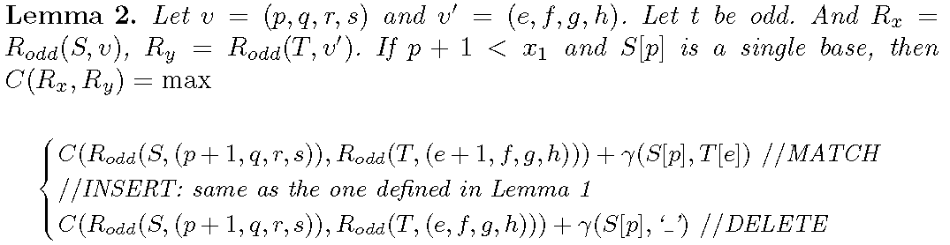
Single Base
p
p+1
q
e
e+1
f
-
e
f

Slide 35
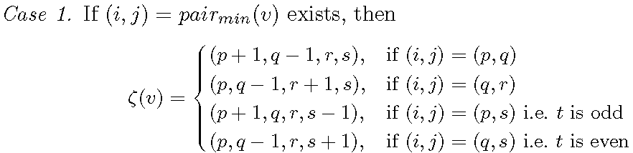
Migration of (p, q, r, s)
If there exists a set of base pairs, say {(i₁, j₁), ..., (i_{d}, j_{d})}, such that all i_{k}, j_{k} (1 ≤ k ≤ d) equals to p (if x ≤ p < x₁), q (if x₁ ≤ q < x₂), r (if x₂ ≤ r < x₃) or s (if x₃ ≤ s ≤ y), then pair_{min}(v) is the pair with minimum value of i.

Slide 36
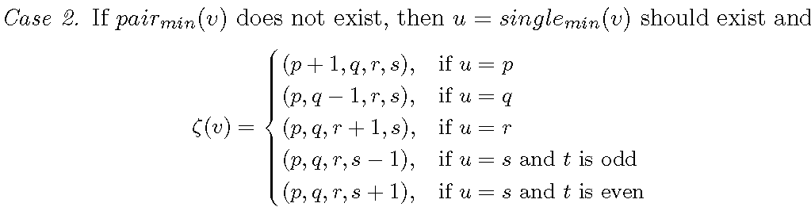
Migration of (p, q, r, s)
If there exists a set of single bases (i.e. the positions which do not belong to any base pair), say {u₁, ..., u_{d}}, such that all u_{k}(1 ≤ k ≤ d) equals to p (if x ≤ p < x₁), q (if x₁ ≤ q < x₂), r (if x₂ ≤ r < x₃) or s (if x₃ ≤ s ≤ y), then single_{min}(v) is the one with minimum value.

Slide 37
Time Complexity for Degree 4
For any sequence S[1..m] with simple non-standard pseudoknot of degree 4 and any sequence T[1..n], let c be the max length of [x₃, n], the optimal alignment score between S[1..m] and T[1..n] can be computed in O(cmn⁴).
All (e, f, g, h) takes O(n⁴)
There are O(m) (p, q, r, s)’s required to find.
When t is even, we need to find trough all x³s

Slide 38
Time Complexity for Degree 4
Note that the factor c is only needed when t is even due to the extra parameterx₃.
We examined all sequences in Rfam and PseudoBase, we found that usually the length of the final segment c is short (< 15) and the average length is only 5.4 with most of the cases having lengths from 5 to 7.
So, we can assume that c is a constant.

Slide 39
Time Complexity for Degree k
For any sequence S[1..m] with simple non-standard pseudoknot of degree k and any sequence T[1...n], the optimal alignment score between S[1..m] and T[1..n] can be computed in O(kmn^{k}).

Slide 40
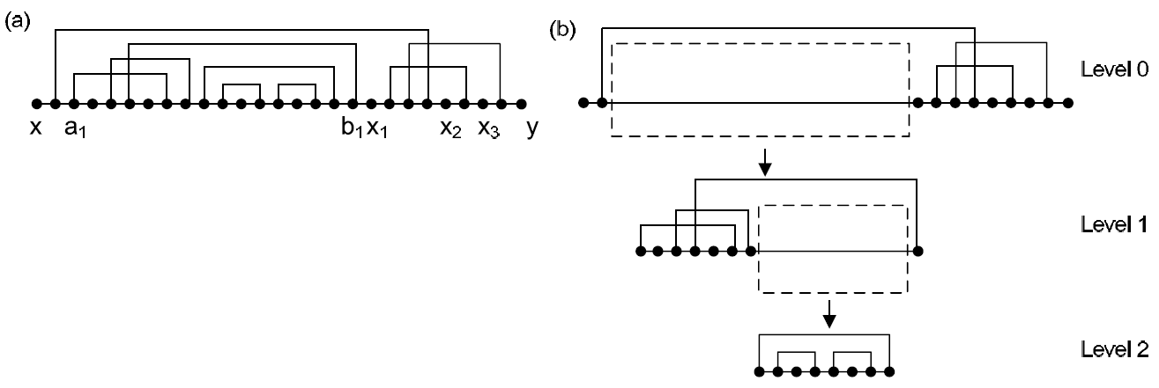
Recursive Pseudoknot

Slide 41
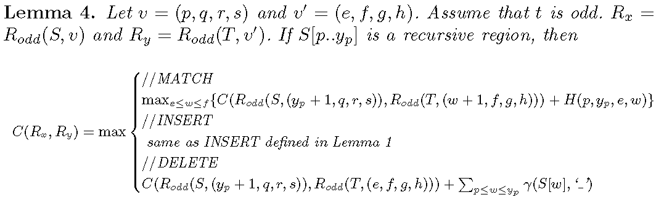
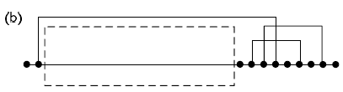
Dynamic Programming
p
y_{p}
y_{p}+1
q
e
w
w+1
f

Slide 42
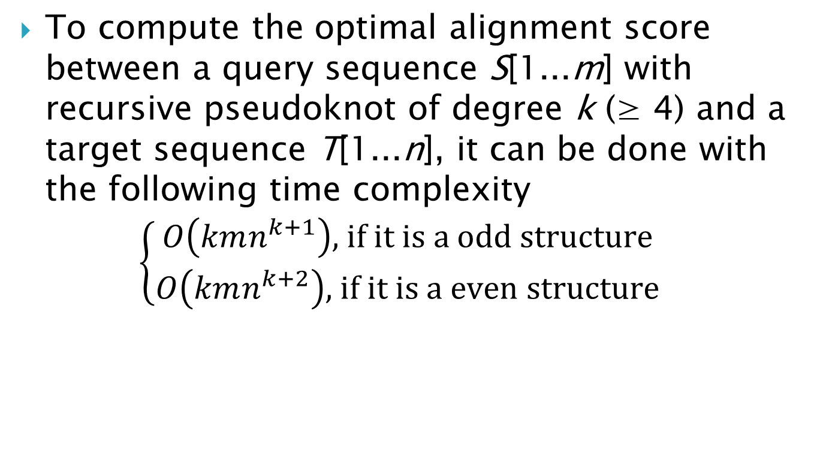
Time Complexity
To compute the optimal alignment score between a query sequence S[1...m] with recursive pseudoknot of degree k (≥ 4) and a target sequence T[1...n], it can be done with the following time complexity
$$\left\{\begin{matrix}O\left(kmn^{k+1}\right)\text{, }\text{if} \text{it} \text{is} \text{a} \text{odd} \text{structure} \\ O\left(kmn^{k+2}\right)\text{,} \text{if} \text{it} \text{is} \text{a} \text{even} \text{structure}\end{matrix}\right.$$

Slide 43
Dataset
We selected two families in Rfam 9.1 database to test the effectiveness of our algorithms.
RF00094 is a family with members having recursive pseudoknots and RF00140 is another with members having simple non-standard pseudoknots.
Both structures of RF00094 and RF00140 are of degree 4.

Slide 44
Result
Since there is no existing software which can perform structural alignment for complex pseudoknot structure, we compared the performance of our programs with BLAST.
We use default parameters for BLAST except the wordsize is set to 7.
Although our method is not designed for generic pseudoknots, we found that our method already cover all ncRNAs with complex pseudoknots in both Rfam 9.1 and PseudoBase databases.

Slide 45
Result
Comparison of resulting scores from our program and BLAST when scanning the whole genome (AB118824) for family RF00094 using AB037948/685-775 as the query sequence. The circled points are the known members of the same family in genome AB118824.

Slide 46
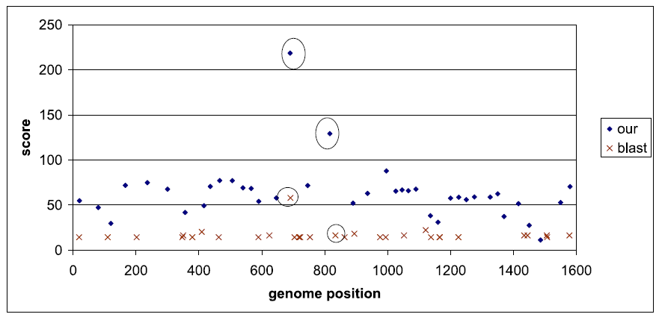
Result

Slide 47
軟體
http://bioinformatics.oxfordjournals.org/content/early/2011/06/08/bioinformatics.btr338.full.pdf

