Slide 1
Efficient algorithms for finding interleaving relationship between sequences
Kuo-Si Huang, Chang-Biau Yang, Kuo-Tsung Tseng,
Hsing-Yen Ann, Yung-Hsing Peng
Information Processing Letters
Vol. 105, pp. 188-193, 2008
Speaker: Kai-Yuan Cheng
Date: Aug. 23, 2011

Slide 2
Abstract
The longest common subsequence and sequence alignment problems have been studied extensively and they can be regarded as the relationship measurement between sequences. However, most of them treat sequences evenly or consider only two sequences.
Recently, with the rise of whole-genome duplication research, the doubly conserved synteny relationship among three sequences should be considered. It is a brand new model to find a merging way for understanding the interleaving relationship of sequences.
Here, we define the merged LCS problem for measuring the interleaving relationship among three sequences. An O(n³) algorithm is first proposed for solving the problem, where n is the sequence length. We further discuss the variant version of this problem with the block information. For the blocked merged LCS problem, we propose an algorithm with time complexity O(n²m),where m is the number of blocks. An improved O(n² +nm²) algorithm is further proposed for the same blocked problem.

Slide 3
LCS
Ex:
A = TAGTCACG
B = AGACTGTC
LCS(A, B) = AGACG

Slide 4
Merged LCS
LCS(T ,E (A,B))
T = t₁t₂ ··· t_{|T|}
A = a₁a₂ ··· a_{|A|}
B = b₁b₂ ··· b_{|B|}
E(A,B) =e₁e₂e₃ ··· e_{|E(A,B)|} is obtained by merging two subsequences of A and B, where e_{i} ∈A∪B and 1≦ i ≦ |E(A,B)|;
that is, there exists one subsequence S of E(A,B) such that S is a subsequence of A and E(A,B) − S is a subsequence of B.

Slide 5
Merged LCS
Ex:
T = atacgcgctt
A = cgatacc
B = aattcgc
E₁(A,B) = cgaaactcgc
E₂(A,B) = cagaatttaccgcc
LCS(T, E₁(A,B)) = aaccgc
LCS(T, E₂(A,B)) = ataccgc
LCS(T, E(A,B)) = LCS(T, E₂(A,B))

Slide 6
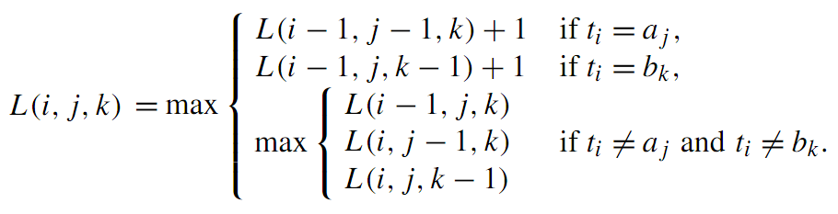
Algorithm MergedLCS
L(i, j, k) = LCS(T[1, i], E(A[1, j], B[1, k]))
time complexity: O(n³)

Slide 7
T=GTC, A=ATAGC, B=TAGCA
L(1, j, k)
L(2, j, k)
L(3, j, k)
 | - | T | A | G | C | T
- | 0 | 0 | 0 | 1 | 1 | 1
A | 0 | 0 | 0 | 1 | 1 | 1
T | 0 | 0 | 0 | 1 | 1 | 1
A | 0 | 0 | 0 | 1 | 1 | 1
G | 1 | 1 | 1 | 1 | 1 | 1
C | 1 | 1 | 1 | 1 | 1 | 1
 | - | T | A | G | C | T
- | 0 | 1 | 1 | 1 | 1 | 2
A | 0 | 1 | 1 | 1 | 1 | 2
T | 1 | 1 | 1 | 2 | 2 | 2
A | 1 | 1 | 1 | 2 | 2 | 2
G | 1 | 2 | 2 | 2 | 2 | 2
C | 1 | 2 | 2 | 2 | 2 | 2
 | - | T | A | G | C | T
- | 0 | 1 | 1 | 1 | 2 | 2
A | 0 | 1 | 1 | 1 | 2 | 2
T | 1 | 1 | 1 | 2 | 3 | 3
A | 1 | 1 | 1 | 2 | 3 | 3
G | 1 | 2 | 2 | 2 | 3 | 3
C | 2 | 3 | 3 | 3 | 3 | 3

Slide 8
The merged LCS problem with block constraint
LCS(T ,E^{b}(A,B))
T = t₁t₂ ··· t_{|T|}
A = A₁A₂ ··· A_{α} = a₁a₂ ··· a_{|A|}
B = B₁B₂ ··· B_{β} = b₁b₂ ··· b_{|B|}
E (A,B) = E₁E₂ ··· E_{ε} = e₁e₂e₃ ··· e_{|E(A,B)|}
E_{i} ∈ (A_{j}∪B_{k}) and 1≦ i ≦ ε, 1 ≦ j ≦ α, 1 ≦ k ≦ β.
b

Slide 9
BMLCS
Ex:
T = atacgcgctt
A = A₁A₂A₃ = cga ta cc
B = B₁B₂B₃B₄ = aa tt cg c
E₁(A,B) = A₁B₁A₃B₃ = cga aa cc cg
E₂(A,B) = A₂A₃B₃B₄ = ta cc cg c
LCS(T, E₁(A,B)) = aaccg
LCS(T, E₂(A,B)) = taccgc
LCS(T, E(A,B)) = LCS(T, E₂(A,B))
b
b
b
b
b

Slide 10
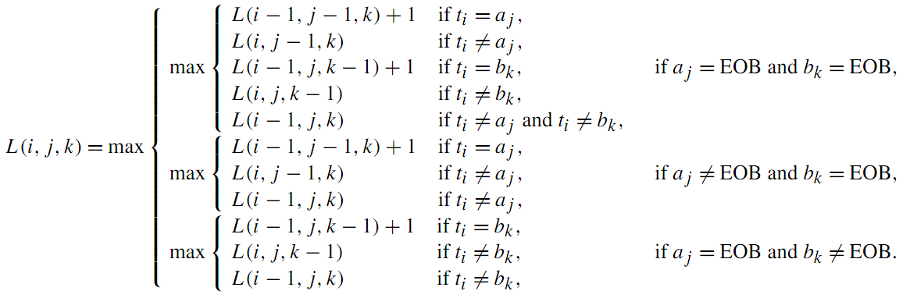
Algorithm BMLCS
time complexity: O(n²m) m = max(α, β)

Slide 11
T=GTC, A=AT AGC, B=TAG CA
L(1, j, k)
L(2, j, k)
L(3, j, k)
 | - | T | A | G | C | T
- | 0 | 0 | 0 | 1 | 1 | 1
A | 0 |  | 0 |  |  | 1
T | 0 |  | 0 |  |  | 1
A | 0 | 0 | 0 | 1 | 1 | 1
G | 1 |  | 1 |  |  | 1
C | 1 | 1 | 1 | 1 | 1 | 1
 | - | T | A | G | C | T
- | 0 | 1 | 1 | 1 | 1 | 2
A | 0 |  | 1 |  |  | 2
T | 1 |  | 1 |  |  | 2
A | 1 | 1 | 1 | 1 | 1 | 2
G | 1 |  | 1 |  |  | 2
C | 1 | 2 | 2 | 2 | 2 | 2
 | - | T | A | G | C | T
- | 0 | 1 | 1 | 1 | 2 | 2
A | 0 |  | 1 |  |  | 2
T | 1 |  | 1 |  |  | 2
A | 1 | 1 | 1 | 1 | 2 | 2
G | 1 |  | 1 |  |  | 2
C | 2 | 2 | 2 | 2 | 3 | 3

Slide 12
Thank you!!!

