Slide 1
A weighting function for improving fuzzy classification systems performance
Eghbal G. Mansoori, Mansoor J. Zolghadri, Seraj D. Katebi
Department of Computer Science and Engineering, Shiraz University, Shiraz, Iran
Fuzzy Sets and Systems, Vol. 158 (2007), pp. 583-591
Presenter: Hung-Hsin Chen (陳紘昕)
Date: Aug. 23, 2011

Slide 2
Abstract
This paper considers the automatic design of fuzzy rule-based classiﬁcation systems from labeled data. The classiﬁcation accuracy and interpretability of generated rules are of major importance in fuzzy classiﬁcation systems. We propose a weighting function for compatibility grade of patterns that improves the performance of fuzzy classiﬁcation system without degrading the interpretability of fuzzy rules. Our approach divides the covering subspace of each fuzzy rule into two subdivisions based on a threshold. Any pattern with compatibility grade above this threshold should be classiﬁed truly so the weighting function enhances their association degree. For patterns below threshold, their compatibility grades remain unchanged. The splitting threshold for each rule (i.e. the compatibility grade of a speciﬁc pattern) is found using distribution of patterns in the covering subspace of that rule. We also show that how the proposed approach is applicable when fuzzy rules have certainty grades. Experiments on some well-known data sets are used to evaluate the performance of our approach.

Slide 3
Data representation
Partial iris flower data set:
Attributes (features) |  |  |  | Class
Sepal Length | Sepal Width | Petal Length | Petal Width | Species
5.1 | 3.5 | 1.4 | 0.2 | setosa
4.9 | 3 | 1.4 | 0.2 | setosa
4.7 | 3.2 | 1.3 | 0.2 | setosa
4.6 | 3.1 | 1.5 | 0.2 | setosa
5 | 3.6 | 1.4 | 0.2 | setosa
0 | 3.2 | 4.7 | 1.4 | versicolor
6.4 | 3.2 | 4.5 | 1.5 | versicolor
6.9 | 3.1 | 4.9 | 1.5 | versicolor
5.5 | 2.3 | 4 | 1.3 | versicolor
6.5 | 2.8 | 4.6 | 1.5 | versicolor
6.3 | 3.3 | 6 | 2.5 | virginica
5.8 | 2.7 | 5.1 | 1.9 | virginica
7.1 | 3 | 5.9 | 2.1 | virginica
6.3 | 2.9 | 5.6 | 1.8 | virginica
6.5 | 3 | 5.8 | 2.2 | virginica
One data is usually called a point or an instance

Slide 4
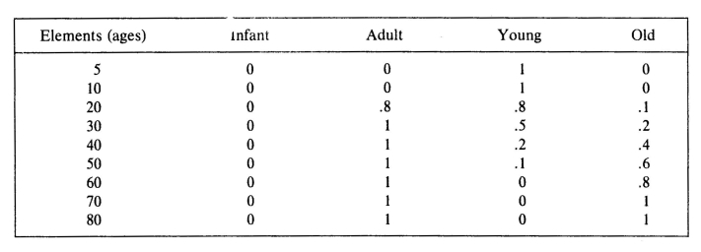
Example of fuzzy set
Attributes
Membership value

Slide 5
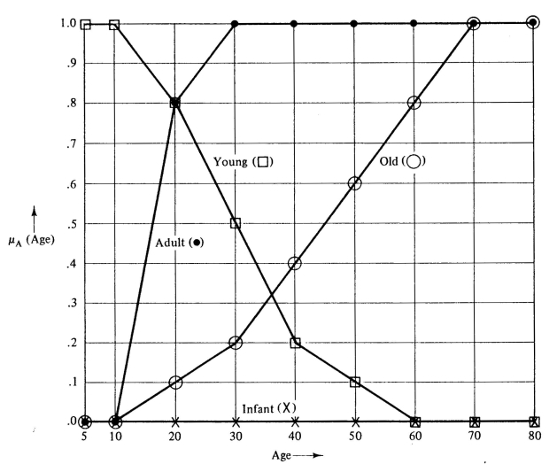

Slide 6
Fuzzy if-then rule
Example:
A₁: height={high, medium, low}
A₂: weight={heavy, middle, light}
R₁: If x₁ is high and x₂ is heavy then basketball player with w₁=0.8
R₂: if x₁ is high and x₂ is middle then runner with w₂=0.7

Slide 7
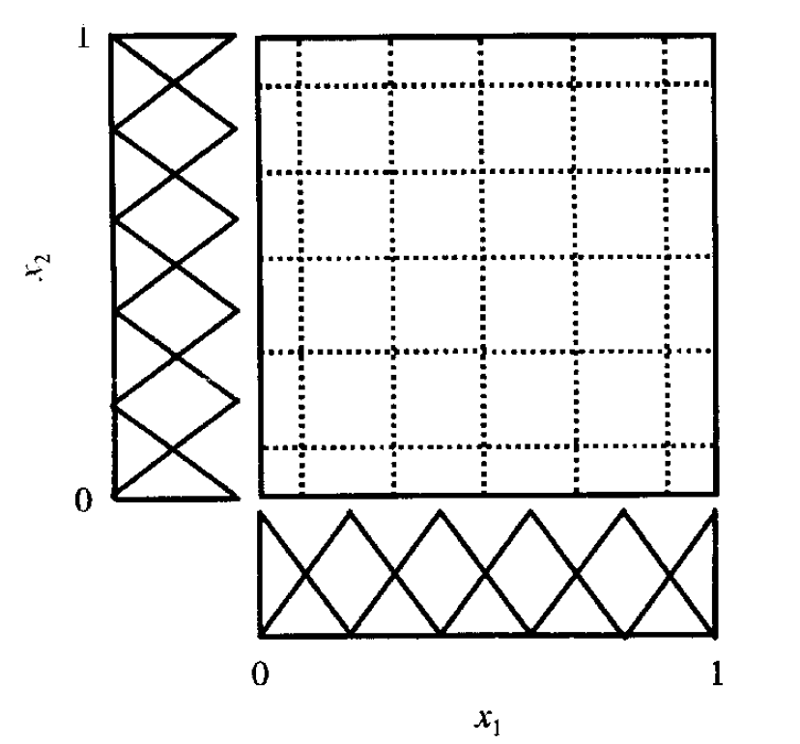
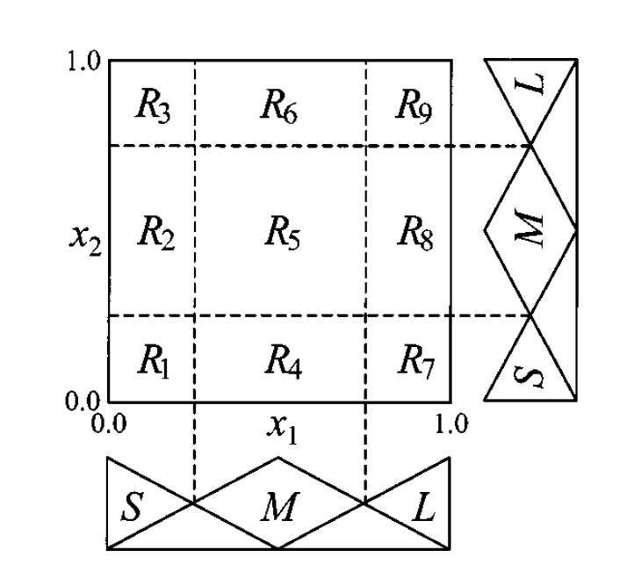
Fuzzy rules generation
Each grid is a fuzzy rule
K=6
K=3
Each attribute is divided into K partitions
There are totally K^{dim} rules!

Slide 8
The compatibility grade of each pattern x_{p}
(X_{p}近似某一條rule敘述的程度, 此時rule的class與w之值仍未知)
Before training:
A₁: height={high, medium, low}
A₂: weight={heavy, middle, light}
R₁: If x₁ is high and x₂ is middle then Class₁ with w₁
R₂: if x₁ is high and x₂ is light then Class₂ with w₂
…
(總共有| A₁ |*|A₂|=3*3=9條rules)
Using labeled data to train fuzzy rule systems

Slide 9
Training the fuzzy rules
Training example:
Jack =(height: 180cm, weight: 70kg, class: boxer)
=>{{0.8/high, 0.4/medium}, {0.9/middle, 0.3/light}}
μ₁(Jack) = 0.8 * 0.9 = 0.72 (the highest, class₁=boxer)
μ₂(Jack) = 0.8* 0.3 = 0.24
…
每個instance都會產生3*3=9 個 compatibility grade
μ 值最高的rule表示該rule將此instance分類正確的可能性越高，因此該rule的class可能為instance的class值

Slide 10
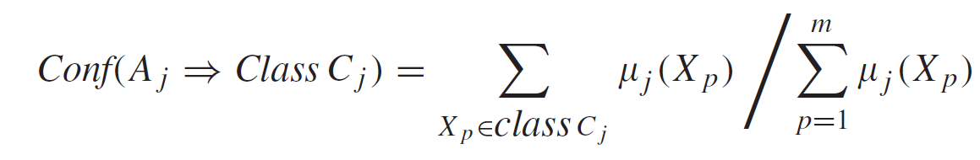
Computing the certainty grade of each rule
Example:
4 instances, 共有3個類別
計算R₁對4個instances之compatibility grade
μ ₁(X₁) = 0.72, (X₁ is class 1), μ ₁(X₂) = 0.55, (X₂ is class 1)
μ ₁(X₃) = 0.05, (X₃ is class 2), μ ₁(X₄) = 0.19, (X₄ is class 3)
則R₁為class 1的certainty grade為0.714,
Conf(class1) = (.72+.55)/(.72+.55+.05+.19)=0.84
Conf(class3) = .19 /(.72+.55+.05+.19)= 0.126
w₁ = 0.84-0.126 = 0.714

Slide 11
Fuzzy reasoning based on a single winner rule
X_{p} ( testing pattern, unknown class)由具有最高u_{j}(X_{p})的rule決定類別
Without certainty grade
Within certainty grade

Slide 12
Testing example:
A₁: height={high, medium, low}
A₂: weight={heavy, middle, light}
R₁: If x₁ is high and x₂ is heavy then basketball player with w₁=0.8
R₂: if x₁ is high and x₂ is middle then runner with w₂=0.7
…
LBJ =(height: 210cm, weight: 100kg, class: unknown)
=>{{0.9/high, 0.1/medium}, {0.8/heavy, 0.2/middle}}
Without certainty grade:
μ ₁(LBJ) = 0.9 * 0.8 = 0.72
μ ₂(LBJ) = 0.9 * 0.2 = 0.18
…
Hence LBJ is a basketball player
Within certainty grade:
μ ₁(LBJ) = 0.9 * 0.8 * 0.8 = 0.577
μ ₂(LBJ) = 0.9 * 0.2 * 0.7 = 0.126
…
Hence LBJ is a basketball player

Slide 13
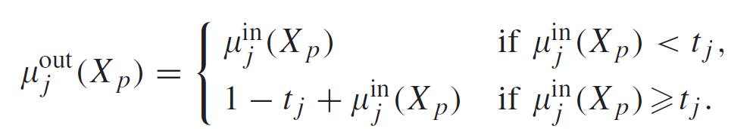
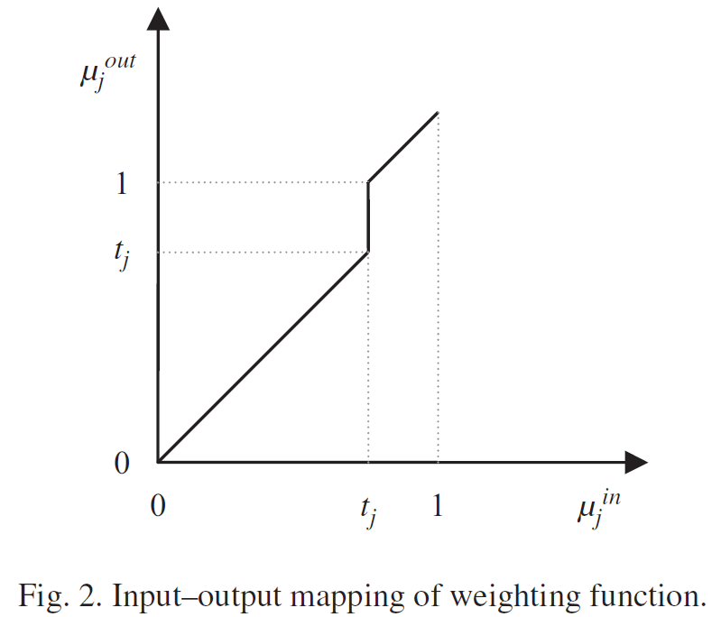
The proposed weighting function (without certainty grade)
增強超過threshold 的 compatibility grade
How to determine t_{j}?
若現在共有9條已訓練完成的rules(使用前面的方法)，則對於每一個已知class的instance，a條rules分類的結果正確，b條rules的分類結果錯誤，總共會有a+b=9個compatibility grade，則t_{j}為a條rules中分數最低之值
在threshold 之下的 compatibility grade保持不變

Slide 14
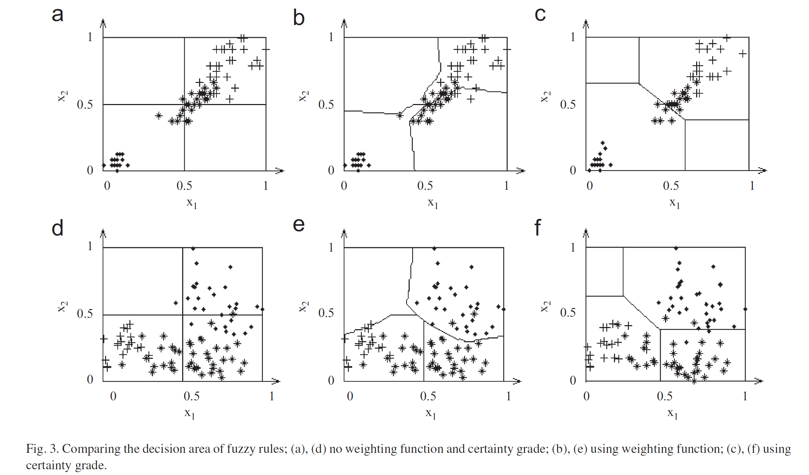

Slide 15
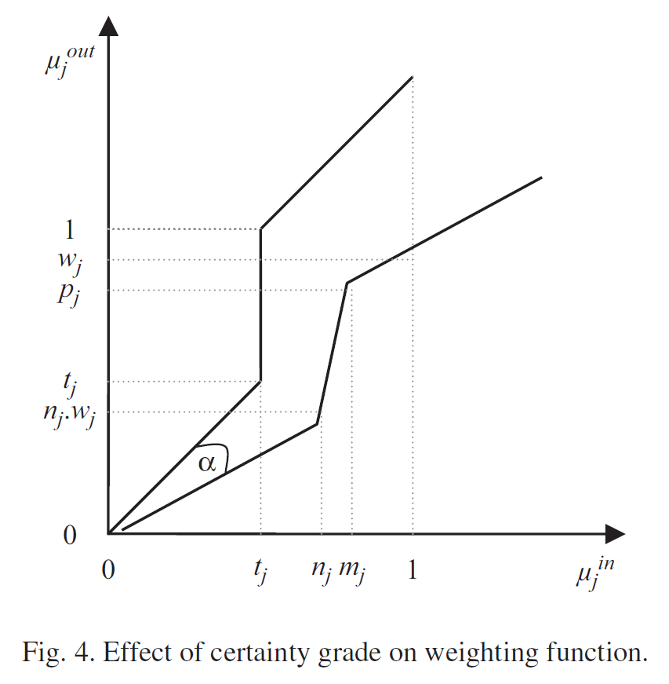

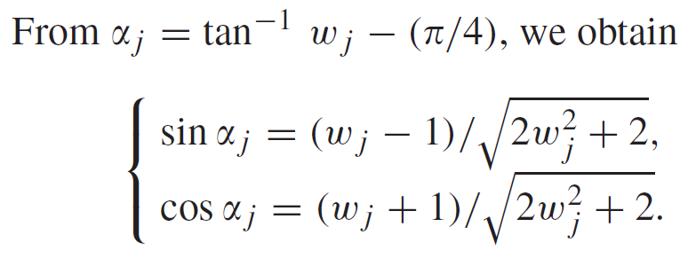
The proposed weighting function (within certainty grade)
Original
原始的u_{j}^{in}使用certainty grade之後值變小
New

Slide 16
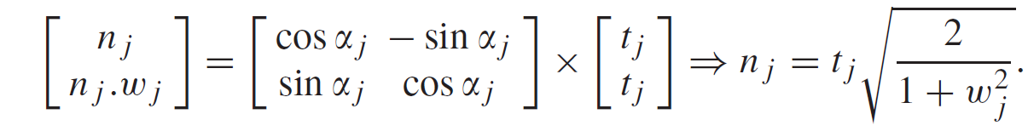
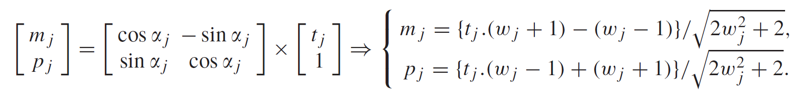
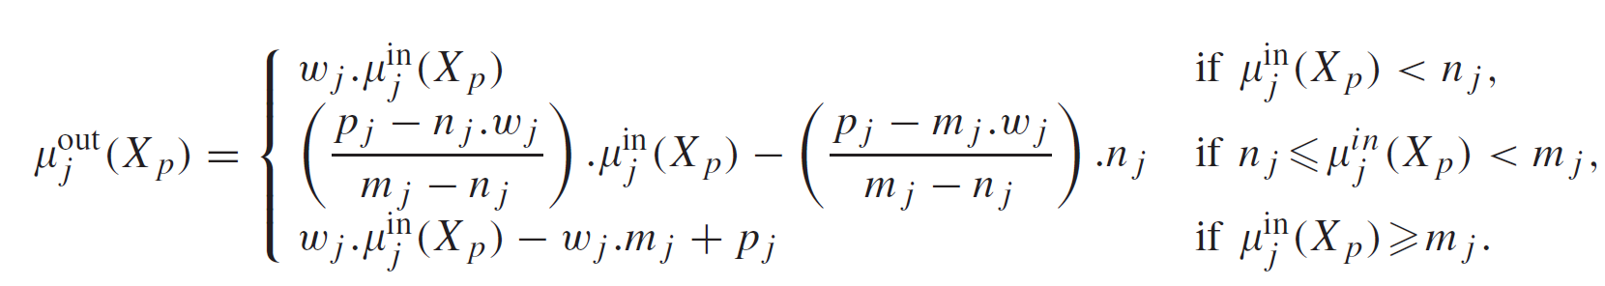

Slide 17
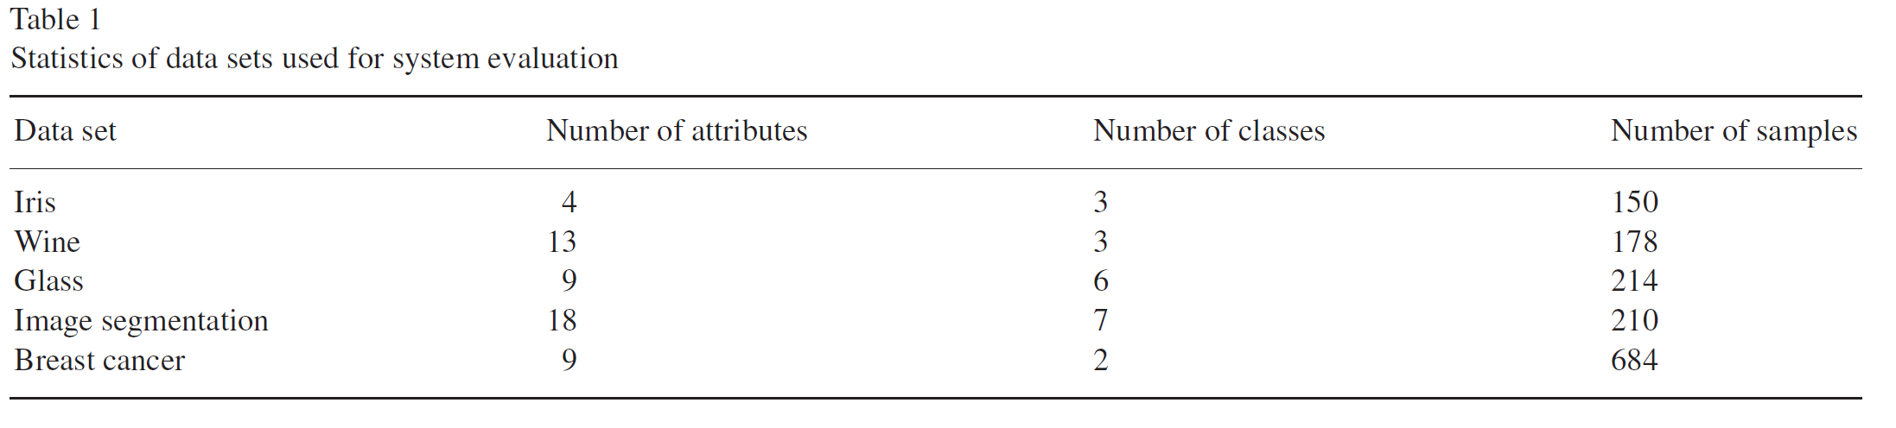
Experiment
Data is collected from the UCI ML repository
3 testing methods:
2FT (full train and full test)
2CV (two-fold cross validation)
LV1 (leave one out)

Slide 18
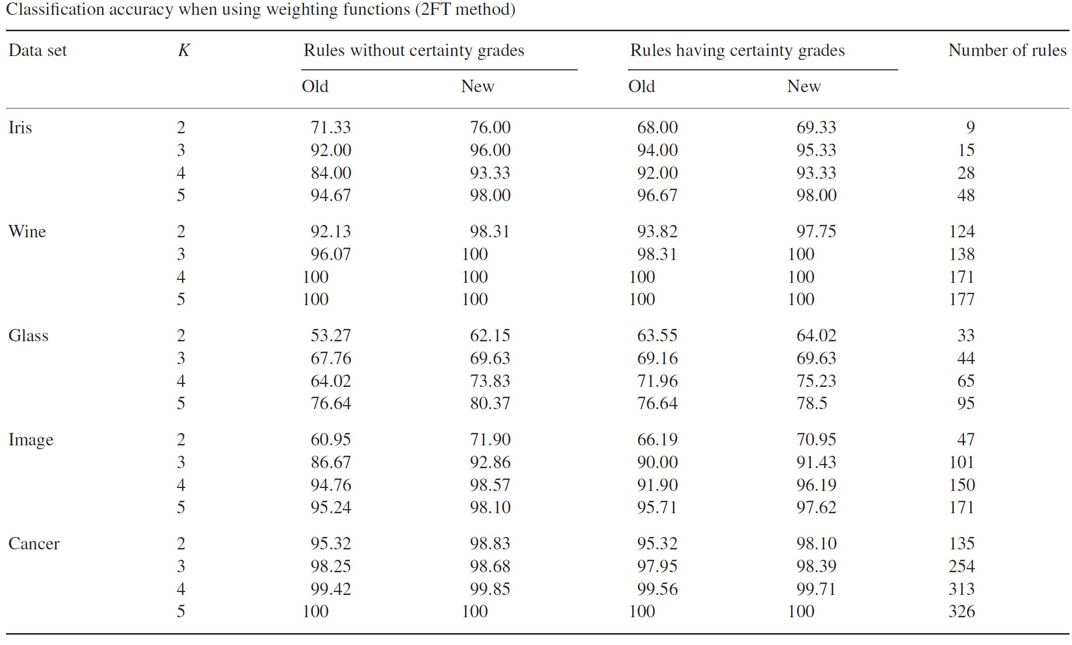
Without weighting fun.

Slide 19
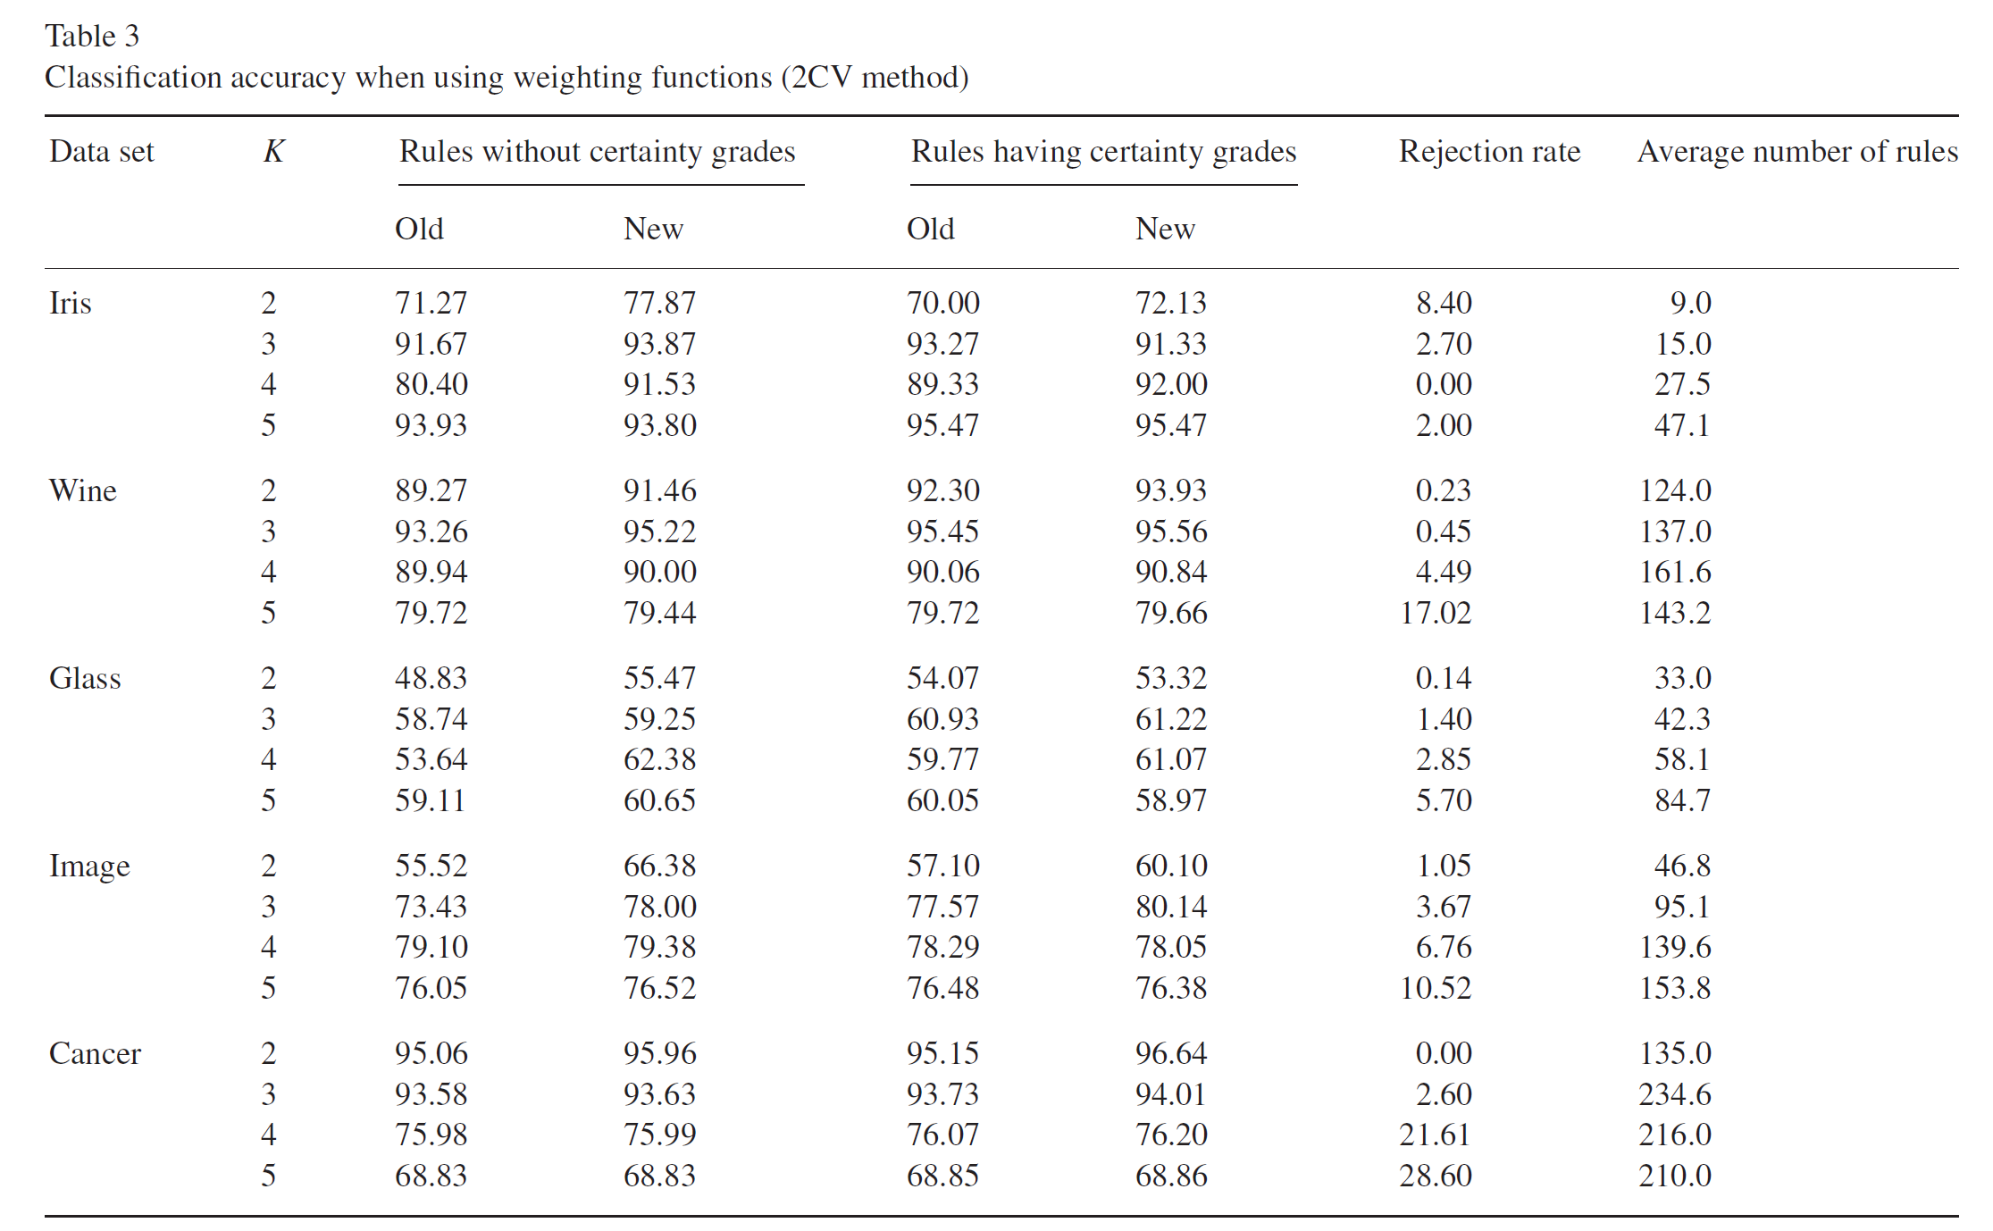

Slide 20
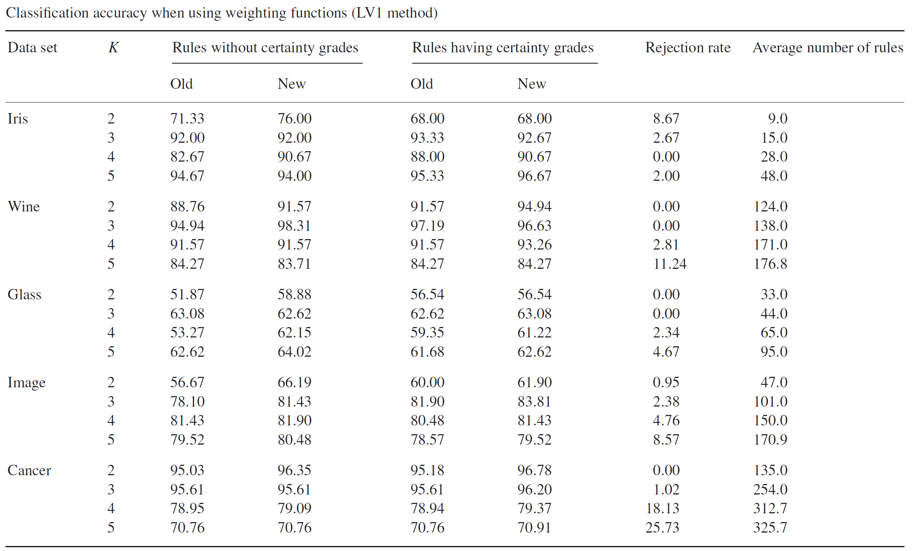

Slide 21
Conclusion
The weighting function enhances the compatibility grade of some patterns to classify them truly.
Experimental results shows that the proposed can improve the classification accuracy.

Slide 22

Thank you!!

