Slide 1
Disulfide Connectivity Prediction with Normalized Bond Vector
Lin-Yu Tseng, Shiau-Kuen Tsai and Hsuan-Hung Lin
The 24th Workshop on Combinatorial Mathematics and Computation Theory, pp. 308-313, 2008
Presenter: Hong-Yu Chen
Date: Aug. 23, 2011

Slide 2
Abstract (1/2)
The prediction of the location of disulfide bridges helps towards the solution of protein folding problem. Most of previous works on disulfide connectivity pattern prediction use the prior knowledge of the bonding state of cysteines. In this study an effective method is proposed to predict disulfide connectivity pattern for proteins that have at least two disulfide bonds but without the prior knowledge of cysteins bonding state. The method is based on template matching and only a global feature called the normalized bond vector is used. This method can also be applied and achieves a better accuracy if the bonding state of cysteines is known.

Slide 3
Abstract (2/2)
In previous research works reported in the literature, to the best of our knowledge, without the prior knowledge of the bonding state of cysteines, the best accuracy of disulfide connectivity pattern prediction is 51%. With the prior knowledge of the bonding state of cysteines, the best accuracy is 70%. Testing our method on the same test dataset SwissProt39 (sp39), the accuracy of a fourfold cross-validation is 61% for disulfide connectivity pattern prediction when the bonding state of cysteines is not known in advance. With the prior knowledge of bonding state, the accuracy increases to 71%.

Slide 4
Introduction
Disulfide bonds play an import structural role in stabilizing protein conformations.
The prediction of the disulfide bonding states and the disulfide bonding pattern.
  Reduce disulfide connectivity to the graph matching problem.
Template matching method with the normalized bond vector (NBV).

Slide 5
Dataset
SWISS-PROT database release no. 39 (SP39)
Less than 20% of SWISS-PROT sequences have more than five disulfide bridges.
In this set, all the chains having more than 10 oxidized cysteines had been excluded.
In total 446 sequences
  156 sequences have two disulfide bridges.
  146 sequences have three.
  99 sequences have four.
  45 sequences have five.
4-fold cross-validation, randomly.

Slide 6
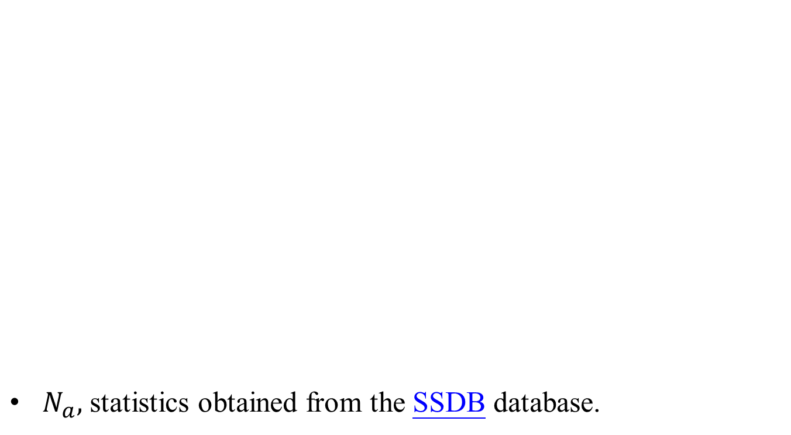
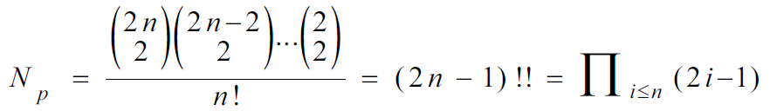
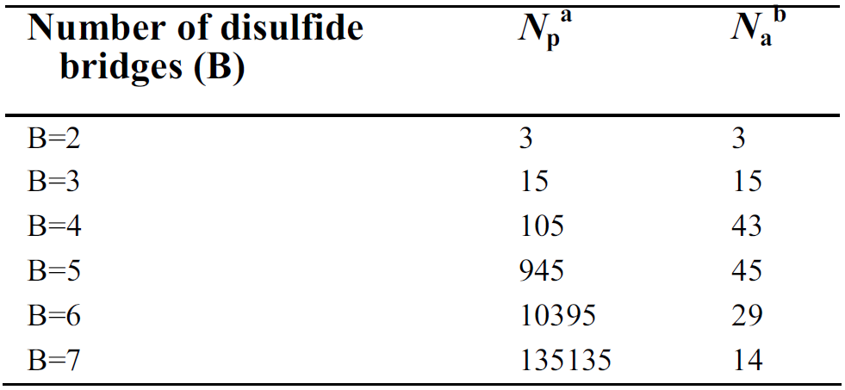
The number of disulfide bonding patterns

Slide 7
The normalized bond vector (NBV)
Predict the disulfide bonding pattern of the test protein sequence to be the same as that of the most similar template sequence.
以 cysteine pairs 相關位置分布作為主要 feature.

Slide 8
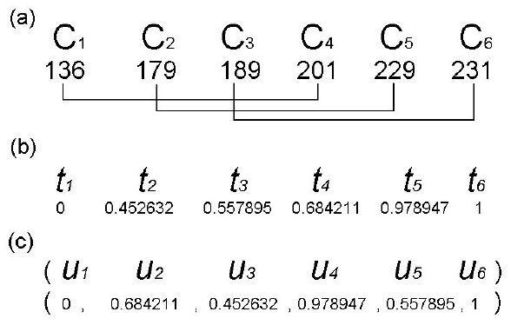
NBV
(a). The protein 1BET.
(b). The normalized positions of six cysteines.
(c). The normalized bond vector.

Slide 9
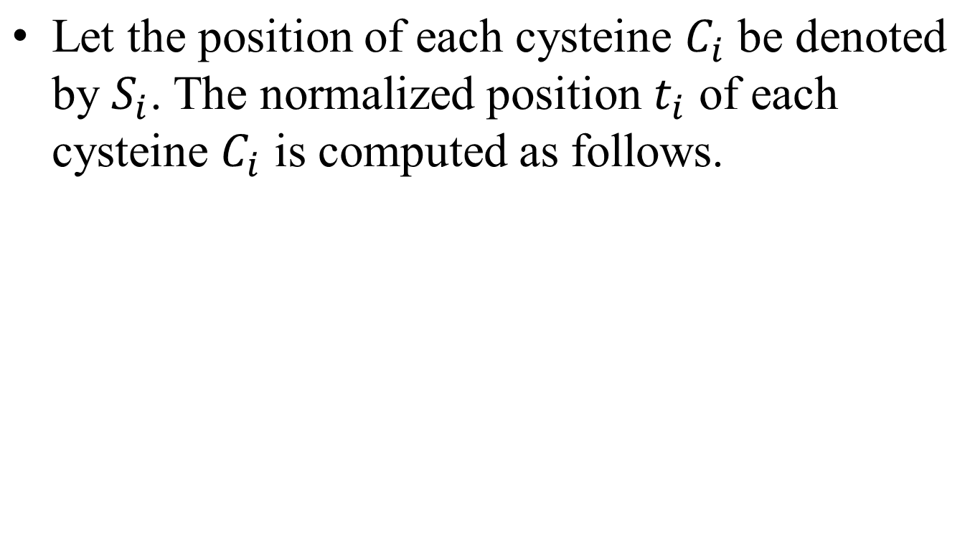
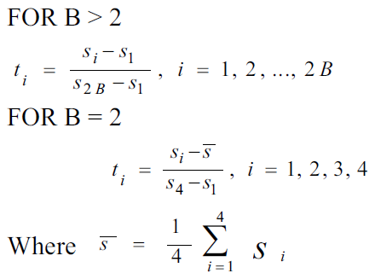
The normalized position

Slide 10


The template matching
All templates are divided into groups according to the number of disulfide bridges.
Assuming that there is exactly one template for each bonding pattern.
On dataset SP39, the numbers of matches are estimated to be 50,824 and 1,283,543.

Slide 11
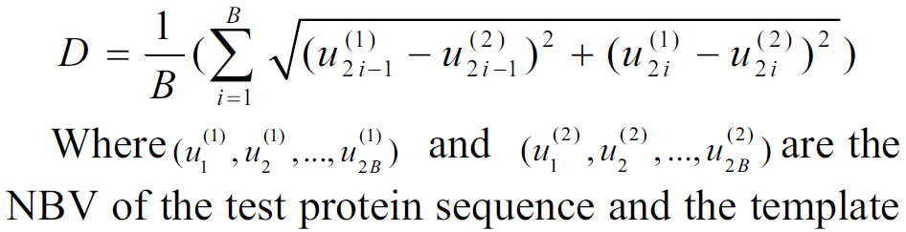
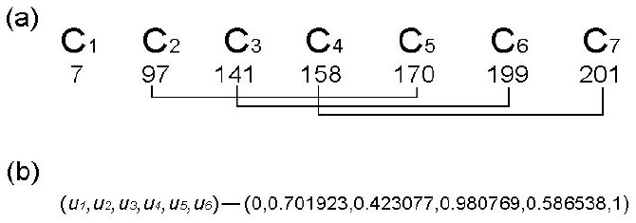
The definition of the distance

Slide 12
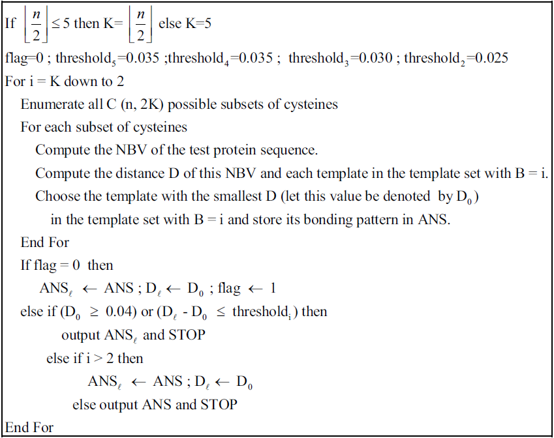
Algorithm

Slide 13
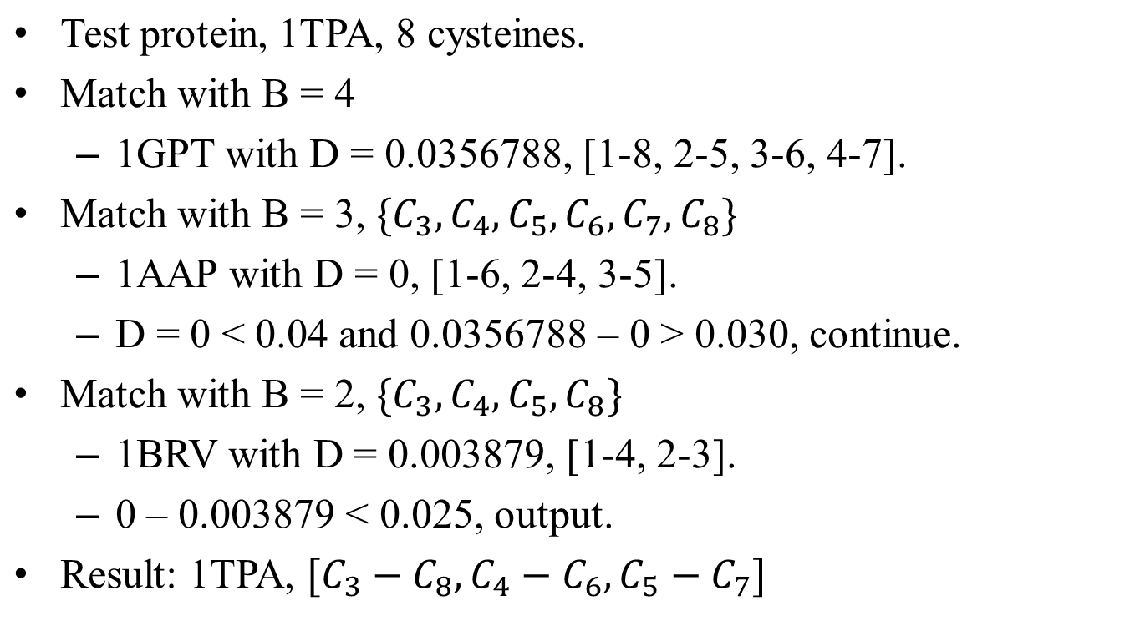
Example

Slide 14
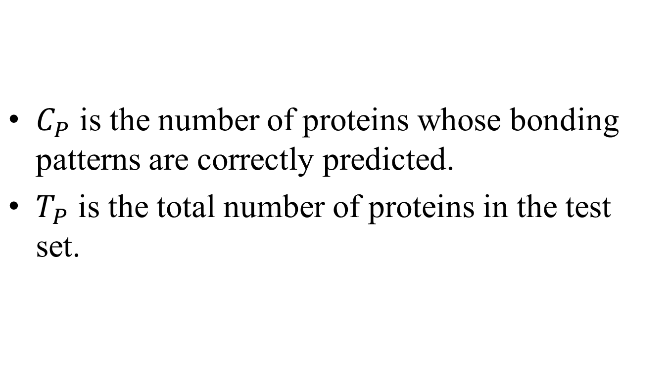
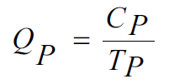

Slide 15
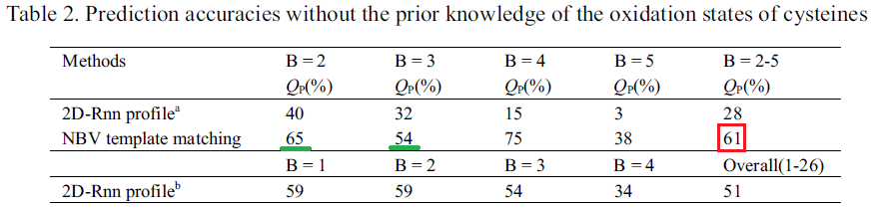
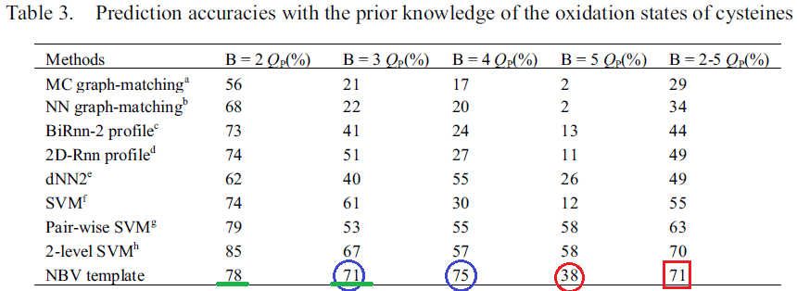
Result

Slide 16
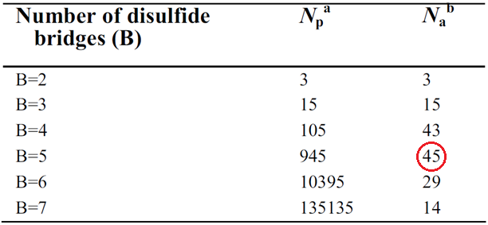
Discussion
Many subsets of four cysteines and subsets of six cysteines have similar NBV and therefore the prediction is prone to error.
45 sequences have five disulfide bridges.

Slide 17
Conclusion
The future work is to find a combination of global features and the local features.

