Slide 1
Incremental Linear Discriminant Analysis for
Classification of Data Streams
IEEE TRANSACTIONS ON SYSTEMS, MAN, AND CYBERNETICS—PART B: CYBERNETICS, VOL. 35, NO. 5, OCTOBER 2005
Shaoning Pang, Member, IEEE, Seiichi Ozawa, Member, IEEE, and Nikola Kasabov, Senior Member, IEEE
Presenter: Chen Yun-Shiun
Date:2011/9/5

Slide 2
Abstract
This paper presents a constructive method for deriving an updated discriminant eigenspace for classification when bursts of data that contains new classes is being added to an initial discriminant eigenspace in the form of random chunks. Basically, we propose an incremental linear discriminant analysis (ILDA) in its two forms: a sequential ILDA and a Chunk ILDA. In experiments, we have tested ILDA using datasets with a small number of classes and small-dimensional features, as well as datasets with a large number of classes and large-dimensional features. We have compared the proposed ILDA against the traditional batch LDA in terms of discriminability, execution time and memory usage with the increasing volume of data addition. The results show that the proposed ILDA can effectively evolve a discriminant eigenspace over a fast and large data stream, and extract features with superior discriminability in classification, when compared with other methods.

Slide 3
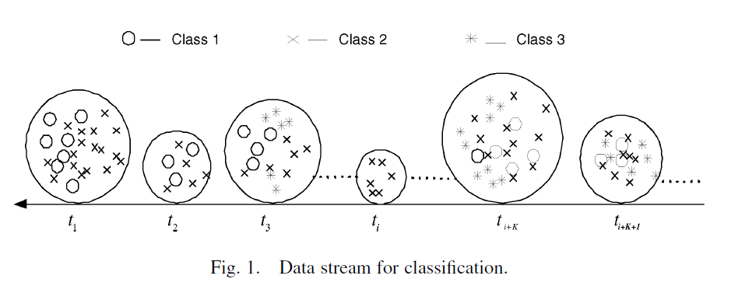
Goal

Slide 4
Straightforward approach
Collect data whenever new data are presented and then construct a provisional system by a batch learning over the collected data so far
  high memory and high computation expenses
  system has to discard the knowledge acquired in the past

Slide 5
Incremental learning
One-pass incremental learning
  system acquire knowledge with a single presentation of the training data
  retain the knowledge acquired in the past without keeping a large number of training samples
ILDA(Incremental Linear Discriminant Analysis)
Notes:
one-pass: 原本的LDA若有新的資料進來，便要抓取舊的資料並重新計算，不用重新抓取舊資料的方法即稱為one-pass。

Slide 6
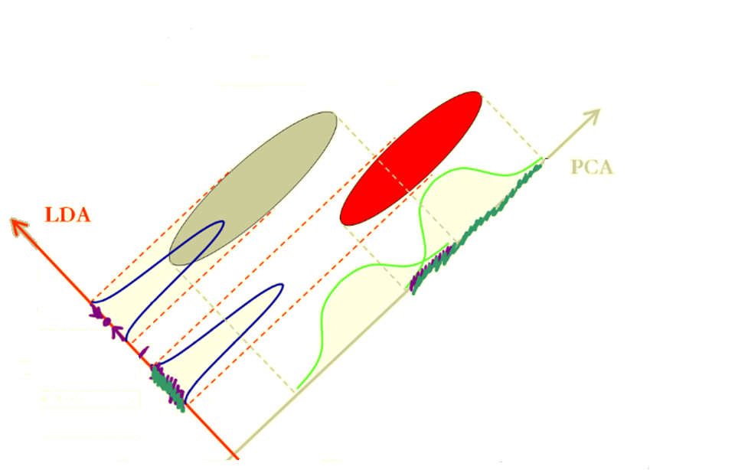
Linear discriminant analysis (LDA)
也稱Fisher linear discriminant (FLD)
PCA是將資料投影(旋轉)至variance最大的方向，但不一定是分類效果最佳的方向。
LDA是將資料投影（旋轉）至分類效果最佳的方向
Notes:
相對於SVM是往高維度尋找解答，LDA則是降低維度投影。

Slide 7
Notations
L : number of classes
N_{i}: number of samples in class i
N : number of all samples
X^{(i)}_{j}: the j-th sample in class I
所以第i類有X^{(i)}₁,X^{(i)}₂,…,X^{(i)}_{Ni}個points

Slide 8
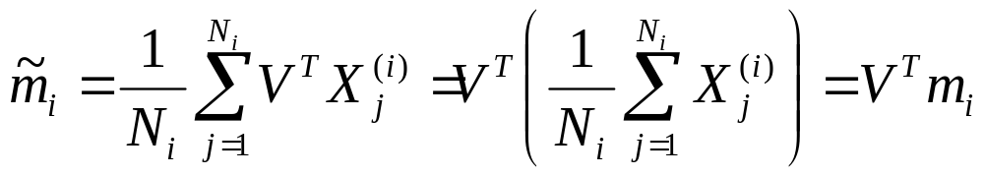
Projection
We projected all points to vector V
Coefficient:
V^{T}X⁽¹⁾₁,V^{T}X⁽¹⁾₂,…,V^{T}X⁽¹⁾_{N1}, V^{T}X⁽²⁾₁,V^{T}X⁽²⁾₂,…,V^{T}X⁽²⁾_{N2},…, V^{T}X^{(L)}₁,V^{T}X^{(L)}₂,…,V^{T}X^{(L)}_{NL}
投影（旋轉）後，第i類的中心點之係數：
scalar
col. vector

Slide 9
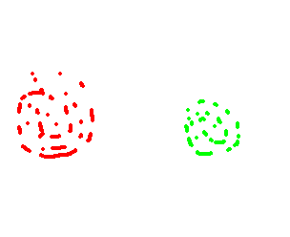

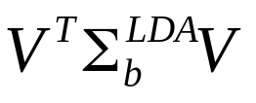
Within & between class scatter
Within-class
Within-class
Class 1
Class 2
Between-class
V
Within-class scatter指的是同一類別內資料的分散程度
Between-class scatter指的是不同類別間資料的分散程度

Slide 10
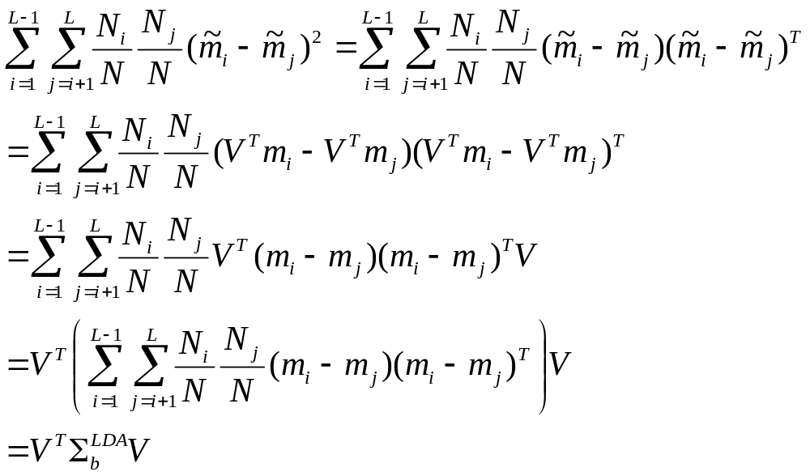
Between class scatter matrix
The sum of square –distance between class means
matrix

Slide 11
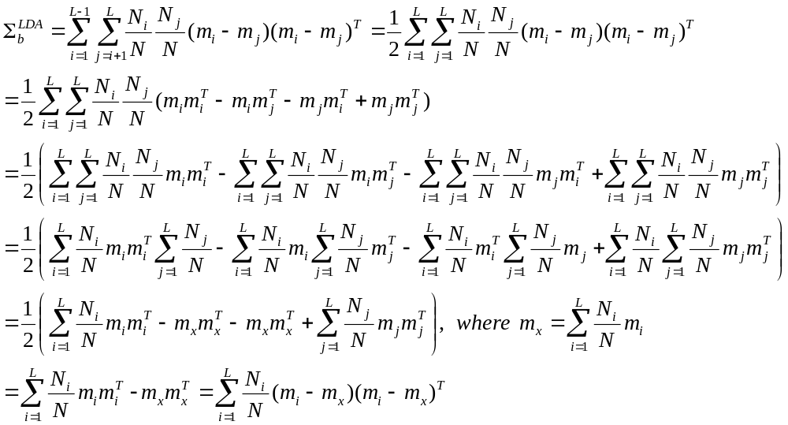
Between class scatter matrix
matrix
m_{x}: 每個類別的中心點加權之後的中心點

Slide 12
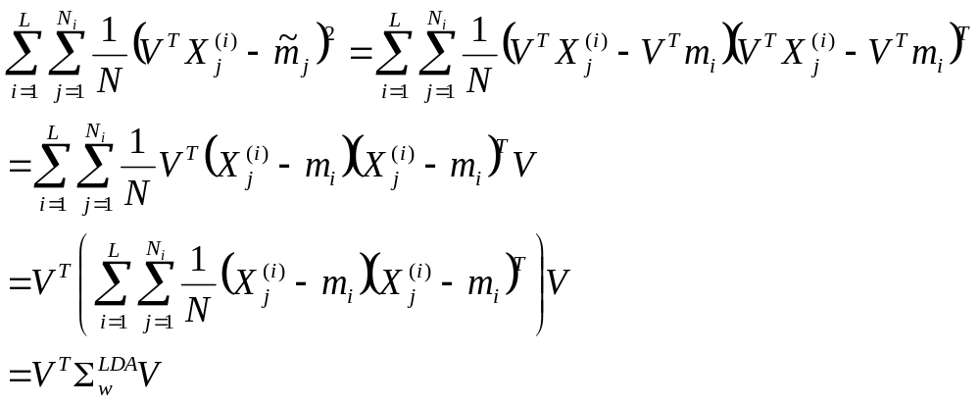
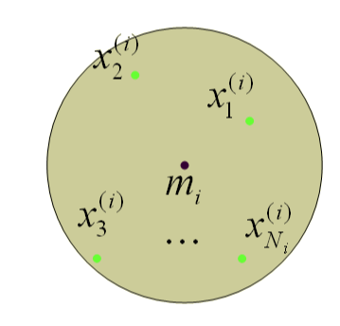
Within class scatter matrix
The sum of all class-variances is:

Slide 13
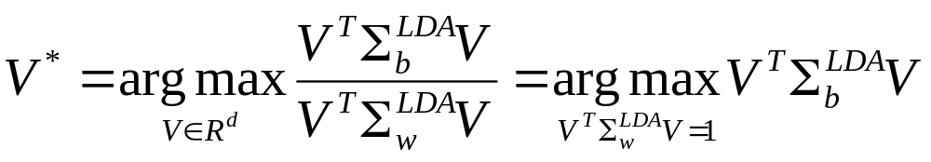
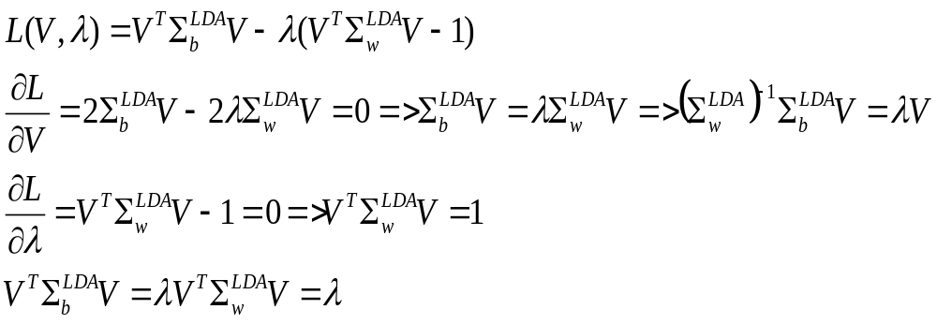
Multiclass linear discriminant analysis
投影(旋轉)後，能夠將類別分的最開的向量V如下:
(組間差距/組內差距)的最大化
Lagrange multiplier:
最佳旋轉方向V為最大eigenvalue所對應之eigenvector

Slide 14
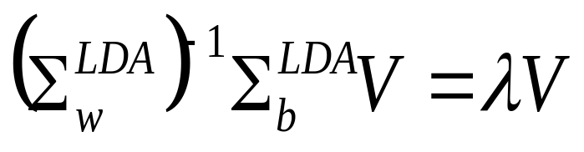
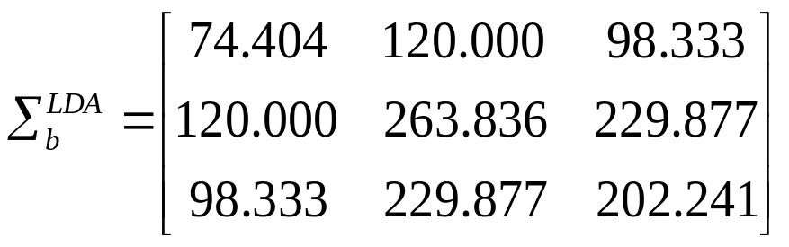
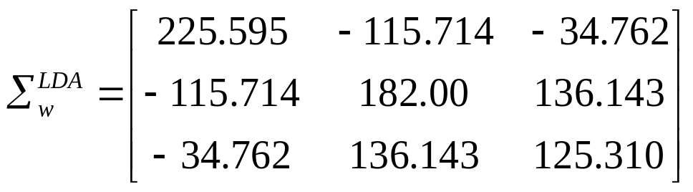
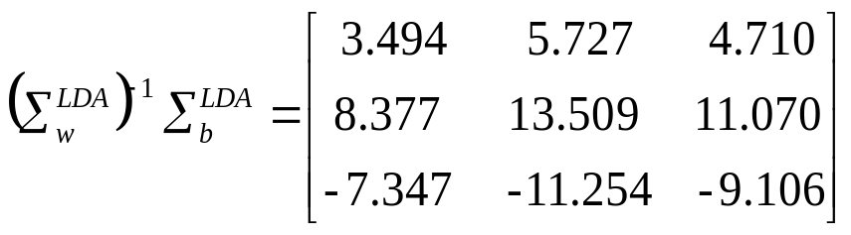
Eigenvalue: 7.414
Eigenvector( -0.301, -0.720, 0.624)
Eigenvalue: 0.483
Eigenvector: (-0.187, -0.563, 0.804)
Eigenvalue: 0
Eigenvector: (-0.215, 0.695, -0.685)
因此將三維資料投影到由
( -0.301, -0.720, 0.624)與
(-0.187, -0.563, 0.804)兩向量所形成的平面時，分散效果最佳

Slide 15
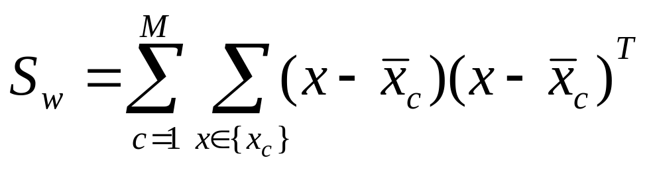
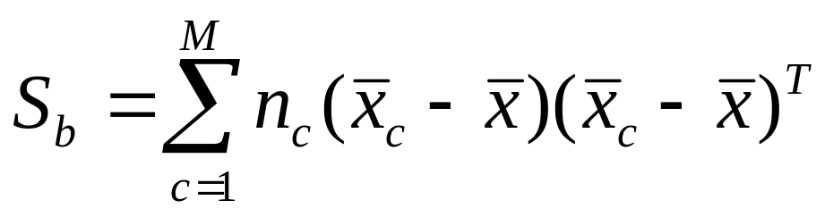
Incremental LDA
Within-class scatter matrix :
Between-class scatter matrix :

Slide 16
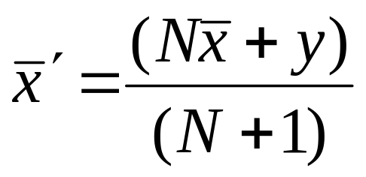
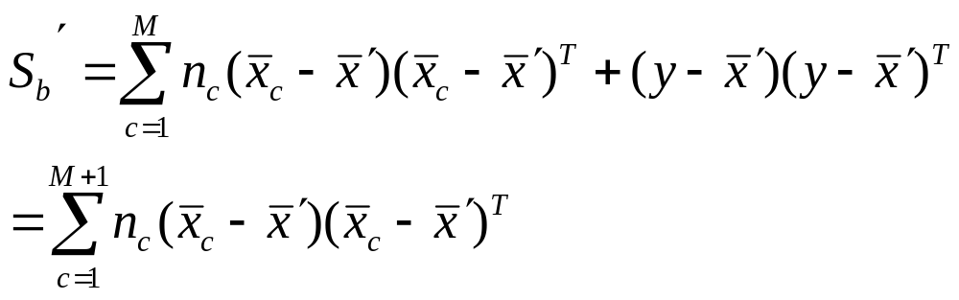
Sequential Incremental LDA
updated mean :
y is a newly introduced class :
Notes:
Sequential是先假設一次只有增加一個點的資料的情況下做公式的推導
當然 這邊的set y其實裡面只有一個點
如果y是新類別 他就自成一國

Slide 17
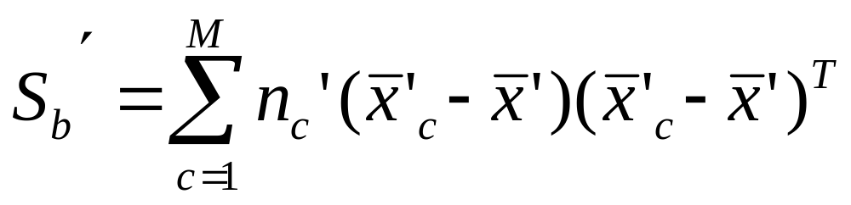
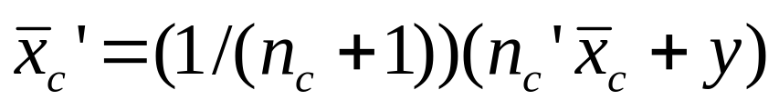
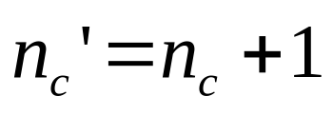
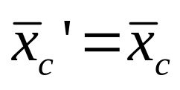
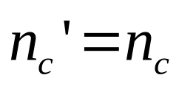
Sequential Incremental LDA
y is not a newly introduced class :
if y belong to class c :
else :
Notes:
y假如是已經出現過的類別
則就要考慮他是哪個類別的 y是class c的成員 當然該class中心就要重算 其他不是的就不用

Slide 18
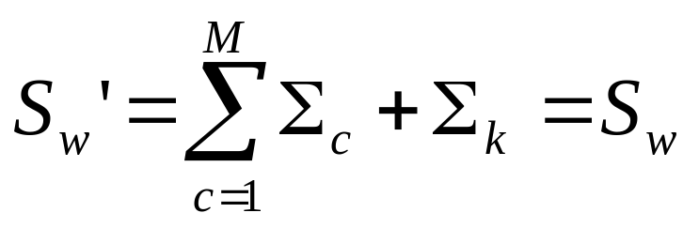
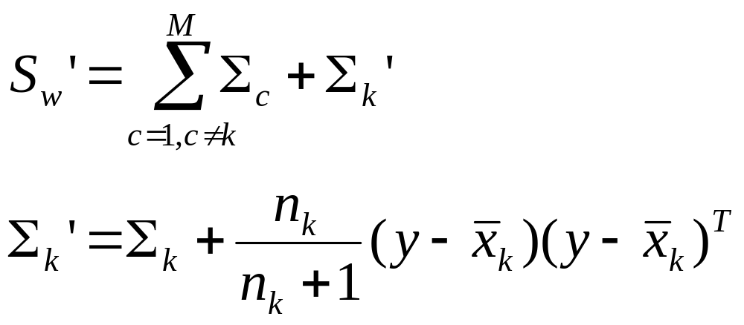
Sequential Incremental LDA
y is a newly introduced class :
y is not a newly introduced class :

Slide 19
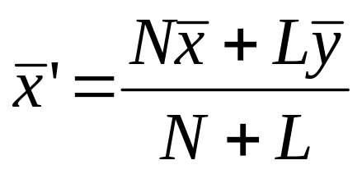
Chunk Incremental LDA
updated mean:
L : number of samples in a chunk
l_{c} : number of samples belong to class c
l_{M+1} : number of samples belong to new class M+1

Slide 20
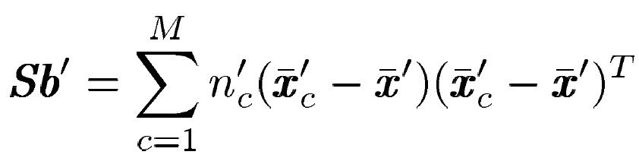
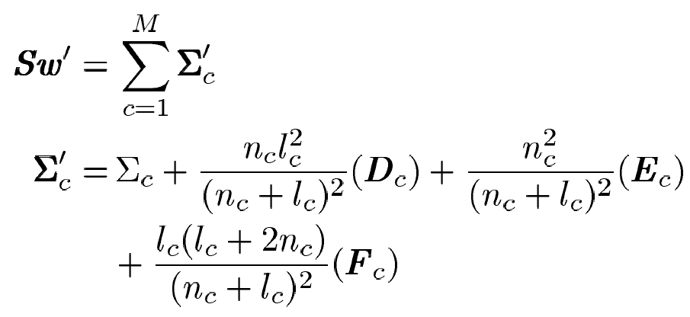
Chunk Incremental LDA
If l_{c} of L are new samples belong to class c:
Notes:
此兩個公式 也就是
意即有new samples的情況下計算會比沒有new samples時情況下快
本篇即改進有new class下資料的merge速度

Slide 21


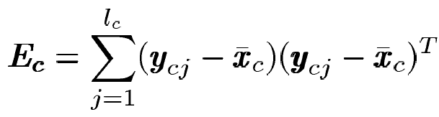
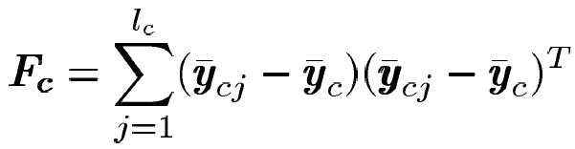
Chunk Incremental LDA

Slide 22
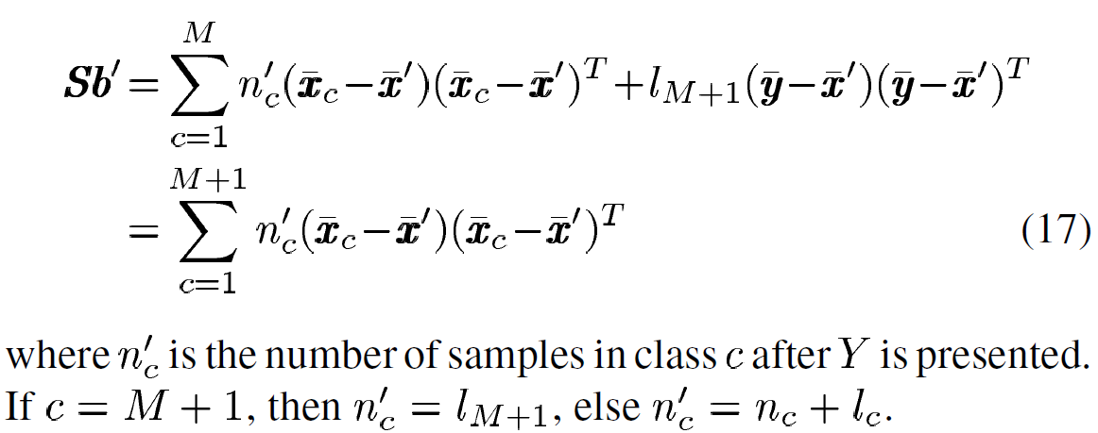
Chunk Incremental LDA
If l_{M+1} of L are new samples belong to new class M+1 :

Slide 23
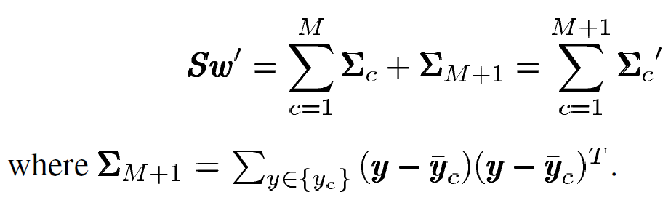
Chunk Incremental LDA
If l_{M+1} of L are new samples belong to new class M+1 :

Slide 24
Experimental Setup
Construct an initial feature space (eigenspace) using 10% of the total samples
  at least two classes data are included
  used for calculating eigenvectors and eigenvalues through conventional LDA/PCA
Enumerate the remaining training data randomly into a number of chunks and number of classes
Encode features by projecting data to the updated LDA discriminant eigenspace and then classify the feature data using KNN classifier(K=1)
  Rank the eigenvectors by their energy, and select a set of top energy eignevectors.
  The number of eigenvectors that ILDA uses equals to the number of eigenvectors that Batch LDA uses.
Evaluate the accuracy under a Leave-one-out cross-validation policy

Slide 25

Experiment (1)
UCI Datasets
  eight standard datasets selected from UCI Machine Learning Repository
  each dataset has its features 100% of continuous/integer values and no missing value
  http://archive.ics.uci.edu/ml/

Slide 26
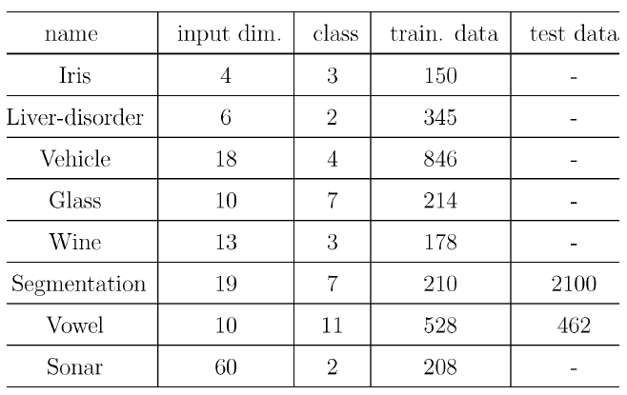
Experiment (1)

Slide 27
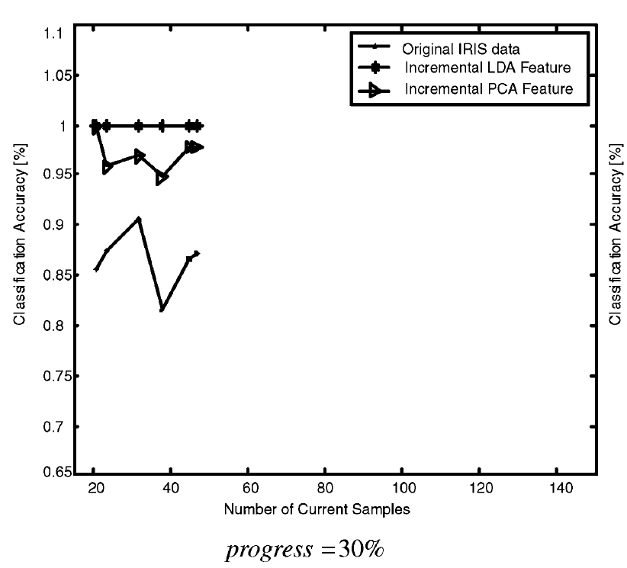

Slide 28
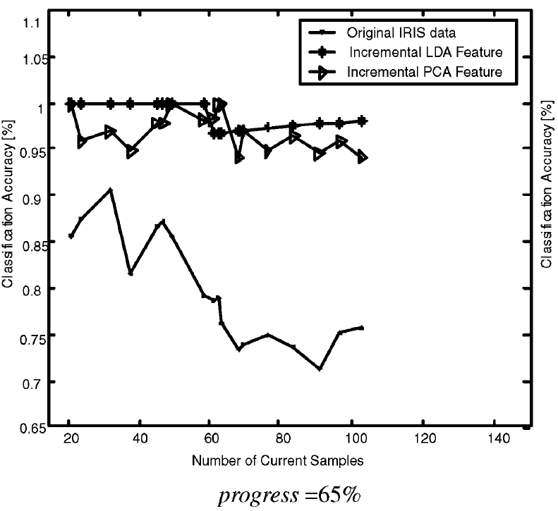

Slide 29
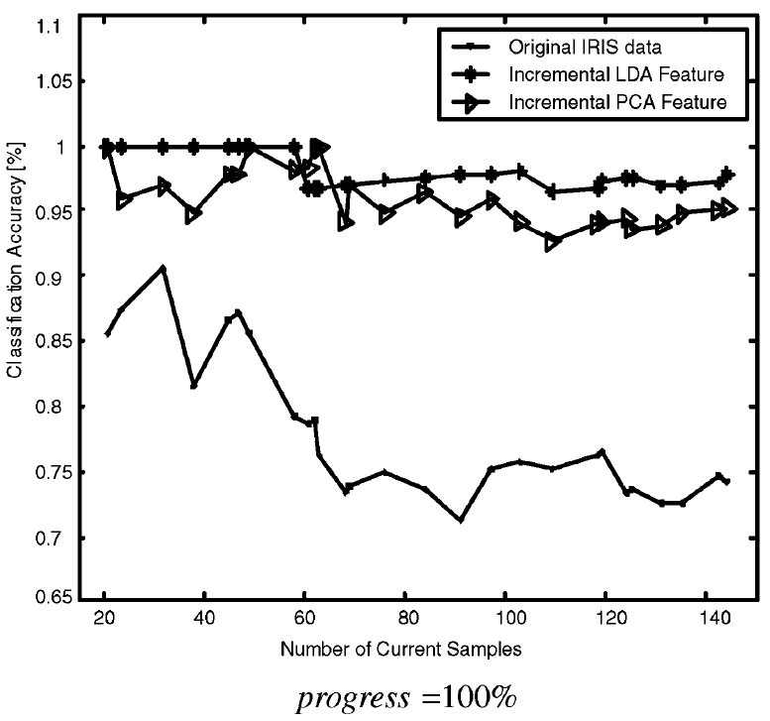

Slide 30
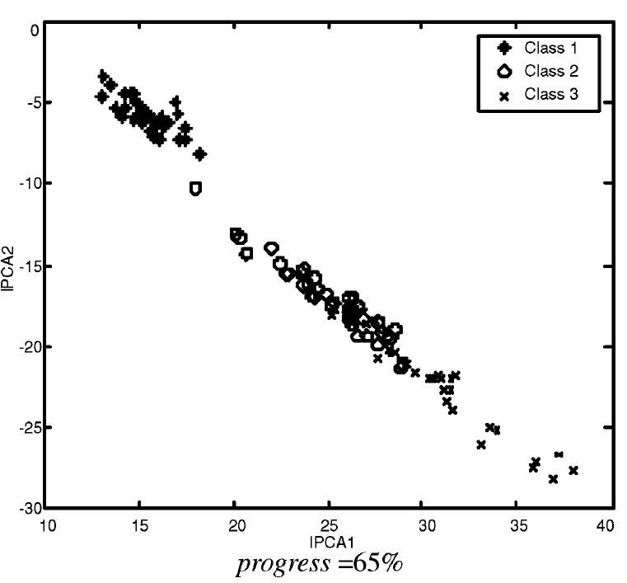

Slide 31
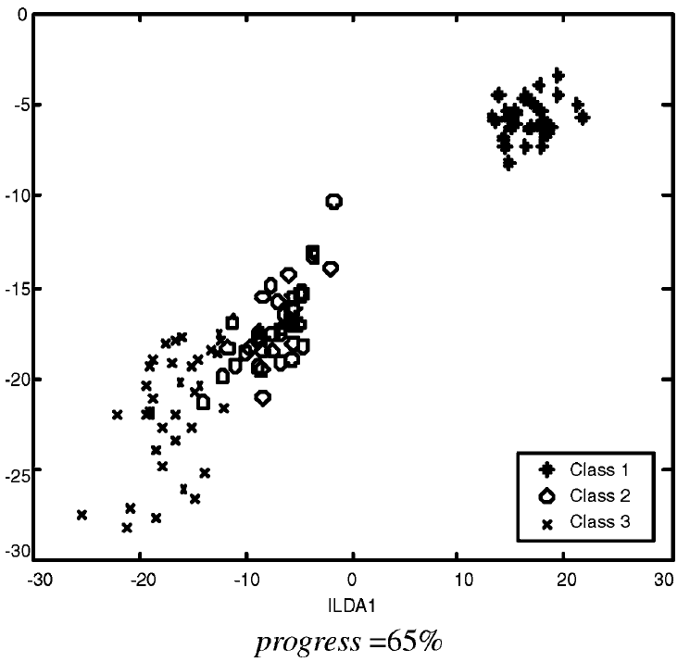

Slide 32
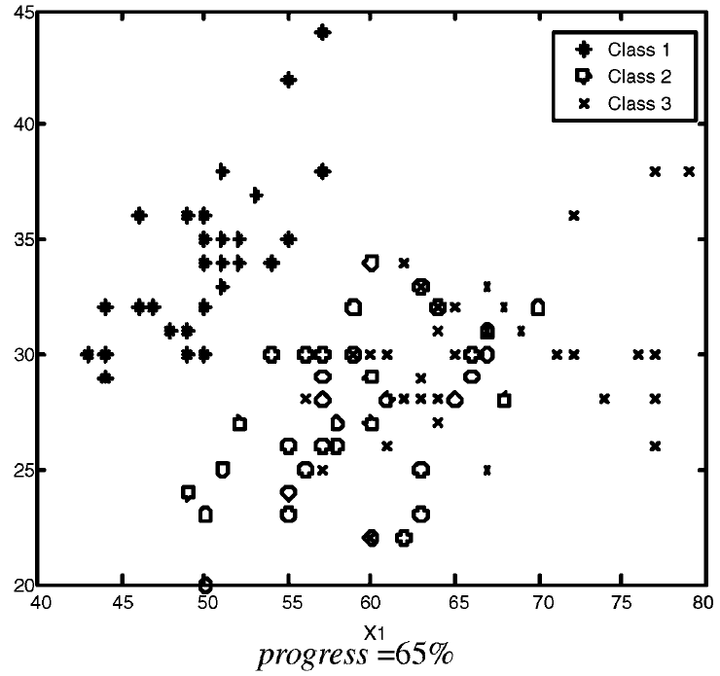

Slide 33
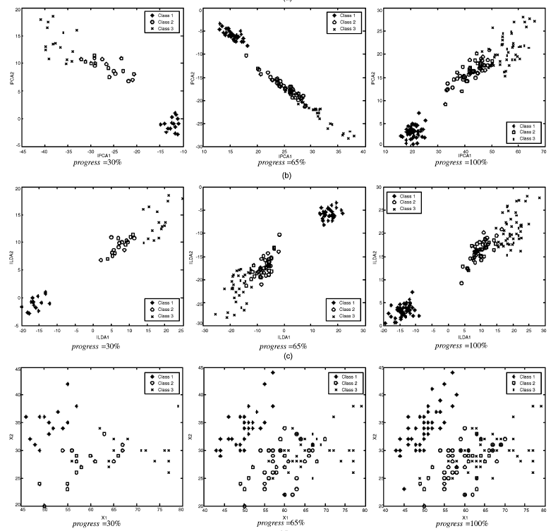

Slide 34
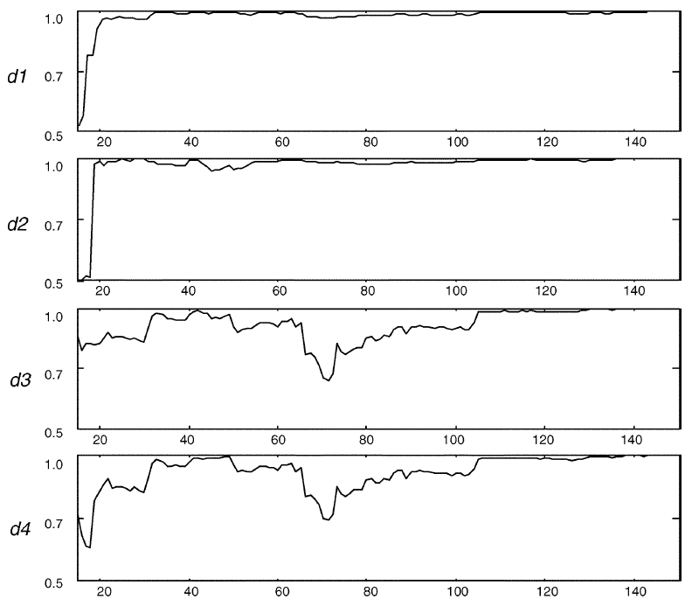
Experiment (1) - similarity
Notes:
Batch LDA和 ILDA的內積圖
這邊unit長度為1

Slide 35
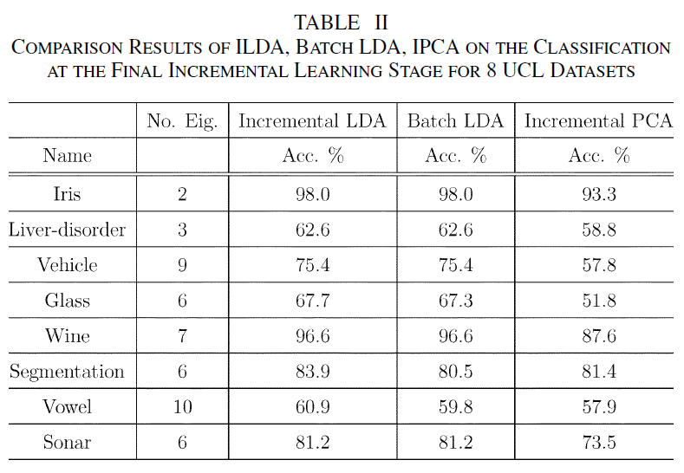
Experiment (1) – final accuracy
Notes:
其中ILDA和BLDA值有些微差別
猜測是因為電腦運算的精準度問題

Slide 36
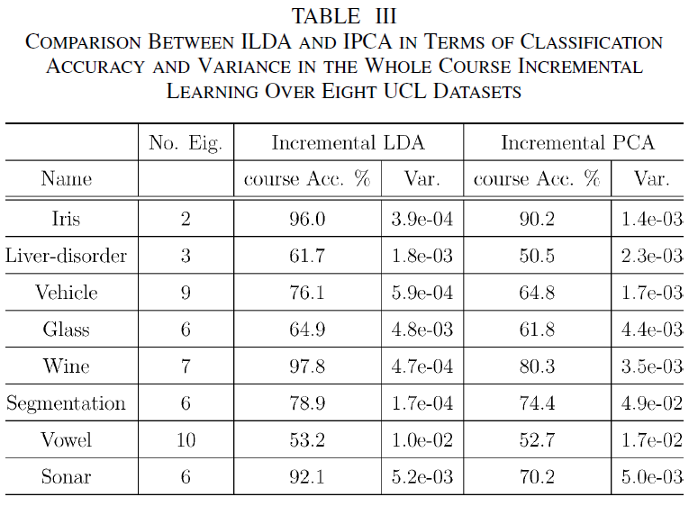
Experiment (1) – stage avg. accuracy

Slide 37
Experiment (2)
Face Database
  benchmark MPEG-7 face database
  consists of 1355 face images of 271 persons
  five different face images per person are taken
  each image has the size of 56 46
The images have been selected from AR(Purdue), AT&T, Yale, UMIST, University of Berne, and some face images obtained from MPEG-7 news videos.

Slide 38
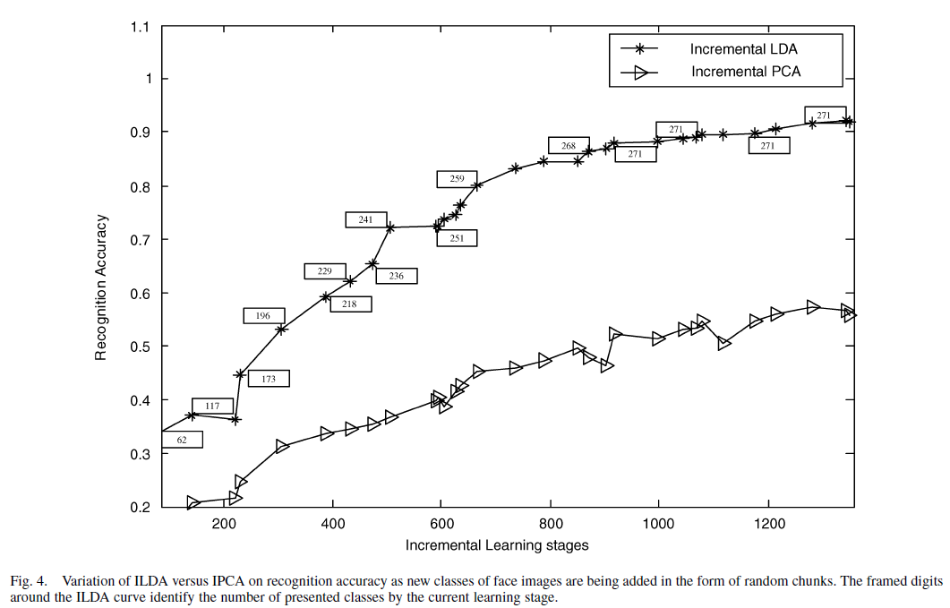
Experiment (2) – random chunk size

Slide 39
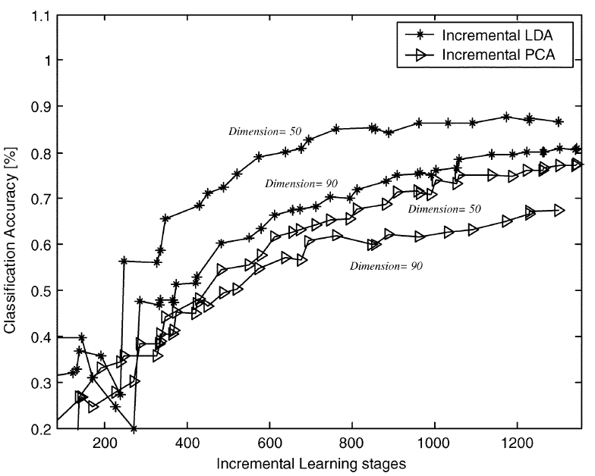
Experiment (2) – accuracy at different stages

Slide 40
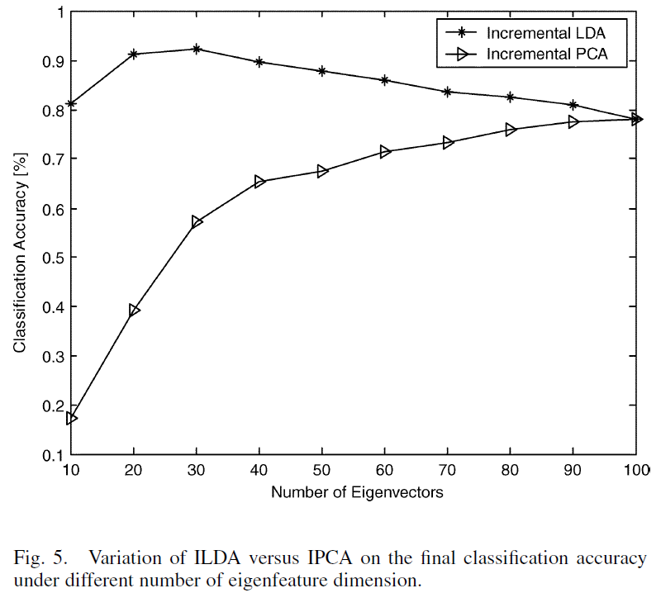
Experiment (2) – accuracy of different numbers of eigenvectors
Notes:
Dim 超過五左右會開始下降

Slide 41
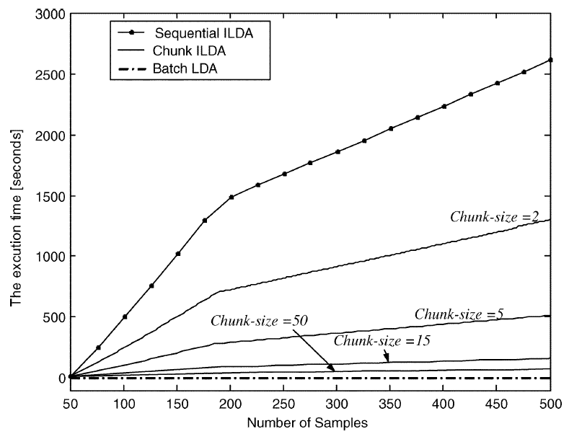
Experiment (2) – time cost of different size of chunks (a)
Notes:
500pic 100person 5 each

Slide 42
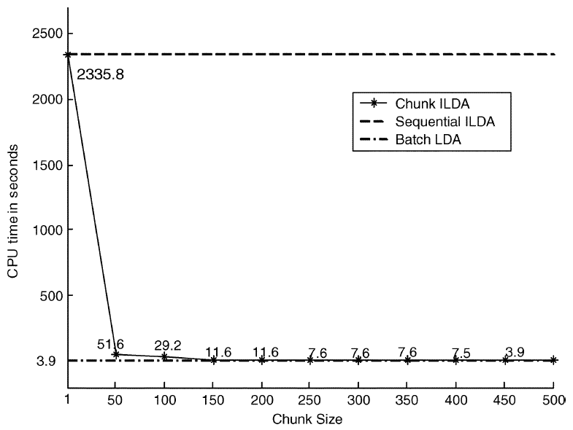
Experiment (2) – time cost of different size of chunks (b)

Slide 43
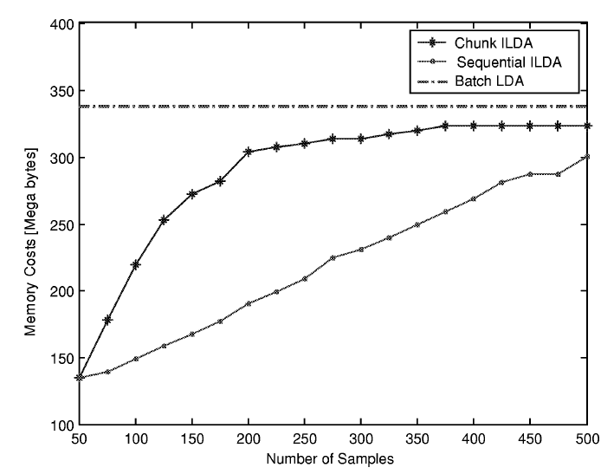
Experiment (2) – memory usage
Notes:
這邊他給自己的辯解是說 他和ICPA在最後的時候(500 pic)也沒差很多

Slide 44
Conclusions
ILDA has an equivalent power to batch LDA in terms of discriminability.
Chunk ILDA has very high memory and speed efficiency.
The efficiency of ILDA is determined by the average chunk-size taken in the whole course of incremental learning.
ILDA is effective for handling bursts of new classes coming in at different times.
As compared with IPCA, ILDA is usually to be superior to IPCA for classification.

Slide 45
Thank you for your attention.
Special thanks to Hong-Hsin Chen.

