Slide 1
Fast Procedure for Reconstruction of Full-Atom Protein Models from Reduced Representatios
PIOTR ROTKIEWICZ, JEFFREY SKOLNICK
Journal of Computational Chemistry, Volume 29, Issue 9, pages 1460–1465, 2008
Presenter: Hsin-Fang Wu
Date: Sep. 5, 2011

Slide 2
Abstract
We introduce PULCHRA, a fast and robust method for the reconstruction of full-atom protein models starting from a reduced protein representation. The algorithm is particularly suitable as an intermediate step between coarse-grained model-based structure prediction and applications requiring an all-atom structure, such as molecular dynamics, protein-ligand docking, structure-based function prediction, or assessment of quality of the predicted structure. The accuracy of the method was tested on a set of high-resolution crystallographic structures as well as on a set of low-resolution protein decoys generated by a protein structure prediction algorithm TASSER. The method is implemented as a standalone program that is available for download from http://cssb.biology.gatech.edu/skolnick/files/PULCHRA.
Notes:
粗粒化模型 (coarse-grained model)：研究二維HP (H:親水性, P:疏水性)晶格模型是研究蛋白質結構與折疊動力過程最簡約化的一種。
----蛋白質結構基本物理性質研究.pdf
分子動力學 (molecular dynamics)：是一套分子模擬方法，該方法主要是依靠牛頓力學來模擬分子體系的運動，以在由分子體系的不同狀態構成的系綜中抽取樣本，從而計算體系的構型積分，並以構型積分的結果為基礎進一步計算體系的熱力學量和其他宏觀性質。--- http://zh.wikipedia.org/zh-hant/%E5%88%86%E5%AD%90%E5%8A%A8%E5%8A%9B%E5%AD%A6
蛋白質 - 配體對接 (Protein–ligand docking)：是一種分子建模技術。目的為預測 配體（一種小分子）當它被綁定到一個蛋白質受體或酶 時的位置和方向。醫藥研究採用對接技術的各種用途，最主要的是在虛擬篩選的大型數據庫的可用化學品，以便選擇可能的候選藥物。
--- http://en.wikipedia.org/wiki/Protein%E2%80%93ligand_docking
排除體積 (excluded volume)：不是真正分子的體積，而是"看起來的分子體積"

Slide 3
Introduction
To efficiently sample protein conformational space, protein structure prediction algorithms often use a reduced protein representation.
The full-atom representation is required for many applications. Therefore, the reduced models need to be translated into detailed atomic models for later analysis.

Slide 4
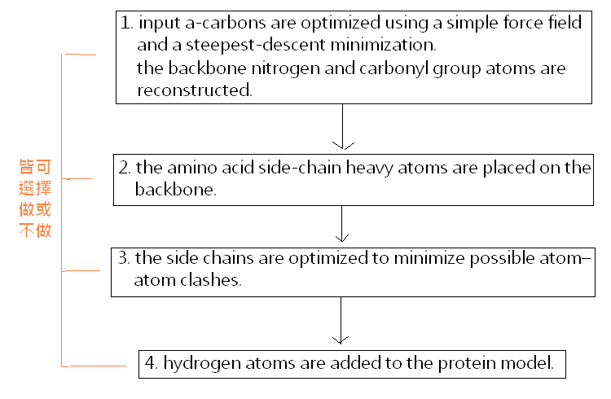
Method

Slide 5
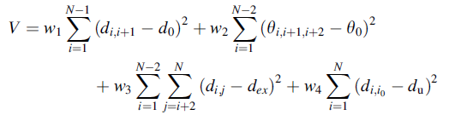
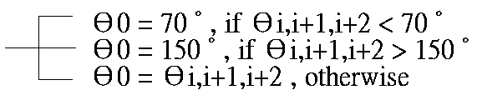
Method: Optimization of α-Carbon Positions (1/3)
The potential (V) consists of the following terms:
  pairwise Cα-Cα distances, Cα-Cα-Cα virtual bond angles, Cα excluded volume, and the deviation from the initial positions.
N: Cα 數
w1, w2, w3, and w4 : 各別term的權重 (預設：1, 2, 10, 0.5)
di,i+1: 第i及i+1個C α 的距離，預設d0為平衡距離= 3.8 Ǻ
Θi,i+1,i+2: 第i,i+1,i+2個Cα的虛擬鍵角
dex = 4 Ǻ , if di,j < 4 Ǻ , else dex = di,j
di,i0 (Cα 原始位置與實際距離差) = du , if di,i0 > threshold (預設 0.5 Ǻ )

Slide 6
Method: Optimization of α-Carbon Positions (2/3)
Two special cases need to be treated differently.
  The first is cis-proline, in which an equilibrium Cα-Cα distance is equal to 2.9 Ǻ .
  The second case is the presence of chain breaks. The chain is considered broken if a distance between two consecutive Cα atoms is larger than a certain threshold (4.5 Ǻ , by default). In such a case, distance and angle restraints are not calculated for the residues involved in the chain break [weights w1 and w2 in eq. are equal to 0].
After performing a steepest-descent minimization procedure (dV/dr → 0), the resulting structure has Cα-Cα distances and Cα-Cα-Cα angles close to native values.

Slide 7
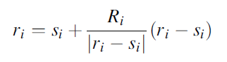
Method: Optimization of α-Carbon Positions (3/3)
If no α-carbon coordinates are provided on input, their positions can be approximated from the side-chain centers of mass.
r i : the position of the ith Cα
s i : the position of the ith side-chain center of mass
Ri : an average statistical Cα -CM distance for an amino acid at position i
|ri - si| : the distance between the ith amino acid Cα atom and the center of mass of its rotamer

Slide 8
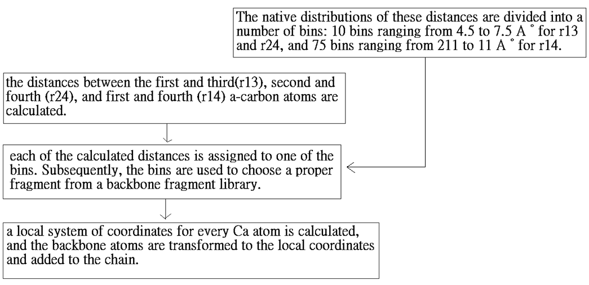
Method: Backbone Reconstruction (1/2)
The backbone reconstruction method is based on a refined version of an algorithm proposed by Milik et al.
The procedure requires four consecutive α -carbon positions rebuild the peptide.
bond atoms between the two central a-carbons.

Slide 9
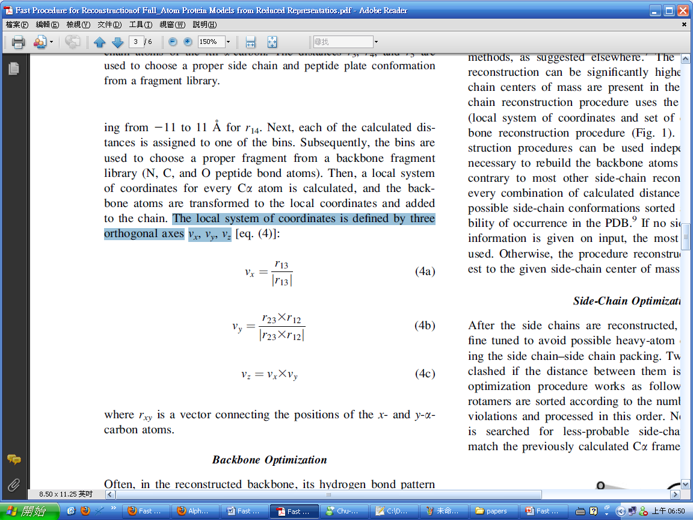
Method: Backbone Reconstruction (2/2)
The local system of coordinates is defined by three orthogonal axes vx, vy, vz bond atoms between the two central a-carbons.

Slide 10
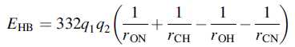
Method: Backbone Optimization
This simple optimization procedure calculates the hydrogen bond energy of every peptide plate with respect to its spatially closest neighbor using the hydrogen bond definition found in the DSSP program.
The hydrogen bond energy of a hydrogen bond C-O. . .H-N is calculated according to a following formula:
  q1 = 0.42e and q2 = 0.20e, e being the electron charge unit.
  rXY : the distance between atoms X and Y in angstroms.
  EHB : the energy in kcal/mole.
The energy is calculated, and if a better peptide plate orientation is found, then the old orientation is replaced by the new one.

Slide 11
Method: Side-Chain Reconstruction
The accuracy of side-chain reconstruction can be significantly higher if positions of side-chain centers of mass are present in the input data.
Our side-chain reconstruction procedure uses the same as the backbone reconstruction procedure.
Therefore, both reconstruction procedures can be used independently.

Slide 12
Results
We compared the performance of PULCHRA with two popular side-chain reconstruction programs, SCWRL 3.0 and SCATD 1.0, the SCATD algorithm is faster and less prone to problems with inaccurate input structures than SCWRL.
Additionally, we compared our results with the results of a similar method published previously, MMTSB.

Slide 13
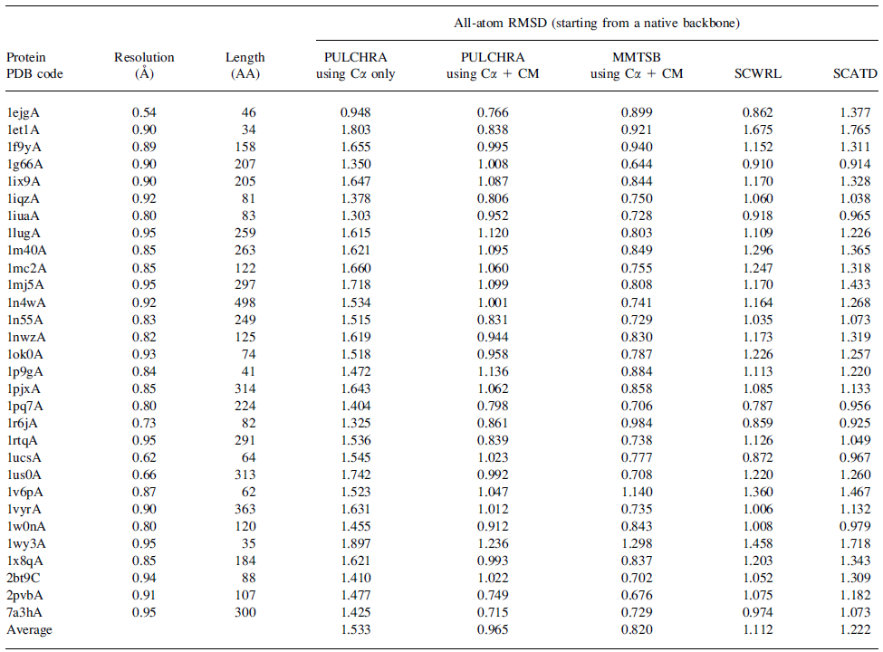
Results (side-chain)
0.8s
1s
2.4s
1.3s

Slide 14
Results (backbone)
To check our method in a real-life application, we performed a test on 500 decoy structures randomly chosen from a genomic scale Monte Carlo protein structure prediction benchmark.
 | RMSD | TIME (s/per protein) | # of not’t fixed punched ring
PULCHRA | 10.18 | 1.3 | 6
MMTSB | 10.26 | 2.0 | 40
SCATD | 10.21 | 2.4 | 130
SCWRL | 9.89 | 28.8 | 70

Slide 15
Conclusion
Compared with similar MMTSB, although the reconstruction accuracy is similar in case of these two methods, PULCHRA is faster, more robust, and less frequently generates nonfixable errors in the reconstructed models.
The calculations can be speeded up by switching off certain parts of the algorithm. For example, disabling the initial Cα position optimization routine reduces the computation time by 20–50%,

Slide 16
Thanks for your listening !!

