Slide 1
HarmonyDOCK: The Structural Analysis of Poses in Protein-Ligand Docking
DARIUSZ PLEWCZYNSKI, ANNA PHILIPS, MARCIN VON GROTTHUSS, LESZEK RYCHLEWSKI and KRZYSZTOF GINALSKI
Computational Biology, November 20, 2010
Presenter: Cheng-Han Lee
Setp.13 2011
Notes:
http://www.liebertonline.com/doi/full/10.1089/cmb.2009.0111

Slide 2
Abstract
Molecular docking is a widely used method for lead optimization. However, docking tools often fail to predict how a ligand (the smaller molecule, such as a substrate or drug candidate) binds to a receptor (the accepting part of a protein). We present here the HarmonyDOCK, a novel method for assessing the docking software accuracy, and creating the scoring function which would determine consensus protein-ligand pose among those generated by available docking programs. Conformations for few hundred protein-ligand complexes with known three-dimensional structure were predicted on a benchmark set by set of different docking programs. On the basis of the derived ranking, the point of reference and the lower score limit were determined for subsequent investigations. The focus of the methodology is on the top-ranked poses, with the assumption being that the conformation of the docked molecules is the most accurate. We found out that some docking programs perform considerably better than the others, yet in all cases the proper selection of decoys, namely HarmonyDOCK, is needed for successful docking procedure.

Slide 3
Introduction
Molecular docking is a simulation process used for predicting how a ligand binds to a receptor.
The Boston Consulting Group has come to the conclusion that genomics could reduce the cost of a new drug production from 800 million euro by about 305 million euro in the ideal case (Terfloth, 2003).

Slide 4
Molecular docking process
electrostatic forces (靜電力)
Van der Walls interactions (凡徳瓦力)
hydrogen bounds (氫鍵)
hydrophobic interactions (疏水性)
In general, the docking problem is posed as an optimization problem, where the objective is to minimize this interaction energy.

Slide 5
Docking search algorithms
The root-mean-squared deviation (RMSD) is frequently used to evaluate the accuracy of the computationally predicted poses.
Combining different docking techniques into a single strategy is a common and useful method
  brute-force search
  genetic algorithms
  Monte Carlo simulations
  simulated annealing
  structure-based methods

Slide 6
Scoring functions
force-field based methods
empirical methods
knowledge-based methods

Slide 7
Flow diagram
protein & ligand
search algorithms
scoring functions
accept
No
Yes
complexes

Slide 8
Methods
Computations
  The RMSD value to the native structure for all poses generated by tested docking methods was calculated.
Evaluation of docking software
  The best-scored poses (proposed by docking application as the best ones) were chosen for each protein-ligand complex.
  The poses with the lowest RMSD were chosen for each protein-ligand complex.

Slide 9
Methods (.cont)
Poses scoring functions
  Arithmetic - arithmetic mean
  Arithmetic - harmonic (+0.5) mean
  Arithmetic - harmonic (+2) mean
  Arithmetic - harmonic (+5) mean
  Arithmetic - harmonic (+20) mean
  Arithmetic - quadric mean
  Harmonic (+0.5) - arithmetic mean
  Harmonic (+1) - arithmetic mean
  Harmonic (+2) - arithmetic mean

Slide 10
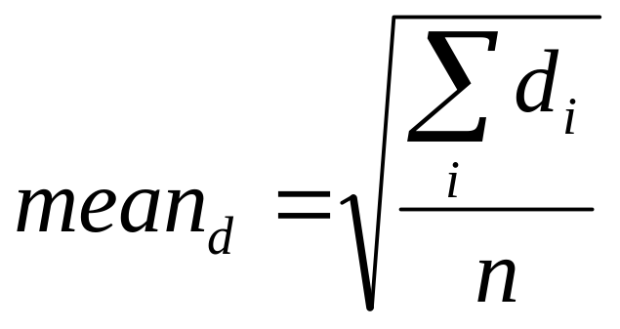
Poses scoring functions
Arithmetic mean

Slide 11
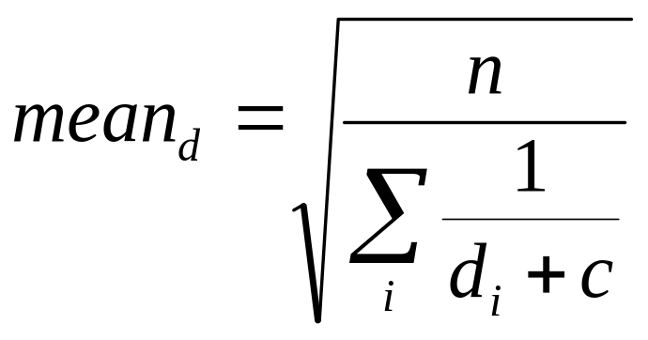
Poses scoring functions (.cont)
Harmonic mean

Slide 12
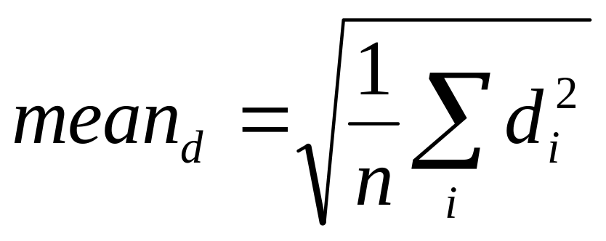
Poses scoring functions (.cont)
Quadric mean

Slide 13

HarmonyDOCK
Step 1. Comparative process.
  All poses derived for a particular protein-ligand complex are compared to each other .
  Calculation of the square-distance between the corresponding heavy atoms .
  Calculation of a distance between two poses as the mean square-distance between all atoms .
    Arithmetic mean,
    Harmonic (+ 0.5, 1, 2) mean

Slide 14
HarmonyDOCK(.cont)
Step 2. Poses scoring process.
  The score of the certain pose is the mean of all distances between this pose and all other poses.
    Arithmetic mean
    Harmonic (+ 0.5, 2, 5,20) mean
    Quadric mean
Subsequently, the poses are ranked by the calculated scores and the lowest-scored pose is chosen as the best one.

Slide 15
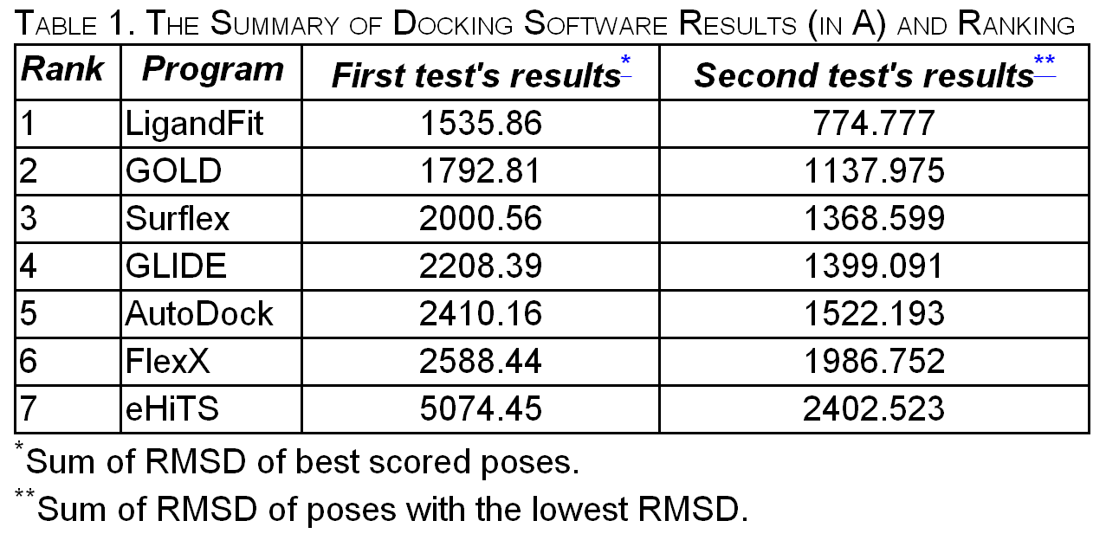
Results

Slide 16
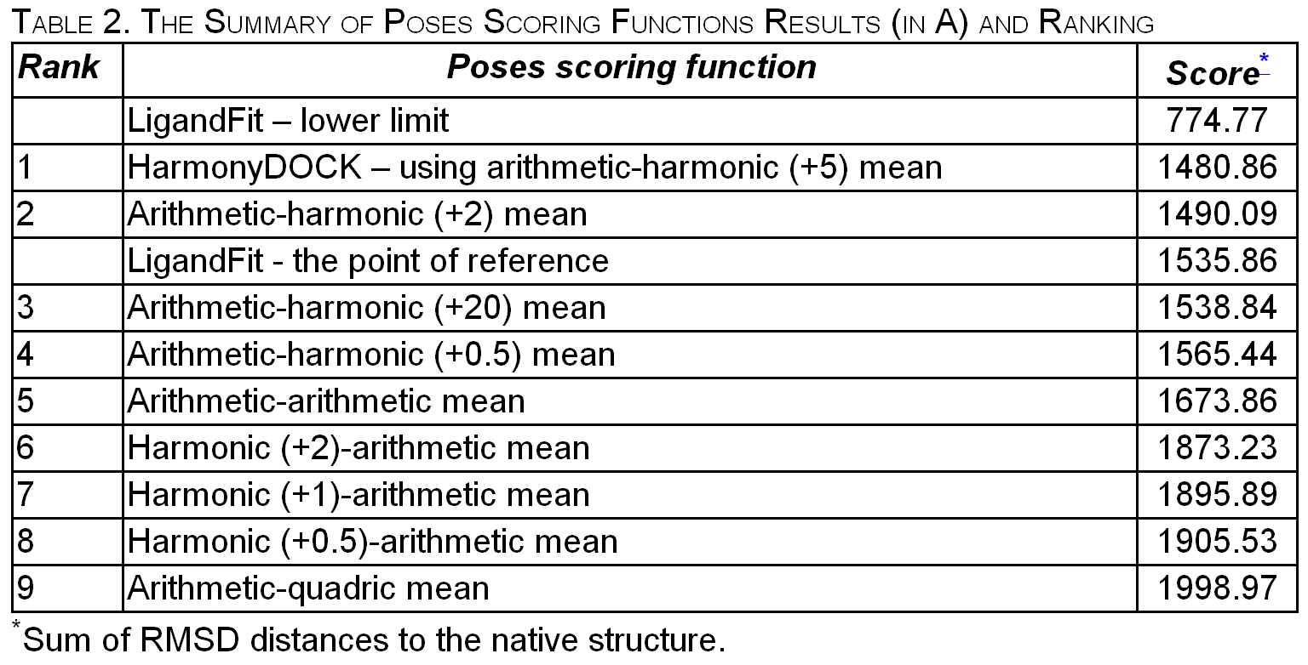
Results

Slide 17
Conclusion
The LigandFit method performed best.
The highest accuracy was observed for Arithmetic-harmonic (+5) mean predictions.

Slide 18
THE END

