Slide 1
A Combination of Rescoring and Refinement Significantly Improves Protein Docking Performance
Brian Pierce and Zhiping Weng(翁志萍)
Proteins, Vol. 72, No. 1, pp. 270-279, 2008
Presenter: Chiou-Ting Tseng
Date: Sept. 13, 2011

Slide 2
Abstract
To determine the structures of protein-protein interactions, protein docking is a valuable tool that complements experimental methods to characterize protein complexes. Although protein docking can often produce a near-native solution within a set of global docking predictions, there are sometimes predictions that require refinement to elucidate correct contacts and conformation. Previously, we developed the ZRANK algorithm to rerank initial docking predictions from ZDOCK, a docking program developed by our lab. In this study, we have applied the ZRANK algorithm toward refinement of protein docking models in conjunction with the protein docking program RosettaDock.
Notes:
elucidate 澄清、闡發

Slide 3
Abstract
This was performed by reranking global docking predictions from ZDOCK, performing local side chain and rigid-body refinement using RosettaDock, and selecting the refined model based on ZRANK score. For comparison, we examined using RosettaDock score instead of ZRANK score, and a larger perturbation size for the RosettaDock search, and determined that the larger RosettaDock perturbation size with ZRANK scoring was optimal. This method was validated on a protein-protein docking benchmark. For refining docking benchmark predictions from the newest ZDOCK version, this led to improved structures of top-ranked hits in 20 of 27 cases, and an increase from 23 to 27 cases with hits in the top 20 predictions.
Notes:
perturbation - 擾動

Slide 4
Abstract
Finally, we optimized the ZRANK energy function using refined models, which provides a significant improvement over the original ZRANK energy function. Using this optimized function and the refinement protocol, the numbers of cases with hits ranked at number one increased from 12 to 19 and from 7 to 15 for two different ZDOCK versions. This shows the effective combination of independently developed docking protocols (ZDOCK/ZRANK, and RosettaDock), indicating that using diverse search and scoring functions can improve protein docking results.

Slide 5
Protein Docking
找出兩個protein之間要怎麼黏在一起，要位移多少、旋轉多少
With the crystal structures (or modeled structures) of the component monomers, protein–protein docking (referred to as protein docking for brevity) can be used to predict the structures of the protein complex when no protein complex structure is available.

Slide 6
Bound vs. Unbound
For bound docking, a protein complex is pulled apart and reassembled.
For unbound docking, individually crystallized component structures are used.
Unbound docking is of more interest to us and is the focus of this work.
It has long been recognized that proteins undergo conformational changes on binding, especially their surface side-chains. This complicates unbound docking tremendously.

Slide 7
Scratch of Previous Methods
Initial global search
  FFT
  Monte Carlo with side chain searching
Subsequent steps to improve these initial predictions
  Clustering
  Reranking
  Structural refinement

Slide 8
Critical Assessment of Predicted
Interactions (CAPRI)
http://www.ebi.ac.uk/msd-srv/capri/
一個protein-docking的比賽網站
Since CAPRI began in 2001, the experiment has had two to four prediction rounds each year, with one or a few targets per round. Each round lasts 3-6 weeks

Slide 9
ZDock
Performs a grid-based docking search using FFT, and its scoring includes desolvation, electrostatics, and a novel shape complementarity function.

Slide 10
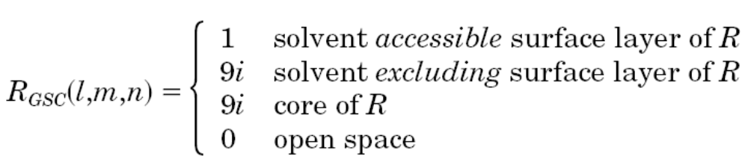
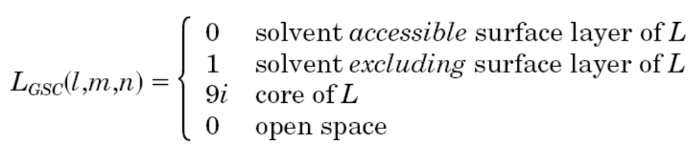
Grid-based Shape Complementarity (GSC)
Discretize the receptor (R, the larger protein) and the ligand (L, the smaller protein) using a N∗N∗ N grid with each grid point (l,m,n = 1,2,…N) assigned the following value

Slide 11
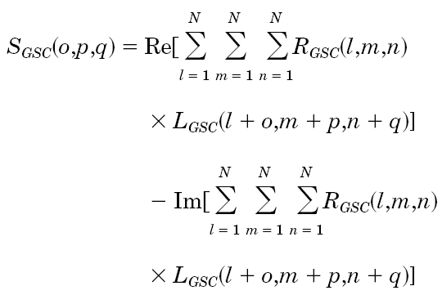
Grid-based Shape Complementarity

Slide 12
Grid-based Shape Complementarity
When there is no contact between R and L, S_{SC} equals zero.
A surface grid point–surface grid point contact contributes 1 to the correlation.
A core-core contact contributes (9i)² = -81 to the correlation, to penalize core-core clashes that are physically forbidden.
A surface-core contact results in a mild penalty of Im[9i]=9.

Slide 13
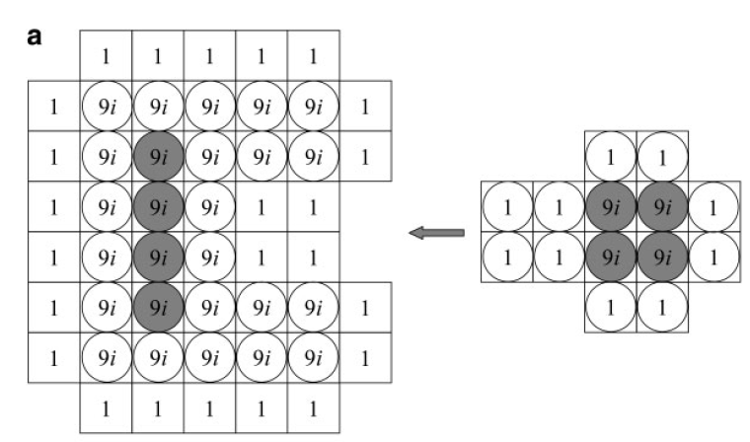
1*1+1*1+1*1+1*1+1*1+1*1 = 6

Slide 14
Pairwise Shape Complementarity Function (PSC)
The favorable component of PSC is defined as the number of receptor-ligand atom pairs within a distance cutoff.
The unfavorable component of PSC is linearly proportional to the number of overlapping grid points between the receptor and the ligand.

Slide 15
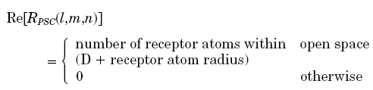

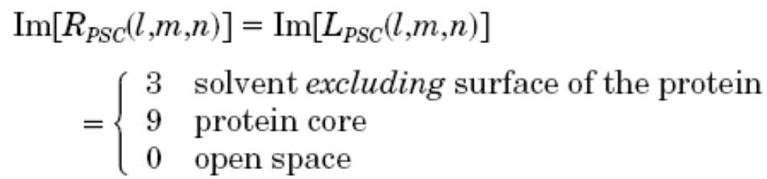
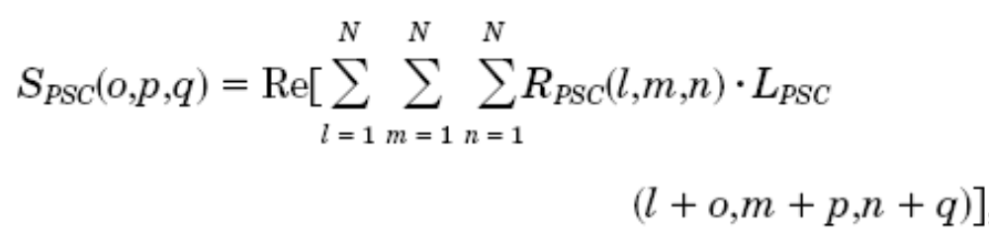
PSC

Slide 16
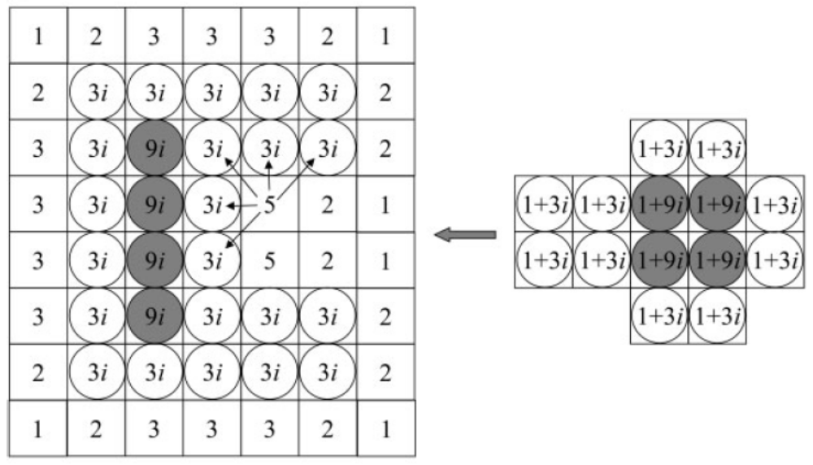
5*1 + 5*1 + 2*1 + 2*1 + 2*1 + 2*1 + 1*1 + 1*1= 20

Slide 17
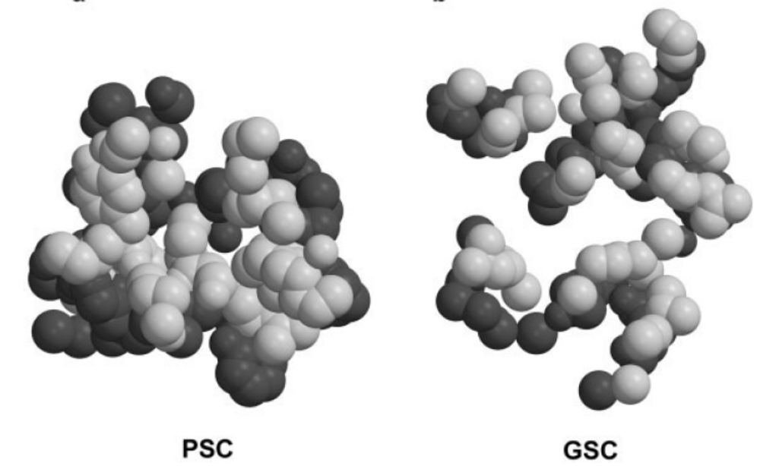

Slide 18
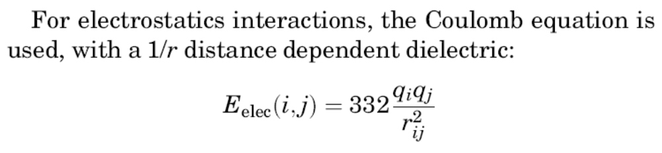
Electrostatics
The electrostatics energy can be expressed as a correlation between the electric potential generated by the receptor and the charges of the ligand atoms, as described by the Coulombic formula. We adopted the approach by Gabb et al., except that we used the partial charges in the CHARMM19 potential
In addition, grid points in the core of the receptor are assigned a value of 0 for the electric potential, to avoid the contributions from non-physical receptor-core/ligand contacts.
Notes:
電介質

Slide 19
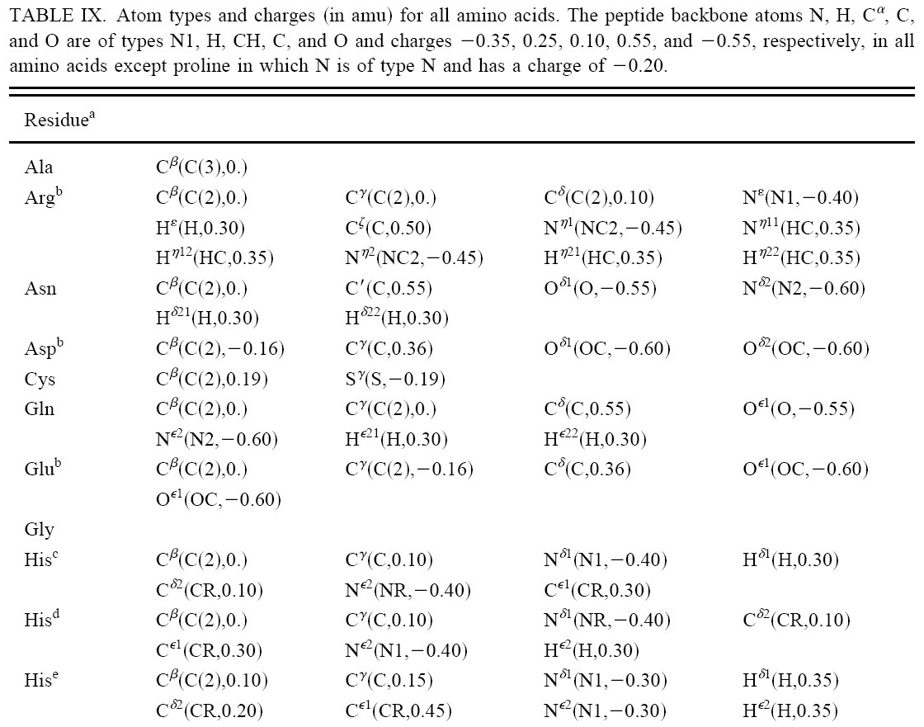

Slide 20
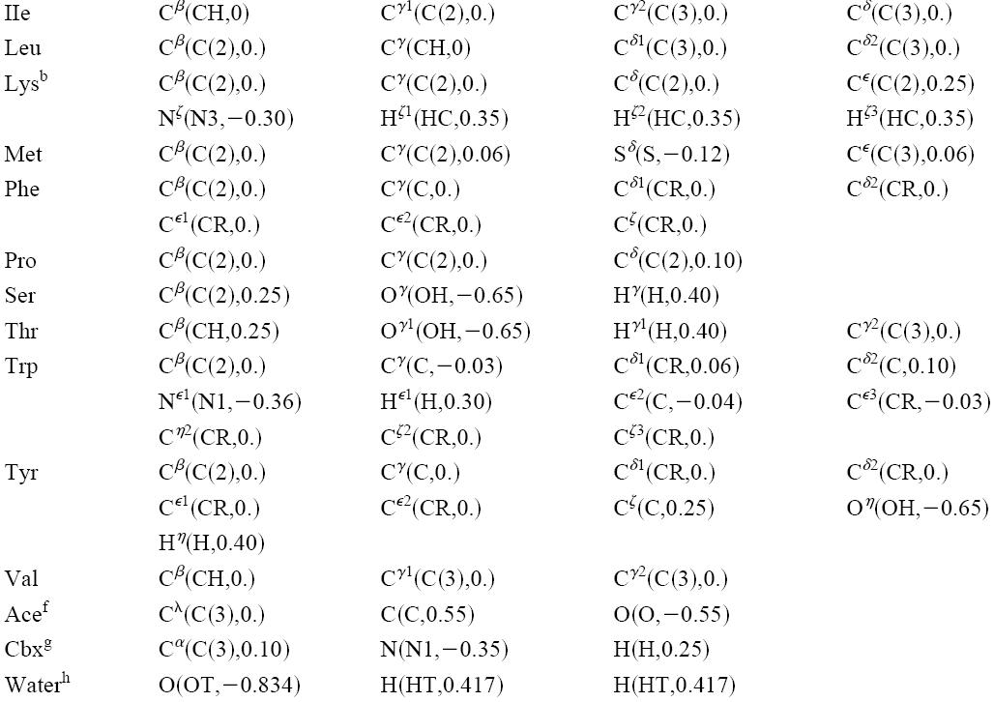
Notes:
carboxy terminal 羧ㄗㄨㄟ基

Slide 21
Desolvation Free Energy
We have implemented the Atomic Contact Energy (ACE) developed by Zhang et al. ACE is a desolvation free energy measure, defined as the free energy of replacing a protein-atom/water contact, by a protein-atom/protein-atom contact.
The ACE scores were obtained for all pairs of 18 atom types. The total desolvation free energy of complex formation is calculated by summing the ACE scores of all atom pairs between the receptor and the ligand that are within 6 Å.

Slide 22
Clustering of the Atoms
Only heavy atoms were considered in our computations and all hydrogen atoms were combined with the heavy atoms to which they are bound.
Atoms of different types generally differ in their contact energies. The exceptions are the backbone atoms N, C_{α} and C, for which we retained separate identities because of the high frequencies of their occurrence, though their contact energies are similar.

Slide 23
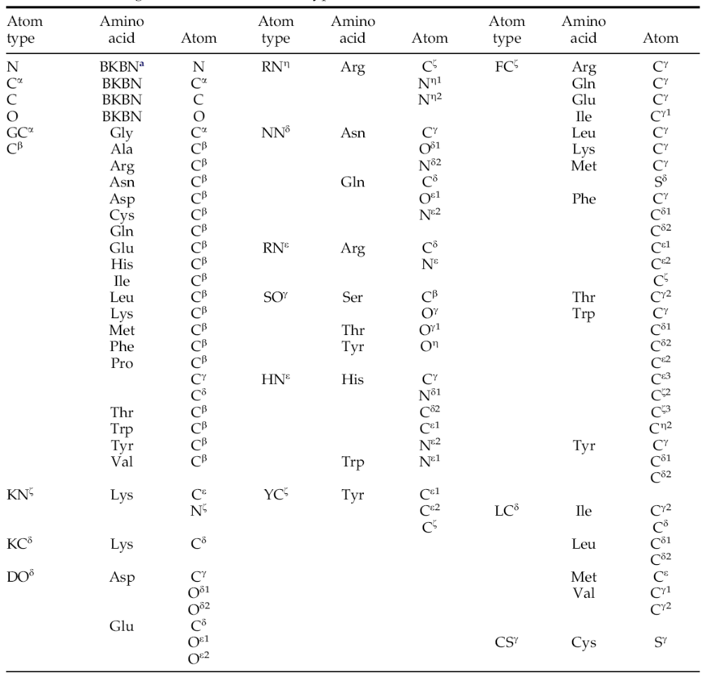

Slide 24
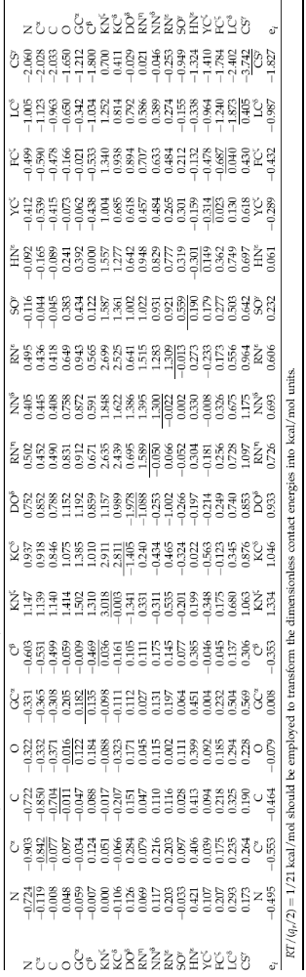

Slide 25
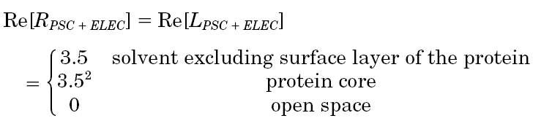
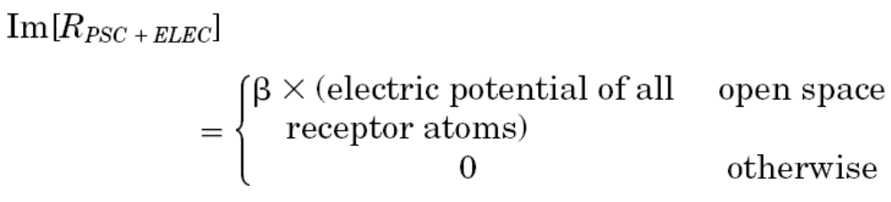
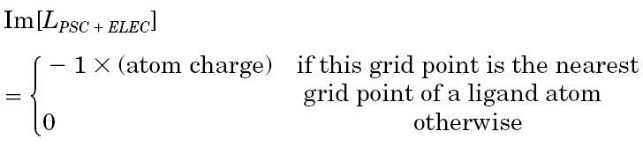
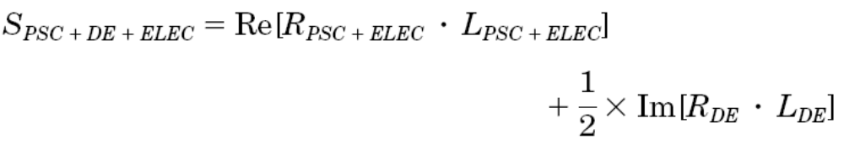
Scoring Function
負越多越好

Slide 26
Good but not Enough
Using ZDOCK to perform docking led to five of six recent targets with at least one prediction rated Acceptable or higher (the highest number among all participants).
Although ZDOCK produces many near-native predictions (hits), they are often not ranked in the top 10.

Slide 27
ZRank
ZRANK utilizes a scoring function that can be quickly computed and effectively rerank the ZDOCK predictions without energy minimization. The scoring function is a linear weighted sum of
  van der Waals attractive and repulsive energies
  electrostatics short and long range attractive and repulsive energies
  desolvation

Slide 28
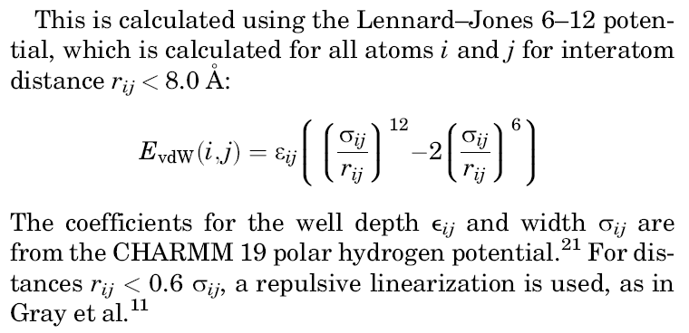
van der Waals
http://juang.bst.ntu.edu.tw/BCbasics/Cellxx.htm#Cell0114

Slide 29
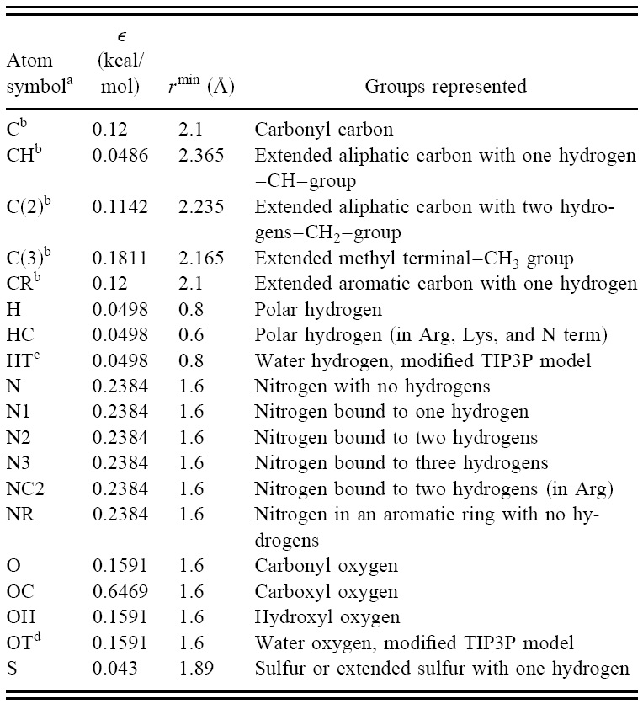
Notes:
Carbonyl (kär′bə nil′) CO
carboxyl (kär bäks′il) COOH
aromatic 芳香

Slide 30
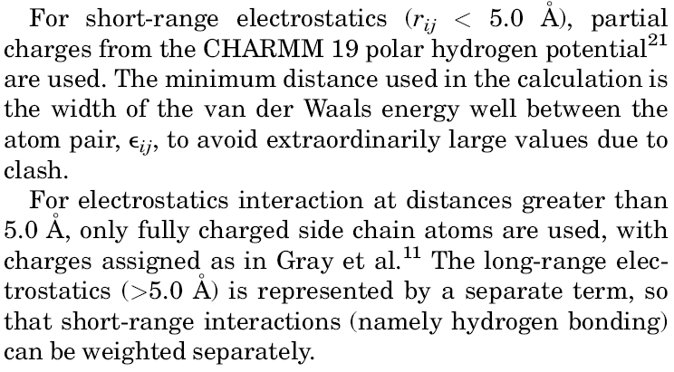
Electrostatics

Slide 31
Fully Charged Side Chain
Charges are modeled only on the most polar side-chain atoms: a charge of -1/2 on each of the δ-oxygen atoms in Asp and the ε-oxygen atoms in Glu, a charge of +1/2 on the η-nitrogen atoms in Arg, and a full positive charge on the ζ-nitrogen atom in Lys.

Slide 32
Evaluation of Docking Predictions
The predictions from ZDOCK were evaluated by calculating the Root Mean Square Deviation (RMSD) between the bound and unbound interface alpha carbon (C_{α}) atoms.
Superposition and RMSD calculation only involve the C atoms of interface residues, which are receptor (or ligand) residues with at least one atom within 10 Å of any atoms of the ligand (or receptor).
Hits are predictions with interface C_{α} RMSD less than 2.5Å .

Slide 33
Weight Training
Each case is docked using ZDOCK 2.3, generating 54,000 predictions per test case.
All predictions for these cases were then classified as hits or non-hits, and scored using the seven terms described earlier.
After obtaining and scoring the ZDOCK predictions, a downhill simplex minimization algorithm was used to determine the optimal set of weights.

Slide 34
Downhill Simplex Minimization
For N-dimensional minimization it selects N points around a starting point (by taking a given offset from the point in each dimension) and successively moves in the direction of the lowest valued point.

Slide 35
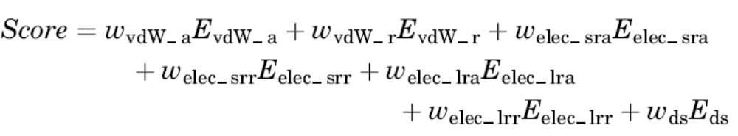
Weights
van derWaals attractive: 1.0
van derWaals repulsive: 0.009
Electrostatics short range attractive: 0.31
Electrostatics short range repulsive: 0.34
Electrostatics long range attractive: 0.44
Electrostatics long range repulsive: 0.50
Desolvation: 1.02

Slide 36
Let’s Return
終於把前言講完了，可以回到今天主要要報告的paper了!!!

Slide 37
Aim of This Paper
It was noted that ZRANK could be followed with structural refinement to further improve the docking success rate.
To examine this possibility, we have combined the initial-stage docking of ZDOCK and scoring of ZRANK with the structural refinement of RosettaDock.
The local refinement of RosettaDock includes side chain repacking and a Monte Carlo search of the local rigid-body space of the ligand.

Slide 38
Method
For the ZDOCK runs, 6º rotational sampling was used, with different initial rotations for each test case to avoid bias.
ZRANK was used to rerank the ZDOCK models, with polar hydrogens added to the unbound proteins using RosettaDock prior to scoring.
The nonpolar hydrogens (which were also added by RosettaDock) were ignored by ZRANK.

Slide 39
Method
For the docking refinement protocol, the Monte Carlo refinement method of RosettaDock 2.0 was used, with ZDOCK predictions as starting structures.
Nonstandard amino acids and non-protein atoms were removed prior to refinement, with exceptions where substitutions were possible (for example modeling MSE as MET).

Slide 40
Method
The Large Perturbation RosettaDock searching (LargePert) is setting Monte Carlo perturbations to 0.4 Å and 0.2º, rather than the default perturbation (DefaultPert) size of 0.1 Å and 0.05º

Slide 41
Dataset
The 76 rigidbody and medium unbound Benchmark 2.0 cases were used for docking.

Slide 42
Results
Hits are defined as predictions with C_{α} root-mean-square distance (RMSD) of less or equal to than 2.5 Å after superposition with the interface atoms in the crystal structure.
Near-hits are defined as having interface C_{α} RMSD greater than 2.5 Å and less than or equal to 4.0 Å.

Slide 43
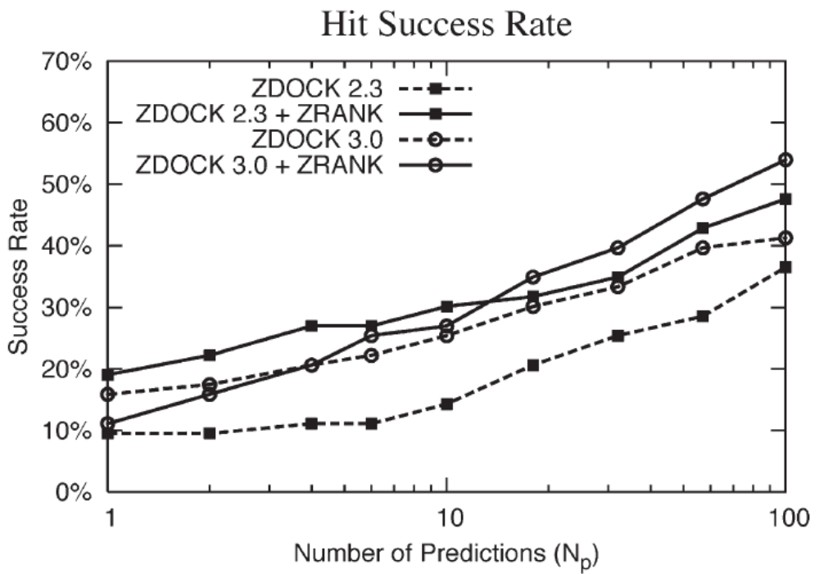
ZDOCK and ZRANK success rates

Slide 44
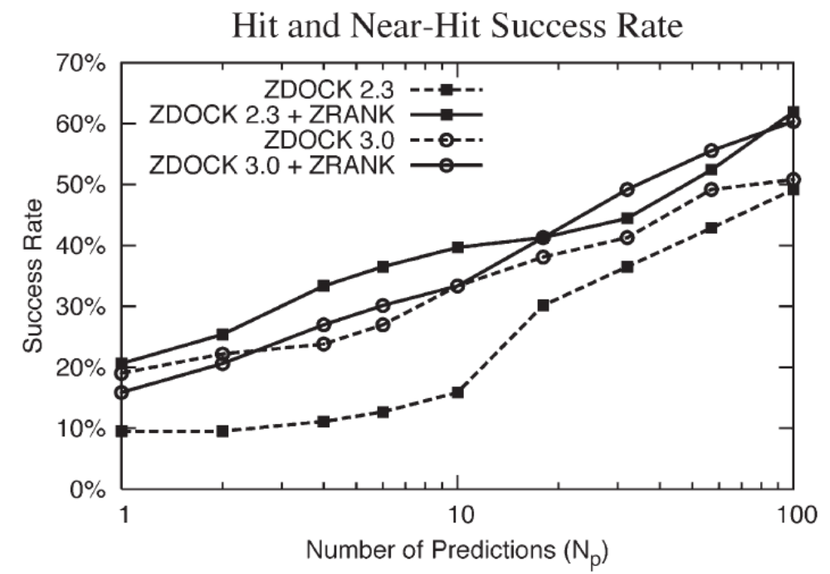
ZDOCK and ZRANK success rates

Slide 45
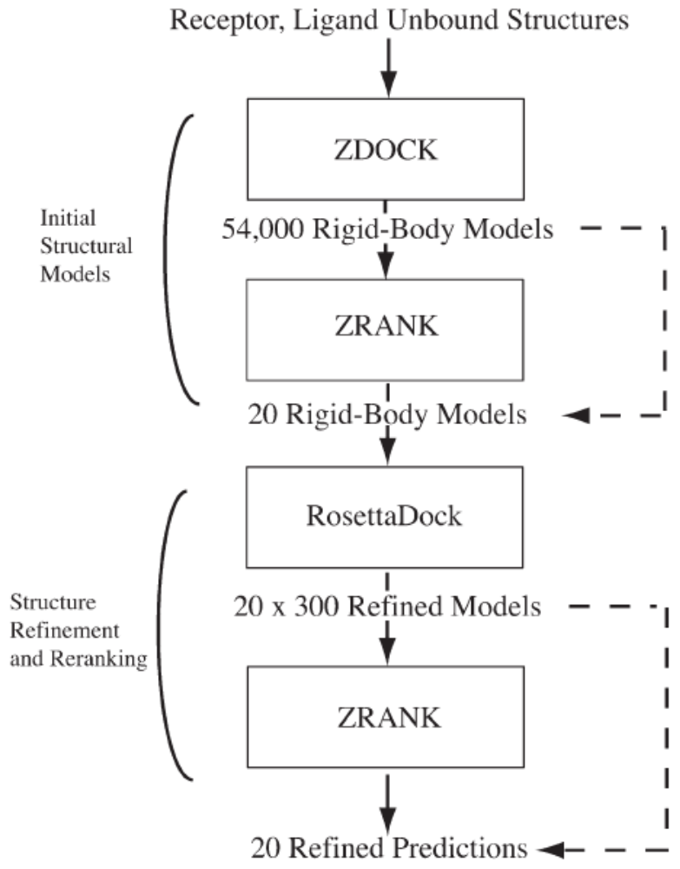
RosettaDock sampling and
ZRANK scoring

Slide 46
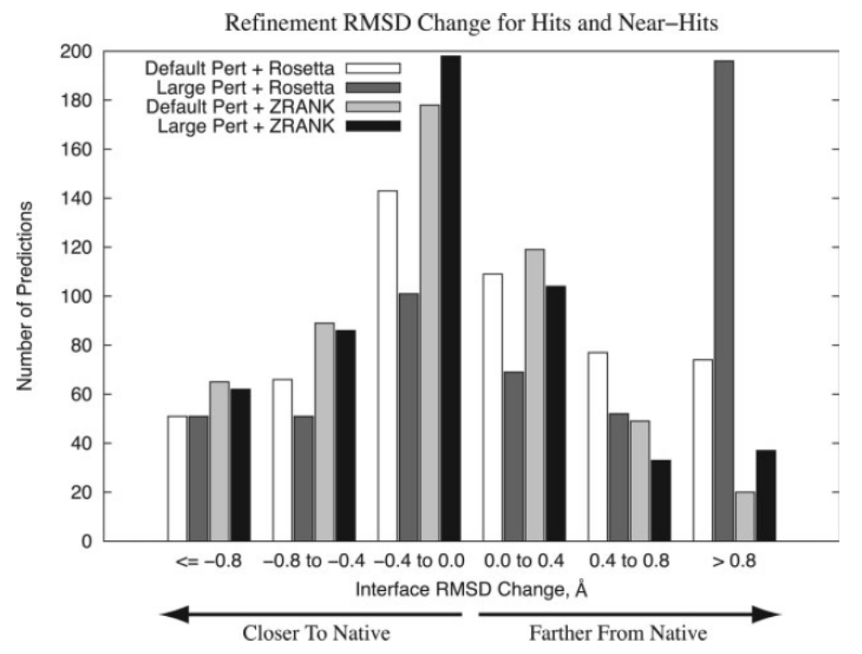
RosettaDock sampling and
ZRANK scoring

Slide 47
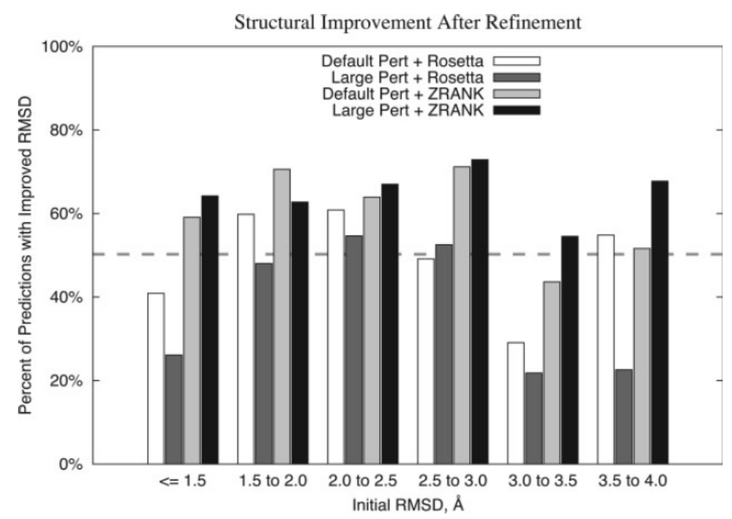
Improved structures versus initial RMSD

Slide 48
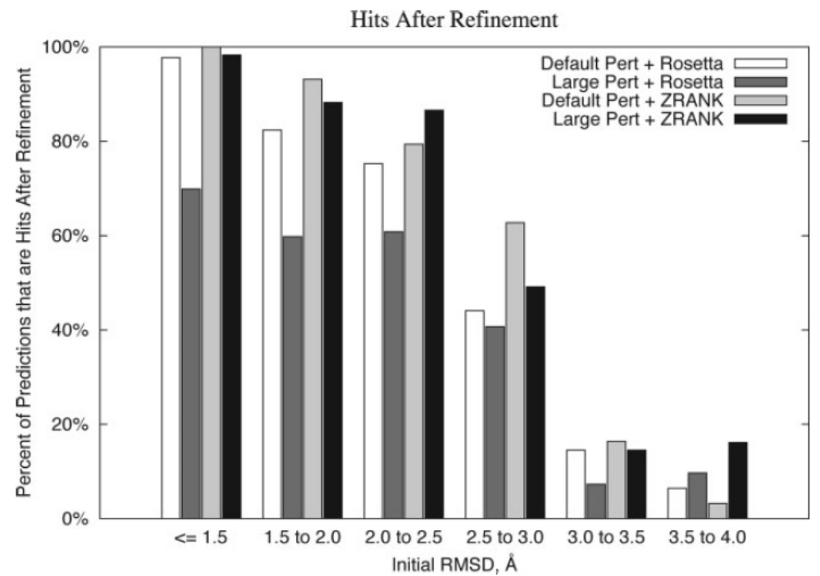
Hits after refinement versus initial RMSD

Slide 49
Original ZRank Weights
van derWaals attractive: 1.0
van derWaals repulsive: 0.009
Electrostatics short range attractive: 0.31
Electrostatics short range repulsive: 0.34
Electrostatics long range attractive: 0.44
Electrostatics long range repulsive: 0.50
Desolvation: 1.02

Slide 50
Refined ZRank Weights
vdW attractive: 1.0
vdW repulsive: 0.23
electrostatics short-range attractive: 0.57
electrostatics short-range repulsive: 0.56
electrostatics long-range attractive: 1.09
electrostatics long-range repulsive: 0.29
ACE: 0.7
IFACE: 0.38

Slide 51
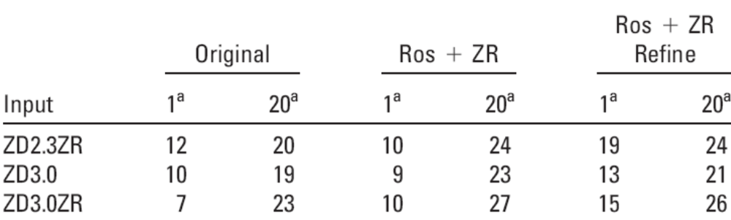
Result

Slide 52
Reference
Zhang C, Vasmatzis G, Cornette JL, DeLisi C. “Determination of atomic desolvation energies from the structures of crystallized proteins” J Mol Biol 1997;267:707–726.
Chen R, Weng Z. “Docking unbound proteins using shape complementarity, desolvation, and electrostatics” Proteins 2002;47:281– 294.
Chen R, Weng Z. “A novel shape complementarity scoring function for protein-protein docking” Proteins 2003;51:397–408.
Chen R, Li L, Weng Z. “ZDOCK: an initial-stage protein-docking algorithm” Proteins. 2003 Jul 1;52(1):80-7.
Jeffrey J. Gray, Stewart Moughon, Chu Wang, Ora Schueler-Furman Brian Kuhlman, Carol A. Rohl and David Baker, ”Protein–Protein Docking with Simultaneous Optimization of Rigid-body Displacement and Side-chain Conformations”, J. Mol. Biol. (2003) 331, 281–299
Eyal Neria, Stefan Fischer and Martin Karplus “Simulation of activation free energies in molecular systems”, The Journal of Chemical Physics, Volume 105, Issue 5, August 1, 1996, pp.1902-1921
Brian Pierce and Zhiping Weng, “ZRANK: Reranking Protein Docking Predictions With an Optimized Energy Function”, PROTEINS: Structure, Function, and Bioinformatics 67:1078–1086 (2007)

Slide 53

Thank You

Slide 54
R_{SC} is computed as follows. All grid points are initialized with 0. We first assign ρi to grid points that are within √1.5 van der Waals (vdW) radii of a core atom or within √0.8 vdW radii of a surface atom. √1.5 is used to avoid assigning 0 to core grid points and√0.8 is used to allow for some softness. Next, we assign 1 to all grid points that have not been assigned ρi and are within 3.4 Å plus the radius of any surface atom. This is equivalent to using a 3.4 Å surface layer for the receptor; 3.4 Å corresponds to the diameter of a water molecule.

Slide 55
L_{SC} is computed as follows, which is similar to RSC except for the extra surface layer. All grids are initialized with 0. First, we assign ρi to grid points that are within 1.5 times of the vdW radii of a core atom. Next, we assign 1 to all grid points that are within the vdW radius of any surface atom. Finally, if a grid point is assigned ρi and two of its nearest neighboring grid points have value 0, it is changed to 1.

Slide 56
Van der Waals Radii
The van der Waals radius, r_{w}, of an atom is the radius of an imaginary hard sphere which can be used to model the atom for many purposes. It is named after Johannes Diderik van der Waals, winner of the 1910 Nobel Prize in Physics, as he was the first to recognize that atoms had a finite size (i.e., that atoms were not simply points) and to demonstrate the physical consequences of their size through the van der Waals equation of state.

