Slide 1
A new taxonomy-based protein fold recognition approach based on autocross-covariance transformation
Qiwen Dong[董啟文], Shuigeng Zhou[周水庚], and Jihong Guan[關佶紅]
Structural bioinformatics, Vol. 25 no. 20, 2009, pp. 2655–2662

Slide 2
Abstract
Motivation: Fold recognition is an important step in protein structure and function prediction. Traditional sequence comparison methods fail to identify reliable homologies with low sequence identity, while the taxonomic methods are effective alternatives, but their prediction accuracies are around 70%, which are still relatively low for practical usage.

Slide 3
Abstract
Results: In this study, a simple and powerful method is presented for taxonomic fold recognition, which combines support vector machine (SVM) with autocross-covariance (ACC) transformation. The evolutionary information represented in the form of position-specific score matrices is converted into a series of fixed-length vectors by ACC transformation and these vectors are then input to a SVM classifier for fold recognition.

Slide 4
Abstract
The sequence-order effect can be effectively captured by this scheme. Experiments are performed on the widely used D-B dataset and the corresponding extended dataset, respectively. The proposed method, called ACCFold, gets an overall accuracy of 70.1% on the D-B dataset (for 27 folds), which is higher than major existing taxonomic methods by 2–14%.

Slide 5
Abstract
Furthermore, the method achieves an overall accuracy of 87.6% on the extended dataset (for 27 folds), which surpasses major existing taxonomic methods by 9–17%. Additionally, our method obtains an overall accuracy of 80.9% for 86-folds and 77.2% for 199-folds. These results demonstrate that the ACCFold method provides the state-of-the-art performance for taxonomic fold recognition.

Slide 6
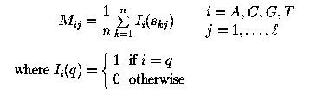
PSSM
A Profile or Position Weigth Matrix (the two terms are used synonymously here) is a motif descriptor. It attempts to capture the intrinsic variability characteristic of sequence patterns.
sequence 1 :GAGGTAAAC
sequence 2 :TCCGTAAGT
sequence 3 :CAGGTTGGA
sequence 4 :ACAGTCAGT
sequence 5 :TAGGTCATT
sequence 6 :TAGGTACTG
sequence 7 :ATGGTAACT
sequence 8 :CAGGTATAC
sequence 9 :TGTGTGAGT
sequence 10:AAGGTAAGT
Position Weigth Matrix
| 1 2 3 4 5 6 7 8 9
--|----------------------------
A | 3 6 1 0 0 6 7 2 1
C | 2 2 1 0 0 2 1 1 2
G | 1 1 7 10 0 1 1 5 1
T | 4 1 1 0 10 1 1 2 6
take http://genome.imim.es/courses/cshl2005/T2/MakeProfile.html as example

Slide 7
PSSM
Position Weigth Matrix
| 1 2 3 4 5 6 7 8 9
--|----------------------------
A | 3 6 1 0 0 6 7 2 1
C | 2 2 1 0 0 2 1 1 2
G | 1 1 7 10 0 1 1 5 1
T | 4 1 1 0 10 1 1 2 6
Each coefficient in this matrix indicates the number of times that a given nucleotide has been observed at a given position, eg. postions 4 and 5 corresponding to the mandatory dinucleotide GT at the begining of the intron. .
The probability of finding the sequence CAGGTTGGA is
0.20•0.6•0.7•1•1•0.10•0.10•0.5•0.10
take http://genome.imim.es/courses/cshl2005/T2/MakeProfile.html as example

Slide 8
PSSM
Position Weigth Matrix
| 1 2 3 4 5 6 7 8 9
--|----------------------------
A | 3 6 1 0 0 6 7 2 1
C | 2 2 1 0 0 2 1 1 2
G | 1 1 7 10 0 1 1 5 1
T | 4 1 1 0 10 1 1 2 6
Often, the coefficients in a Position Weight Matrix are directly computed as log-likelyhood values according with the following transformation log(Mij/pi), where Mij is the probability of nucleotide i at position j in the Matrix M, and pi is the background probability of nucleotide i. The background probability of nucleotide can be assumed to be an "a priory" probability.
take http://genome.imim.es/courses/cshl2005/T2/MakeProfile.html as example

Slide 9
PSSM
Position Weigth Matrix in different types
Absolute frequency
| 1 2 3 4 5 6 7 8 9
--|----------------------------
A | 3 6 1 0 0 6 7 2 1
C | 2 2 1 0 0 2 1 1 2
G | 1 1 7 10 0 1 1 5 1
T | 4 1 1 0 10 1 1 2 6
Relative frequency
| 1 2 3 4 5 6 7 8 9
--|-------------------------------------------------------
A | 0.3 0.6 0.1 0.00 0.00 0.6 0.7 0.2 0.1
C | 0.2 0.2 0.1 0.00 0.00 0.2 0.1 0.1 0.2
G | 0.1 0.1 0.7 1.00 0.00 0.1 0.1 0.5 0.1
T | 0.4 0.1 0.1 0.00 1.00 0.1 0.1 0.2 0.6
pb=0.25
Log-likelihood
--|-------------------------------------------------------
A | 0.18 0.87 -0.91 -inf -inf 0.87 1.02 -0.22 -0.91
C | -0.22 -0.22 -0.91 -inf -inf -0.22 -0.91 -0.91 -0.22
G | -0.91 -0.91 1.02 1.38 -inf -0.91 -0.91 0.69 -0.91
T | 0.47 -0.91 -0.91 -inf 1.38 -0.91 -0.91 -0.22 0.87
log(0.1/0.25)
take http://genome.imim.es/courses/cshl2005/T2/MakeProfile.html as example

Slide 10
PSSM
Absolute frequency
| 1 2 3 4 5 6 7 8 9
--|----------------------------
A | 3 6 1 0 0 6 7 2 1
C | 2 2 1 0 0 2 1 1 2
G | 1 1 7 10 0 1 1 5 1
T | 4 1 1 0 10 1 1 2 6
Sliding window approaches
Take ACTCAGCCCCAGCG as example
actcagcccCAGCG
ActcagccccAGCG
Score=11
| A C T C A G C C C
--|----------------------------
A | 3 0 0 0 0 0 0 0 0
C | 0 2 0 0 0 0 1 1 2
G | 0 0 0 0 0 1 0 0 0
T | 0 0 1 0 0 0 0 0 0
Score=10
| C T C A G C C C C
--|----------------------------
A | 0 0 0 0 0 0 0 0 0
C | 2 0 0 0 0 1 1 2 2
G | 0 0 0 0 1 0 0 0 0
T | 0 1 0 0 0 0 0 0 0
take http://genome.imim.es/courses/cshl2005/T2/MakeProfile.html as example

Slide 11
PSSM
The score for ACTCAGCCCCAGCG is
Assuming the threshold is 10
Score
| 0 1 2 3 4 5 6 7
--|-------------------------
11 10 22 21 21 13 12 8
Hit at
0 ACTCAGCCC 11
1 CTCAGCCCC 10
2 TCAGCCCCA 22
3 CAGCCCCAG 21
4 AGCCCCAGC 21
5 GCCCCAGCG 13
6 CCCCAGCG 12
take http://genome.imim.es/courses/cshl2005/T2/MakeProfile.html as example

Slide 12
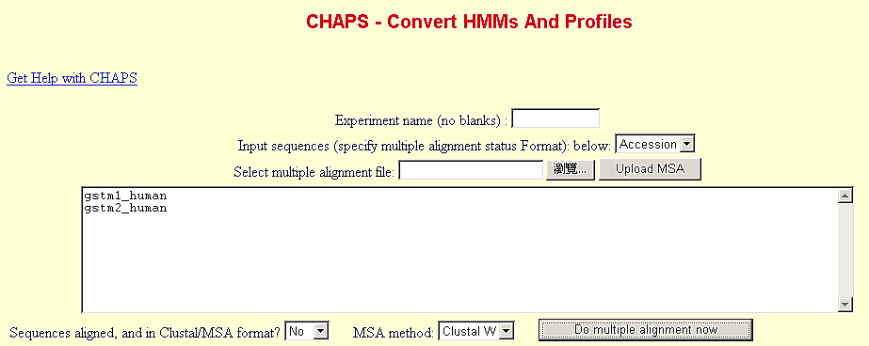
Program to generate PSSM
blastpgp -Q
CHAPS
  http://fasta.achs.virginia.edu//fasta_www2/chaps.cgi?msa_query=gstm1_human%0Agstm2_human
http://fasta.bioch.virginia.edu/cshl/cshl_run_page.cgi?page=pearson/cshl_psiblast_ex

Slide 13
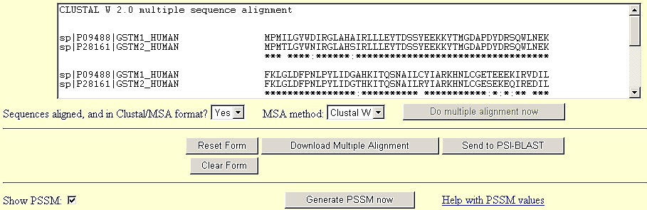
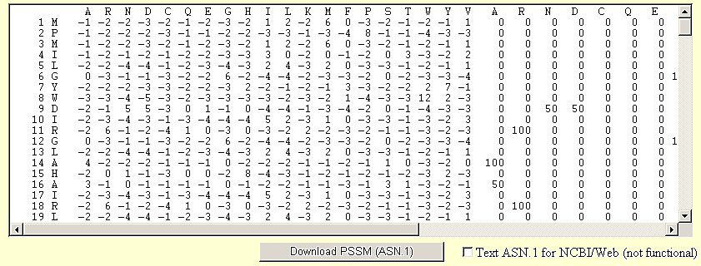
Program to generate PSSM
CHAPS
http://fasta.bioch.virginia.edu/cshl/cshl_run_page.cgi?page=pearson/cshl_psiblast_ex

Slide 14
Program to generate PSSM
CHAPS
the information content at the position, and the relative weight of the multiple alignment data and the pseudocounts
A R N D C Q E G H I L K M F P S T W Y V A R N D C Q E G H I L K M F P S T W Y V
1 M -1 -3 -3 -4 7 -2 -3 -3 -3 0 1 -2 5 -1 -3 -2 -1 -2 -2 0 0 0 0 0 44 0 0 0 0 0 0 0 56 0 0 0 0 0 0 0 0.66 0.09
2 A 3 -1 -2 -1 -2 0 3 -2 -2 -1 -1 -1 4 -2 -2 0 -1 -3 -2 -1 41 0 0 0 0 0 31 0 0 0 0 0 29 0 0 0 0 0 0 0 0.32 0.15
3 E -1 -2 -1 -1 -3 -1 2 2 -2 -2 -2 -1 3 -3 4 1 -1 -3 -3 -2 0 0 0 0 0 0 18 18 0 0 0 0 20 0 25 19 0 0 0 0 0.45 0.18
4 K -1 0 -1 -1 -3 0 -1 -2 -2 -3 -3 3 -2 -4 6 1 -1 -4 -3 -3 0 0 0 0 0 0 0 0 0 0 0 36 0 0 45 19 0 0 0 0 0.91 0.18
5 P -2 -2 -3 -3 -3 -2 -2 -3 -1 -1 0 -2 5 0 5 -2 -2 -1 4 -1 0 0 0 0 0 0 0 0 0 0 0 0 40 0 36 0 0 0 25 0 0.75 0.18
6 K -1 0 -2 -2 -2 -1 -1 -3 -2 2 -1 3 -1 -2 -2 -1 2 -3 -2 2 0 0 0 0 0 0 0 0 0 20 0 36 0 0 0 0 25 0 0 19 0.27 0.18
7 L -2 -3 -4 -4 -2 -3 -3 -4 -4 1 4 -3 1 0 -3 -3 -1 -3 -2 2 0 0 0 0 0 0 0 0 0 0 75 0 0 0 0 0 0 0 0 25 0.57 0.18
8 H -1 -2 -1 -2 -3 -1 -2 4 6 -1 -2 -2 -2 -2 -3 -1 -2 -3 -1 1 0 0 0 0 0 0 0 40 36 0 0 0 0 0 0 0 0 0 0 25 0.53 0.18
9 Y -2 -2 -3 -4 -3 -2 -3 -4 1 -2 -2 -2 -2 3 -4 -2 -2 2 8 -2 0 0 0 0 0 0 0 0 0 0 0 0 0 0 0 0 0 0 100 0 1.25 0.18
10 F -3 -3 -4 -5 -3 -3 -4 -4 -2 -1 -1 -4 -1 6 -4 -3 -3 9 2 -2 0 0 0 0 0 0 0 0 0 0 0 0 0 60 0 0 0 40 0 0 1.38 0.18
the frequencies (percents) of each amino acid at that position
the scores that would be used in a similarity search, eg, psi-blast
http://fasta.bioch.virginia.edu/cshl/cshl_run_page.cgi?page=pearson/cshl_psiblast_ex

Slide 15


AC (auto-cross variance)
Autocross covariance transformation of PSSM
| 1 2 3 4 5 6 7 8 9 | Ŝi
--|-------------------------------------------------------|------
A | 0.3 0.6 0.1 0.00 0.00 0.6 0.7 0.2 0.1 | 0.29
C | 0.2 0.2 0.1 0.00 0.00 0.2 0.1 0.1 0.2 | 0.12
G | 0.1 0.1 0.7 1.00 0.00 0.1 0.1 0.5 0.1 | 0.30
T | 0.4 0.1 0.1 0.00 1.00 0.1 0.1 0.2 0.6 | 0.29
AC(1,1)=(0.3-0.29)(0.6-0.29)+(0.6-0.29)(0.1-0.29)+(0.1-0.29)(0.0-0.29)+ (0.0-0.29)(0.0-0.29)+
(0.0-0.29)(0.6-0.29)+ (0.6-0.29)(0.7-0.29)+ (0.7-0.29)(0.2-0.29)+ (0.2-0.29)(0.1-0.29)
i=1~20, lg=1~LG, total 20*LG features

Slide 16

CC (cross variance)
| 1 2 3 4 5 6 7 8 9 | Ŝi
--|-------------------------------------------------------|------
A | 0.3 0.6 0.1 0.00 0.00 0.6 0.7 0.2 0.1 | 0.29
C | 0.2 0.2 0.1 0.00 0.00 0.2 0.1 0.1 0.2 | 0.12
G | 0.1 0.1 0.7 1.00 0.00 0.1 0.1 0.5 0.1 | 0.30
T | 0.4 0.1 0.1 0.00 1.00 0.1 0.1 0.2 0.6 | 0.29
AC(i1=1,i2=2,1)=(0.3-0.29)(0.2-0.12)+(0.6-0.29)(0.1-0.12)+(0.1-0.29)(0.0-0.12)+
(0.0-0.29)(0.0-0.12)+(0.0-0.29)(0.2-0.12)+ (0.6-0.29)(0.1-0.12)+
(0.7-0.29)(0.1-0.12)+ (0.2-0.29)(0.2-0.12)
i1,i2=1~20, i1≠i2,lg=1~LG, total 20*19*LG features

Slide 17
Datasets
number of data / number of folds
  The D-B dataset: 696/27
  The extended D-B dataset: 3202/27
  The F86 dataset: 5671/86
  The F199 dataset: 7437/199

Slide 18
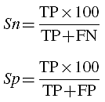

Performance measure
Accuracy(Q), sensitivity(Sn), and specificity(Sp)

Slide 19
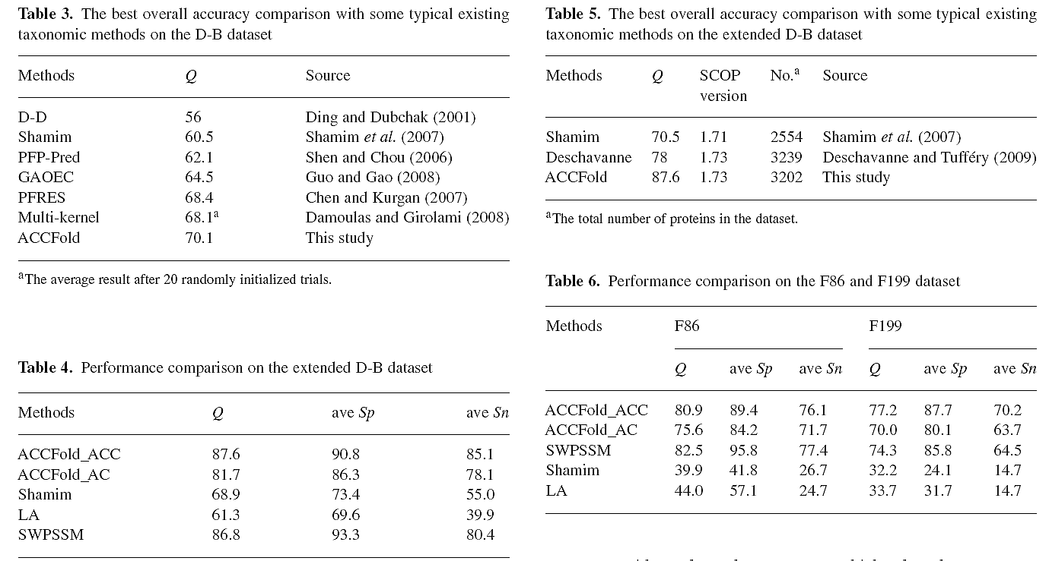
Results

Slide 20


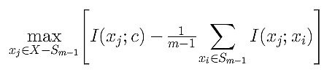

mRMR feature selection
Min-Redundancy, Max-Relevance
depedency
features
label
Min depedency between features
Max depedency between features & class label
Combinatorial!
For incremental search
IEEE TRANSACTIONS ON PATTERN ANALYSIS AND MACHINE INTELLIGENCE, VOL. 27, NO. 8, AUGUST 2005, Feature Selection Based on Mutual Information: Criteria of Max-Dependency, Max-Relevance, and Min-Redundancy

Slide 21
mRMR algorithm - stage 1
Use the following equation to select n sequential feature subsets S1,...,Sn with S1⊂S2...⊂Sn
Calculate cross-validation errors for the feature subdets and pick the one with smallest error

Slide 22
mRMR algorithm - stage 2
Use the feature set from stage 1 to perform
  backward feature removal: remove selected features one by one and not not deteriorate the classification
  forward feature addition: add un-selected features one by one if the classification rate improvement is observed

Slide 23
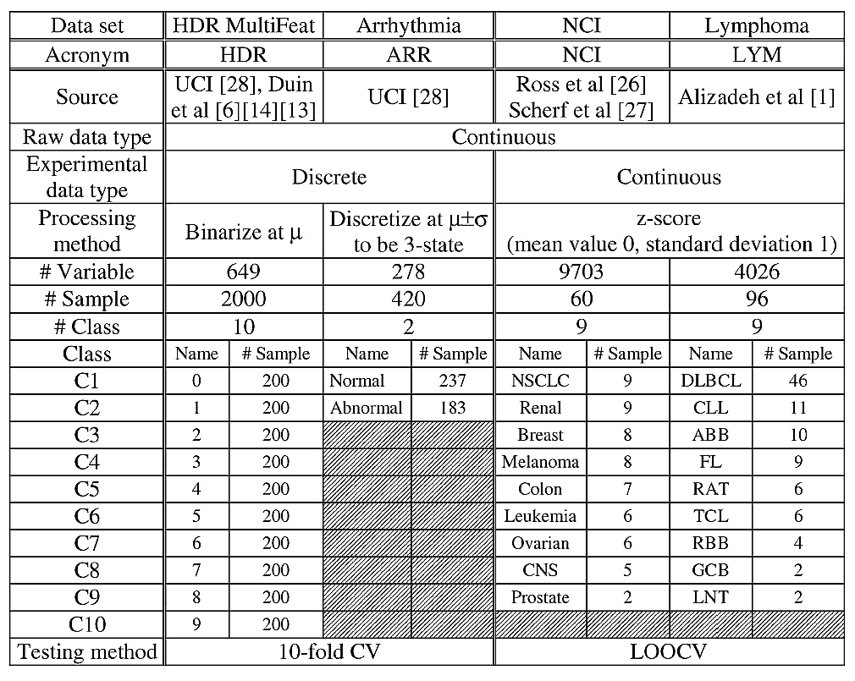
Datasets

Slide 24
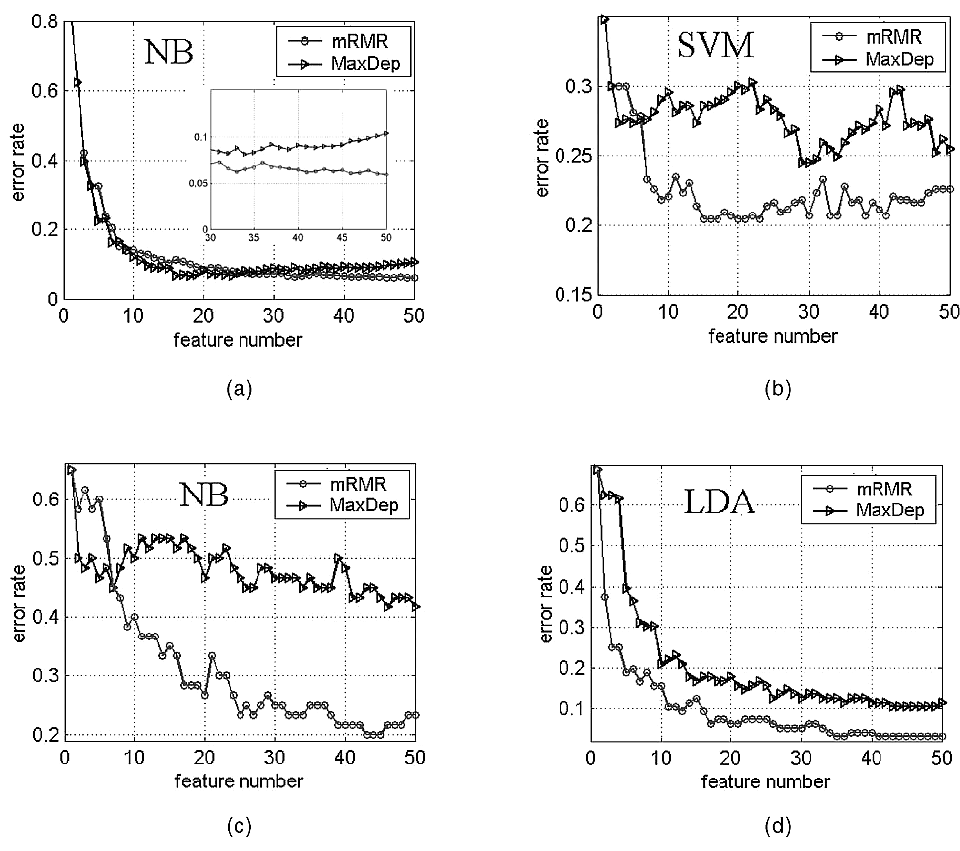
Experiments
Comparison of feature classification accuracies of mRMR and MaxDep. Classifiers NB, SVM, and LDA were used.
(a) 10-fold CV error rates of HDR data.
(b) 10-fold CV error rates of ARR data.
(c) LOOCV error rates of NCI data.
(d) LOOCV error rates of LYM data.

Slide 25
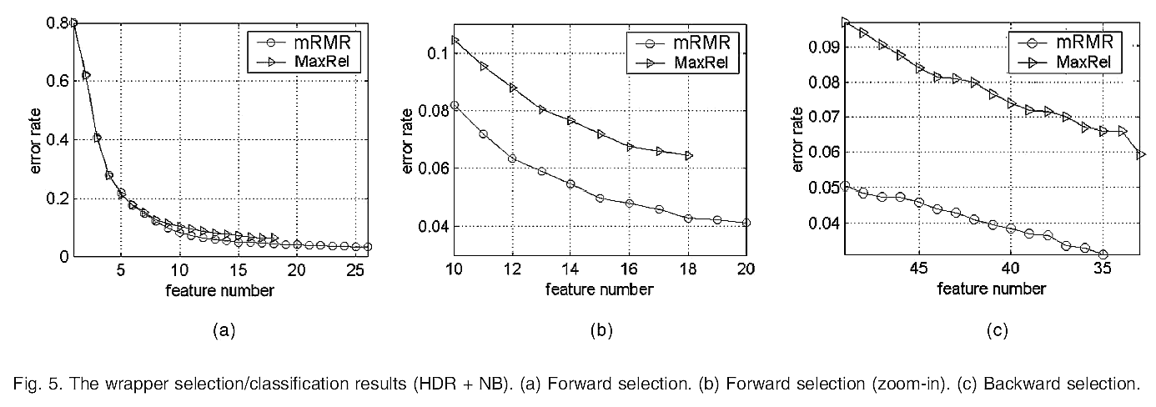
Experiments

Slide 26
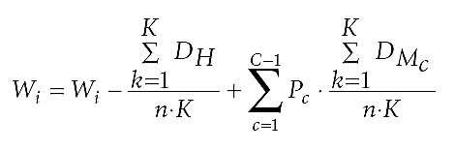
ReliefF algorithm
the data number with the same class among the K nearest neigboors
the data number with the distinct class among the K nearest neigboors
the feature weights
the prior probabilities
the K nearest neigboors
The reliefF algorithm encourages features that result in more hit within the K nearest neighbors.
BMC Genomics 2008, 9(Suppl 2):S27, Gene selection algorithm by combining reliefF and mRMR

Slide 27
ReliefF algorithm
Hit
Miss
Wi?↓
Wi?↑
?
?

Slide 28


ReliefF-mRMR vs. mRMR algorithm
use mutual information to encourage features
mRMR
ReliefF-mRMR
use mutual information to penalize features
use correlation to penalize features
use reliefF to encourage features

Slide 29
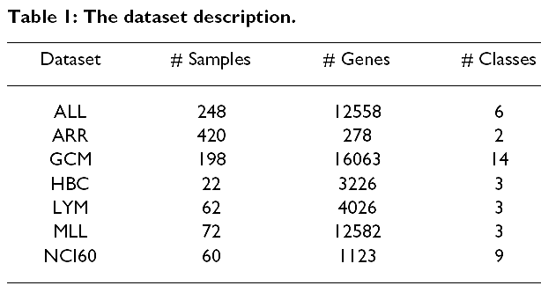
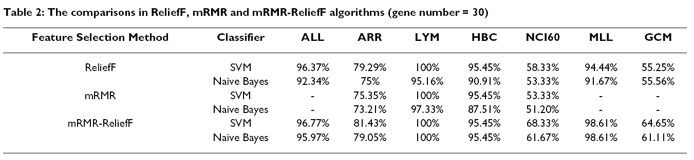
Experiments
Since mRMR is time-consuming, the ReliefF is served as a filter before mRMR is performed.
BMC Genomics 2008, 9(Suppl 2):S27, Gene selection algorithm by combining reliefF and mRMR

